Slide 1
Canadian Bioinformatics Workshops
www.bioinformatics.ca

Slide 2
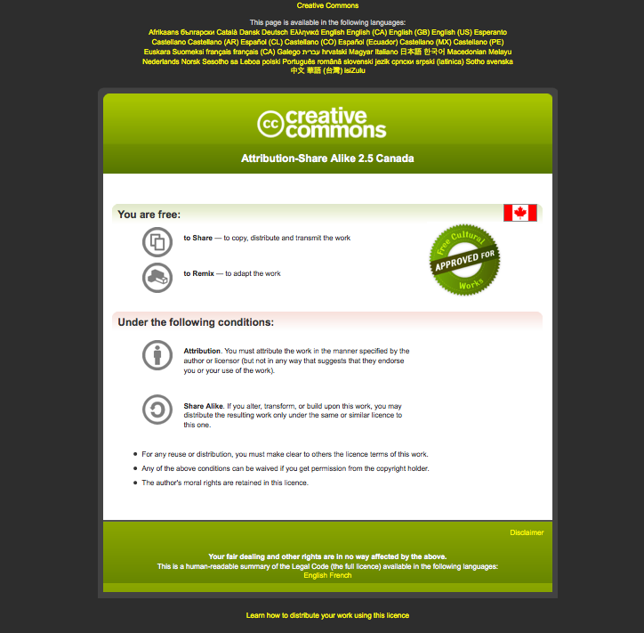
Module #: Title of Module
2

Slide 3
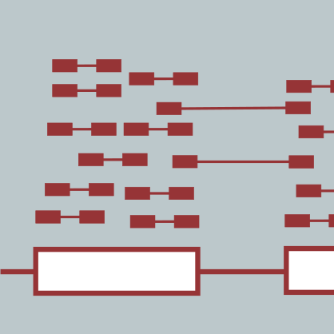
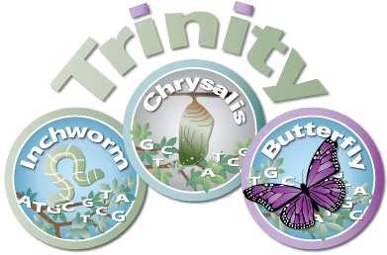
Genome-Free De novo Transcriptome Assembly
Brian Haas
Informatics for RNA-Seq Analysis
July 10-12, 2017

Slide 4
Learning Objectives of Module
Understand the challenges involved in reconstructing transcripts from RNA-Seq data
Become familiar with computational algorithms and data structures leveraged for transcript assembly
Appreciate the importance of strand-specific RNA-Seq data.
Learn various ways to assess the quality of an assembled transcriptome.

Slide 5
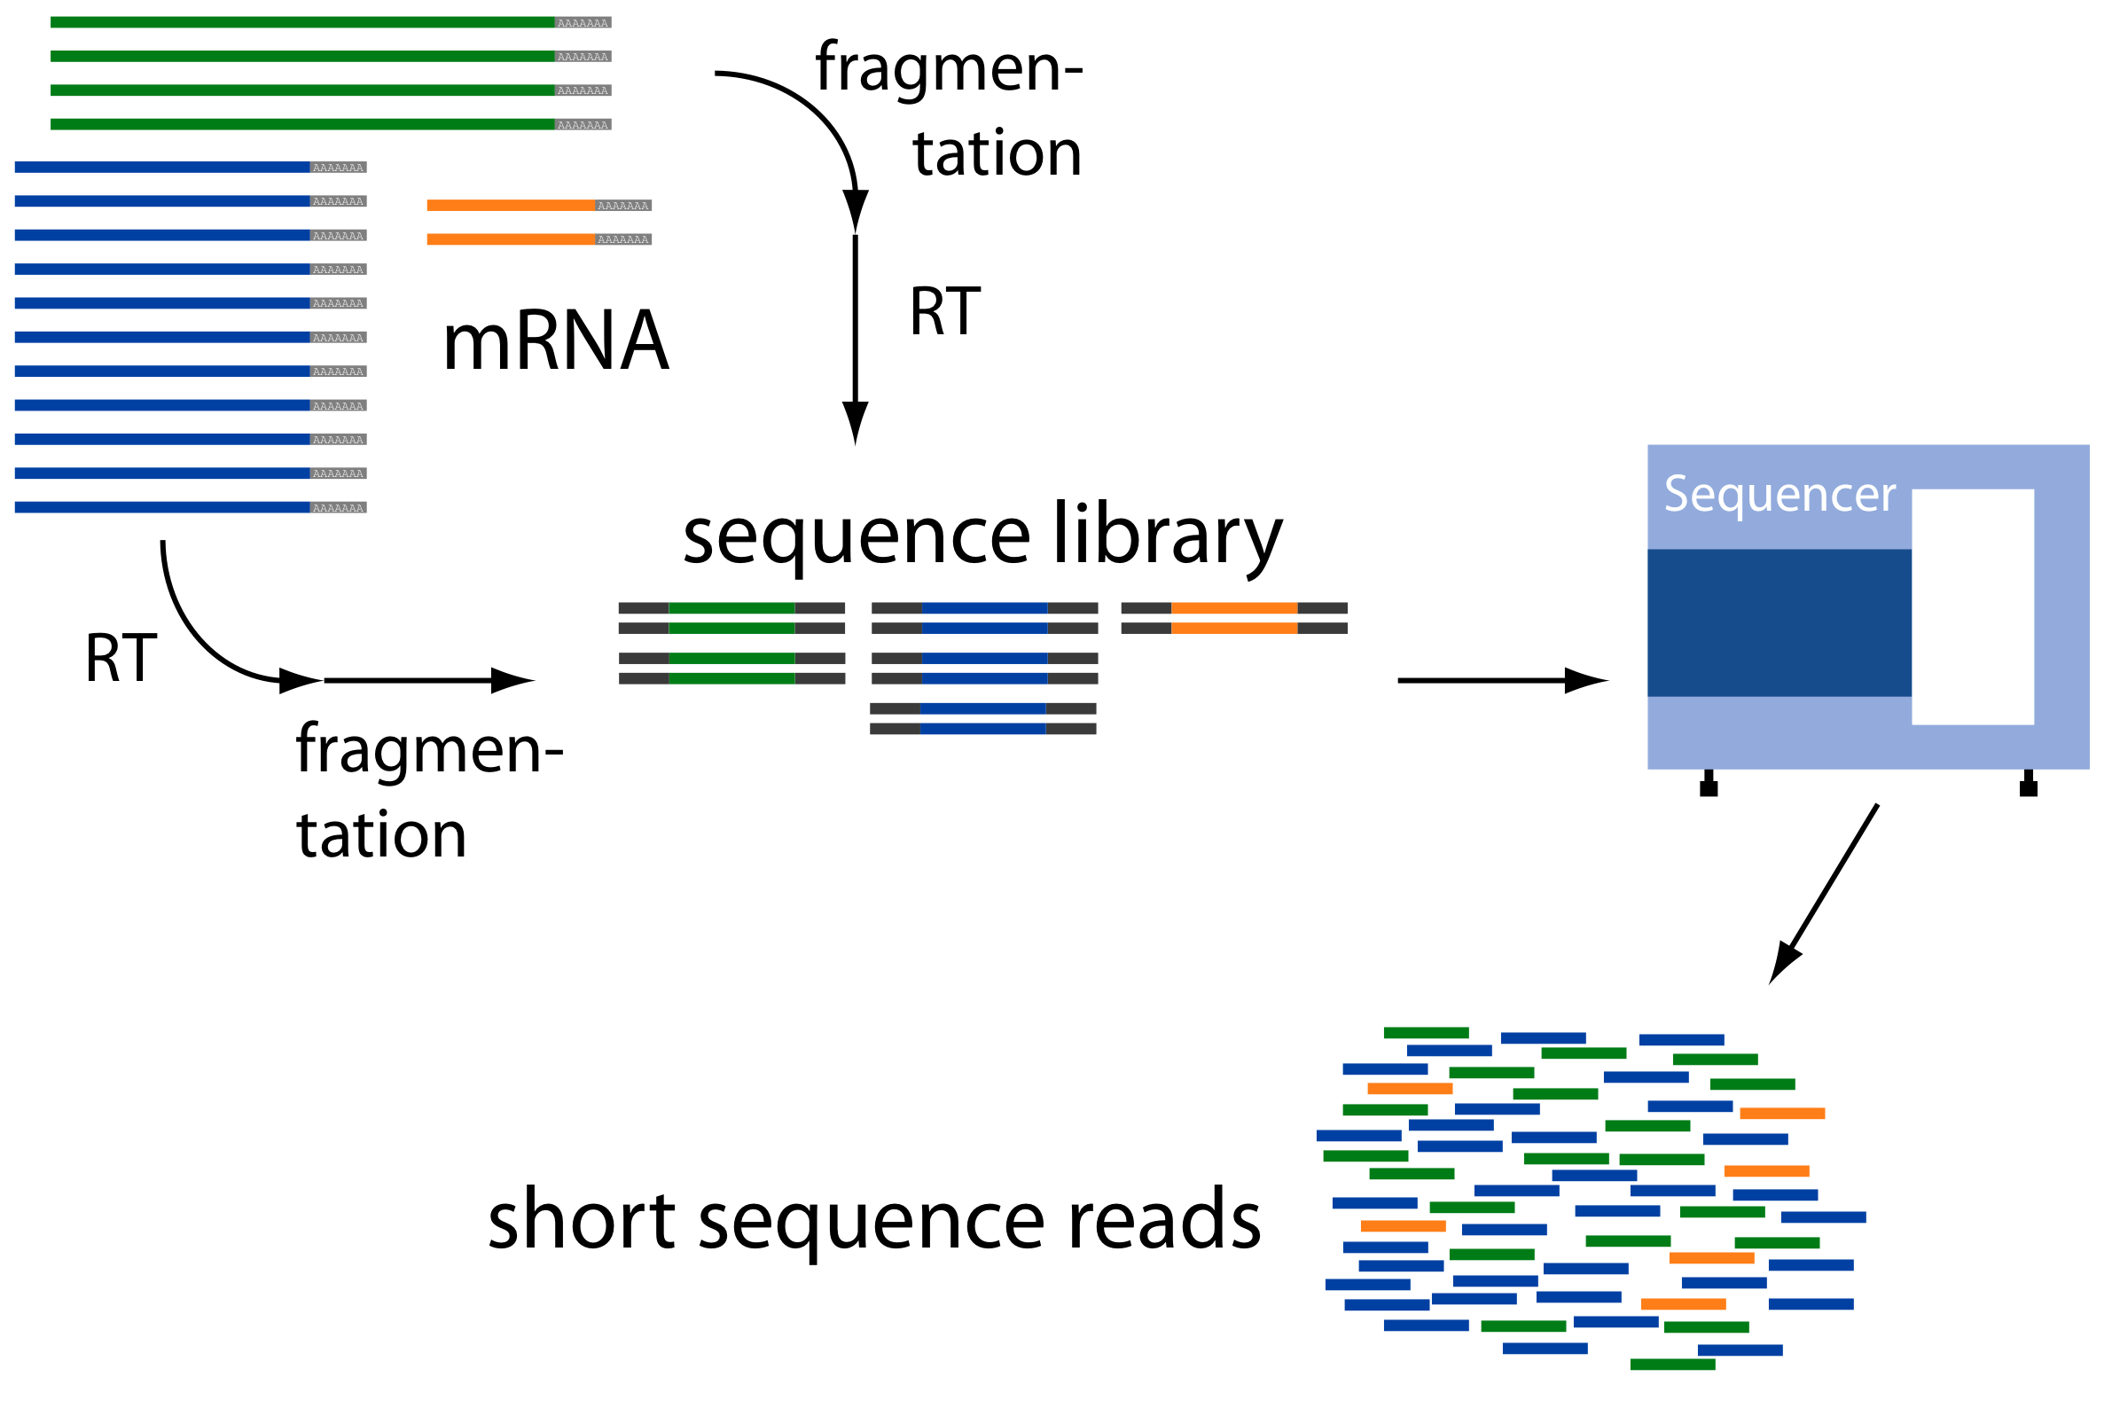
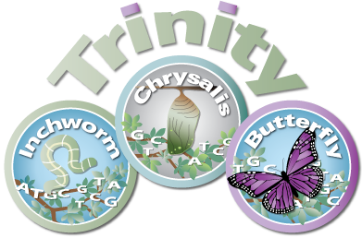
Assembly Required
Reconstruct original full-length transcripts
Adapted from G. Raetsch

Slide 6
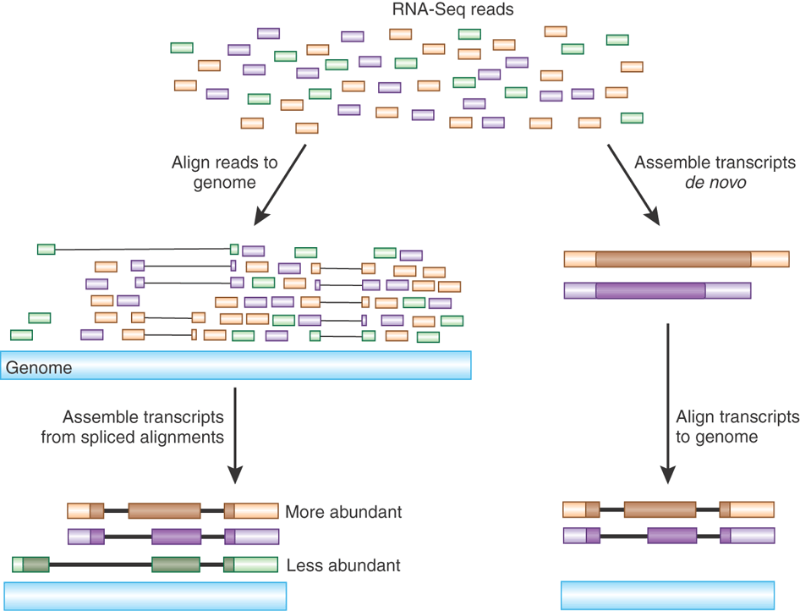
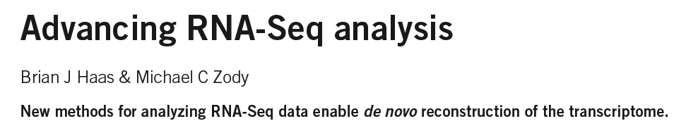
Transcript Reconstruction from RNA-Seq Reads
Nature Biotech, 2010
Notes:
There are two different commonly used strategies for reconstructing transcripts from RNA-Seq reads.

Slide 7
Transcript Reconstruction from RNA-Seq Reads
Notes:
One strategy requires having a reference genome and involves first aligning reads to the genome using a spliced aligner.
When mapping the RNA-Seq reads to the genome, the aligner takes into account that the RNA-Seq reads are derived from fully processed transcripts that have undergone intron splicing, and maps the spliced transcript fragments across intervening intronic sequences that occur in the genome.
In this view, candidate intron sequences are shown as thin lines separating the mapped read segments.

Slide 8
Transcript Reconstruction from RNA-Seq Reads
Notes:
Clusters of aligned reads reveal the exon and intron components of transcript structures, and these alignments can be further assembled into transcript isoforms.
Whenever there are multiple introns that overlap but have different splice sites, we have evidence of alternative splicing, as those splicing events had to derive from differently processed transcript molecules.

Slide 9
Transcript Reconstruction from RNA-Seq Reads
Trinity
Non-model organisms:
“I don’t have a reference genome!”
GMAP
Notes:
Although there has been much progress in the last two decades towards sequencing and assembling genomes of a wide variety of model and non-model organisms, it is still very often the case that a reference genome is not available for your organism of interest, or that the reference genome that is available is not a perfect match to your sample, which could contain significant variation.

Slide 10
Transcript Reconstruction from RNA-Seq Reads
TopHat
Cufflinks
Notes:
Instead of reconstructing transcripts using a reference genome, transcripts can be reconstructed in a genome-free way in a process termed de novo assembly.
Here, overlapping sequences between reads are directly leveraged to assemble longer transcript sequences.

Slide 11
Transcript Reconstruction from RNA-Seq Reads
TopHat
Cufflinks
Notes:
Then, if a genome sequence is available, even if it’s not a perfect match to your sample, you could align the reconstructed transcripts to that genome to further glean insights into intron and exon structures as well as any sequence variations between your transcriptome and the reference genome. This can be particularly useful in biomedical applications, as I’ll highlight later on.

Slide 12
Transcript Reconstruction from RNA-Seq Reads
Many tools to choose among:
Trinity
Oases
SoapDenovoTrans
AbyssTrans
IDBA-Tran
Shannon
BinPacker
Bridger
…
TopHat STAR HISAT
GSNAP
…
GMAP
BLAT
AAT
Spidey
Sim4
…
Cufflinks
Stringtie
IsoLasso
Bayesembler
Trip
Traph
CEM
TransComb
…
Notes:
Since the advent of RNA-Seq about a decade ago, there has been great progress in the development of bioinformatics tools for performing all of these operations, supporting both genome-guided and genome-free transcriptome reconstruction and analysis.
In the next series of slides, I’ll describe the basic computational algorithms used for transcript reconstruction.

Slide 13
Graph Data Structures Commonly Used For Assembly
Sequence
Order
Orientation (+, -)
Overlap
Reads to Graph
GTC
AGTCA
GATC
CG
GATTACA
CGATCA
AGC
Nodes = sequence (+/-)
Edges = order, overlap
Notes:
Both the genome-guided and genome-free transcript reconstruction approaches share some common algorithmic techniques.
----
A general features of these algorithms is to encode read sequences, read order, orientation, and overlap information
---
into a directed graph structure, with oriented sequences represented by nodes, and directed edges indicating overlap and orientation.

Slide 14
Graph Data Structures Commonly Used For Assembly
Sequence
Order
Orientation (+, -)
Overlap
Reads to Graph
GTC
AGTCA
GATC
CG
GATTACA
CGATCA
AGC
Nodes = sequence (+/-)
Edges = order, overlap
GATCGTCCGAGCGATTACA
Notes:
Full length transcripts are then reconstructed by traversing a directed path in the graph, guided by characteristics of the original reads including mate-pair constraints.
If there are multiple well-supported paths through this graph, then this would be considered evidence for alternative splicing.

Slide 15
Read Overlap Graph: Reads as nodes, overlaps as edges
Notes:
One way to build such a graph is treat each read as a separate node, and to perform all combinations of pairwise alignments between reads in order to identify overlaps and extensions.

Slide 16
Read Overlap Graph: Reads as nodes, overlaps as edges
Node = read
Edge = overlap
Notes:
From the overlap information, we would build an overlap graph with reads as nodes and overlaps as edges.

Slide 17
Read Overlap Graph: Reads as nodes, overlaps as edges
Transcript A
Generate consensus sequence where reads overlap
Node = read
Edge = overlap
Transcript B
Notes:
One could then trace the path of overlap extensions to assemble the longer sequence
----
If there are minor sequence differences in the regions of overlap that are likely due to sequencing error, these could be corrected by just taking a consensus and taking any original read quality information into account.

Slide 18
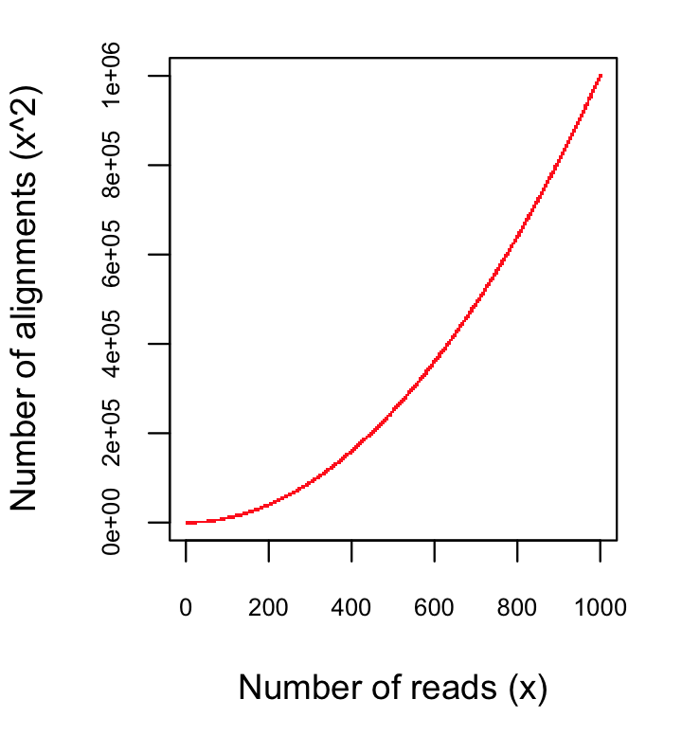
Finding pairwise overlaps between n reads involves ~ n² comparisons.
Impractical for typical RNA-Seq data (50M reads)
Notes:
This approach can be highly effective, but it simply doesn’t scale well for large data sets such as those generated using RNA-Seq.
Building the overlap graph involved aligning and comparing each read to every other read. If we have ‘n’ reads, then this would involve roughly n^2 number of comparisons.
----
If we plot the number of pairwise alignments required as a function of the number of reads, we see that the number of alignments grows exponentially.
----
This is a problem because it means that the amount of time it would take to do the alignments as well as the amount of computer hardware required to store the information would also grow exponentially, and so it’s just not a viable approach for assembling the many millions or billions of reads generated in an RNA-Seq experiment.

Slide 19
No genome to align to… De novo assembly required
Want to avoid n² read alignments to define overlaps
Use a de Bruijn graph
Notes:
If we don’t have a genome to align to, we need to be able to assemble the reads directly, but we need a way to avoid doing all pairwise alignments between the reads.
----
A popular technique for doing de novo assembly of short reads is to leverage a de Bruijn graph data structure. The de Bruijn graph was initially applied to genome assembly and was later adopted for transcriptome assembly. There are some key differences between assembling genomes and assembling transcriptomes using de Bruijn graphs, and I’ll comment more on that shortly.

Slide 20
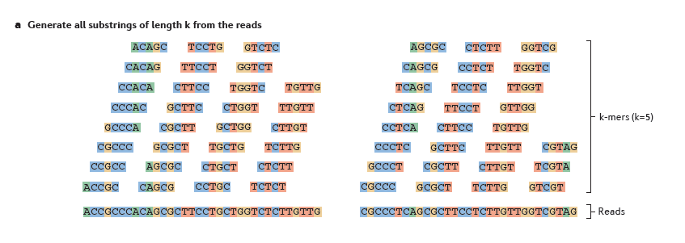
Sequence Assembly via De Bruijn Graphs
Generate all substrings of length k from the reads
k-mers (k=5)
Reads
From Martin & Wang, Nat. Rev. Genet. 2011
Notes:
A de Bruijn graph represents connectivity between sequences observed within reads, and the overlaps between reads are apparent by the virtue of having shared substrings.
The first step in a de Bruijn graph-based assembly is to construct the de Bruijn graph from the sequence reads.
Each read is decomposed into substrings of some specified length k. Each word of length k is called a k-mer. In this example, k is set to 5, so here each 5-mer is extracted from the read.
----
An ordered list of k-mers is generated by scanning a window of length k across the length of the read.

Slide 21
Sequence Assembly via De Bruijn Graphs
Generate all substrings of length k from the reads
k-mers (k=5)
Reads
From Martin & Wang, Nat. Rev. Genet. 2011
Notes:
That kmer is extracted from the read sequence

Slide 22
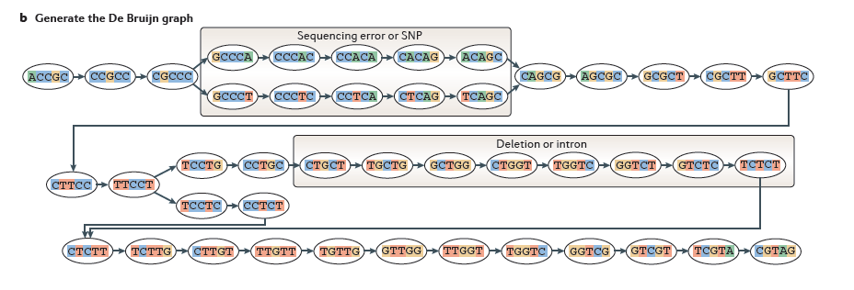
Sequence Assembly via De Bruijn Graphs
Generate all substrings of length k from the reads
k-mers (k=5)
Reads
Construct the de Bruijn graph
From Martin & Wang, Nat. Rev. Genet. 2011
Nodes = unique k-mers, Edges = overlap by (k-1)
Notes:
and inserted as a node in our de Bruijn graph. This graph node now represents this unique kmer sequence, and this single node will represent this unique kmer for every occurrence of this kmer in the entire set of reads.

Slide 23
Sequence Assembly via De Bruijn Graphs
Generate all substrings of length k from the reads
k-mers (k=5)
Reads
Construct the de Bruijn graph
From Martin & Wang, Nat. Rev. Genet. 2011
Nodes = unique k-mers, Edges = overlap by (k-1)
Notes:
We then shift the window over by one base, extract that k-mer…

Slide 24
Sequence Assembly via De Bruijn Graphs
Generate all substrings of length k from the reads
k-mers (k=5)
(k-1) overlap
Reads
Construct the de Bruijn graph
From Martin & Wang, Nat. Rev. Genet. 2011
Nodes = unique k-mers, Edges = overlap by (k-1)
Notes:
and insert it as another node in our de Bruijn graph.

Slide 25
Sequence Assembly via De Bruijn Graphs
Generate all substrings of length k from the reads
k-mers (k=5)
(k-1) overlap
Reads
Construct the de Bruijn graph
From Martin & Wang, Nat. Rev. Genet. 2011
Nodes = unique k-mers, Edges = overlap by (k-1)
Notes:
For each pair of neighboring k-mers, which overlap by k-1 bases, we include an edge between them in the graph.

Slide 26
Sequence Assembly via De Bruijn Graphs
Generate all substrings of length k from the reads
k-mers (k=5)
Reads
Construct the de Bruijn graph
From Martin & Wang, Nat. Rev. Genet. 2011
Nodes = unique k-mers, Edges = overlap by (k-1)
Notes:
We continue to do this for all reads and fully construct our de Bruijn graph.
This de Bruijn graph is a very effective and compact way of representing the sequence data within the reads. For example, hundreds of millions of reads can be sequenced, and the identical sequence regions within reads become compressed into individual nodes within the graph.
At positions where related sequences diverge due to allelic polymorphisms, splicing variations, repeats, or due to sequencing errors, the graph will branch and can form bulges or loops.

Slide 27
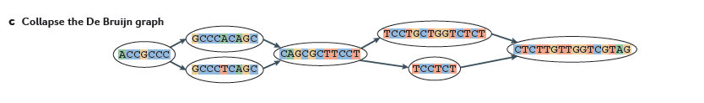
Construct the de Bruijn graph
Collapse the de Bruijn graph
From Martin & Wang, Nat. Rev. Genet. 2011
Notes:
After building the graph from all the reads, the graph is typically pruned to remove bubbles and structures that likely stem from sequencing errors,
and the graph is further simplified by collapsing those nodes that form linear unbranched chains of overlapping k-mers.
--
For example, this linear chain of kmers is compressed into a single node in the compacted graph.

Slide 28
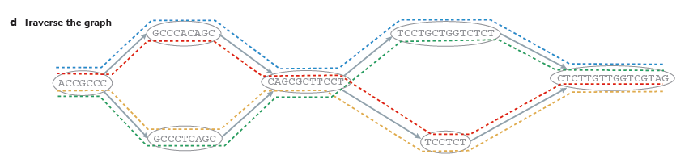

Collapse the de Bruijn graph
Traverse the graph
Assemble Transcript Isoforms
From Martin & Wang, Nat. Rev. Genet. 2011
Notes:
Now, to reconstruct transcripts, we define paths in the graph that are supported by the reads, and traverse those paths to reconstruct complete isoform sequences.
--
In this example, there are again four possible paths from the beginning to the end of the graph, each path shown traced by a different color.
By traversing each path, a different transcript sequence is generated.
--
Again, there are many different algorithms and techniques for defining best paths within this graph, and ideally the best paths reported are those that are best supported by the RNA-Seq data, taking into account the paths supported by individual read sequences and any mate-pairing information that may be available.

Slide 29

Contrasting Genome and Transcriptome De novo Assembly
Genome Assembly
Transcriptome Assembly
Uniform coverage
Exponentially distributed coverage levels
Single contig per locus
Multiple contigs per locus (alt splicing)
Assemble small numbers of large Mb-length chromosomes
Assemble many thousands of Kb-length transcripts
Double-stranded data
Strand-specific data available
Notes:
Both genome and transcriptome assemblers make use of de Bruijn graphs for assembly, but they are tuned to assemble reads according to very different expected characteristics. This is why you wouldn’t want to leverage a genome assembler for transcriptome assembly and vice-versa, since each method is highly specialized.
Some of the key differences between what’s expected by genome and transcriptome assemblers include the following:
--
Genome assemblers expect that read coverage is going to be rather uniform and will often discard sequences that occur at high coverage as repetitive sequences. In contrast, transcriptome assembly needs to consider a wide range of coverage levels spanning several orders of magnitude since sequences with high coverage are more likely to represent highly expressed transcripts instead of repeats.
--
Genome assemblers typically aim to generate a single contig per locus. In transcriptome assembly, it’s understood that single genes can generate many alternatively spliced transcripts, and multiple contigs are reported per locus where evidence of transcript complexity exists.
--
Genome assemblers aim to produce small numbers of very long contig, ideally reconstructing entire megabase-sized chromosomes where possible. Transcriptome assemblers are generally tasked with assembling many thousands of separate transcripts, on the order of thousands of bases in length.
--
Finally, in genome assembly, reads are assumed to be derived from either strand of the double-stranded DNA molecule. Conventional RNA-Seq offers the option of generating strand-specific data, and Transcriptome assemblers need to consider strand-specific data in order to assemble sense and antisense transcripts separately.

Slide 30
Trinity Aggregates Isolated Transcript Graphs
Genome Assembly
Single Massive Graph
Trinity Transcriptome Assembly
Many Thousands of Small Graphs
Entire chromosomes represented.
Ideally, one graph per expressed gene.
Notes:
A significant difference between Trinity as compared to all other assemblers is how it goes about building the graphs.
Genome assemblers (and other transcriptome assemblers that are built on top of genome assemblers) typically build single large graphs.
Trinity instead tries to partition the data into many thousands of small graphs, ideally one graph per expressed gene. This is possible because most expressed transcripts tend to be non-overlapping.
Having many small graphs lends itself to massive parallel processing, which is an added computational benefit.

Slide 31
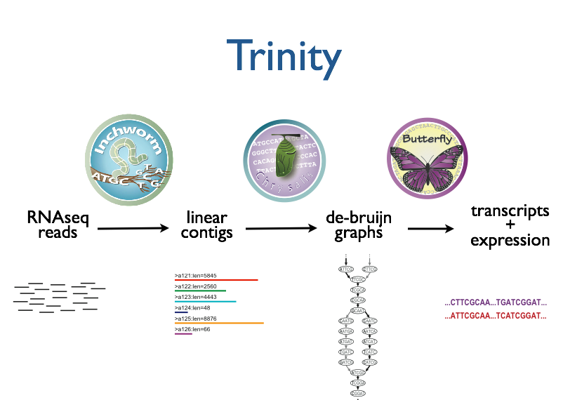
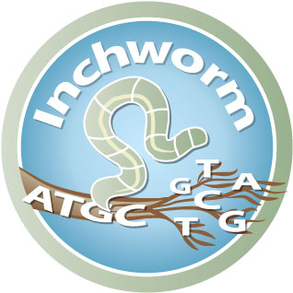
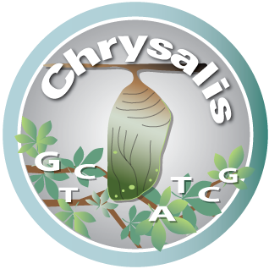

Trinity – How it works:
RNA-Seq reads
Linear
contigs
de-Bruijn
graphs
Transcripts
+
Isoforms
Thousands of disjoint graphs
Notes:
Here’s a high-level overview of the whole Trinity assembly algorithm.
We call it Trinity because it involves three major steps that we’ve built into three separate software modules.
It starts with Inchworm, which first assembles the RNA-Seq data into linear contigs.
Then, Chrysalis groups contigs that are related due to alternative splicing or gene duplication and constructs de bruijn graphs.
Finally, Butterfly examines reads in the context of the de bruijn graphs, and reports the final full-length transcripts and isoforms of transcripts.

Slide 32
Inchworm Algorithm
Decompose all reads into overlapping Kmers => hashtable(kmer, count)
Read:
AATGTGAAAACTGGATTACATGCTGGTATGTC…
AATGTGA
ATGTGAA
Overlapping kmers of length (k)
TGTGAAA
…
Kmer Catalog (hashtable)
Kmer | Count among all reads
AATGTGA | 4
ATGTGAA | 2
TGTGAAA | 1
GATTACA | 9
Module
bioinformatics.ca
Notes:
The inchworm algorithm is quite simple.
It first decomposes reads into a catalog of overlapping Kmers,
----
and builds a hashtable containing the kmers and the count of the number of times that kmer is found in all the reads.

Slide 33
Inchworm Algorithm
Decompose all reads into overlapping Kmers => hashtable(kmer, count)
Identify seed kmer as most abundant Kmer, ignoring low-complexity kmers.
GATTACA
9
Kmer Catalog (hashtable)
Kmer | Count among all reads
AATGTGA | 4
ATGTGAA | 2
TGTGAAA | 1
GATTACA | 9
Module
bioinformatics.ca
Notes:
The single most abundant kmer with reasonable sequence complexity is identified as a seed kmer.

Slide 34
Inchworm Algorithm
Decompose all reads into overlapping Kmers => hashtable(kmer, count)
Identify seed kmer as most abundant Kmer, ignoring low-complexity kmers.
Extend kmer at 3’ end, guided by coverage.
G
A
GATTACA
9
T
C
Module
bioinformatics.ca
Notes:
This seed kmer is then extended at the 3’ end guided by the coverage of overlapping kmers.
For each extension, there are four possible kmers, each ending with one of the four possible nucleotides.

Slide 35
Inchworm Algorithm
G
4
A
GATTACA
9
T
C
Module
bioinformatics.ca
Notes:
Each of the possible overlapping kmers is looked up in the kmer catalog to determine their frequency within the reads.
In this toy example, the kmer ending with ‘G’ is found 4 times.

Slide 36
Inchworm Algorithm
G
4
A
GATTACA
1
9
T
C
Module
bioinformatics.ca
Notes:
‘A’ is found once.

Slide 37
Inchworm Algorithm
G
4
A
GATTACA
1
9
T
0
C
Module
bioinformatics.ca
Notes:
The kmer ending with ‘T’ doesn’t exist in the reads, so it has a count of zero.

Slide 38
Inchworm Algorithm
G
4
A
GATTACA
1
9
T
0
C
4
Module
bioinformatics.ca
Notes:
And the kmer ending with ‘C’ is found 4 times.

Slide 39
Inchworm Algorithm
G
4
A
GATTACA
1
9
T
0
C
4
Module
bioinformatics.ca
Notes:
In this case we have a tie.

Slide 40
Inchworm Algorithm
G
A
0
5
T
1
G
4
C
A
0
GATTACA
1
9
T
0
G
C
1
4
A
1
C
T
1
1
Module
bioinformatics.ca
Notes:
When we encounter a tie, we explore the tied paths recursively to find that extension that provides the highest cumulative coverage.

Slide 41
Inchworm Algorithm
G
A
0
5
T
1
G
4
C
A
0
GATTACA
1
9
T
0
G
C
1
4
A
1
C
T
1
1
Module
bioinformatics.ca
Notes:
In this case, the extension of two overlapping kmers ending with an ‘A’ provides the highest cumulative coverage, and so the other paths are ignored.

Slide 42
Inchworm Algorithm
A
5
G
4
GATTACA
9
Module
bioinformatics.ca
Notes:
Extensions continue to occur in this way until there are no more kmers that provide for an extension.

Slide 43
Inchworm Algorithm
A
5
C
G
0
4
T
0
GATTACA
A
9
6
G
1
Module
bioinformatics.ca
Notes:
Then, we extend from right to left in the same manner, following the path of greatest coverage.

Slide 44
Inchworm Algorithm
A
5
G
4
GATTACA
A
9
6
A
7
Report contig: ….AAGATTACAGA….
Remove assembled kmers from catalog, then repeat the entire process.
Module
bioinformatics.ca
Notes:
Once the extension completes, the assembled contig is reported.
--transition—
The kmers found in the contig are removed from the kmer catalog, and the entire process is repeated starting from a new seed. The Inchworm assembly ends when the entire k-mer catalog has been depleted.

Slide 45
Inchworm Contigs from Alt-Spliced Transcripts
Expressed isoforms
Isoform A
Isoform B
Module
bioinformatics.ca
Notes:
Inchworm alone performs well at reconstructing full-length transcripts, but in the case of alternative splicing, inchworm alone is unable to reconstruct full-length transcripts for each of the isoforms.
This is because it assembles contigs from unique kmers and the sequences shared between isoforms can be reported in only one Inchworm contig.
For example, here are two expressed isoforms which share the orange and green sequence regions in common, and Isoform A has a stretch of unique sequence shown in yellow, such as coming from an exon skipped in isoform B.

Slide 46
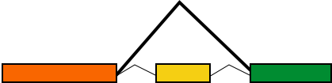
Inchworm Contigs from Alt-Spliced Transcripts
Expressed isoforms
Expression
Isoform A
(low)
Isoform B
(high)
Graphical representation
Module
bioinformatics.ca
Notes:
This can be represented graphically like so. Based on the read support, we find that Isoform B is highly expressed as compared to Isoform A, and we indicate that in the graph by the thicker edge.

Slide 47
Inchworm Contigs from Alt-Spliced Transcripts
Module
bioinformatics.ca
Notes:
When Inchworm greedily assembles k-mers, it will often report the more highly expressed isoform as a single full-length contig.

Slide 48
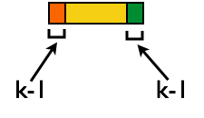
Inchworm Contigs from Alt-Spliced Transcripts
+
No k-mers in common
Module
bioinformatics.ca
Notes:
And only the unique regions of alternatively spliced isoforms are reported as separate contigs.
Again, these contigs share no k-mers in common.
The remaining components of Trinity are responsible for linking these related contigs together and reporting more complete sequences for each. This is where Chrysalis first comes in.

Slide 49
Inchworm Contigs from Alt-Spliced Transcripts
+
Module
bioinformatics.ca
Notes:
Although these inchworm contigs lack complete kmers in common, they maintain partial kmer overlap at points where the isoforms diverge.
The smaller contig can still be associated with the larger contig based on these partial kmers of length k-1, and we can find reads to support the junction.

Slide 50
Chrysalis Re-groups Related Inchworm Contigs
+
Chrysalis uses (k-1) overlaps and read support to link related Inchworm contigs
Module
bioinformatics.ca
Notes:
The Chrysalis tool, in the next step, exploits these partial kmers to regroup related contigs. If reads exist that support the junction at the k-1 overlaps, then Chrysalis will cluster the inchworm contigs together.

Slide 51
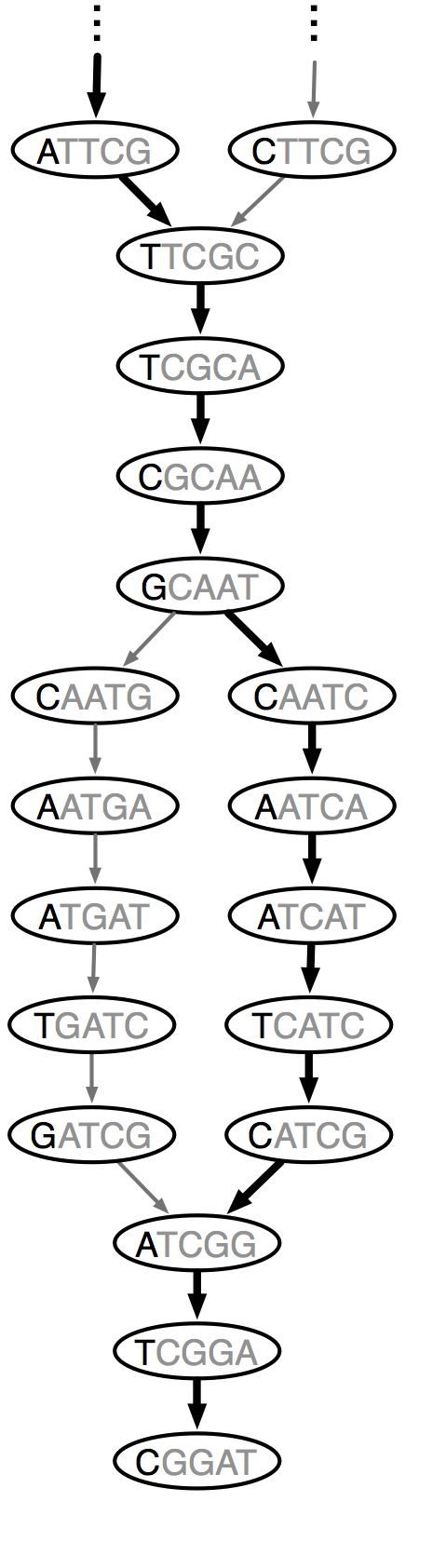

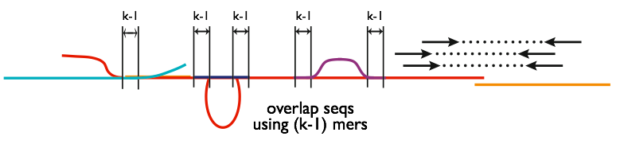
Chrysalis
Integrate isoforms
via k-1 overlaps
Build de Bruijn Graphs
(ideally, one per gene)
Module
bioinformatics.ca
Notes:
Here is a high-level overview of the Chrysalis operations.
Chrysalis clusters related contigs based on these k-1mer overlaps.
Chyrsalis also leverages read pairing information to join minimally overlapping contigs.
--
After identifying the connected inchworm contigs, it constructs a separate de Bruijn graph for each group.
(Again, the de Bruijn graph represents the overlaps between adjacent kmers in the sequences with branches at sites of variation.)

Slide 52
Thousands of Chrysalis Clusters
Notes:
And this is how we end up with many separate graphs, ideally one graph per gene, with each graph representing the transcriptional complexity at that locus.
These graphs can then be processed in a parallel fashion by the next step of Trinity involving Butterfly.

Slide 53
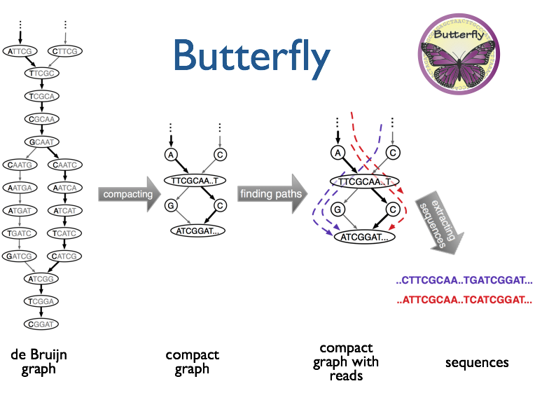
(isoforms and paralogs)
Module
bioinformatics.ca
Notes:
Butterfly operates on each of these graphs independently.
It first compacts the de Bruijn graph by collapsing the unbranched stretches, as described earlier.
It then threads the original sequencing reads into the graph, tracking the paths occupied by the reads and those paths supported by mate pairs.
Butterfly then reports the most probable paths through the graph supported by the reads and read pairings, emitting full-length transcripts for isoforms and paralogs.

Slide 54
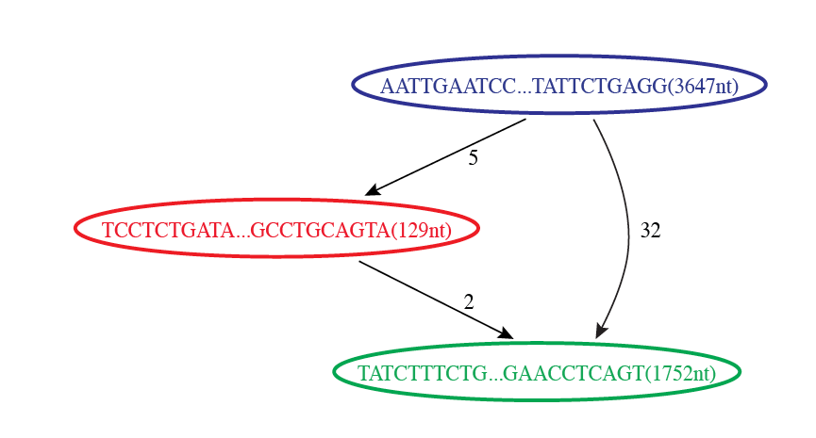

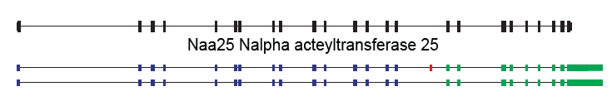
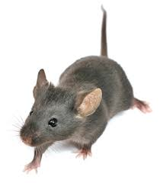
Butterfly Example 1: Reconstruction of Alternatively Spliced Transcripts
Butterfly’s Compacted Sequence Graph
Reconstructed Transcripts
Aligned to Mouse Genome
Module
bioinformatics.ca
Notes:
Here’s a real example to demonstrate how this works in practice.
In our mouse RNA-Seq data set, we find a compacted de Bruijn graph that has three nodes.

Slide 55
Reconstruction of Alternatively Spliced Transcripts
Butterfly’s Compacted Sequence Graph
Reconstructed Transcripts
Aligned to Mouse Genome
Module
bioinformatics.ca
Notes:
By traversing the path from the top blue node to the bottom green node, we generate a single transcript sequence.

Slide 56
Reconstruction of Alternatively Spliced Transcripts
Butterfly’s Compacted Sequence Graph
Reconstructed Transcripts
Aligned to Mouse Genome
Module
bioinformatics.ca
Notes:
By traversing the alternative path through the red node, we generate another transcript sequence. This second transcript shares the blue and green segments, but contains an additional internal red segment.

Slide 57
Reconstruction of Alternatively Spliced Transcripts
Butterfly’s Compacted Sequence Graph
Reconstructed Transcripts
Aligned to Mouse Genome
(Reference structure)
Module
bioinformatics.ca
Notes:
From mapping the transcripts to the reference genome sequence we can see that the inserted sequence actually corresponds to a cassette exon that is alternatively spliced, and novel given that it wasn’t found in the reference transcript structure.

Slide 58
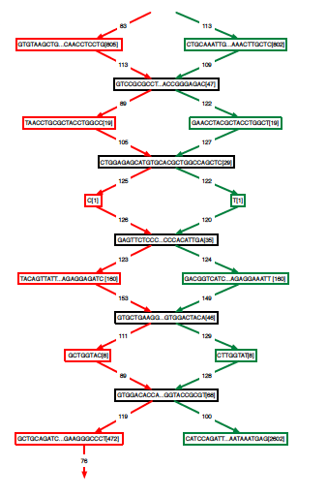
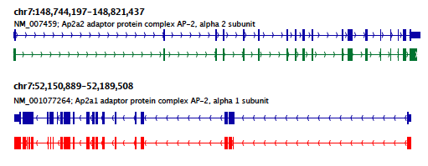
Teasing Apart Transcripts of Paralogous Genes
Butterfly Example 2:
Ap2a1
Ap2a2
Module
bioinformatics.ca
Notes:
Some transcript graphs are far more complex.
Here we have an example of two such transcripts derived from paralogous genes that became intertwined in the compacted graph due to stretches of sequence identity among segments of the transcripts.
Shared sequences are represented by the central sequence nodes and paralog-specific sequences are represented by branched nodes.
By tracing consistent paths of reads through the graph, Butterfly is able to tease apart the paralogous gene sequences and report the individual transcripts. In this case, the green path yields one of the transcripts and the red path yields the other.

Slide 59
Teasing Apart Transcripts of Paralogous Genes
Butterfly Example 2:
Ap2a1
Ap2a2
Module
bioinformatics.ca
Notes:
These transcripts, when mapped to the mouse genome match perfectly with the reference gene structures. Here, the reference structures are shown in blue, and the Trinity-reconstructed transcripts are shown below.

Slide 60


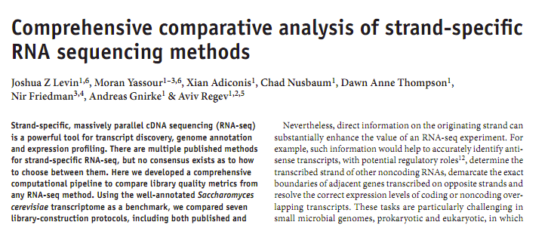
Strand-specific RNA-Seq is Preferred
Computationally: fewer confounding graph structures in de novo assembly:
ex. Forward != reverse complement
(GGAA != TTCC)
Biologically: separate sense vs. antisense transcription
‘dUTP second strand marking’ identified as the leading protocol
Module
bioinformatics.ca
Notes:
Although Trinity doesn’t absolutely require it, Strand specific rna-seq is the preferred substrate for transcriptome assembly.
Computationally, there are fewer confounding graph structures since forward kmers and the reverse complement kmers are treated as distinct.
Biologically, it’s important because it allows for the separation of sense and antisense transcription.
--
Our group at the Broad performed a study of the various methods for generating strand-specific RNA-Seq,
--
and we found the ‘dUTP second strand marking’ method to be the leading protocol.
We routinely generate strand-specific RNA-Seq as our default protocol at the Broad, and there are now kits available that make the approach readily accessible.

Slide 61
dUTP 2nd Strand Method: Our Favorite
RNA
First-strand synthesis with normal dNTPs
cDNA
Second-strand synthesis with dTTP → dUTP
U
U
UU
U
UU
Adaptor ligation
U
U
UU
U
UU
U
U
UU
U
UU
USER™
(Uracil-Specific Excision Reagent)
Remove “U”s
PCR and paired-end sequencing
Modified from Parkhomchuk et al. (2009) Nucleic Acids Res. 37:e123
Slide from J. Levin
Module
bioinformatics.ca

Slide 62
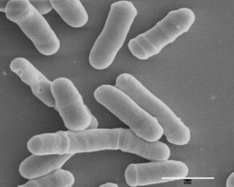
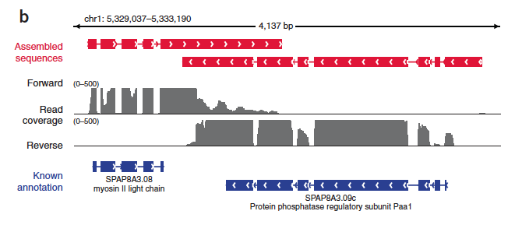
Overlapping UTRs from Opposite Strands
Schizosacharomyces pombe
(fission yeast)
Module
bioinformatics.ca
Notes:
Strand-specific RNA-Seq is tremendously useful when applied to organisms that have compact genomes.
Here’s an example from Schizosaccharomyces pombe (fission yeast) where we have two known genes that are transcribed on opposite strands and point toward each other.
We have strand specific rna-seq and the coverage plots for each strand are shown above. From the coverage plots, you can see that there’s overlap in the coverage in their UTR regions, and if we didn’t have strand-specific data, then we’d reconstruct a single transcript that covers both genes. Because we have the strand-specific data, though, Trinity is able to separately reconstruct these transcripts, allowing for overlap among their UTRs.

Slide 63
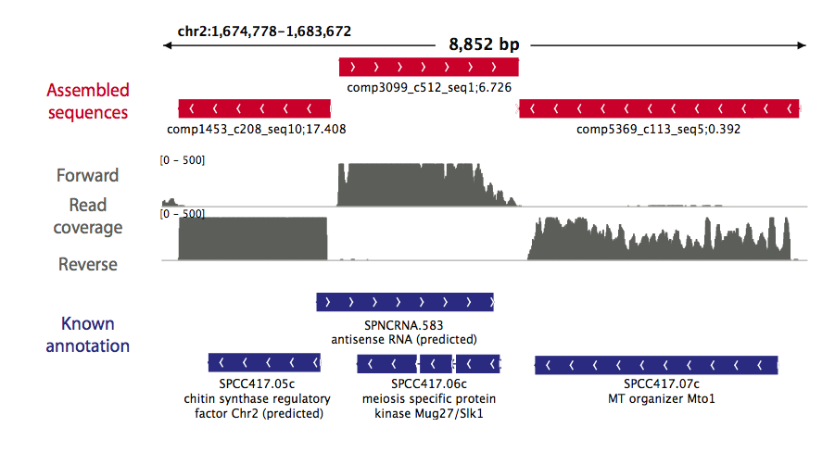
Antisense-dominated Transcription
Module
bioinformatics.ca
Notes:
Here’s another example in fission yeast that highlights the importance of strand-specific rna-seq.
This region of the genome encodes three genes that are all encoded on the same strand. From the rna-seq coverage plots, we can see that the two genes on the end are transcribed on their coding strand, but the central gene encoding a meiosis specific protein kinase is dominated by transcription on the opposite strand. This antisense transcription is thought to play an important role in the regulation of meiotic genes in fission yeast, and would have gone unnoticed if we hadn’t used strand-specific rna-seq.

Slide 64
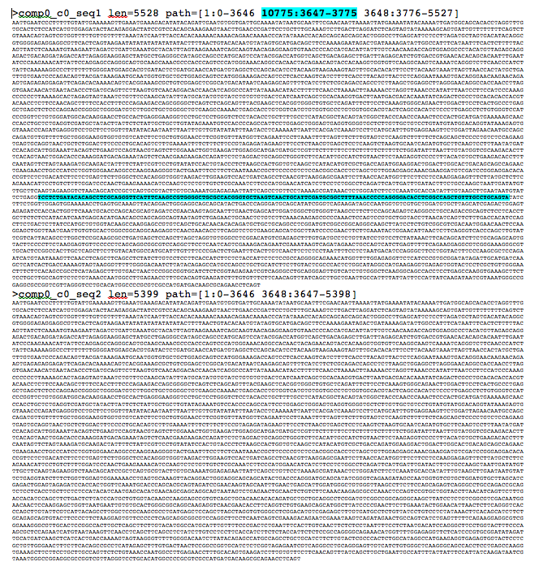
Trinity output: a multi-fasta file
Module
bioinformatics.ca

Slide 65
We are on a Coffee Break & Networking Session

