Slide 1


University of Puerto Rico
Puerto Rico - IDeA Networks of Biomedical Research Excellence
Python3 Part 1 – Crash Course in Python3 for Future STEM Coders
Prof. Judith S. Rodriguez-Martinez, MSc, PhD
Ph.D. Candidate
Penn State University – University Park Campus judiths.r91@gmail.com
May 31 - June 5, 2026

Slide 2
The following material is the result of PR-INBRE research and curriculum development effort to provide a set of educational materials for research training and curriculum changes in biology programs across the island to support PR-INBRE efforts to establish a Community of Practice in Bioinformatics that offers a fruitful environment to increase computational and bioinformatics skills among traditional researchers and students (undergraduate and graduate) in the island. They have been developed as a part of the NIH funded project “Puerto Rico IDeA Network Biomedical Research Excellence (PRINBRE)” (Award Number 5P20GM103475).
Unless otherwise specified, all the information contained within is Copyrighted © by University of Puerto Rico. Permission is granted for use, modify, and reproduce these materials for research and teaching purposes. A copy of the modified material should be sent to help@hpcf.upr.edu.
Most recent versions of these presentations can be found at http://inbre.hpcf.upr.edu/.

Slide 3
Competencies
Record and write simple and common Python scripts to deal with Bioinformatic needs for biological data analyses using a Jupyter Notebook

Slide 4
Objectives
Use Google Colab as an environment to practice and learn common Python lines of code.
Formulate simple calculations using Python
Identity the following datatypes: integer, float, and string
Employ variables for different datatypes

Slide 5
Objectives
Manipulate integer, float, and string datatypes
Use bioinformatic tools to find a protein-coding sequence
Evaluate a protein-coding sequence of interest and calculate its GC content.
Debug code

Slide 6
Target Audience
This training is addressed to beginners, highly motivated (eager to learn what is needed in order to be competitive without the tendency to self-limit when learning computational skills by saying that is difficult) wanting to become familiar with the Python programming language and become the Script Master of their bioinformatic analysis.

Slide 7
The importance of Python
R is great; however, you’ll eventually run into the Python language
No matter your field, python will be a necessity (chemistry, biology, engineering, ecology, mathematics, etc)
Knowing Python gives you an edge when job searching and navigating graduate research
The majority of bioinformatic tools are python-based and will lead you navigate under the hood code to successfully execute said program’s purpose.

Slide 8
Lesson 1.0.0 Connecting to Google Colab to learn common Python lines of code
(Gmail account ready for colab.research.google.com)

Slide 9


Google Colab
https://colab.research.google.com
1
Activate the link

Slide 10
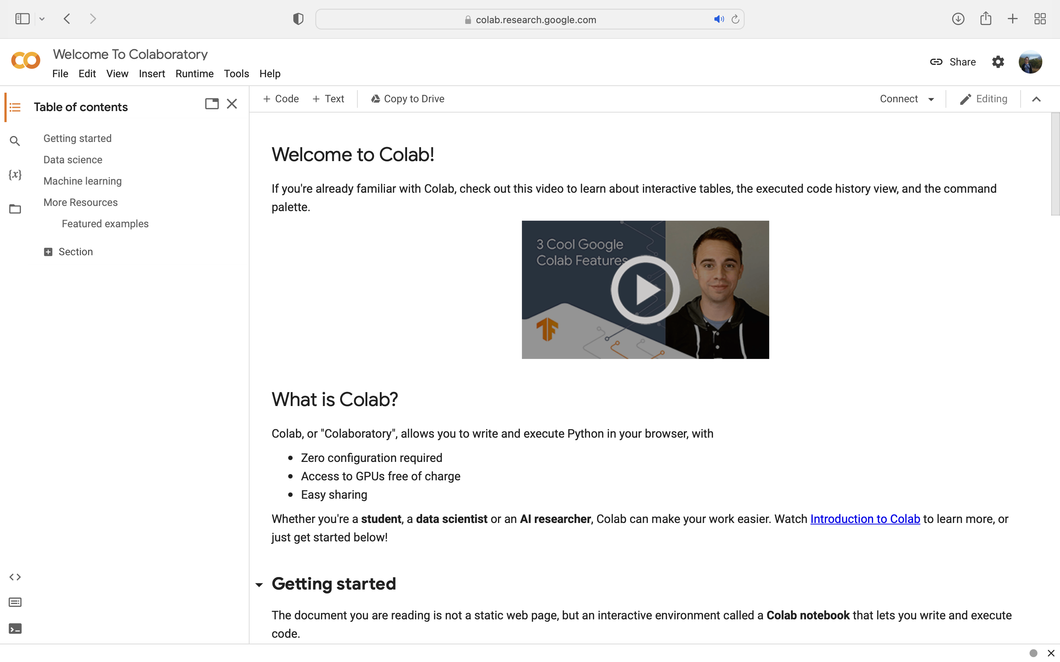
Activate colab.research.google.com

Slide 11
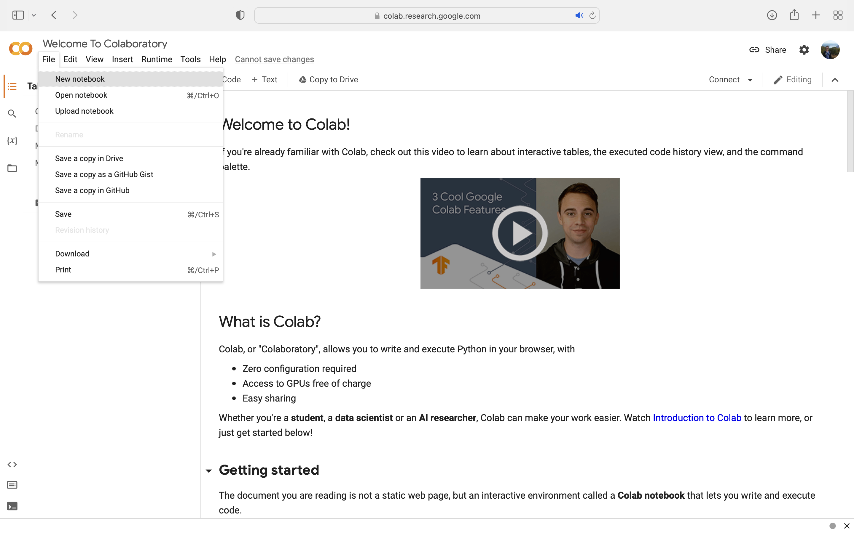
Open a New notebook
1
New notebook

Slide 12
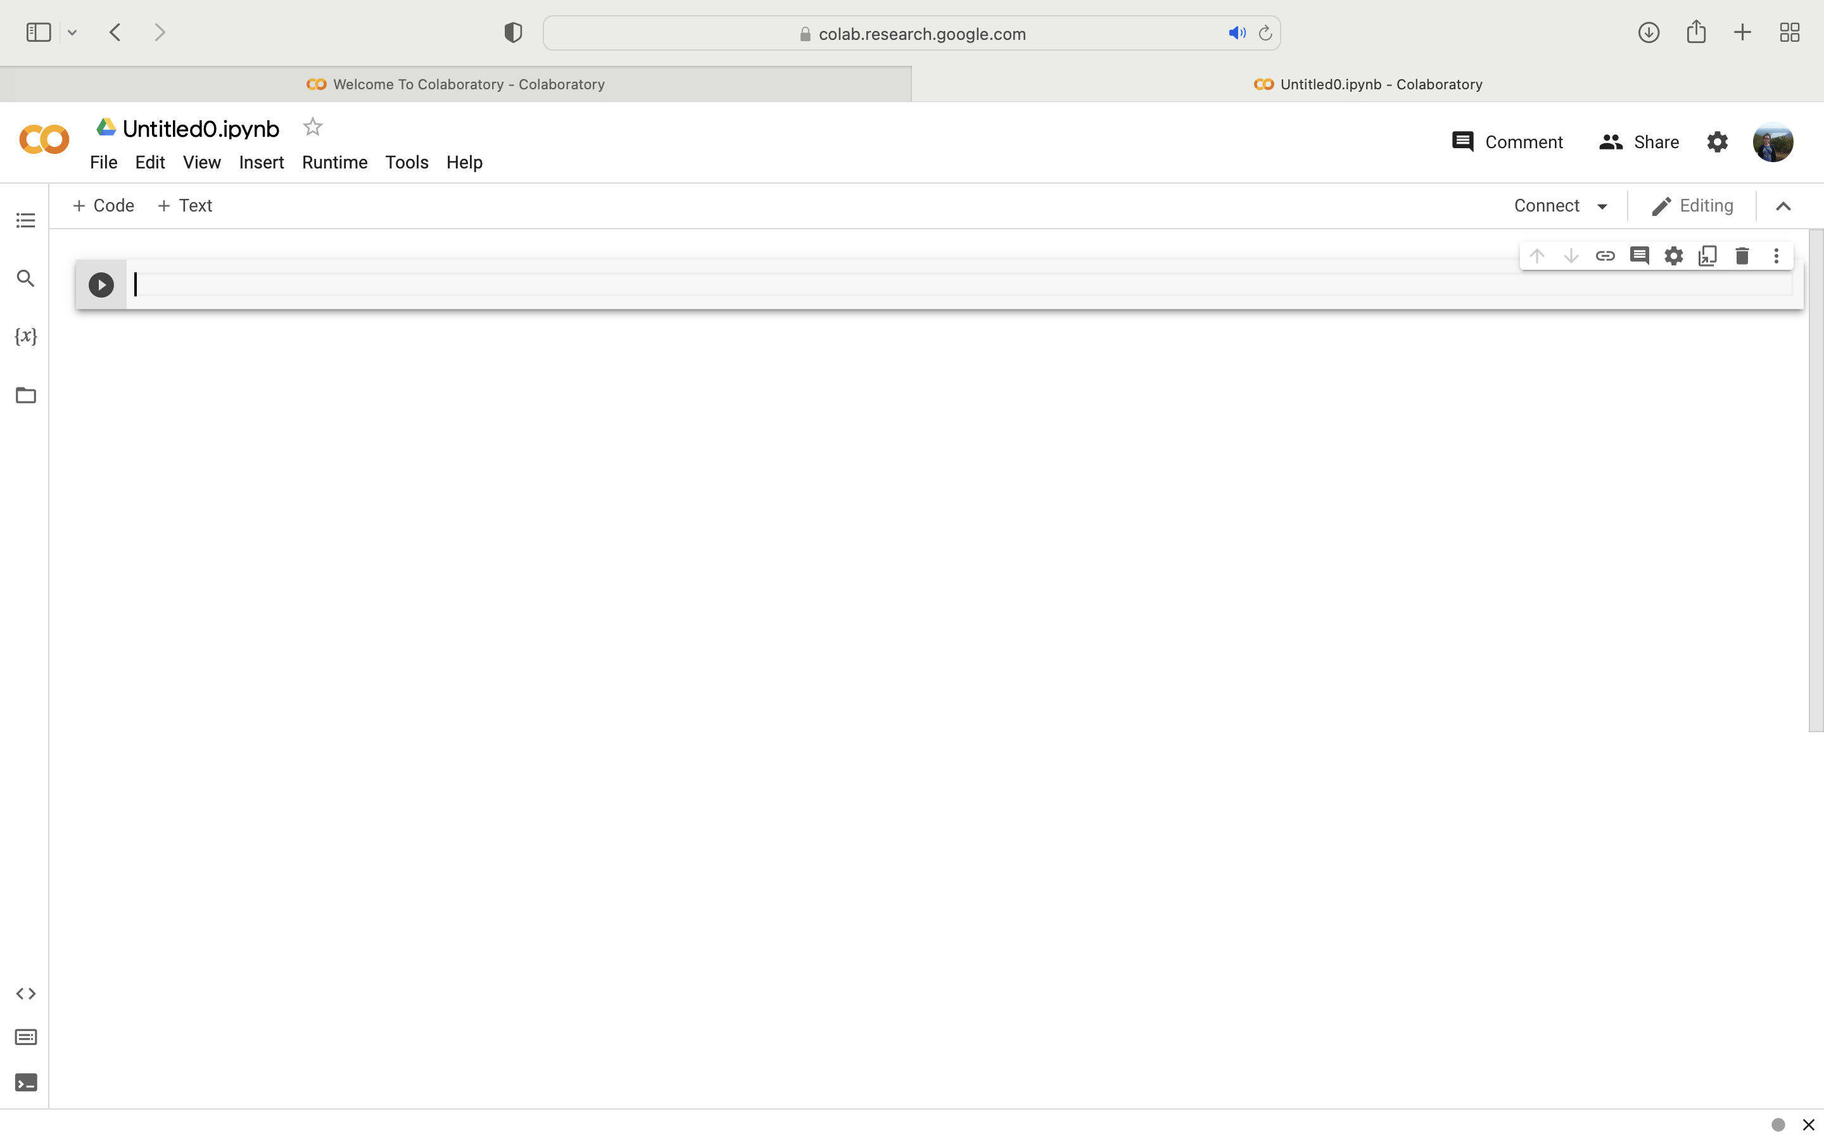
Welcome to your new notebook!
2
1
Your notebook name
New tab opens

Slide 13

https://github.com/bioinfwithjudith/PR-INBRE_Python_Workshop
3
In a new tab, activate the link

Slide 14
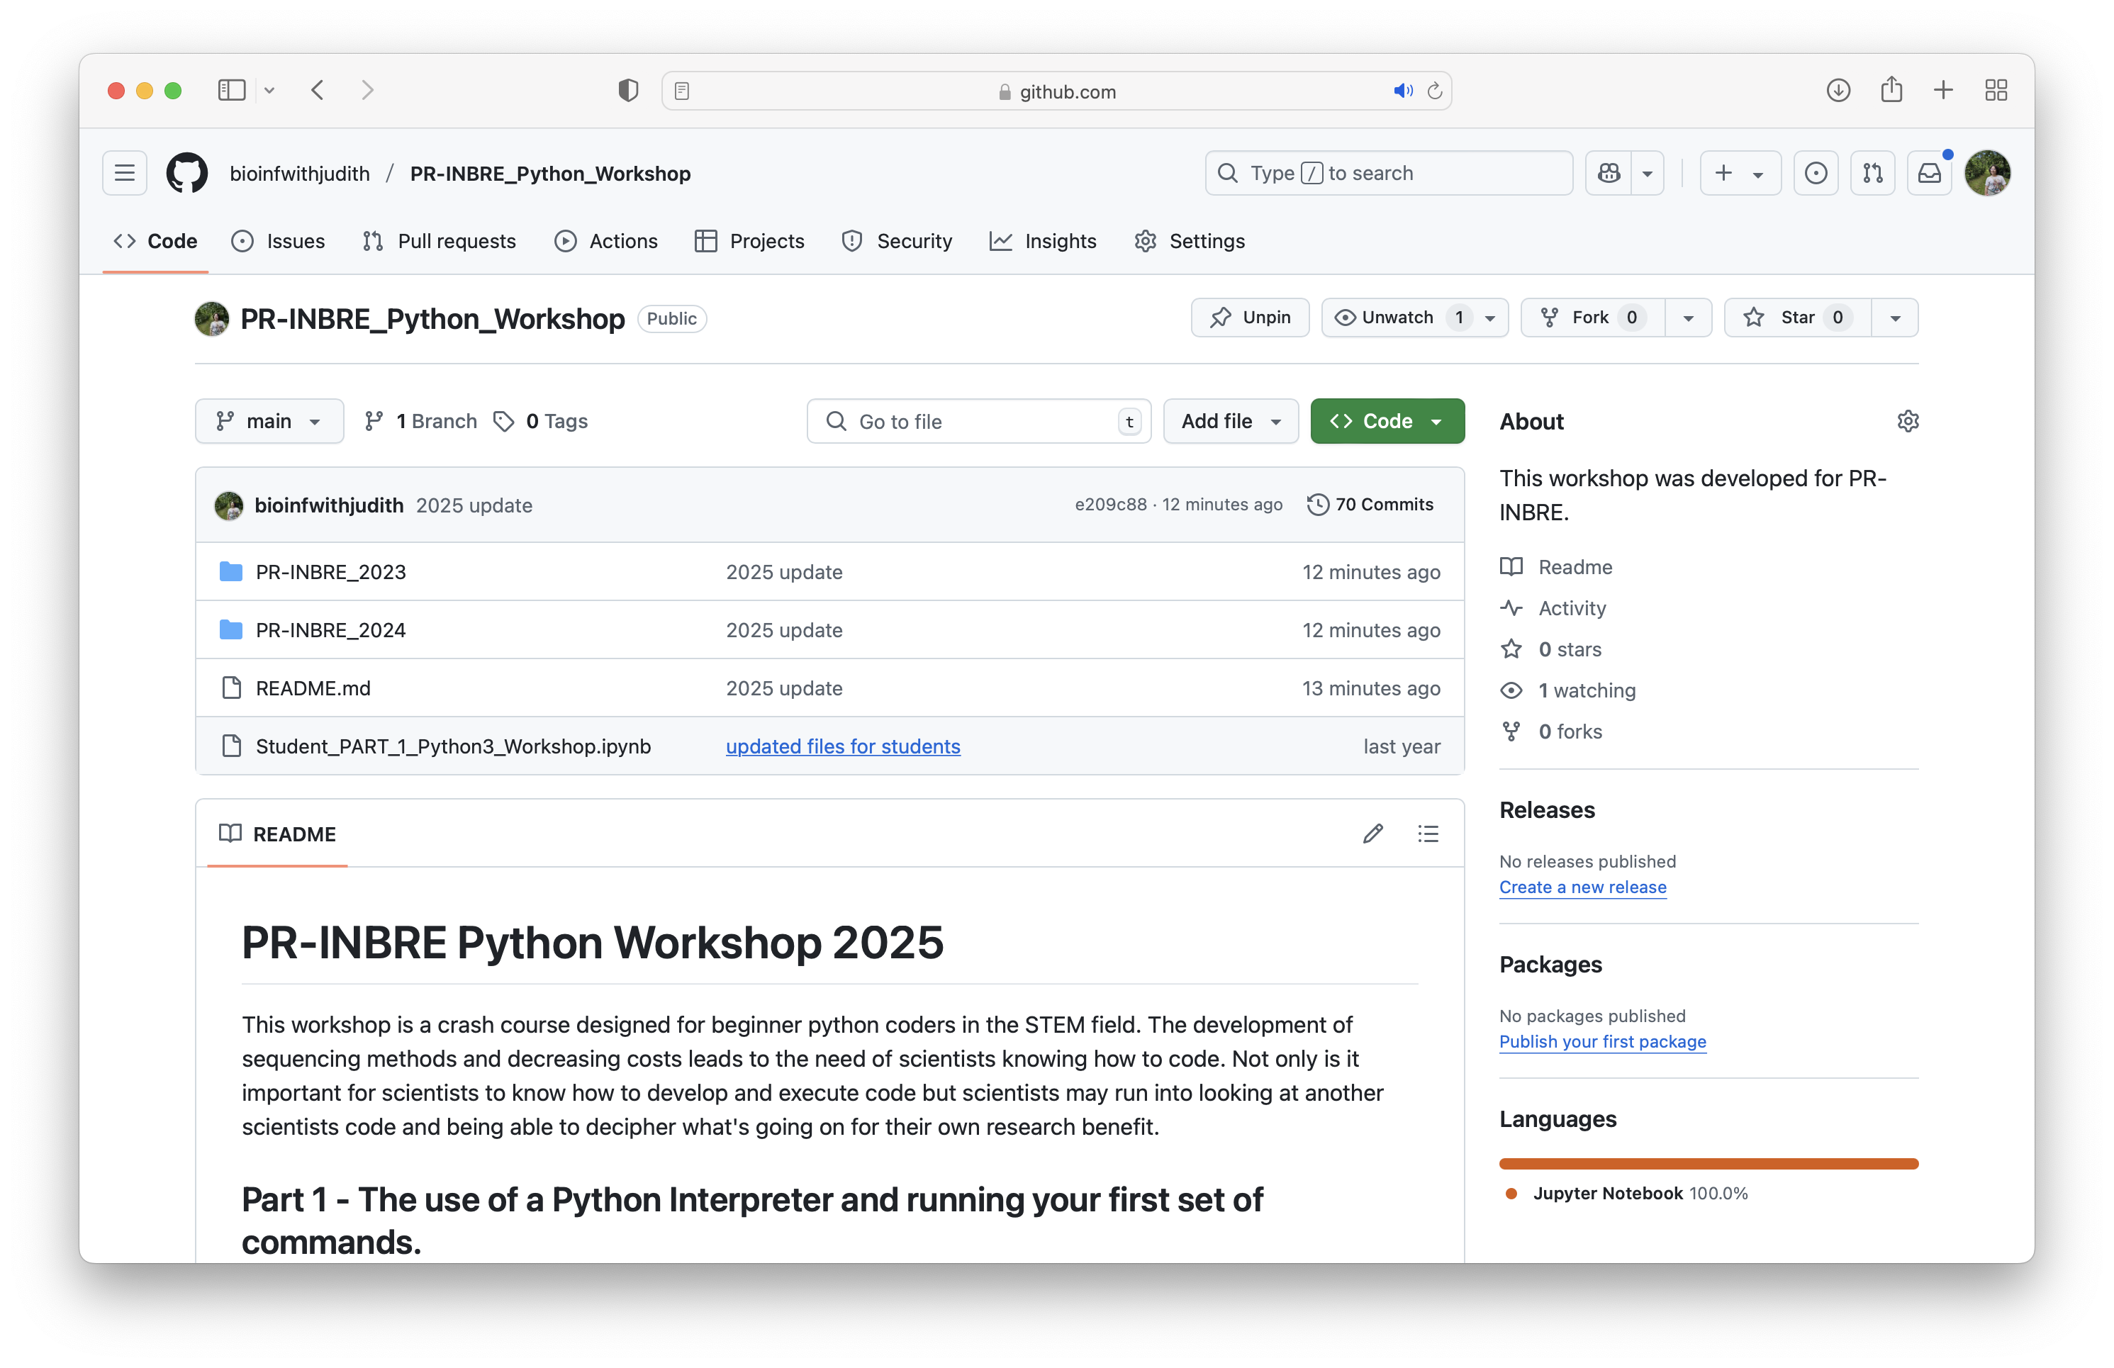
This is a GitHub repository!

Slide 15
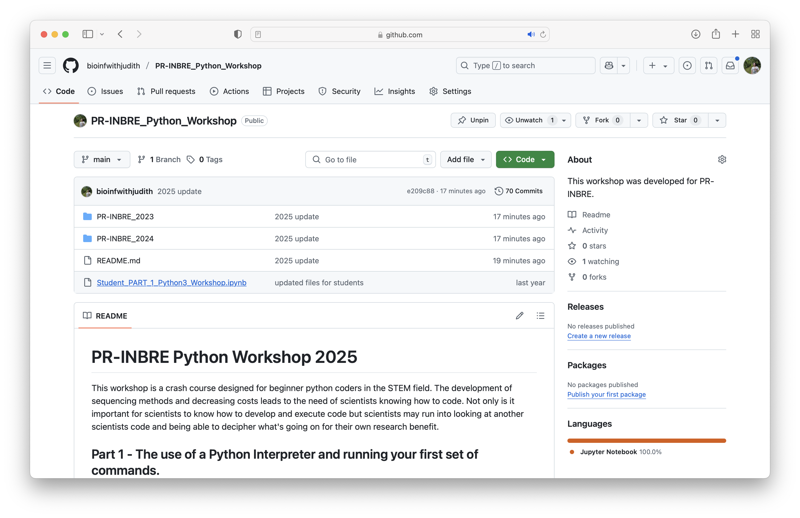
Download Jupyter Notebook
4
Click

Slide 16
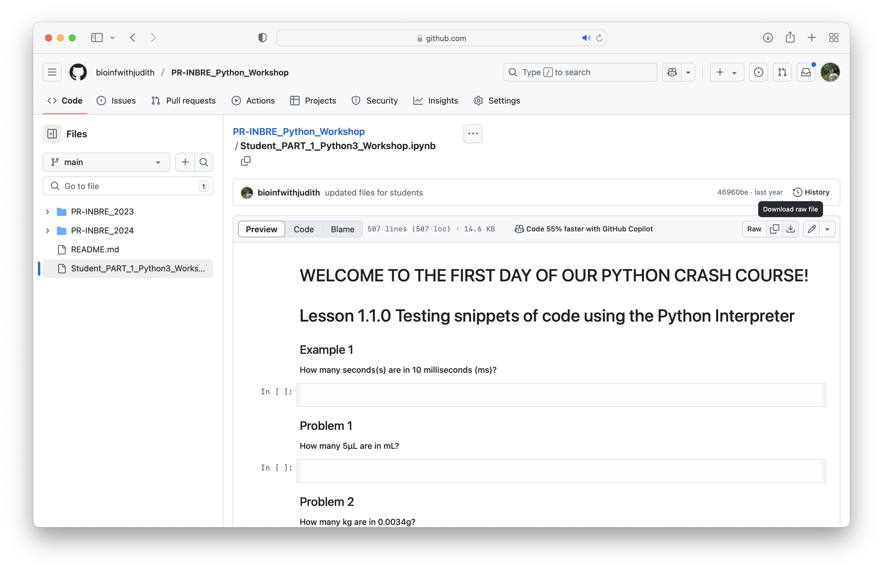
Download Jupyter Notebook
5
Download notebook

Slide 17
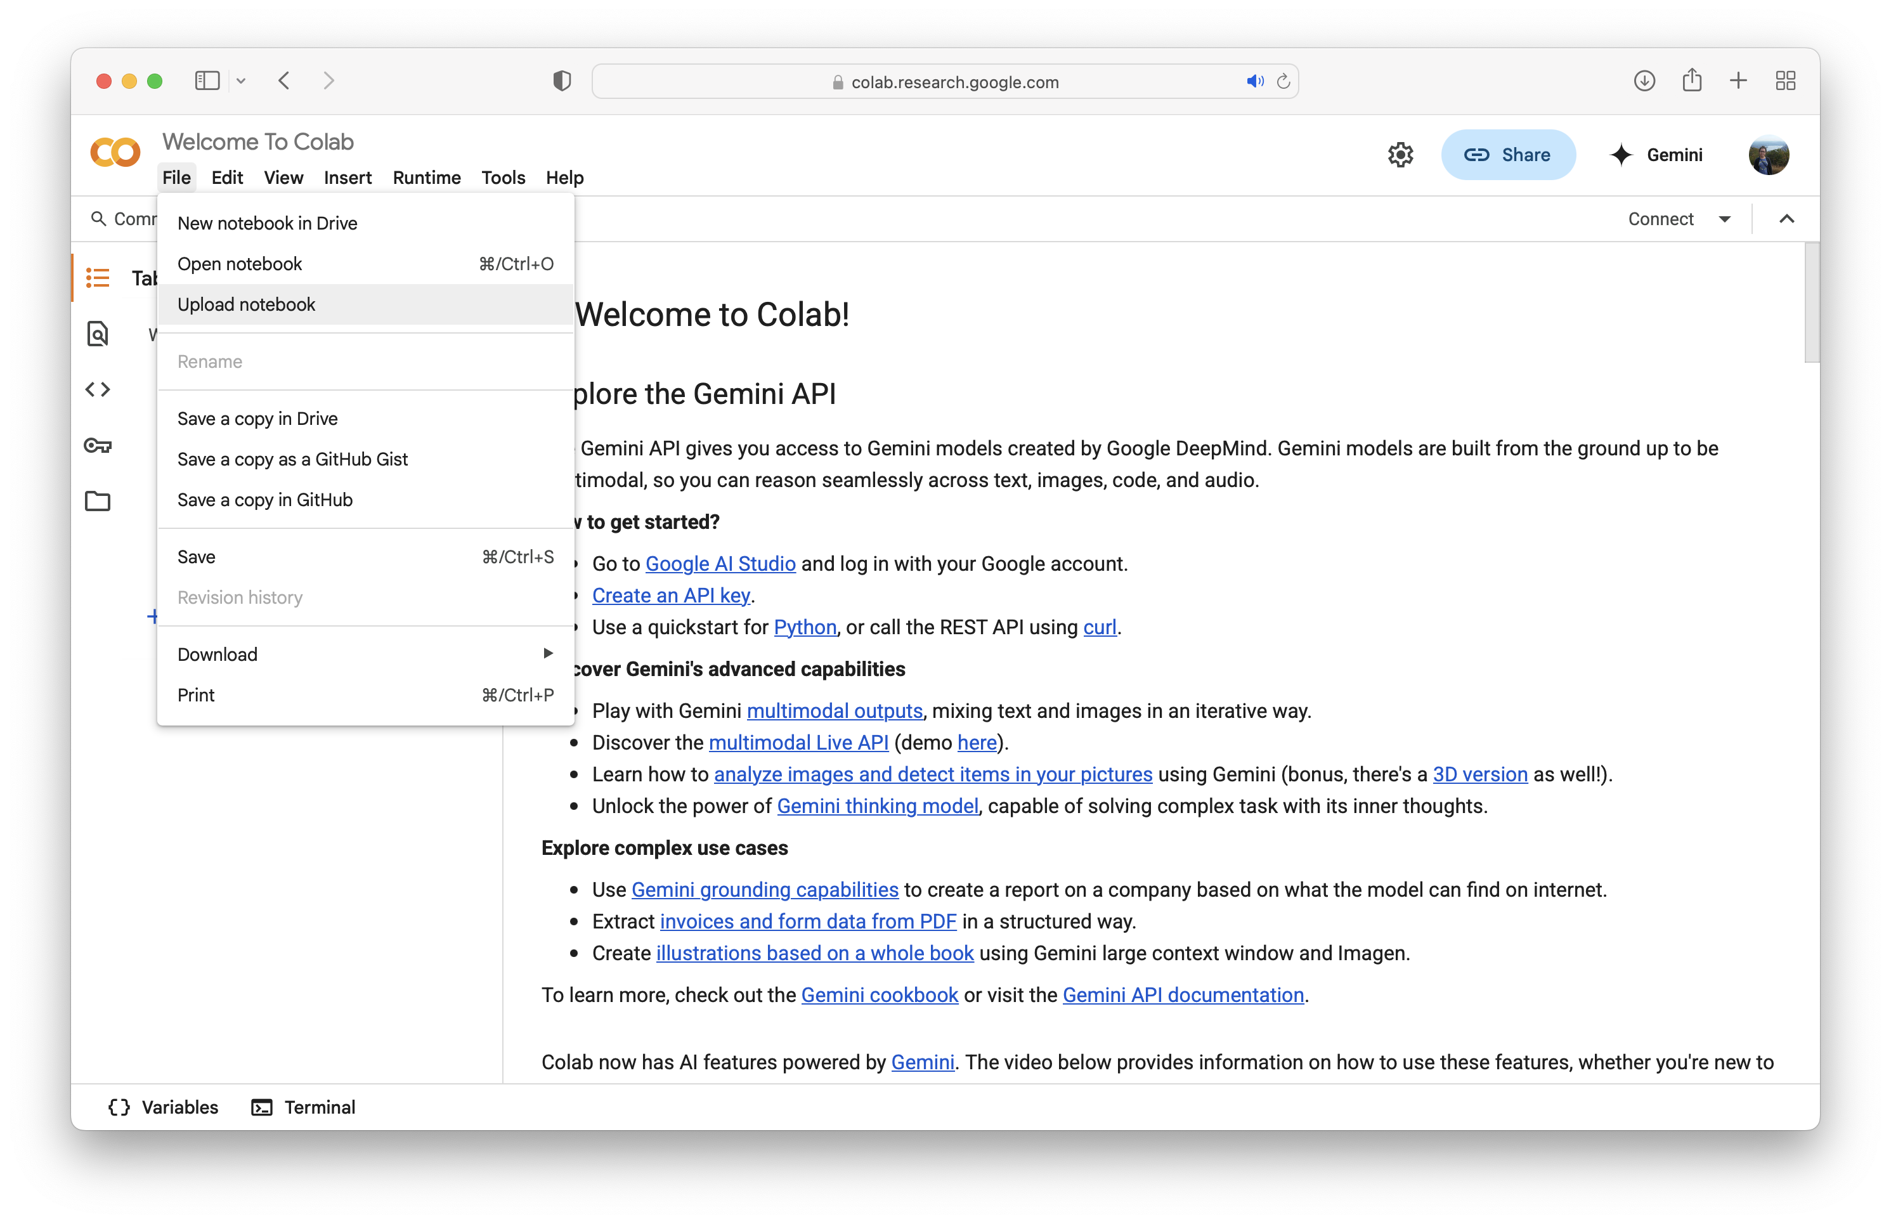
Upload existing notebook
6
1
Upload notebook
New notebook

Slide 18
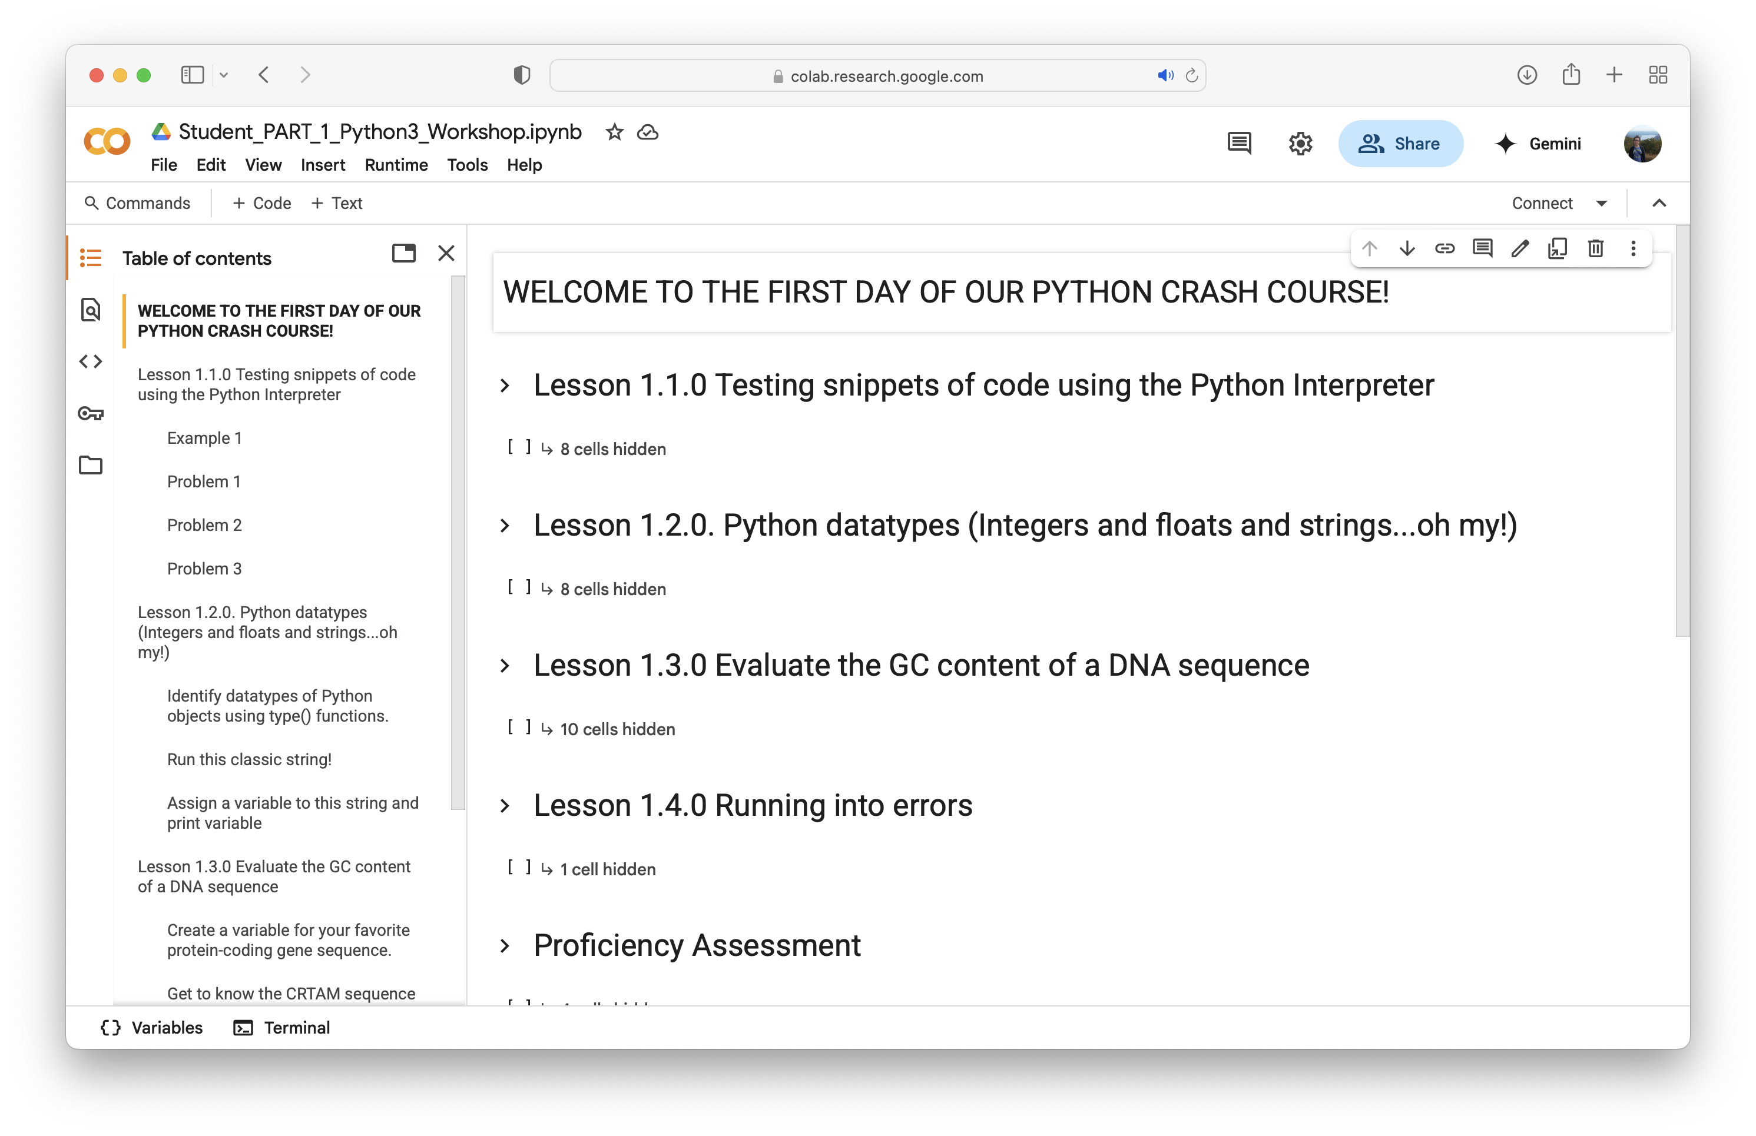
Remember this for the next few days!
1
1
Upload notebook
New notebook

Slide 19
Lesson 1.1.0 Test snippets of code using the Python interpreter
Notes:
ways to reach the interpreter (command prompt, start menu on windows, shell),

Slide 20
Python is your new calculator!
Addition | +
Subtraction | -
Multiplication | *
Division | /
Modulus | %
Floor division | //
Exponent | **

Slide 21
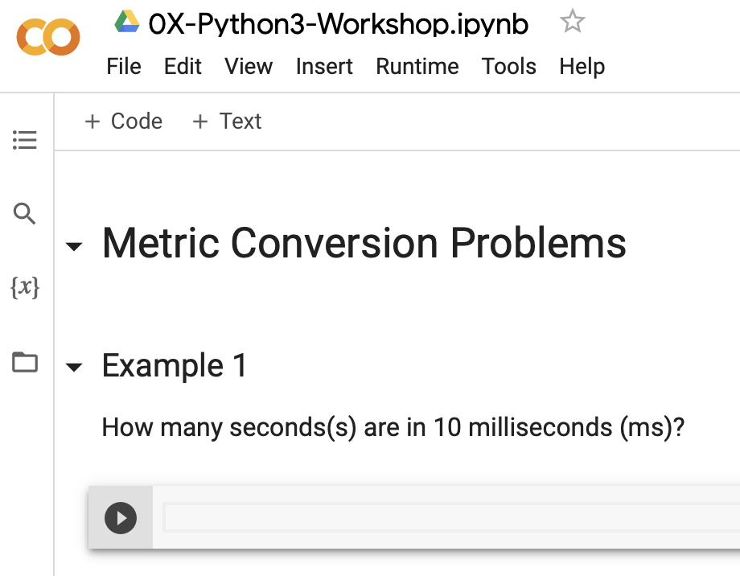
Let’s solve metric conversion problems!
Type equation
1
2
Run

Slide 22
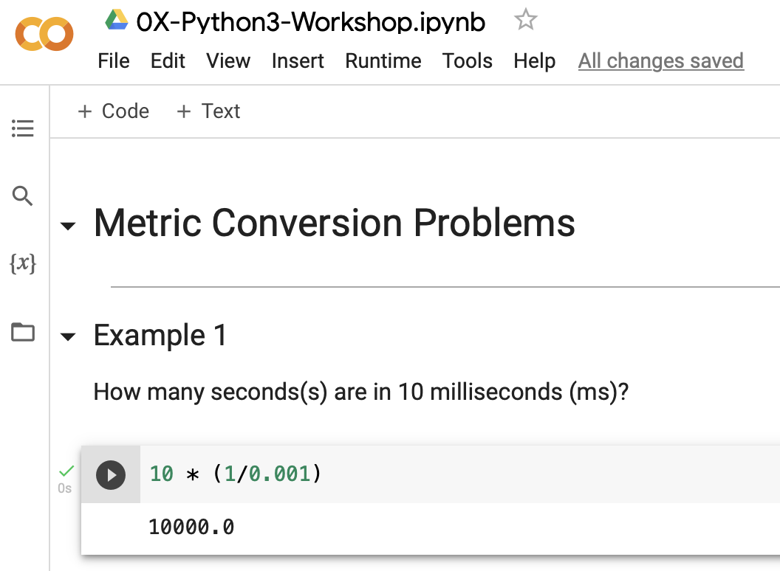
Let’s solve metric conversion problems!
Note: Python interprets the numbers as integers or floats
Answer
3

Slide 23
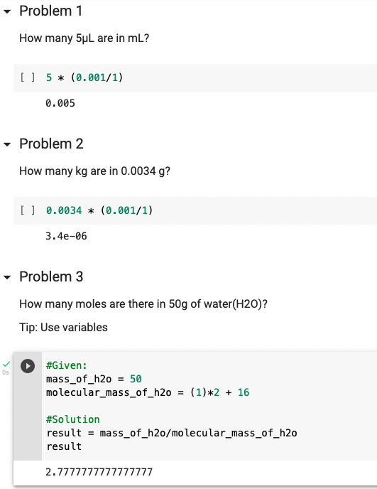
Try it on your own!
ANSWER
Notes:
Discuss other ways to run.. Command enter (mac) others for windowssd

Slide 24
Try it on your own!
Notes:
Discuss other ways to run.. Command enter (mac) others for windowssd

Slide 25
Try it on your own!
ANSWER
Notes:
Discuss other ways to run.. Command enter (mac) others for windowssd

Slide 26
Try it on your own!
Notes:
Discuss other ways to run.. Command enter (mac) others for windowssd

Slide 27
Try it on your own!
ANSWER
Notes:
Discuss other ways to run.. Command enter (mac) others for windowssd

Slide 28
Try it on your own!
Note: Facilitate your programing employing variables!
Notes:
Discuss other ways to run.. Command enter (mac) others for windowssd

Slide 29
Lesson 1.2.0 Python datatypes
Notes:
ways to reach the interpreter (command prompt, start menu on windows, shell),

Slide 30
Integers and floats and strings… oh my!
Datatypes
Tip: Knowing the function type(object) of objects you are working with during coding can help you get around programming obstacles!
int() | 12
float() | 12.0
str() | "hola"
list() | [1,2,3, "hola"]
dictionary() | {"blue":"azul"}

Slide 31
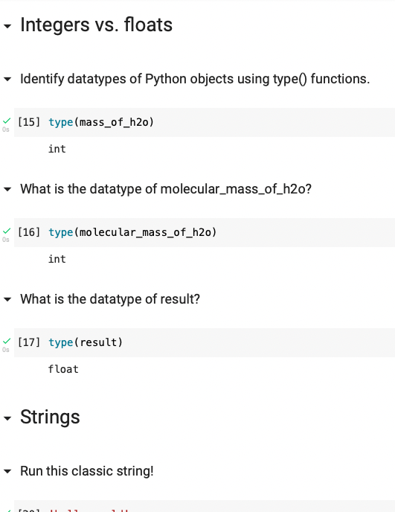
Integers and floats and strings… oh my!
Answer

Slide 32
Integers and floats and strings… oh my!

Slide 33
Integers and floats and strings… oh my!
Answer

Slide 34
Integers and floats and strings… oh my!

Slide 35
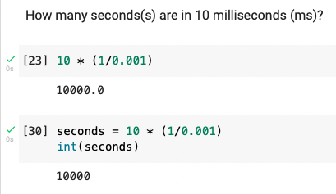
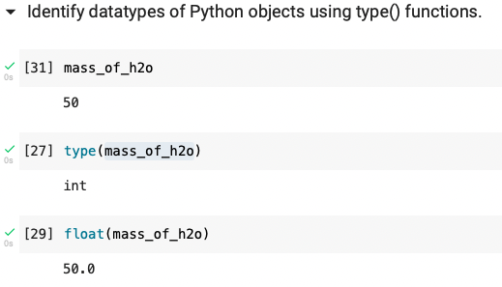
Int and Float Types can be manipulated
int(object)
float(object)

Slide 36
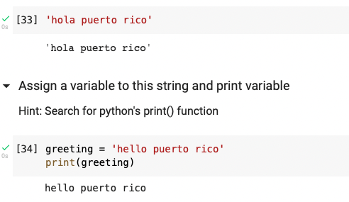
Integers and floats and strings… oh my!
Answer

Slide 37
Integers and floats and strings… oh my!

Slide 38
There are a multitude of functions to evaluate and manipulate your strings
len(str)
str.count("")
str.replace("", "")
str.capitalize()
str.split("")
"".join(str)
Note: These are my favorite and most used string functions!

Slide 39
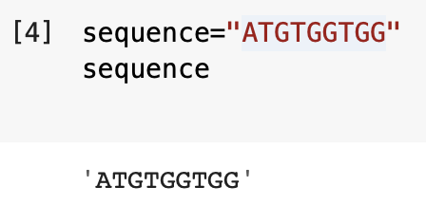
Indexing a String
Strings have a property called indexes, which are positions in the string
0
1
2
3
4
5
6
7
8

Slide 40
Indexing a String
Strings have a property called indexes, which are positions in the string

Slide 41
Indexing a String
Strings have a property called indexes, which are positions in the string
0
1
2
3
4
5
6
7
8

Slide 42
Indexing a String
Strings have a property called indexes, which are positions in the string
0
1
2
3
4
5
6
7
8
The index of the first position is 0

Slide 43
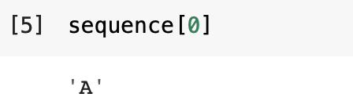
Indexing a String
The index of the first position is 0
0
1
2
3
4
5
6
7
8
Call the character at index 0

Slide 44
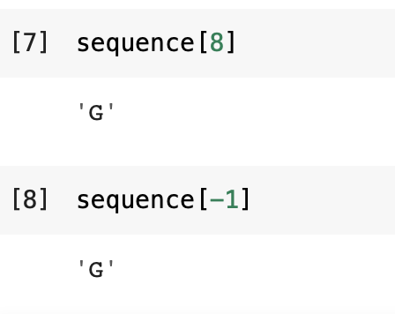
Indexing a String
The index of the last position is can be 8 or -1
0
1
2
3
4
5
6
7
8
Call the last character using 8
Call the last character using -1
Note: Using -1 is useful when last index is unknown!

Slide 45
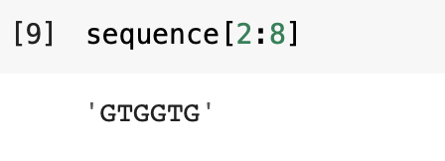
Indexing a String
Index a range of the sequence
0
1
2
3
4
5
6
7
8
Index is included and starts new string
Index is not included in new string

Slide 46
Lesson 1.3.0 Evaluate the GC content of a DNA sequence.
Notes:
ways to reach the interpreter (command prompt, start menu on windows, shell),

Slide 47


Connect to Uniprot
https://www.uniprot.org
1
Activate link

Slide 48
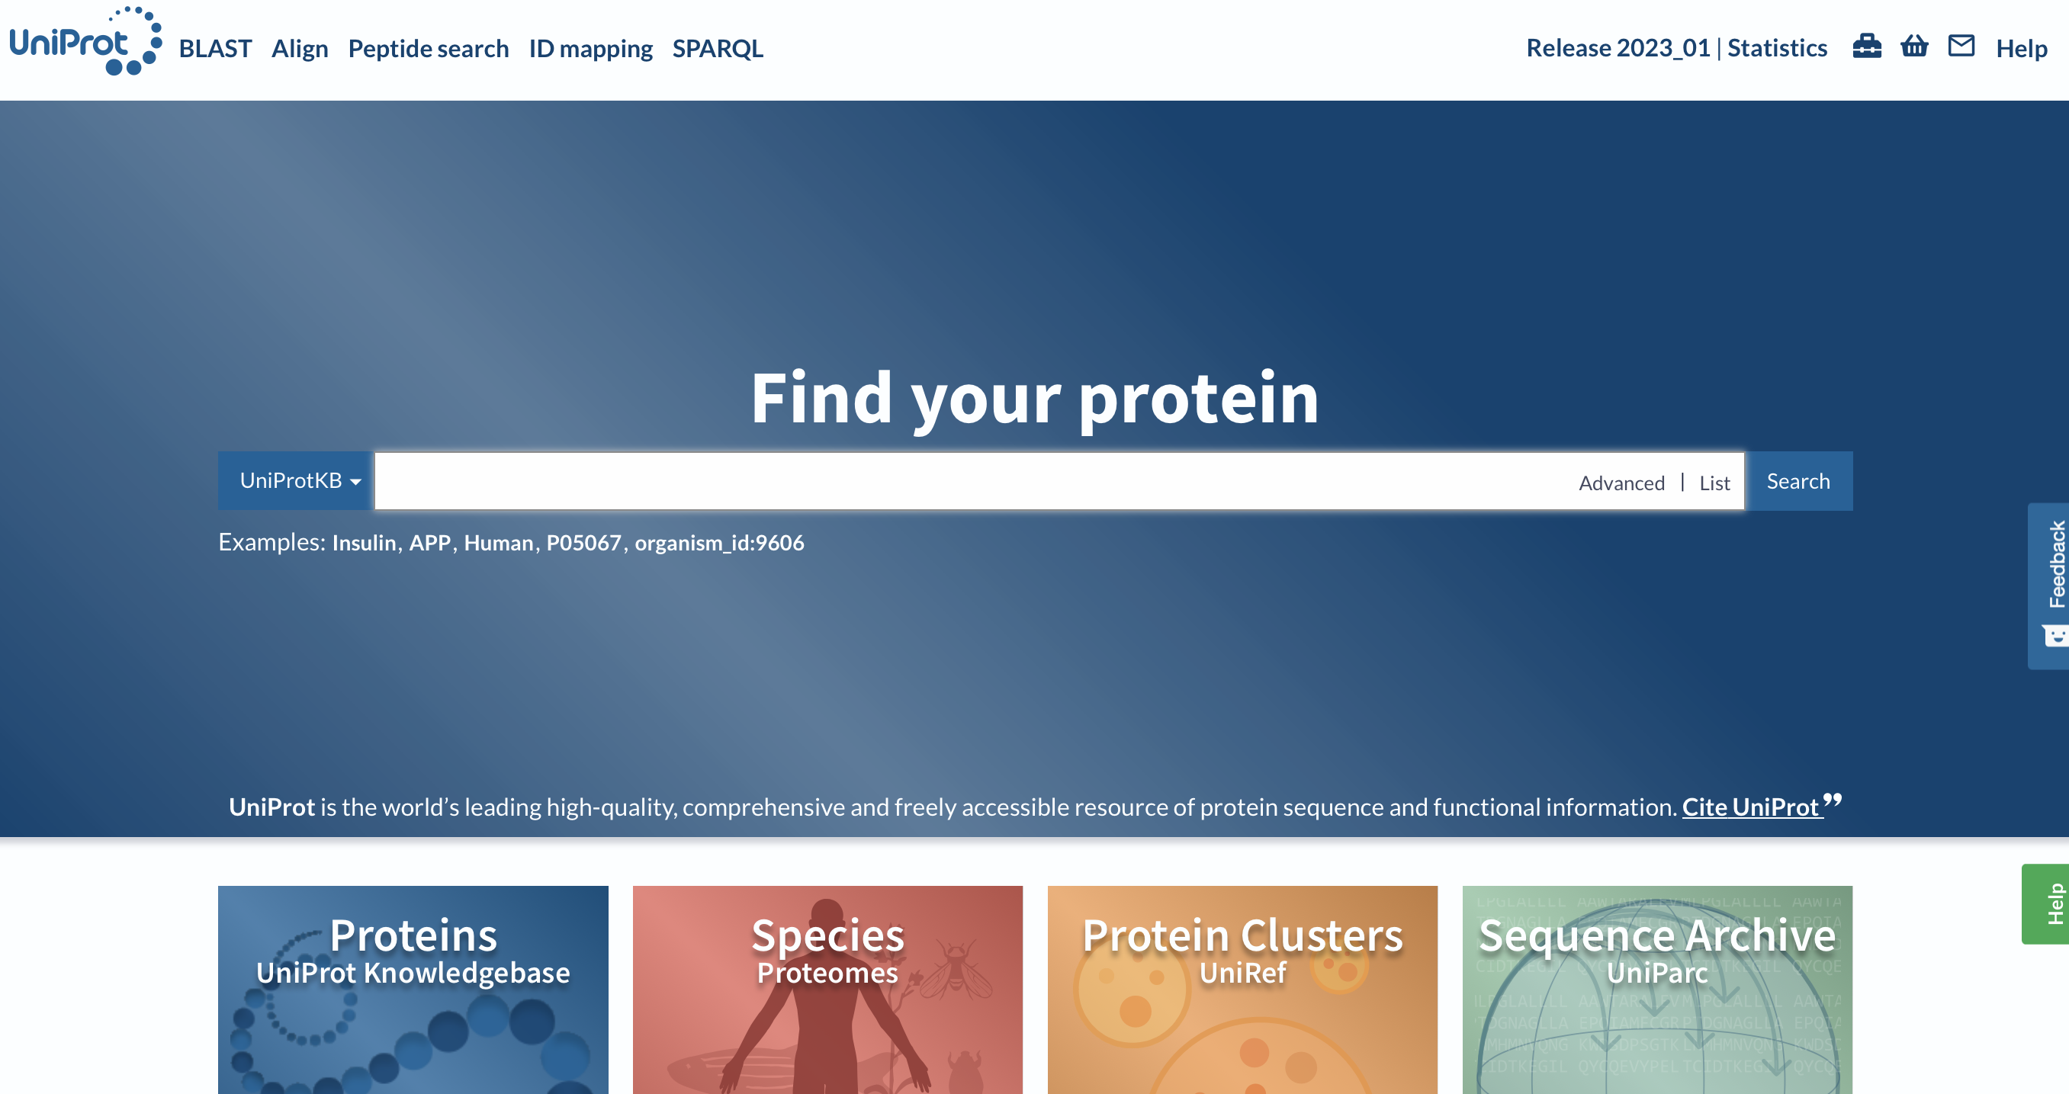
Activate uniprot.org

Slide 49

CRTAM is a biomarker found in prostate cancer and was a major part of my undergraduate research.
2
Search CRTAM

Slide 50
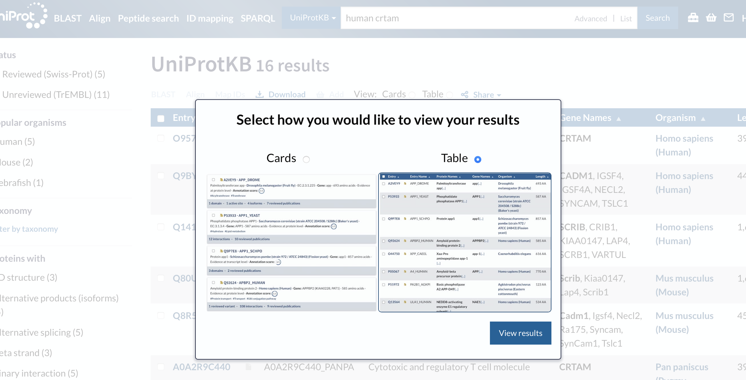
CRTAM is a biomarker found in prostate cancer and was a major part of my undergraduate research.
Select Table
3

Slide 51
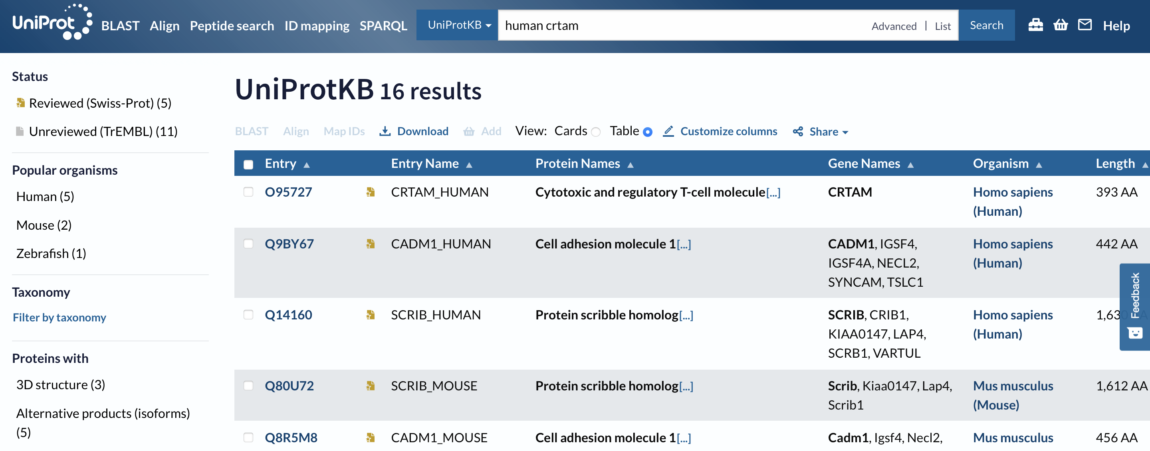
CRTAM is a biomarker found in prostate cancer and was a major part of my undergraduate research.
4
Activate link to Entry

Slide 52
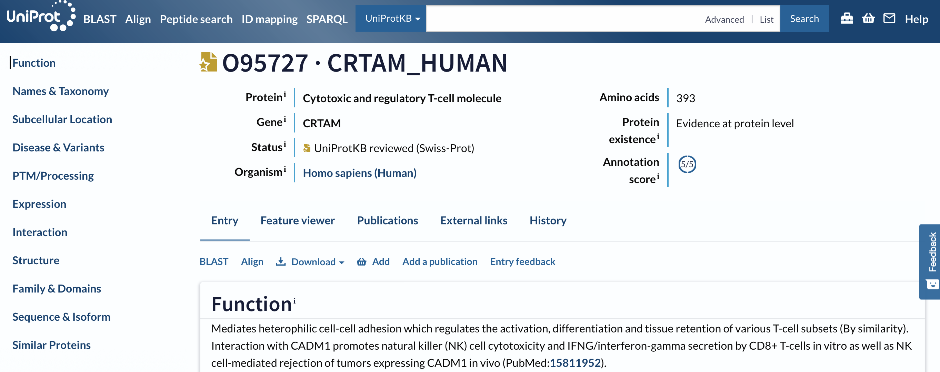
CRTAM is a biomarker found in prostate cancer and was a major part of my undergraduate research.
Scroll
5

Slide 53
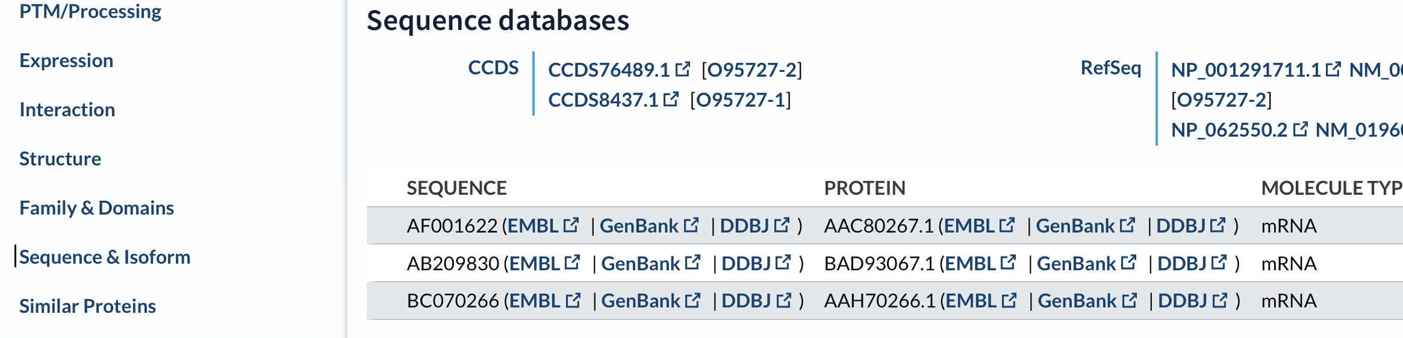
CRTAM is a biomarker found in prostate cancer and was a major part of my undergraduate research.
6
Activate link to EMBL

Slide 54
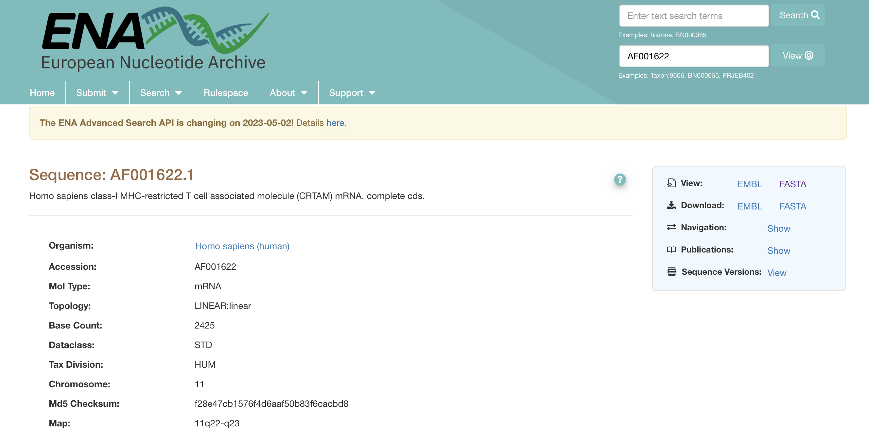
CRTAM is a biomarker found in prostate cancer and was a major part of my undergraduate research.
6
Activate link to FASTA

Slide 55
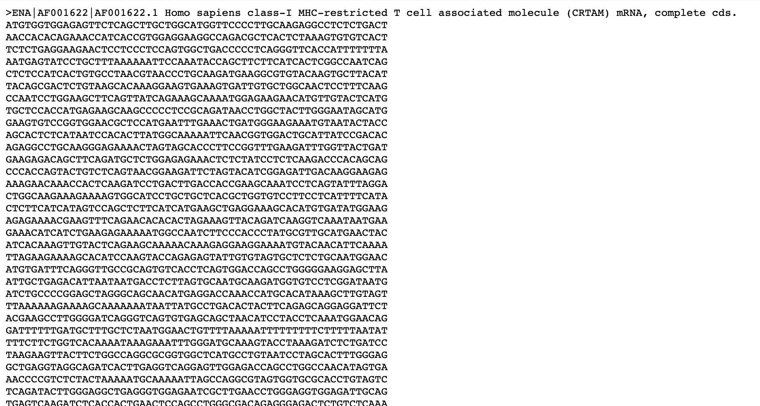
CRTAM is a biomarker found in prostate cancer and was a major part of my undergraduate research.
Copy Sequence
7

Slide 56
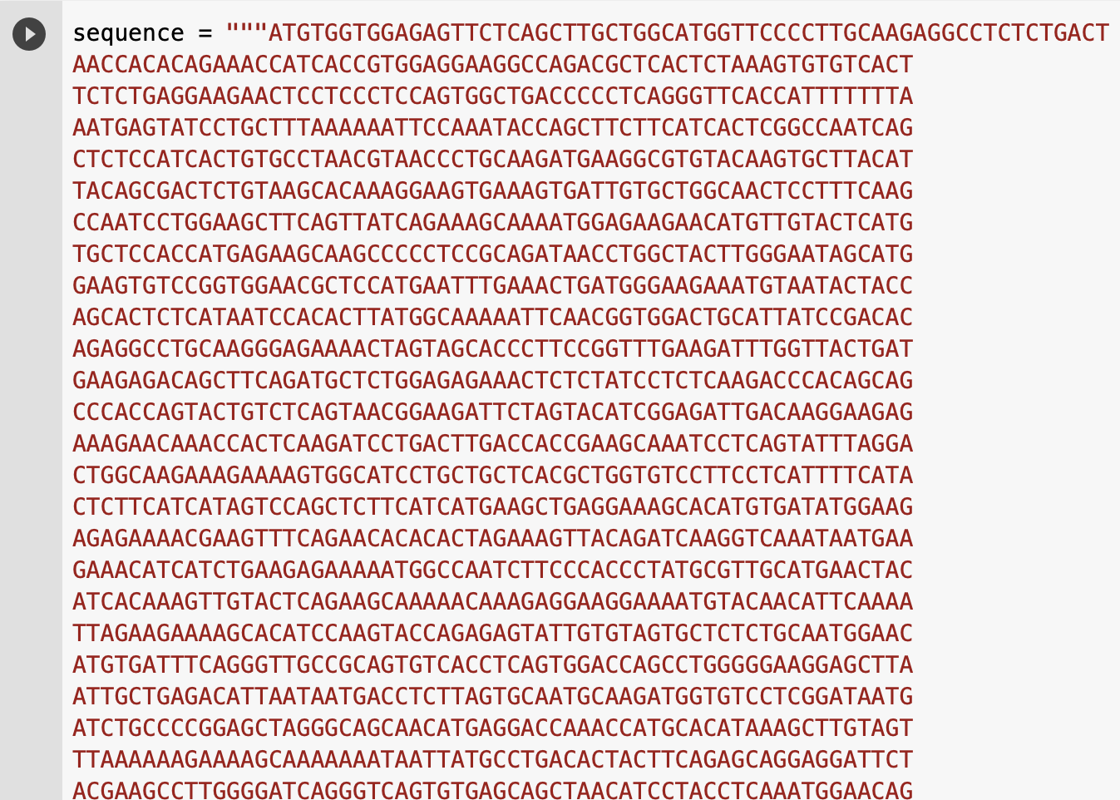
CRTAM is a biomarker found in prostate cancer and was a major part of my undergraduate research.
8
Assign sequence to variable as a string
Note: Use triple quotations to fit the sequence in a block of code

Slide 57
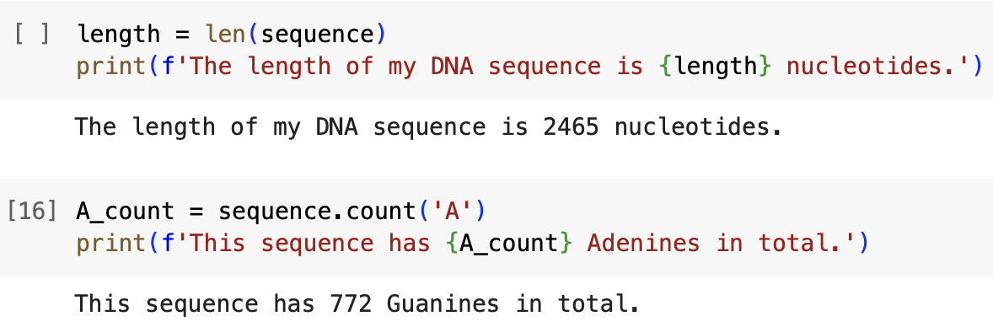
Using the functions that you have learned, get to know the CRTAM DNA sequence.
Answer the following questions using complete sentences:
What is the length of the CRTAM DNA sequence?
How many Adenines are in your sequence?
Answer

Slide 58
Using the functions that you have learned, get to know the CRTAM DNA sequence.
Answer the following questions using complete sentences:
What is the length of the CRTAM DNA sequence?
How many Adenines are in your sequence?

Slide 59
Let’s find the GC content of the CRTAM DNA sequence.
GC content
The percentage of the proportion of guanines and cytosines to the total length of the DNA sequence.
Provides an idea of stable a sequence is.
Knowledge
Check
$$\frac{\text{Total} \text{Guanines}\text{ + }\text{Total} \text{Cytosines}}{Total Sequence Length} ∗100$$

Slide 60
Let’s find the GC content of the CRTAM DNA sequence.
GC content
The percentage of the proportion of guanines and cytosines to the total length of the DNA sequence.
Provides an idea of stable a sequence is.
Knowledge
Check
$$\frac{\text{Total} \text{Guanines}\text{ + }\text{Total} \text{Cytosines}}{Total Sequence Length} ∗100$$
What are we missing?
🤔

Slide 61
Let’s find the GC content of the CRTAM DNA sequence.
GC content
The percentage of the proportion of guanines and cytosines to the total length of the DNA sequence.
Provides an idea of stable a sequence is.
Knowledge
Check
$$\frac{\text{Total} \text{Guanines}\text{ + }\text{Total} \text{Cytosines}}{Total Sequence Length} ∗100$$
Return the total length of DNA sequence

Slide 62
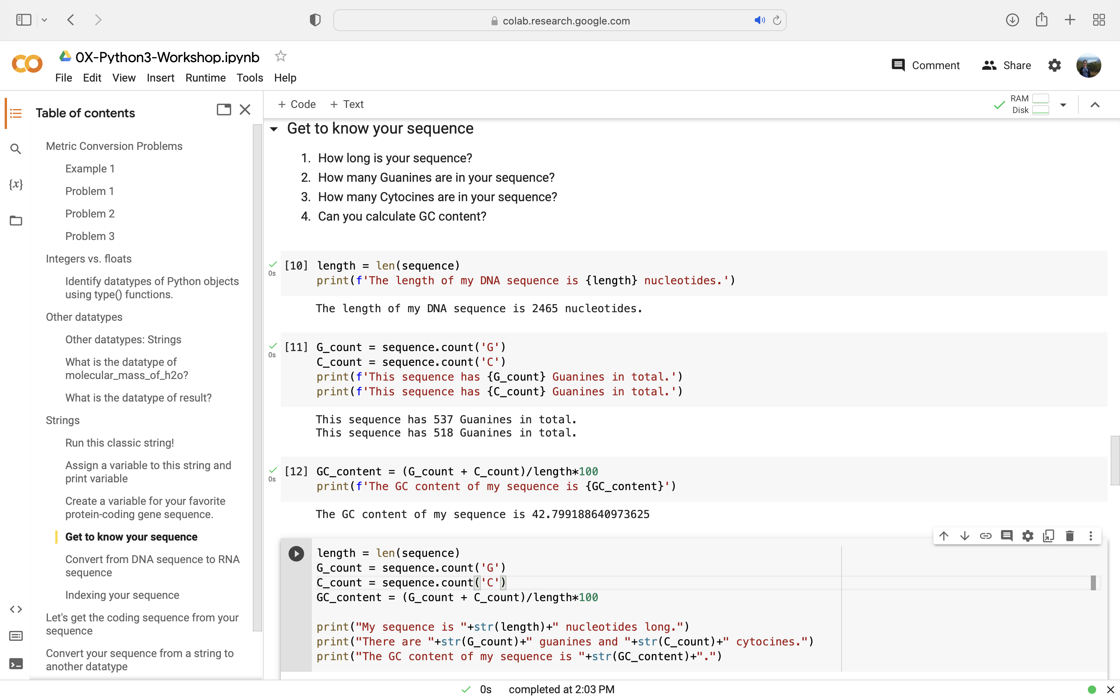
Let’s find the GC content of the CRTAM DNA sequence.
GC content
The percentage of the proportion of guanines and cytosines to the total length of the DNA sequence.
Provides an idea of stable a sequence is.
Knowledge
Check
$$\frac{\text{Total} \text{Guanines}\text{ + }\text{Total} \text{Cytosines}}{Total Sequence Length} ∗100$$
Tip: Using string formatting eases mixing different datatypes together

Slide 63
Let’s find the GC content of the CRTAM DNA sequence.
GC content
The percentage of the proportion of guanines and cytosines to the total length of the DNA sequence.
Provides an idea of stable a sequence is.
Knowledge
Check
$$\frac{\text{Total} \text{Guanines}\text{ + }\text{Total} \text{Cytosines}}{Total Sequence Length} ∗100$$
Return total Guanines and Cytosines of the DNA sequence

Slide 64
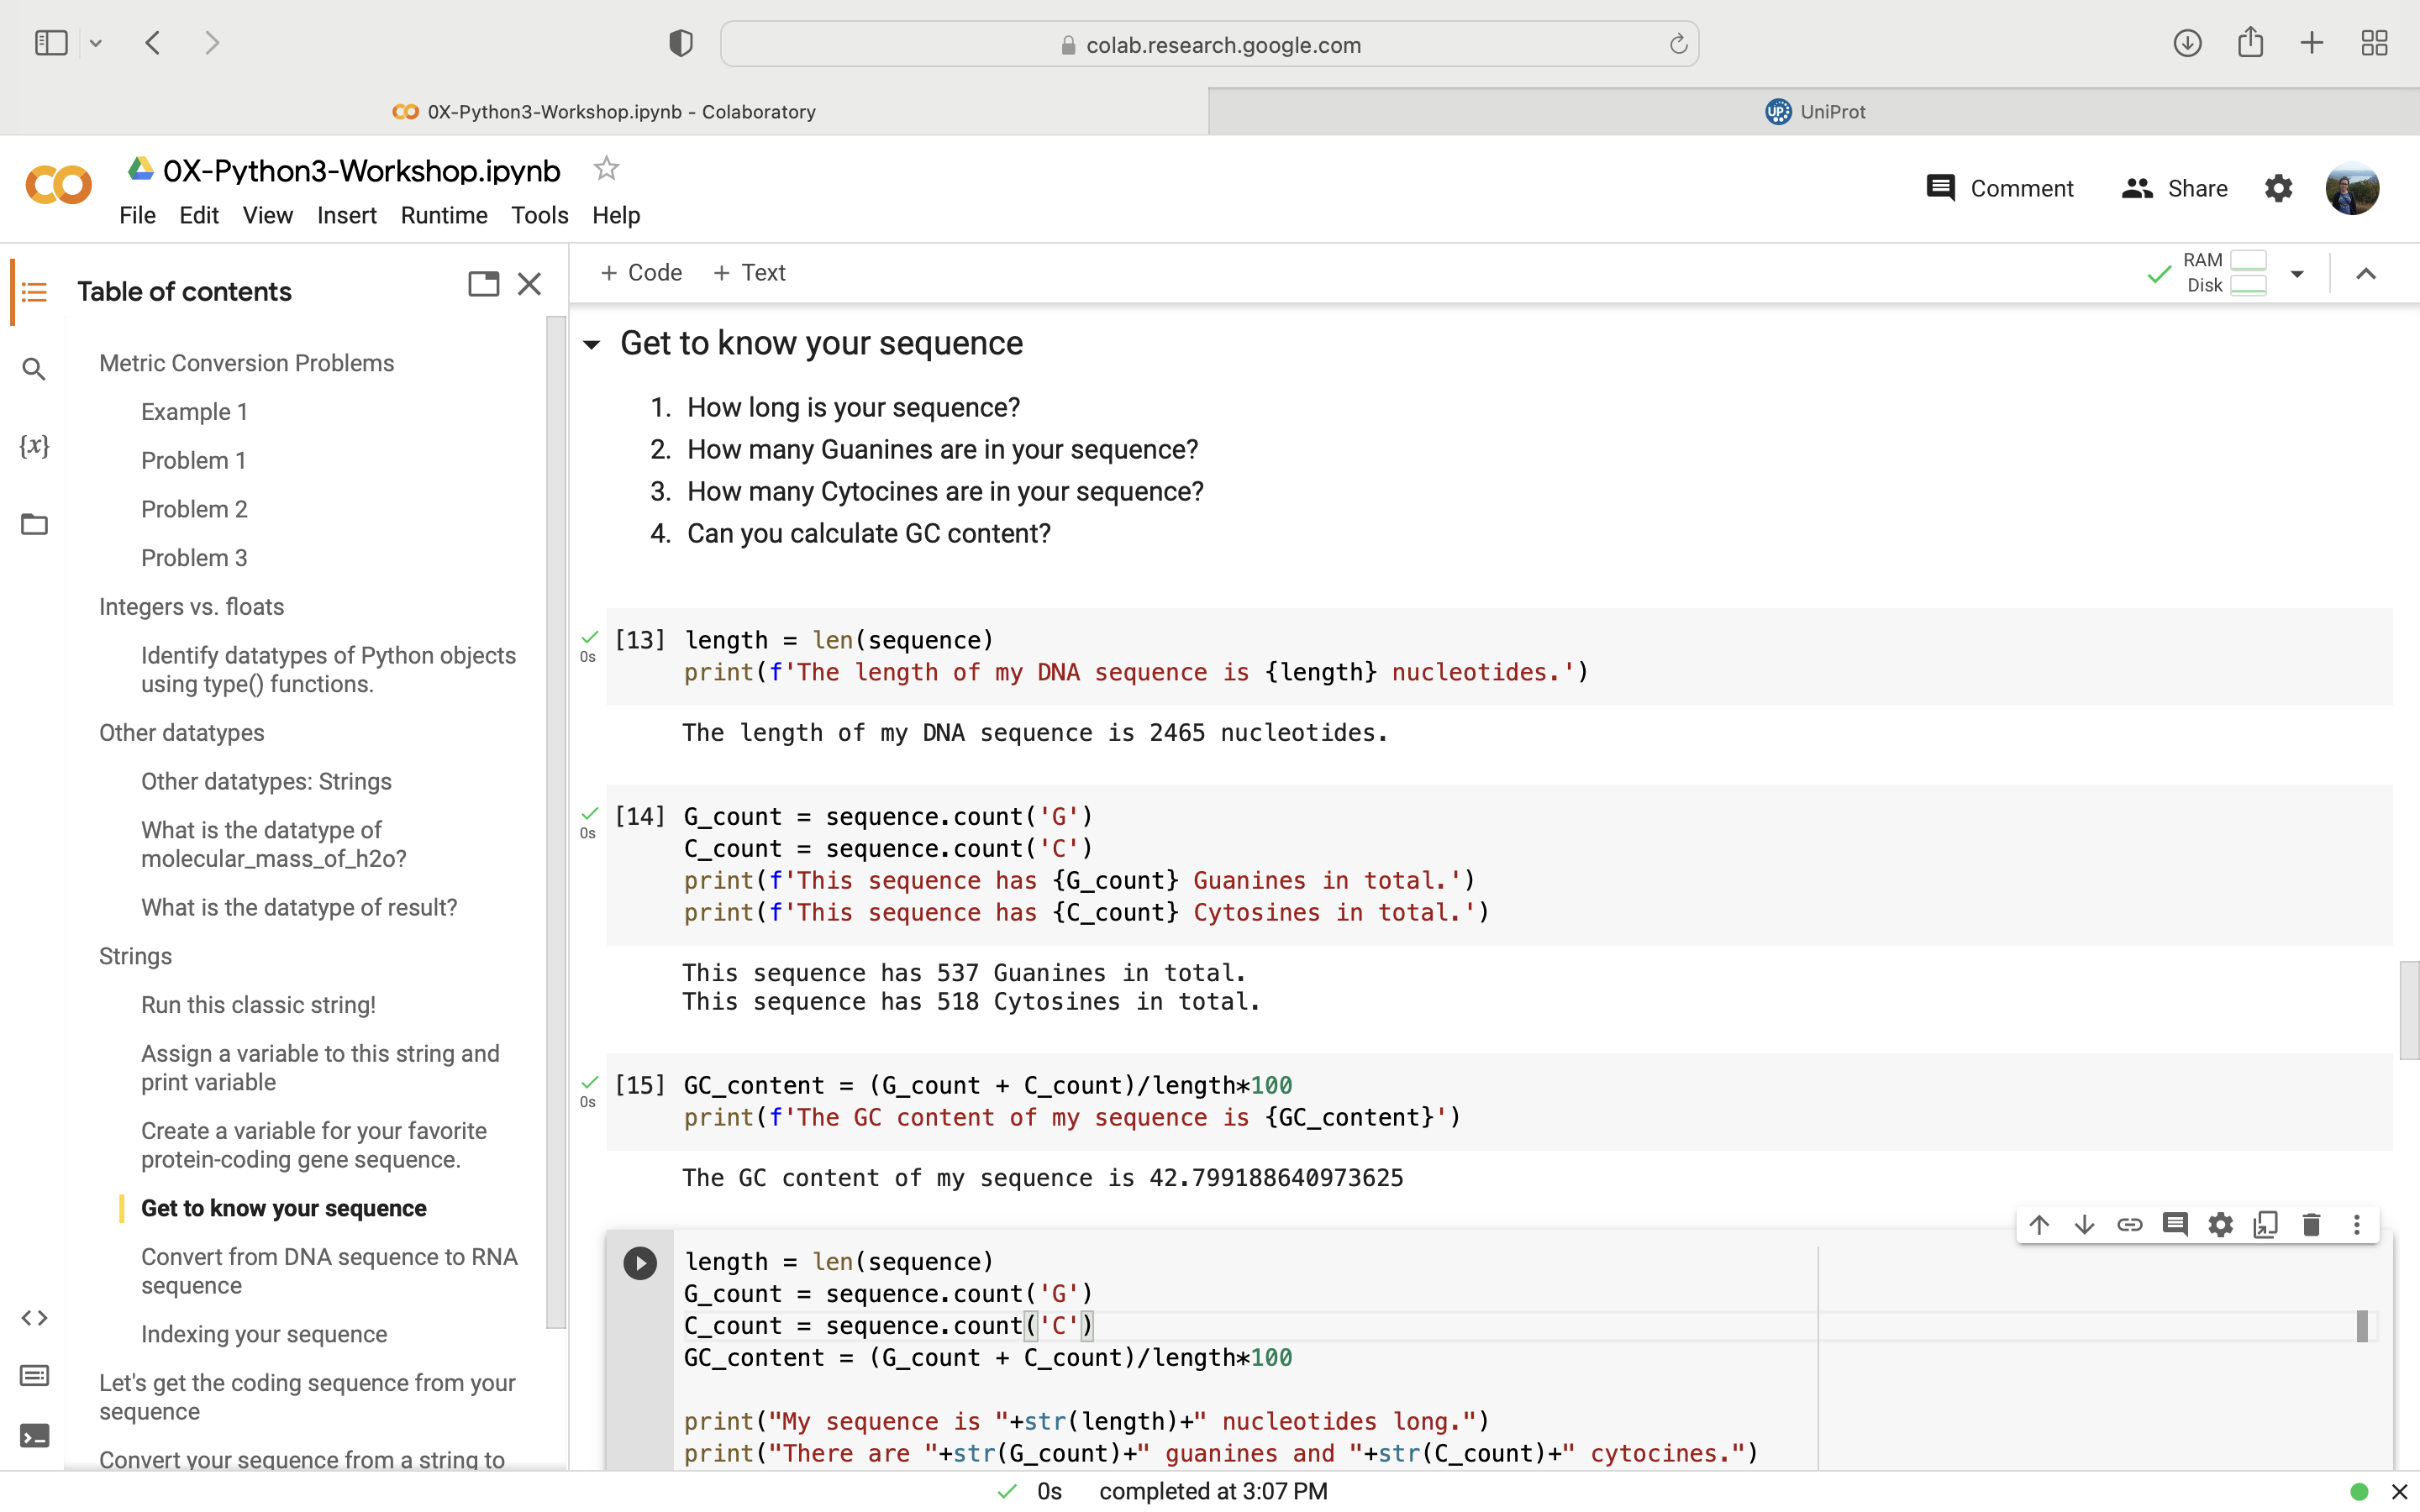
Let’s find the GC content of the CRTAM DNA sequence.
GC content
The percentage of the proportion of guanines and cytosines to the total length of the DNA sequence.
Provides an idea of stable a sequence is.
Knowledge
Check
$$\frac{\text{Total} \text{Guanines}\text{ + }\text{Total} \text{Cytosines}}{Total Sequence Length} ∗100$$

Slide 65
Let’s find the GC content of the CRTAM DNA sequence.
GC content
The percentage of the proportion of guanines and cytosines to the total length of the DNA sequence.
Provides an idea of stable a sequence is.
Knowledge
Check
$$\frac{\text{Total} \text{Guanines}\text{ + }\text{Total} \text{Cytosines}}{Total Sequence Length} ∗100$$
Return GC Content

Slide 66
Let’s find the GC content of the CRTAM DNA sequence.
GC content
The percentage of the proportion of guanines and cytosines to the total length of the DNA sequence.
Provides an idea of stable a sequence is.
Knowledge
Check
$$\frac{\text{Total} \text{Guanines}\text{ + }\text{Total} \text{Cytosines}}{Total Sequence Length} ∗100$$

Slide 67
Let’s find the GC content of the CRTAM DNA sequence.
Overall Code

Slide 68
Lesson 1.3.1 Define a function that returns the GC content of a DNA sequence.
Notes:
ways to reach the interpreter (command prompt, start menu on windows, shell),

Slide 69
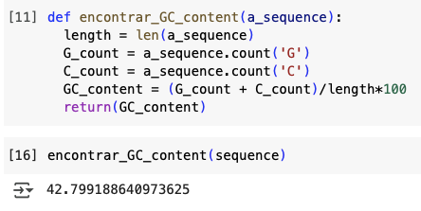
Define a function that calculates GC content

Slide 70
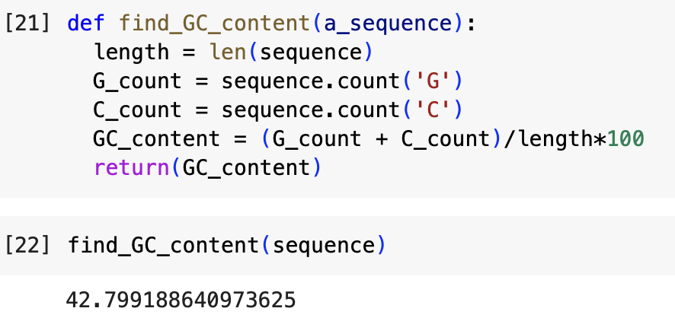
Define a function that calculates GC content
In the first line, a function is initiated by using def

Slide 71
Define a function that calculates GC content
Name the function as you see fit

Slide 72
Define a function that calculates GC content
Identify if the function takes input. Here, our function just needs one input. The function needed as input is a DNA sequence in order to return the GC content. DON’T FORGET PARENTHESES!

Slide 73
Define a function that calculates GC content
End it with a colon

Slide 74
Define a function that calculates GC content
Body of the function defined dictates what the function is doing

Slide 75
Define a function that calculates GC content
Using the return function will give you the result of the function when you run it DON’T FORGET PARENTHESES!

Slide 76
Define a function that calculates GC content
Tip: Functions are a great way to control code when running a repeated block of code more than once on different datatypes!

Slide 77
Lesson 1.4.0 Running into errors
Notes:
ways to reach the interpreter (command prompt, start menu on windows, shell),

Slide 78
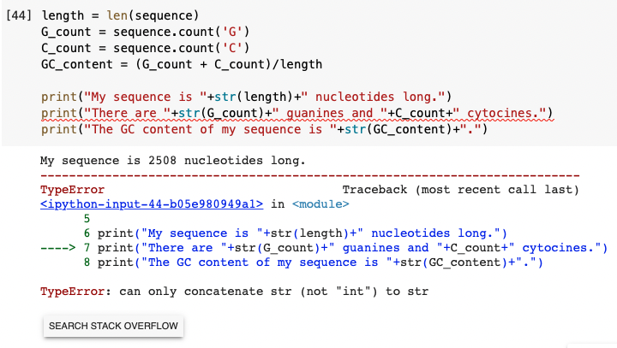
Uh oh!
Ran into an error!
Where is my error?

Slide 79
Debug and rerun program
Where is my error?

Slide 80
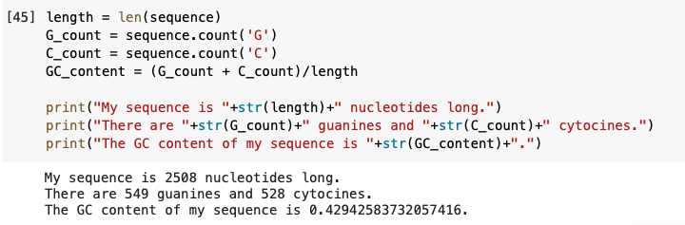
Error Corrected

Slide 81

Proficiency Assessment
Show off your new skills using Google COLAB with a proficiency assessment

Slide 82
Develop a block of code
Find a DNA sequence of your interest using Uniprot and cross referencing a database. Assign your sequence a variable.
Define and return the following functions:
Total number of Guanines
Total number of Cytosines
Total number of Adenines
Total number of Uridines
A+T/G+C ratio
Notes:
If you remember from your general biology genetics and moleular courses you have to recall thiss knowledge in order to solve this problem
If I know biology but I don’t know computer science, that is the case for all of you theissue I am teaching how to code but you have to recall on yourself your biological knowledge

Slide 83
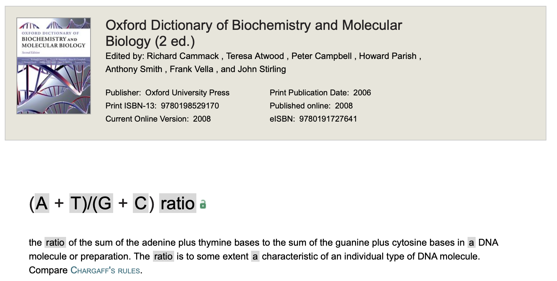
Define a function that calculates the A+T/G+C ratio of your sequence of interest
https://www.oxfordreference.com/display/10.1093/acref/9780198529170.001.0001/acref-9780198529170-e-1681

