Slide 1
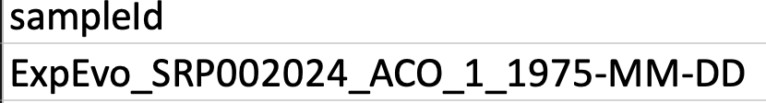
The sampleId is important because it gets used to name the names after they are processed. It must take this format (although your sample will have a slightly different name).
Must have this prefix
A simple and concise string
with only letters/numbers
Collection date. If you cannot figure it out
The BioProject number (use the one from our shared Excel file)
Should be numbered 1-N, one for each sample

Slide 2
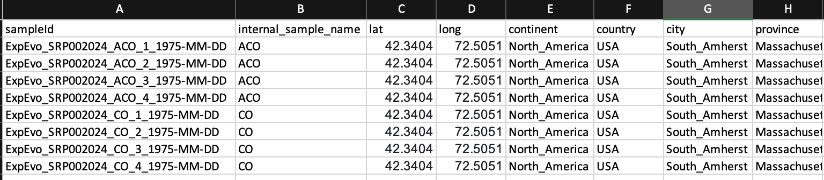
Using the publication, or references cited in it, start to fill in the collection information. Don’t use spaces in any names.
For Lat/Long (if they are not provided) look up the named city/landmark.

Slide 3
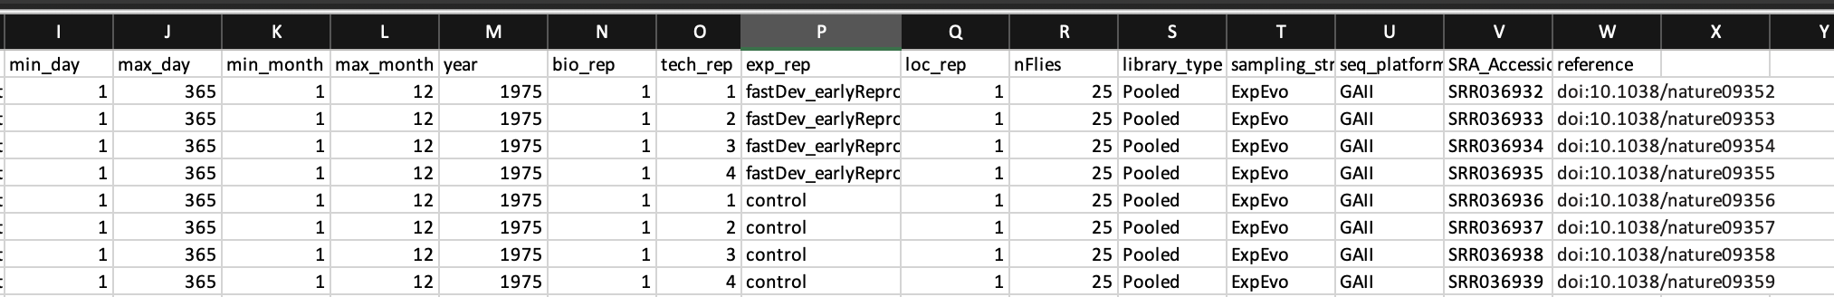
Same for collection times. Sometimes flies are collected over a range of dates. You can provide the minimum/max possible dates (e.g., if only July is listed as the collection time, give the days as 1-31).
bio_rep=1 for all of your samples
tech_rep=1-N. Was the same sample of DNA sequenced twice?
Exp_rep=bespoke. Come up with a descriptor that includes the treatment, the generation (if available).
Loc_rep=1
nFlies=figure out from paper
Library_type=pooled
Sampling_strategy=ExpEvo
Platform=figure out from paper
SRA_accession=from shared excel file
Look up doi

