Slide 1
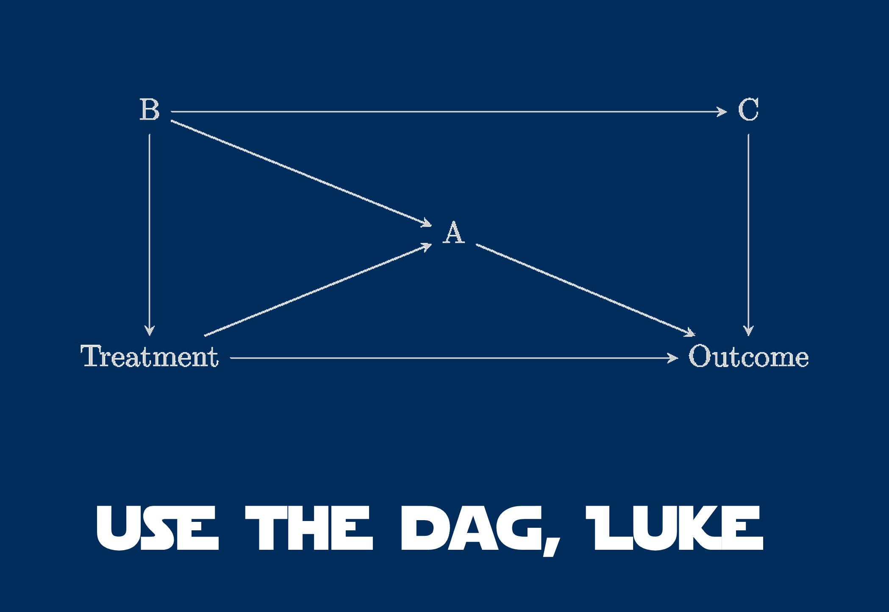
Using Your Causal Diagram

Slide 2
Uses of Causal Diagrams
Simplifying Complex Causal Diagrams
Determining Covariates with Conditional Independence
Finding Open Backdoors to Confounding
Counterfactual Thinking

Slide 3
What Is It Good For?
We can test our intuition by examining things that do not connect
We cannot take apart our system without imagining what would happen if something changes.
We can begin to understand what we must grapple with to tease apart the Gordian knot of Simpson’s Paradox and confounders
x₁
y₁
y₂

Slide 4
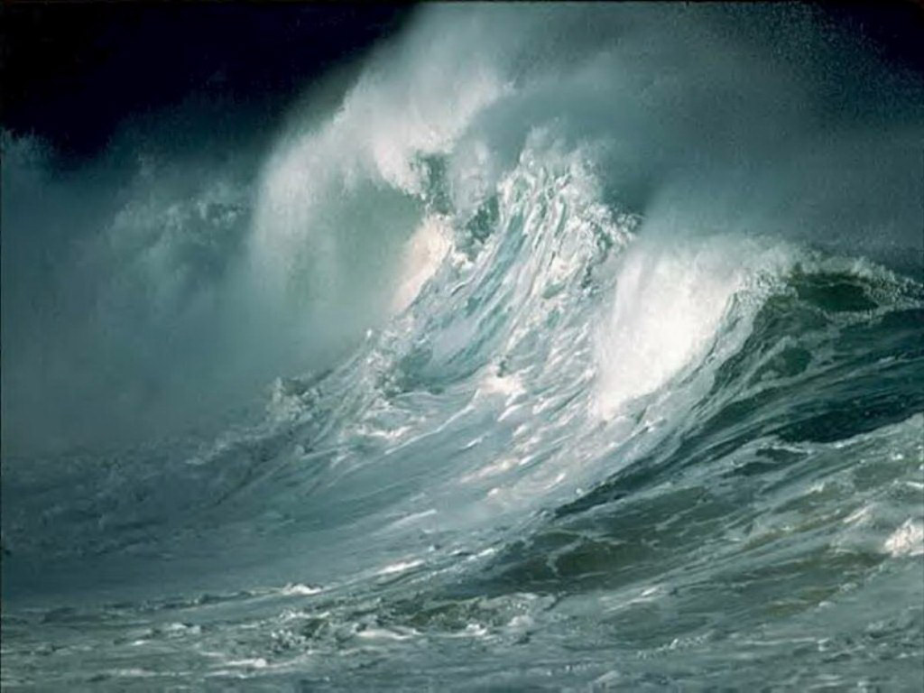
So Let’s Draw a DAG: Where we Start
Waves
Invertebrates

Slide 5
But there are Mediators
Waves
Kelp
Algae
Invertebrates

Slide 6
Waves Really Means Two Things
Wave
Height
Wave
Frequency
Kelp
Algae
Invertebrates

Slide 7
The Kelp -> Algae Effect is Light Availability
Wave
Height
Wave
Frequency
Kelp
Light
Algae
Invertebrates

Slide 8
What About the Rest of the System?
Wave
Height
Wave
Frequency
Kelp
Light
Algae
Acidification
Invertebrates

Slide 9
AGH! How do I Simplify This?
Wave
Height
Wave
Frequency
Kelp
Light
Algae
Acidification
Invertebrates

Slide 10
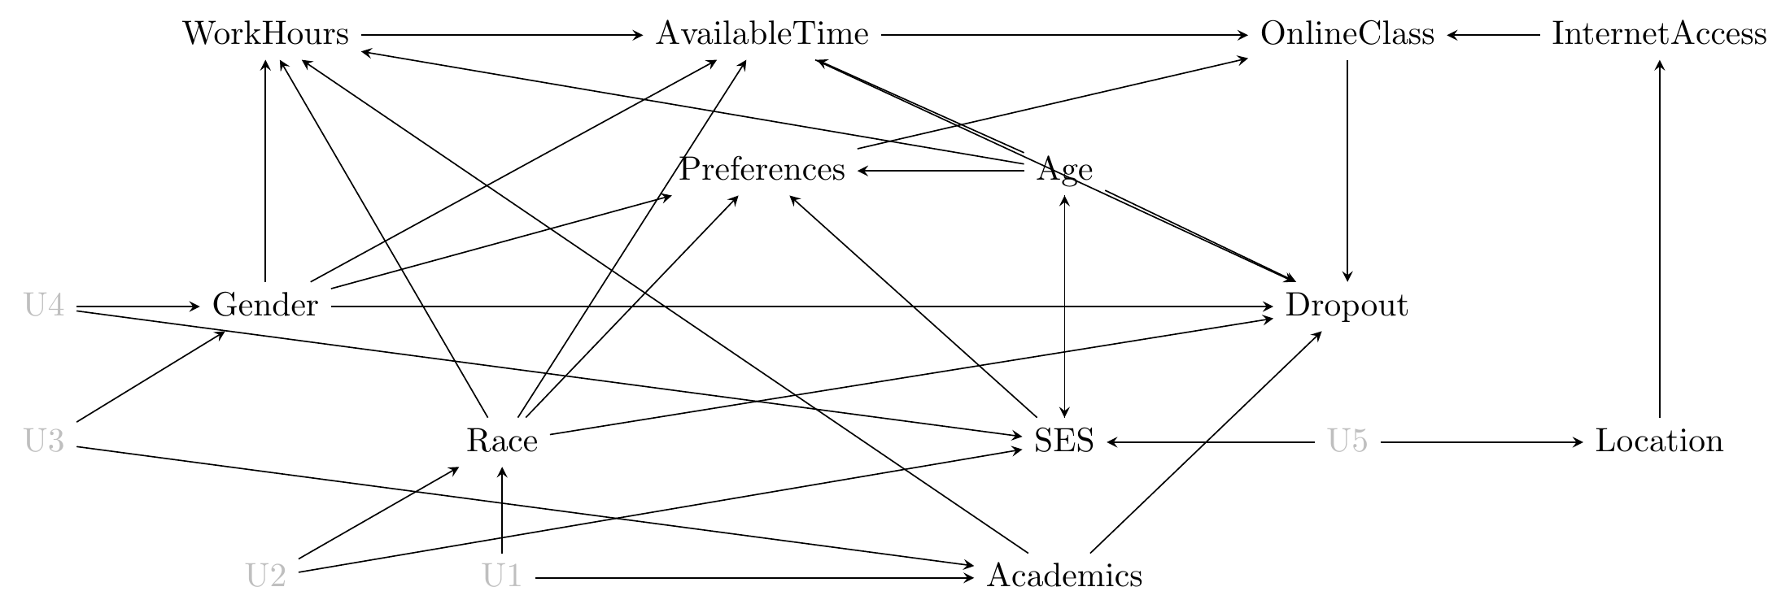
Strategies of Simplification
Remove unimportant variables
Combine redundant variables
Eliminate unneeded mediators
Get rid of irrelevant variables
Huntington-Klein 2023 The Effect

Slide 11
Get Rid of Weak Variables (we already did)
Wave
Height
Wave
Frequency
Phosphorous
Kelp
Light
Algae
Acidification
Invertebrates

Slide 12
Combine Redundant Variables
Wave
Height
Wave
Frequency
Redundant variables have the same influences in and out
Kelp
Light
Algae
Acidification
Invertebrates

Slide 13
Combine Redundant Variables
Wave
Energy
Redundant variables have the same influences in and out
Kelp
Light
Algae
Acidification
Invertebrates

Slide 14
Remove Unneeded Mediators
Waves
Energy
If you are not interested in a mediator and it is the only on the graph as a way to get from one variable to another, remove
Kelp
Light
Algae
Acidification
Invertebrates

Slide 15
Remove Unneeded Mediators
Wave
Energy
If you are not interested in a mediator and it is the only on the graph as a way to get from one variable to another, remove
Kelp
Algae
Acidification
Invertebrates

Slide 16
Get Rid of Irrelevant Variables
Wave
Energy
Are variables irrelevant to the question at hand and just randomly distributed? Do you need them?
Kelp
Algae
Acidification
Invertebrates

Slide 17
Simplify your Causal Diagrams

Slide 18
Uses of Causal Diagrams
Simplifying Complex Causal Diagrams
Determining Covariates with Conditional Independence
Finding Open Backdoors to Confounding
Counterfactual Thinking

Slide 19
So This is How we Think Our System Works
Waves
If we want to know the importance of waves on invertebrates, what covariates do I need?
If we want to know the importance of algae on invertebrates, what covariates do I need?
Kelp
Algae
Invertebrates
If we want to know the importance of kelp on invertebrates, what covariates do I need?

Slide 20
Do I need to Control for Waves or Kelp?
Waves
Kelp
Algae
Invertebrates

Slide 21
Conditional Independence: The Hard Causal Claim
y₁
x
y₃
y₂
These two relationships are declared to be non-existent
This is a hard causal claim
Is it real? How do we assess?

Slide 22
Quick Note: Nonlinearities
Conditional indepdence generally excludes non-linear components (interactions)
x₁
y₁
y₂
x₂
x₁ ⏊ y₂ | (y₁)
x₂ ⏊ y₂ | (y₁)
x₁ * x₂ ⏊ y₂ | (y₁)

Slide 23
Conditional Independence (Directed Separation)
Concept from Graph Theory
Two nodes are d-separated if they are conditionally independent e.g., the effect of x on y₃ is zero conditioning on the influences of y₁ and y₂
y₁
x
y₃
y₂
x ⊥ y3 | y1, y2

Slide 24
What are the Conditional Independence Relationships Here?
Waves ⊥ Inverts | Algae
Kelp ⊥ Inverts | Algae
Waves
Kelp
Algae
Invertebrates

Slide 25
Should I Condition on Anything? NO!
Waves ⊥ Inverts | Algae
Kelp ⊥ Inverts | Algae
Waves
Conditioning on either kelp or waves is not necessary and could even create bias
Kelp
Algae
Further, if we condition on an ancestor, it will look like the ancestor has no effect!
Invertebrates

Slide 26
What if I Wanted to Look at Inverts ~ Waves?
Wave -> Invert Analyses CANNOT include Kelp and Algae
Conditioning on descendants removes the effect of the causal variable of interest
Instead, sampling must cover a wide range of kelp and algae
Otherwise, we would miss the wave -> invert relationship
Waves
Kelp
Algae
Invertebrates

Slide 27
What does Conditional Independence Mean Here?
If you tried to look at the relationship between kelp and algae, conditioned on invertebrates, you’d induce a correlation via collider bias
Any analysis of kelp on algae must include waves as a conditioning variable
Otherwise, waves would be a confounding variable
Waves
Kelp
Algae
Invertebrates
Kelp ⊥ Algae | Waves

Slide 28
What claims of conditional independence do *you* have involving your response of interest?
(and are they plausible?)

Slide 29
Uses of Causal Diagrams
Simplifying Complex Causal Diagrams
Determining Covariates with Conditional Independence
Finding Open Backdoors to Confounding
Counterfactual Thinking

Slide 30
Confounding Variables
Any analysis of kelp on algae must include waves as a conditioning variable
Otherwise, waves would be a confounding variable
Waves
Kelp
Algae
Invertebrates
Kelp ⊥ Algae | Waves

Slide 31
Why All of this Worry About Structure of a Whole System?
x₁
y₁
y₂
Is it possible to assess the causal relationship between y1 and y2 if you do not know x1? What can you say about any measured relationship between y1 and y2 if x1 varies, but is unmeasured?

Slide 32
What is a Confounder?
x₁
y₁
y₂
X1 is a confounder - it influences both y1 and y2
- information flows from y1 to y2 via x1

Slide 33
The Back-Door Effect sensu Judea Pearl
x₁
y₁
y₂
X1 is a confounder - We need to find a way to shut the back door!!!

Slide 34
Open Back Doors and Omitted Variable Bias
x₁
y₁
y₂
If we omit x1 from a model, our results will be BIASED

Slide 35
Where does OVB Come From in a Model?
x₁
e
y₁
y₂
We have violated the assumption of endogeneity
y1 is no longer exogenous to the system
We have induced a correlation between the random term and y1

Slide 36
Omitted Variable Bias and Causal Identification
If we KNOWINGLY omit x1, models linking y1 and y2 are not
causally
identified
x₁
y₁
y₂
Notes:
This is where correlation does not equal causation – so, how can we fix this (knowing that even experiments are not the answer)

Slide 37
Causal Identification
Your model need not be causally identified – but be specific that you are only talking about associations/predictions
You can only make counterfactual statements if you are confident in causal identification
x₁
y₁
y₂
Notes:
This is where correlation does not equal causation – so, how can we fix this (knowing that even experiments are not the answer)

Slide 38
Causal Identification
Causal identification does not require knowing ULTIMATE cause
Nor does it require knowing exact mechanisms within a causal pathway
x₁
y₁
y₂
Notes:
This is where correlation does not equal causation – so, how can we fix this (knowing that even experiments are not the answer)

Slide 39
How do we solve this problem?
This
relationship
is
not
causally
identified
x₁
y₁
y₂
Notes:
This is where correlation does not equal causation – so, how can we fix this (knowing that even experiments are not the answer)

Slide 40
Solution 1: Fulfill the Backdoor Criteria
Include variables that block the pathway from cause to effect
Variables must block all backdoor paths from cause to effect
AND variables must not be descendants of the cause
Exogenous
Cause
Cause
Effect
Regression Model
Exogenous
Cause
Effect
Cause

Slide 41
Proximate Backdoors
Exogenous Cause
Proximate Cause
Cause
Effect
Often we only have proximate variables in a backdoor path. Controlling for just them is sufficient.
Notes:
This works for a wide variety of different back-door scenarios
SOLICIT EXAMPLES

Slide 42
Proximate Backdoors and Regression
Regression Model
Proximate
Cause
Exogenous
Cause
Effect
Cause
Notes:
This works for a wide variety of different back-door scenarios
SOLICIT EXAMPLES

Slide 43
What Variables Block the Back Door?
X1
Y3
Y2
Y1
Y4
There are two ways to build a multiple regression with closed back doors to determine if Y1 -> Y4. What are they?
Notes:
This works for a wide variety of different back-door scenarios
SOLICIT EXAMPLES

Slide 44
Sometimes We Cannot Shut the Backdoor
Billion Dollar
Environmental Covariates
Cause
Effect

Slide 45
Or, we suspect, but don’t know, of backdoors
Who Knows
??
??
Independent
Mediator
Cause
Effect

Slide 46
Solution 2: The Front-Door Criterion
A variable satisfies the front-door criteria when it blocks all paths from X to Y.
In practice, you need a causally identified mediating variable unaffected by anything else.
Thus, the influence of the cause is felt by the effect solely through its mediator.
Who Knows
??
??
Cause
Independent
Mediator
Effect

Slide 47
Example: Smoking and Cancer
Other factors (genetic, stress, environment)
Tar in
Lungs
Smoking
Cancer
See Pearl’s books and papers for the do calculus of this
Notes:
Do you have any front-doors in your system?

Slide 48
Example: Sharing a Rideshare
Cheap People make Cheap Choices
Chose a Shared
Lyft/Uber
Get a Shared
Lyft/Uber
Tip
Amount
Bellemere et al. 2022 The Paper of How: Estimating Treatment Effects Using the Front-Door Criterion∗
Notes:
Do you have any front-doors in your system?

Slide 49
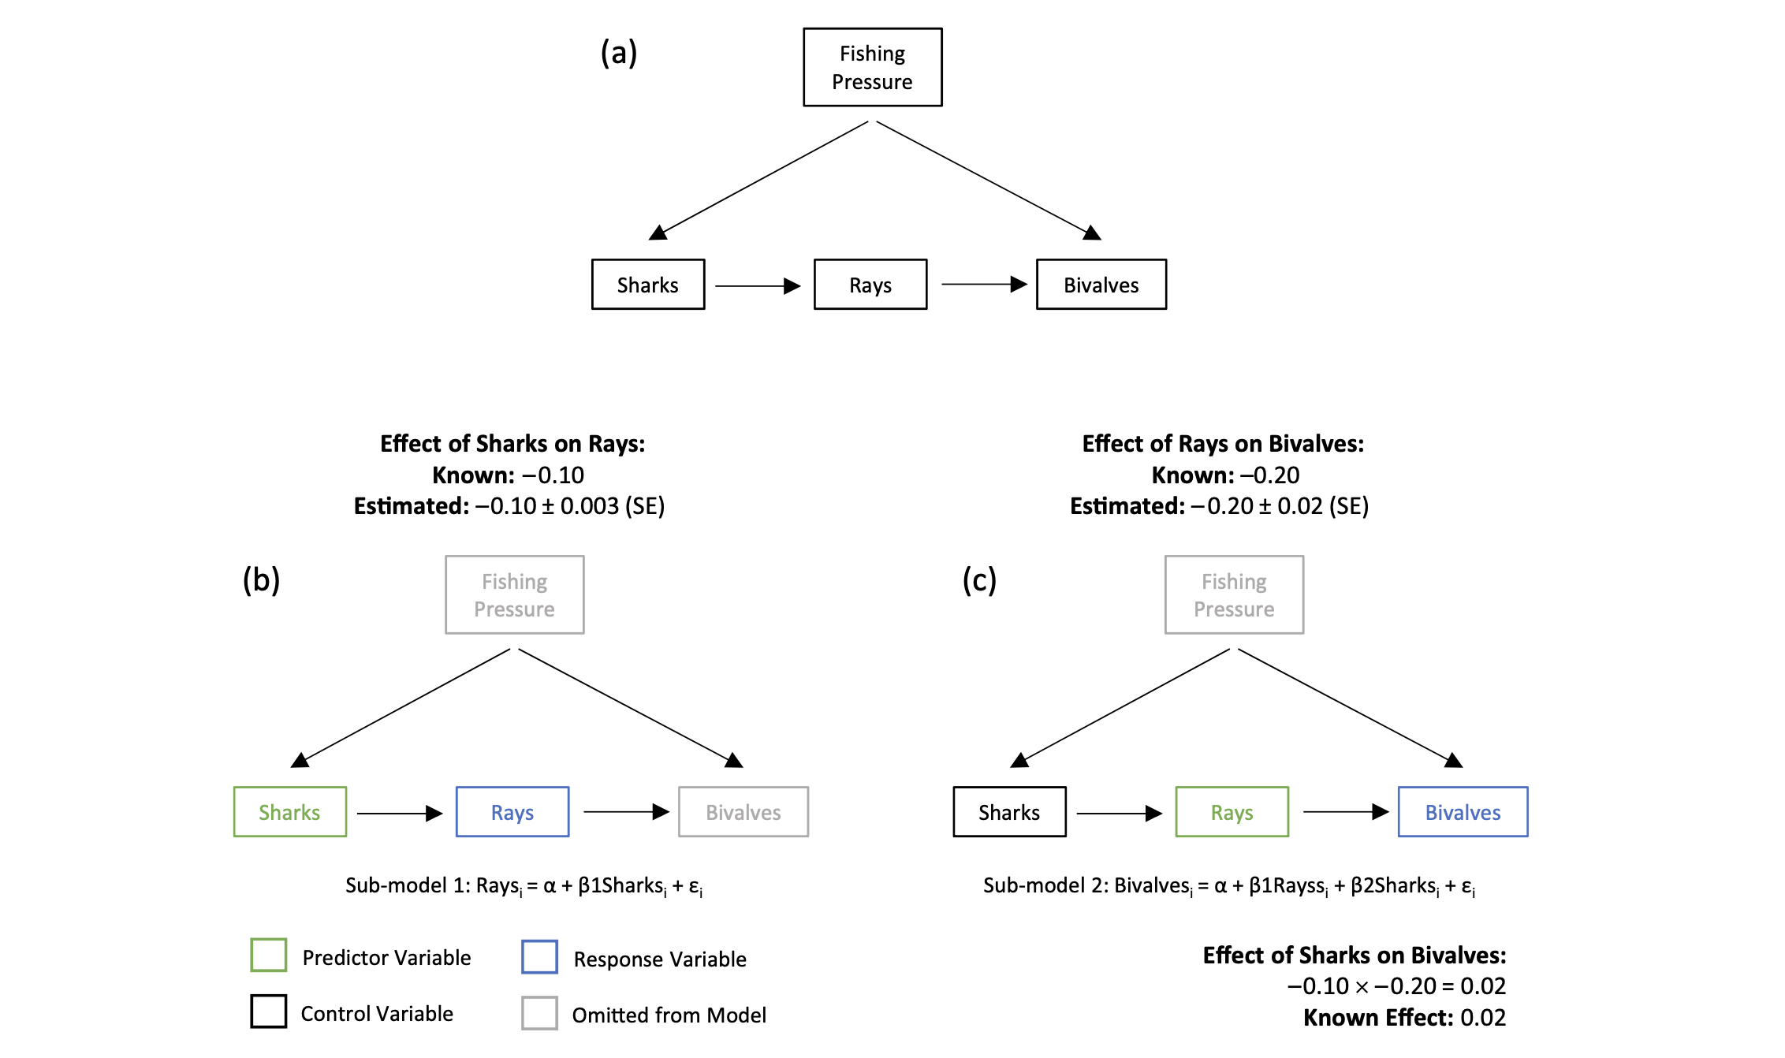
Example: Sharks and Bivalves
Arif and MacNeil 2022

Slide 50
Uses of Causal Diagrams
Simplifying Complex Causal Diagrams
Determining Covariates with Conditional Independence
Finding Open Backdoors to Confounding
Counterfactual Thinking

Slide 51

Counterfactual Thinking: What would Happen If….
The Present
Waves
Near Future
Kelp
Algae
Invertebrates
Far Future

Slide 52
Seemingly Simple, But, At the Core of Understanding Causality
We want to estimate an Average CAUSAL Effect of waves on invertebrates
We observe Inverts With Waves – Inverts Without Waves
This is a POPULATION phenomenon – the Average Treatment Effect
From our measurements, we only observe what happens with waves or no waves in the sample we have
What would have happened if those same replicates had opposite the “treatments”? Would our observation hold?
Waves
Kelp
Algae
Invertebrates

Slide 53
DAGs Let us See If We Can Estimate Valid ATEs and Make Counterfactual Predictions
Difference in means = ATE +
Selection Bias +
Treatment Heterogeneity Bias
Waves
Kelp
Algae
Do confounders lead to selection bias?
Have we controlled for selection bias in our sample or experiment?
Are “treatments” uniform? Or being experienced in the same way?
Invertebrates

Slide 54
Using DAGs to Get ATEs for Inference Requires Methods to Remove Bias
Difference in means = ATE +
Selection Bias +
Treatment Heterogeneity Bias
Our job is to remove bias so Difference in Means = ATE
Experiments let us remove selection and heterogeneity bias by removing drivers of bias
Observational studies let us remove bias via carefully constructed models based on DAGS
We can even include interactions!
Waves
Kelp
Algae
Invertebrates

Slide 55
DAGS + Counterfactuals = Clear Inference
With a DAG, we can see potential sources of bias
We can use counterfactual thinking here to understand how changing waves should cascade through the system
In practice, we can see what variables might obscure our counterfactual inferences
Waves
Kelp
Algae
Invertebrates

Slide 56
What do you need to control for to have valid counterfactual inference?

Slide 57
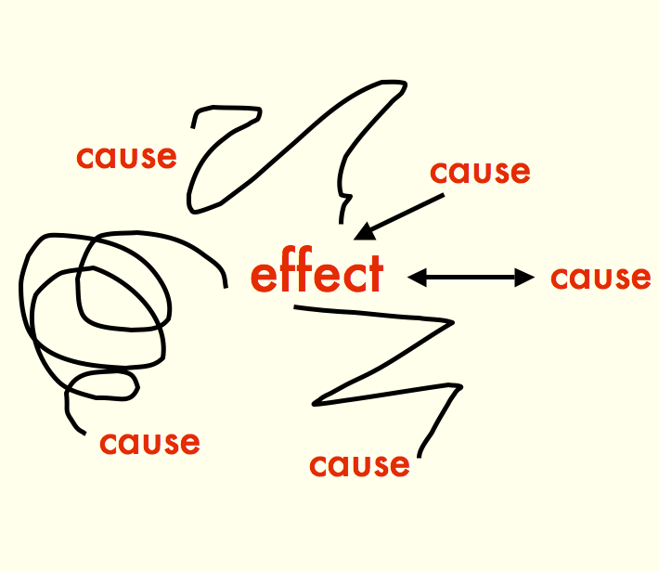
Boxes and Arrows, Oh My!
Causal Diagrams let you be specific about cause and effect in a system
We can incorporate many aspects of our knowledge into Causal Diagrams
Causal Diagrams illuminate potential confounders to watch out for via Back-Door effects
Causal diagrams let us design effective experiments and observational studies

