Slide 1
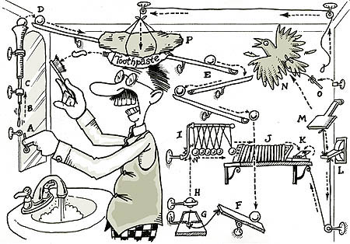
Causal Inference

Slide 2
Goals of Science and Links Between Them
Pattern
Recognition
Causal
Understanding
Prediction &
Forecasting
Mechanistic
Understanding
All are valid and useful in particular contexts – What are YOU seeking to do?

Slide 3
Example Questions
Pattern
Recognition
Prediction &
Forecasting
Causal
Understanding
What are the population trends of introduced fish species and endemic amphibians in alpine lakes?
Which lakes are likely to provide suitable habitat for both introduced fish and endemic amphibians?
Does the increase in populations of introduced fish species cause a decline in endemic amphibian populations in alpine lakes?
Siegel and Dee 2025

Slide 4
Example Questions
Pattern
Recognition
Prediction &
Forecasting
Causal
Understanding
What are the current rates of cancer in relation to home proximity to highways?
Does the distance of a house from a highway predict the probability of contracting cancer?
Does the construction of highways in a community cause a change in the probability of contracting cancer?
Mechanistic
Understanding
Do the aerosolized chemicals from highways cause cancer?

Slide 5
What is your question? Is it fundamentally causal? Or not?

Slide 6
Do You Need to be Doing Causal Inference?
No!
Not all studies will provide causal links between different variables of interest
If the study goal is predictive or descriptive rather than causal, this might not be needed
But…
We cannot hope to understand the world without developing an understanding of causal associations
Indeed
Understanding the clockwork machinery of the universe is an end goal of science – one which we can never achieve, but strive for!

Slide 7
Building an Understanding of Our System
Causal Thinking and Potential Outcomes
Causal Diagrams (aka DAGs)
Linking DAGs and Statistical Models

Slide 8
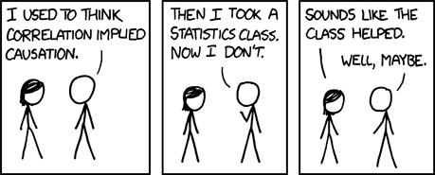
xkcd

Slide 9
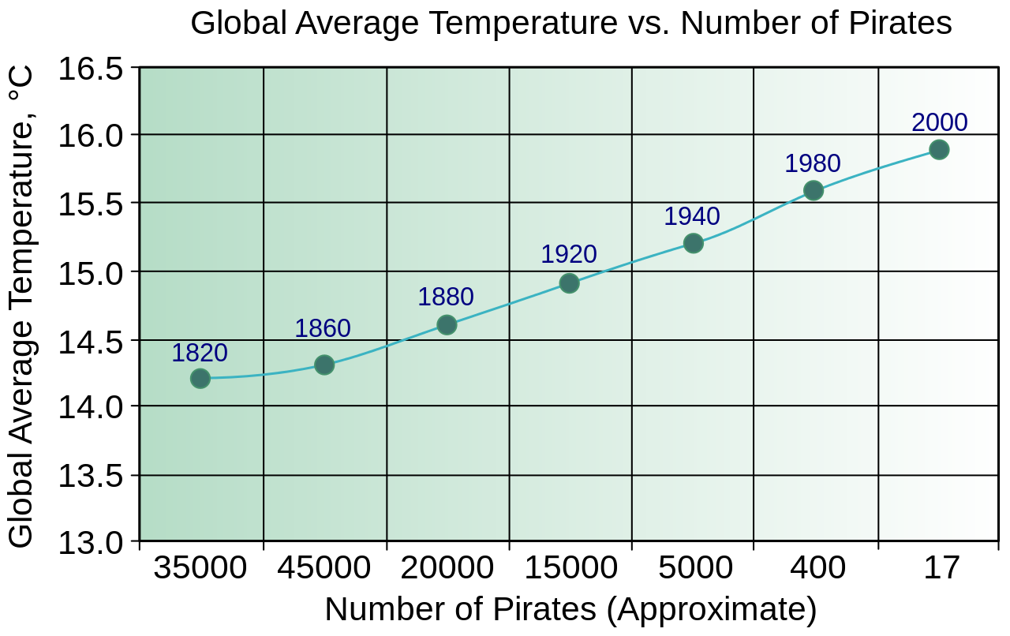
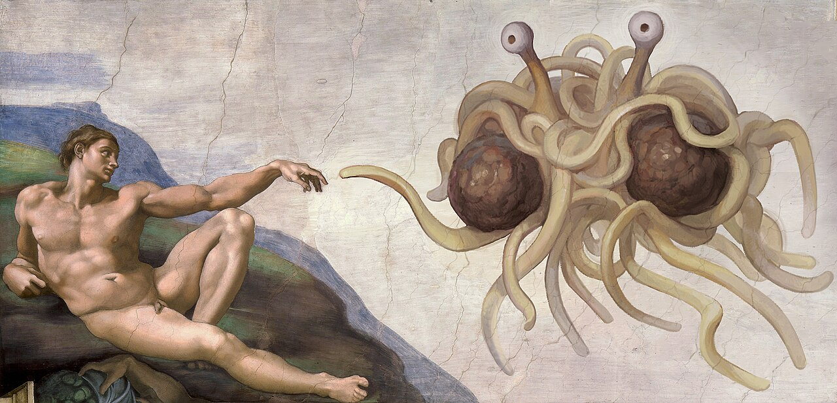
The Classic Example Used to Dissuade us from Causal Thinking
Church of the Flying Spaghetti Monster

Slide 10
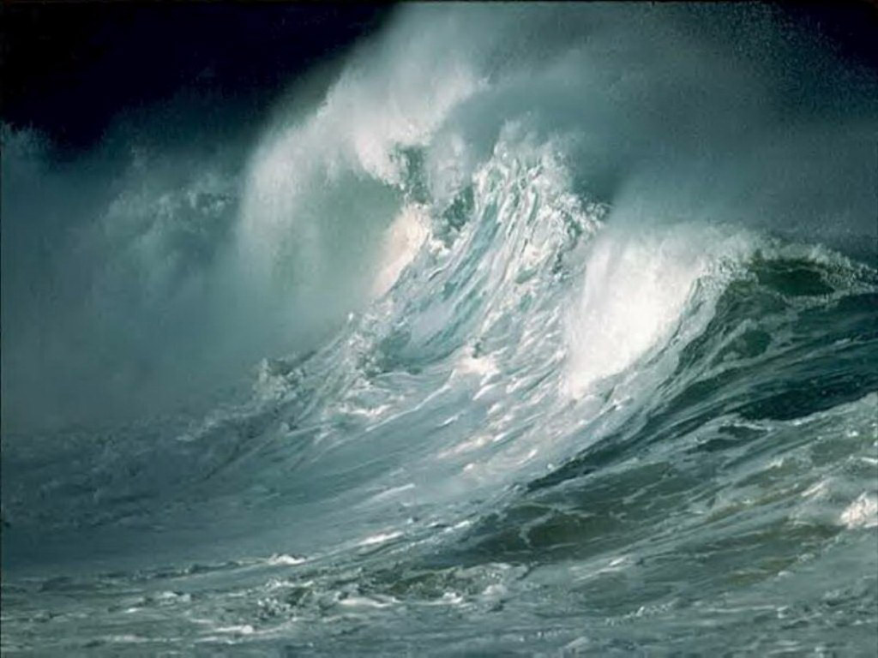

What is Causal Thinking?
Do waves drive biodiversity of invertebrates?
Treated
D_{i} = 1
POTENTIAL OUTCOMES
Y_{1i}
Unit
Y_{i}
Untreated
D_{i} =0
Y_{0i}

Slide 11
If we Only Observed D_{i} = 1, Y_{0i} is Counterfactual and vice-versa
Treated
D_{i} = 1
POTENTIAL OUTCOMES
Y_{1i}
Unit
Y_{i}
Untreated
D_{i} =0
Y_{0i}

Slide 12
What we Want to Know: The Potential Outcomes Framework
D_{i} = 1
Y_{1i}
Average Treatment Effect
ATE = E[Y_{1i} - Y_{0i}]?
D_{i} = 0
Y_{0i}
BUT – we CANNOT observe both Y_{1i} and Y_{0i}
Neyman-Rubin Framework, see Holland 1986 JSA

Slide 13
What We Hope For
Unit | Y | D = 0 | Y | D = 1 | Y1i – Y01 | D
A | 3 | 4 | 1 | 1
B | 6 | 7 | 1 | 1
C | 3 | 4 | 1 | 1
D | 2 | 3 | 1 | 1
E | 5 | 6 | 1 | 0
F | 1 | 2 | 1 | 0
G | 6 | 7 | 1 | 0
H | 9 | 10 | 1 | 0
ATE = E[Y_{1i} – Y_{0i}]
= E[Y_{1i}] – E[Y_{0i}]
= 1

Slide 14
What We Have
Unit | Y | D = 0 | Y | D = 1 |  | D
A |  | 4 |  | 1
B |  | 7 |  | 1
C |  | 4 |  | 1
D |  | 3 |  | 1
E | 5 |  |  | 0
F | 1 |  |  | 0
G | 6 |  |  | 0
H | 9 |  |  | 0
ATE = E[Y₁ – Y₀]
= E [Y₁] – E[Y₀]
= 4.5 – 5.25 = -0.75
WAIT, WHAT?!?!?!?!?!?!

Slide 15
Treatment Effects in a Partially Observed World
D_{i} = 1
Y_{1i}
Difference in means = ATE +
Selection Bias +
Treatment Heterogeneity Bias
D_{i} = 0
Y_{0i}

Slide 16
Selection Bias: Unequal Representation
Units from D = 1
Differences in units between treated and untreated that create bias
Can be that units are different or have different other external forces influencing them
We get around this with experimental or statistical design controls
Units from D = 0

Slide 17
Treatment Heterogeneity Bias
Units from D = 1
Applied Treatment
Units in different treatment groups responded in different ways
Can adjust for with experimental or statistical design control
Units from D = 0
If we Had Applied Treatment

Slide 18
What are Our Potential Enemies and Solutions for Potential Outcomes?
We must find ways to parcel out selection bias and treatment heterogeneity in experiments
We must find ways to adjust or control for selection bias and treatment heterogeneity in observations
We must imagine counterfactual outcomes
But HOW do we know what to adjust and control for?

Slide 19
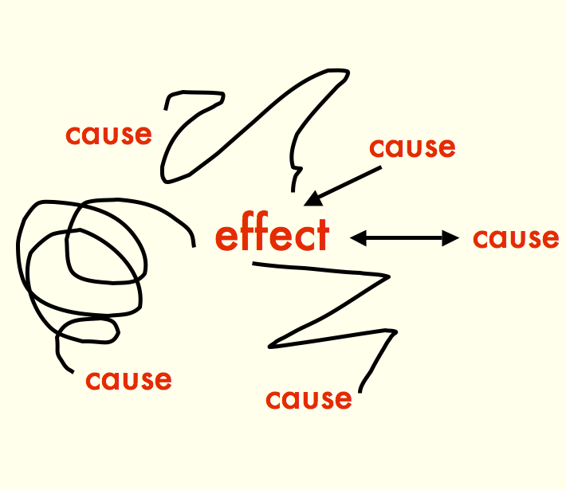

Slide 20
Building an Understanding of Our System
Causal Thinking and Potential Outcomes
Causal Diagrams (aka DAGs)
Linking DAGs and Statistical Models

Slide 21
The Core of Causal Inference – what you want to evaluate
Cause
Effect
In your research, what is your primary cause and effect of interest?

Slide 22
Directed Acyclic Graphs as a Means of Describing the World
AKA path diagram, AKA DAG

Slide 23
Directed Acyclic Graphs as a Means of Describing the World
Boxes represent OBSERVED variables

Slide 24
Directed Acyclic Graphs as a Means of Describing the World
Directed Arrows show flow of causality (information)

Slide 25
Exogenous Drivers of a System
Exogenous variable = ultimate independent variable, predictor, unexplained
x₁

Slide 26
Endogenous Variables are Inside of a System
Exogenous variable
Endogenous variable =
dependent variable,
response
x₁
y₂
y₁
Note: You might not be interested in an exogenous variable, or connection between pairs of variables, but you cannot design a study without understanding a system.

Slide 27
Mediators are Endogenous Variables that Can Also Be Predictors
Exogenous variable
Endogenous variable
x₁
y₂
y₁
Endogenous Mediator Variable =
Endogenous variable that drives other endogenous variables
Often we are interested in a mediator variable – but we cannot assess its importance without the exogenous variable

Slide 28
Direct Effects Have No Mediators
Direct Effect
x₁
y₂
y₁
This does not mean there are not other mediators between x1 and y2, but, those mediators are not influenced by anything else in the system.

Slide 29
Indirect Effects Flow Through a Mediators
Direct Effect
x₁
y₂
y₁
Indirect Effect
If we do not measure y1, we can only assess the TOTAL EFFECT of x1 on y2 – which might be 0, but doesn’t mean there is no causal link!

Slide 30
Unobserved Variables are Things We Have Not Measured
Unobserved Latent
Variable
Everything else affecting y2
e₂
e₂
x₁
y₂
y₁
Unobserved Latent
Variable
Everything else affecting y1
Note: unless something wild is going on with error, we often don’t draw it.
e₁
e₁

Slide 31
There Can Be Connections Between Unobserved Variables
x₃
x₁
y₂
y₁
If we do not consider these, we *can* produce invalid inferences
x₂

Slide 32
You Can Have Multiple Unobserved Variables: Random v. Systematic Error
e₂
x₃
x₁
y₂
Knowing the structure of your system, what you have, and what you have not measured is key
y₁
Error is not usually in DAGs as we focus on Data Generating process not Error Generating process
e₁
x₂
x₄

Slide 33
Interaction Effects: Moderators
x₁
y₁
x₂
OR
x₁
x₁*x₂
y₁
x₂

Slide 34
You Can Have an Uncertain of Unanalyzed Correlation Between Variables
Unexplained correlation
x₁
y₁
x₂

Slide 35
Really This Represents a Correlation Between Unexplained Variances
d₁
δ₁
x₁
y₁
d₂
δ₂
x₂

Slide 36
Could be Due to a Shared Driver
d₁
δ₁
x₁
d₃
y₁
d₂
δ₂
x₂

Slide 37
So Draw the Shared Driver!
x₁
d₁
y₁
x₂

Slide 38
Could Be Due to a Directed Relationship
d₁
δ₁
x₁
y₁
d₂
δ₂
x₂
If correlation is between exogenous variables, we don’t care. If endogenous, we need to consider *why* as it can affect modeling choices and experimental design. And draw the reason!

Slide 39
Why All of this Worry About Structure of a Whole System?
x₁
y₁
y₂
Is it possible to assess the causal relationship between y1 and y2 if you do not know x1? What can you say about any measured relationship between y1 and y2 if x1 varies, but is unmeasured?

Slide 40
Building an Understanding of Our System
Causal Thinking and Potential Outcomes
Causal Diagrams (aka DAGs)
Linking DAGs and Statistical Models

Slide 41
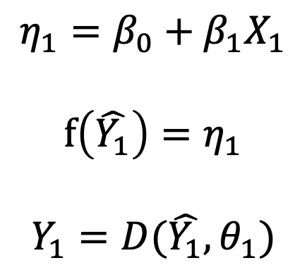
DAGs and the Generalized Linear Model
Relationship 1
DAGs do not make assumptions of functional form
DAGs do not make assumptions of error distribution
They are representations of the causal flow of information
$$η_{1}=β_{0}+β_{1}X_{1}$$
$$f\left(\hat{Y_{1}}\right)=η_{1}$$
$$Y_{1}=D(\hat{Y_{1}},θ_{1})$$
x₁
y₂
y₁

Slide 42
This is Not a Statistical Model
x₁
y₂
y₁

Slide 43
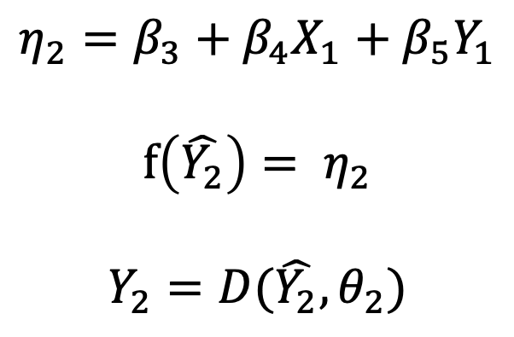
DAGs and the Generalized Linear Model
Relationship 1
Relationship 2
$$η_{1}=β_{0}+β_{1}X_{1}$$
$$f\left(\hat{Y_{1}}\right)=η_{1}$$
$$Y_{1}=D(\hat{Y_{1}},θ_{1})$$
$$η_{2}=β_{3}+β_{4}X_{1}+β_{5}Y_{1}$$
$$f\left(\hat{Y_{2}}\right)= η_{2}$$
$$Y_{2}=D(\hat{Y_{2}}, θ_{2})$$
x₁
y₂
y₁
Doesn’t even need to be a Generalized Linear Model!
Could add clustering variables as REs if they satisfy endogeneity
DAGs will show this!

Slide 44
Random Effects and the Question of Endogeneity and Confounding
cluster effects
x₁
y₁
What does this mean?

Slide 45
Two Options of How Things Affect Variables at a Cluster Level
no correlation
shared cluster effects
cluster effects on y
cluster effects on x
x₁
y₁
x₁
y₁
The same drivers that affect x1 also affect y1: endogeneity violation!
Different drivers affect x1 and y1 and they do not covary: endogeneity OK!

Slide 46
Draw Your System
Start with what is the variable you are ultimately interested in.
What influences that variable DIRECTLY?
What things influence those variables?
Note what you have/can measure and what you cannot.
Any endogeneity problems?

