Slide 1
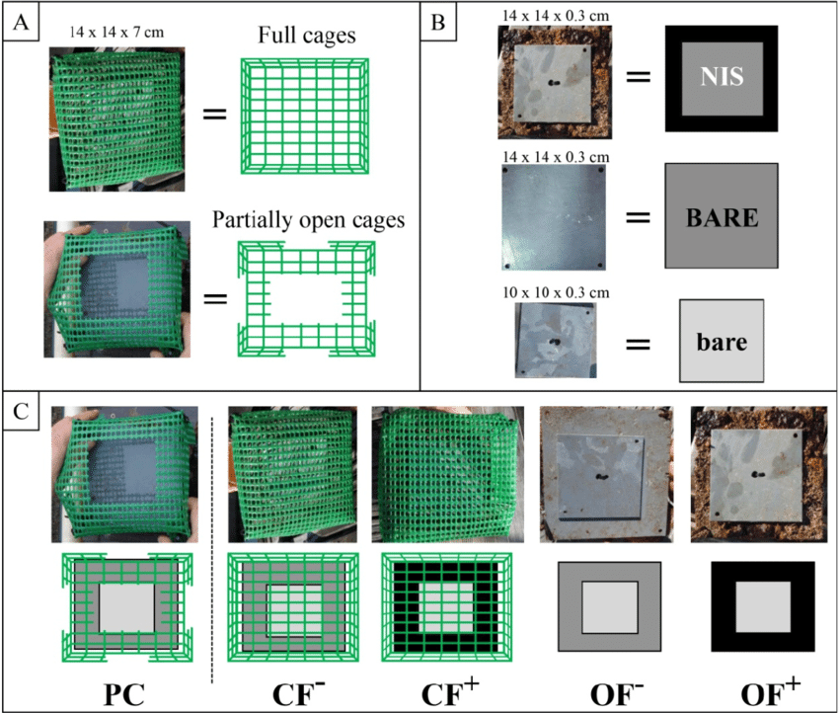
Deriving Causal Inference from Nature with Experiments
Substrate
Type = slate, granite, concrete
Predation = Caged, Uncaged, Cage Control
Barnacles

Slide 2
Build an Understanding of Our System to Design Experiments
Using Causal Diagrams with a System to Design a simple Experiment
Designs Manipulating One Thing
Causal Implications of Experimental Manipulations You Might Not have Thought Of
Treatment Assignment
Manipulating More than One Thing

Slide 3
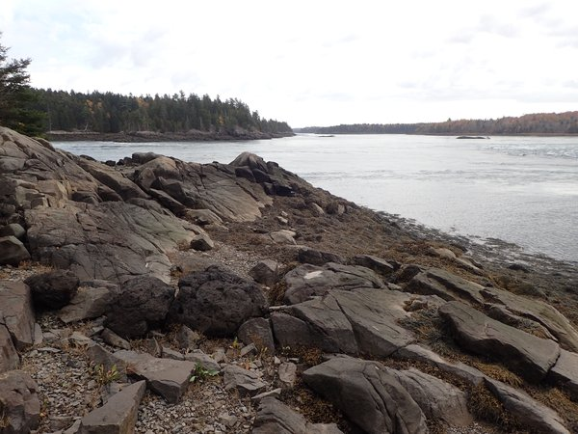
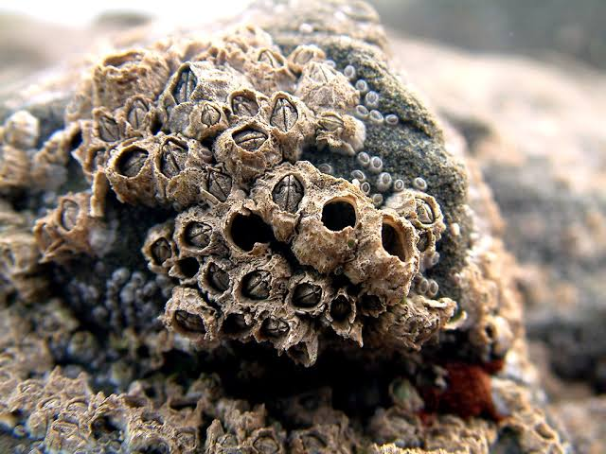
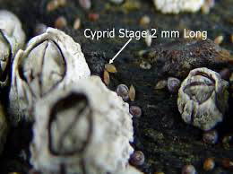
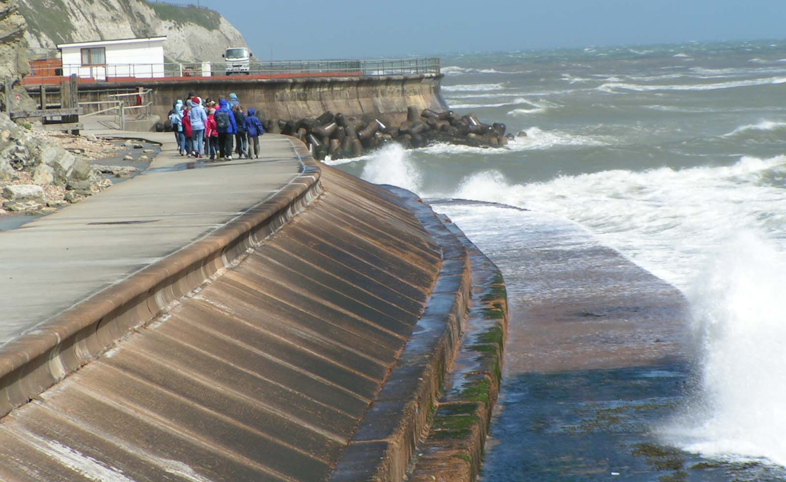
Barnacles and Substrate Type Focus
POTENTIAL OUTCOMES
National Marine Sanctuaries
Bigelow.org
?

Slide 4
Example from Gotelli and Ellison: Substrate and Barnacles
Substrate
Type
Barnacles

Slide 5
First: What How Deeply Mechanistic Do You Want to Get?
Substrate
Roughness
Substrate
Type
Other Properties
Barnacles
You can follow the mechanistic rabbit hole as deep as you want for your question, but it is not always necessary
Substrate
Temperature

Slide 6
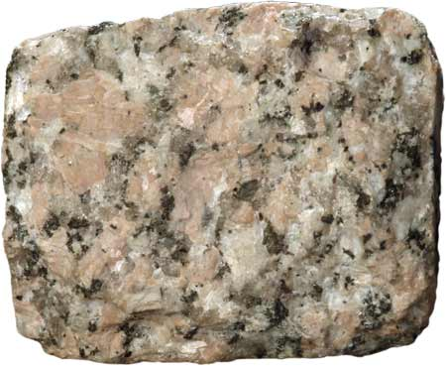

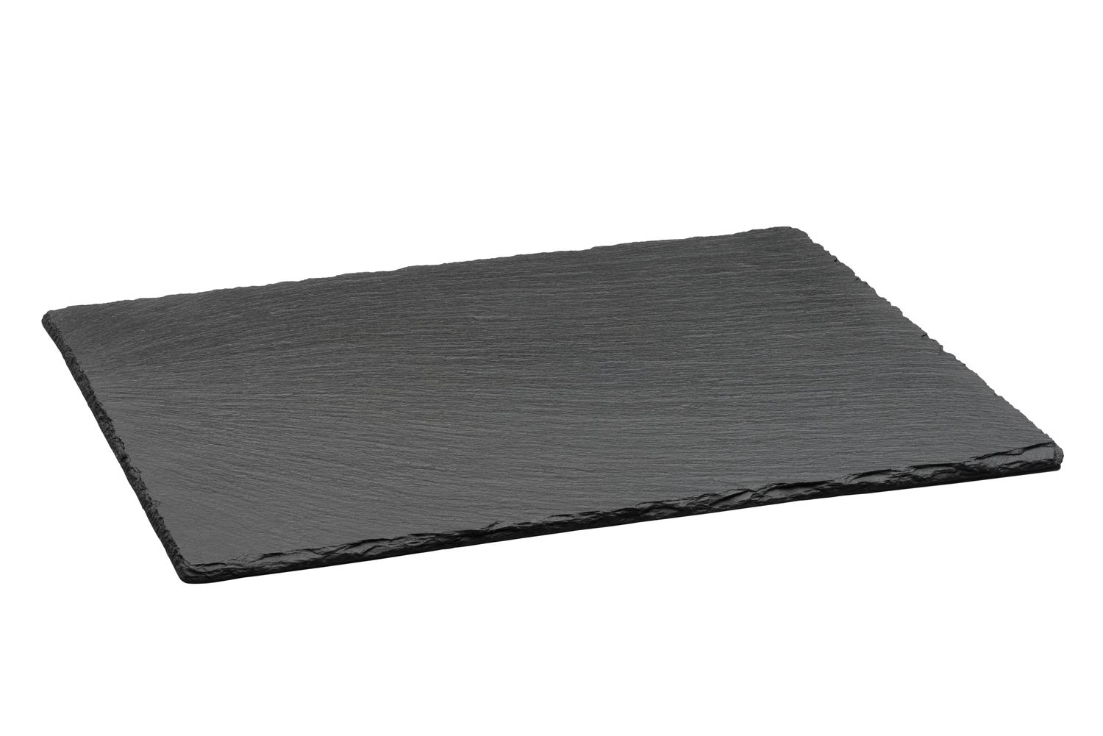
Barnacles and Rugosity
POTENTIAL OUTCOMES
?
?
Bigelow.org

Slide 7
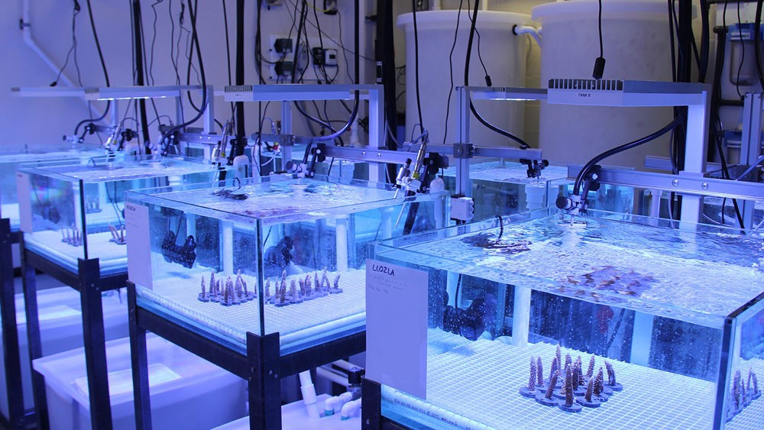
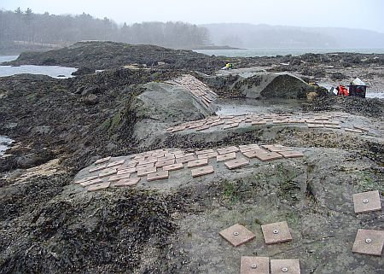
In vitro versus In vivo
NOAA/AOML
Trussel Lab

Slide 8
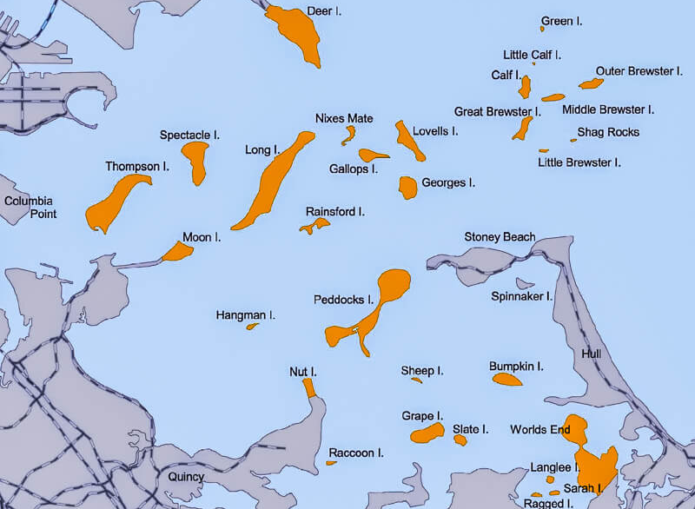
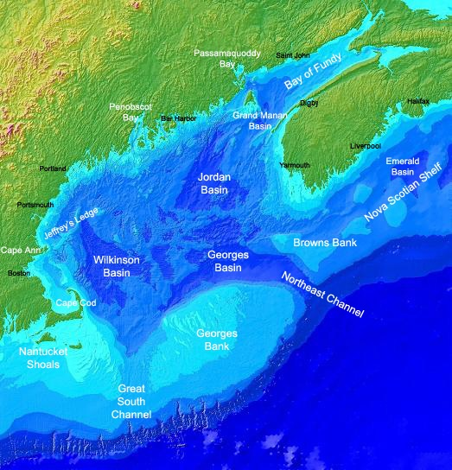

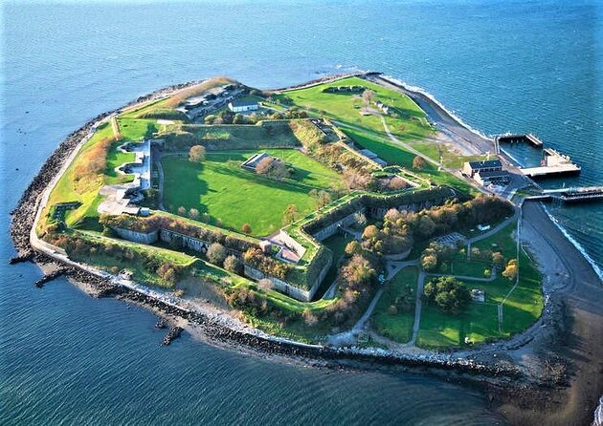
Where Should We Do This?

Slide 9
Our Worry….
Other Site Factors
Substrate
Type
Barnacles
Fight the Confounding!

Slide 10
Flesh Out the System
Other Site Factors
Predation
Substrate
Type
Barnacles
Source of treatment heterogeneity bias
Within-Site Variability
Source of selection bias
Recruitment
Any other assumptions you see here?

Slide 11
Sever Links to Get at Causal Inference Via an Experiment or Statistical Control
Other Site Factors
x
Other Site Factors=0
Predation =
Constant
Predation
x
x
x
Substrate
Type
Barnacles
x
x
Within-Site Variability
Recruitment =
Constant
Recruitment
Your inference will be circumscribed, but you have to start somewhere!

Slide 12
Where Should We Do This?

Slide 13
Causal Diagrams and Experimental Design
Use your diagram to determine what influences you can cut out
Your choices in experimental design can be charted on your diagram
You can then tell if your resulting design is causally identified or not

Slide 14
Build a simplified causal diagram of your system. Then diagram out how you would turn it into an experiment that answers your question of interest.
Notes:
make clearer - enumerate what links are severed, and how will you do that - spider that back into the preceeding slides. Also picutres - what is a barnacle? Identify boston harbor and how to isolate sites.

Slide 15
Build an Understanding of Our System to Design Experiments
Using Causal Diagrams with a System to Design a simple Experiment
Designs Manipulating One Thing
Causal Implications of Experimental Manipulations You Might Not have Thought Of
Treatment Assignment
Manipulating More than One Thing

Slide 16
To Start: Substrate Only – One-Way Layout
Substrate
Type = slate, granite, concrete
How many replicates of each treatment?
Placement of replicates
Randomize or randomize within gradient
Scale over which to run experiment
Dispersion of treatments to ensure independence
Barnacles

Slide 17
A Word on Continuous v. Categorical Designs
Substrate
Rugosity = 0-100
Regression-based designs can work like ANOVA-based designs
You can assign treatment levels evenly
You can assign discrete levels and add random noise
The causal model is *THIS SAME*, it’s the details of implementation and statistical modeling that are different
Barnacles

Slide 18
Our “One-Way” Design
Substrate
Type = slate, granite, concrete
Slate
Granite
Concrete
Barnacles

Slide 19
How Many Replicates Do I Need?
Generally, p^(3/2) / n_{tot} should approach 0
Portnoy 1998
So, 3 means
p^(3/2) ~ 5
So, 5 / (3*n) should be close-ish to 0
Practically, 5-10

Slide 20
5-10 Replicates? That’s it?
Not so fast!
The noisier the system and smaller the effect, the more replicates you need for good precision

Slide 21
OK, How do I Determine Power (or Likely Precision)
SIMULATION!
Make a simulated data set with your design, fit a model, get SE of parameters or other indices
Rinse and repeat to see how often you fall in an acceptable range

Slide 22
Build an Understanding of Our System to Design Experiments
Using Causal Diagrams with a System to Design a simple Experiment
Designs Manipulating One Thing
Causal Implications of Experimental Manipulations You Might Not have Thought Of
Treatment Assignment
Manipulating More than One Thing

Slide 23
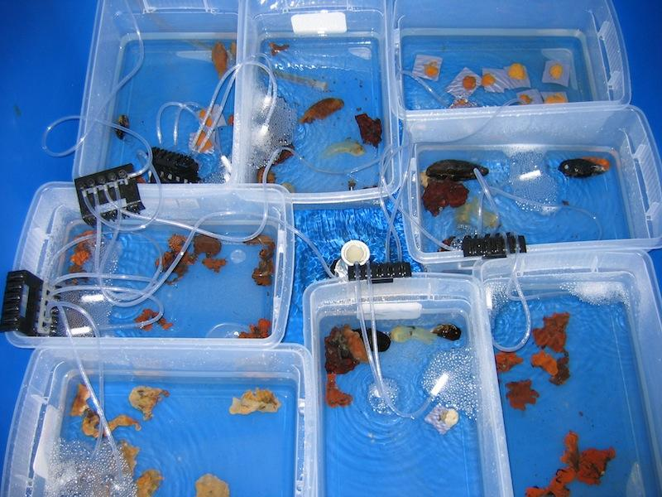
Reality Check: Lots of Things Happen in an Experiment – they are Not So Simple!
Notes:
GET EXAMPLES FROM CLASS OF UNCLEAR CAUSALITY IN AN EXPERIMENT THEY HAVE CONDUCTED

Slide 24
Internal Validity versus External Validity
x
Other Site Factors
Predation = none, ambient
x
x
x
Barnacles
Recruitment
x
Results are valid for one site where experiment was conducted
High Internal Validity
What do they teach us about predation and substrate in nature?
If no recruitment interaction, High External Validity
Otherwise, Low External Validity
Substrate
Type = slate, granite, concrete

Slide 25
Decisions as to How to Treat Moderators & Validity – Averaging Over versus Holding Constant
If we wanted to know the direct causal effect of substrate type, should we hold predation pressure constant, or do the experiment at many levels of predation?
Predation
Barnacles
Substrate
Type

Slide 26
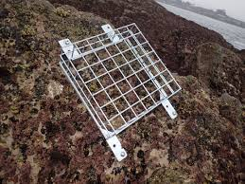
Are You Introducing Hidden Treatments?
Predation = Caged,
Uncaged
Barnacles

Slide 27
Are You Introducing Hidden Treatments?
Predator Access
Cage Treatment = Caged,
Uncaged
Barnacles
Flow of Water
Violation of excludability - outcomes responding solely to treatment through desired pathway
Kimmel et al. 2021

Slide 28
Solution – Diagram it to Devise Procedural Controls
Predator Access
Cage Treatment = Caged,
Uncaged, Sides
Barnacles
Flow of Water

Slide 29
Solution – Diagram it to Devise Procedural Controls with Separate Exogenous Variables
Open
Predator Access
Caged
Barnacles
Sides
Flow of Water

Slide 30
Causal Diagrams of an Experiment
Re-diagram your system as an experiment
Think carefully about what is added and what is subtracted
What is the scope of your inference when you compare your diagram of an experiment to that of the world?
Did you open any new back doors? How can you close them?

Slide 31
Evaluate your experimental diagram – would you change anything? Why?

Slide 32
Build an Understanding of Our System to Design Experiments
Using Causal Diagrams with a System to Design a simple Experiment
Designs Manipulating One Thing
Causal Implications of Experimental Manipulations You Might Not have Thought Of
Treatment Assignment
Manipulating More than One Thing

Slide 33
Replicate Placement – In An Area of Minimal Variation in Other Conditions
Randomize coordinates
Or petri dish placement, labbies!
Once you accommodate, gradients, etc., it’s a different design
Note – this is done at one *time* as well

Slide 34
Bad Replicate Placement: Non-Independence of Plots
If there is bleedover from one plot to the next, you violate the principle of interference
Plots must be spatially or temporally separate
This goes double for plots with the same treatment!
Heats
Kimmel et al. 2021

Slide 35
Bad Replicate Placement: Non-Independence of Treatments
Pseudoreplication sensu Hurlbert
Really a violation of excludability sensu Kimmel et al., as treatment = treatment + location

Slide 36
Subsampling As a Form of Pseudoreplication

Slide 37
Is it Pseudoreplication – How Many Replicates Are There?
If treatments AND plots are non-independent, this is a problem with n = 2, not 4

Slide 38
Subsampling (Nested Design) Can be Great!
If you take subsamples from true replicates, can minimize within replicate variation
Average subsamples
Or use mixed models
.
.
.
.
.
.
.
.
.
.
.
.
.
.
.
.
.
.
.
.
.
.
.
.
.
.
.
.
.
.
.
.
.
.
.
.

Slide 39
Repeated Measures as Subsamples
Let’s say these were samples through time
Analyze the same way
UNLESS – there is change through time
Then, need to consider plot AND a time effect
Notes:
add a few more diagrams

Slide 40
What if There is a Gradient?
Tide Height

Slide 41
Two-Way Blocked Design: Additivity with n = 1 per block/treatment
Substrate
Type
Block
What model would you use?
Barnacles

Slide 42
Randomized Controlled Blocked Design (RCBD)
Randomize treatment placement within blocks
Accommodates potential other gradients
n_{block} = n_{trt} replicates

Slide 43
What Can Blocks Be?
Areas along a gradient
Plots close together in patches
Replicates run at the same time
And more!

Slide 44
Many Gradients? Latin Squares!
Columns
Substrate
Type
Rows
Column
Row
Barnacles

Slide 45
Build an Understanding of Our System to Design Experiments
Using Causal Diagrams with a System to Design a simple Experiment
Designs Manipulating One Thing
Causal Implications of Experimental Manipulations You Might Not have Thought Of
Treatment Assignment
Manipulating More than One Thing

Slide 46
Two Way Designs are Not Just for Blocks
Predation = Caged, Uncaged, Cage Control
Barnacles
Substrate
Type = slate, granite, concrete
But assumes additivity

Slide 47
Beyond Additivity: Factorial Designs
 | Treatment A, Level 1 | Treatment A, Level 2
Treatment B, Level 1 | N=5 | N=5
Treatment B, Level 2 | N=5 | N=5

Slide 48
Factorial Blocked Design: Does your Treatment Vary by Block?
Substrate
Type
Block
Block 1
Block 2
Block 3
What model would you use?
Barnacles
Useful for site variation, temporal variation, and more

Slide 49
Factorial Designs are Not Just for Blocks
Predation = Caged, Uncaged, Cage Control
Predation*Substrate
Barnacles
Substrate
Type = slate, granite, concrete
Notes:
add response surface

Slide 50
You can Mix Things – e.g., Blocks and Factorial Design (re-randomize each block)
Block 1
Block 2
Block 3

Slide 51
Notes On Experimental Design Basics
Elements of any and all of these designs can be combined
Thinking about site, time, location, arrangement in a room, etc., are all key in designing effective experiments
Always diagram out not just your system of interest, but the experimental system you are constructing

Slide 52
Take your question, your system diagram, and make a schematic of an experimental design. Are there artefacts to control? Are there gradients? More than one thing to manipulate?

