Slide 1
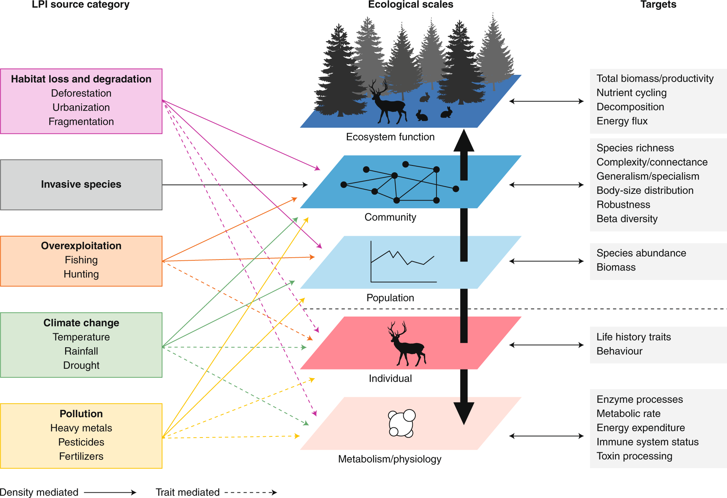
Multifactor Experimental Design

Slide 2
More than A Simple Set of Treatments
When your manipulation creates a need for additional treatments
Dealing with gradients in experimental design
Combining multiple drivers
A bestiary of nonlinear designs

Slide 3
Internal Validity versus External Validity
x
Other Site Factors
Predation
x
x
x
Barnacles
Recruitment
x
Results are valid for one site where experiment was conducted
High Internal Validity
What do they teach us about predation and substrate in nature?
If no recruitment interaction, High External Validity
Otherwise, Low External Validity
Substrate
Type = slate, granite, concrete

Slide 4
The Hidden Treatment Problem of Manipulations
x
Other Site Factors
Predation
x
x
Barnacles
Recruitment
x
x
Substrate
Type = slate, granite, concrete
x
How do we design experiments to give us meaningful inference about >1 driver?

Slide 5
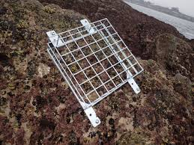
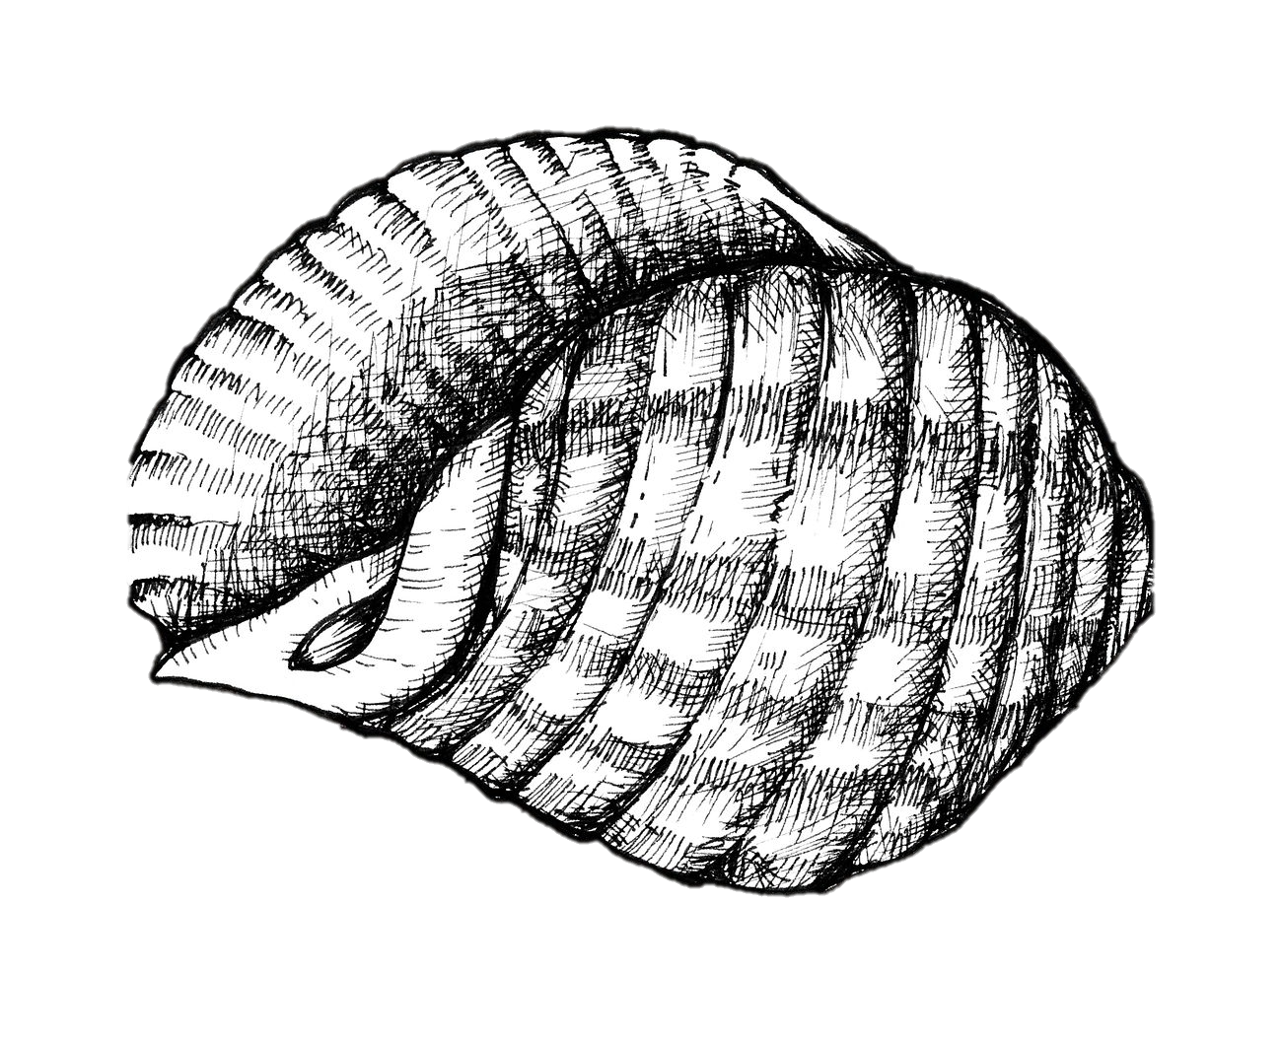
What Does it Mean to Test An Effect of the Environmental Driver in vivo?
Predation = Caged,
Uncaged
Predation = Caged with Snails, Caged Empty

Slide 6
Are You Introducing Hidden Treatments?
Predation = Caged,
Uncaged
Barnacles

Slide 7
Are You Introducing Hidden Treatments?
Predator Access
Cage Treatment = Caged,
Uncaged
Barnacles
Flow of Water
Violation of excludability - outcomes responding solely to treatment through desired pathway
Kimmel et al. 2021

Slide 8
Solution – Diagram it to Devise Procedural Controls – More Treatments!
Predator Access
Cage Treatment = Caged,
Uncaged, Sides
Barnacles
Flow of Water
But will this work? What does it mean to have K = 3?

Slide 9
Solution – Diagram it to Devise Procedural Controls with Separate Exogenous Variables
Open
Predator Access
Caged
Barnacles
Sides
Flow of Water
This is also a way of ensuring you are not violating excludability in your interpretation

Slide 10
Solution – Diagram it to Devise Procedural Controls with Separate Exogenous Variables
Open
Predator Access
Caged
Barnacles
Sides
Flow of Water
Compare (Caged v. Uncaged) - (Uncaged v. Sides)

Slide 11
Causal Diagrams of an Experiment
Re-diagram your system as an experiment
Think carefully about what is added and what is subtracted
What is the scope of your inference when you compare your diagram of an experiment to that of the world?
Does your manipulation change things other than the effect you are interested in?

Slide 12
More than A Simple Set of Treatments
When your manipulation creates a need for additional treatments
Dealing with gradients in experimental design
Combining multiple drivers
A bestiary of nonlinear designs

Slide 13
Replicate Placement – In An Area of Minimal Variation in Other Conditions
Randomize coordinates
Or petri dish placement, labbies!
Once you accommodate, gradients, etc., it’s a different design
Note – this is done at one *time* as well

Slide 14
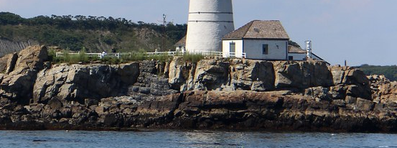
What if There is a Gradient?
Tide Height

Slide 15
Two-Way Blocked Design: Additivity with n = 1 per block/treatment
Substrate
Type
Block
What model would you use?
Barnacles

Slide 16
Randomized Controlled Blocked Design (RCBD)
Randomize treatment placement within blocks
Accommodates potential other gradients
n_{block} = n_{trt} replicates

Slide 17
What Can Blocks Be?
Areas along a gradient
Plots close together in patches
Replicates run at the same time
And more!

Slide 18
Many Gradients? Latin Squares!
Columns
Substrate
Type
Rows
Column
Row
Barnacles

Slide 19
Many Many Gradients? Blocked Latin Squares!
Tide Height
Block 1
Block 2
Block 3

Slide 20
More than A Simple Set of Treatments
When your manipulation creates a need for additional treatments
Dealing with gradients in experimental design
Combining multiple drivers
A bestiary of nonlinear designs

Slide 21
Considering Multiple Drivers
x
Other Site Factors
Predation = none, ambient
x
x
Barnacles
Recruitment
x
Substrate
Type = slate, granite, concrete
How do we design experiments to give us meaningful inference about >1 driver?

Slide 22
Decisions as to How to Treat Moderators & Validity – Averaging Over versus Holding Constant
If we wanted to know the direct causal effect of substrate type, should we hold predation pressure constant, or do the experiment at many levels of predation?
Predation
Barnacles
Substrate
Type

Slide 23
Two Way Designs are Not Just for Blocks
Predation = Caged, Uncaged, Cage Control
Barnacles
Substrate
Type = slate, granite, concrete
But assumes additivity

Slide 24
Beyond Additivity: Factorial Designs
 | Treatment A, Level 1 | Treatment A, Level 2
Treatment B, Level 1 | N=5 | N=5
Treatment B, Level 2 | N=5 | N=5

Slide 25
Factorial Blocked Design: Does your Treatment Vary by Block?
Substrate
Type
Block
Block 1
Block 2
Block 3
What model would you use?
Barnacles
Useful for site variation, temporal variation, and more

Slide 26
Factorial Designs are Not Just for Blocks
Predation = Caged, Uncaged, Cage Control
Predation*Substrate
Barnacles
Substrate
Type = slate, granite, concrete
Notes:
add response surface

Slide 27
You can Mix Things – e.g., Blocks and Factorial Design (re-randomize each block)
Block 1
Block 2
Block 3

Slide 28
The Split Plot Problem
What if one treatment must be applied to a non-independent set of a plots?
E.g. You have been gifted with barnacle cages that cover 3 plates at once, and you don’t have the $$$ to afford more
Or, you are studying the effect of a drug on different cell types in subjects, but all of the cell types from each subject have experienced the same treatment

Slide 29
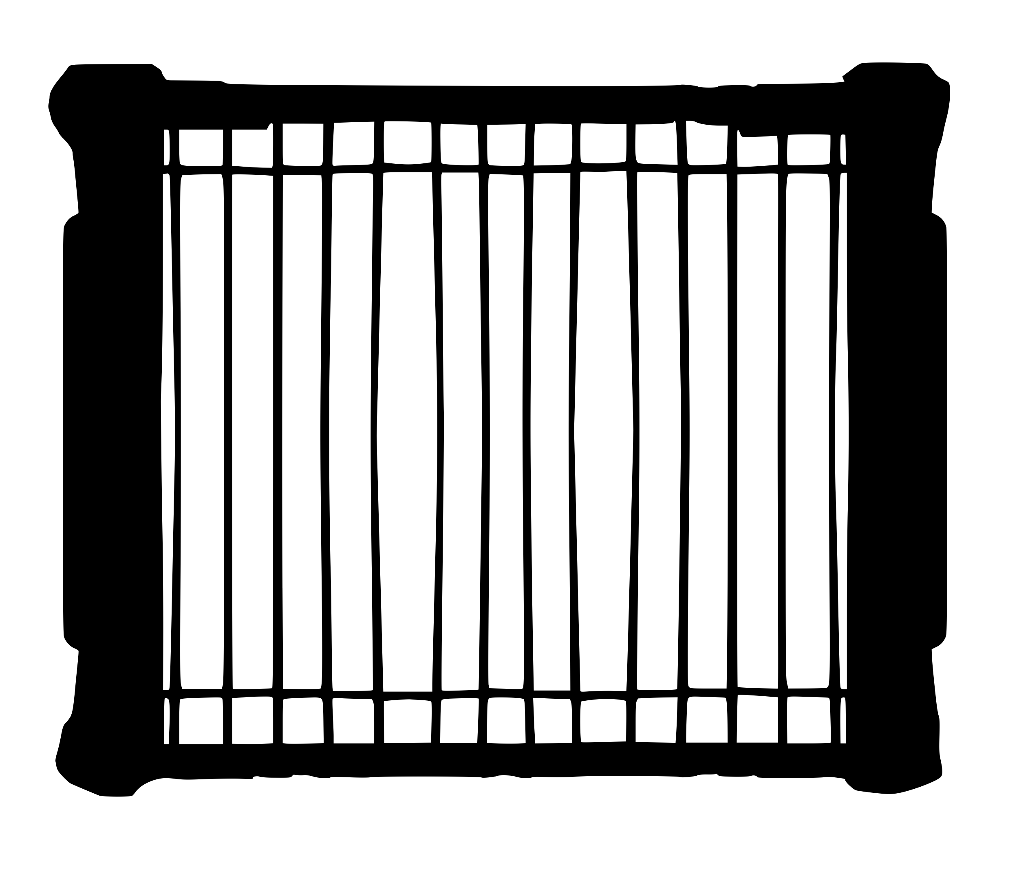
Treatment Application: Cage Covers 3 Panels

Slide 30
Split-Plot Design: If You Have to Have Non-Independence, What are Your Sources of Error?

Slide 31
Split-Plot Design: Start Getting into Thinking About Error in your Causal Model
Predation = Caged, Uncaged, Cage Control
error
Predation*Substrate
Barnacles
Substrate
Type = slate, granite, concrete
“Plot”
error
Random Effect!

Slide 32
More than A Simple Set of Treatments
When your manipulation creates a need for additional treatments
Dealing with gradients in experimental design
Combining multiple drivers
A bestiary of nonlinear designs

Slide 33
Remember: DAGs Do Not Have a Functional Form
Predation
Barnacles
Substrate
Type
While the effect of Substrate might depend on Predation, it might not be strictly multiplicative

Slide 34
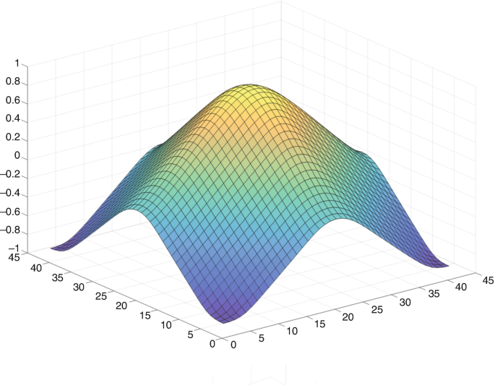
How Do We Design an Experiment to Characterize This?
Fraction Barnacle Survival
Predation Pressure
Substrate Roughness

Slide 35
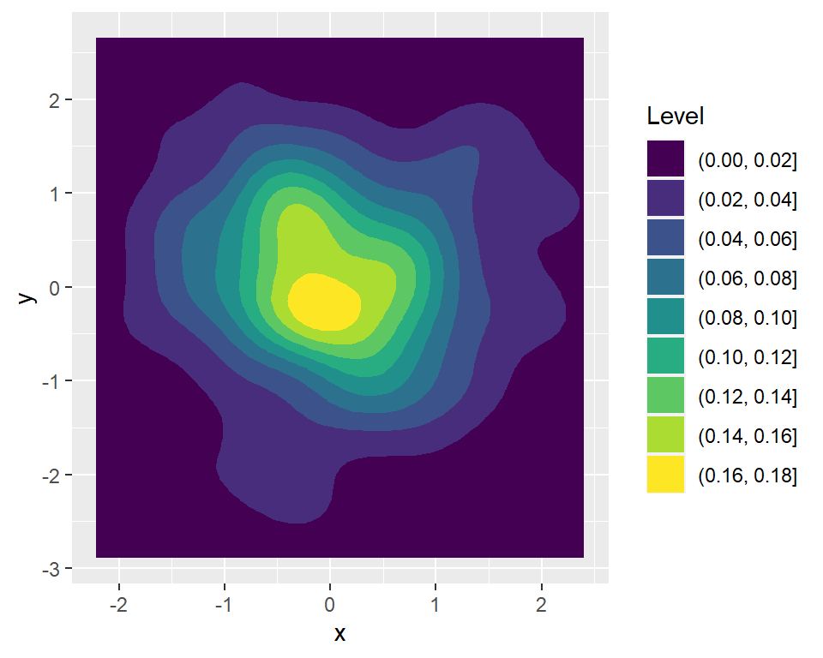
Simple Factorial Design Could Miss Things
Concludes no Interaction
AH HA! INTERACTION!
Concludes no Interaction

Slide 36
Moving Towards a Response Surface
Each iteration searches more space
Replicating each treatment combo helps build knowledge of nonlinear interactions

Slide 37
Response Surfaces Fully Characterize Nonlinear Interactions
This is Great!
We can even reduce replication per combo – all continuous
BUT – is this possible?
How many combos do you need?

Slide 38
Quadratic Designs Target If a Nonlinear Synergy Exists
Higher replication in the middle
Could also be a second “ring” of treatments in the middle
Efficiently explores IF there is a nonlinearity
Might not get exact shape

Slide 39
Or, Optimize Based on Constraints and Fill Space
E.g., I can have 8 treatments – how do I best assign treatment levels?
Optimizes to fill n-dimensional treatment space
Common in computer science – Latin Hypercube

Slide 40
Use Prior Knowledge to Fill Space
Can use prior knowledge to bias where you will randomly put treatment combinations to sample space
Very efficient – but, your prior knowledge must be right

Slide 41
Ultimately, You Bring System-Specific Knowledge to your DAG to Determine Design
Predation
Barnacles
Substrate
Type
Start exploratory then tighten down, or run small trials exploring parameter space if uncertain

Slide 42
Final Notes On Experimental Design Basics
Elements of any and all of these designs can be combined
Thinking about site, time, location, arrangement in a room, etc., are all key in designing effective experiments
Always diagram out not just your system of interest, but the experimental system you are constructing

Slide 43
Take your question, your system diagram, and make a “schematic” of an experimental design. Are there artefacts to control? Are there gradients? More than one thing to manipulate?

