Slide 1
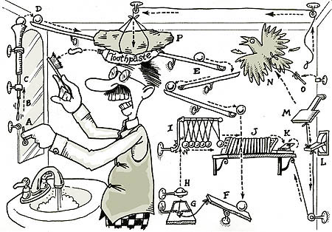
Deriving Causal Inference from Nature with Experiments

Slide 2
Goals of Science
Pattern
Recognition
Mechanistic
Understanding
Prediction
All are valid and useful in particular contexts – What are YOU seeking to do?

Slide 3
Build an Understanding of Our System to Design Experiments
Introduction to Causal Thinking
Anatomy of Causal Diagrams
Causal Diagrams and Experiments
Using Causal Diagrams with a System to Design an Experiment
Causal Implications of Experimental Manipulations You Might Not have Thought Of

Slide 4

Pearl’s Ladder of Causality
3. Counterfactual – Can imagine what would happen under unobserved conditions
- Requires model of a system
- Requires identification of causality
Prediction
2. Intervention – Understand what happens you do something
- Experiments
- Provides evidence of causal link
Mechanistic
Understanding
1. Observation – Cause is associated with effect
- Correlation
- Can only predict within the range of data
Pattern
Recognition
Pearl and Mackenzie 2018

Slide 5
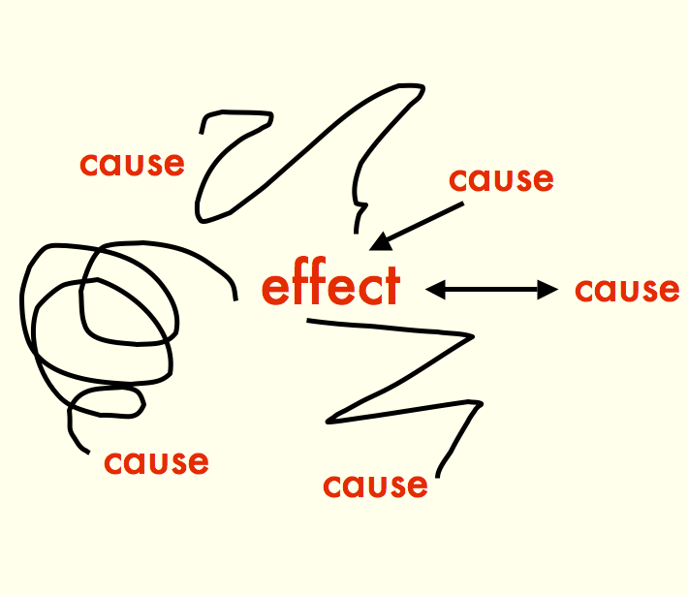

Slide 6
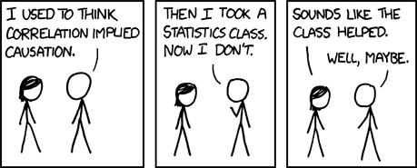
xkcd

Slide 7
Do You Need to be Doing Causal Inference?
No!
Not all studies will provide causal links between different variables of interest
If the study goal is predictive or descriptive rather than causal, this might not be needed
But…
We cannot hope to understand the world without developing an understanding of causal associations
Indeed
Understanding the clockwork machinery of the universe is an end goal of science – one which we can never achieve, but strive for!

Slide 8
What is your question? Is it fundamentally causal? Or not?

Slide 9
Build an Understanding of Our System to Design Experiments
Introduction to Causal Thinking
Anatomy of Causal Diagrams
Causal Diagrams and Experiments
Using Causal Diagrams with a System to Design an Experiment
Causal Implications of Experimental Manipulations You Might Not have Thought Of

Slide 10
The Core of Causal Inference – what you want to evaluate
Cause
Effect
In your research, what is your primary cause and effect of interest?

Slide 11
Directed Acyclic Graphs as a Means of Describing the World
AKA path diagram, AKA DAG

Slide 12
Directed Acyclic Graphs as a Means of Describing the World
Boxes represent OBSERVED variables

Slide 13
Directed Acyclic Graphs as a Means of Describing the World
Directed Arrows show flow of causality (information)

Slide 14
Exogenous Drivers of a System
Exogenous variable = ultimate independent variable, predictor, unexplained
x₁

Slide 15
Endogenous Variables are Inside of a System
Exogenous variable
Endogenous variable =
dependent variable,
response
x₁
y₂
y₁
Note: You might not be interested in an exogenous variable, or connection between pairs of variables, but you cannot design a study without understanding a system.

Slide 16
Mediators are Endogenous Variables that Can Also Be Predictors
Exogenous variable
Endogenous variable
x₁
y₂
y₁
Endogenous Mediator Variable =
Endogenous variable that drives other endogenous variables
Often we are interested in a mediator variable – but we cannot assess its importance without the exogenous variable

Slide 17
Direct Effects Have No Mediators
Direct Effect
x₁
y₂
y₁
This does not mean there are not other mediators between x1 and y2, but, those mediators are not influenced by anything else in the system.

Slide 18
Indirect Effects Flow Through a Mediators
Direct Effect
x₁
y₂
y₁
Indirect Effect
If we do not measure y1, we can only assess the TOTAL EFFECT of x1 on y2 – which might be 0, but doesn’t mean there is no causal link!

Slide 19
Unobserved Variables are Error or Things We Have Not Measured
Unobserved Latent
Variable
Everything else affecting y2
e₂
e₂
x₁
y₂
y₁
Unobserved Latent
Variable
Note: unless something wild is going on with error, we often don’t draw it.
Everything else affecting y1
e₁
e₁

Slide 20
There Can Be Connections Between Unobserved Variables
x₃
x₁
y₂
y₁
If we do not consider these, we *can* produce invalid inferences
x₂

Slide 21
You Can Have Multiple Unobserved Variables
e₂
x₃
x₁
y₂
Knowing the structure of your system, what you have, and what you have not measured is key
y₁
e₁
x₂
x₄

Slide 22
Interaction Effects
x₁
e₁
y₁
x₂
OR
x₁
x₁*x₂
e₁
y₁
x₂

Slide 23
You Can Have an Uncertain of Unanalyzed Correlation Between Variables
Unexplained correlation
x₁
y₁
x₂
e₁

Slide 24
Really This Represents a Correlation Between Unexplained Variances
d₁
δ₁
x₁
y₁
d₁
δ₂
x₂
e₁

Slide 25
Could be Due to a Shared Driver
d₁
δ₁
x₁
d₃
y₁
d₁
δ₂
x₂
e₁

Slide 26
Could Be Due to a Directed Relationship
d₁
δ₁
x₁
y₁
d₁
δ₂
x₂
e₁
If correlation is between exogenous variables, we don’t care. If endogenous, we need to consider *why* as it can affect modeling choices and experimental design.

Slide 27
Why All of this Worry About Structure of a Whole System?
x₁
y₁
y₂
Is it possible to assess the causal relationship between y1 and y2 if you do not know x1? What can you say about any measured relationship between y1 and y2 if x1 varies, but is unmeasured?

Slide 28
The Back-Door Effect sensu Judea Pearl
x₁
y₁
y₂
We need to find a way to shut the back door!!!

Slide 29
Boxes and Arrows, Oh My!
Causal Diagrams let you be specific about cause and effect in a system
We can incorporate many aspects of our knowledge into Causal Diagrams
Causal Diagrams illuminate potential confounders to watch out for via Back-Door effects

Slide 30
Build an Understanding of Our System to Design Experiments
Introduction to Causal Thinking
Anatomy of Causal Diagrams
Causal Diagrams and Experiments
Using Causal Diagrams with a System to Design an Experiment
Causal Implications of Experimental Manipulations You Might Not have Thought Of

Slide 31
So…. How Do We Tease This…
Cause
Effect

Slide 32
Out of This?
Exogenous Cause
Cause
Effect
Mediator
Cause 2
Notes:
So, if you only measure cause and effect, you might not be getting the right coefficients/assessment of causality
Heck, if you even measure what you think is the whole world, but miss just one thing, you can still F it up.
Indeed – even if you included the mediator, but not cause 2, you’d still have problems
GET EXAMPLES FROM CLASS

Slide 33
Experiments as an Intervention
Exogenous Cause=0
X
X
X
Cause
Effect
X
X
Mediator=0
X
X
Cause 2=0
Notes:
Note: Severing this mediation can be the hardest of all, and so in many cases we need to either include the mediator in the analysis or content ourselves that we are looking at summed effects!

Slide 34
In Experiments We Manipulate the Cause of Interest
Exogenous Cause=0
Cause = 0,1,2,…
Effect
Mediator=0
Cause 2=0
Notes:
Note: Severing this mediation can be the hardest of all, and so in many cases we need to either include the mediator in the analysis or content ourselves that we are looking at summed effects!

Slide 35
Build an Understanding of Our System to Design Experiments
Introduction to Causal Thinking
Anatomy of Causal Diagrams
Causal Diagrams and Experiments
Using Causal Diagrams with a System to Design an Experiment
Causal Implications of Experimental Manipulations You Might Not have Thought Of

Slide 36
Example from Gotelli and Ellison: Substrate and Barnacles
Substrate
Type
Barnacles

Slide 37
Example from Gotelli and Ellison: Substrate and Barnacles – Worth Considering Mediators?
Substrate
Roughness
Substrate
Type
Other Properties
Barnacles
Substrate
Temperature

Slide 38
Example from Gotelli and Ellison: Flesh Out the System
Other Site Factors
Predation
Barnacles
Recruitment
Substrate
Type
Any other assumptions you see here?

Slide 39
Example from Gotelli and Ellison: Use Just One Site
x
Other Site Factors
Predation
x
x
Barnacles
Recruitment
x
Substrate
Type

Slide 40
Example from Gotelli and Ellison: What are our Treatment Levels?
x
Other Site Factors
Predation = none, ambient
x
x
Barnacles
Recruitment
x
Substrate
Type = slate, granite, concrete
Can be continuous or discrete!

Slide 41
Causal Diagrams and Experimental Design
Use your diagram to determine what influences you can cut out
Your choices in experimental design can be charted on your diagram
You can then tell if your resulting design is causally identified or not

Slide 42
Build a simplified causal diagram of your system. Then diagram out how you would turn it into an experiment that answers your question of interest.

Slide 43
Build an Understanding of Our System to Design Experiments
Introduction to Causal Thinking
Anatomy of Causal Diagrams
Causal Diagrams and Experiments
Using Causal Diagrams with a System to Design an Experiment
Causal Implications of Experimental Manipulations You Might Not have Thought Of

Slide 44
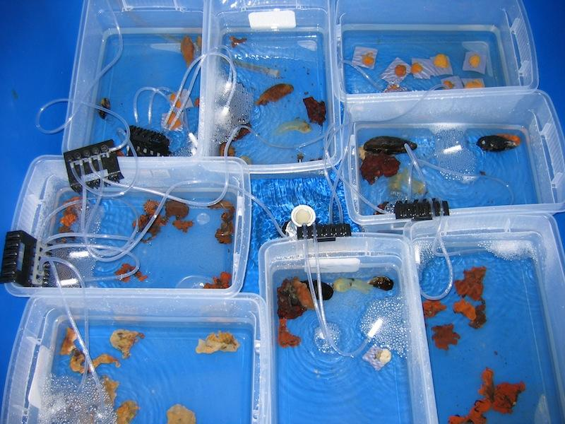
Reality Check: Lots of Things Happen in an Experiment – they are Not So Simple!
Notes:
GET EXAMPLES FROM CLASS OF UNCLEAR CAUSALITY IN AN EXPERIMENT THEY HAVE CONDUCTED

Slide 45
Internal Validity versus External Validity
x
Other Site Factors
Predation = none, ambient
x
x
Barnacles
Recruitment
x
Results are valid for one site where experiment was conducted
High Internal Validity
What do they teach us about predation and substrate in nature?
If no recruitment interaction, High External Validity
Otherwise, Low External Validity
Substrate
Type = slate, granite, concrete

Slide 46
Decisions as to How to Treat Confounders & Validity – Averaging Over versus Holding Constant
If we wanted to know the direct causal effect of substrate type, should we hold recruitment pressure constant, or do the experiment at many recruitment levels?
Recruitment
Barnacles
Substrate
Type

Slide 47
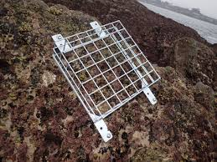
Are You Introducing Hidden Treatments?
Predation = Caged,
Uncaged
Barnacles

Slide 48
Are You Introducing Hidden Treatments?
Predator Access
Cage Treatment = Caged,
Uncaged
Barnacles
Flow of Water

Slide 49
Solution – Diagram it to Devise Procedural Controls
Predator Access
Cage Treatment = Caged,
Uncaged, Sides
Barnacles
Flow of Water

Slide 50
Solution – Diagram it to Devise Procedural Controls with Separate Exogenous Variables
Open
Predator Access
Caged
Barnacles
Sides
Flow of Water

Slide 51
Causal Diagrams of an Experiment
Re-diagram your system as an experiment
Think carefully about what is added and what is subtracted
What is the scope of your inference when you compare your diagram of an experiment to that of the world?
Did you open any new back doors? How can you close them?

Slide 52
Evaluate your experimental diagram – would you change anything? Why?

