Slide 1
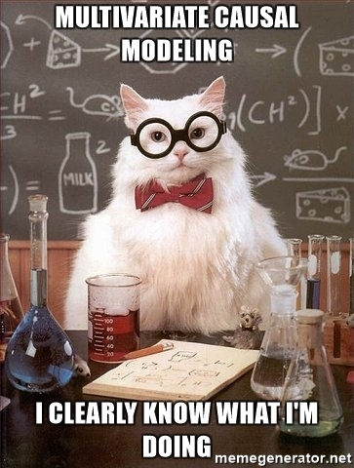
Observational Studies and Causal Models

Slide 2
I Thought Correlation Wasn’t Causation…
Correlation, causation, and long-standing misunderstanding in science
Thinking in causal models to formulate multiple regression models
Ensuring causal identification of your regression models

Slide 3

Pearl’s Ladder of Causality
3. Counterfactual – Can imagine what would happen under unobserved conditions
- Requires model of a system
- Requires identification of causality
2. Intervention – Understand what happens you do something
- Experiments
- Provides evidence of causal link
1. Observation – Cause is associated with effect
- Correlation
- Can only predict within the range of data
Pearl and Mackenzie 2018

Slide 4
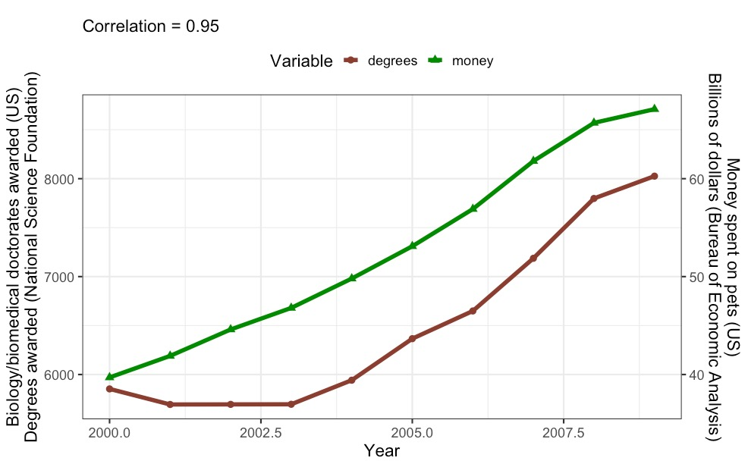
Observation: Can We Learn Anything?
http://tylervigen.com/

Slide 5
Correlation does not equal causation… but where there’s smoke, there’s fire. -Jim Grace

Slide 6
Where’s the Fire?
http://tylervigen.com/

Slide 7
What We Want to Evaluate
Cause
Effect

Slide 8
But This is the World
Exogenous Cause
Cause
Effect
Mediator
Cause 2
Notes:
So, if you only measure cause and effect, you might not be getting the right coefficients/assessment of causality
Heck, if you even measure what you think is the whole world, but miss just one thing, you can still F it up.
Indeed – even if you included the mediator, but not cause 2, you’d still have problems
GET EXAMPLES FROM CLASS

Slide 9
What Is The World Behind This Association?
http://tylervigen.com/

Slide 10
I Thought Correlation Wasn’t Causation…
Correlation, causation, and long-standing misunderstanding in science
Thinking in causal models to formulate multiple regression models
Ensuring causal identification of your regression models

Slide 11
Can We Think of Multiple Regression from a Causal Standpoint?
We estimate the effect of exogenous variables controlling for all others
Covariances implied
Not controlling for the right variables = bad inference
Controlling for the wrong variables = bad inference
X1
X2
Y
X3

Slide 12
Why Use Multiple Predictors: Simpson’s Paradox
Classic Problem: Does having more native species hinder invasive species success?
Invasive Species Richness
Native Species Richness

Slide 13
Why Use Multiple Predictors: Simpson’s Paradox
Classic Problem: Does having more native species hinder invasive species success?
Native Richness
Invasive Species Richness
Invasive Richness
Native Species Richness

Slide 14
Why Use Multiple Predictors: Simpson’s Paradox
Simpson’s Paradox addresses the influence of confounders causing flips in signs of relationships
Native
Richness
Site
Invasive Species Richness
Invasive Richness
Native Species Richness
Shea and Chesson 1998 TREE

Slide 15
Simpson’s Paradox is Everywhere
@infowetrust/Twitter

Slide 16
But Which Predictors? All? Some? Which?!?!?!?!
X4
X1
X5
X2
Y
X6
X3
X7
X8

Slide 17
Why Not to Use All Predictors
Increased SE on all coefficients
Spurious correlations might give false signals
Including variables that can obfuscate the signal of causation
Including variables that WILL create correlations where there are none

Slide 18
Features of Causal Graphs to Watch Out For
The Collider
The Chain
X1
X2
X1
X2
Y
Y
The Descendant
The Fork
X2
X1
X2
Y
X3
X1
Y

Slide 19
Chain of Foolish Inference
Consider the following:
You are following a cohort of patients with tumors to see if tumor size influences buildup of blood toxins. You measure differences in tumor sizes at t0, and then again at t1, when you take blood samples
Which tumor size(s) do you use as predictors of blood toxin concentrations? Initial, final, or both?
Initial Tumor
Final
Tumor
Toxin
Concentration

Slide 20
Consider the Consequences
Truth
Final
Tumor
Toxin
Concentration
Initial Tumor
Regression 1
Toxin
Concentration
Initial Tumor
Net effect, ignoring mediator
Regression 2
Initial Tumor
What does this mean?
Toxin
Concentration
Adjust effects
holding mediator
or initial constant
Final
Tumor
What does this mean?

Slide 21
The Chain
Causal Model
In experiments, this is controlling for post-treatment effects
Cause
Mediator
Effect
What it can do to Multiple Regression
Mediator blocks cause
Looks like no or opposite link between cause and effect
Can be OK if you are also analyzing the cause -> mediator relationship
Cause
Effect
Mediator

Slide 22
Will a Child Set us Free?
Consider the following:
What if we knew the final tumor was shedding cells, and we had their concentration. Should we control for that?
Initial Tumor
Final
Tumor
Toxin
Concentration
Shed
Cells

Slide 23
The Descendant Problem
Causal Model
Cause
Mediator
Effect
Descendant
What it would do to Multiple Regression
Cause
Descendant still partially blocks cause
Masks effect of cause – many possibilities
Effect
Descendant

Slide 24
A Collision of Sampling and Regression
Consider the following:
You are interested to see if academic ability and athletic ability are correlated. So, you sample students at your university.
Athletic Ability
Academic Ability

Slide 25
A Collision of Sampling and Regression
But how do you get into college?
Academic Ability
College
Admit
Athletic
Ability
Athletic Ability
Academic Ability

Slide 26
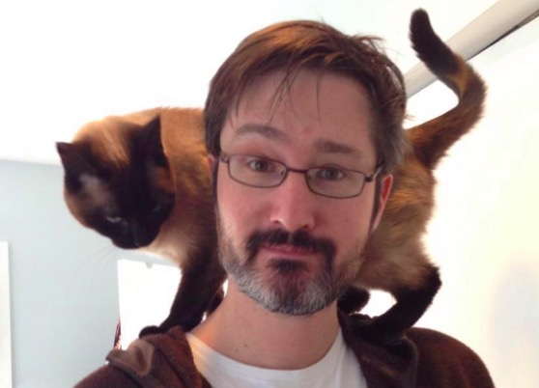
Example of Collider Bias
My cat jumps on my shoulders when she is lonely, I am on Zoom, or both.
It’s more likely she is satisfying one of those conditions at any one time, rather than both
Thus, if I am on zoom, I know she is likely not lonely
I’d falsely conclude there’s a relationship between my being on zoom and if she is lonely
cat on shoulders
Am I on Zoom?
Lonely?

Slide 27
The Collider
Causal Model
Cause 1
Effect
Cause 2
What it would do to Multiple Regression
Cause 1
Conditions on effect, opening path between causes
Creates spurious correlations
Cause 2
Effect

Slide 28
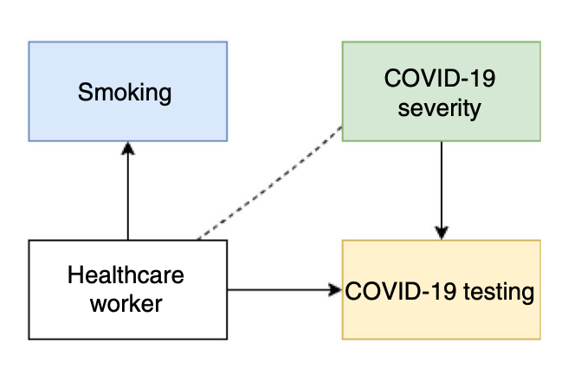
Surely We Wouldn’t Fall Prey To Collider Bias…
Preliminary studies suggested that
a) Healthcare workers were likely to get less severe Covid infections
b) Covid infection was lower among smokers
WHY?
Griffith et al. 2020 Nat. Com.

Slide 29
The Fork
Exogenous Cause
Causal Model
Cause
Effect
What it would do to Multiple Regression
Cause
Effect
Nothing – this is great!
Exogenous
Cause

Slide 30
The Bigger Problem…
Exogenous Cause
Causal Model
Cause
Effect
Univariate Regression
Cause
Effect
The relationship is contaminated – results unreliable!

Slide 31
The Omitted Variable Bias Problem
We assume that sampling means that omitted variables average to 0
Omission produces downward bias in SE of coefficients
But, if omitted variables are correlated causally with a predictor, they likely are not averaged out
This will bias your estimates
You will not know in what direction
Exogenous
Cause
Cause
Effect
Notes:
This is where correlation does not equal causation – so, how can we fix this (knowing that even experiments are not the answer)

Slide 32
I Thought Correlation Wasn’t Causation…
Correlation, causation, and long-standing misunderstanding in science
Thinking in causal models to formulate multiple regression models
Ensuring causal identification of your regression models

Slide 33
OVB and Causal Identification
This
path
is
not
causally
identified
Exogenous
Cause
Cause
Effect
Notes:
This is where correlation does not equal causation – so, how can we fix this (knowing that even experiments are not the answer)

Slide 34
Causal Identification
Your model need not be causally identified – but be specific that you are only talking about associations
You can only make counterfactual statements if you are confident in causal identification
Exogenous
Cause
Cause
Effect
Notes:
This is where correlation does not equal causation – so, how can we fix this (knowing that even experiments are not the answer)

Slide 35
Causal Identification
Causal identification does not require knowing ULTIMATE cause
Nor does it require knowing exact mechanisms within a causal pathway
Exogenous
Cause
Cause
Effect
Notes:
This is where correlation does not equal causation – so, how can we fix this (knowing that even experiments are not the answer)

Slide 36
How do we solve this problem?
This
relationship
is
not
causally
identified
Exogenous
Cause
Cause
Effect
Notes:
This is where correlation does not equal causation – so, how can we fix this (knowing that even experiments are not the answer)

Slide 37
Solution 1: The Backdoor Criteria
If we want to know the link between cause and effect given variables that affect both, we must include all variables with a path into the cause
So, variables must block all backdoor paths from treatment to outcome
AND variables must not be descendants of the cause (i.e., no mediators – see the pipe!)
Exogenous
Cause
Cause
Effect
Regression Model
Exogenous
Cause
Effect
Cause

Slide 38
Proximate Backdoors
Exogenous Cause
Proximate Cause
Cause
Effect
Often we only have proximate variables in a backdoor path. Controlling for just them is sufficient.
Notes:
This works for a wide variety of different back-door scenarios
SOLICIT EXAMPLES

Slide 39
Proximate Backdoors and Regression
Regression Model
Proximate
Cause
Exogenous
Cause
Effect
Cause
Notes:
This works for a wide variety of different back-door scenarios
SOLICIT EXAMPLES

Slide 40
What Variables Block the Back Door?
X1
Y3
Y2
Y1
Y4
There are two ways to build a multiple regression with closed back doors to determine if Y1 -> Y4. What are they?
Notes:
This works for a wide variety of different back-door scenarios
SOLICIT EXAMPLES

Slide 41
Space and Time Live in the Backdoor
Site, Spatial and Temporal Covariates and Lags
Cause
Effect

Slide 42
Sometimes We Cannot Shut the Backdoor
Billion Dollar
Environmental Covariates
Cause
Effect

Slide 43
Or, we suspect, but don’t know, of backdoors
Who Knows
??
??
Independent
Mediator
Cause
Effect

Slide 44
Solution 2: The Front-Door Criterion
A variable satisfies the front-door criteria when it blocks all paths from X to Y.
In practice, you need a causally identified mediating variable unaffected by anything else.
Thus, the influence of the cause is felt by the effect solely through its mediator.
Who Knows
??
??
Cause
Independent
Mediator
Effect

Slide 45
Example: Smoking and Cancer
Other factors (genetic, stress, environment)
Tar in
Lungs
Smoking
Cancer
See Pearl’s books and papers for the do calculus of this
Notes:
Do you have any front-doors in your system?

Slide 46
Front Doors and Instruments
Instrumental variables are those that **only** affect the cause, and have no relation to anything else
By examining their relationship to both the cause and effect, we can derive an estimate of the causal effect
Also useful when cause and effect involved in a feedback
Who Knows
??
??
Instrument
Cause
Effect

Slide 47
Smoking and Cancer as Classic Example
BUT – are laws a TRUE exogenous variable
If laws are in response to cancer rates, they might not be
Unless a priori cancer is the same everywhere
Multiple methods to test validity of instrument
Genes, Environment
Laws
Restricting
Smoking
Smoking
Cancer

Slide 48
Two Approaches in Instruments
ic
1. Fit two models, leveraging the fact that
IE = IC * CE
so, CE = IE/IC
Instrument
Cause
ie
Instrument
Effect
2. Fit two models, but only use fitted values of the cause for the second
Instrument
Cause
Fitted
Cause
Effect
See ivreg

Slide 49
Causal Diagrams and Modeling Observational Data
Yes you can!
Causal diagrams guide you to the appropriate set of predictors – and fend off testy reviewers
Sometimes, your model is non-causal, and that’s OK!
If you begin by thinking in terms of a causal system, you will produce more robust meaningful inference

