Slide 1
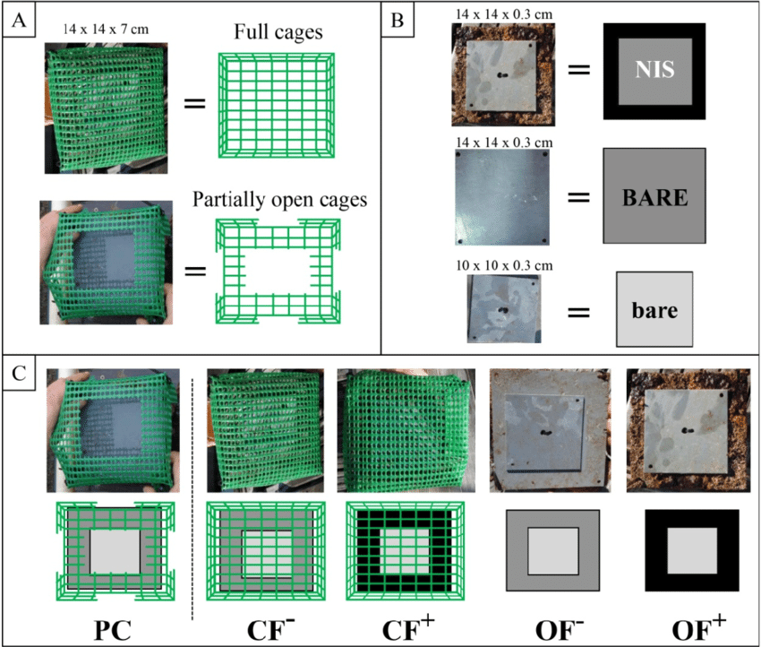
Deriving Causal Inference from Nature with Experiments
Substrate
Type = slate, granite, concrete
Predation = Caged, Uncaged, Cage Control
Barnacles

Slide 2
Build an Understanding of Our System to Design Experiments
Using Causal Diagrams with a System to Design a simple Experiment
What is a Replicate Versus a Subsample?
Randomization
Replication
Closing Thoughts

Slide 3
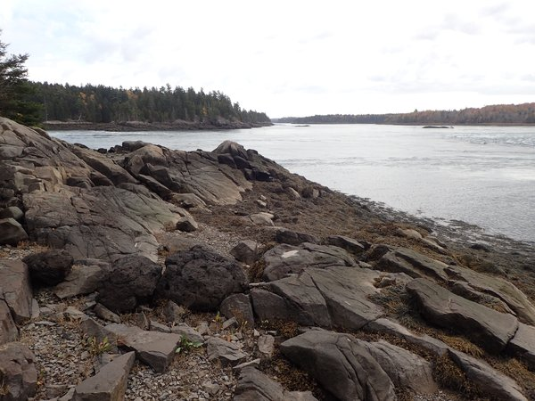
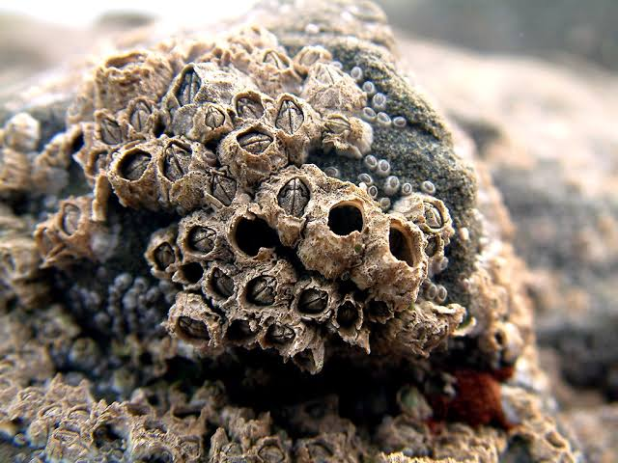
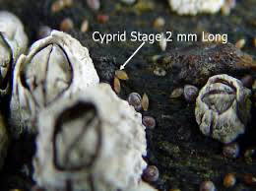

Barnacles and Substrate Type Focus
POTENTIAL OUTCOMES
National Marine Sanctuaries
Bigelow.org
?

Slide 4
Example from Gotelli and Ellison: Substrate and Barnacles
Substrate
Type
Barnacles

Slide 5
First: What How Deeply Mechanistic Do You Want to Get?
Substrate
Roughness
Substrate
Type
Other Properties
Barnacles
You can follow the mechanistic rabbit hole as deep as you want for your question, but it is not always necessary
Substrate
Temperature

Slide 6
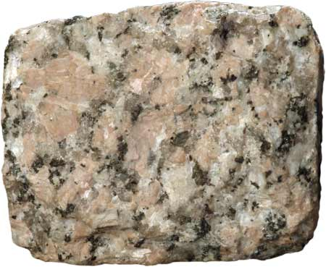

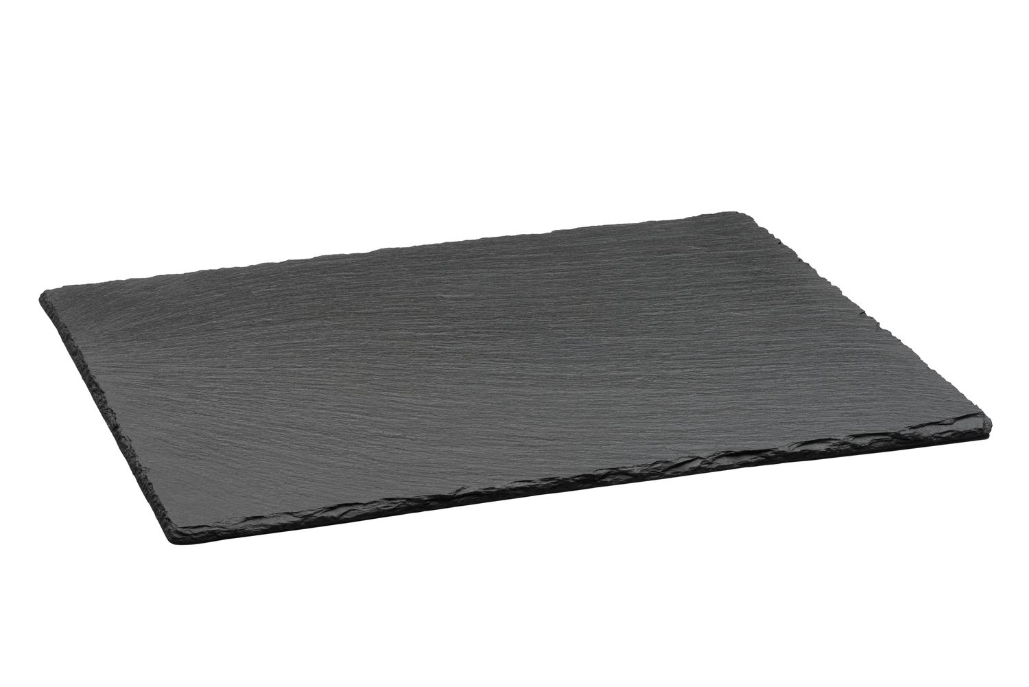
Barnacles and Rugosity
POTENTIAL OUTCOMES
?
?
Bigelow.org

Slide 7
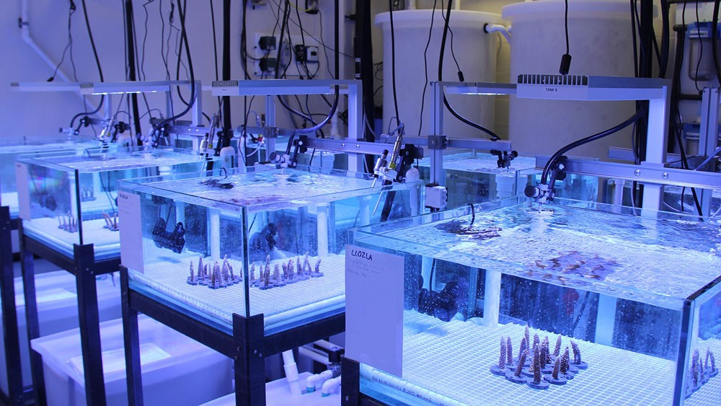
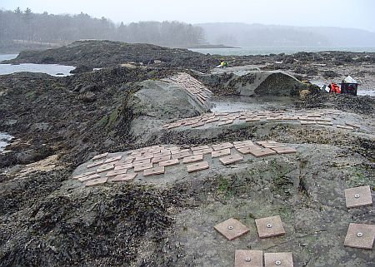
In vitro versus In vivo
NOAA/AOML
Trussel Lab

Slide 8
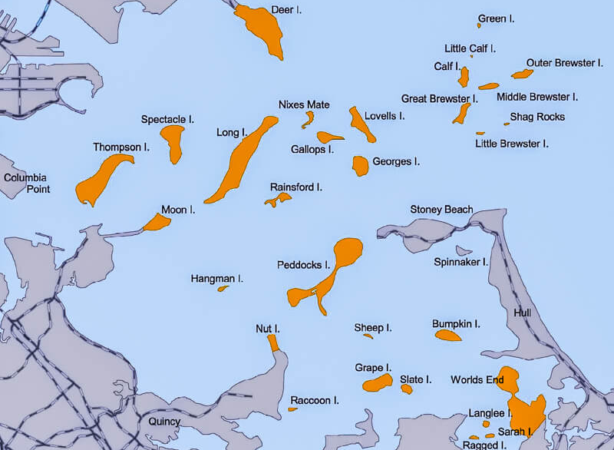
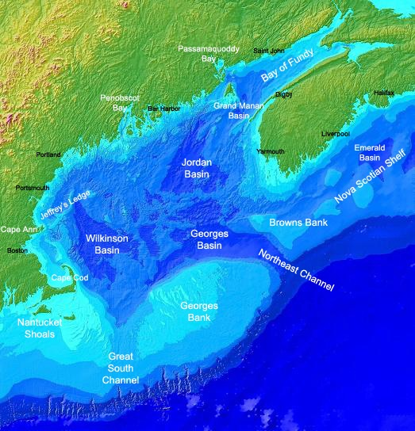

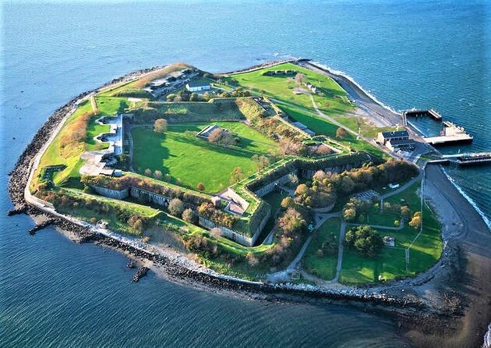
Where Should We Do This?

Slide 9
Our Worry….
Other Site Factors
Substrate
Type
Barnacles
Fight the Confounding!

Slide 10
Flesh Out the System
Other Site Factors
Predation
Substrate
Type
Barnacles
Source of treatment heterogeneity bias
Within-Site Variability
Source of selection bias
Recruitment
Any other assumptions you see here?

Slide 11
Sever Links to Get at Causal Inference Via an Experiment or Statistical Control
Other Site Factors
x
Other Site Factors=0
Predation =
Constant
Predation
x
x
x
Substrate
Type
Barnacles
x
x
Within-Site Variability
Recruitment =
Constant
Recruitment
Your inference will be circumscribed, but you have to start somewhere!

Slide 12
Where Should We Do This?

Slide 13
Causal Diagrams and Experimental Design
Use your diagram to determine what influences you can cut out
Your choices in experimental design can be charted on your diagram
You can then tell if your resulting design is causally identified or not

Slide 14
Build a simplified causal diagram of your system. Then diagram out how you would turn it into an experiment that answers your question of interest.
Notes:
make clearer - enumerate what links are severed, and how will you do that - spider that back into the preceeding slides. Also picutres - what is a barnacle? Identify boston harbor and how to isolate sites.

Slide 15
Build an Understanding of Our System to Design Experiments
Using Causal Diagrams with a System to Design a simple Experiment
What is a Replicate Versus a Subsample?
Randomization
Replication
Closing Thoughts

Slide 16
To Start: Substrate Only – One-Way Layout
Substrate
Type = slate, granite, concrete
How many replicates of each treatment?
Placement of replicates
Randomize or randomize within gradient
Scale over which to run experiment
Dispersion of treatments to ensure independence
Barnacles

Slide 17
The Core Assumptions of Experimental Design
Excludability – Units respond to treatment itself and not other mechanisms generated by treatment assignment or implementation
No interference – The outcome of a unit depends solely on the treatment assigned and not adjacent treatments
No multiple versions of treatments – Each treatment is implemented the same way every time
No noncompliance – Each unit receives its assigned treatment
SUTVA
Stable Unit Treatment Value Assumption

Slide 18
Our “One-Way” Design
Substrate
Type = slate, granite, concrete
Slate
Granite
Concrete
Barnacles

Slide 19

Where do I Place my Replicates?

Slide 20
Bad Replicate Placement: Non-Independence of Treatments
Plots are subsamples of treatment with
n = 1
Really a violation of excludability sensu Kimmel et al., as treatment = treatment + location

Slide 21
Subsampling More Cleanly Visualized with “pseudoreplicates” to show n = 1

Slide 22
Nonrandom Placement Creates Selection Bias via Confounding
Substrate
Type = slate, granite, concrete
Other Properties
Barnacles

Slide 23
Is it Subsampling? – How Many Replicates Are There?
If treatments AND plots are non-independent, this is a problem with n = 2, not 4

Slide 24
Subsampling in the Lab via Lab Equipment
N = 1
Subsamples = 3 per replicate
N = 1
Subsamples = 4 per replicate
Sea table 1
Barnacle
Larvae
Sea table 2
Barnacle
Larvae
Barnacle
Larvae
Sea table 3

Slide 25
Solutions: Common or Separate Sources of Error
N = 2
Subsamples = 2 per replicate
N = 2
Subsamples = 2 per replicate
Barnacle
Larvae
Barnacle
Larvae
Barnacle
Larvae
Barnacle
Larvae
Barnacle
Larvae
Barnacle
Larvae
Barnacle
Larvae

Slide 26
Subsampling (Nested Design) Can be Great!
If you take subsamples from true replicates, can minimize within replicate variation
Average subsamples
Or use mixed models
.
.
.
.
.
.
.
.
.
.
.
.
.
.
.
.
.
.
.
.
.
.
.
.
.
.
.
.
.
.
.
.
.
.
.
.

Slide 27
Repeated Measures as Subsamples
Let’s say these were samples through time
Analyze the same way
UNLESS – there is change through time
Then, need to consider plot AND a time effect
Notes:
add a few more diagrams

Slide 28
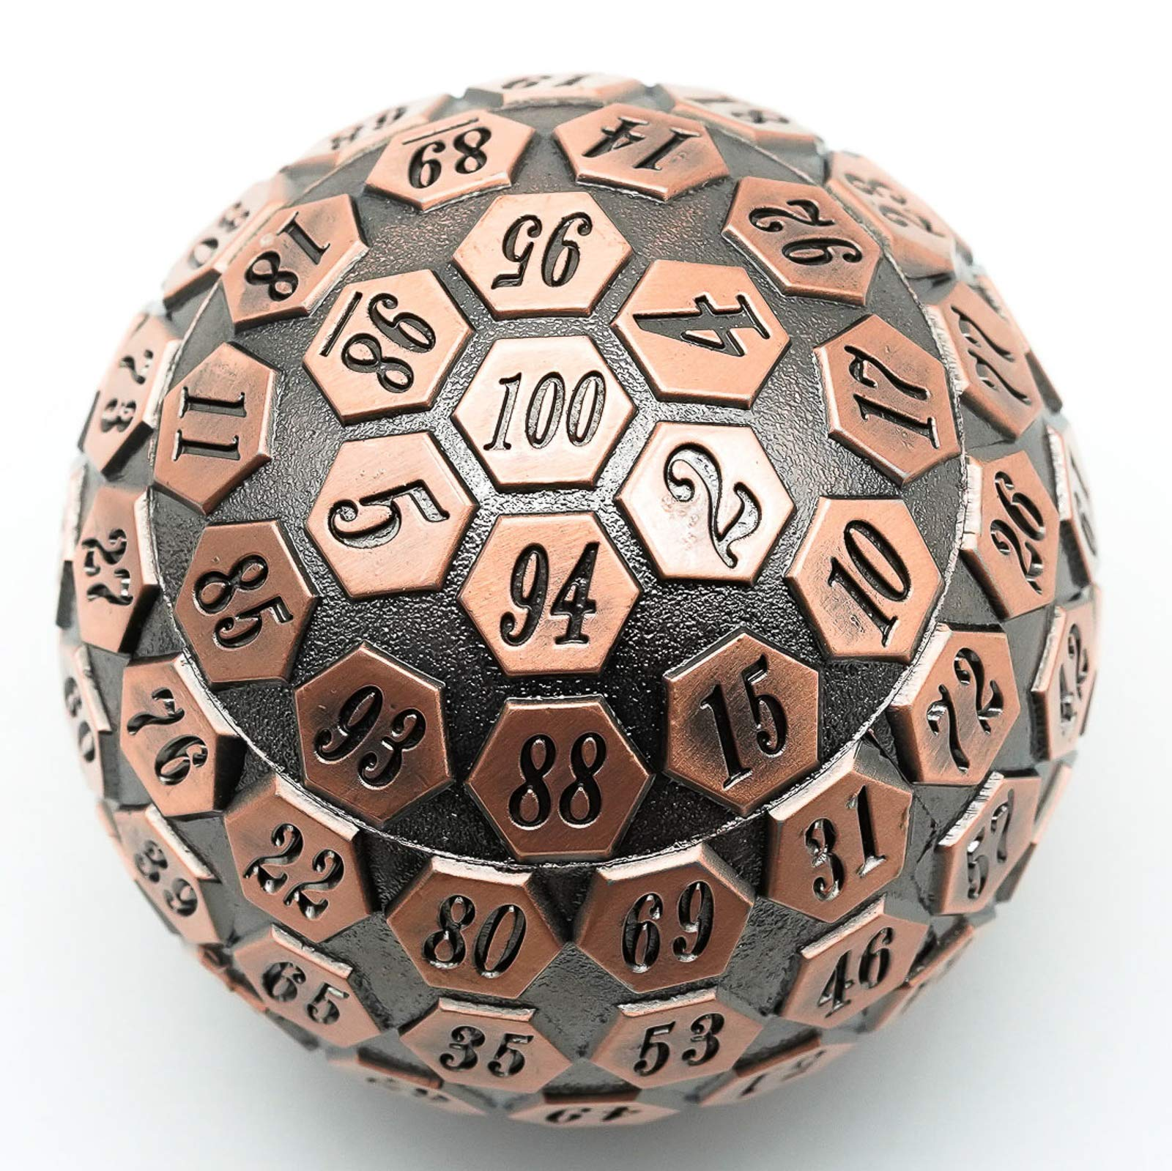
The Big Solution: Randomization
Randomized Controlled Trial = RCT
Does randomization = even dispersion?
NO!

Slide 29
Build an Understanding of Our System to Design Experiments
Using Causal Diagrams with a System to Design a simple Experiment
What is a Replicate Versus a Subsample?
Randomization
Replication
Closing Thoughts

Slide 30
Why Randomization?
Treatments are identical on average before the experiment
Each unit has the same probability of receiving a treatment
These break confounding paths

Slide 31

Why Not Equal Dispersion?
Depending on how its done, can induce dependency between treatments
Might tap sub-scale gradients
Patterns = Potential Problems!

Slide 32
Nonrandom Placement Could Create Selection Bias via Confounding
Substrate
Type = slate, granite, concrete
Gradient 2
Gradient 1
Subscale Features
Barnacles

Slide 33
Randomization And/Or Statistical Control with Blocking or Covariates
Substrate
Type = slate, granite, concrete
X
X
X
Gradient 2
Gradient 1
Subscale Features
X
X
X
Barnacles

Slide 34
What is the Problem Here? It’s Randomized! And Easier to Sample!

Slide 35
Bad Replicate Placement: Non-Independence of Plots – Violates SUTVA
If there is bleed-over from one plot to the next, you violate the principle of interference
Plots must be spatially or temporally separate
This goes double for plots with the same treatment!
Heats
Kimmel et al. 2021

Slide 36
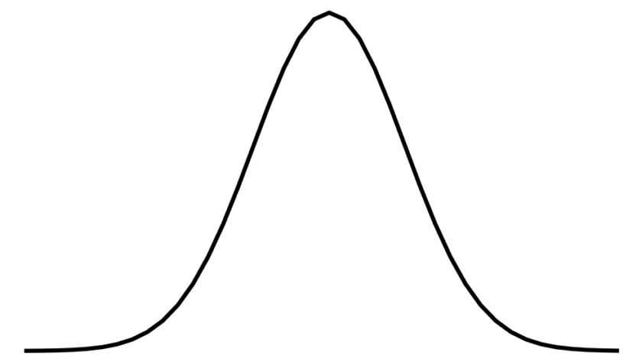
Solution: Randomization + Interspersion using Biology!
Effect Dispersion

Slide 37
Build an Understanding of Our System to Design Experiments
Using Causal Diagrams with a System to Design a simple Experiment
What is a Replicate Versus a Subsample?
Randomization
Replication
Closing Thoughts

Slide 38
How Many Replicates Do I Need?
Generally, p^(3/2) / n_{tot} should approach 0
Portnoy 1998
So, 3 means
p^(3/2) ~ 5
So, 5 / (3*n) should be close-ish to 0
Practically, 5-10

Slide 39
5-10 Replicates? That’s it?
Not so fast!
The noisier the system and smaller the effect, the more replicates you need for good precision

Slide 40
OK, How do I Determine How Sample Size Influences Precision?
SIMULATION!
Make a simulated data set with your design, fit a model, get SE of parameters or other indices
Rinse and repeat to see how often you fall in an acceptable range

Slide 41
Precision of Difference Between Two Means by Sample Size
dat <- tibble(n = rep(3:10, 100)) |>
rowwise() |>
#make sim data
mutate(internal_dat = tibble(trt = rep(c("A", "B"), n),
y = rep(c(1,4), n) +
rnorm(n*2, sd = s)
) |>list()) |>
ungroup() |>
# fit and evaluate
mutate(mod = map(internal_dat, ~lm(y ~ trt, data = .)),
em = map(mod, ~emmeans(., ~trt) |>
contrast(method = "pairwise") |>
tidy())) |>
unnest(em)
Notes:
library(tidyverse)
library(emmeans)
library(broom)
s <- 3
dat <- tibble(n = rep(3:10, 100)) |>
rowwise() |>
#make sim data
mutate(internal_dat = tibble(trt = rep(c("A", "B"), n),
y = rep(c(1,4), n)+rnorm(n*2, sd = s)
) |>list()) |>
ungroup() |>
# fit and evaluate
mutate(mod = map(internal_dat, ~lm(y ~ trt, data = .)),
em = map(mod, ~emmeans(., ~trt) |>
contrast(method = "pairwise") |>
tidy())) |>
unnest(em)
ggplot(dat,
aes(x = estimate, y = std.error,
color = n)) +
geom_point() +
scale_color_viridis_c()
ggplot(dat,
aes(x = n, y = std.error,
color = n)) +
geom_point() +
scale_color_viridis_c()

Slide 42
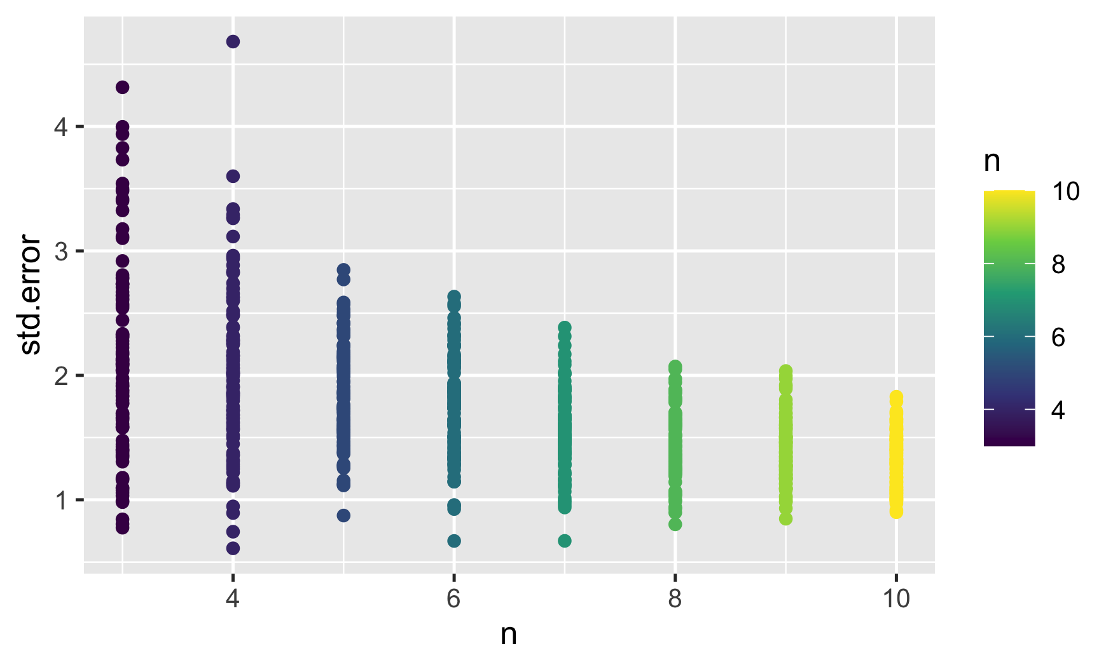
Precision of Difference Between Two Means by Sample Size
Notes:
library(tidyverse)
library(emmeans)
library(broom)
s <- 3
dat <- tibble(n = rep(3:10, 100)) |>
rowwise() |>
#make sim data
mutate(internal_dat = tibble(trt = rep(c("A", "B"), n),
y = rep(c(1,4), n)+rnorm(n*2, sd = s)
) |>list()) |>
ungroup() |>
# fit and evaluate
mutate(mod = map(internal_dat, ~lm(y ~ trt, data = .)),
em = map(mod, ~emmeans(., ~trt) |>
contrast(method = "pairwise") |>
tidy())) |>
unnest(em)
ggplot(dat,
aes(x = estimate, y = std.error,
color = n)) +
geom_point() +
scale_color_viridis_c()
ggplot(dat,
aes(x = n, y = std.error,
color = n)) +
geom_point() +
scale_color_viridis_c()

Slide 43
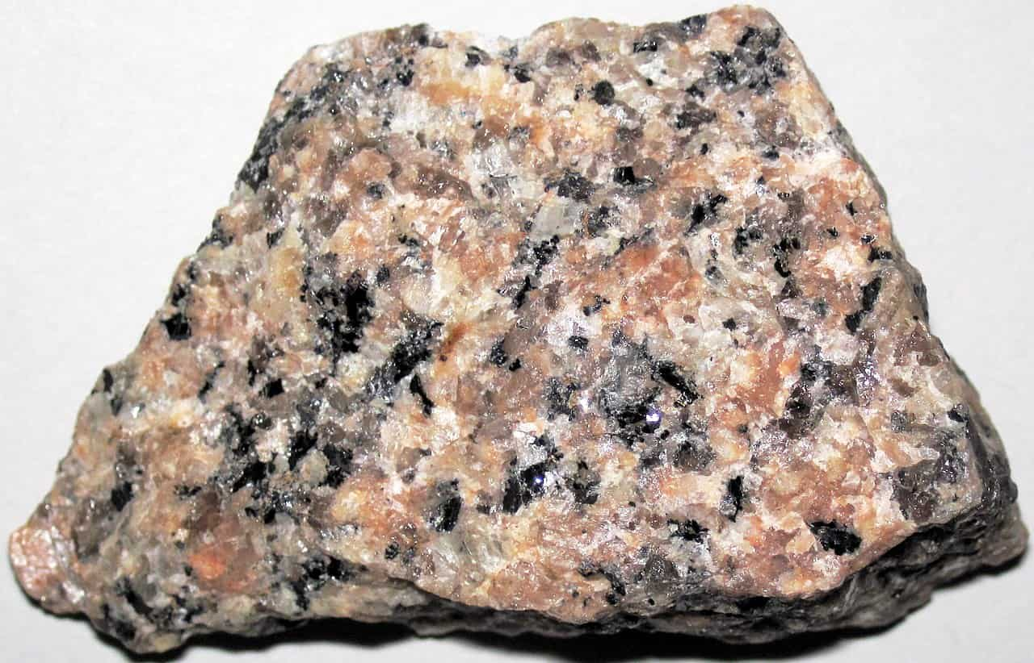
What About This Scenario?
Oops – Home Depot Only had 3 Granite tiles. So I got 2 more from Lowe’s. My n = 5, right?
NO – This is Multiple Versions of a Treatment
SUTVA Violation

Slide 44
Multiple Versions Muck Up Sample Sizes
Substrate
Type = slate, granite from Home Depot, granite from Lowe’s concrete
Barnacles

Slide 45
The Core Assumptions of Experimental Design
Excludability – Units respond to treatment itself and not other mechanisms generated by treatment assignment or implementation
No interference – The outcome of a unit depends solely on the treatment assigned and not adjacent treatments
No multiple versions of treatments – Each treatment is implemented the same way every time
No noncompliance – Each unit receives its assigned treatment
SUTVA
Stable Unit Treatment Value Assumption

Slide 46
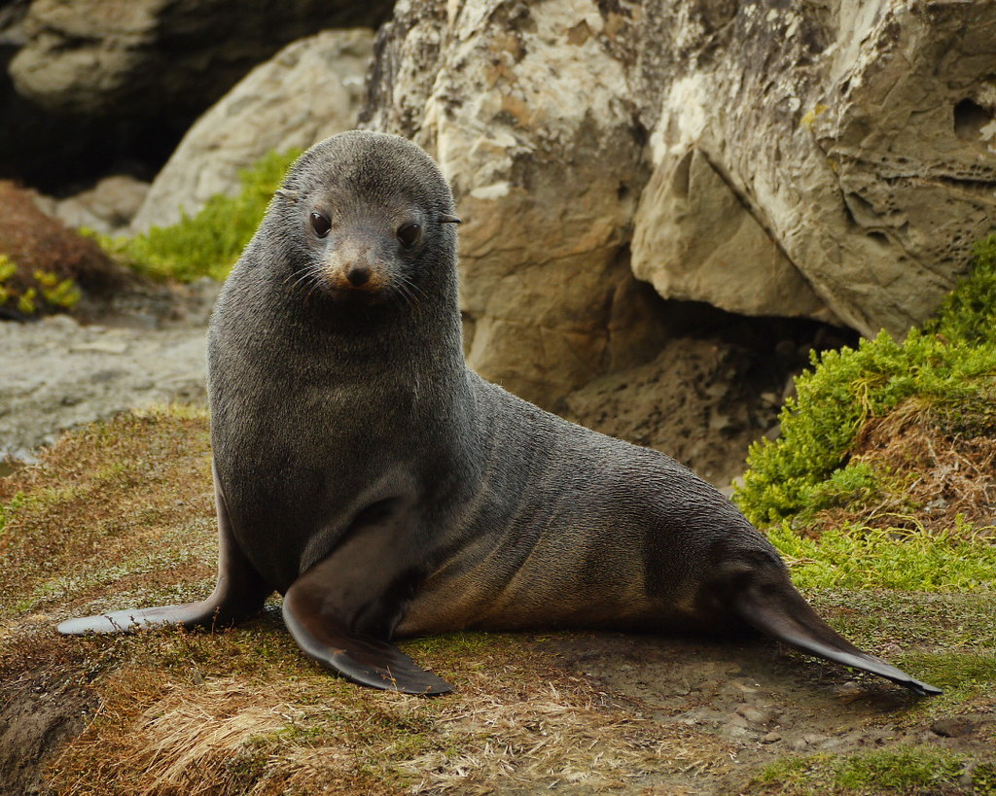
Noncompliance in Biological Sciences
This is more often used with human subjects who don’t engage in the treatment assigned
Granite Tile Under There

Slide 47
Build an Understanding of Our System to Design Experiments
Using Causal Diagrams with a System to Design a simple Experiment
What is a Replicate Versus a Subsample?
Randomization
Replication
Closing Thoughts

Slide 48
A Word on Continuous v. Categorical Designs
Substrate
Rugosity = 0-100
Regression-based designs can work like ANOVA-based designs
You can assign treatment levels evenly
You can assign discrete levels and add random noise
The causal model is *THIS SAME*, it’s the details of implementation and statistical modeling that are different
Barnacles

Slide 49
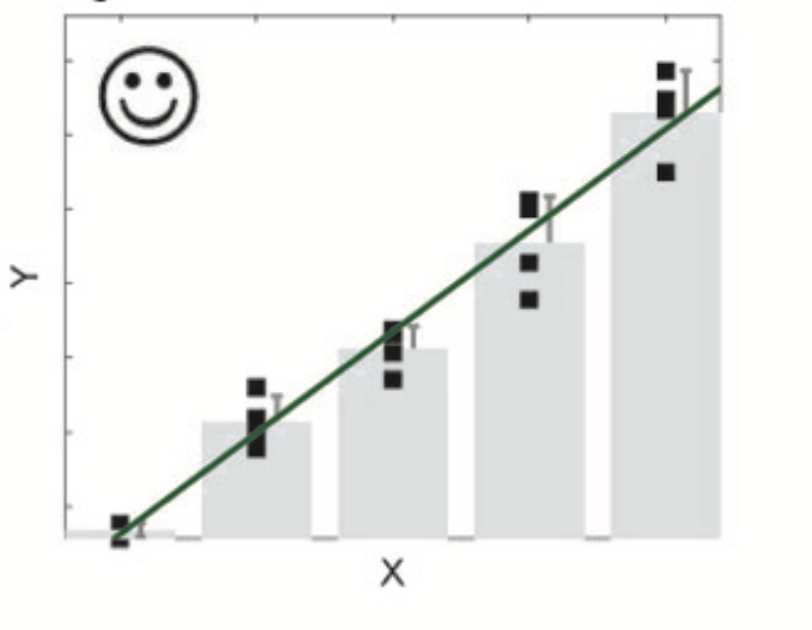
Estimate One Slope or Multiple Means?
Estimating a slope takes 1 parameter
Estimating 5 means takes 5 parameters
Higher precision for the slope
But – beware nonlinearities!
Cottingham et al. 2014

Slide 50
We Sever Everything Except Cause and Effect – Think of Holding Constant
Other Site Factors
x
Other Site Factors=0
Predation =
Constant
Predation
x
x
x
Substrate
Type
Barnacles
x
x
Within-Site Variability
Recruitment =
Constant
Recruitment

Slide 51
Ask Yourself if Your Design is Clean
Excludability – Units respond to treatment itself and not other mechanisms generated by treatment assignment or implementation
No interference – The outcome of a unit depends solely on the treatment assigned and not adjacent treatments
No multiple versions of treatments – Each treatment is implemented the same way every time
No noncompliance – Each unit receives its assigned treatment
SUTVA

Slide 52
Experiments are Powerful But Not the Only Way to Counterfactuals
POTENTIAL OUTCOMES
National Marine Sanctuaries
Bigelow.org
?

