Slide 1
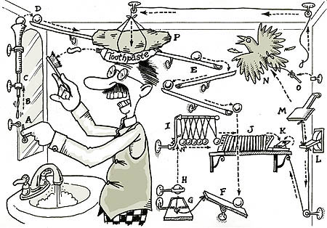
Causal Inference

Slide 2
Goals of Science and Links Between Them
Pattern
Recognition
Causal
Understanding
Prediction &
Forecasting
Mechanistic
Understanding
All are valid and useful in particular contexts – What are YOU seeking to do?

Slide 3
What is your question? Is it fundamentally causal? Or not?

Slide 4
Do You Need to be Doing Causal Inference?
No!
Not all studies will provide causal links between different variables of interest
If the study goal is predictive or descriptive rather than causal, this might not be needed
But…
We cannot hope to understand the world without developing an understanding of causal associations
Indeed
Understanding the clockwork machinery of the universe is an end goal of science – one which we can never achieve, but strive for!

Slide 5
Building an Understanding of Our System
Introduction to Causal Thinking and Potential Outcomes
Causal Diagrams
Using our Causal Diagrams:
Conditional Independence
Backdoors and Frontdoors
Counterfactual Thinking

Slide 6
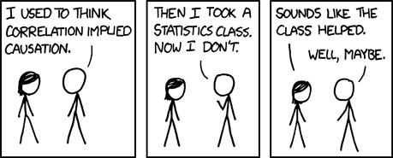
xkcd

Slide 7
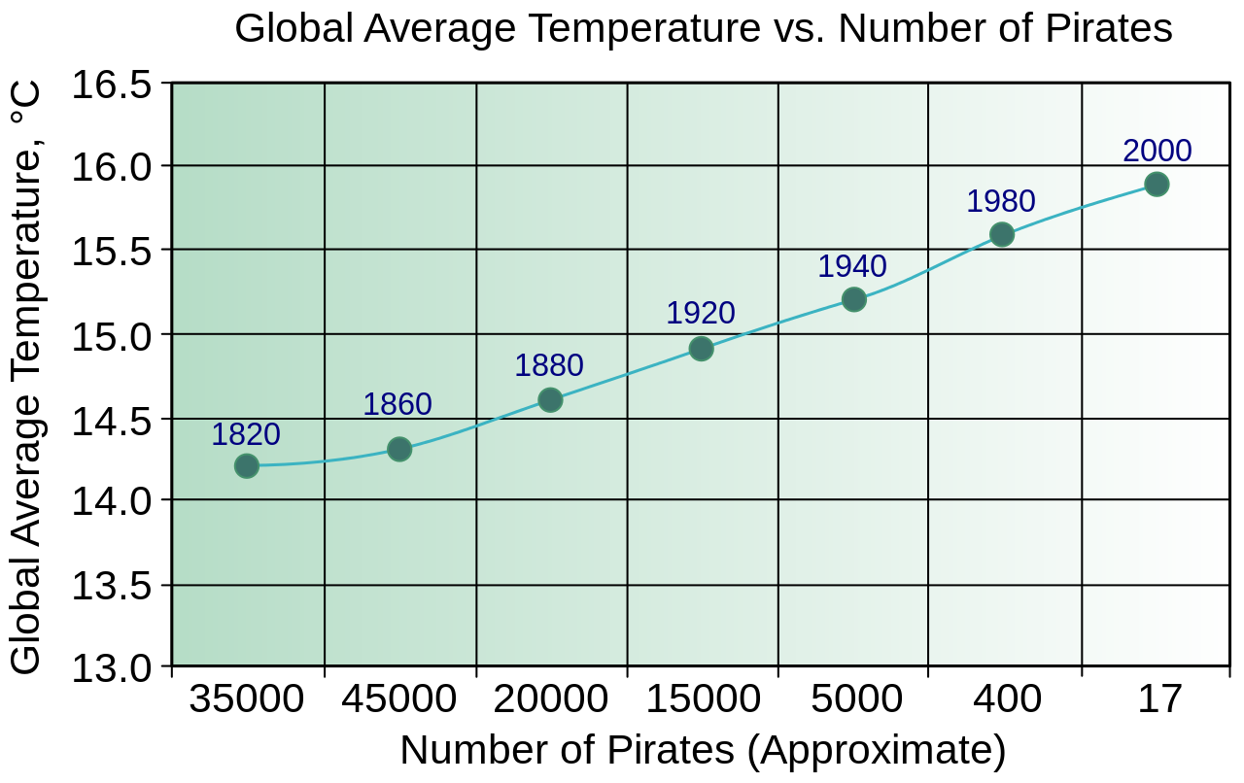
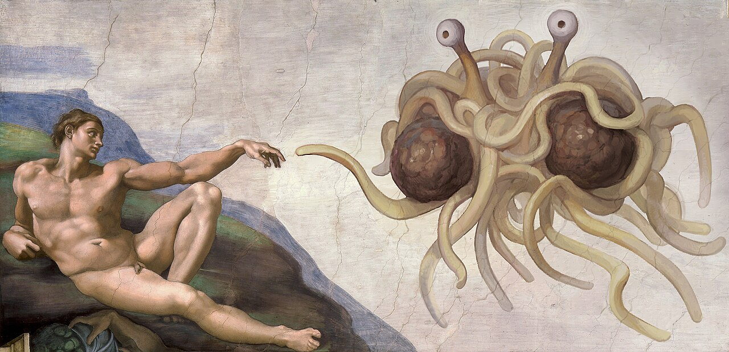
The Classic Example Used to Dissuade us from Causal Thinking
Church of the Flying Spaghetti Monster

Slide 8
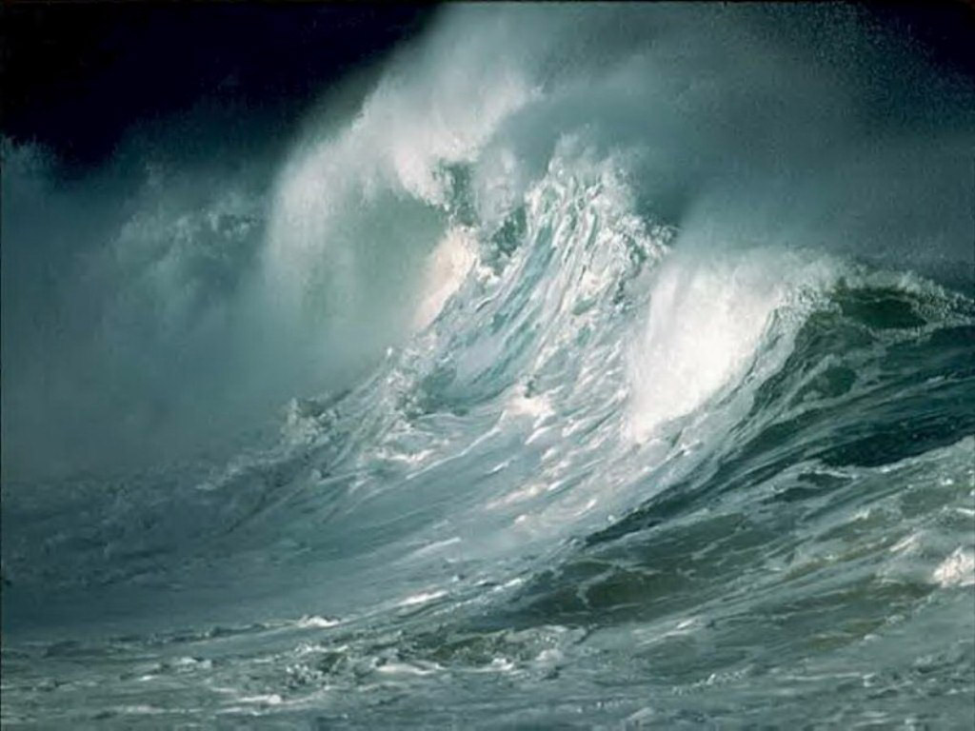

What is Causal Thinking?
Do waves drive biodiversity of invertebrates?
Treated
D_{i} = 1
POTENTIAL OUTCOMES
Y_{1i}
Unit
Y_{i}
Untreated
D_{i} =0
Y_{0i}

Slide 9
If we Only Observed D_{i} = 1, Y_{0i} is Counterfactual and vice-versa
Treated
D_{i} = 1
POTENTIAL OUTCOMES
Y_{1i}
Unit
Y_{i}
Untreated
D_{i} =0
Y_{0i}

Slide 10
What we Want to Know: The Potential Outcomes Framework
D_{i} = 1
Y_{1i}
Average Treatment Effect
ATE = E[Y_{1i} - Y_{0i}]?
D_{i} = 0
Y_{0i}
BUT – we CANNOT observe both Y_{1i} and Y_{0i}
Neyman-Rubin Framework, see Holland 1986 JSA

Slide 11
What We Hope For
Unit | Y | D = 0 | Y | D = 1 | Y1i – Y01 | D
A | 3 | 4 | 1 | 1
B | 6 | 7 | 1 | 1
C | 3 | 4 | 1 | 1
D | 2 | 3 | 1 | 1
E | 5 | 6 | 1 | 0
F | 1 | 2 | 1 | 0
G | 6 | 7 | 1 | 0
H | 9 | 10 | 1 | 0
ATE = E[Y_{1i} – Y_{0i}]
= E[Y_{1i}] – E[Y_{0i}]
= 1

Slide 12
What We Have
Unit | Y | D = 0 | Y | D = 1 |  | D
A |  | 4 |  | 1
B |  | 7 |  | 1
C |  | 4 |  | 1
D |  | 3 |  | 1
E | 5 |  |  | 0
F | 1 |  |  | 0
G | 6 |  |  | 0
H | 9 |  |  | 0
ATE = E[Y₁ – Y₀]
= E [Y₁] – E[Y₀]
= 4.5 – 5.25 = -0.75
WAIT, WHAT?!?!?!?!?!?!

Slide 13
Treatment Effects in a Partially Observed World
D_{i} = 1
Y_{1i}
Difference in means = ATE +
Selection Bias +
Treatment Heterogeneity Bias
D_{i} = 0
Y_{0i}

Slide 14
Selection Bias: Unequal Representation
Units from D = 1
Differences in units between treated and untreated that create bias
Can be that units are different or have different other external forces influencing them
We get around this with experimental or statistical design controls
Units from D = 0

Slide 15
Treatment Heterogeneity Bias
Units from D = 1
Applied Treatment
Units in different treatment groups responded in different ways
Can adjust for with experimental or statistical design control
Units from D = 0
If we Had Applied Treatment

Slide 16
What are Our Potential Enemies and Solutions for Potential Outcomes?
We must find ways to parcel out selection bias and treatment heterogeneity in experiments
We must find ways to adjust or control for selection bias and treatment heterogeneity in observations
We must imagine counterfactual outcomes
But HOW do we know what to adjust and control for?

Slide 17
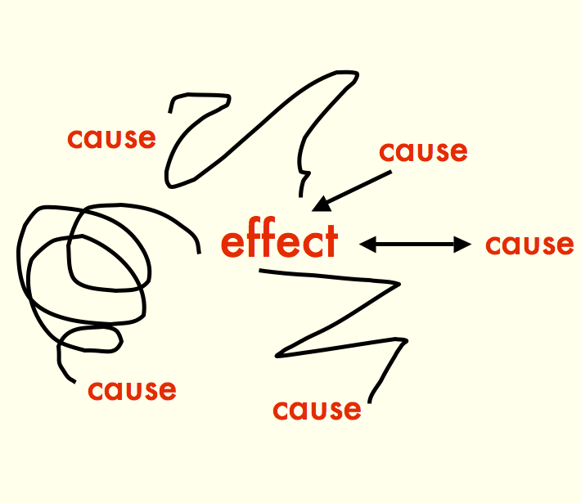

Slide 18
Building an Understanding of Our System
Introduction to Causal Thinking
Causal Diagrams
Using our Causal Diagrams:
Conditional Independence
Backdoors and Frontdoors
Counterfactual Thinking

Slide 19
The Core of Causal Inference – what you want to evaluate
Cause
Effect
In your research, what is your primary cause and effect of interest?

Slide 20
Directed Acyclic Graphs as a Means of Describing the World
AKA path diagram, AKA DAG

Slide 21
Directed Acyclic Graphs as a Means of Describing the World
Boxes represent OBSERVED variables

Slide 22
Directed Acyclic Graphs as a Means of Describing the World
Directed Arrows show flow of causality (information)

Slide 23
Exogenous Drivers of a System
Exogenous variable = ultimate independent variable, predictor, unexplained
x₁

Slide 24
Endogenous Variables are Inside of a System
Exogenous variable
Endogenous variable =
dependent variable,
response
x₁
y₂
y₁
Note: You might not be interested in an exogenous variable, or connection between pairs of variables, but you cannot design a study without understanding a system.

Slide 25
Mediators are Endogenous Variables that Can Also Be Predictors
Exogenous variable
Endogenous variable
x₁
y₂
y₁
Endogenous Mediator Variable =
Endogenous variable that drives other endogenous variables
Often we are interested in a mediator variable – but we cannot assess its importance without the exogenous variable

Slide 26
Direct Effects Have No Mediators
Direct Effect
x₁
y₂
y₁
This does not mean there are not other mediators between x1 and y2, but, those mediators are not influenced by anything else in the system.

Slide 27
Indirect Effects Flow Through a Mediators
Direct Effect
x₁
y₂
y₁
Indirect Effect
If we do not measure y1, we can only assess the TOTAL EFFECT of x1 on y2 – which might be 0, but doesn’t mean there is no causal link!

Slide 28
Unobserved Variables are Error or Things We Have Not Measured
Unobserved Latent
Variable
Everything else affecting y2
e₂
e₂
x₁
y₂
y₁
Unobserved Latent
Variable
Everything else affecting y1
Note: unless something wild is going on with error, we often don’t draw it.
e₁
e₁

Slide 29
There Can Be Connections Between Unobserved Variables
x₃
x₁
y₂
y₁
If we do not consider these, we *can* produce invalid inferences
x₂

Slide 30
You Can Have Multiple Unobserved Variables: Random v. Systematic Error
e₂
x₃
x₁
y₂
Knowing the structure of your system, what you have, and what you have not measured is key
y₁
e₁
x₂
x₄

Slide 31
Interaction Effects: Moderators
x₁
e₁
y₁
x₂
OR
x₁
x₁*x₂
e₁
y₁
x₂

Slide 32
You Can Have an Uncertain of Unanalyzed Correlation Between Variables
Unexplained correlation
x₁
y₁
x₂
e₁

Slide 33
Really This Represents a Correlation Between Unexplained Variances
d₁
δ₁
x₁
y₁
d₁
δ₂
x₂
e₁

Slide 34
Could be Due to a Shared Driver
d₁
δ₁
x₁
d₃
y₁
d₁
δ₂
x₂
e₁

Slide 35
Could Be Due to a Directed Relationship
d₁
δ₁
x₁
y₁
d₁
δ₂
x₂
e₁
If correlation is between exogenous variables, we don’t care. If endogenous, we need to consider *why* as it can affect modeling choices and experimental design.

Slide 36
Why All of this Worry About Structure of a Whole System?
x₁
y₁
y₂
Is it possible to assess the causal relationship between y1 and y2 if you do not know x1? What can you say about any measured relationship between y1 and y2 if x1 varies, but is unmeasured?

Slide 37
Draw Your System
Start with what is the variable you are ultimately interested in.
What influences that variable DIRECTLY?
What things influence those variables?
Note what you have/can measure and what you cannot.

Slide 38
Building an Understanding of Our System
Introduction to Causal Thinking
Anatomy of Causal Diagrams
Using our Causal Diagrams:
Conditional Independence
Backdoors and Frontdoors
Counterfactual Thinking

Slide 39
What Is It Good For?
We can test our intuition by examining things that do not connect
We cannot take apart our system without imagining what would happen if something changes.
We can begin to understand what we must grapple with to tease apart the Gordian knot of Simpson’s Paradox and confounders
x₁
y₁
y₂

Slide 40
So Let’s Draw a DAG: Where we Start
Waves
Invertebrates

Slide 41
But there are Mediators
Waves
Kelp
Algae
Invertebrates

Slide 42
So Waves are Conditionally Independent of Invertebrates
Waves
Kelp
Algae
Invertebrates

Slide 43
Conditional Independence: The Hard Causal Claim
y₁
x
y₃
y₂
These two relationships are declared to be non-existent
This is a hard causal claim
Is it real? How do we assess?

Slide 44
Quick Note: Nonlinearities
Conditional indepdence generally excludes non-linear components (interactions)
x₁
y₁
y₂
x₂
x₁ ⏊ y₂ | (y₁)
x₂ ⏊ y₂ | (y₁)
x₁ * x₂ ⏊ y₂ | (y₁)

Slide 45
What claims of conditional independence do *you* have involving your response of interest?
(and are they plausible?)

Slide 46
Conditional Independence (Directed Separation)
Concept from Graph Theory
Two nodes are d-separated if they are conditionally independent e.g., the effect of x on y₃ is zero conditioning on the influences of y₁ and y₂
y₁
x
y₃
y₂
x ⊥ y3 | y1, y2

Slide 47
What does Conditional Independence Mean Here?
Wave -> Invert Analyses CANNOT include Kelp and Algae
It would only show conditional independence
Sampling must cover a wide range of kelp and algae
Otherwise, we would miss the wave -> invert relationship
Waves
Kelp
Algae
Invertebrates
Waves ⊥ Inverts | Kelp, Algae

Slide 48
What does Conditional Independence Mean Here?
If you tried to look at the relationship between kelp and algae, conditioned on invertebrates, you’d induce conditional dependence
Any analysis of kelp on algae must include waves as a conditioning variable
Otherwise, waves would be a confounding variable
Waves
Kelp
Algae
Invertebrates
Kelp ⊥ Algae | Waves

Slide 49
Building an Understanding of Our System
Introduction to Causal Thinking
Anatomy of Causal Diagrams
Using our Causal Diagrams:
Conditional Independence
Confounding, Backdoors, and Frontdoors
Counterfactual Thinking

Slide 50
Confounding Variables
Any analysis of kelp on algae must include waves as a conditioning variable
Otherwise, waves would be a confounding variable
Waves
Kelp
Algae
Invertebrates
Kelp ⊥ Algae | Waves

Slide 51
What is a Confounder?
x₁
y₁
y₂
X1 is a confounder - it influences both y1 and y2
- information flows from y1 to y2 via x1

Slide 52
The Back-Door Effect sensu Judea Pearl
x₁
y₁
y₂
X1 is a confounder - We need to find a way to shut the back door!!!

Slide 53
Open Back Doors and Omitted Variable Bias
x₁
y₁
y₂
If we omit x1 from a model, our results will be BIASED

Slide 54
Where does OVB Come From in a Model?
x₁
e
y₁
y₂
We have violated the assumption of endogeneity
y1 is no longer exogenous to the system
We have induced a correlation between the random term and y1

Slide 55
Omitted Variable Bias and Causal Identification
If we KNOWINGLY omit x1, models linking y1 and y2 are not
causally
identified
x₁
y₁
y₂
Notes:
This is where correlation does not equal causation – so, how can we fix this (knowing that even experiments are not the answer)

Slide 56
Causal Identification
Your model need not be causally identified – but be specific that you are only talking about associations/predictions
You can only make counterfactual statements if you are confident in causal identification
x₁
y₁
y₂
Notes:
This is where correlation does not equal causation – so, how can we fix this (knowing that even experiments are not the answer)

Slide 57
Causal Identification
Causal identification does not require knowing ULTIMATE cause
Nor does it require knowing exact mechanisms within a causal pathway
x₁
y₁
y₂
Notes:
This is where correlation does not equal causation – so, how can we fix this (knowing that even experiments are not the answer)

Slide 58
How do we solve this problem?
This
relationship
is
not
causally
identified
x₁
y₁
y₂
Notes:
This is where correlation does not equal causation – so, how can we fix this (knowing that even experiments are not the answer)

Slide 59
Solution 1: Fulfill the Backdoor Criteria
Include variables that block the pathway from cause to effect
Variables must block all backdoor paths from cause to effect
AND variables must not be descendants of the cause
Exogenous
Cause
Cause
Effect
Regression Model
Exogenous
Cause
Effect
Cause

Slide 60
Proximate Backdoors
Exogenous Cause
Proximate Cause
Cause
Effect
Often we only have proximate variables in a backdoor path. Controlling for just them is sufficient.
Notes:
This works for a wide variety of different back-door scenarios
SOLICIT EXAMPLES

Slide 61
Proximate Backdoors and Regression
Regression Model
Proximate
Cause
Exogenous
Cause
Effect
Cause
Notes:
This works for a wide variety of different back-door scenarios
SOLICIT EXAMPLES

Slide 62
What Variables Block the Back Door?
X1
Y3
Y2
Y1
Y4
There are two ways to build a multiple regression with closed back doors to determine if Y1 -> Y4. What are they?
Notes:
This works for a wide variety of different back-door scenarios
SOLICIT EXAMPLES

Slide 63
Sometimes We Cannot Shut the Backdoor
Billion Dollar
Environmental Covariates
Cause
Effect

Slide 64
Or, we suspect, but don’t know, of backdoors
Who Knows
??
??
Independent
Mediator
Cause
Effect

Slide 65
Solution 2: The Front-Door Criterion
A variable satisfies the front-door criteria when it blocks all paths from X to Y.
In practice, you need a causally identified mediating variable unaffected by anything else.
Thus, the influence of the cause is felt by the effect solely through its mediator.
Who Knows
??
??
Cause
Independent
Mediator
Effect

Slide 66
Example: Smoking and Cancer
Other factors (genetic, stress, environment)
Tar in
Lungs
Smoking
Cancer
See Pearl’s books and papers for the do calculus of this
Notes:
Do you have any front-doors in your system?

Slide 67
Example: Sharing a Rideshare
Cheap People make Cheap Choices
Chose a Shared
Lyft/Uber
Get a Shared
Lyft/Uber
Tip
Amount
Bellemere et al. 2022 The Paper of How: Estimating Treatment Effects Using the Front-Door Criterion∗
Notes:
Do you have any front-doors in your system?

Slide 68
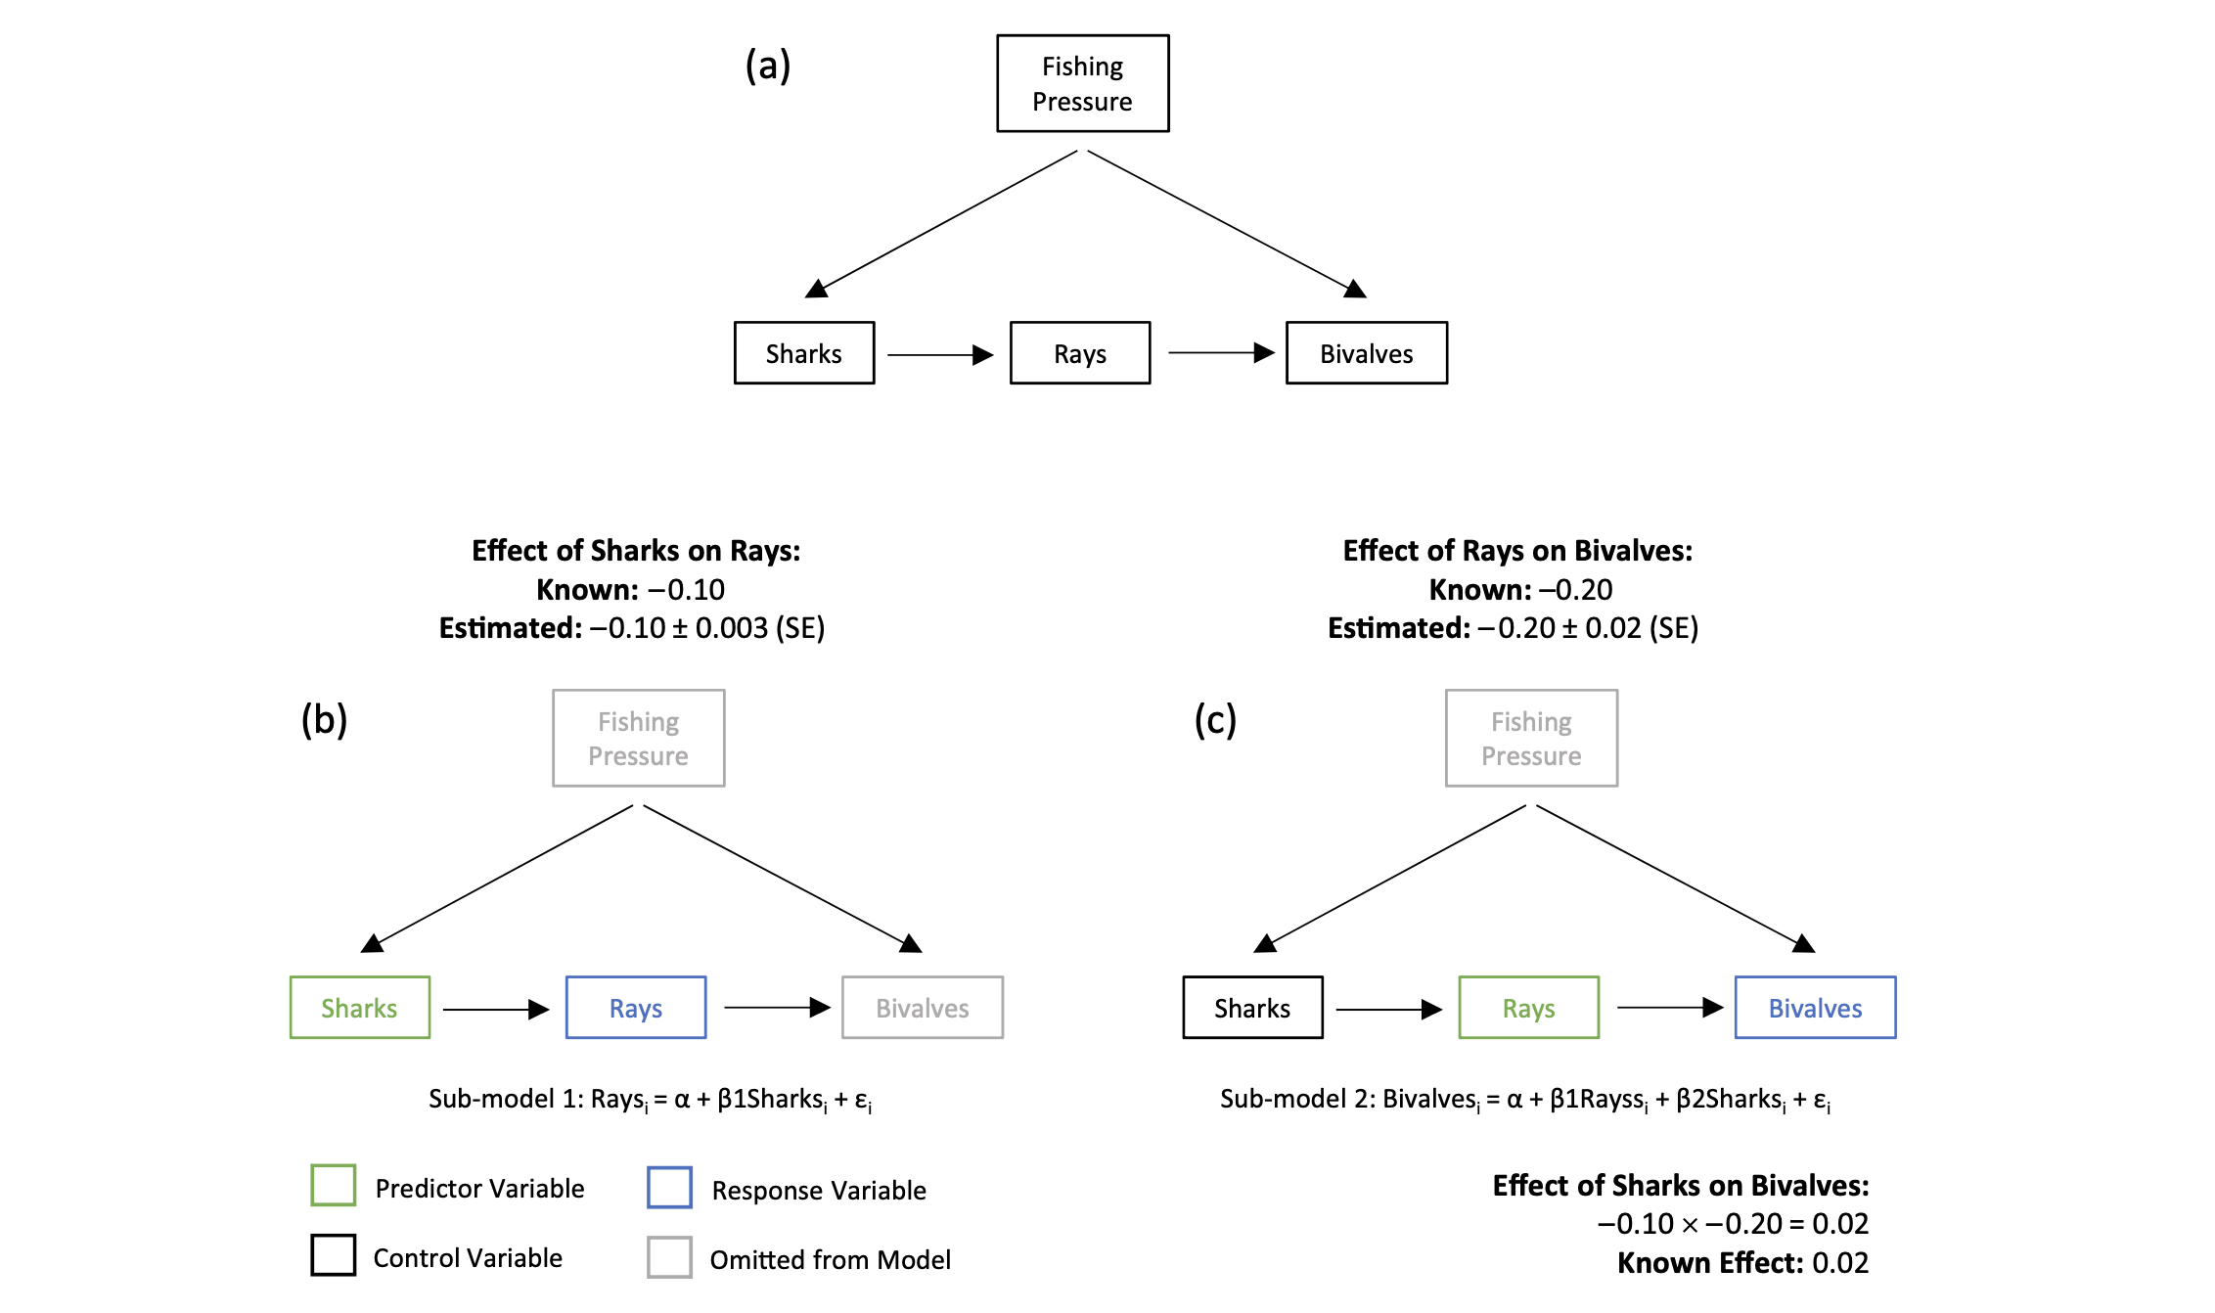
Example: Sharks and Bivalves
Arif and MacNeil 2022

Slide 69
Building an Understanding of Our System
Introduction to Causal Thinking
Anatomy of Causal Diagrams
Using our Causal Diagrams:
Conditional Independence
Confounding, Backdoors, and Frontdoors
Counterfactual Thinking

Slide 70
Counterfactual Thinking: What would Happen If….
The Present
Waves
Near Future
Kelp
Algae
Invertebrates
Far Future

Slide 71
Seemingly Simple, But, At the Core of Understanding Causality
We want to estimate an Average CAUSAL Effect of waves on invertebrates
We observe Inverts With Waves – Inverts Without Waves
This is a POPULATION phenomenon – the Average Treatment Effect
From our measurements, we only observe what happens with waves or no waves in the sample we have
What would have happened if those same replicates had opposite the “treatments”? Would our observation hold?
Waves
Kelp
Algae
Invertebrates

Slide 72
DAGs Let us See If We Can Estimate Valid ATEs and Make Counterfactual Predictions
Difference in means = ATE +
Selection Bias +
Treatment Heterogeneity Bias
Waves
Kelp
Algae
Do confounders lead to selection bias?
Have we controlled for selection bias in our sample or experiment?
Are “treatments” uniform? Or being experienced in the same way?
Invertebrates

Slide 73
Using DAGs to Get ATEs for Inference Requires Methods to Remove Bias
Difference in means = ATE +
Selection Bias +
Treatment Heterogeneity Bias
Our job is to remove bias so Difference in Means = ATE
Experiments let us remove selection and heterogeneity bias by removing drivers of bias
Observational studies let us remove bias via carefully constructed models based on DAGS
We can even include interactions!
Waves
Kelp
Algae
Invertebrates

Slide 74
DAGS + Counterfactuals = Clear Inference
With a DAG, we can see potential sources of bias
We can use counterfactual thinking here to understand how changing waves should cascade through the system
In practice, we can see what variables might obscure our counterfactual inferences
Waves
Kelp
Algae
Invertebrates

Slide 75
What do you need to control for to have valid counterfactual inference?

Slide 76
Boxes and Arrows, Oh My!
Causal Diagrams let you be specific about cause and effect in a system
We can incorporate many aspects of our knowledge into Causal Diagrams
Causal Diagrams illuminate potential confounders to watch out for via Back-Door effects
Causal diagrams let us design effective experiments and observational studies

