Slide 1
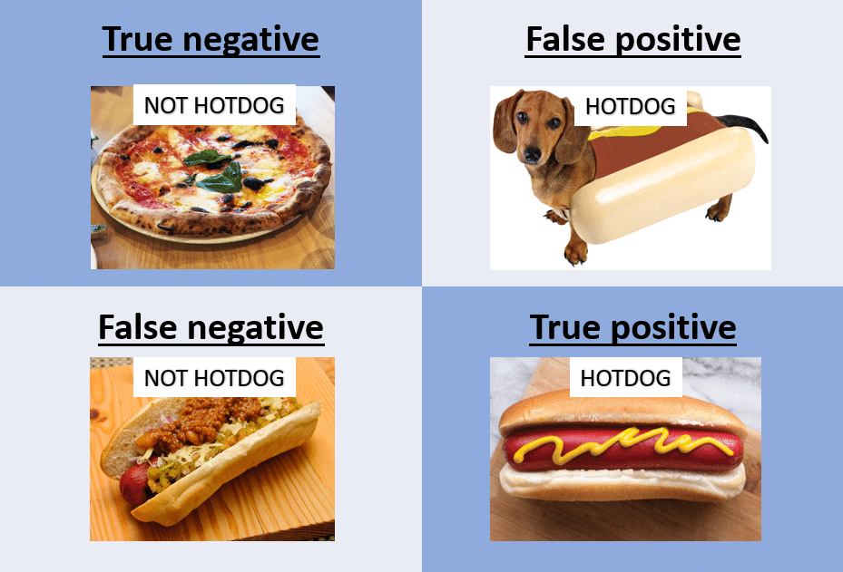
p > ⍶ – Not a Hotdog
p ≤ ⍶ – It is a Hotdog
No, It is Not a Hotdog
Type I Error
Yes, It Is a Hotdog
Type II Error

Slide 2
p > ⍶ – Not a Hotdog
p ≤ ⍶ – It is a Hotdog
No, It is Not a Hotdog
Yes, It Is a Hotdog

Slide 3
p > ⍶ – Not a Hotdog
p ≤ ⍶ – It is a Hotdog
No, It is Not a Hotdog
Yes, It Is a Hotdog

Slide 4
p > ⍶ – Not a Hotdog
p ≤ ⍶ – It is a Hotdog
No, It is Not a Hotdog
Type I Error
Yes, It Is a Hotdog
Type II Error

Slide 5
p > ⍶ – Not a Hotdog
p ≤ ⍶ – It is a Hotdog
No, It is Not a Hotdog
Type I Error
Yes, It Is a Hotdog
Type II Error

Slide 6
p > ⍶ – Not a Hotdog
p ≤ ⍶ – It is a Hotdog
No, It is Not a Hotdog
Type I Error
Yes, It Is a Hotdog
Type II Error

Slide 7
p > ⍶ – Not a Hotdog
p ≤ ⍶ – Not a Hotdog
No, It is Not a Hotdog
Type I Error
Yes, It Is a Hotdog
Type II Error

Slide 8
p > ⍶ – Not a Hotdog
p ≤ ⍶ – Not a Hotdog
No, It is Not a Hotdog
Type I Error
Yes, It Is a Hotdog
Type II Error

