Slide 1
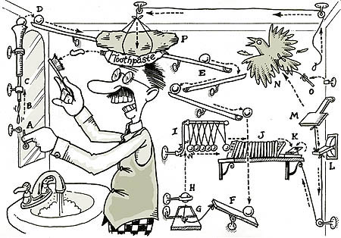
Causal Diagrams and Inference

Slide 2
Goals of Science
Pattern
Recognition
Mechanistic
Understanding
Prediction
All are valid and useful in particular contexts – What are YOU seeking to do?

Slide 3
Building an Understanding of Our System
Introduction to Causal Thinking
Anatomy of Causal Diagrams
Using our Causal Diagrams:
Counterfactual Thinking
Conditional Independence
Backdoors and Frontdoors

Slide 4

Pearl’s Ladder of Causality
3. Counterfactual – Can imagine what would happen under unobserved conditions
- Requires model of a system
- Requires identification of causality
Prediction
2. Intervention – Understand what happens you do something
- Experiments
- Provides evidence of causal link
Mechanistic
Understanding
1. Observation – Cause is associated with effect
- Correlation
- Can only predict within the range of data
- Can even be predictive
Pattern
Recognition
Pearl and Mackenzie 2018

Slide 5
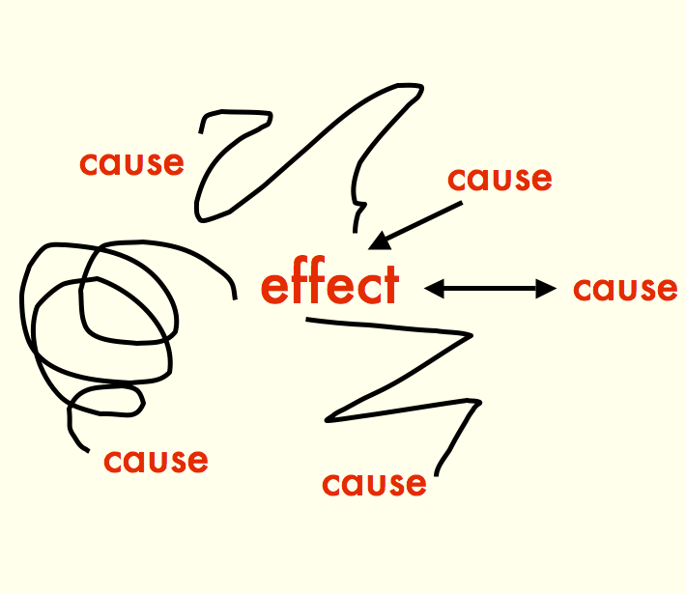

Slide 6
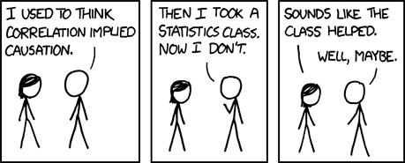
xkcd

Slide 7
Do You Need to be Doing Causal Inference?
No!
Not all studies will provide causal links between different variables of interest
If the study goal is predictive or descriptive rather than causal, this might not be needed
But…
We cannot hope to understand the world without developing an understanding of causal associations
Indeed
Understanding the clockwork machinery of the universe is an end goal of science – one which we can never achieve, but strive for!

Slide 8
What is your question? Is it fundamentally causal? Or not?

Slide 9
Building an Understanding of Our System
Introduction to Causal Thinking
Anatomy of Causal Diagrams
Using our Causal Diagrams:
Counterfactual Thinking
Conditional Independence
Backdoors and Frontdoors

Slide 10
The Core of Causal Inference – what you want to evaluate
Cause
Effect
In your research, what is your primary cause and effect of interest?

Slide 11
Directed Acyclic Graphs as a Means of Describing the World
AKA path diagram, AKA DAG

Slide 12
Directed Acyclic Graphs as a Means of Describing the World
Boxes represent OBSERVED variables

Slide 13
Directed Acyclic Graphs as a Means of Describing the World
Directed Arrows show flow of causality (information)

Slide 14
Exogenous Drivers of a System
Exogenous variable = ultimate independent variable, predictor, unexplained
x₁

Slide 15
Endogenous Variables are Inside of a System
Exogenous variable
Endogenous variable =
dependent variable,
response
x₁
y₂
y₁
Note: You might not be interested in an exogenous variable, or connection between pairs of variables, but you cannot design a study without understanding a system.

Slide 16
Mediators are Endogenous Variables that Can Also Be Predictors
Exogenous variable
Endogenous variable
x₁
y₂
y₁
Endogenous Mediator Variable =
Endogenous variable that drives other endogenous variables
Often we are interested in a mediator variable – but we cannot assess its importance without the exogenous variable

Slide 17
Direct Effects Have No Mediators
Direct Effect
x₁
y₂
y₁
This does not mean there are not other mediators between x1 and y2, but, those mediators are not influenced by anything else in the system.

Slide 18
Indirect Effects Flow Through a Mediators
Direct Effect
x₁
y₂
y₁
Indirect Effect
If we do not measure y1, we can only assess the TOTAL EFFECT of x1 on y2 – which might be 0, but doesn’t mean there is no causal link!

Slide 19
Unobserved Variables are Error or Things We Have Not Measured
Unobserved Latent
Variable
Everything else affecting y2
e₂
e₂
x₁
y₂
y₁
Unobserved Latent
Variable
Everything else affecting y1
Note: unless something wild is going on with error, we often don’t draw it.
e₁
e₁

Slide 20
There Can Be Connections Between Unobserved Variables
x₃
x₁
y₂
y₁
If we do not consider these, we *can* produce invalid inferences
x₂

Slide 21
You Can Have Multiple Unobserved Variables
e₂
x₃
x₁
y₂
Knowing the structure of your system, what you have, and what you have not measured is key
y₁
e₁
x₂
x₄

Slide 22
Interaction Effects: Moderators
x₁
e₁
y₁
x₂
OR
x₁
x₁*x₂
e₁
y₁
x₂

Slide 23
You Can Have an Uncertain of Unanalyzed Correlation Between Variables
Unexplained correlation
x₁
y₁
x₂
e₁

Slide 24
Really This Represents a Correlation Between Unexplained Variances
d₁
δ₁
x₁
y₁
d₁
δ₂
x₂
e₁

Slide 25
Could be Due to a Shared Driver
d₁
δ₁
x₁
d₃
y₁
d₁
δ₂
x₂
e₁

Slide 26
Could Be Due to a Directed Relationship
d₁
δ₁
x₁
y₁
d₁
δ₂
x₂
e₁
If correlation is between exogenous variables, we don’t care. If endogenous, we need to consider *why* as it can affect modeling choices and experimental design.

Slide 27
Why All of this Worry About Structure of a Whole System?
x₁
y₁
y₂
Is it possible to assess the causal relationship between y1 and y2 if you do not know x1? What can you say about any measured relationship between y1 and y2 if x1 varies, but is unmeasured?

Slide 28
Draw Your System
Start with what is the variable you are ultimately interested in.
What influences that variable DIRECTLY?
What things influence those variables?
Note what you have/can measure and what you cannot.

Slide 29
Building an Understanding of Our System
Introduction to Causal Thinking
Anatomy of Causal Diagrams
Using our Causal Diagrams:
Conditional Independence
Counterfactual Thinking
Backdoors and Frontdoors

Slide 30
What Is It Good For?
We can test our intuition by examining things that do not connect
We cannot take apart our system without imagining what would happen if something changes.
We can begin to understand what we must grapple with to tease the Gordian knot of Simpson’s Paradox and confounders
x₁
y₁
y₂

Slide 31
Conditional Independence: The Hard Causal Claim
y₁
x
y₃
y₂
These two relationships are declared to be non-existent
This is a hard causal claim
Is it real? How do we assess?

Slide 32
Conditional Independence (Directed Separation)
Concept from Graph Theory
Two nodes are d-separated if they are conditionally independent e.g., the effect of x on y₃ is zero conditioning on the influences of y₁ and y₂
y₁
x
y₃
y₂
x ⊥ y3 | y1, y2

Slide 33
Directed Separation: Independence Claims
The d-separation criterion for any pair of variables involves:
Controlling for common ancestors that could generate correlations between the pair
Controlling for causal connections through multi-link directed pathways via parents
Not controlling for common descendent variables.

Slide 34
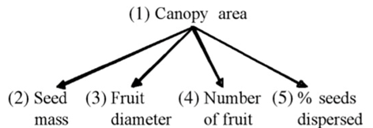
What are the Conditional Independence Claims Here?
mass ⏊ dia | (canopy)
mass ⏊ # | (canopy)
mass ⏊ %| (canopy)
dia ⏊ # | (canopy)
dia ⏊ % | (canopy)
% ⏊ # | (canopy)
From Shipley

Slide 35
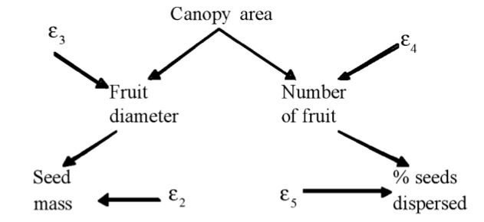
What are the Conditional Independence Claims Here?
dia ⏊ # | (canopy)
dia ⏊ % | (canopy, #)
canopy⏊ mass | (dia)
mass ⏊ #| (dia, canopy)
mass ⏊ % | (dia, #)
canopy ⏊ % | (#)
From Shipley

Slide 36
What are the Conditional Independence Claims Here?
pesticide
Pesticide ⏊ epiphytes (macroalgae, eelgrass, caprellids, gammarids)
Caprellids ⏊ gammarids (macroalage, eelgrass, pesticide)
ε
ε
Caprellids
Gammarids
macroalgae
Epiphytes
eelgrass
ε

Slide 37
Quick Note: Nonlinearities
Basis set generally excludes non-linear components (interactions)
x₁
y₁
y₂
x₂
x₁ ⏊ y₂ | (y₁)
x₂ ⏊ y₂ | (y₁)
x₁ * x₂ ⏊ y₂ | (y₁)

Slide 38
What claims of conditional independence do *you* have involving your response of interest?
(and are they plausible?)

Slide 39
Building an Understanding of Our System
Introduction to Causal Thinking
Anatomy of Causal Diagrams
Using our Causal Diagrams:
Conditional Independence
Counterfactual Thinking
Backdoors and Frontdoors

Slide 40

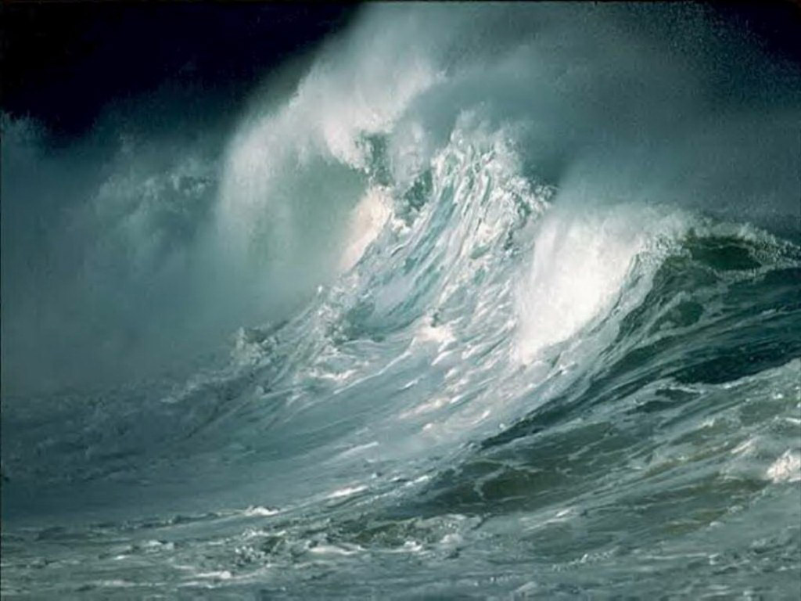
Counterfactual Thinking: What would Happen If….
The Present
Waves
Near Future
Kelp
Algae
Invertebrates
Far Future

Slide 41
Seemingly Simple, But, At the Core of Understanding Causality
We want to estimate an Average CAUSAL Effect of waves on invertebrates
We observe Inverts With Waves – Inverts Without Waves
This is a POPULATION phenomenon – the Average Treatment Effect
From our measurements, we only observe what happens with waves or no waves in the sample we have
What would have happened if those same replicates had opposite the “treatments”? Would our observation hold?
Waves
Kelp
Algae
Invertebrates

Slide 42
Average Treatment Effects Are More than Observed Differences
ATE = Observation with treatment –
Observation without treatment +
What would have happened to treatment plots with no treatment –
What would have happened to plots without a treatment if they had received one
This latter term is known as selection bias
This is the Potential Outcomes Framework
Waves
Kelp
Algae
Invertebrates

Slide 43
Average Treatment Effects Are More than Observed Differences
ATE = Average Causal Effect + Selection Bias
Our job is to remove selection bias
Experiments let us remove selection bias by removing drivers of bias
Observational studies let us remove selection bias via carefully constructed models based on DAGS
Waves
Kelp
Algae
Invertebrates

Slide 44
DAGS + Counterfactuals = Clear Inference
With a DAG, we can see that there are no external sources of selection bias
We can use counterfactual thinking here to understand how changing waves should cascade through the system
In practice, we can see what variables might obscure our counterfactual inferences
Waves
Kelp
Algae
Invertebrates

Slide 45
What do you need to control for to have valid counterfactual inference?

Slide 46
Building an Understanding of Our System
Introduction to Causal Thinking
Anatomy of Causal Diagrams
Using our Causal Diagrams:
Conditional Independence
Counterfactual Thinking
Backdoors and Frontdoors

Slide 47
The Back-Door Effect sensu Judea Pearl
x₁
y₁
y₂
X1 is a confounder - We need to find a way to shut the back door!!!

Slide 48
Open Back Doors and Omitted Variable Bias
x₁
y₁
y₂
If we omit x1 from a model, our results will be BIASED

Slide 49
Omitted Variable Bias and Causal Identification
If we KNOWINGLY omit x1, models linking y1 and y2 are not
causally
identified
x₁
y₁
y₂
Notes:
This is where correlation does not equal causation – so, how can we fix this (knowing that even experiments are not the answer)

Slide 50
Causal Identification
Your model need not be causally identified – but be specific that you are only talking about associations/predictions
You can only make counterfactual statements if you are confident in causal identification
x₁
y₁
y₂
Notes:
This is where correlation does not equal causation – so, how can we fix this (knowing that even experiments are not the answer)

Slide 51
Causal Identification
Causal identification does not require knowing ULTIMATE cause
Nor does it require knowing exact mechanisms within a causal pathway
x₁
y₁
y₂
Notes:
This is where correlation does not equal causation – so, how can we fix this (knowing that even experiments are not the answer)

Slide 52
How do we solve this problem?
This
relationship
is
not
causally
identified
x₁
y₁
y₂
Notes:
This is where correlation does not equal causation – so, how can we fix this (knowing that even experiments are not the answer)

Slide 53
Solution 1: Fulfill the Backdoor Criteria
Include variables that block the pathway from cause to effect
Variables must block all backdoor paths from cause to effect
AND variables must not be descendants of the cause
Exogenous
Cause
Cause
Effect
Regression Model
Exogenous
Cause
Effect
Cause

Slide 54
Proximate Backdoors
Exogenous Cause
Proximate Cause
Cause
Effect
Often we only have proximate variables in a backdoor path. Controlling for just them is sufficient.
Notes:
This works for a wide variety of different back-door scenarios
SOLICIT EXAMPLES

Slide 55
Proximate Backdoors and Regression
Regression Model
Proximate
Cause
Exogenous
Cause
Effect
Cause
Notes:
This works for a wide variety of different back-door scenarios
SOLICIT EXAMPLES

Slide 56
What Variables Block the Back Door?
X1
Y3
Y2
Y1
Y4
There are two ways to build a multiple regression with closed back doors to determine if Y1 -> Y4. What are they?
Notes:
This works for a wide variety of different back-door scenarios
SOLICIT EXAMPLES

Slide 57
Sometimes We Cannot Shut the Backdoor
Billion Dollar
Environmental Covariates
Cause
Effect

Slide 58
Or, we suspect, but don’t know, of backdoors
Who Knows
??
??
Independent
Mediator
Cause
Effect

Slide 59
Solution 2: The Front-Door Criterion
A variable satisfies the front-door criteria when it blocks all paths from X to Y.
In practice, you need a causally identified mediating variable unaffected by anything else.
Thus, the influence of the cause is felt by the effect solely through its mediator.
Who Knows
??
??
Cause
Independent
Mediator
Effect

Slide 60
Example: Smoking and Cancer
Other factors (genetic, stress, environment)
Tar in
Lungs
Smoking
Cancer
See Pearl’s books and papers for the do calculus of this
Notes:
Do you have any front-doors in your system?

Slide 61
Boxes and Arrows, Oh My!
Causal Diagrams let you be specific about cause and effect in a system
We can incorporate many aspects of our knowledge into Causal Diagrams
Causal Diagrams illuminate potential confounders to watch out for via Back-Door effects

