Slide 1

Quantitative growth analysis: Theoretical Background
The BioLabSim.nrw consortium

Slide 2
Requirements
Biology:
Yield biomass: gDW/gGlc
Computer Science:
Python: numpy, pandas, scikitlearn
Python for Data Science https://jupyter.rwth-aachen.de/hub/spawn?profile=p4ds
Excel: Cell functions, optimization

Slide 3
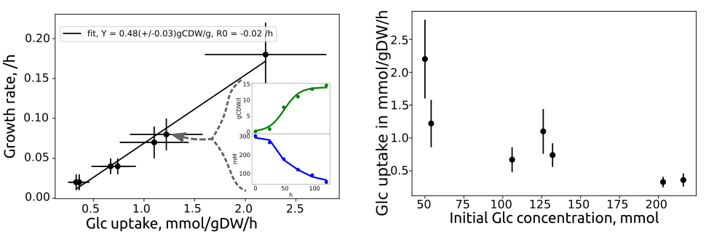
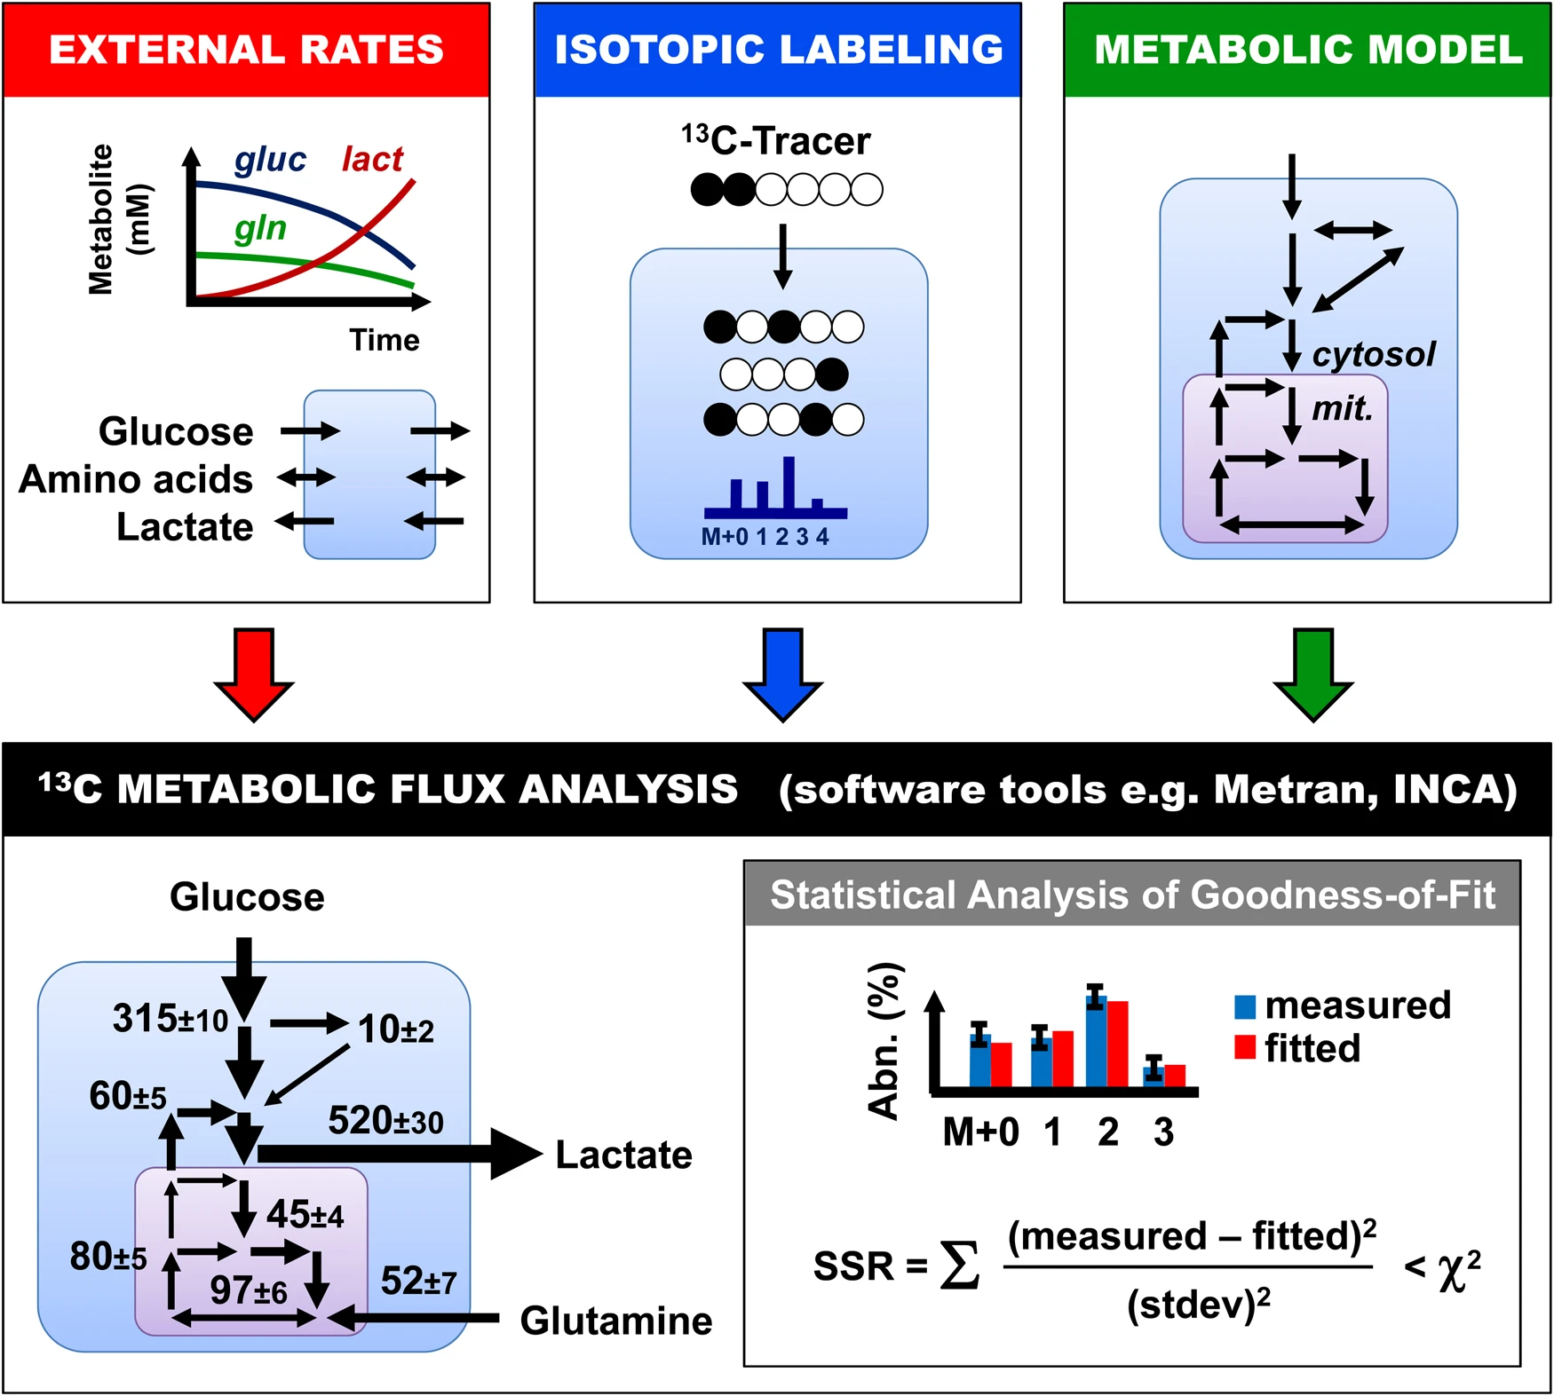
Quantitative growth analysis
Rates for growth, substrate uptake and productivity are important parameters to evaluate biotechnological efficiency.
Starting point for complex analysis:
13C isotope based MFA,
FBA with GSMM
Growth Figure: Liebal et al., 2022, doi: 10.3390/jof8050524
MFA Figure: Antoniewicz, 2018, doi: 10.1038/s12276-018-0060-y

Slide 4
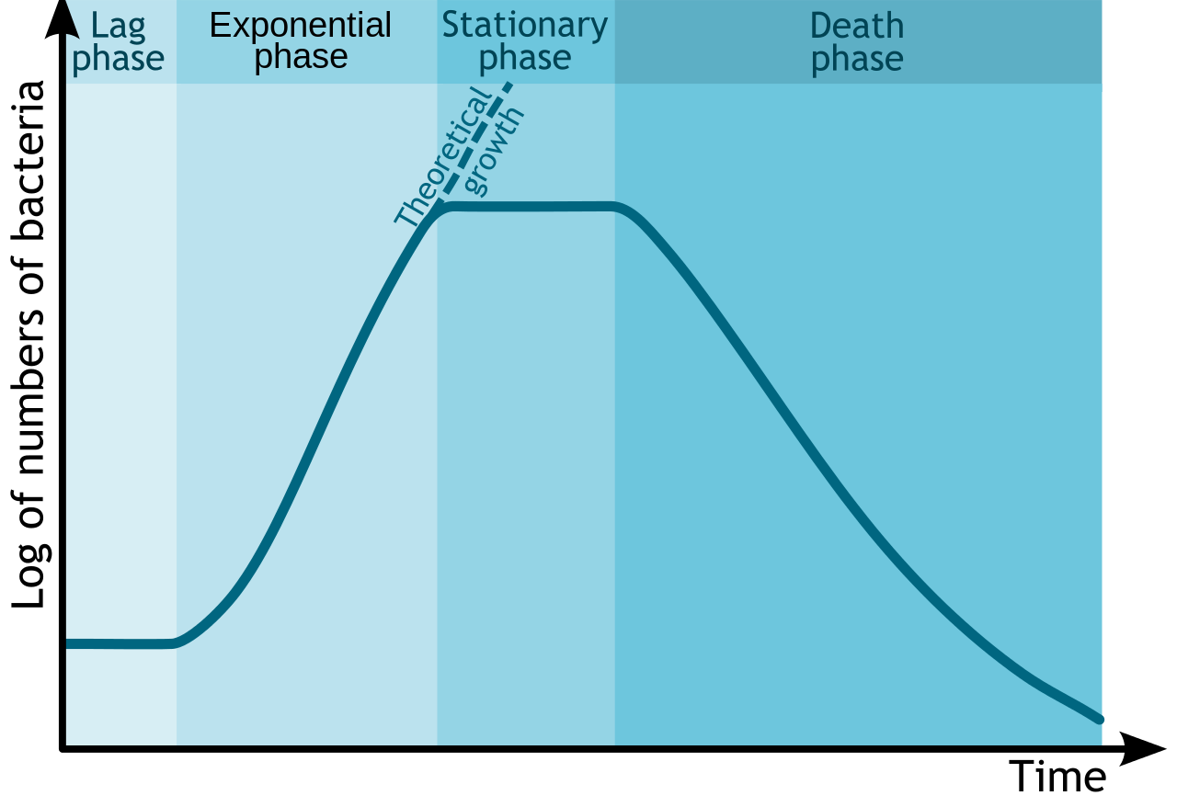
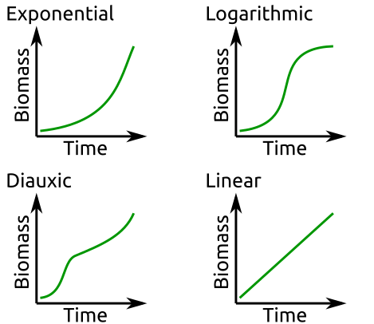
Microbial Growth Phenotypes
Environmental conditions determine growth rate:
Temperature, Substrate, pH, etc.
Growth is separated in different phases
In non-optimal conditions and environmental changes microorganisms adapt their growth.
Michał Komorniczak, https://en.wikipedia.org/wiki/Bacterial_growth#/media/File:Bacterial_growth_en.svg

Slide 5
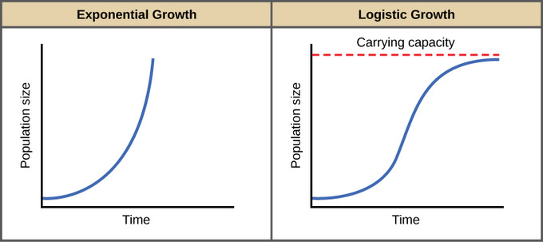
Biomass Growth Models
Mechanistic Growth Model:
Logistic Function – self-limiting Growth of a Biological Population
$X\underset{→}{μ}2X$
$X\left(t\right)=\frac{K}{1+\left(\frac{K−X_{0}}{X_{0}}\right)e^{−μt}}$
$\frac{dX}{dt}=μX$
X(t) = biomass conc. after t hours [g/L]
X₀ = biomass conc. of inoculum [g/L]
μ = growth rate [ /h ]
t = time [h]
$X\left(t\right)=X_{0}e^{μt}$
$ln\left(X\left(t\right)\right)=ln\left(X_{0}\right)+μt$
K = maximum biomass conc. [g/L]

Slide 6
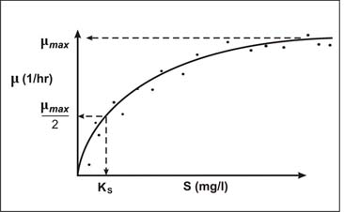
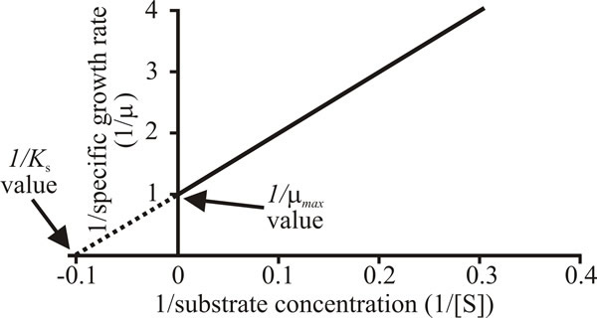
Growth Models: The Monod Equation
Growth rate is variable and depends on environment, e.g. substrate level, temperature.
Monod assumed that growth is substrate limited by enzymatic actions.
Similar to Michaelis-Menten equation.
$X+S\underset{→}{μ}2X$
$μ=\frac{μ_{max}S}{K_{S}+S}$
μ: growth rate, /h
μ _{max}: max rate, /h
S: substrate, mM
K_{S}: substrate affinity, mM
Parameter estimation with double reciprocal plot, uncertainties from low concentrations are amplified.
File:https://www.davidmoore.org.uk/21st_century_guidebook_to_fungi_platinum/Ch17_06.htm

Slide 7
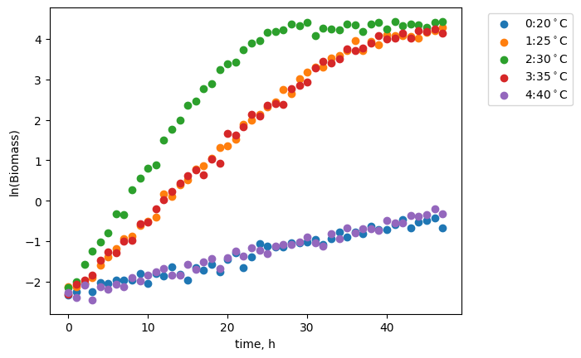
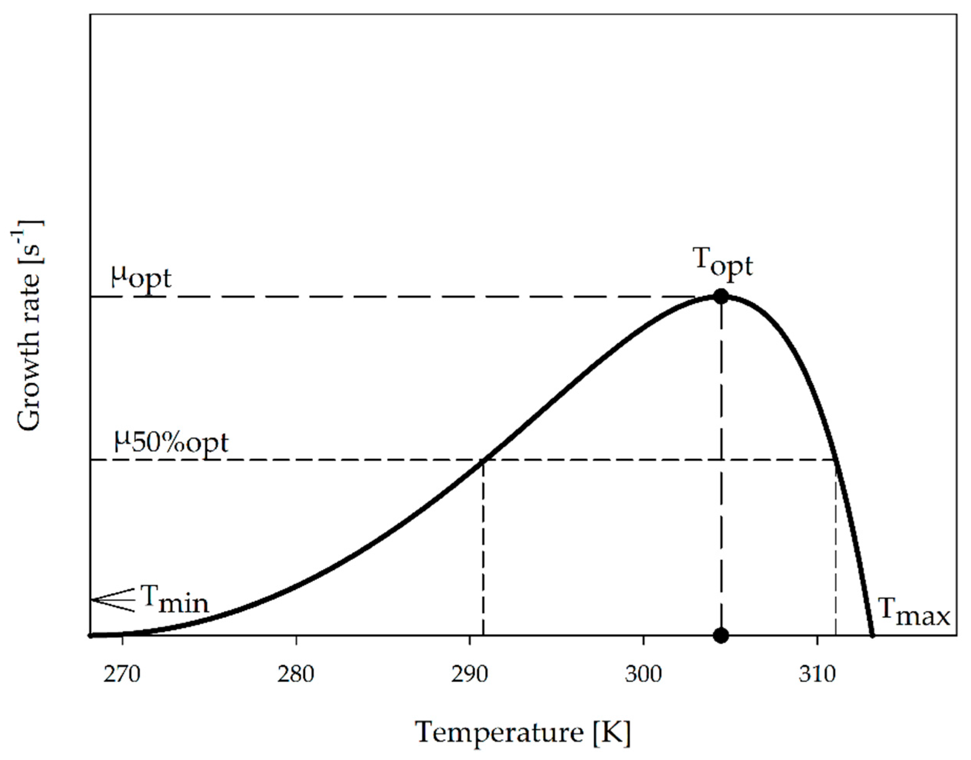
Growth Models: Temperature sensitivity
Enzymes show optimal flexibility at the most frequent temperature of a MO
Proteins and membranes become disordered/fluid at higher and rigid at lower temperatures both inhibiting metabolism and signaling.
File:Noll et al., 2020, doi: https://doi.org/10.3390/pr8010121

Slide 8
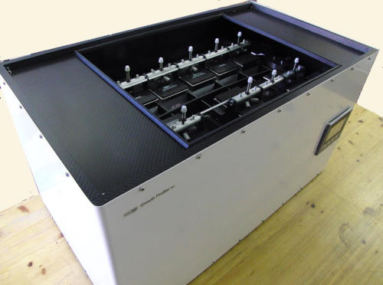
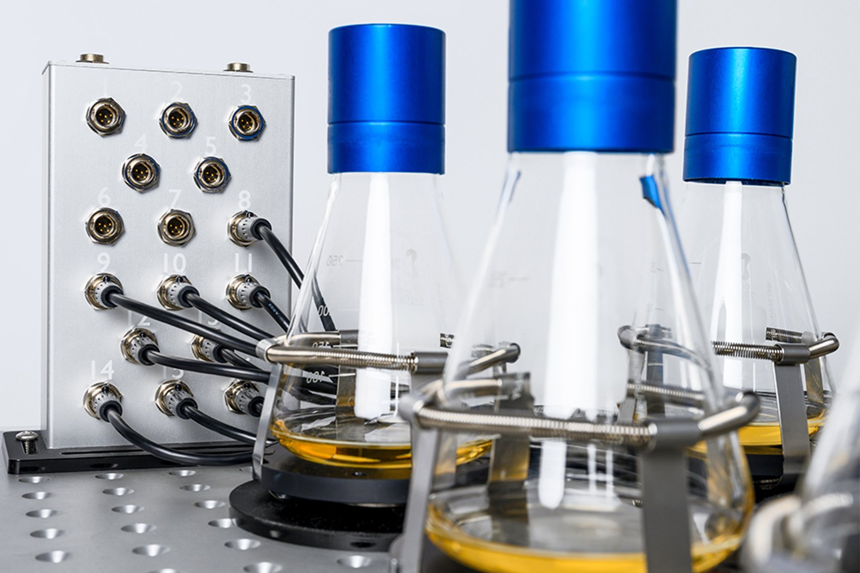
Biomass Growth Models with the Logistic Function
Enzyscreen: Growth Profiler
SBI: Cell Growth Quantifier

Slide 9
Analysis Task
Goals:
Identify the optimal growth temperature of the bacterium.
Calculate the correlation between OD and dry weight
Compute the biomass yield on glucose substrate
Identify the maximum growth rate
Determine the maximum glucose uptake rate
Estimate the glucose concentration with half maximal growth rate

Slide 10
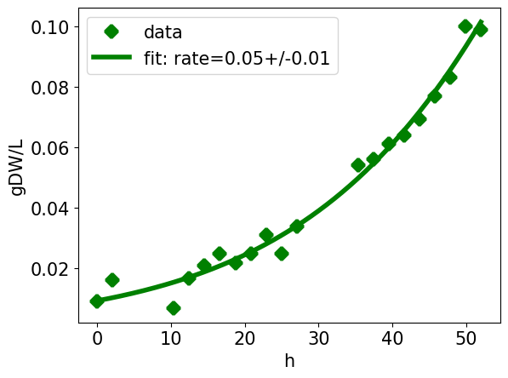
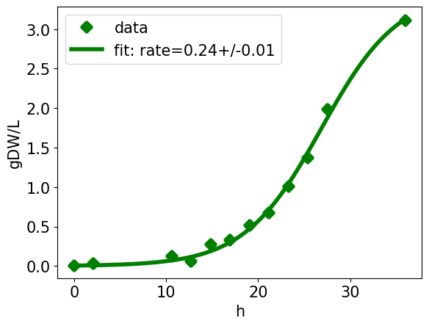
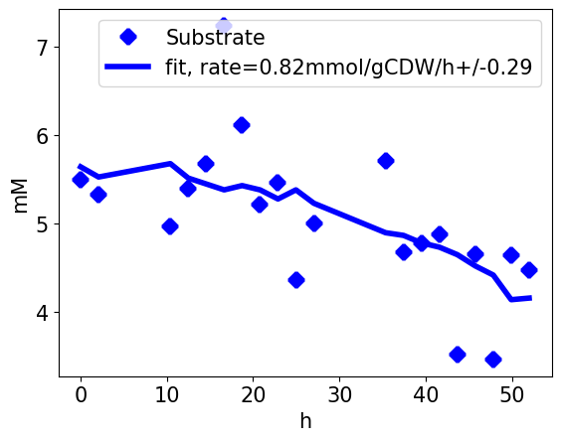
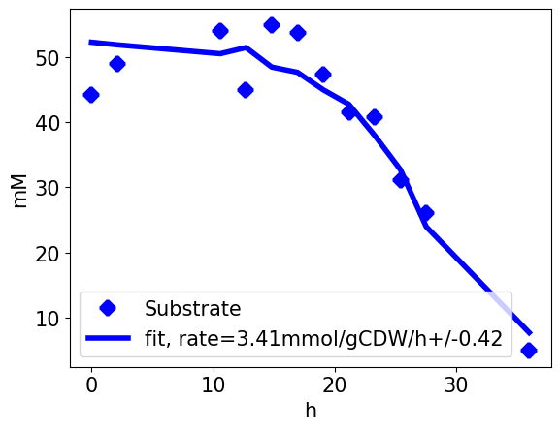
Physiological Characterization with Multiple Concentrations
Make multiple experiments with different substrate concentrations to identify parameters of the Monod-equation for growth rate.
Experiment #1
Cglc = 1 g/L
Time = 50 h
Sampling = 2 /h
Nightshift = 5 h
Calculate:
RBio = 0.05 /h
RGlc = 0.82 mmol/gDW/h
Experiment #2
Cglc = 10 g/L
Time = 37 h
Sampling = 1 /h
Nightshift = 5 h
Calculate:
RBio = 0.24 /h
RGlc = 3.41 mmol/gDW/h
Experiments #...

Slide 11
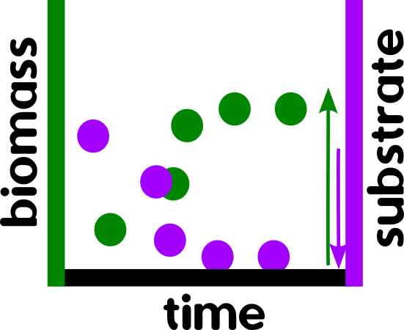
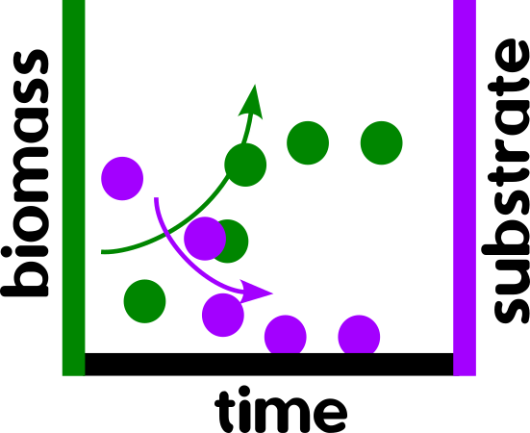
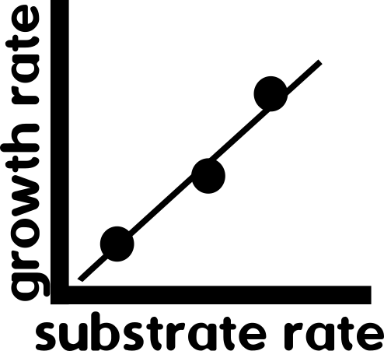
Calculation of biomass yield
The biomass yield on a substrate is defined by the unit: gDW/gSubstrate
Typical values for glucose range from 0.3-0.5 g/g
Strategy #1
Divide the biomass at the end of experiment by the substrate consumed.
Strategy #2
Divide the growth rate (/h) with the substrate uptake rate (/h/gGlc*gDW*h).
Strategy #3
Linear correlation of multiple experiments with different substrate uptake and growth rates.
Y=
Y=
Y=Δr_{growth}/Δr_{substrate}

Slide 12
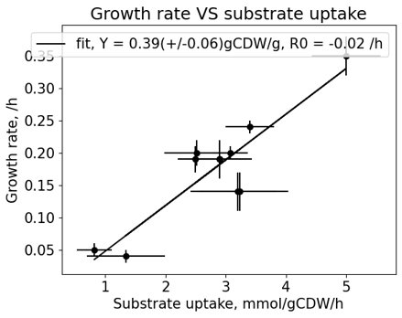
Physiological Characterization with Multiple Concentrations
Plot the calculated substrate uptake rates versus the growth rates.
There should be roughly a linear relationship -> the yield remains constant at different growth rates.
The slope of the linear regression is the yield.

Slide 13
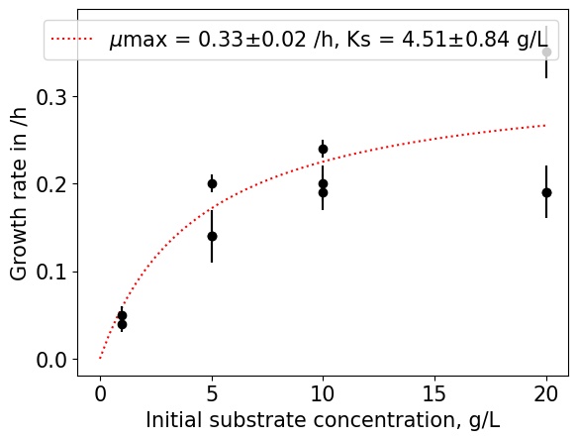
Physiological Characterization with Multiple Concentrations
Analyse the relationship between initial substrate concentration and growth rate.
Use hyperbolic curve fitting or double reciprocal plot with linear regression of substrate concentration and growth rate.
$μ=\frac{μ_{max}S}{K_{S}+S}$
$\frac{1}{μ}=\frac{1}{μ_{max}}+\frac{K_{S}}{μ_{max}}∙\frac{1}{S}$

Slide 14
Simulation to generate growth data
Procedure:
Login to RWTH Jupyter Hub site: https://jupyter.rwth-aachen.de
Start [BioLabSim] Biotechnologie
In the Jupyter directory overview (left panel) navigate to Notebooks
Run the Notebook GroExpSim.ipynb
Conduct data analysis either within Python, Excel, GraphPad, etc...

Slide 15
Data Analysis Templates
Excel template:
Publication: Sato et al., 2016, PLoS, Directed Evolution Reveals Unexpected Epistatic Interactions That Alter Metabolic Regulation and Enable Anaerobic Xylose Use by Saccharomyces cerevisiae
doi: https://doi.org/10.1371/journal.pgen.1006372
Supplement Appendices 2+3
Server:
Data\iAMBAll\_Subgroups\Modeling-group\Templates_XlsAnalysis\jennifer.xlsx
Python workflow:
IAMBJudas: https://jupyter.rwth-aachen.de/hub/spawn?profile=iambjudas
Git clone: https://git.rwth-aachen.de/ulf.liebal/iambanalyses.git

Slide 16
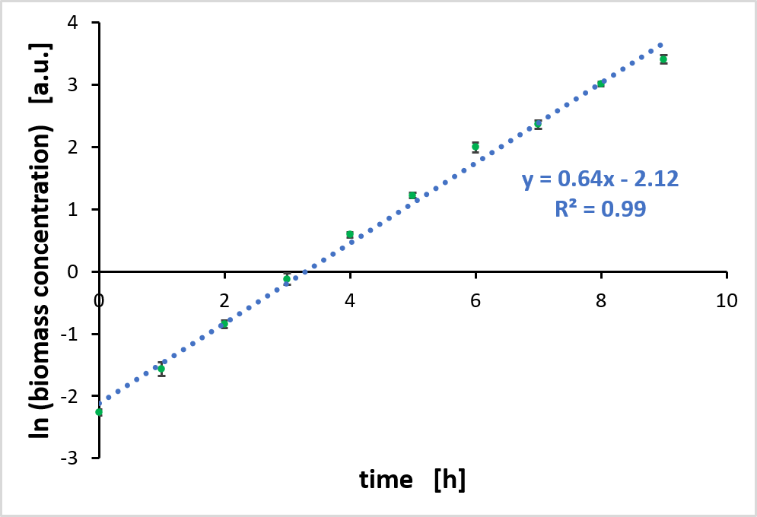
Excel-based Growth Rate Calculation with linearized exponential
Determine mean value and standard deviation (only necessary for biological replicates)
Plot the Logarithm of biomass concentrations against time
Perform a linear regression with the linear range
→ The slope of the regression line is equal to the growth rate
Example cultivation from BioLabSim at 35 °C. Shown is the mean value and the standard deviation of three biological replicates.

Slide 17
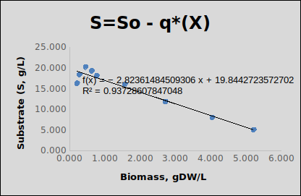
Excel-based Growth Rate Calculation
Plot the substrate concentrations against the biomass
Perform a linear regression, the slope is equal to q=g/gDW
Convert to molar concentration (mmol/gDW) by division of q with substrate molar mass, e.g. n(glucose) = 0.18 g/mmol
Calculate the rate by multiplying q with the growth rate, mmol/gDW/h
Reference Excel sheet for calculations 'jennifer.xlsx'.
Sato et al., 2016, doi: 10.1371/journal.pgen.1006372

Slide 18
Python-based Growth Rate Calculation
Rearrange code lines
Extract the highest growth slope for ln(biomass)
Extract the range of linear slope for ln(biomass)
Rearrange code lines for linear regression and max biomass extraction
# Rearrange the correct code sequence for plotting the growth curves with the logarithm of biomass.
Time, Biomass = my_data[:,0], my_data[:,1:]
DataFile = 'Strain_characterization_1.csv' LnBiomass = np.log(Biomass)
[plt.scatter(Time, X, label=Exp) for Exp,X in enumerate(LnBiomass.T)]
plt.legend(bbox_to_anchor=(1.05, 1), loc='upper left')
my_data = np.genfromtxt(DataFile, delimiter=',', skip_header=1)

Slide 19
The BioLabSim is based on a Jupyter Notebook
Jupyter navigation and coding example:
https://jupyter.org/try
https://nbviewer.jupyter.org/github/jupyter/notebook/blob/master/docs/source/examples/Notebook/Running%20Code.ipynb

Slide 20

Authors and License
Check the BioLabSim.nrw members at:
https://git.rwth-aachen.de/ulf.liebal/biolabsim/-/blob/91dd40b2f40e6a24263af96c2d5b9817733f4a25/AUTHORS.md
All material in this lecture is free to use, adapt and distribute according to CC BY 4.0 citing:
Ulf Liebal, BioLabSim.nrw consortium, GroExpSim Lecture, 2024, https://git.rwth-aachen.de/ulf.liebal/biolabsim

