Slide 1

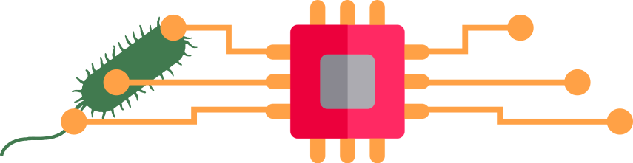
Computational Biotechnologie and Data Science
BioLabSim Consortium
iAMB-RWTH, BPT-WHS, HSRW
02.06.2022

Slide 2


Motivation: Data Literacy in Biotechnology
Lab Automation &
High Throughput
Complex Data &
Large Volumes
Experiments become:
technical demanding,
costly,
time consuming.
Hard to realize in lab courses.
Data analysis requires:
computer science skills,
integration of various data types,
Combination of methods in workflows.
Extended biology data science
courses.

Slide 3


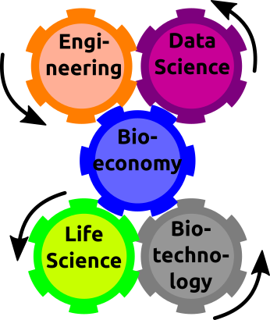




Exclusive Competencies between Life and Data Science
The biotechnological revolution
is significantly fueled by the
exponential advances in
information technology.
Effective data analysis with
industrial impact [for Biotechnology]
requires intelligent algorithms and
integrative workflows.
Problem:
Experts missing with skills covering Data Science and Life Science.
Solution:
Design of engaging data science projects with lab relevant workflows.
Notes:
Experts needed for Life Science & Biotechnology, Engineering & Data Science.
The required skills are trained in separate domains – e.g. Life and Data Science.

Slide 4
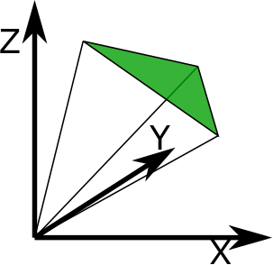


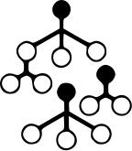



BioLabSim works via a Simulation of a Virtual Organism
Mechanistic Models
Statistical Models
Random Events
Genome
Scale Model Simulation
Recombinant Expression Simulation
+
+
GenScalSim
RecExpSim
Growth
Experiment
Simulation
Fermentation
Process
Simulation
GroExpSim
FermProSim
Simulator of Virtual Organisms (silvio):
Public Python library
Easy package installation via Pypi
Project development via rwth-GitLab
Biological Laboratory Simulation (BioLabSim):
Educational workflow to simulate a biotech experiment with data and analysis.
Each BioLabSim is a Jupyter Notebook.
Direct implementation in JupyterHubs (e.g. RWTHjupyter).
Local installation from rwth-GitLab.

Slide 5
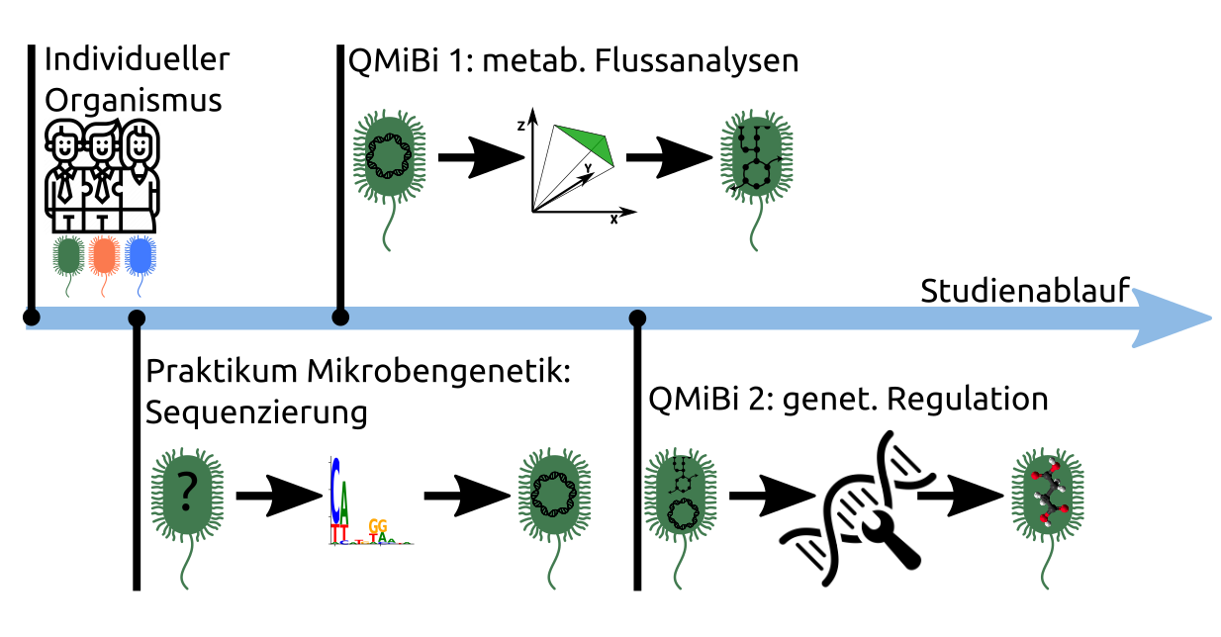
BioLabSim in OERContent: Learning Perspective
Individual organism, e.g. growth temperature, substrate preference, genome, metabolism etc...
Each lectures presents a set of different experiments to investigate the organism.
Different complexities from single seminar (90 Min), regular seminars to full day training.
Work in groups with each participant studying individual organism.
Performance control by automated comparison results with internally stored parameter references.

Slide 6
Educational Workflow: RecExpSim
Time | 3h: Lecture 0.5h Guided training 2h
Content | Growth curve analysis Promoter library construction
Equipment | Notebook/PC, Internet
Engagement | Student pairs
6

Slide 7

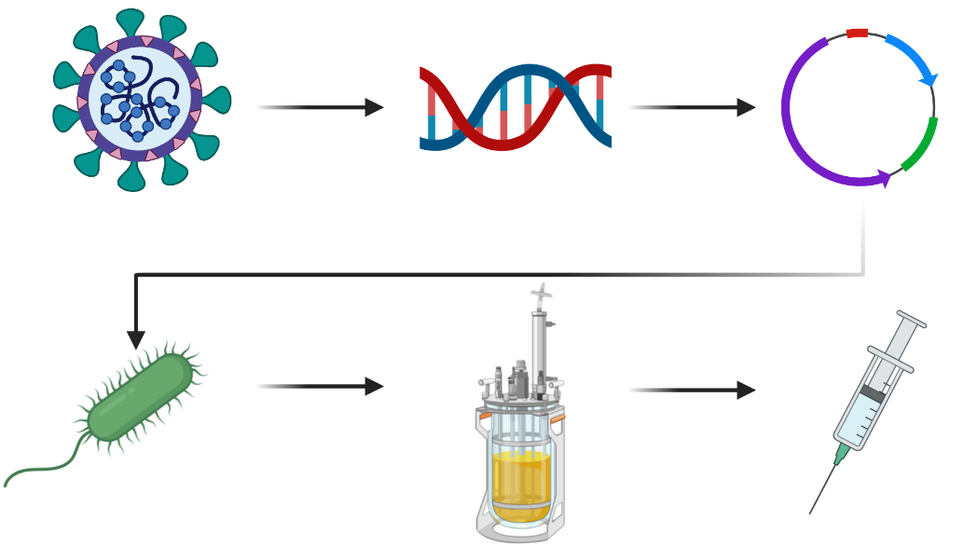
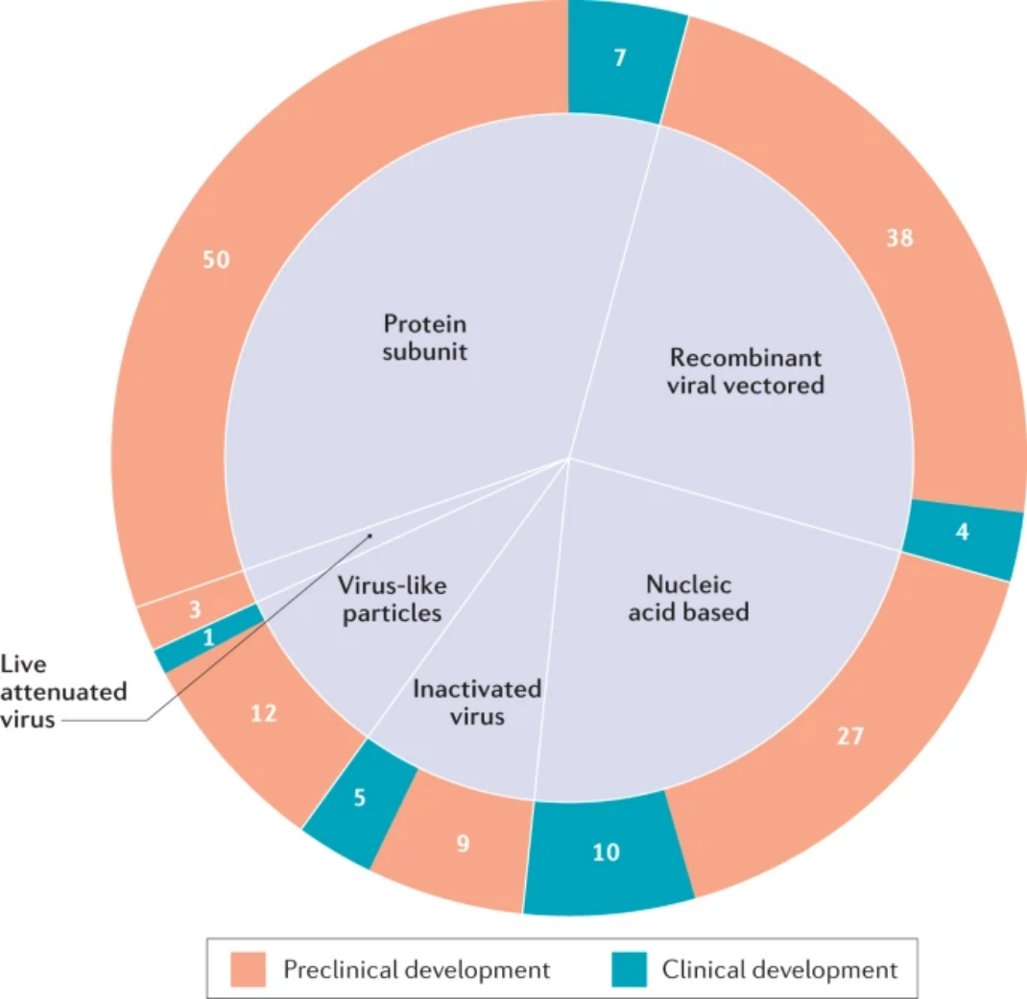
RecExpSim: Recombinant Expression Simulation
Story:
Develop an expression system for recombinant production of COVID19 protein subunit vaccine.
Jeyanathan et al., 2020, doi: 10.1038/s41577-020-00434-6
1. Characterize host
2. Find optimal promoter sequences
3. Clone genes into host
4. Measure expression rate
The majority of vaccine (candidates) is based on recombinant expression of protein subunits.

Slide 8


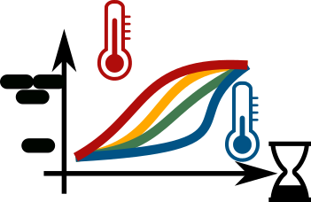



RecExpSim: Data Analysis Example
Objective
Optimal
temperature
Growth rate &
max biomass
Procedure
Analysis
Scrambled code-lines provided
User rearranges line order for functional code
Standard for quick laboratory data analysis.
Users implement Excel linear regression.

Slide 9

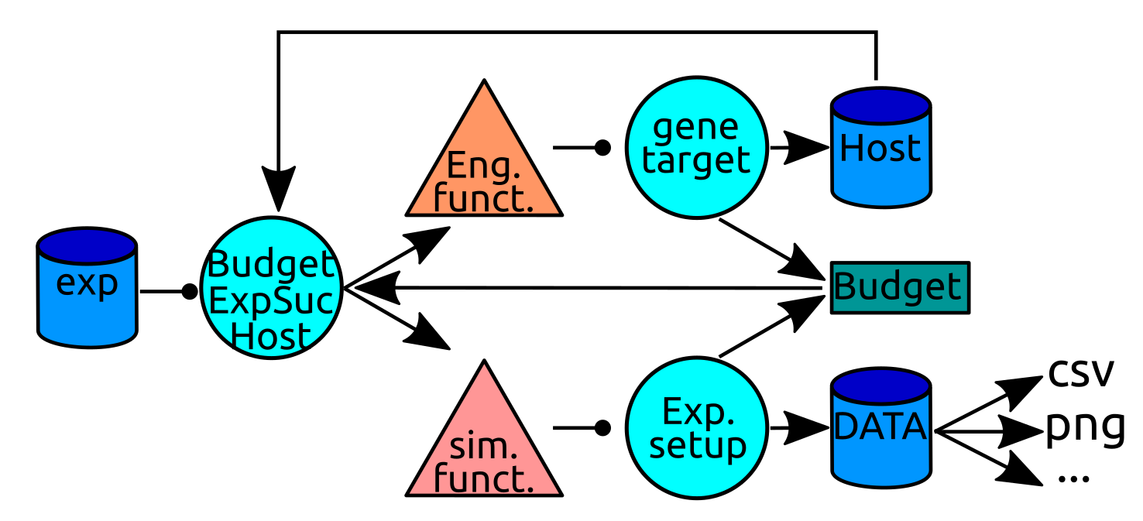




silvio Code Logic
Genetic
manipulation
Create experiment
> Exp = exp(Invest, seed)
Define host organism
> Host = Exp.create_host('ecol')
Set conditions
> temperature = [27, 32, 37]
Conduct experiment
> data = Exp.simulate_growth
(Host,temperature)
Export data
> data.export_data(‘file.csv’)
Budget & Equipment
Random initialization
Analytical experiments

Slide 10





RecExpSim: Training Evaluation
Seminars in 6 different lectures
~70 Master Students in Biotechnology
>60% Participants low coding experience
>80% Participants fully enjoyed learning with
RecExpSim
Student Quotes:
I am a beginner of computers,
and I was really afraid of
the seminar!
But now I am relieved
that I managed it well.
I have Python and Jupyter
experience. The seminar
was enjoyable and I
learnt new stuff.

Slide 11


Summary
Data science training for the life scientist/biotechnologist
Relevant biotechnology scenarios and realistic data
Independent access: group learning or self-learning strategies possible
Remote use: no requirements on hard- and software

Slide 12
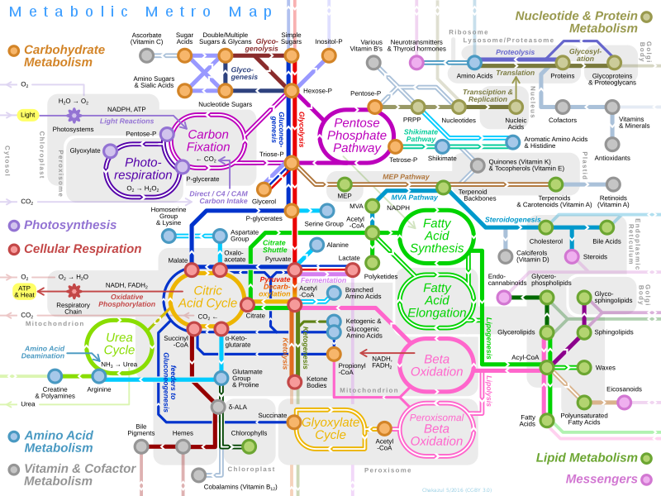
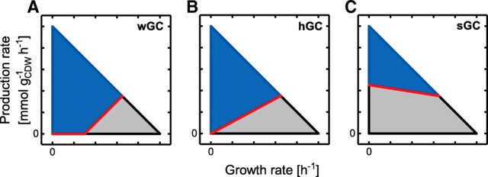
Next Week: GenScaleSim Implementation
Objective: Understanding computer-based strain simulations.
Simple Python commands.
Exploring the modelling software cobrapy.
Compartimentalization of metabolites in models.
Simulated yield calculations.
Alter & Ebert, doi: 10.1186/s12859-019-2946-7
https://en.wikipedia.org/wiki/File:Metabolic_Metro_Map.svg
Organism-specific metabolic model

Slide 13

Funding
ETS488
data.RWTH
Exzellenzcluster 2186: The Fuel Science Center
OERContent

