Slide 1

Growth Curve Analysis
Ulf Liebal
Rafael Schimassek
Lars Küpfer
Lars Blank

Slide 2
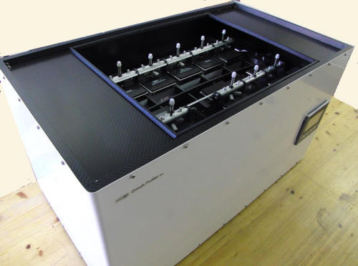
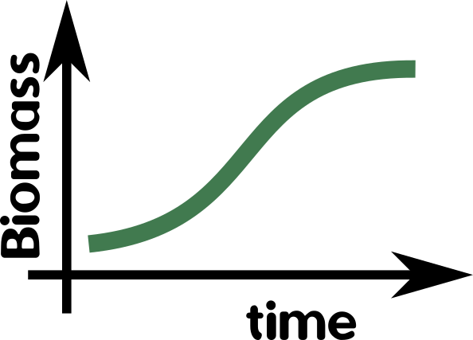
Biomass Growth Models with the Logistic Function
Logistic Function – self-limiting Growth of a Biological Population
P(t) = biomass conc. after t hours [g/L]
K = maximum biomass conc. [g/L]
P₀ = biomass conc. of inoculum [g/L]
r = growth rate (temperature-dependent) [ /h ]
t = time [h]
Enzyscreen: Growth Profiler

Slide 3






Growth Curve Data Analysis Example
Objective
Optimal
Temperature
Growth Rate &
Max Biomass
Procedure
Analysis
Scrambled code-lines provided
User rearranges line order for functional code
Standard for quick laboratory data analysis.
Users implement Excel linear regression.

Slide 4
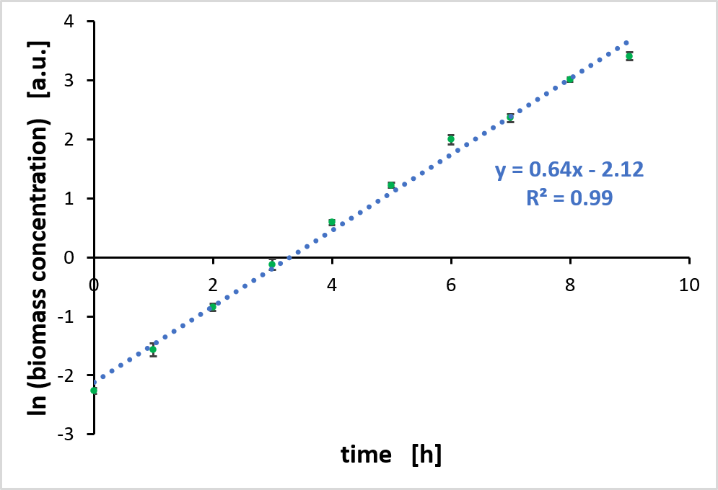
Excel-based Growth Rate Calculation
Determine mean value and standard deviation (only necessary for biological replicates)
Plot the Logarithm of biomass concentrations against time
Perform a linear regression with the linear range
→ The slope of the regression line is equal to the growth rate
Example cultivation from BioLabSim at 35 °C. Shown is the mean value and the standard deviation of three biological replicates.

Slide 5
Python-based Growth Rate Calculation
Rearrange code lines
Extract the highest growth slope for ln(biomass)
Extract the range of linear slope for ln(biomass)
Rearrange code lines for linear regression and max biomass extraction
# Rearrange the correct code sequence for plotting the growth curves with the logarithm of biomass.
Time, Biomass = my_data[:,0], my_data[:,1:]
DataFile = 'Strain_characterization_1.csv' LnBiomass = np.log(Biomass)
[plt.scatter(Time, X, label=Exp) for Exp,X in enumerate(LnBiomass.T)]
plt.legend(bbox_to_anchor=(1.05, 1), loc='upper left')
my_data = np.genfromtxt(DataFile, delimiter=',', skip_header=1)

Slide 6
Simulation Task
Goals:
Identify the optimal growth temperature of the bacterium.
Calculate the growth rate 'r' and capacity 'K' (max. biomass level) in the logistic growth function
Procedure:
Login to RWTH Jupyter Hub site: https://jupyter.rwth-aachen.de
Start [BioLabSim] Biotechnologie (page middle)
Start RecExpSim.ipynb
Run the Notebook and conduct data analysis either within Python or in Excel
Outcome:
Report the optimal temperature, growth rate and max. biomass

Slide 7
The BioLabSim is based on a Jupyter Notebook
Jupyter navigation and coding example:
https://jupyter.org/try
https://nbviewer.jupyter.org/github/jupyter/notebook/blob/master/docs/source/examples/Notebook/Running%20Code.ipynb
Important for Binder: Run code within 5 minutes! Otherwise restart is necessary.

