Slide 1
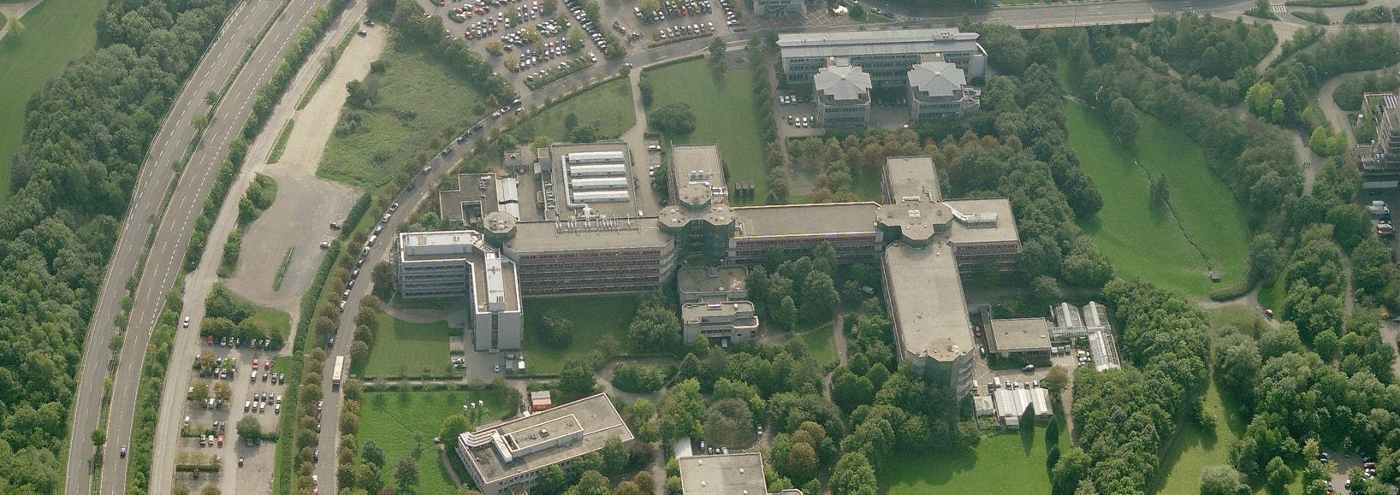
Quantitative Microbiology Dr. Ulf Liebal
Prof. Dr. Lars Blank

Slide 2
Content
Genome-scale models
Structure
Hands on tutorial
FBA with Jupyter Notebooks
https://jupyter.rwth-aachen.de/hub/spawn?profile=biolabsim

Slide 3
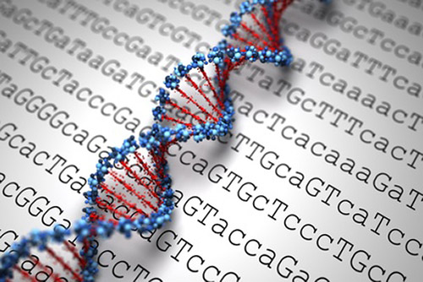
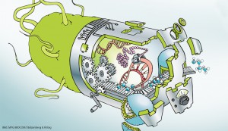
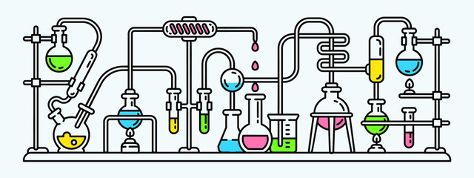
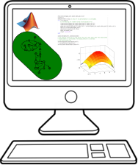
Warum simulieren in der Biotechnologie?
genetischer Code/ DNA-Sequenzen können einfach entschlüsselt werden.
enzymatische Ausstattung von Mikroben ist bekannt.
Experimente sind langwierig und teuer.
Änderungen wirken anders als geplant.
Neue metabolische Fähigkeiten durch veränderte enzymatischen Austattung.
Computersimulation des Metabolismus:
Identifikation von genetischen Modifikationen zur Herstellung von Zielsubstanzen.
Kurze Zeitspannen zur Hypothesenbildung.
Hohe Reproduktivität.

Slide 4
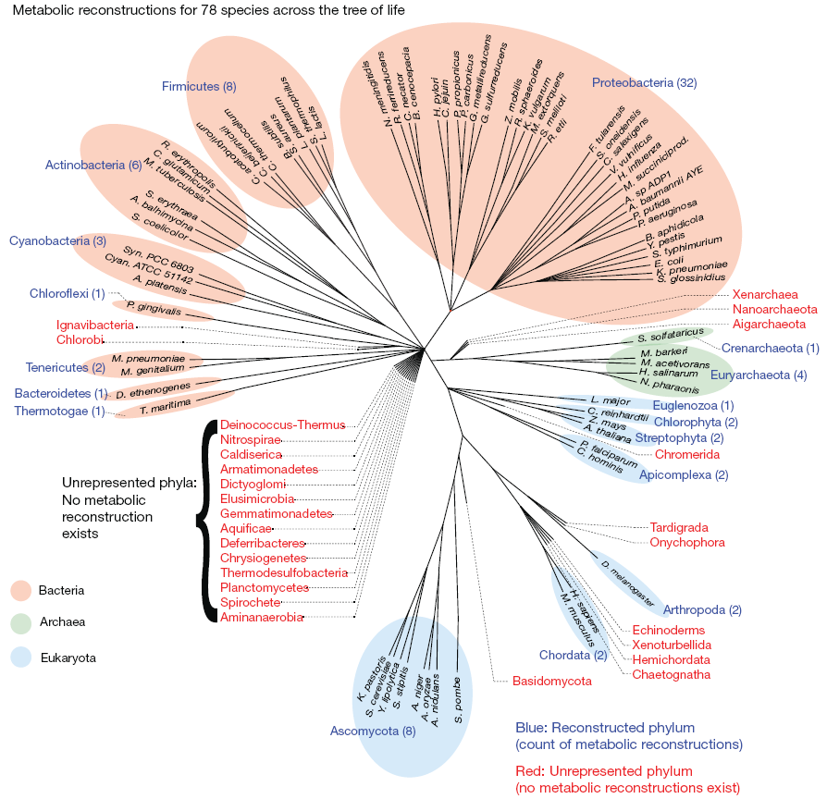
Genome-scale Network Reconstructions: Huge phylogenetic coverage
78 species across the tree of life
A GEnome scale Network Reconstructions (GENREs) structured knowledge base of biochemical facts
GEnome scale Models (GEMs)
model which supplements the established biochemical information with additional (potentially hypothetical) information to enable computational simulation and analysis.

Slide 5
Size of GEMs
Helicobacter pylori:
iIT341
485 metabolites
554 reactions
339 genes
(21% of predicted genes)
Escherichia coli: iML1515
1877 metabolites
2712 reactions
1515 genes (35% of predicted genes)
Pseudomonas putida KT2440
iJN746
907 metabolites
1054 reactions
746 genes (14% of predicted genes)
S. cerevisiae: yeastGEM
2691 metabolites
3963 reactions
1139 genes
Mus musculus iMM1415 2775 metabolites
3726 reactions
1375 genes
Homo Sapiens
Recon3D
4140 unique metabolites
13543 reactions
3288 genes
(17% of functionally annotated human genes)
Repositories: BiGG database: http://bigg.ucsd.edu
EMBL-EBI Biomodels DB: https://www.ebi.ac.uk/biomodels-main/

Slide 6
Small scale models

Slide 7
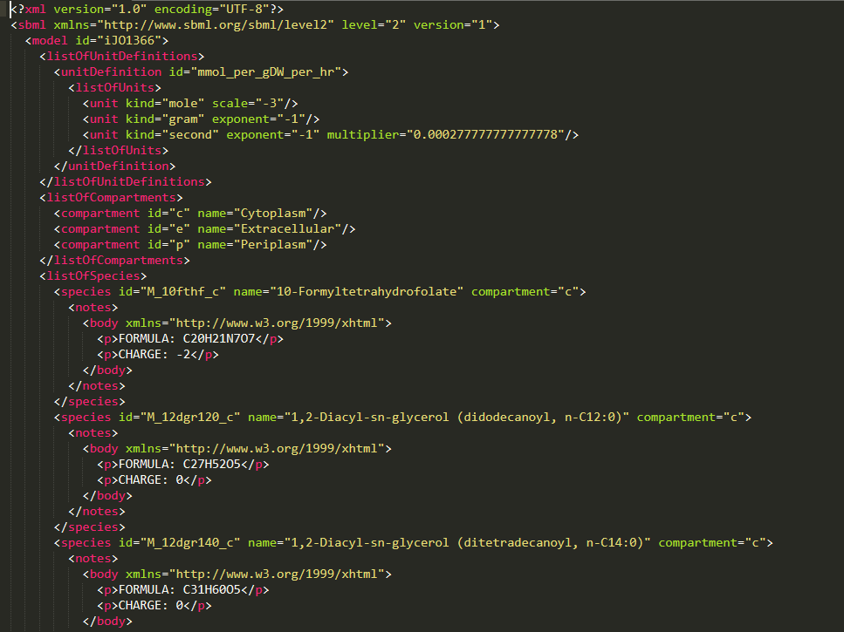
Common model format: SBML Systems Biology Mark-up Language
SBML is a machine-readable format for representing models.
widely accepted and used by the metabolic modeling community
→ Compatible w/ most modeling tools

Slide 8
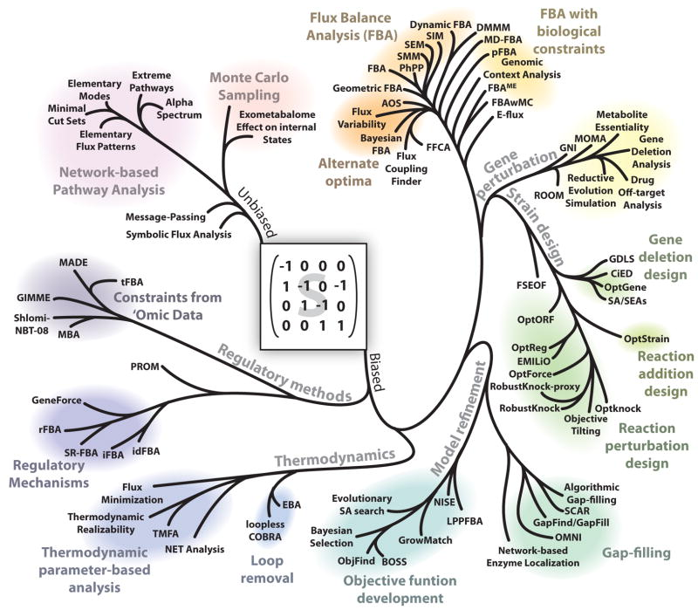
A phylogeny of modeling methods
Lewis N et al. Nat Rev Microbiol. 2012 Feb 27; 10(4): 291–305.

Slide 9
COBRApy
COBRA: COnstraint-Based Reconstruction and Analysis
py: Python
Python – general-purpose programming language; emphasizes code readability with clear, easy syntax (→ easy to learn),open-source
In COBRApy models are defined as a set of classes
Classes (object-oriented programming): extensible program-code-template for creating objects, providing initial values for state (member variables) and implementations of behavior (member functions or methods).

Slide 10
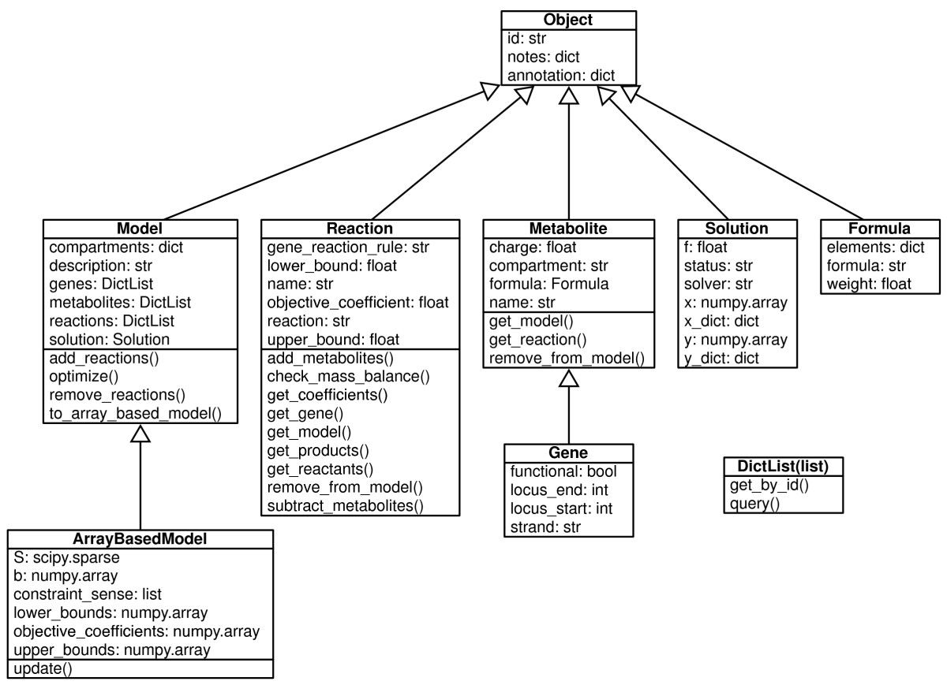
Core classes in COBRA for Python with key attributes and methods listed
Ebrahim, A. et al. BMC Syst Biol 2013;7: 74.

Slide 11
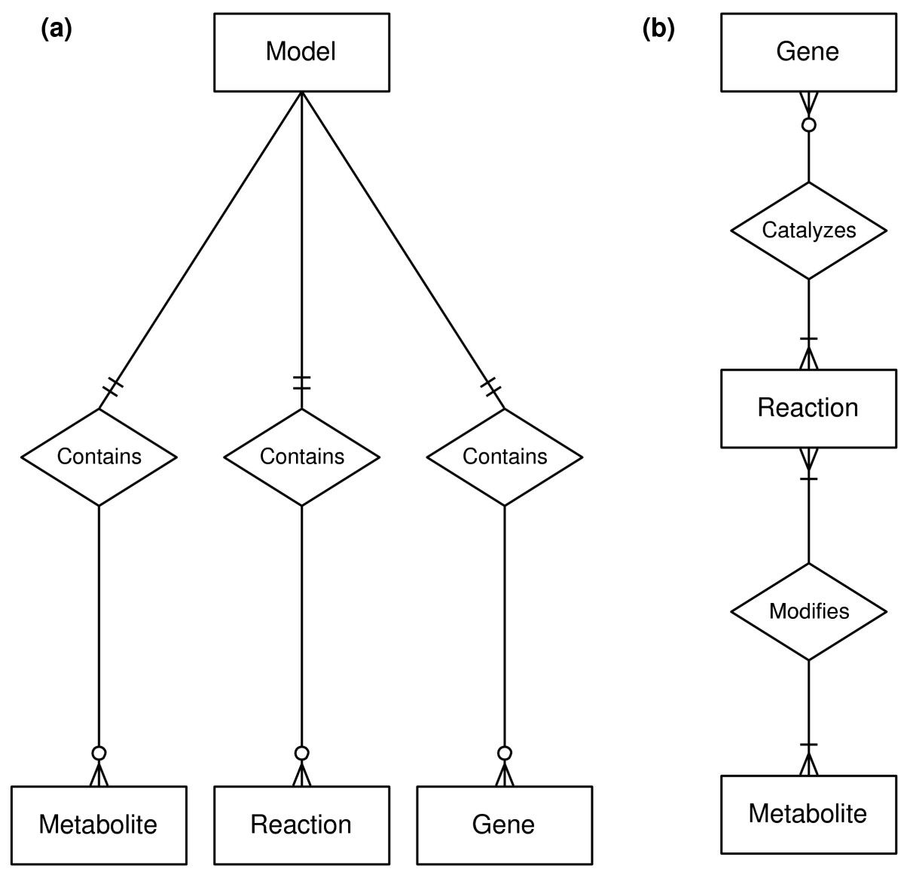
Entity relationship diagrams for core classes in COBRApy
A Model contains Metabolites, Reactions, and Genes.
A Reaction may be catalyzed by 0 or more Genes. Reactions catalyzed by 0 Genes are spontaneous. A Reaction may be catalyzed by different sets of Genes. Reactions modify 1 or more Metabolites. A reaction that modifies only 1 metabolite is an external boundary condition. A Metabolite may be modified by many different Reactions.

Slide 12
How to work with COBRApy models?
Loading E. coli SBML-model from Jeffrey Orth et al., with 1366 annotated genes:
model = read_sbml_model('iJO1366.xml.gz')
Get a summary of the entity 'nadh_c' from the subclass 'metabolites' in the class 'model' by calling the method 'summary()':
model.metabolites.nadh_c.summary()
Optimize (run an FBA) on the model:
solution = model.optimize()

Slide 13
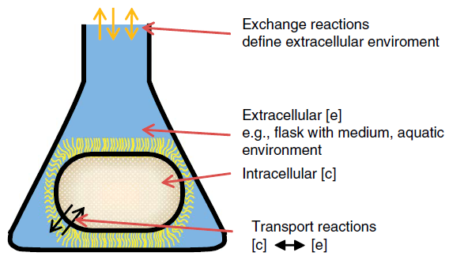
iJO1366: E. coli GEM
Compartments:
e extracellular
c cytosol
p periplasma
Definition of exchange reactions: metab_e <=>
Phosphate exchange: pi_e <=>
Phosphate transport via diffusion (extracellular to periplasm)
pi_e <=> pi_p
Phosphate transport via ABC system (uptake, periplasm)
atp_c + h2o_c + pi_p -> h_c + adp_c + 2 pi_c
pi_e

Slide 14
Biomass synthesis reaction
Lumped biomass equation used in previous lectures:
Genome-scale models allow a bit more detail:
0.000223 10fthf[c] + 0.000223 2ohph[c] + 0.5137 ala-L[c] + 0.000223 amet[c] + 0.2958 arg-L[c] + 0.2411 asn-L[c] + 0.2411 asp-L[c] + 59.984 atp[c] + 0.004737 ca2[c] + 0.004737 cl[c] + 0.000576 coa[c] + 0.003158 cobalt2[c] + 0.1335 ctp[c] + 0.003158 cu2[c] + 0.09158 cys-L[c] + 0.02617 datp[c] + 0.02702 dctp[c] + 0.02702 dgtp[c] + 0.02617 dttp[c] + 0.000223 fad[c] + 0.007106 fe2[c] + 0.007106 fe3[c] + 0.2632 gln-L[c] + 0.2632 glu-L[c] + 0.6126 gly[c] + 0.2151 gtp[c] + 54.462 h2o[c] + 0.09474 his-L[c] + 0.2905 ile-L[c] + 0.1776 k[c] + 0.01945 kdo2lipid4[e] + 0.4505 leu-L[c] + 0.3432 lys-L[c] + 0.1537 met-L[c] + 0.007895 mg2[c] + 0.000223 mlthf[c] + 0.003158 mn2[c] + 0.003158 mobd[c] + 0.01389 murein5px4p[p] + 0.001831 nad[c] + 0.000447 nadp[c] + 0.011843 nh4[c] + 0.02233 pe160[c] + 0.04148 pe160[p] + 0.02632 pe161[c] + 0.04889 pe161[p] + 0.1759 phe-L[c] + 0.000223 pheme[c] + 0.2211 pro-L[c] + 0.000223 pydx5p[c] + 0.000223 ribflv[c] + 0.2158 ser-L[c] + 0.000223 sheme[c] + 0.003948 so4[c] + 0.000223 thf[c] + 0.000223 thmpp[c] + 0.2537 thr-L[c] + 0.05684 trp-L[c] + 0.1379 tyr-L[c] + 5.5e-005 udcpdp[c] + 0.1441 utp[c] + 0.4232 val-L[c] + 0.003158 zn2[c] → 59.81 adp[c] + 59.81 h[c] + 59.806 pi[c] + 0.7739 ppi[c]

Slide 15
Content
Genome-scale models
Structure
Hands on tutorial
FBA with Jupyter Notebooks
https://jupyter.rwth-aachen.de/hub/spawn?profile=biolabsim

Slide 16
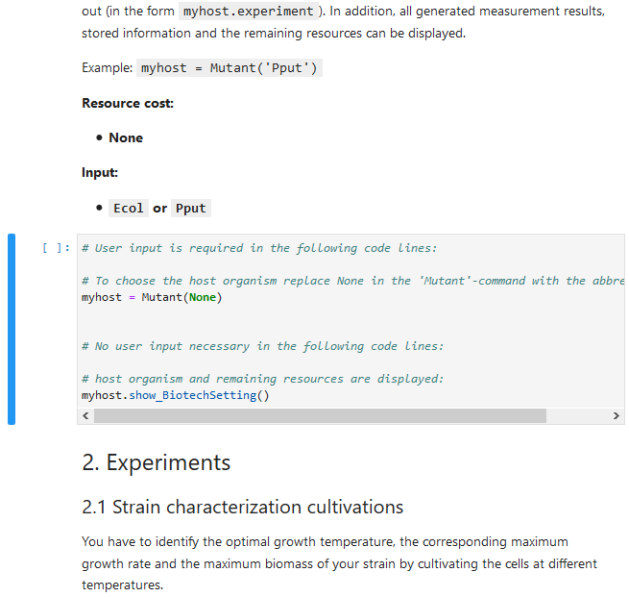

The Simulations are based on a Jupyter Notebook
Embedded in the browser
Composed of a sequence of cells that can be either text or python code cells to be run
Main page to work on is QMiBi_GSMM-cobrapy_L1.ipynb: Work through it and adjust the code cells in such a way that the simulations are successful
After execution a code cell the output is shown directly beneath
Code cells can be executed multiple times
Display of the status of a code cell
Marker of the currently active cell
To activate a cell below or above, use the arrow down and up keys in Command mode
more detailed information on Jupyter Notebook Cheat Sheet in biolabsim/PrepMaterial/Python_and_Jupyternotebook_basics
Example status:
Not executed yet
Currently executing
Executed, number correspomds to the execution order of the cells

Slide 17
Further Tasks
An equally important organism for biotechnology is S. cerevisiae with one of the main models called iMM904. Your goal is to visualize the effect of different oxygen uptake rates on the growth rate. This can be achieved using the production envelope if you plot growth as dependent variable against oxygen exchange (uptake rate/ transport).
Find the iMM904 model in the BIGG database.
Extract the map name from Escher for visualization.
Check growth on glucose and visualize the fluxes.
Use the production envelope command to check the dependence of growth on oxygen uptake.
Identify the reaction name for the oxygen exchange reaction.
Use as 'objective' the default biomass reaction and as 'reactions' the oxygen exchange reaction.
For plotting, examine the column header names in 'prod_env'.
Is the resulting graph visually appealing? Try using np.abs(prod_env['?...?']) to improve the figure.

