Slide 1
Metabolic Engineering Simulation
Paula Lanze

Slide 2
Genome-scale metabolic models
Contain metabolic information of a biological system
Breaks them down into mathematical model
Insight into molecular mechanisms
Enables analysis of metabolic pathways

Slide 3
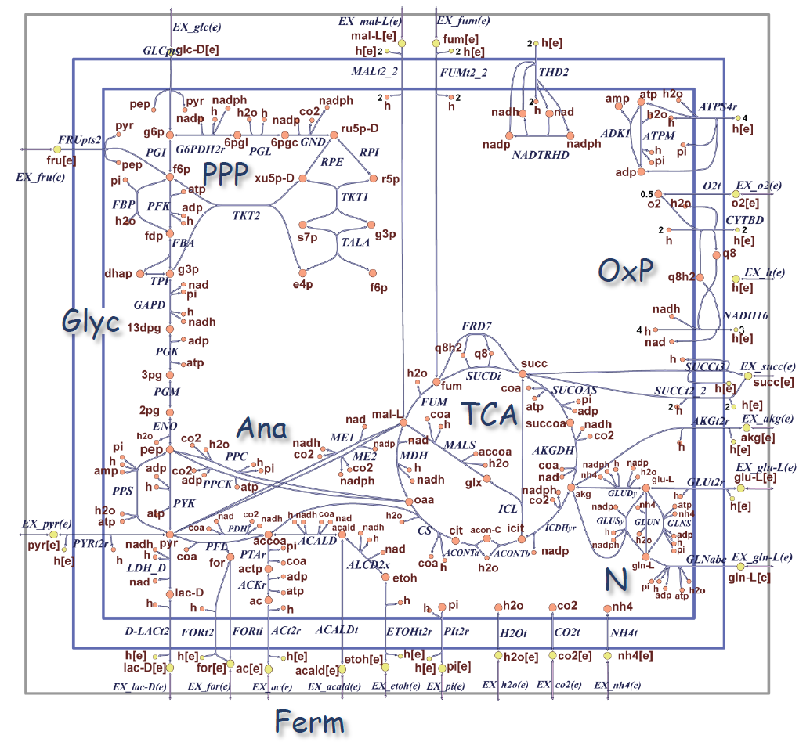
E. coli core model
A simplified model of E.coli
a great model to analyze and explore metabolic pathways
metabolic map of the E.coli core model
the larger letters (Glyc, PPP, etc.) refer to the major components of the metabolism
(OxP) oxidative phosphorylation
(Glyc) glycolysis pathway
(PPP) pentose phosphate pathway
(TCA) tricarboxylic acid cycle
(Ana) glycoxylate cycle, gluconeogenesis, and anapleurotic reactions
(Ferm) fermentation
(N) nitrogen metabolism
Figure 2: E. coli core metabolism.
https://opencobra.github.io/cobratoolbox/stable/tutorials/reconstruction/ecoliCoreModel/part1/tutorial_ecoliCoreModel_part1.html

Slide 4
Databases
Kyoto Encyclopedia of genes and genomes (KEGG):
Bioinformatics database, containing genes, proteins, reactions and metabolites, provides a metabolic-map
BioCyc/EcoCyc:
Collection of genome databases, containing genes, enzymes, reactions and metabolites, provides a metabolic-map
BiGG Models:
database for genome-scale metabolic networks, utilizes ESCHER-map for reactions, enzymes, metabolites and pathways
ChatGPT:
Artificial Intelligence (AI), provides information about reactions and metabolites, does not provide a metabolic map

Slide 5
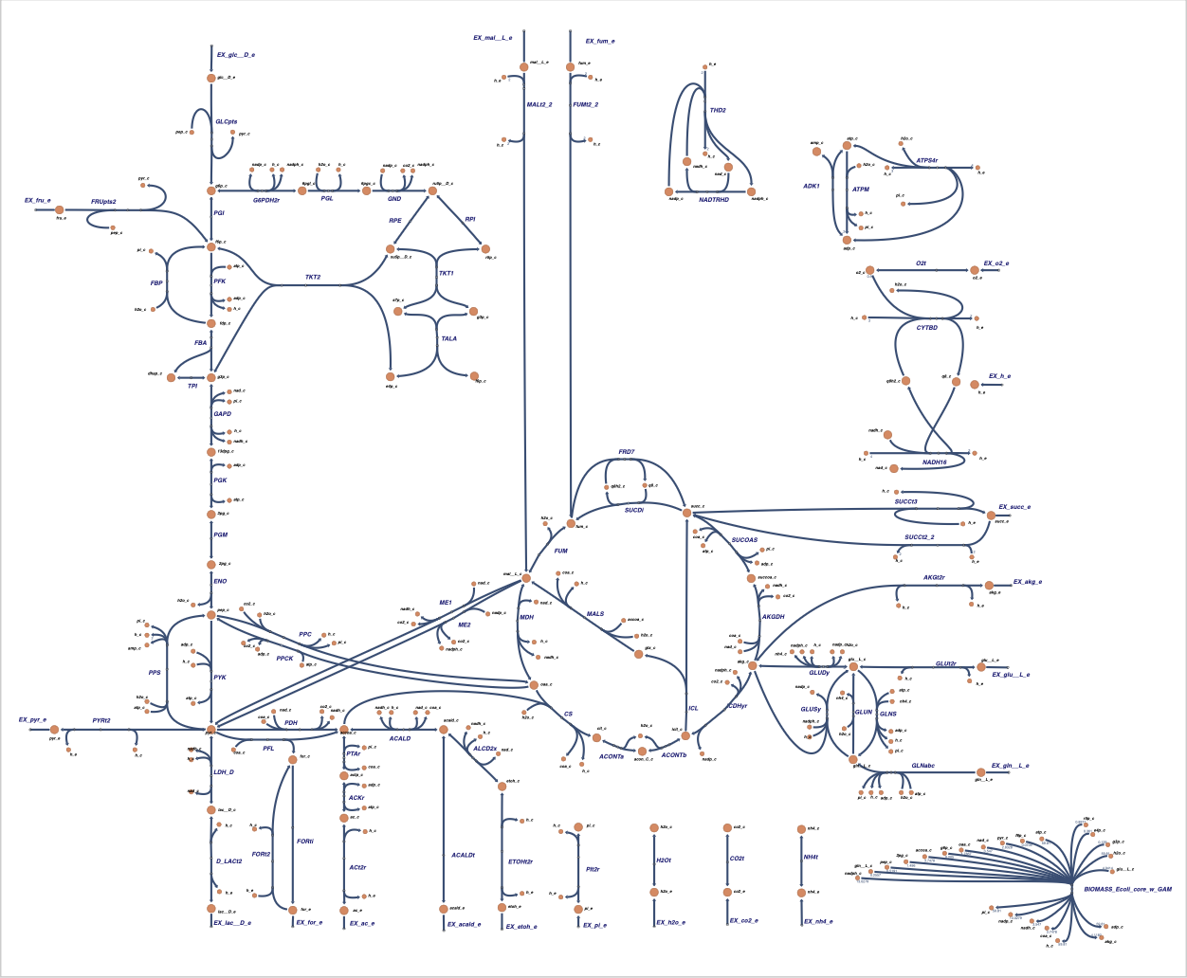
Example:
Escher-map:
Reaction ID
Metabolites ID
components of metabolism
Figure 3: ESCHER-map.
https://escher.github.io/#/app?map=e_coli_core.Core%20metabolism&tool=Builder&model=e_coli_core.

Slide 6
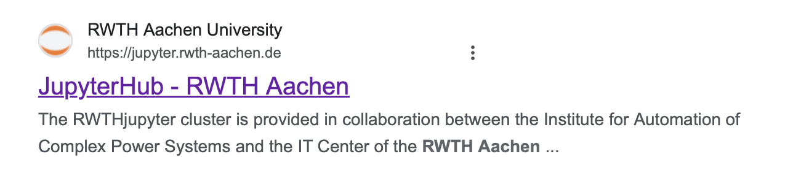
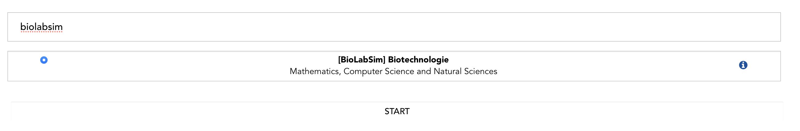
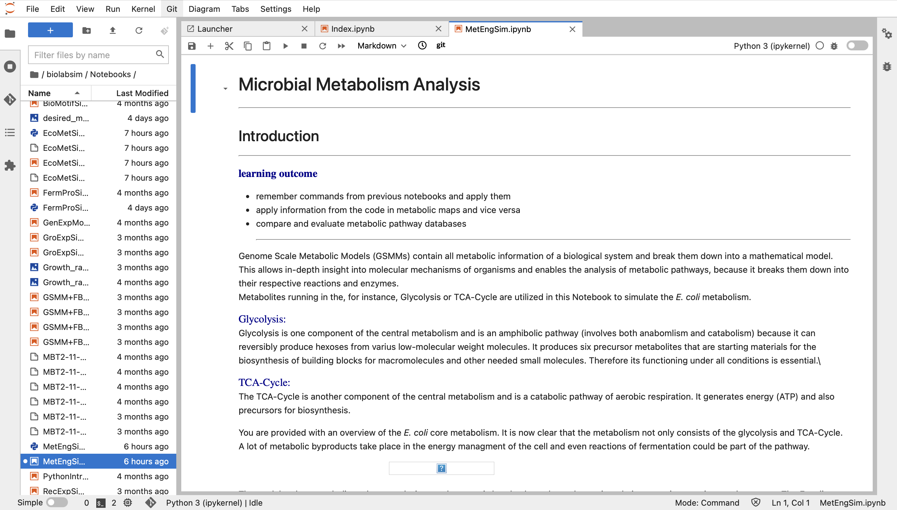
MetEngSim Notebook
Working environment:
RWTH Jupyter hub (biolabsim)
*click* Notebooks
*click* MetEngSim.ipynb
Installing requirements
Restarting Kernel

Slide 7
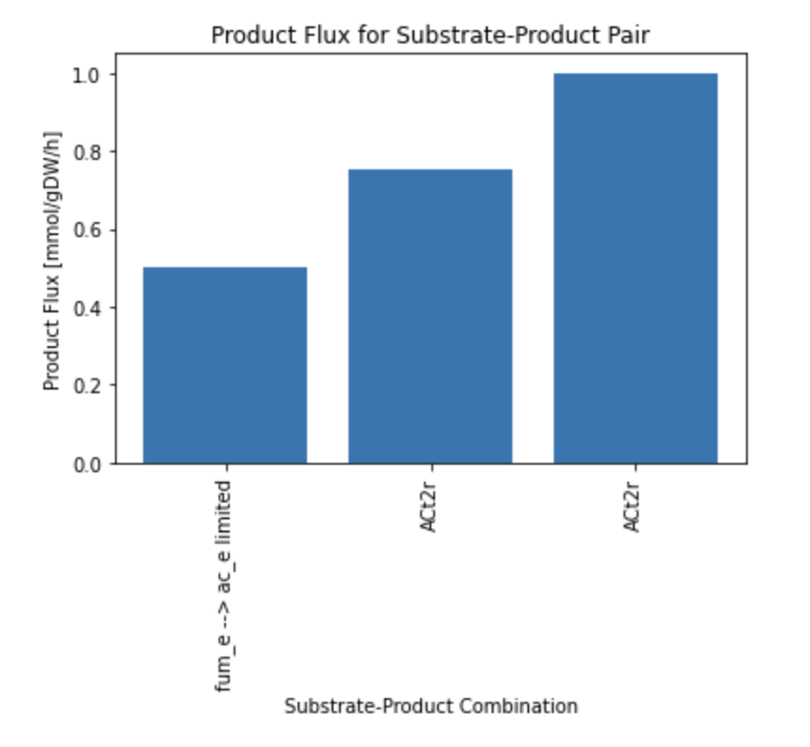
MetEngSim Notebook
Theoretical background
Metabolic pair (substrate and product)
Main tasks:
Familiarize with metabolic pathways by utilizing databases
Solve limited biomass outcome
Experiment
Figure 4: Optimized model with correct reaction ID.

Slide 8

Evaluation
https://www.soscisurvey.de/BioLabSim24/

Slide 9
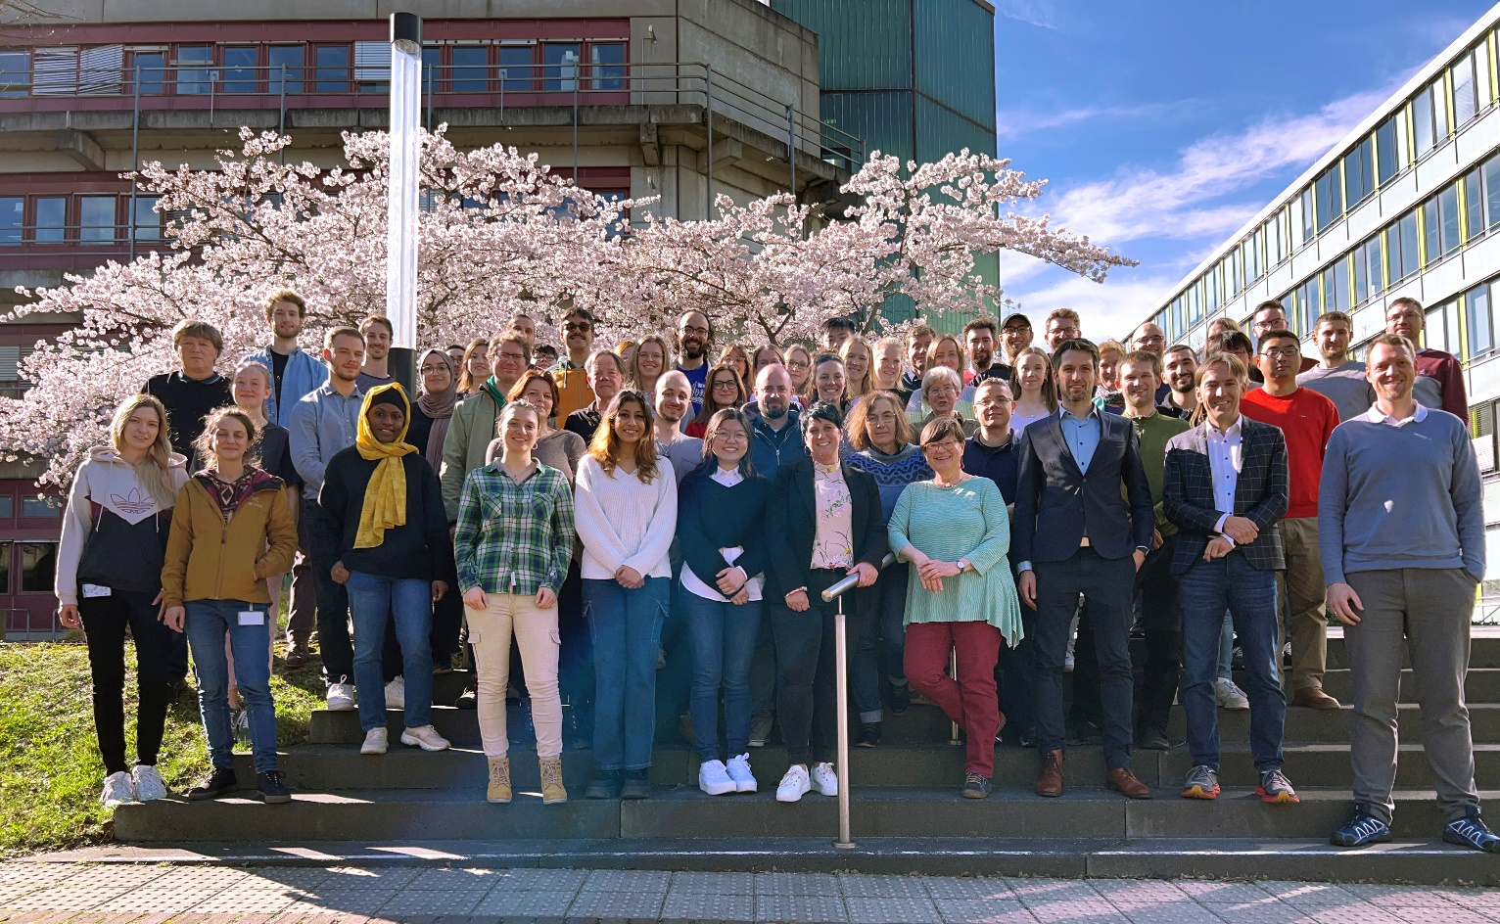
Thank you for your attention Questions?

Slide 10

Authors and License
Check the BioLabSim.nrw members at:
https://git.rwth-aachen.de/ulf.liebal/biolabsim/-/blob/91dd40b2f40e6a24263af96c2d5b9817733f4a25/AUTHORS.md
All material in this lecture is free to use, adapt and distribute according to CC BY 4.0 citing:
Ulf Liebal, BioLabSim.nrw consortium, MetExpSim Lecture, 2024, https://git.rwth-aachen.de/ulf.liebal/biolabsim

