Slide 1
Metabolic Engineering Simulation
Paula Lanze

Slide 2
Genome-scale metabolic models
Contain information about a biological system

Slide 3
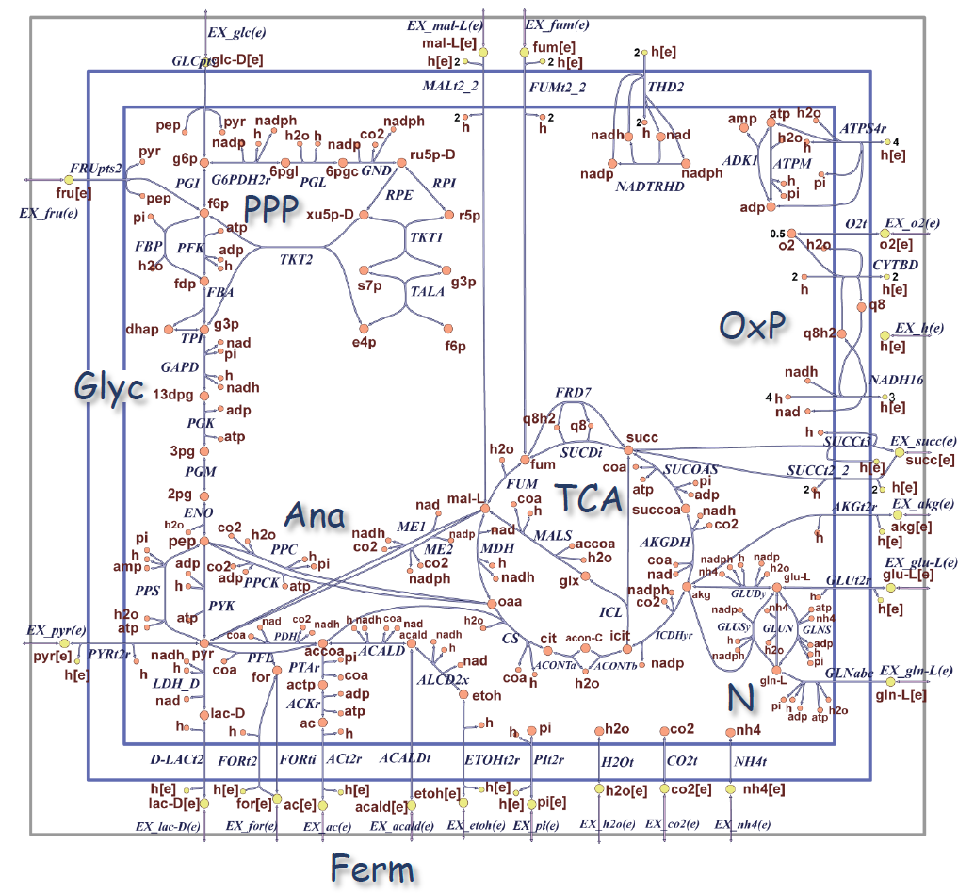
E. coli core model
A simplified model of E.coli
a great model to analyze and explore metabolic pathways
The metabolic map of the E.coli core model
the larger letters (Glyc, PPP, etc.) refer to the major components of the metabolism
(OxP) oxidative phosphorylation
(Glyc) glycolysis pathway
(PPP) pentose phosphate pathway
(TCA) tricarboxylic acid cycle
(Ana) glycoxylate cycle, gluconeogenesis, and anapleurotic reactions
(Ferm) fermentation
(N) nitrogen metabolism
Figure 1: E. coli core metabolism.
https://opencobra.github.io/cobratoolbox/stable/tutorials/reconstruction/ecoliCoreModel/part1/tutorial_ecoliCoreModel_part1.html

Slide 4
Databases
Kyoto Encyclopedia of genes and genomes (KEGG):
Bioinformatics database, containing genes, proteins, reactions and metabolites, provides a metabolic-map
BioCyc/EcoCyc:
Collection of genome databases, containing genes, enzymes, reactions and metabolites, provides a metabolic-map
BiGG Models:
database for genome-scale metabolic networks, utilizes ESCHER-map for reactions, enzymes, metabolites and pathways
ChatGPT:
Artificial Intelligence (AI), provides information about reactions and metabolites, does not provide a metabolic map

Slide 5
MetEngSim Notebook
RWTH Jupyter hub (biolabsim)
Theoretical background
Metabolic pair (substrate and product)
Main tasks:
Familiarize with metabolic pathways by utilizing databases
Solve limited biomass outcome
Experiment

Slide 6
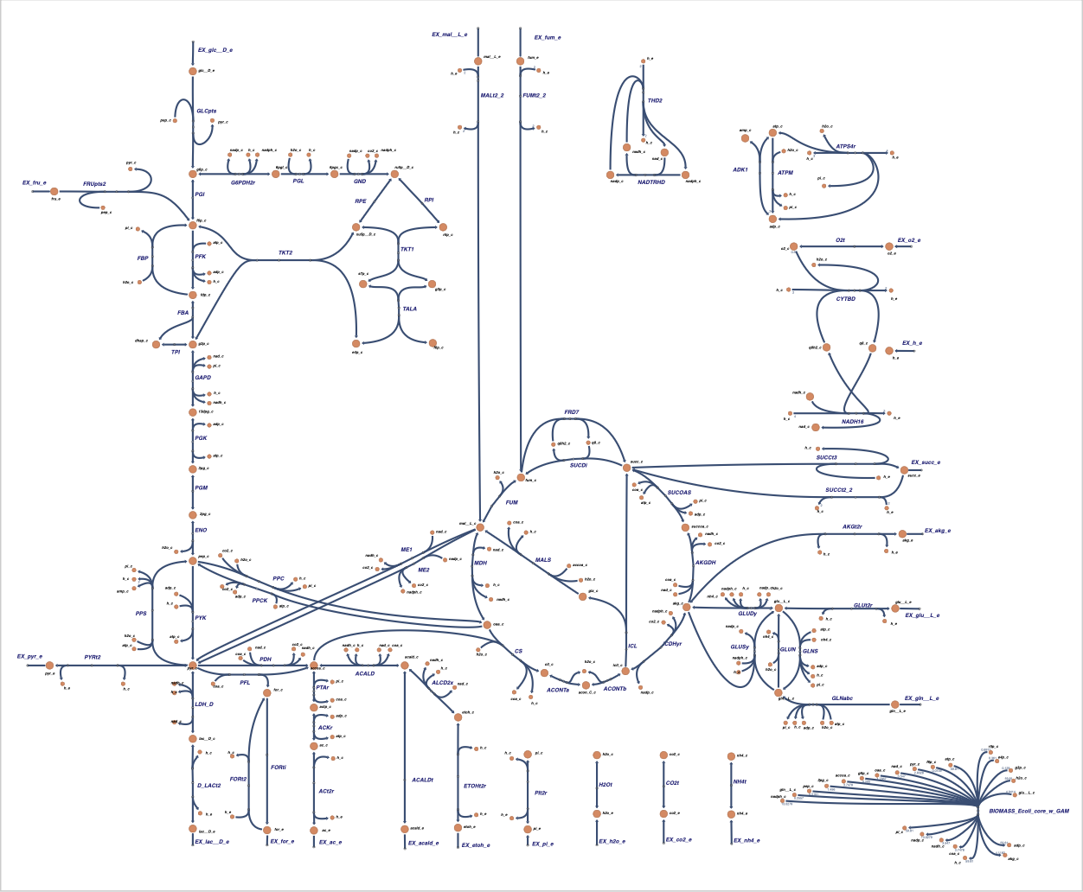
Beispiel:
Escher-map:
Reaction ID
Metabolites ID
components of metabolism
Figure 2: ESCHER-map.
https://escher.github.io/#/app?map=e_coli_core.Core%20metabolism&tool=Builder&model=e_coli_core.

Slide 7

Evaluation
https://www.soscisurvey.de/BioLabSim24/

Slide 8
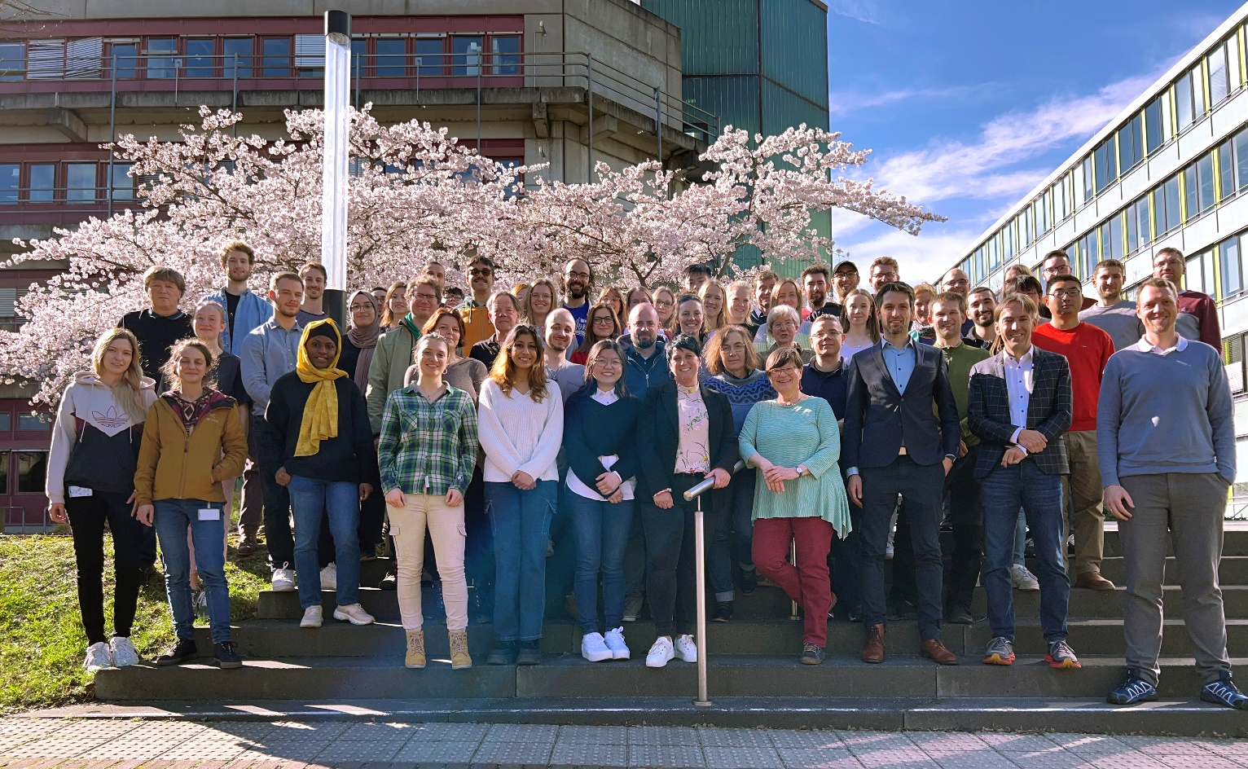
Thank you for your attention Questions?
Acknowlegements
…
Funding
…

