Slide 1

BioLabSim
Ulf Liebal
Iris Broderius
Lars Küpfer
Lars Blank

Slide 2
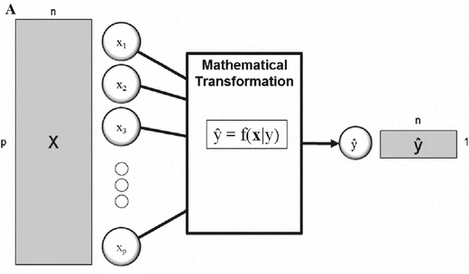
Principles of Regression
Variables
Observations
Regression:
Prediction of continuous observations with variables.
Mathematical transformation:
Machine learning with generic formula.
Mechanistic modeling with biological interactions and laws.
Machine learning
VS
Mechanistic modeling
D. I. Broadhurst and D. B. Kell, doi: 10.1007/s11306-006-0037-z
Examples
Machine Learning
X: Sequence Library with mutations in promoter region
Y: Expression rate, measured with GFP
Regression model: Random Forest
Mechanistic Modeling
X: time of culture growth
Y: Biomass
Regression model: Logistic Function

Slide 3
Promoter Activity Prediction with Random Forest
Synthetic Promoter Library:
Promoter samples
Nucleotide Positions (in our case 40)
Base variations (A, C, G, T)
Observation (GFP activity, real number)
Pos | 1 | 2 | 3 | GFP-Exp
Sample 1 | A | T | T | 10
Sample 2 | A | G | T | 11
Sample 3 | G | G | T | 2
GFP-Pred
10
10.5
6.5
Tree #1
Trained with Samples 1, 3
If: Pos1 == A
Tree #2
Trained with Samples 1, 2
If: Pos2 == G
Algorithm
Select sample subset.
Select random position (1-40).
Find nucleotide that predicts expression.
Average results of many algorithms.
Yes
No
Yes
No
10
2
11
10

Slide 4
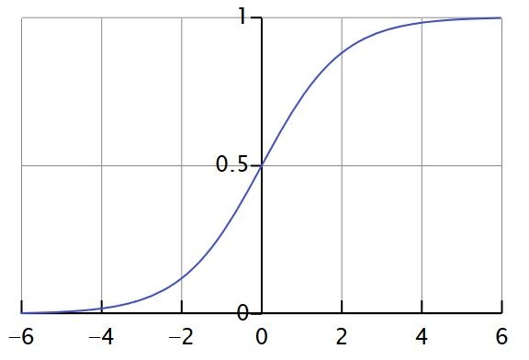
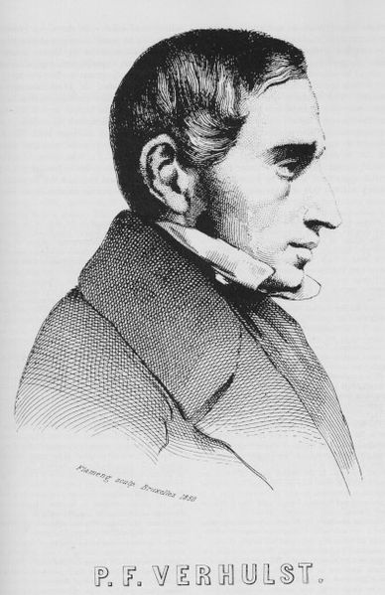
Biomass Prediction with the Logistic Function
Logistic Function – self-limiting Growth of a Biological Population Originally due to Verhulst
P(t) = biomass conc. after t hours [g/L]
K = maximum biomass conc. [g/L]
P₀ = biomass conc. of inoculum [g/L]
r = growth rate (temperature-dependent) [ - ]
t = time [h]
source: https://en.wikipedia.org/wiki/Logistic_function

Slide 5
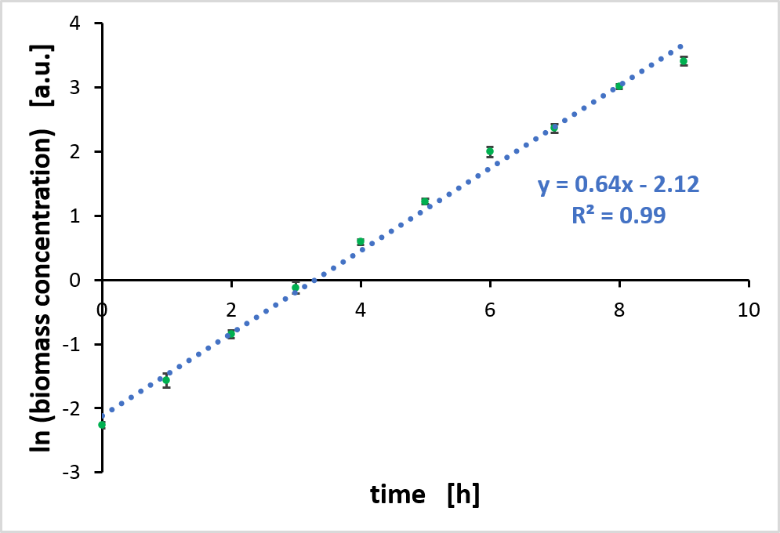
Calculating of the growth rate of each cultivation
Determine mean value and standard deviation (only necessary for biological replicates)
Plot the Logarithm of biomass concentrations against time
Perform a linear regression with the linear range
→ The slope of the regression line is equal to the growth rate
Example cultivation from BioLabSim at 35 °C. Shown is the mean value and the standard deviation of three biological replicates.

Slide 6
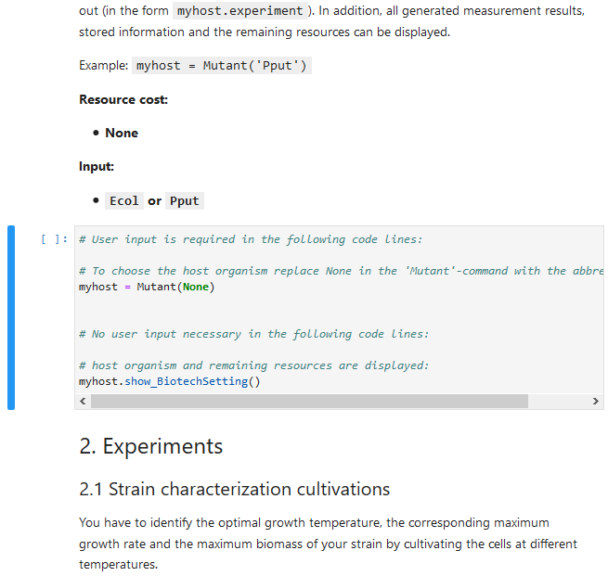
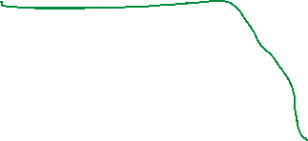
The BioLabSim is based on a Jupyter Notebook
Embedded in the browser
Composed of a sequence of cells that can be either text or python code cells to be run
Main page to work on is 1-Laboratory: Work through it and adjust the code cells in such a way that the simulations are successful
After execution a code cell the output is shown directly beneath
Code cells can be executed multiple times
Display of the status of a code cell
Marker of the currently active cell
To activate a cell below or above, use the arrow down and up keys in Command mode
more detailed information on Jupyter Notebook Cheat Sheet
Extract from 1-Laboratory.ipynb
Not executed yet
Currently executing
Executed, number correspomds to the execution order of the cells

