Slide 1
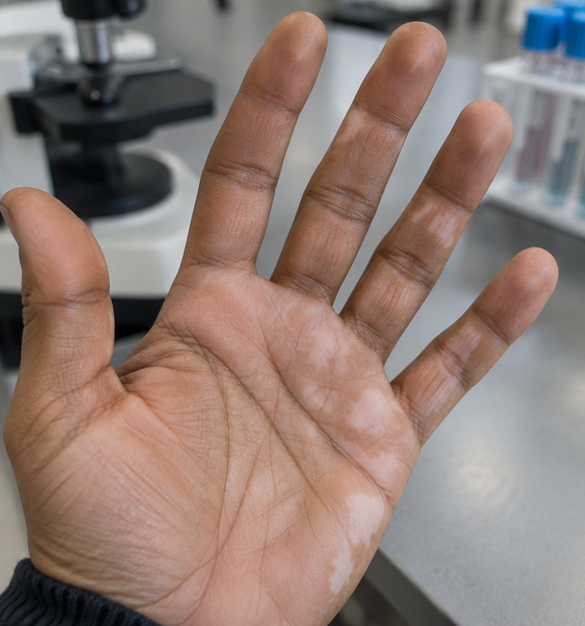
Continuous and Discontinuous Variation
Investigating human traits and biological data
Notes:
Welcome students and state that today's practical focus examines how genetic and environmental influences shape measurable phenotypes.

Slide 2
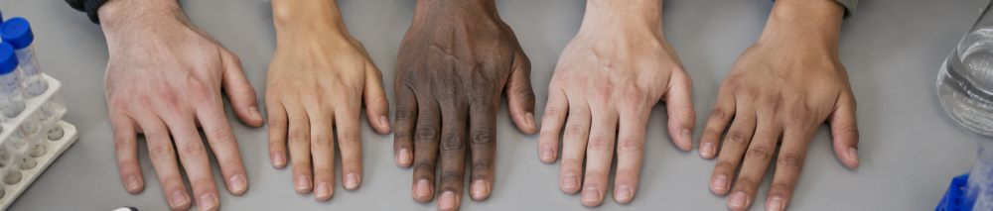
Learning Objectives
What: Investigate measured and categorical traits.
Why: Infer how continuous and discontinuous variation differ.
How: Measure, classify, tabulate and graph evidence.
Notes:
Set out the three aims: what learners will investigate, why they will infer a data pattern, and how they will measure or classify, tabulate and graph results.

Slide 3

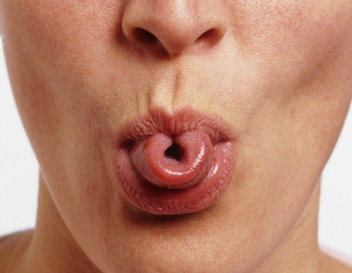
Starter: Phenotypic Observation
Let students answer
Which is measured: hand span or tongue-rolling ability?
Notes:
Facilitate a brief 3-minute opening discussion.
Listen for the distinction between a numerical measurement (hand span) and a categorical observation (tongue-rolling ability).

Slide 4
Starter: Phenotypic Observation
Let students answer
Compare the records.
Measure hand span in centimetres.
Classify tongue rolling as “can” or “cannot”.

Slide 5
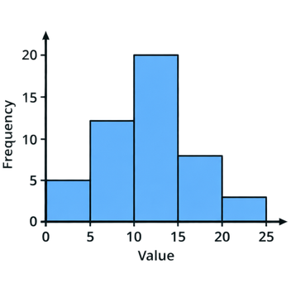
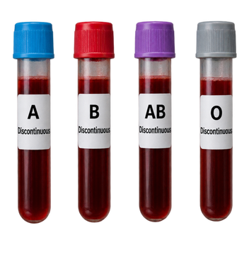
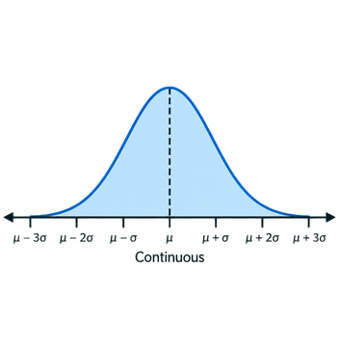
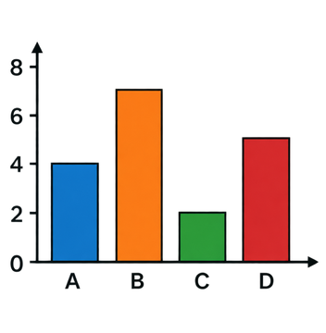
Key Terms
Histogram 直方圖
Touching bars
Discontinuous 不連續
Named categories
Continuous 連續
A measured range
Bar chart 棒形圖
Separate bars
Notes:
Review the four essential terms. Emphasise that bars touch in histograms because intervals are adjacent, whereas bar charts require gaps.

Slide 6
More key terms
Variation 變異
Differences between individuals.
Phenotype 表現型
An observable characteristic.
Frequency 頻數
The number of observations.
Class interval 組距
A range used to group values.

Slide 7
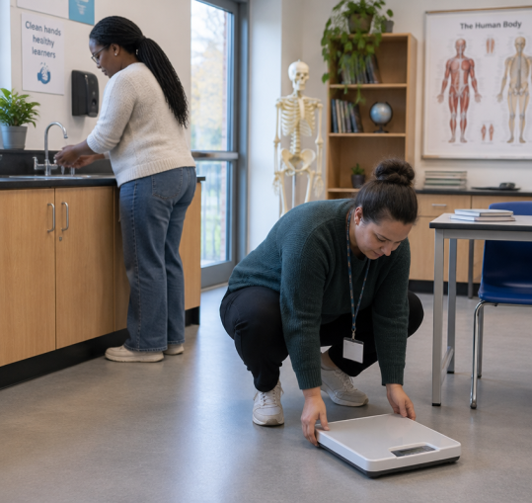
Risk assessment
Consent first; anyone may opt out.
Keep body mass private; share grouped totals.
Place balances on level floors; avoid trips.
Wash hands after plants or seeds; do not taste.
Use simulated blood-group data.

Slide 8
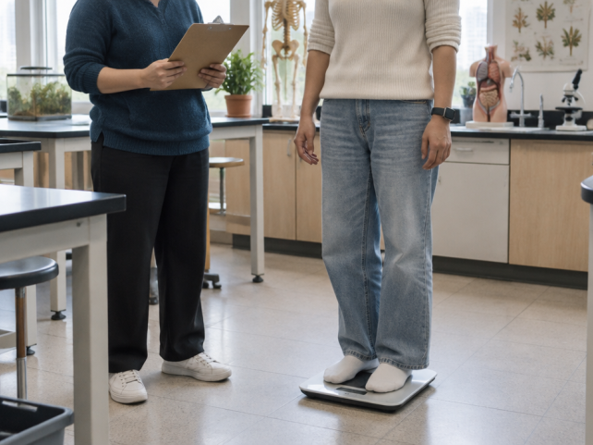
Investigation 1: Body Mass
Measure and record
Gain consent; zero the balance.
Stand still; record one reading in kg privately.
Enter a code and mass in a table. Do not use names.
Then: Choose and justify a graph.
Notes:
Keep participation voluntary and measure body mass privately with consent. Use anonymous codes, do not put individual values on the board, and pool only grouped results.

Slide 9
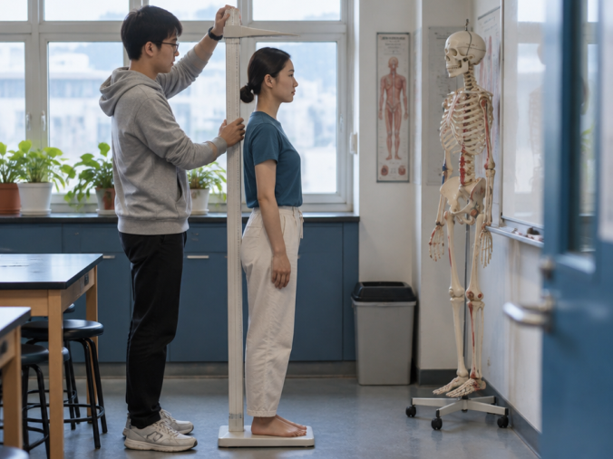
Investigation 2: Height
Measure and record
Remove shoes; stand upright at a stadiometer.
Keep head level; measure to the crown once.
Enter a code and height in cm in a table.
Then: Choose and justify a graph.
Notes:
Demonstrate stadiometer measurement with the head level and posture standardised. Record one reading in centimetres.

Slide 10
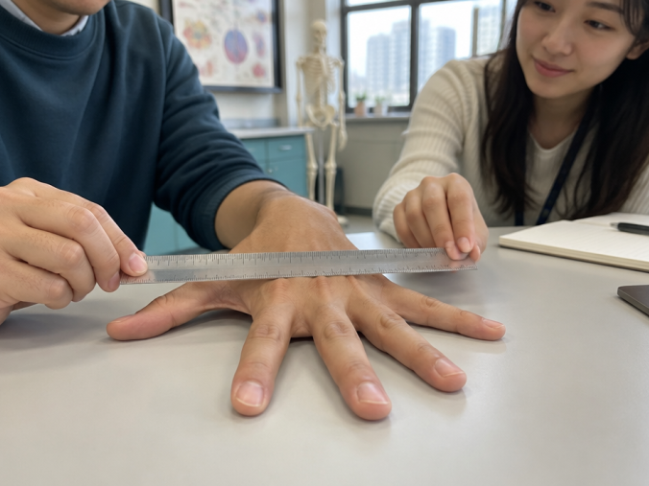
Investigation 3: Hand Span
Measure and record
Place one hand palm-down; spread fingers gently.
Measure thumb tip to little-finger tip once, in cm.
Enter a code and hand span in a table.
Then: Choose and justify a graph.
Notes:
Standardise the hand used and fingertip endpoints. Compare measured span values and discuss why intermediate values are possible.

Slide 11
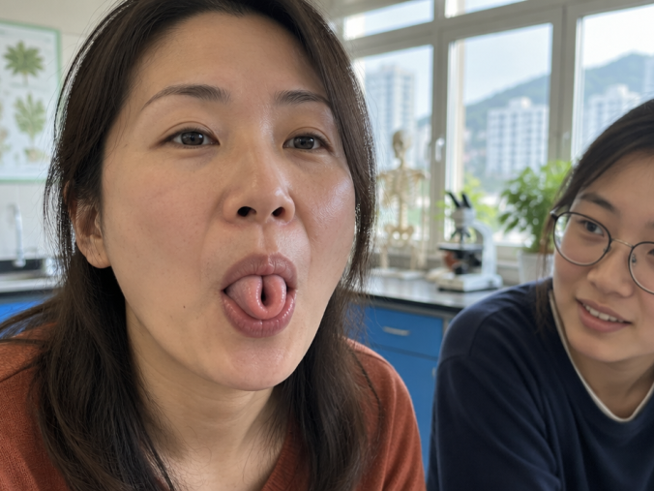
Investigation 4: Tongue Rolling
Observe and record
Invite volunteers; allow opting out.
Try tongue rolling once.
Tally “can” or “cannot” in a nameless table.
Then: Choose a graph; explain your choice.
Notes:
Record the voluntary observation as “can” or “cannot” and tally frequencies. Stress that this classification does not establish the trait's inheritance.

Slide 12
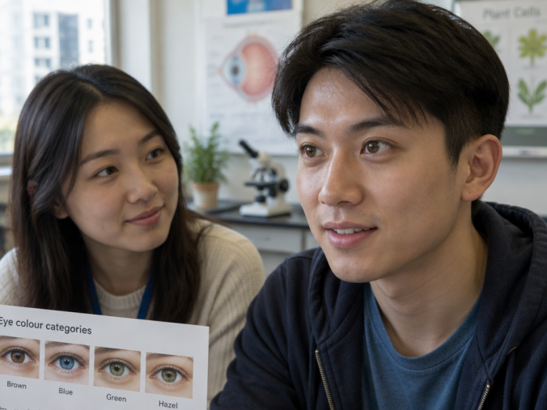
Investigation 5: Eye Colour
Observe and record
Ask consent; participation is optional.
Use steady light; agree colour categories.
Record one category in a nameless tally table.
Then: Choose and justify a graph.
Notes:
Agree eye-colour categories before recording. Discuss how mixed shades can make category boundaries subjective; keep names off the frequency table.

Slide 13
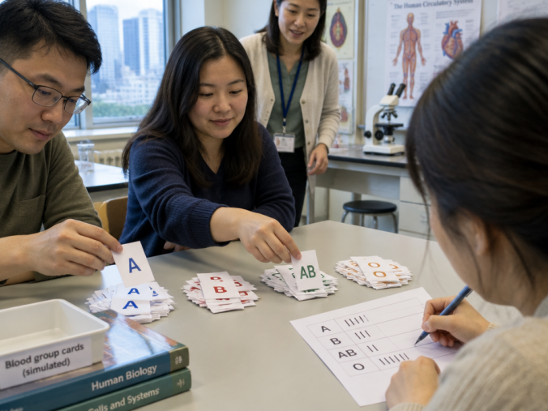
Investigation 6: Blood Group
Classify and record
Use simulated data only.
Sort each result into A, B, AB or O.
Make a nameless table; tally and count each group.
Then: Choose and justify a graph.
Notes:
Use only a simulated supplied data set; never ask learners to reveal blood groups.

Slide 14
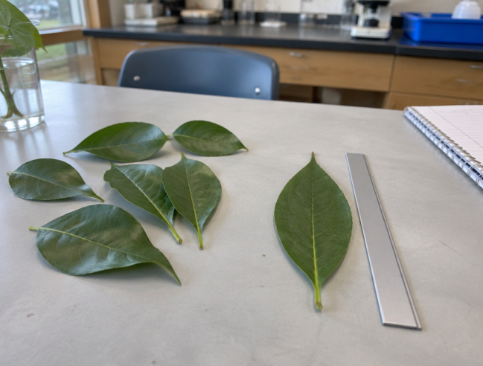
Investigation 7: Leaf length
Use leaves from the same species.
Measure blade base to tip once, in cm.
Table: leaf number and length.
Choose and justify a graph.

Slide 15
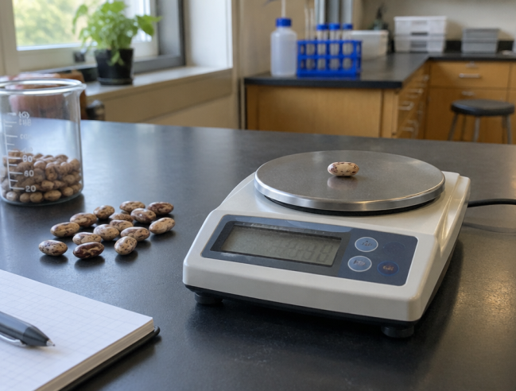
Investigation 8: Seed mass
Use dry seeds of the same type.
Zero the balance; weigh each seed once in g.
Table: seed number and mass.
Choose and justify a graph.

Slide 16
Infer from Your Evidence
1. Observe
Which results are measurements? Which are categories?
2. Compare
Can values fall between measurements? Do categories have intermediates?
3. Infer
State a rule for each data type, using your evidence.
Then: Compare and justify your graph choices.
Notes:
Guide learners from their own tables and graphs to a general rule: identify evidence, compare how values are recorded, then infer the shared pattern. Do not invent class frequencies.

Slide 17
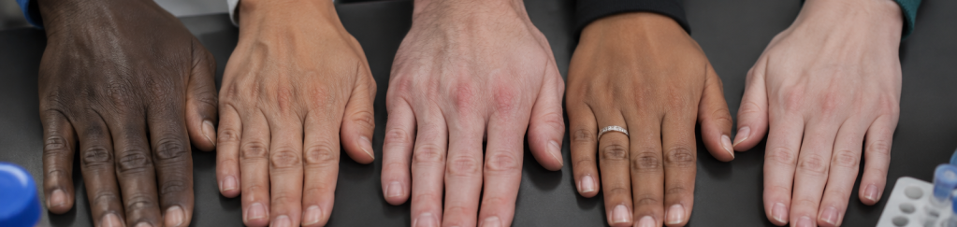
Biological Variation
Phenotype is shaped by genotype and environment. We can measure some differences and classify others into categories.
Notes:
Highlight that phenotype is the outward expression of genotype modulated by environment. Introduce why quantitative measurements matter.

Slide 18
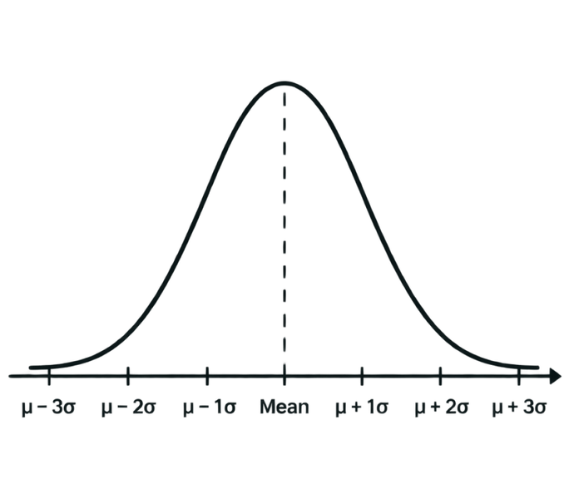
Continuous Variation
Measured values span a range; intermediate values are possible.
Examples: height, body mass and hand span.
Many such traits reflect several genes and environmental effects.
Grouped measurements can be shown in a histogram.
Notes:
Emphasise that the term 'continuous' means that between any two recorded values, an intermediate value can theoretically exist.

Slide 19
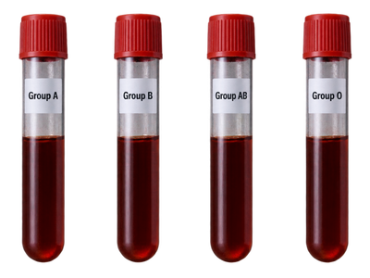
Discontinuous Variation
Record each observation in a named category, then count category frequencies.
Examples: ABO blood groups and the categories used for eye colour or tongue rolling.
Use a bar chart to compare categories.
Categories alone do not explain inheritance.
Distinct categories; no intermediates in the classification.
Notes:
Emphasise that categories describe how an observation is recorded; they do not by themselves prove a simple genetic cause. Model a frequency table and separate bars.

Slide 20
Evaluate the Investigation
How could you measure hand span more consistently?
1
What limits conclusions from one class?
2
How do class intervals affect a histogram?
3
Notes:
Lead an evaluation discussion. Prompt learners to think about sources of error and the criteria needed to make scientific data valid and generalisable.

Slide 21
Main: Trait Classification Check
Let students answer
Which pair is classified correctly?
Hand span: categorical; blood group: continuous
1
Eye colour: continuous; height: discontinuous
2
Tongue rolling: continuous; hand span: categorical
3
Hand span: continuous; tongue-rolling group: categorical
4
Notes:
The correct option is Hand span: continuous; tongue-rolling group: categorical. Hand span is measured across a numerical range; this classroom tongue-rolling observation is recorded in categories.

Slide 22
Main: Trait Classification Check
Let students answer
Which pair is classified correctly?
Hand span: categorical; blood group: continuous
1
Eye colour: continuous; height: discontinuous
2
Tongue rolling: continuous; hand span: categorical
3
Hand span: continuous; tongue-rolling group: categorical
4
✓

Slide 23
Plenary: Graph Construction Test
Let students answer
A hand-span histogram has gaps between its bars.
👍 True
👎 False
Notes:
The statement is false.
Hand span is continuous quantitative data grouped into adjacent intervals; bars must touch with no gaps between them in a histogram.

Slide 24
Plenary: Graph Construction Test
Let students answer
A hand-span histogram has gaps between its bars.
👍 True
👎 False
✓
Why?
False. Histogram bars touch between continuous intervals.

Slide 25
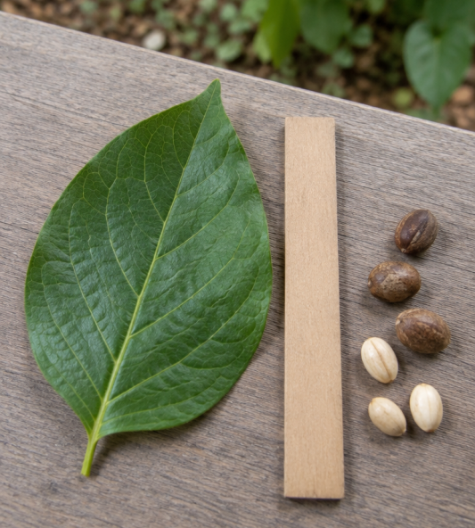
Plenary: Be the Biologist
Choose one measurement and one category from our investigations.
Classify each type of variation. Why?
Choose a graph for each. Explain your choices.
Suggest one way to improve the evidence.
Notes:
Histograms suit grouped measurements and bar charts suit categories. Ask students to justify classifications from their evidence and suggest a realistic improvement, such as a larger, more representative sample.

Slide 26
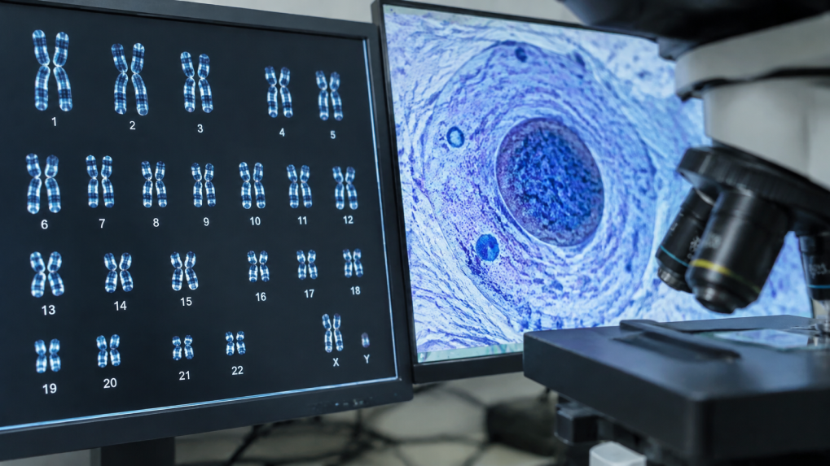
Summary of Variation
Measurements span ranges: continuous variation. Named categories: discontinuous variation. Match the graph to the evidence.
Notes:
Summarise how the class investigation separates a measured range from categorical observations, and connect each data type to an appropriate graph. Categories alone do not establish inheritance.

