Slide 1

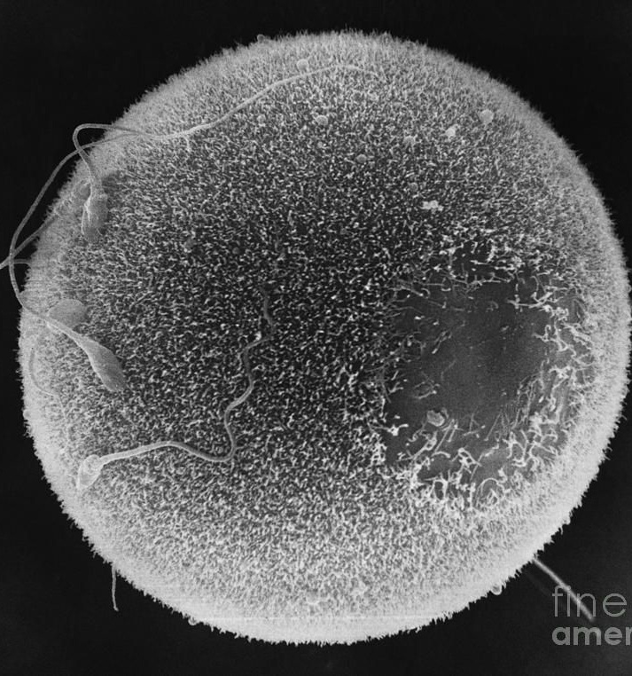
Human Reproduction
Cambridge IGCSE Biology (16.4 Core & Supplement)

Slide 2
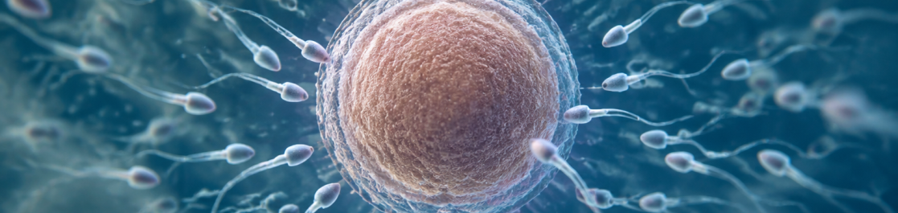
Starter: Scale and Numbers
CORE CONTENT
Consider this biological puzzle: A human male produces over 100 million sperm cells every single day, yet a human female releases only one egg cell every 28 days. Why does such an extreme evolutionary disparity in gamete production exist between the sexes?

Slide 3
Learning Objectives
What: Identify reproductive anatomy and explain gamete adaptations in humans.
1
Why: Understand how anatomical structures ensure successful fertilisation and embryo survival.
2
How: Analyse placental exchange mechanisms, fetal protection, and pathogen transport.
3

Slide 4
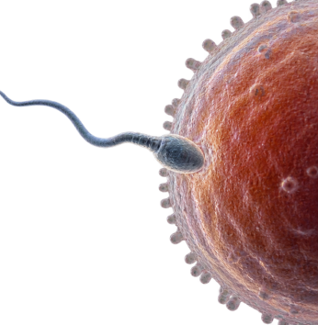
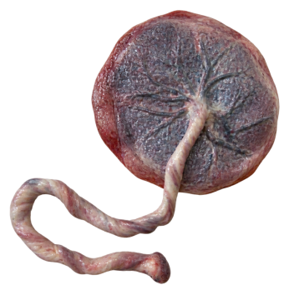
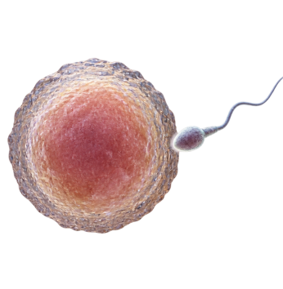
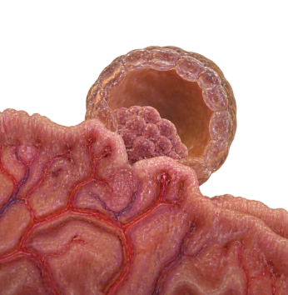
Key Vocabulary
Fertilisation: Fusion of the nuclei from a male gamete and female gamete.
Placenta: Organ facilitating nutrient and gas exchange between maternal and fetal blood.
Gamete: A specialised haploid sex cell (sperm or egg) carrying 23 chromosomes.
Implantation: Sinking of the early embryo ball of cells into the uterine lining.

Slide 5
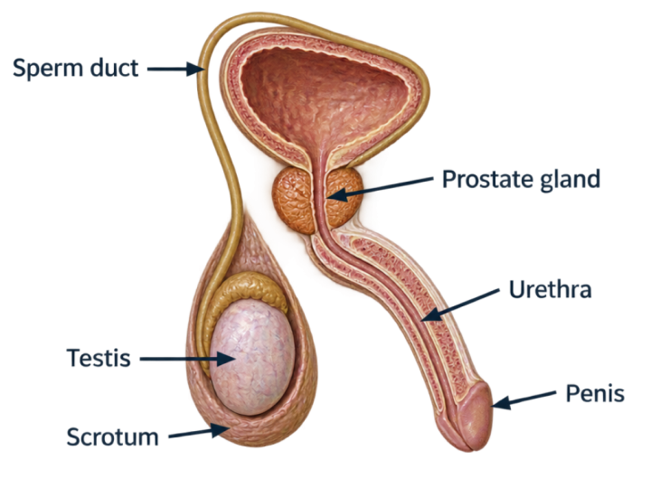
Male Reproductive System Anatomy
CORE CONTENT
The male system produces gametes and delivers them to the female tract:
Testes: Production of sperm cells and testosterone.
Scrotum: Sac holding testes outside the body cavity at 2-3°C below core body temperature.
Sperm ducts (vas deferens): Muscular tubes carrying sperm from testes to urethra.

Slide 6
Semen Production & Ejaculation
Sperm cells require specialised fluid media to survive the acidic environment of the female vagina:
Prostate gland: Secretes an alkaline fluid that neutralises vaginal acidity and activates sperm motility.
Urethra: Dual-purpose duct that conveys semen or urine through the penis to the exterior.
Penis: Contains erectile tissue that fills with blood to facilitate internal fertilisation.
CORE CONTENT
Prostate, urethra, and erectile mechanisms during delivery.
📌
Exam Specification Note
A ring of muscle stops urine and semen from exiting simultaneously through the urethra.

Slide 7
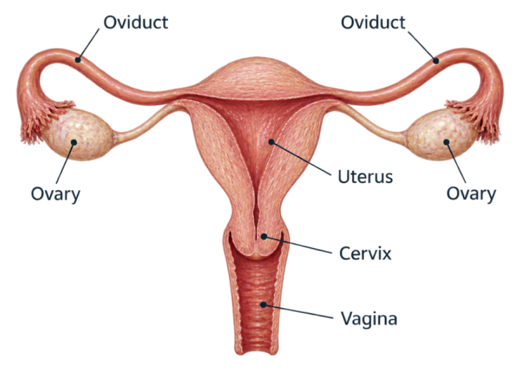
Female Reproductive System Anatomy
CORE CONTENT
The female reproductive system produces ova, enables fertilisation, and supports development:
Ovaries: Release female gametes (ova) and secrete oestrogen and progesterone.
Oviducts (fallopian tubes): Ciliated tubes transporting the egg towards the uterus; the site of fertilisation.

Slide 8
Uterus, Cervix and Vagina
CORE CONTENT
Uterus
Muscular organ with a soft, vascular lining where the embryo implants and fetus develops during gestation.
Cervix
Narrow neck of muscular tissue at the base of the uterus that dilates during birth and produces protective mucus.
Vagina
Elastic muscular tube receiving the penis during sexual intercourse and acting as the birth canal during parturition.
Cilia in Oviduct
Microscopic ciliated epithelial cells waft the ovum along the oviduct towards the uterus using coordinated wave beats.

Slide 9
Match Organs to Functions
Match the words with the definitions
Oviduct
Muscular chamber where embryo implants
Testes
Produces sperm cells and male testosterone
Uterus
Site of fertilisation and ovum transport
Prostate gland
Secretes alkaline fluid to nourish sperm

Slide 10
Match Organs to Functions
✅
Match the words with the definitions
Oviduct
A
Muscular chamber where embryo implants
Testes
B
Produces sperm cells and male testosterone
Uterus
C
Site of fertilisation and ovum transport
Prostate gland
D
Secretes alkaline fluid to nourish sperm

Slide 11
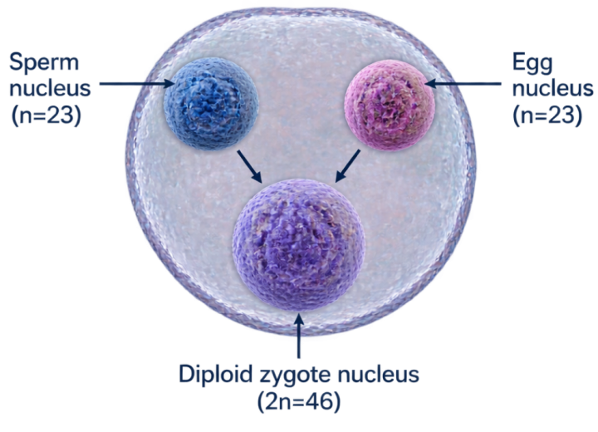
Defining Fertilisation
CORE CONTENT
The Genetic Fusion
In IGCSE Biology, fertilisation is strictly defined as: the fusion of the nuclei from a male gamete (sperm) and a female gamete (egg cell).
Each gamete is haploid ($n=23$ chromosomes). Their nuclear fusion restores the diploid number ($2n=46$ chromosomes) in the newly formed zygote.

Slide 12
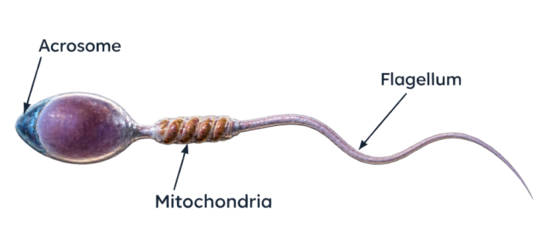
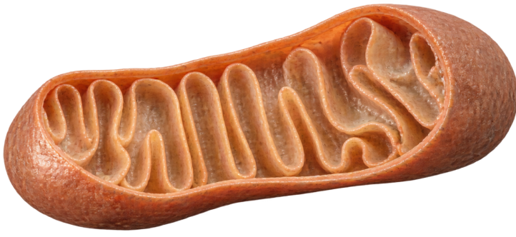
Adaptive Features of Sperm Cells
CORE CONTENT
Specialised Motility
The flagellum whips rhythmically to propel the cell through cervical mucus and up the oviduct toward the ovum.
Energy & Digestion
Spiral mitochondria supply ATP for swimming. The acrosome releases digestive enzymes to penetrate the egg jelly coat.

Slide 13
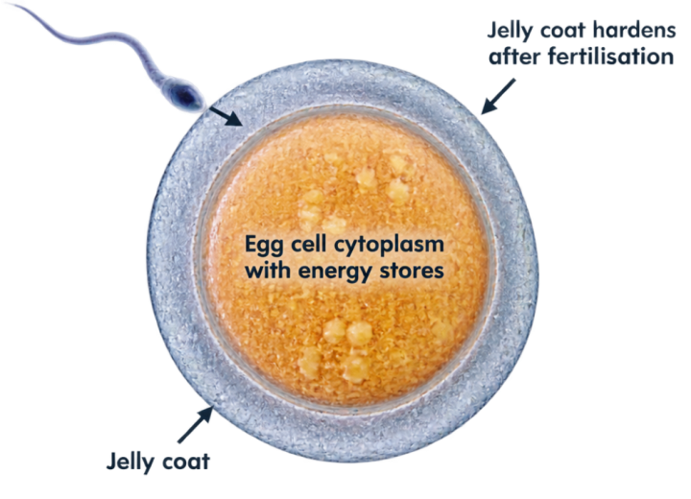
Adaptive Features of Egg Cells
CORE CONTENT
Nutrition and Monospermy
Energy stores: The large cytoplasm contains rich yolk droplets providing nutrients for early cell division before implantation.
Jelly coat (zona pellucida): Modifies chemically immediately after the first sperm nucleus enters, hardening to prevent polyspermy.

Slide 14
Gamete Comparison Matrix
Size: Sperm is microscopic (~0.05 mm long); egg is visible to naked eye (~0.1 mm diameter).
Structure: Sperm has head, midpiece, and flagellum; egg is spherical with yolk and jelly coat.
Motility: Sperm swims actively using its flagellum; egg is non-motile, moved by cilia and peristalsis.
Numbers: Hundreds of millions per ejaculation; one ovum released per menstrual cycle.
CORE CONTENT
Four core criteria tested in IGCSE examination papers.

Slide 15
Gamete Adaptation Check
Why does the jelly coat surrounding the ovum change immediately after fertilisation?
1.
To release nutrients directly into the fallopian tube
2.
To prevent any further sperm cells from entering the egg
3.
To trigger the immediate production of amniotic fluid
4.
To attract white blood cells for embryonic protection

Slide 16
Gamete Adaptation Check
✅
Why does the jelly coat surrounding the ovum change immediately after fertilisation?
1.
To release nutrients directly into the fallopian tube
✓
2.
To prevent any further sperm cells from entering the egg
3.
To trigger the immediate production of amniotic fluid
4.
To attract white blood cells for embryonic protection

Slide 17
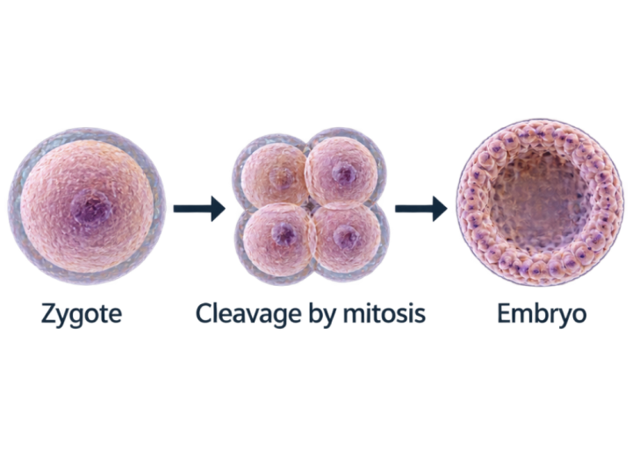
Early Embryonic Development
CORE CONTENT
From Zygote to Blastocyst
Following fertilisation in the oviduct, the single-celled zygote divides repeatedly by mitosis to form a hollow ball of cells called an embryo.
Over 4-5 days, cilia sweep the dividing embryo down toward the uterus, preparing it for uterine attachment.

Slide 18
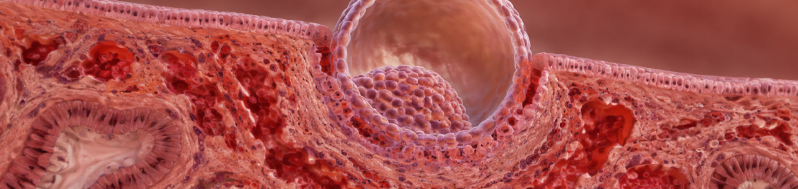
The Process of Implantation
CORE CONTENT
Around day 6 to 8 after fertilisation, the embryo reaches the uterus and implants into the spongy, vascular lining (endometrium). Implantation secures maternal nutritional access and establishes pregnancy.

Slide 19
Timeline: Ovulation to Implantation
CORE CONTENT
Day 1
Fertilisation forms a diploid zygote.
Days 6-8
Embryo implants into uterine wall.
Day 0
Ovulation releases ovum into oviduct.
Days 2-5
Mitosis produces ball of cells in oviduct.

Slide 20
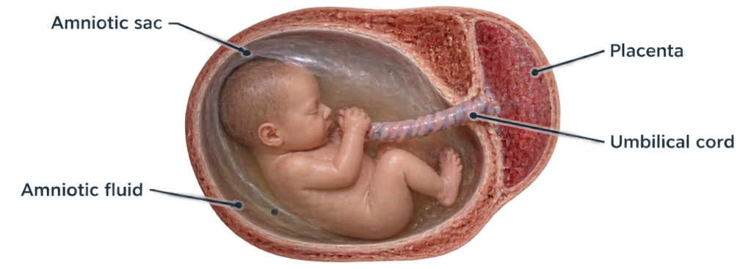
Fetal Support Systems Overview
CORE CONTENT

Slide 21
Amniotic Sac and Fluid Functions
CORE CONTENT
Mechanical Cushioning
Amniotic fluid absorbs physical shocks, preventing blunt mechanical trauma to vulnerable fetal tissues during maternal movement.
Temperature Homeostasis
The high specific heat capacity of water maintains an optimal and uniform thermal environment for enzymatic development.
Musculoskeletal Growth
Fluid buoyancy allows the fetus to practise limb movements without skeletal deformation or uterine wall compression.
Amniotic Sac Integrity
The amniotic membrane encloses the fluid hermetically, providing a sterile barrier against ascending bacterial infection.

Slide 22
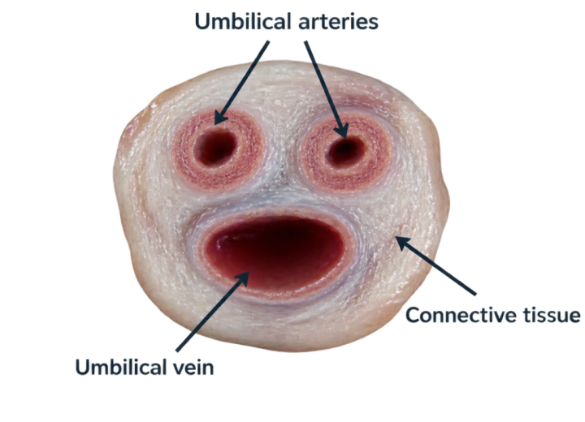
Placenta and Umbilical Cord (Core)
CORE CONTENT
Lifeline to the Mother
Placenta: A temporary disk-like organ embedded in the uterine wall, specialised for substance exchange between maternal and fetal blood.
Umbilical cord: Vascular connection containing umbilical blood vessels running between the fetus and placental chorionic villi.

Slide 23
Sequence Fetal Development
Order the chronological stages of early human reproduction from start to finish:
Mitotic cleavage forming embryo ball
Fertilisation forming diploid zygote
Ovulation of ovum into oviduct
Implantation into uterine lining

Slide 24
Sequence Fetal Development
✅
Order the chronological stages of early human reproduction from start to finish:
1
Ovulation of ovum into oviduct
2
Fertilisation forming diploid zygote
3
Mitotic cleavage forming embryo ball
4
Implantation into uterine lining

Slide 25
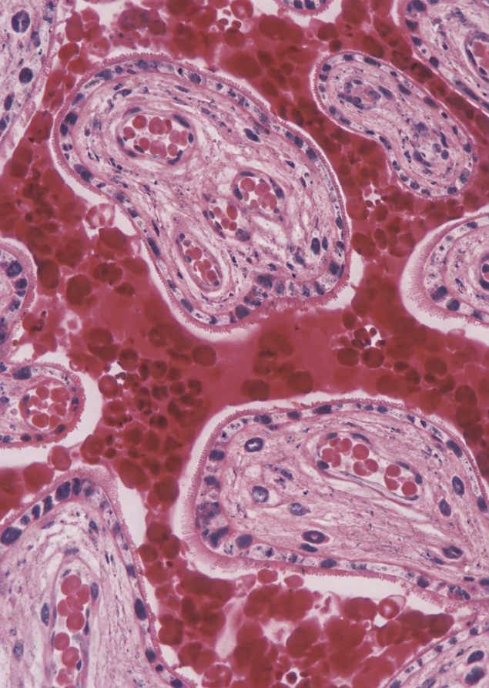
Supplement Section: Advanced Fetal Physiology
EXTENDED CONTENT
We now extend beyond basic identification to analyse counter-current exchange mechanics, placental barrier function, and the transplacental transmission of pathogens and toxins.

Slide 26
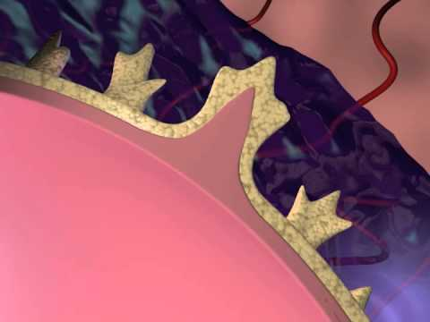
Video: Fetal Circulation and Placenta
EXTENDED CONTENT

Slide 27
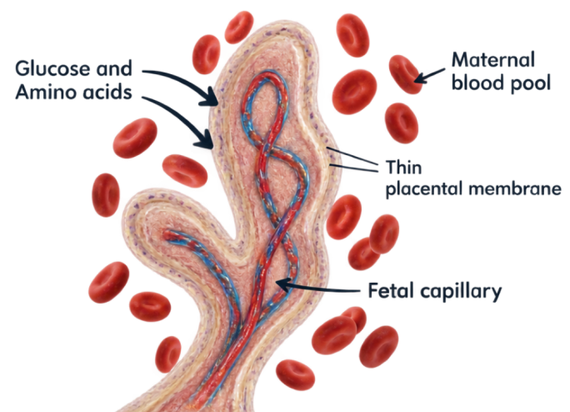
Exchange of Dissolved Nutrients
EXTENDED CONTENT
Maternal to Fetal Transfer
Maternal blood enters intervillous spaces. Nutrients diffuse down steep concentration gradients across placental membranes into fetal capillaries:
Glucose: Rapid facilitated diffusion for continuous fetal cellular respiration.
Amino acids: Active transport for fetal protein synthesis and rapid tissue growth.
Fatty acids, vitamins & mineral ions: For membrane formation and bone ossification.

Slide 28
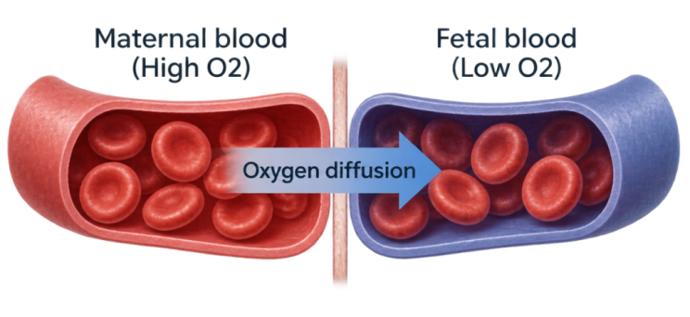
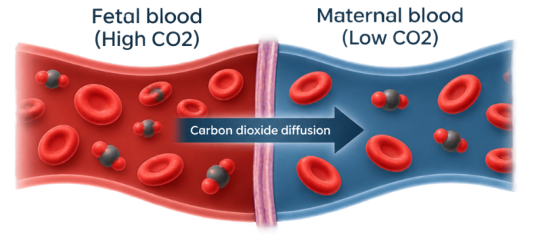
Gas Exchange Across the Placenta
EXTENDED CONTENT
Oxygen Influx
Oxygen diffuses from maternal oxyhaemoglobin to fetal haemoglobin, which has higher oxygen affinity.
Carbon Dioxide Removal
Carbon dioxide diffuses down its gradient from fetal blood into maternal plasma, then expelled by mother's lungs.

Slide 29
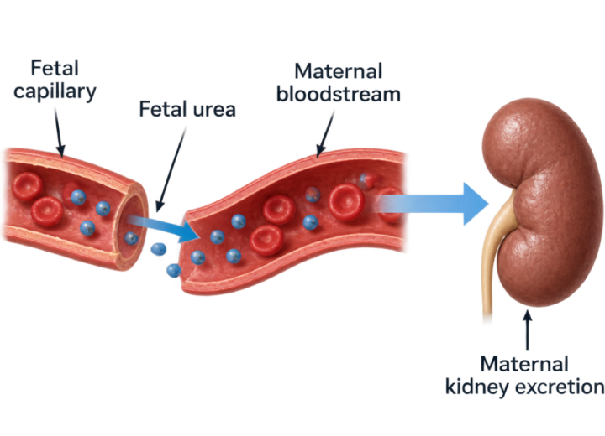
Removal of Fetal Excretory Products
EXTENDED CONTENT
Urea Clearance Mechanism
Fetal liver metabolism produces nitrogenous waste products. Urea diffuses from high concentration in fetal capillaries into maternal blood.
The maternal circulatory system carries the fetal urea to maternal kidneys for filtration and excretion in maternal urine.

Slide 30
Umbilical Vessel Circulation
Umbilical artery (two vessels): Carry deoxygenated blood and metabolic waste (urea, COX2) from fetal internal iliac arteries to placenta.
Umbilical vein (one vessel): Carries oxygenated, nutrient-rich blood from placenta into fetal inferior vena cava.
EXTENDED CONTENT
Direction of blood flow and oxygenation states.
⚠️
Common Exam Error
Unlike adult circulation, umbilical arteries carry deoxygenated blood, while the umbilical vein carries oxygenated blood!

Slide 31
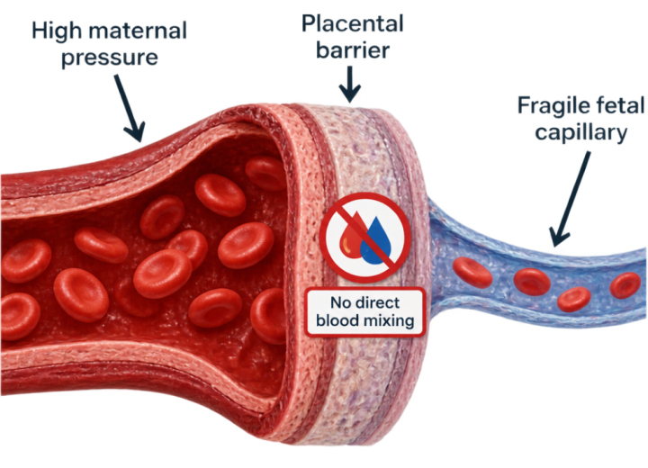
Separation of Maternal and Fetal Blood
EXTENDED CONTENT
Why Blood Must Never Mix
1. Pressure protection: High maternal arterial pressure would instantly rupture delicate fetal capillaries.
2. Immune compatibility: Maternal and fetal blood groups (ABO and Rhesus) may conflict. Direct contact triggers agglutination.

Slide 32
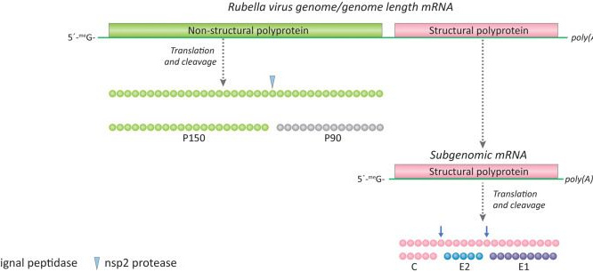
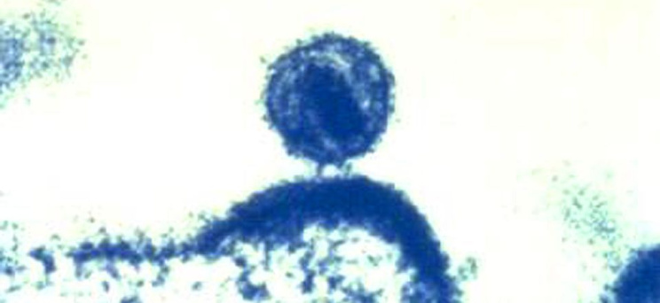
Pathogens Crossing the Placenta
EXTENDED CONTENT
Rubella Virus
Crosses placental barrier during first trimester, causing congenital defects (deafness, cataracts, cardiac malformation).
HIV Pathogen
Can cross micro-fissures in placental barrier or during delivery, potentially infecting fetal lymphocytes.

Slide 33
Toxins Crossing the Placental Barrier
EXTENDED CONTENT
Nicotine
Constricts maternal and placental blood vessels, severely reducing placental blood flow and oxygen delivery.
Carbon Monoxide
Binds irreversibly to maternal and fetal haemoglobin, causing fetal hypoxia and low birthweight.
Alcohol (Ethanol)
Diffuses freely into fetal bloodstream, impairing brain development (Fetal Alcohol Syndrome).
Therapeutic Drugs
Certain prescription medications cross villi and interfere with limb and neural tube morphogenesis.

Slide 34
Placental Transport True/False
Which statements regarding placental exchange are scientifically accurate? (Select all correct options)
1.
Nicotine can cross the placenta and cause narrowing of fetal blood vessels
2.
Urea diffuses from fetal blood into maternal blood down its concentration gradient
3.
Maternal red blood cells mix directly with fetal blood inside chorionic villi
4.
The umbilical artery carries oxygenated blood from the placenta to the fetus

Slide 35
Placental Transport True/False
✅
Which statements regarding placental exchange are scientifically accurate? (Select all correct options)
✓
1.
Nicotine can cross the placenta and cause narrowing of fetal blood vessels
✓
2.
Urea diffuses from fetal blood into maternal blood down its concentration gradient
3.
Maternal red blood cells mix directly with fetal blood inside chorionic villi
4.
The umbilical artery carries oxygenated blood from the placenta to the fetus

Slide 36
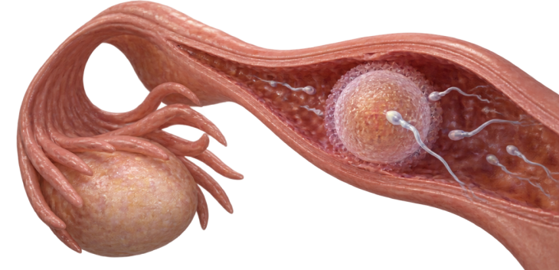
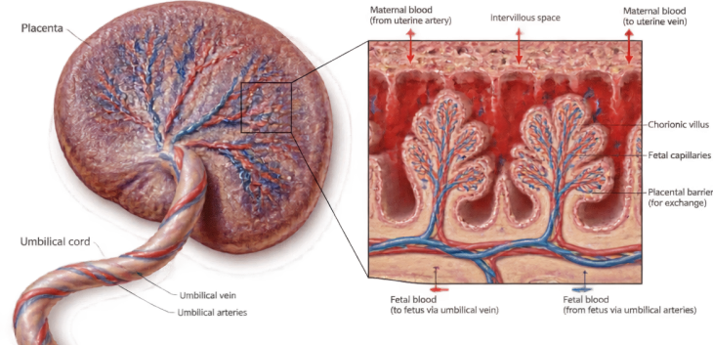
Key Takeaways: Core vs Supplement
Core Foundations
Master anatomy identification, gamete structural adaptations, definition of fertilisation, and embryo implantation.
Supplement Mastery
Understand diffusion mechanisms of gases, nutrients, and urea; vessel roles; and barrier permeability to toxins and pathogens.

Slide 37

Mastery Check
Question 1:
What specific cellular event constitutes fertilisation in humans?
Question 2:
Which blood vessel transports oxygen and dissolved nutrients from the placenta to the fetus?
Question 3:
Why does maternal blood not flow directly into the fetal circulatory system?

Slide 38
Mastery Check
✅
Answer 1:
The fusion of the nuclei of a male gamete (sperm) and a female gamete (egg cell)
Answer 2:
The umbilical vein
Answer 3:
To prevent maternal high blood pressure from rupturing fetal capillaries and to stop immune rejection between conflicting blood types

Slide 39

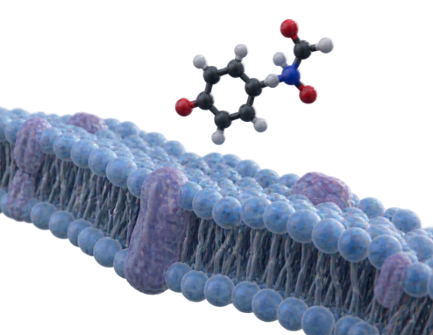
Plenary Discussion
A firm develops a painkiller for pregnant women. Why must trials test if molecules cross chorionic villi, even if the drug shows zero adult toxicity?

Slide 40
Plenary Discussion
✅
You might have said...
Small molecules diffusing across the placenta enter fetal blood.
The fetus lacks mature liver enzymes to detoxify pharmaceuticals.
Toxic exposure during organogenesis causes severe malformations.

Slide 41
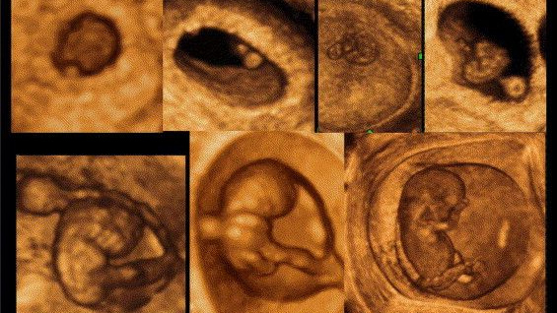
Lesson Complete: Human Reproduction
Review your syllabus checklist for 16.4 Core and Supplement objectives before the next exam practice session.

