Slide 1
Major HMs:
H3K4me1 – Enhancers (active/poised)
H3K4me2 – Promoters & Enhancers (active/poised)
H3K4me3 – Promoters (active)
H3K9me3 – Heterochromatin
H3K27ac – Promoters & Enhancers (active/poised)
H3K27me3 – Promoters (active/poised)
H3K36me3 – transcribed genes

Slide 2
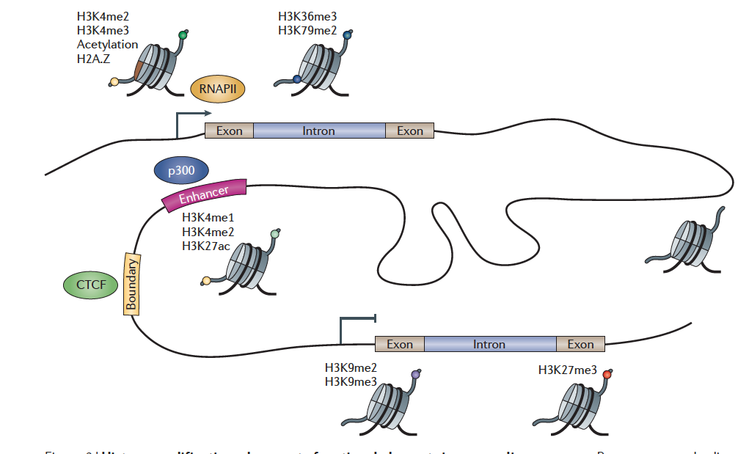
Histone modifications demarcate functional elements
Zhou, Goren & Bernstein Nature Reviews Genetics 2010

Slide 3
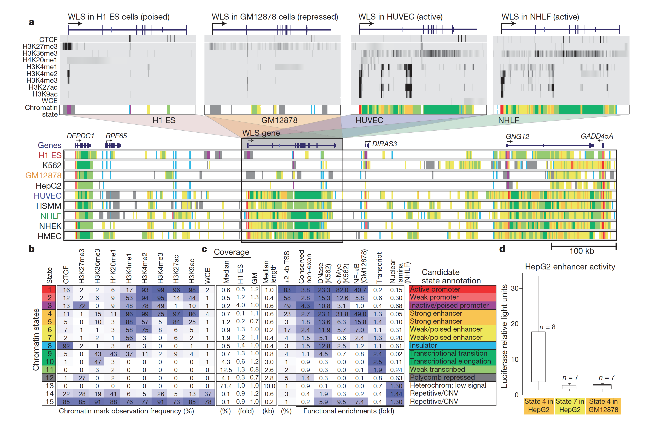
Chromatin States – Discrete Genomic Combinations of HMs
Ernst et al., Nature 2011

