Slide 1
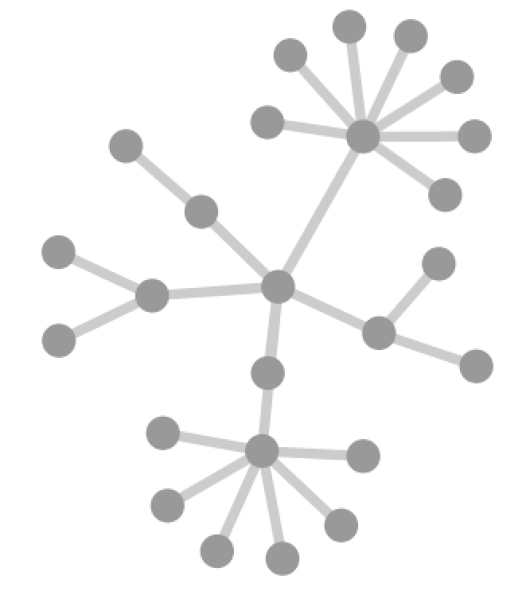
Challenges for Network Inference
Network Type?
Protein interactions
Regulatory interactions
Genetic interactions
Metabolic interactions
PTMs …
Notes:
Network analysis very exciting but it does face a few challenges
First need to decide what type of network to use for analysis
Physical interactions, functional interactions, etc …

Slide 2
Challenges for Network Inference
False positive
edges
Missing nodes
and edges
X
X
Study bias
Notes:
Information about molecular interactions within the cell are incomplete
There may be false positive information
Study bias such that highly-studied genes have more connections

Slide 3
Challenges for Network Inference
Edge direction
Activation
Inhibition
Notes:
Information about interactions also incomplete
Directional information important for reasoning about cause-effect relationships or signal transduction

Slide 4
Challenges for Network Inference
Tissue specific expression
Ubiquitous
Tissue A
Tissue B
?
Cancer
Notes:
Context is important – some genes are expressed ubiquitously while some are tissue specific
Cellular environment e.g. drug exposure or DNA damage can initiate cellular responses that alter expression paterns
How to analyze cells with aberrant expression patterns in disease state

Slide 5
Challenges for Network Inference
X
Epistasis
XX
XX
Negative
X
X
Positive
Notes:
Mutations occur on a genetic background
Interactions are often not additive
Mutations in same pathway versus parallel pathways mediating the same behavior

Slide 6
Challenges for Network Inference
X
X
Integration of data types
Mutation
Expression
PTM
X
Notes:
Multiple molecular measurement technologies often applied simultaneously
Although networks are a good framework or integration, it’s not trivial to integrate this information

Slide 7
Challenges for Network Inference
False positive
edges
Missing nodes
and edges
Tissue specific expression
Ubiquitous
X
Tissue A
X
Tissue B
?
Cancer
Study bias
Edge direction
Activation
Inhibition
X
Epistasis
Integration of data types
Mutation
Expression
PTM
XX
XX
Negative
X
X
X
Positive
Network Type?
Protein interactions
Regulatory interactions
Genetic interactions
Metabolic interactions
PTMs …
Notes:
Issues considered so far all at once

Slide 8
Challenges for Network Inference
False positive
edges
Missing nodes
and edges
Tissue specific expression
Ubiquitous
X
Tissue A
X
Tissue B
?
Cancer
Dynamic response to environmental cues
Compensatory response to mutations
Nodes often represent a population of molecules
Non-coding regions of the genome
…
Study bias
Edge direction
Activation
Inhibition
X
Epistasis
Integration of data types
Mutation
Expression
PTM
XX
XX
Negative
X
X
X
Positive
Network Type?
Protein interactions
Regulatory interactions
Genetic interactions
Metabolic interactions
PTMs …
Notes:
Other important considerations
Cells are dynamic, cause and effect relationships may be difficult to disentangle
Important to keep in mind that each node represents a population of molecules and heterozygous vs homozygous events may have distinct effects
Models need to incorporate ncRNAs and regulatory regions of the genome
Despite all these challenges, many interesting network-based strategies have been developed for mining useful information from large scale tumor data

Slide 9
Managing uncertainty in networks
Take a probabilistic approach: Incorporate information about the confidence of measurements on nodes or edges
Design benchmarks to determine the extent to which a network recovers expected biology
Design simulations to determine sensitivity to parameters
Try to validate/establish reproducibility by using independent datasets

Slide 10
Exercise: Load a network in Cytoscape

Slide 11
Conclusions (Day 1)
Properties of biological networks can lead to new insights about the function/evolution of biological systems
Need to carefully consider what you can and can’t infer and given the limitations of the data
Networks can be created from virtually any type of data

Slide 12
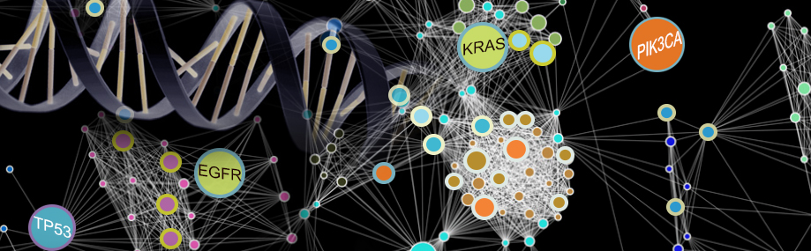
Thank you!

Slide 13
Contact Information
Questions / comments / suggestions
hkcarter@ucsd.edu

Slide 14
Related Reading

