Slide 1
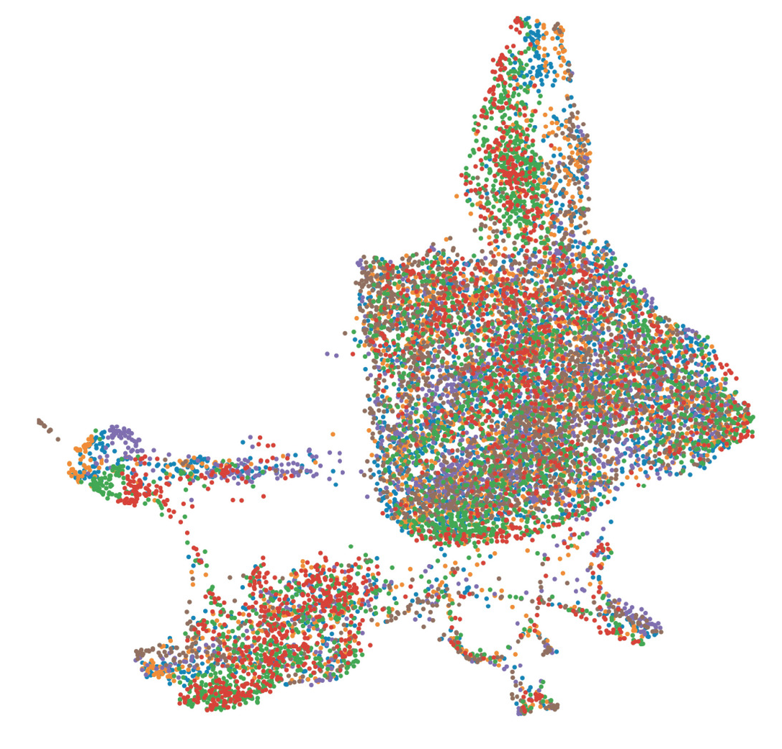
Quantitative Methods in Genetic and Genomics Single Cell Module
Rob Morey
February 2026

Slide 2
Module Overview
Day 1:
Single cell RNA-seq methods/biochemistry (lecture)
Analysis methods through pre-processing (lecture)
Start the "Winter 2026 part1" notebook (Data analysis using Liu et al., "Reprogramming roadmap reveals route to human induced trophoblast stem cells"; Nature 2020)
Day 2:
Finish "Winter 2026 part1" notebook if necessary
PBMC pre-processing practice notebook
Start the "Winter 2026 part2" notebook

Slide 3
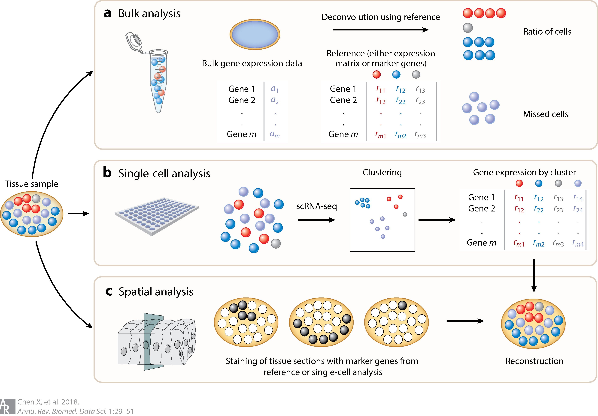
Why single cell transcriptomics?
Microarrays and bulk RNA sequencing mask the true distribution of gene expression levels across cells.

Slide 4
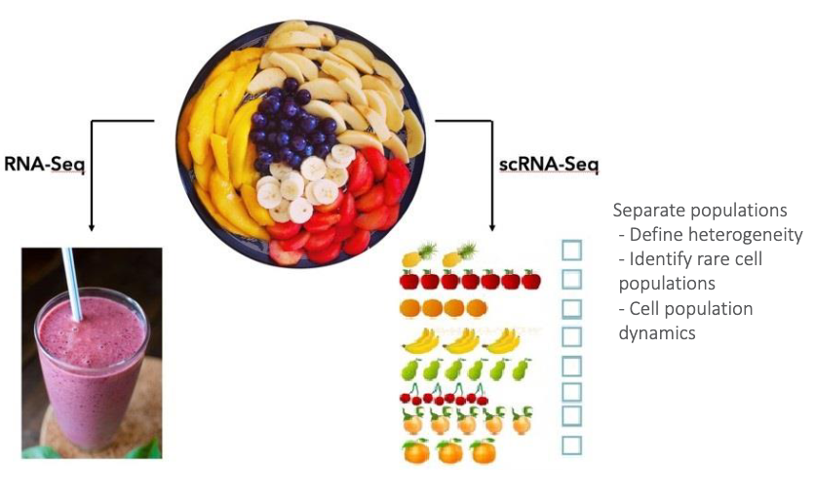
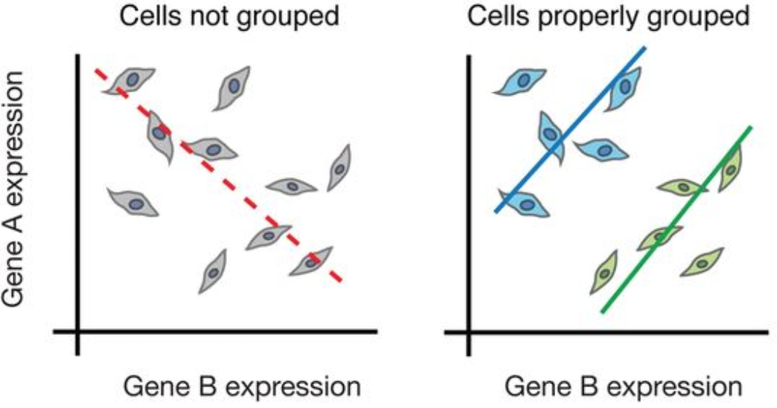
Bulk vs single cell RNA-seq
Why use scRNA-seq?
Discover which cell types are present in a sample
Identify unknown/rare cell types or states hidden in bulk RNA-seq
Monitor changes in gene expression during differentiation or across time/states
Identify genes that are differentially between cell types/states
Can be paired with spatial information or protein information (CITE-seq)
Image credit: (Left) Cambridge), (Right) Trapnell, C. Defining cell types and states with single-cell genomics, Genome Research 2015 (doi: https://dx.doi.org/10.1101/gr.190595.115)

Slide 5
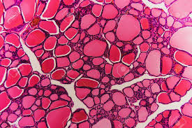
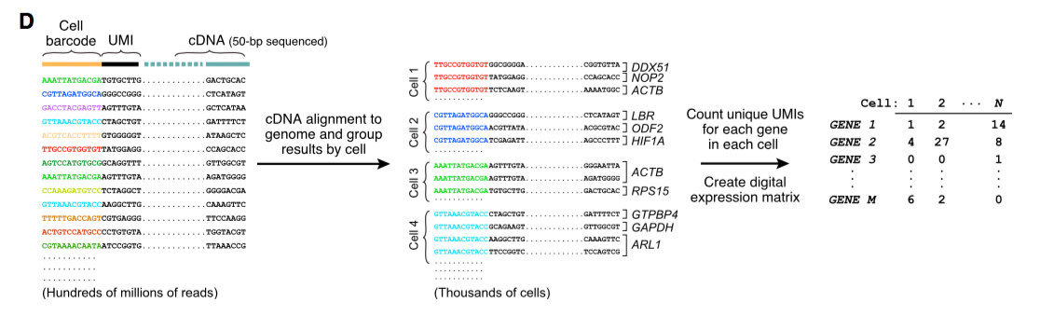
How do we go from cell to count matrix?

Slide 6
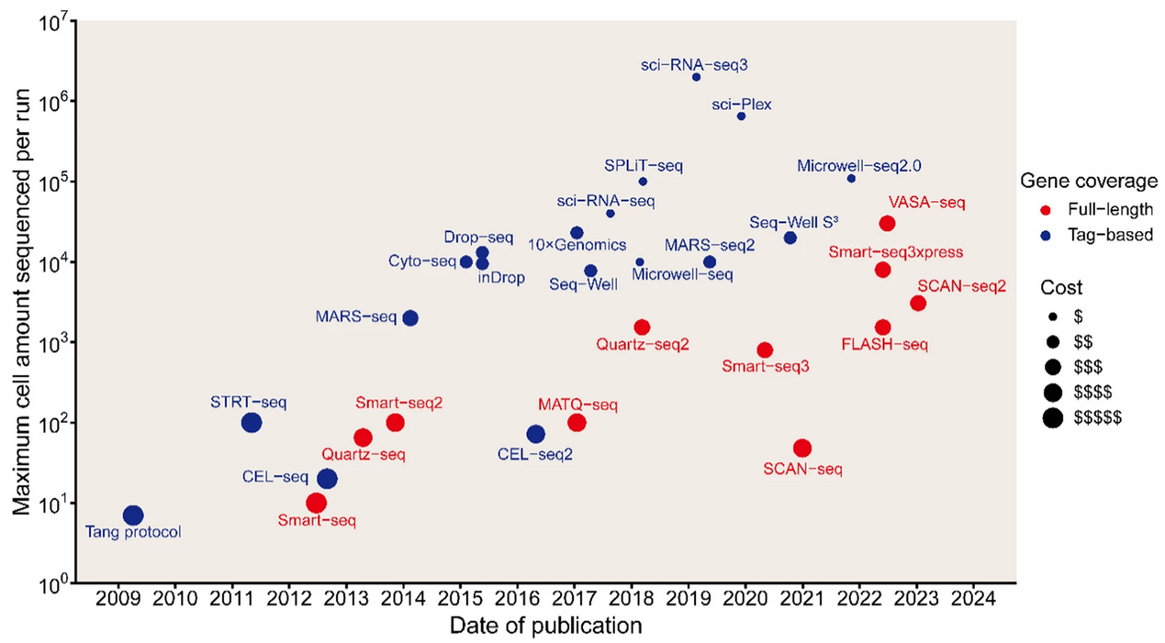
A decade of single-cell RNA-seq
Huang, D., Ma, N., Li, X. et al. Advances in single-cell RNA sequencing and its applications in cancer research. J Hematol Oncol 16, 98 (2023). https://doi.org/10.1186/s13045-023-01494-6

Slide 7
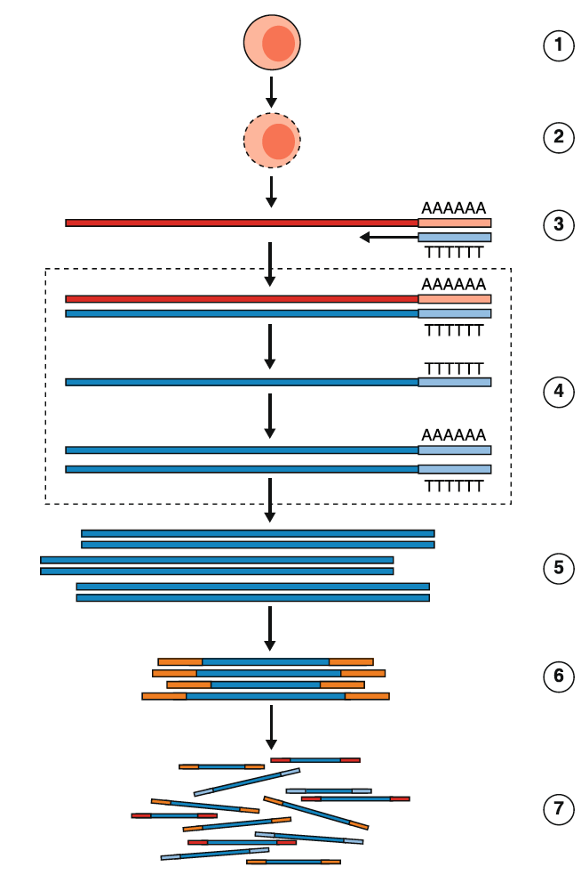
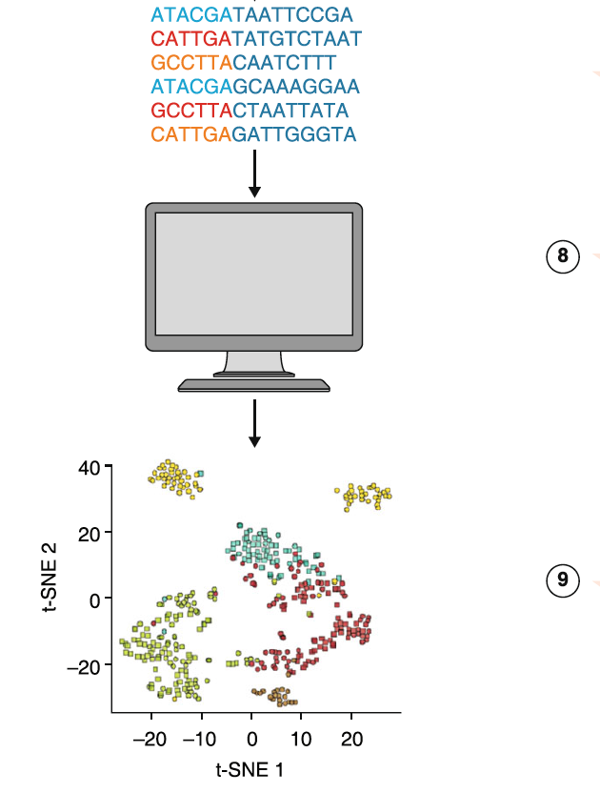
General workflow of a single cell (sc) RNA-Seq experiment
Critical Steps
Cell Isolation (cell or nuclei)
Cell lysis
mRNA capture
Cell Barcoding
Demultiplexing/counting
Second Strand Generation
cDNA amplification
Analysis
Library Construction
Pool and sequence
Haque et al., 2017 Genome Medicine

Slide 8
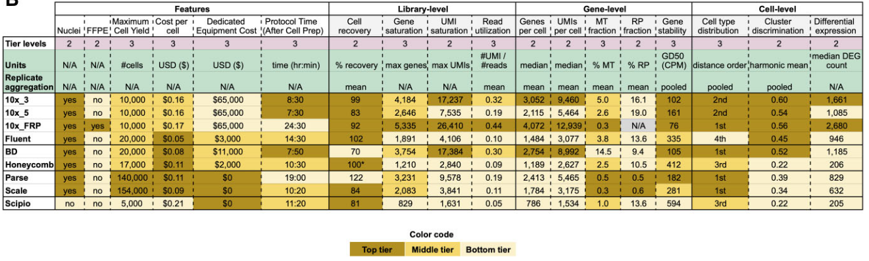
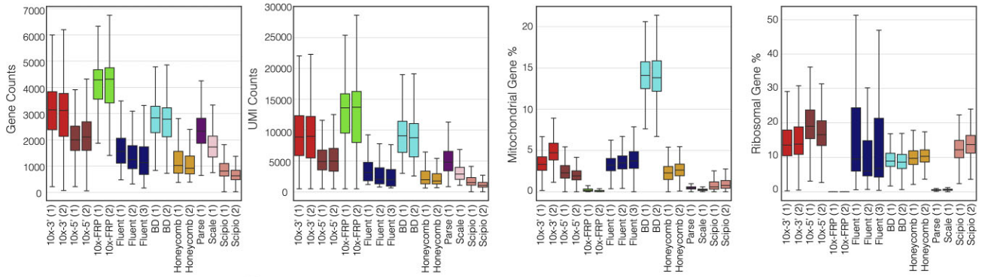
Popular single-cell RNA-seq protocols
Nucleic Acids Research, 2025, 53, gkae1186, https://doi.org/10.1093/nar/gkae1186, Advance access publication date: 16 December 2024

Slide 9
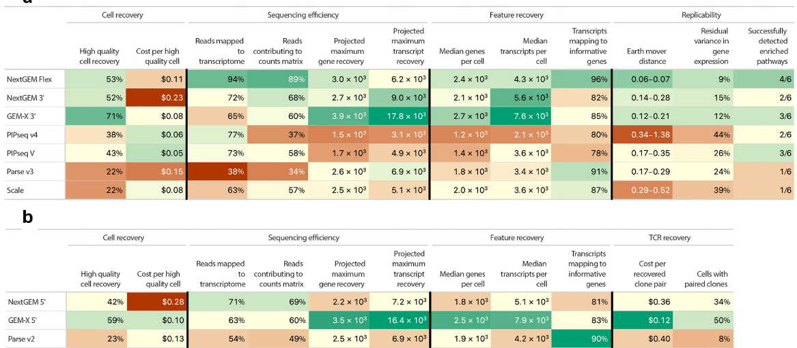
2026 Evaluation of scRNA-seq platforms
Elz et al., Evaluating the practical aspects and performance of commercial single-cell RNA sequencing technologies, NAR Genomics and Bioinformatics, Volume 8, Issue 1, March 2026, lqaf215, https://doi.org/10.1093/nargab/lqaf215

Slide 10
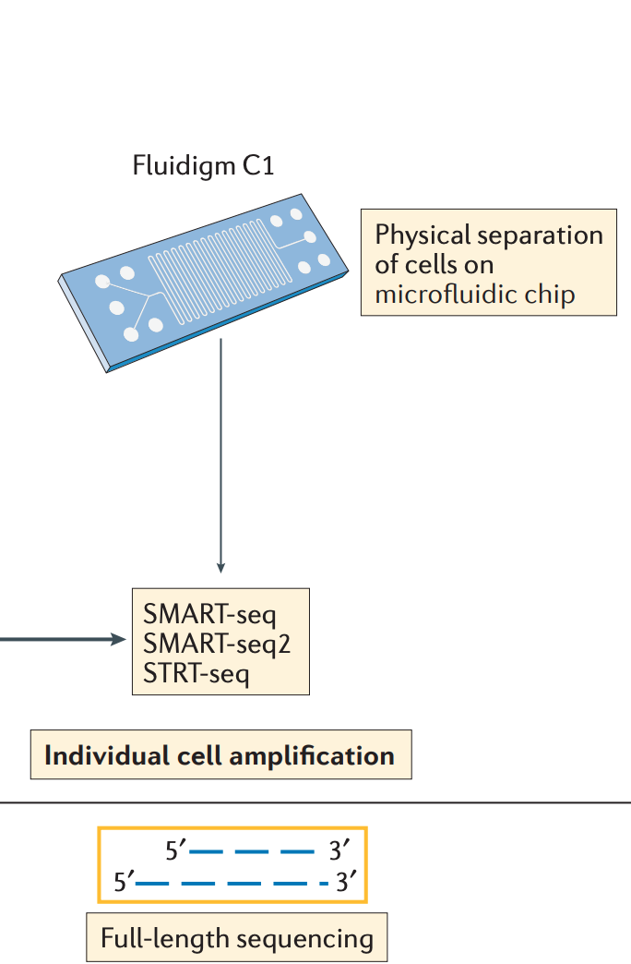
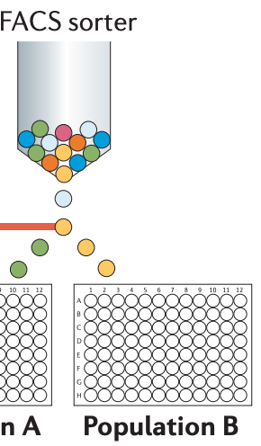
Full length transcripts: SMART-seq2
Allows for either sorting of cells into individual wells or separating cells based on size on a microfluidic chip (Fluidigm)
Gives full transcript information
Ideal for low cell numbers (100's – 1,000's)
Papalexi and Satija, 2017. DOI:10.1038/nri.2017.76

Slide 11
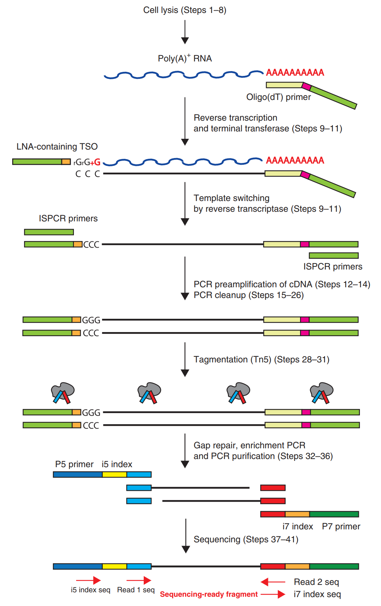
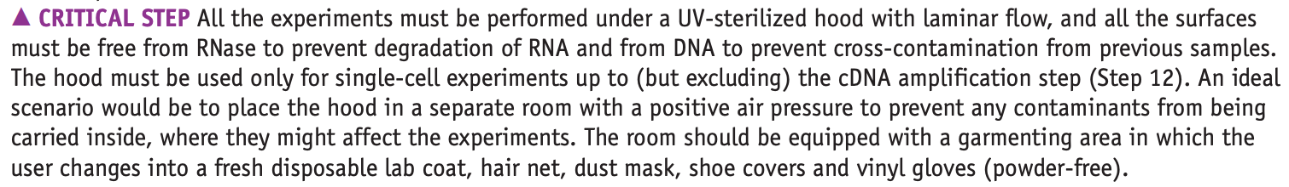
Example: library preparation for SMART-Seq2
Picelli et al., 2014. DOI:10.1038/nri.2017.76

Slide 12
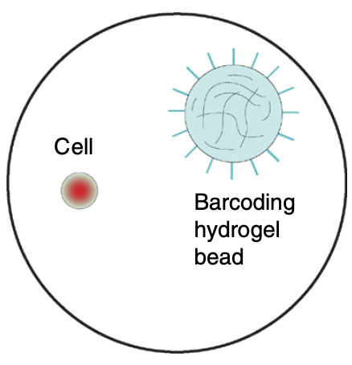
Droplet vs. Physical Microfluidic methods: Beads, Cells, and Droplets
• Droplet methods give single cell information, BUT require high cell numbers to achieve best results. (>10,000 cells) • Capture 50-80% of the input cells depending on the platform used. • Extreme 3’-bias in standard data. • Can not look at splicing / isoforms with standard methods.
Zilionis et al. 2016. DOI:10.1038/nprot.2016.154

Slide 13
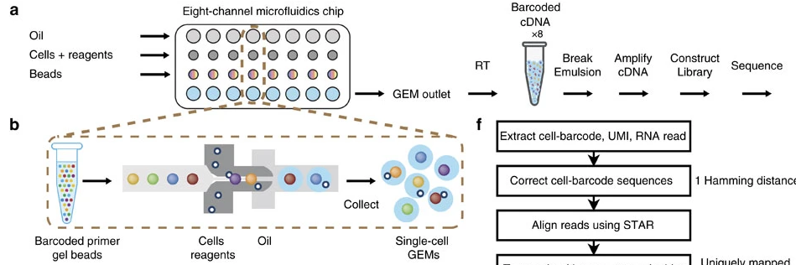
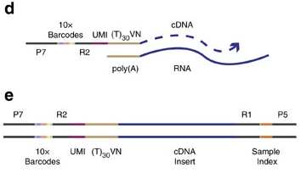
10X Genomics Overview
Zheng et al., 2017 Nature Communications​

Slide 14

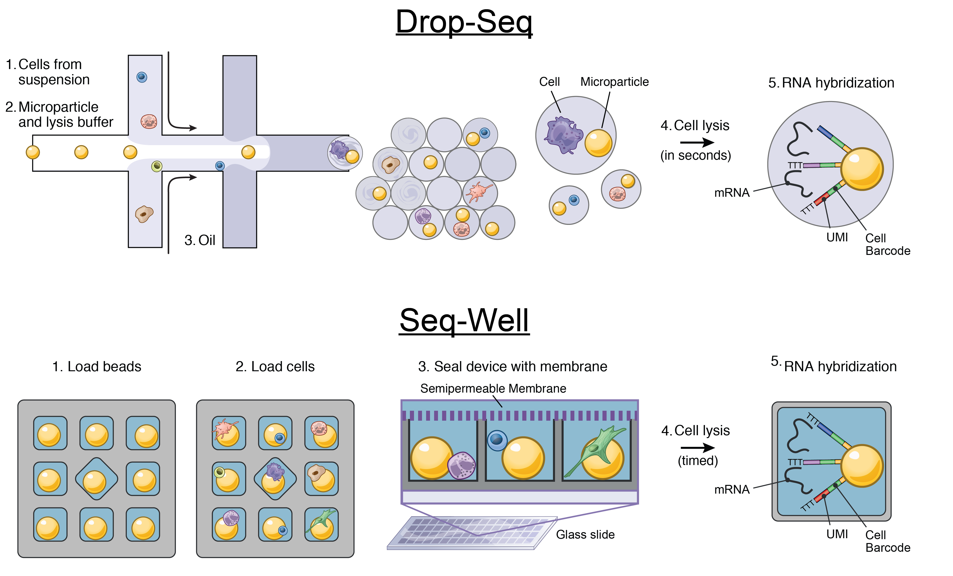
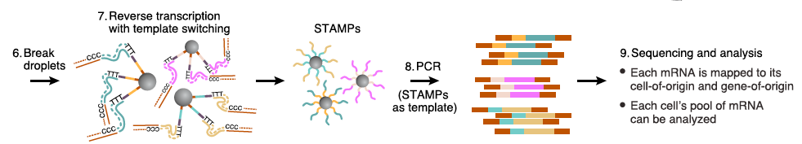
Drop-Seq
Macosko et al., 2015 Cell

Slide 15
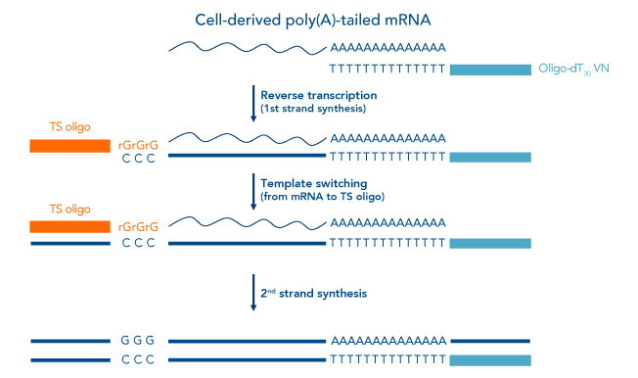
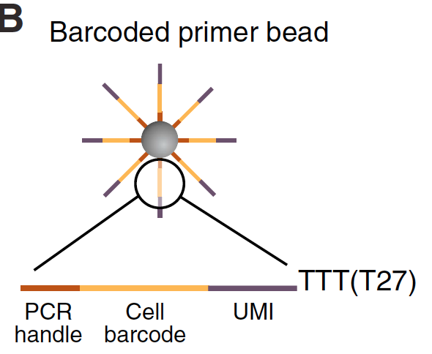
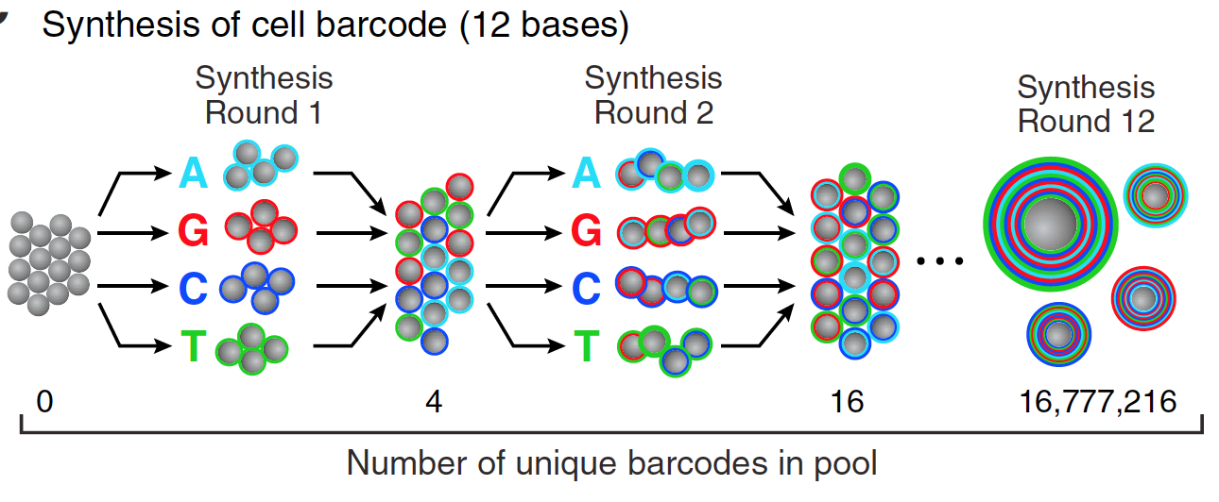
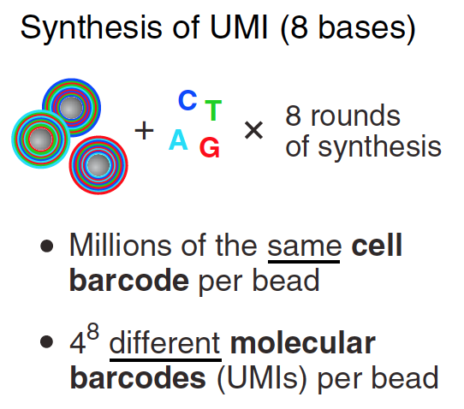
3’ end Capture Beads - UMIs and Bead Barcodes
UMI
BBC
PCR
4¹² = 16,777,216 barcodes
4⁸ = 65,536 UMIs
> 10⁶ oligos/bead
Macosko et al., 2015 Cell

Slide 16
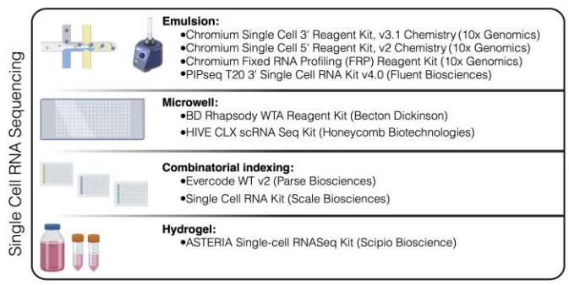
Summary of commercial technologies
Nucleic Acids Research, 2025, 53, gkae1186, https://doi.org/10.1093/nar/gkae1186, Advance access publication date: 16 December 2024

Slide 17
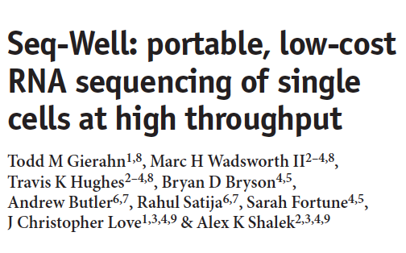

Seq-Well and hydrogel abrogates the need for droplet-based microfluidic devices

Slide 18
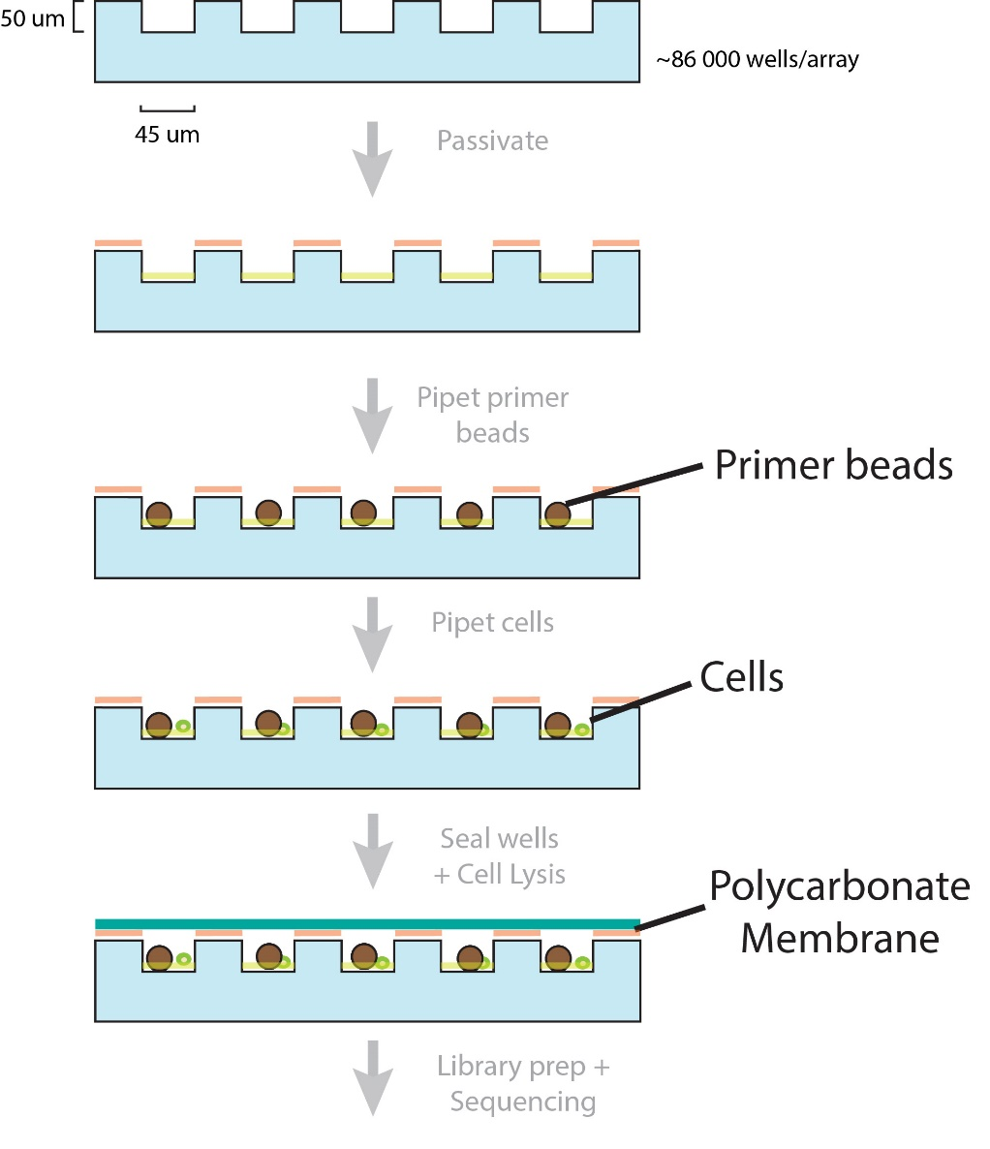
Seq-Well workflow in Images
Pre-wash
100 um
Post-wash + shake
100 um

Slide 19
Seq-Well workflow in Images
Pre-cell loading
100 um
Cell
Post-cell loading + shake
Bead
Capture rate > 50%
100 um

Slide 20
Common problems - Technical doublets
Technical doublets arise when two or more cells are captured in a droplet with a single bead. The technical doublet rate is therefore the probability of capturing two or more cells in a droplet given that at least one cell has been captured in a droplet:
Note that “overloading” a microfluidics single-cell experiment by loading more cells while keeping flow rates constant will increase the number of technical doublets due to an effective increase in and also the number of synthetic doublets due to a decrease in relative barcode diversity.

Slide 21
Doublet detection: the barnyard plot
Croset et al. 2018. DOI:10.7554/eLife.34550

Slide 22
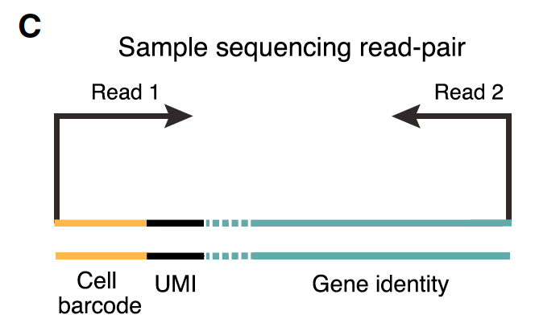
3’-end based technologies Post-sequencing

Slide 23
3’-end based technologies - Post-sequencing
Macosko et al., 2015 Cell

Slide 24

Break Time

