Slide 1
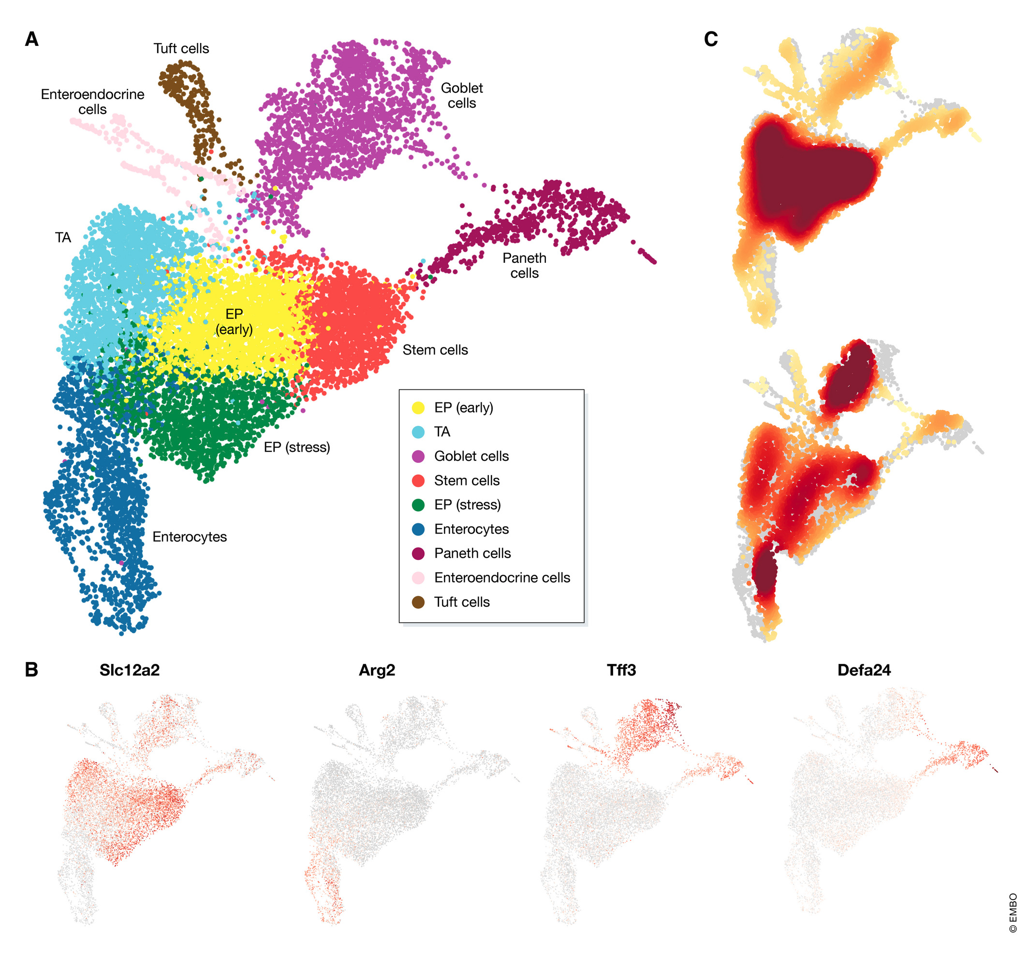
Single Cell Data Analysis
BNFO262-2026
Rob Morey
remorey@health.ucsd.edu

Slide 2
Challenges of scRNA-seq
Large volume of data
Low depth of sequencing
Technical and biological variability across cells/samples
Computational tools used to analyze scRNA-seq are continually improving but lag the engineering advances

Slide 3
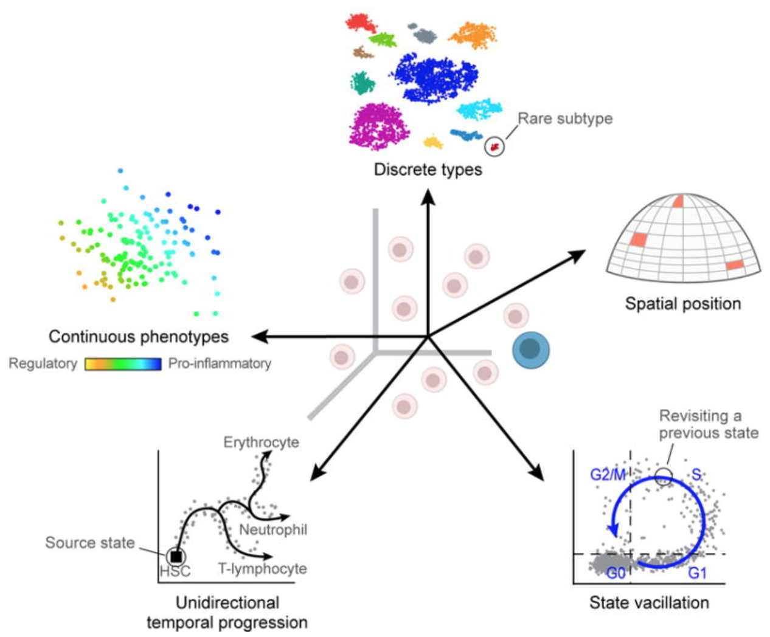
Biological variability
Transcriptional bursting: Gene transcription is not turned on/off all of the time.
Varying rates of RNA processing: Different RNAs are processed at different rates.
Continuous or discrete cell identities
Environmental stimuli: The local environment of the cell can influence the gene expression depending on spatial position, signaling molecules, etc.
Temporal changes: Fundamental fluxuating cellular processes, such as cell cycle, can affect the gene expression profiles of individual cells.
Image credit: Wagner, A, et al. Revealing the vectors of cellular identity with single-cell genomics, Nat Biotechnol. 2016 (doi:https://dx.doi.org/10.1038%2Fnbt.3711)

Slide 4
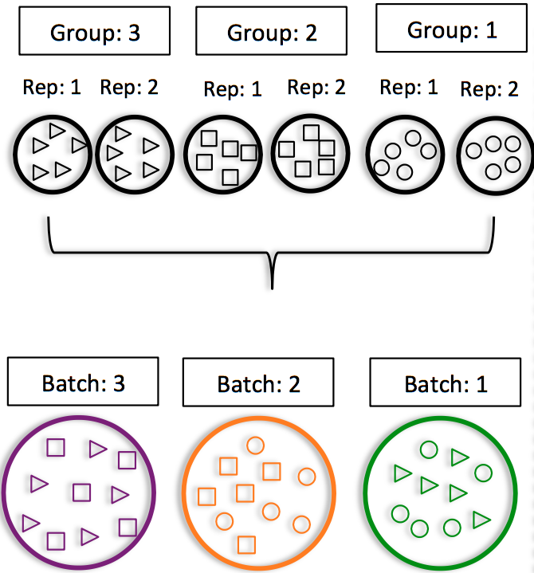
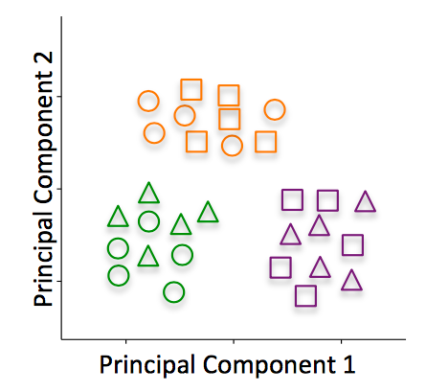
Technical variability
Cell-specific capture efficiency: Different cells will have differing numbers of transcripts captured resulting in differences in sequencing depth (e.g. 10-50% of transcriptome).
Library quality: Degraded RNA, low viability/dying cells, lots of free floating RNA, poorly dissociated cells, and inaccurate quantitation of cells
Amplification bias: Not all transcripts are amplified to the same level.
Batch effects

Slide 5
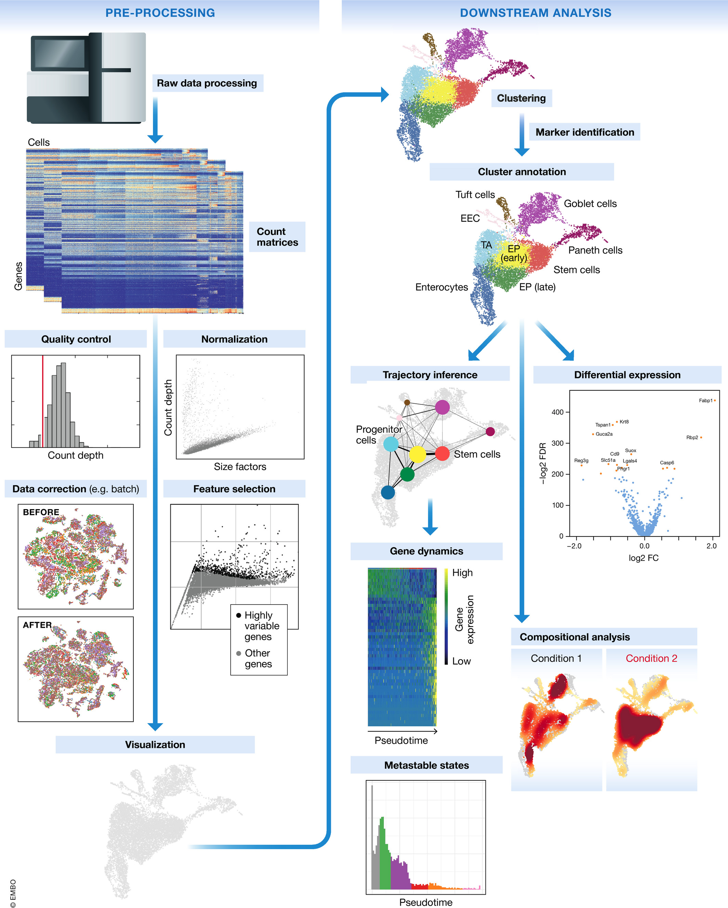
Typical Single-cell RNA-seq Analysis Workflow
Workflow:​
Filter for good cells and detected genes (arbitrary cutoffs)​ and filter out doublets and technical variability
Normalize/Scale Data
Remove unwanted sources of variation (batch/cell cycle)
Feature selection, dimensionality reduction and visualization
Feature selection (highly variable genes)
Dimensionality Reduction – summarization (describe data in as few dimensions as possible for downstream)
Dimensionality Reduction – visualization (describe data in 2D or 3D)
Clustering (grouping cells based on expression profiles)
Define Cell-Type specific signatures​ through cluster annotation.
Trajectory analysis (transitions between cell identities)
Unification between clustering and trajectory inference - (partition-based graph abstraction - PAGA)

Slide 6
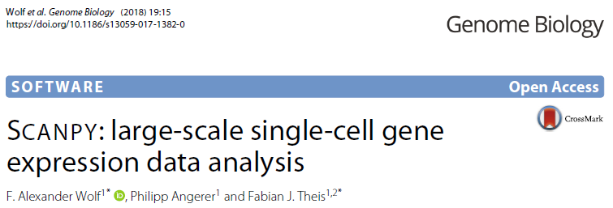
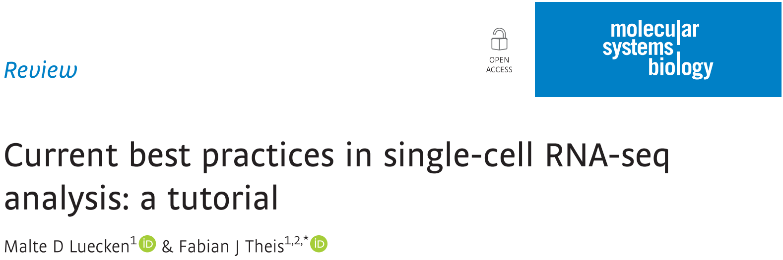

https://github.com/theislab/single-cell-tutorial/ https://www.sc-best-practices.org/introduction/raw_data_processing.html

Slide 7
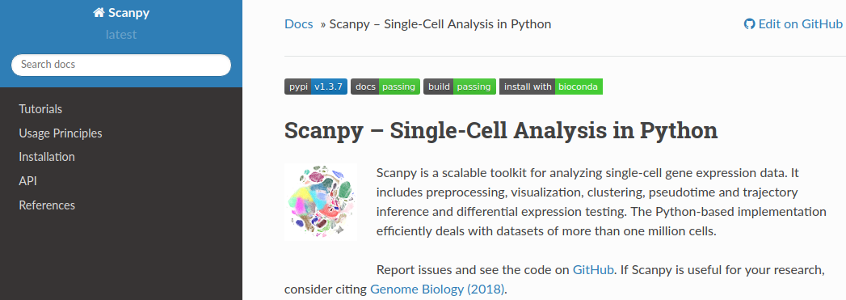
https://scanpy.readthedocs.io/en/stable/
https://discourse.scverse.org/

Slide 8
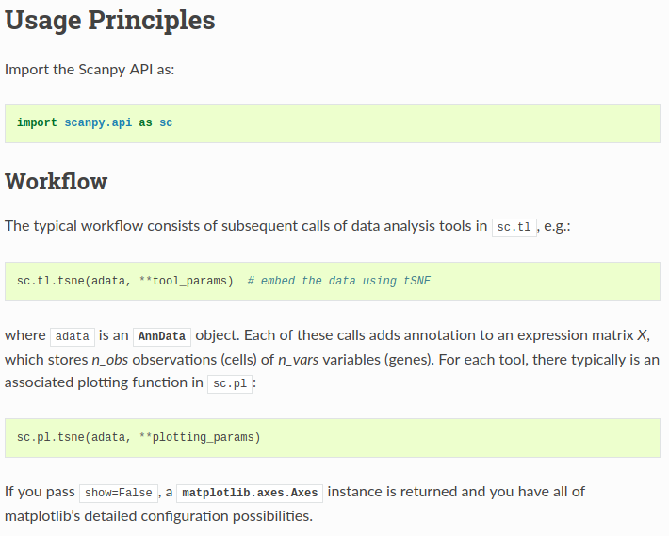

Slide 9
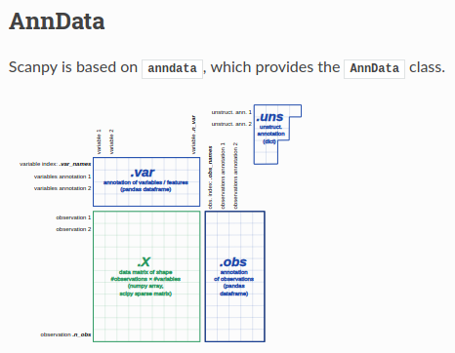
At the most basic level, an AnnData object adata stores a data matrix (adata.X), dataframe-like annotation of observations (adata.obs) and variables (adata.var) and unstructured dict-like annotation (adata.uns). Values can be retrieved and appended via adata.obs['key1'] and adata.var['key2']. Names of observations and variables can be accessed via adata.obs_names and adata.var_names, respectively. AnnData objects can be sliced like dataframes, for example, adata_subset = adata[:, list_of_gene_names].
http://falexwolf.de/blog/171223_AnnData_indexing_views_HDF5-backing/

Slide 10
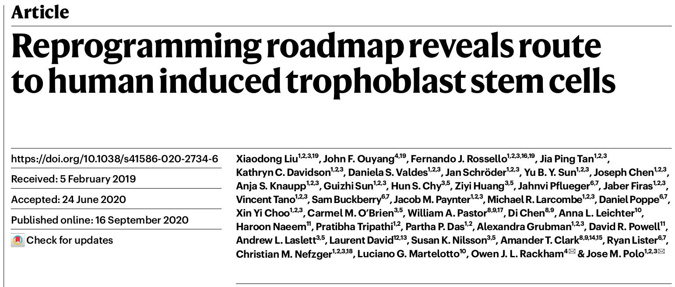
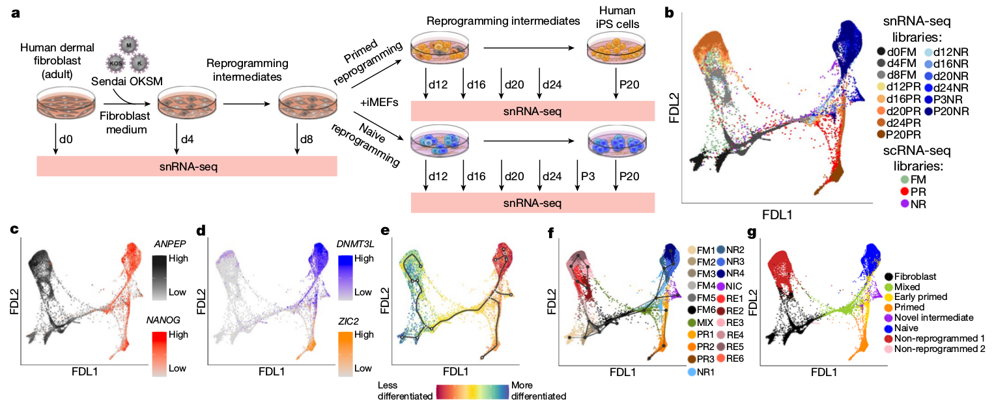
https://www.ncbi.nlm.nih.gov/geo/query/acc.cgi?acc=GSE150637

Slide 11
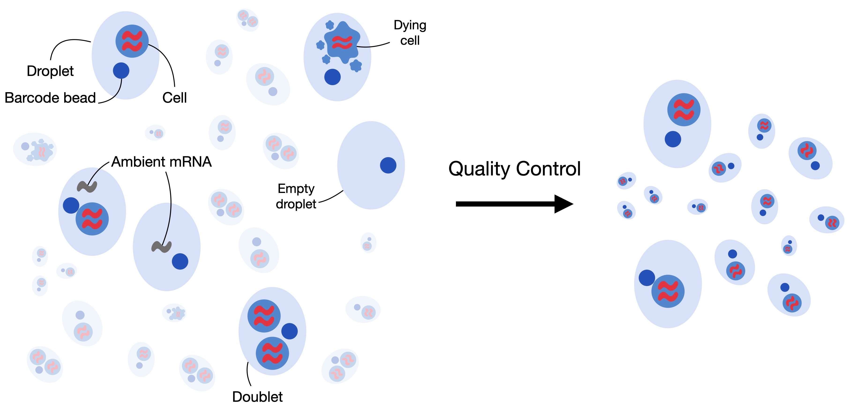
Quality Control

Slide 12
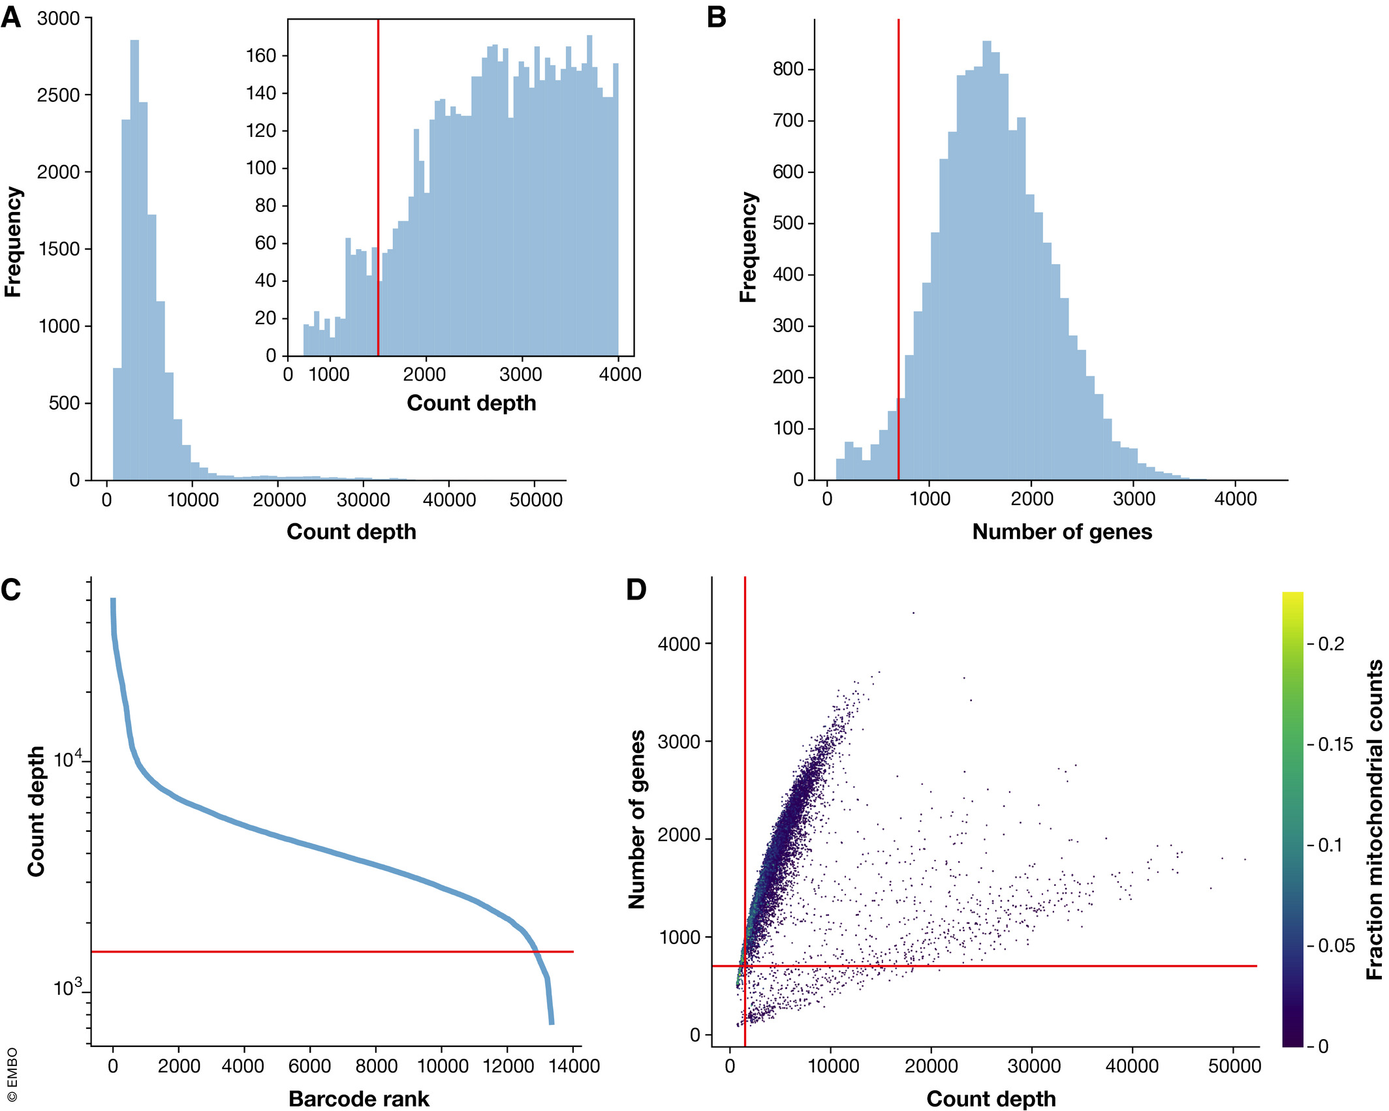
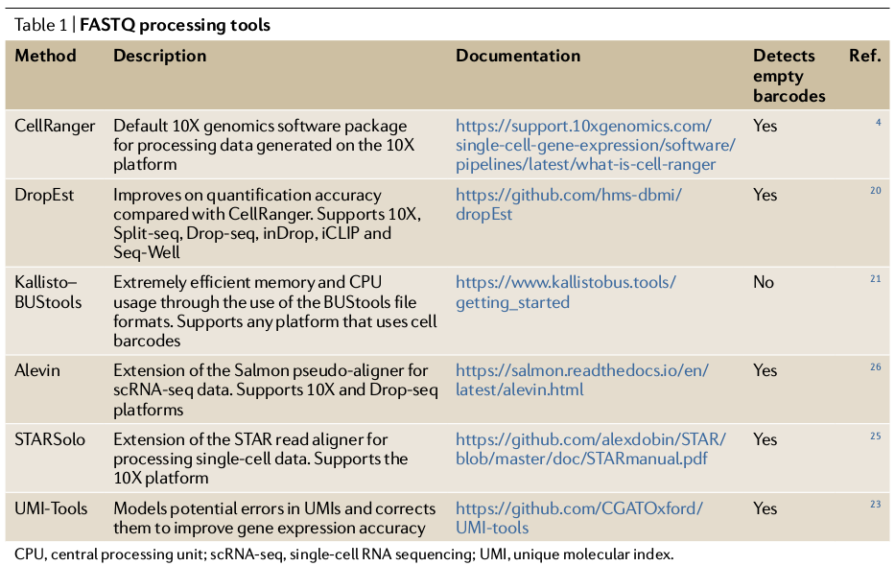
Preprocessing: Raw data processing and filtering
Raw data processing pipelines like Cell Ranger assign reads to cells, align reads to genome, and create count matrices.
Cell QC performed on three QC covariates:
1) Count Depth (number of reads per cell barcode)
2) Number of genes per barcode (cell)
3) Fraction of counts from mitochondrial genes
Wu et al., 2020 https://doi.org/10.1038/s41581-020-0262-0
Notes:
For example, barcodes with a low count depth, few detected genes, and a high fraction of mitochondrial counts are indicative of cells whose cytoplasmic mRNA has leaked out through a broken membrane, and thus, only mRNA located in the mitochondria is still conserved (Fig 2). In contrast, cells with unexpectedly high counts and a large number of detected genes may represent doublets. Thus, high-count depth thresholds are commonly used to filter out potential doublets. Three recent doublet detection tools offer more elegant and potentially better solutions (DoubletDecon: preprint: DePasquale et al, 2018; Scrublet: Wolock et al, 2019; Doublet Finder: McGinnis et al, 2018).

Slide 13
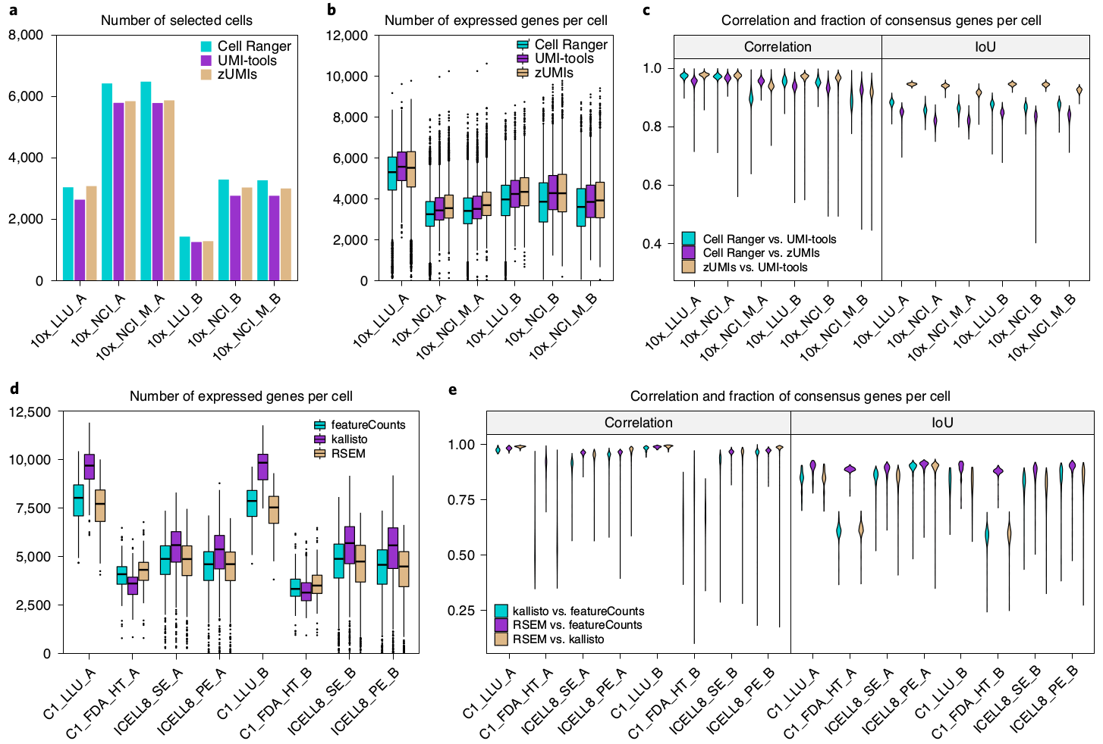
Preprocessing variation
Chen et al. Nature Biotech 2020
Notes:
"Cell Ranger version 3 was the most sensitive method for cell barcode identification."
"Overall, we found that the gene expression (counts) and the fraction of consensus genes per cell were highly variable across three preprocessing pipelines, both for UMI- and non-UMI-based scRNA-seq datasets (Fig. 2c,e)."

Slide 14
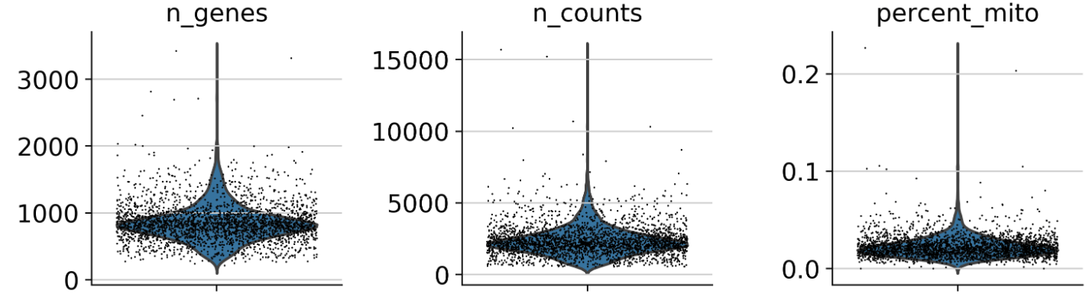
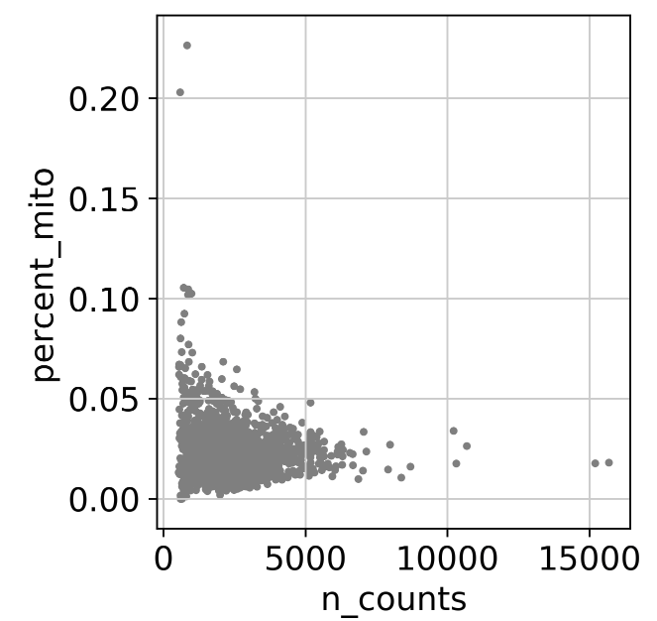
Remove outlier cells/genes
A guideline to setting gene thresholds is to use the minimum cell cluster size that is of interest and leaving some leeway for dropout effects.
Be permissive and revisit QC after clustering (judged based on downstream analysis, but not "p-hacking")
Do not look at any of the covariates in isolation
Notes:
Cells with low counts and/or genes may correspond to quiescent cell populations, and cells with high counts may be larger in size.
You can also correct for ambient gene expression from lysed cells – SoupX
Total efficiency calculations estimate that only 10-15% of the total RNA in a cell is captured and transcribed – zero inflation

Slide 15
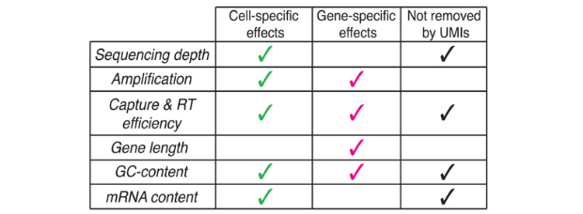
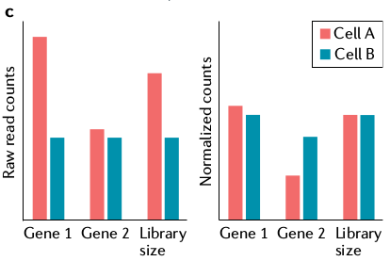
Normalization
How do you normalize for sequencing depth?
Should you normalize for sequencing depth in single cell data?
Is length an important normalization step here?
Should you perform gene scaling (weight genes equally)?
Log transformation? - allows for normal dist. Assumption
Scone tool can be used to select appropriate normalization method
Nat Methods. 2017 Jun; 14(6): 565–571
Wu et al., 2020 https://doi.org/10.1038/s41581-020-0262-0
Notes:
The most commonly used normalization protocol is count depth scaling, also referred to as “counts per million” or CPM normalization. This protocol comes from bulk expression analysis and normalizes count data using a so-called size factor proportional to the count depth per cell. Variations of this method scale the size factors with different factors of 10, or by the median count depth per cell in the dataset. CPM normalization assumes that all cells in the dataset initially contained an equal number of mRNA molecules and count depth differences arise only due to sampling. SCRAN and non-linear methods allow for more cell heterogeneity and do better when there are a lot of batch effects.

Slide 16
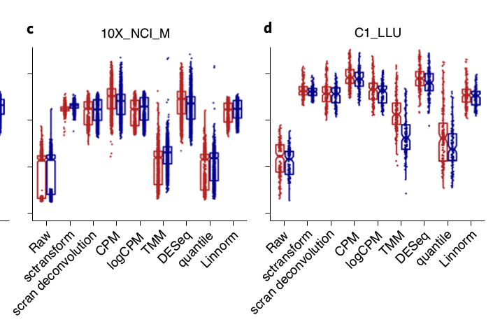
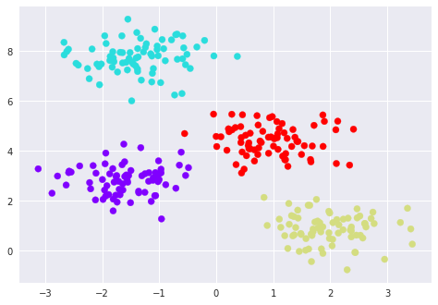

Effects of Normalization
Silhouette width score quantifies how well two different types of cells are separated from each other. The larger the silhouette width score, the better the performance of the normalization method
Chen et al. Nature Biotech 2020
Notes:
"We noticed that TMM and quantile failed to normalize either the breast cancer cells (sample A) or B lymphocytes (sample B), with silhouette scores that were similar to the unnormalized raw data (Fig. 3a–g). The other methods provided similar normalization, as measured by silhouette scores. sctransform seemed to perform slightly better than scran deconvolution, logCPM or Linnorm, in that it had the least variation among all normalization methods"

Slide 17
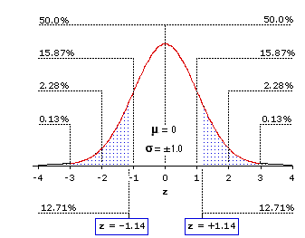
Z-score scaling for comparing between genes:
Z-score is the number of standard deviations away from the mean
Purpose is to scale expression of each gene relative to all the cells
The preference between the two choices revolves around whether all genes should be weighted equally for downstream analysis, or whether the magnitude of expression of a gene is an informative proxy for the importance of the gene.
Notes:
In the same way that cellular count data can be normalized to make them comparable between cells, gene counts can be scaled to improve comparisons between genes. Gene normalization constitutes scaling gene counts to have zero mean and unit variance (z scores). This scaling has the effect that all genes are weighted equally for downstream analysis. There is no consensus as to if this is appropriate or not because the magnitude of expression of a gene could be a proxy for its importance.

Slide 18

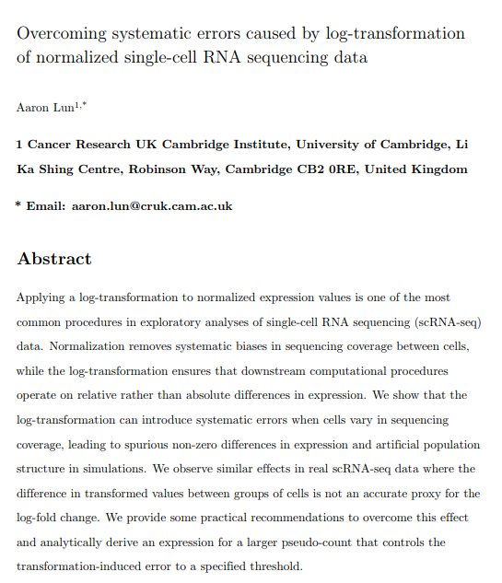
Notes:
Data is typically log transformed after normalization – this mitigates mean-variance relationship in data and reduces skew to approximate normal distribution which many downstream tools rely on.

Slide 19
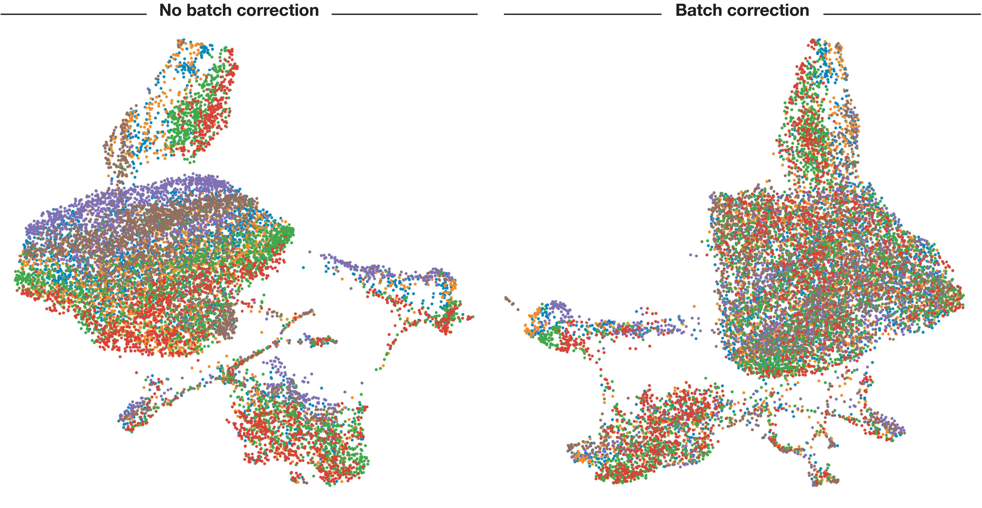
Data Correction and Integration
Correct for biological (e.g. cell cycle) covariates – warning: Regress out biological covariates only for trajectory inference and if other biological processes of interest are not masked by the regressed out biological covariate
Correct for technical covariates (e.g. batch effects – data integration)
Notes:
Buttner et al showed that as with bulk RNA-seq data and microarrays, ComBat works for single cells as well and outperform Mutual Nearest Neighbours MNN but MNN-based methods does allow for the comparison of samples across platfoms, patients, etc.

Slide 20
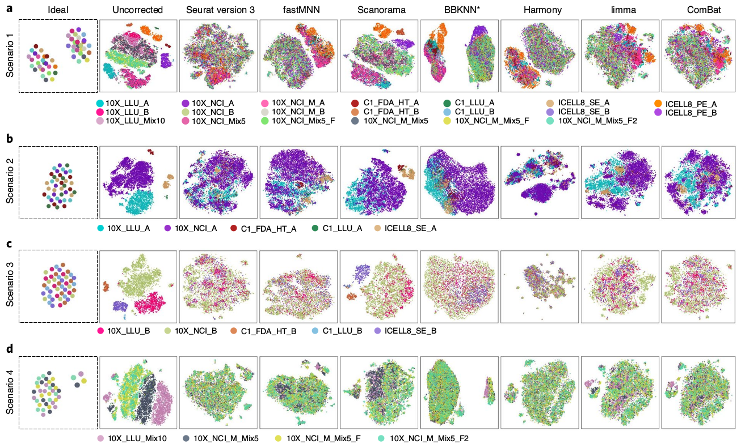
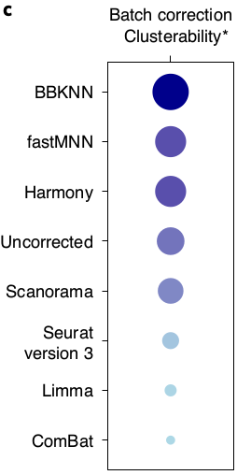
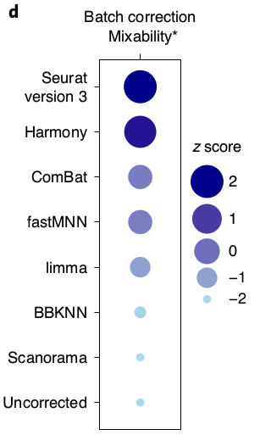
Batch Effect Comparison
Clusterability - ability to separate different cell types from each other
Mixability - ability to group similar cells to-gether across datasets
Chen et al. Nature Biotech 2020

Slide 21
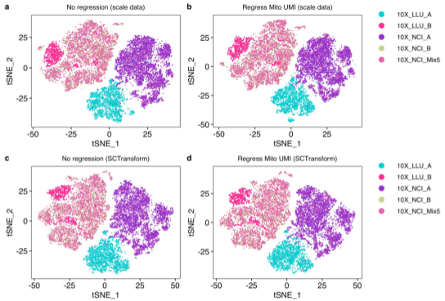
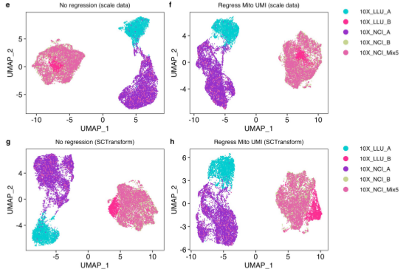
Regressing out mitochondrial genes does not seem to help downstream clustering
Chen et al. Nature Biotech 2020
Notes:
"We found that regressing out mitochondrial genes did not improve the downstream clustering results (Extended Data Fig. 2a–h) and that regressing out the number of genes detected or using a sequencing depth approach did not improve silhouette scores"

Slide 22
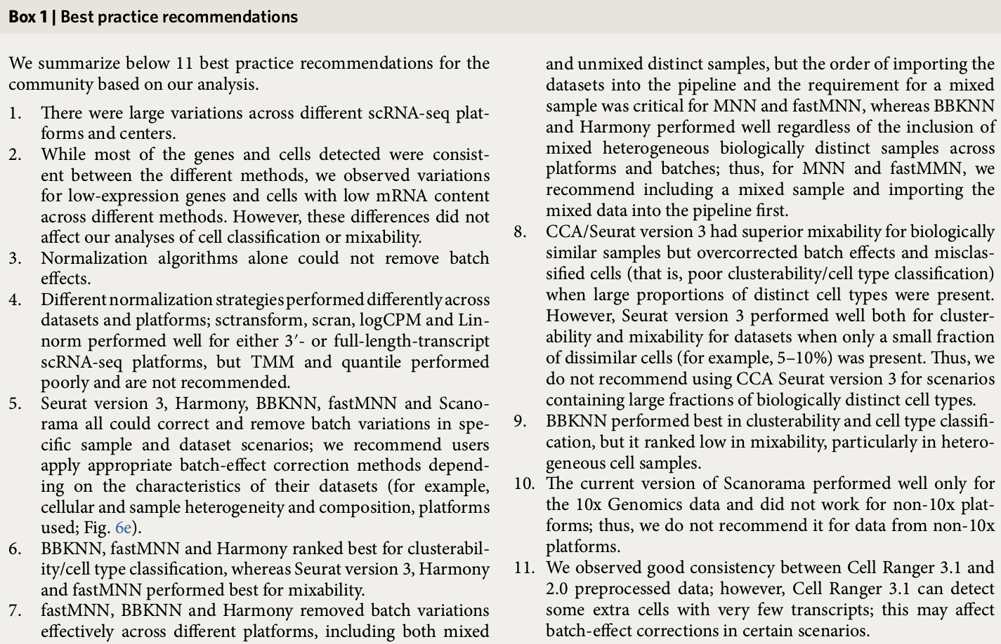
Chen et al. Nature Biotech 2020 – best practices summary

Slide 23
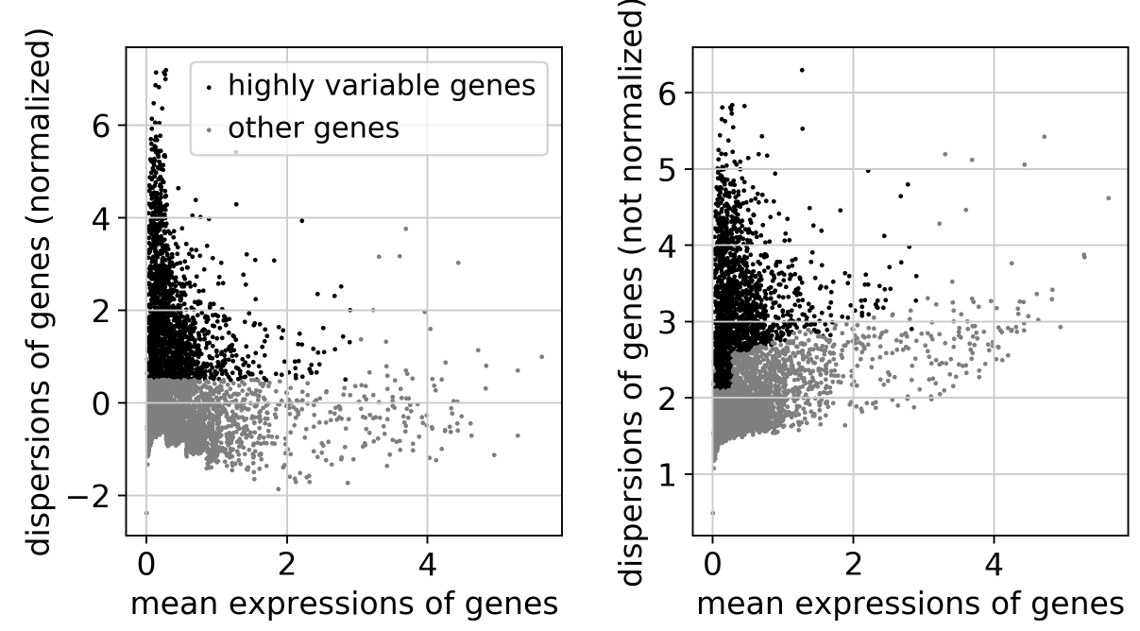
Feature Selection: Filter for variable genes to control the relationship between variability and average expression
Preliminary results from Klein et al (2015) suggest that downstream analysis is robust to the exact choice of the number of HVGs (between 200-2400).
Notes:
In an effort to only analyze "informative" genes we filter based on variability.
Genes are binned by their mean expression and then the genes with the highest variance-to-mean ratio are selected as "highly variable genes" in each bin. This is also termed variance stabilization (one simple way to do this is to log transform the normalized data).

Slide 24

Break Time!

Slide 25
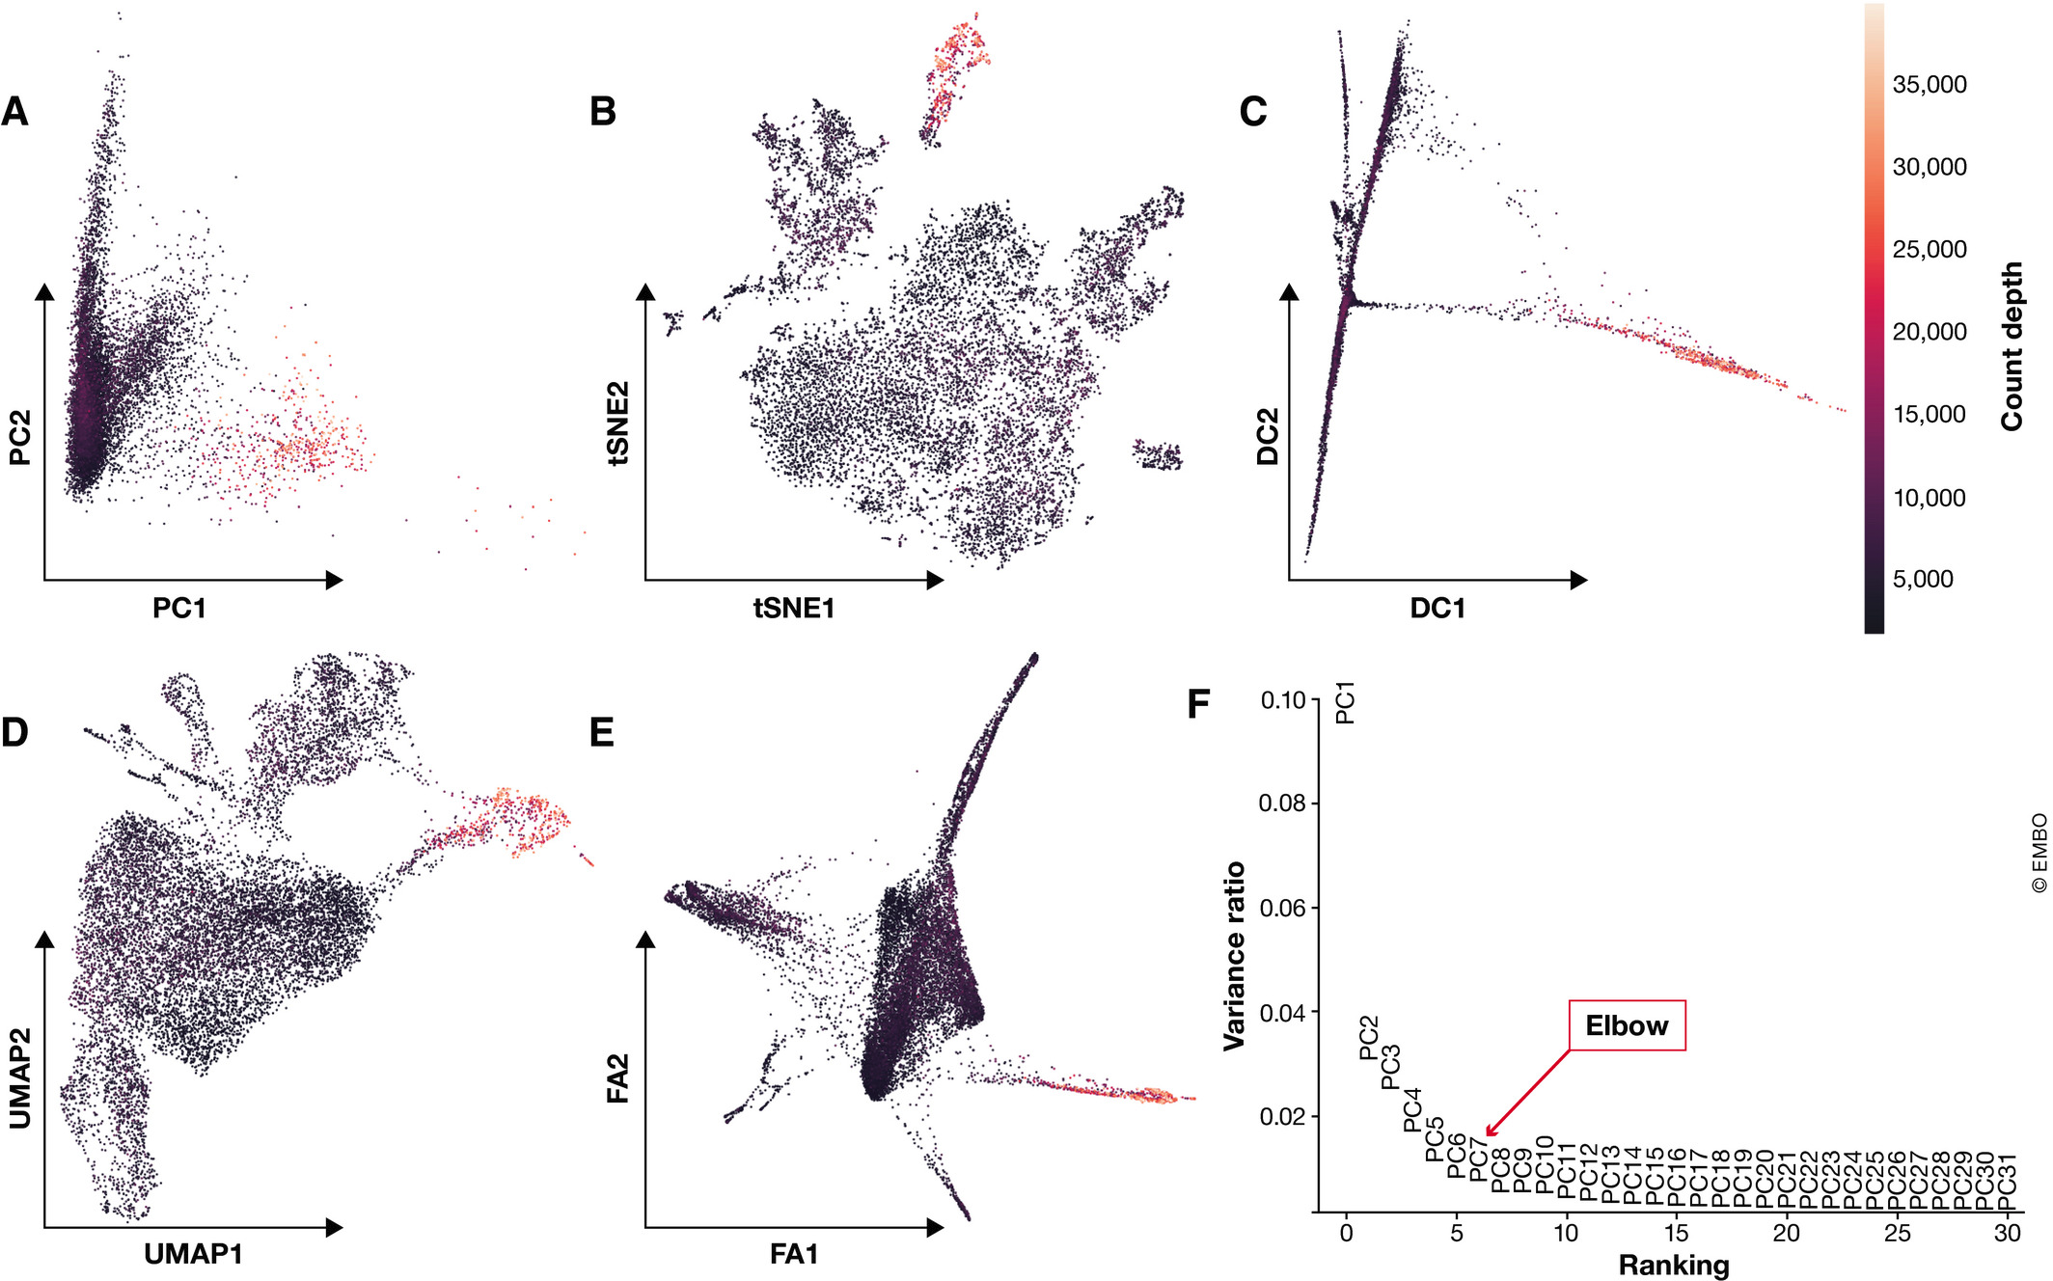
Dimensionality Reduction
Goal: Embed expression matrix into low-dimensional space that still captures the underlying structure of the data
Two Goals:
1) Visualization – describe data in 2D or 3D
2) Summarization – reduce data to essential components - used downstream
Notes:
Embedding = the reduced dimensions of the dataset
Linear Methods – linear relationship between two variables – so both variables change at the same rate = PCA.
PCA creates a linear combination of genes that best captures the variance in the data.
PCA does not capture the structure of the data in few dimensions as well as the non-linear methods but is used upstream of these methods as a pre-processing step.

Slide 26
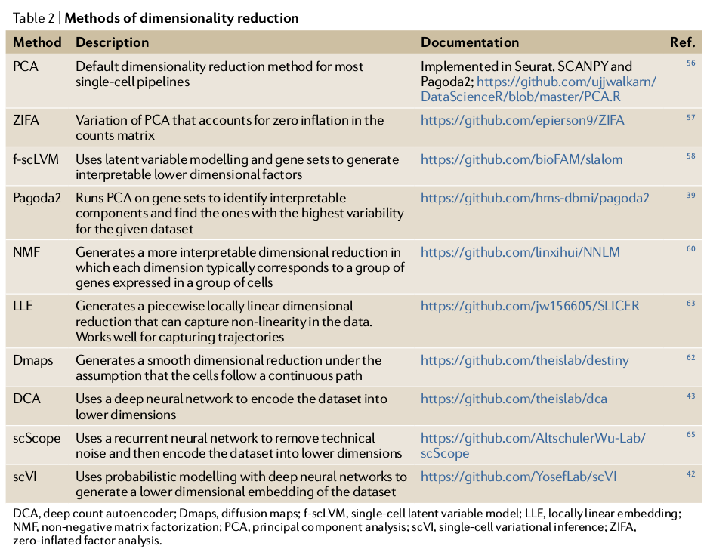
Dimensionality Reduction Methods
Wu et al., 2020 https://doi.org/10.1038/s41581-020-0262-0

Slide 27
Visualization
Standard Practice – non-linear dimensionality reduction methods
t-SNE dimensions focus on capturing local similarity at the expense of global structure. Thus, these visualizations may exaggerate differences between cell populations and over- look potential connections between these populations.
Uniform Approximation and Projection method (UMAP; preprint: McInnes & Healy, 2018) - arguably represent the best approximation of the underlying topology
Recently published - den-SNE and densMAP (Jan 18, 2021 - Nature Biotech)

Slide 28
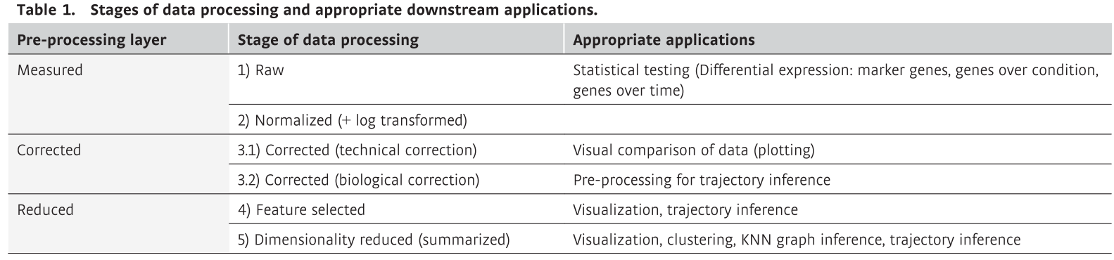
Stages of pre-processed data
Notes:
Use measured data for statistical testing, corrected data for visual comparison of data and reduced data for other downstream analysis based on finding the underlying biological data manifold.

Slide 29
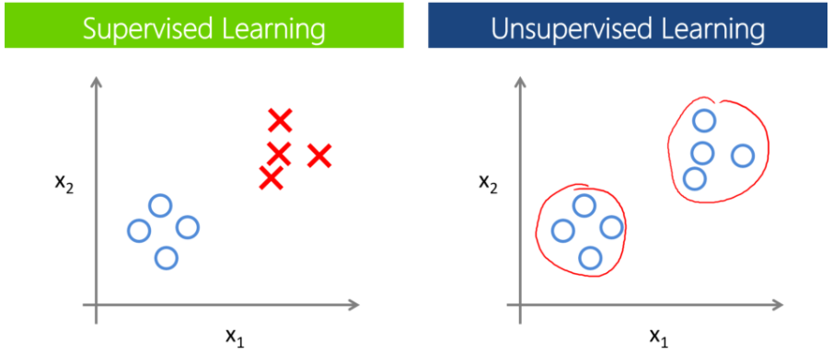
Cluster Analysis
Clustering – group cells based on similarity of expression profiles determined by distance metrics
Supervised:
Have prior knowledge of the groups.
Unsupervised:
Have no priors. Looking for substructure to find new patterns
Generally: cells are assigned to clusters by minimizing intra-cluster distances or finding dense regions in the reduced expression space.
Notes:
Estimating the number of cell types can be considered as finding the optimal number of clusters for a given scRNA-seq data with the assumption that each cluster corresponds to a unique cell type in the dataset.

Slide 30
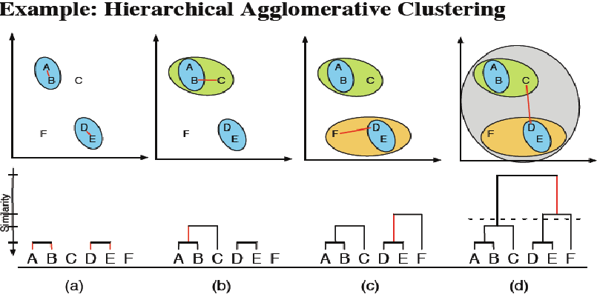
Hierarchical Clustering:
Grouping cells together based on similarity
Bottom up: Start with individual points and add most similar data points
Top down: Start with one big group, and drop out one at a time based on similarity
Cluster groups are defined based on your chosen similarity metric
Often used in subclustering but is slow compared to graph-based methods
https://www.researchgate.net/figure/Example-of-hierarchical-clustering-clusters-are-consecutively-merged-with-the-most_273456906

Slide 31
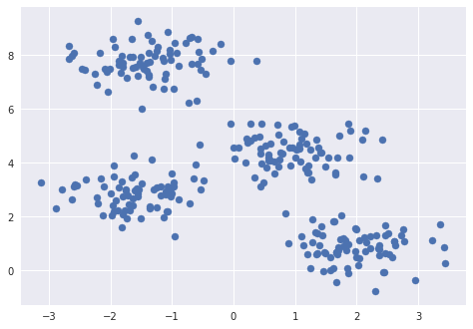
How many clusters exist in this dataset?
K-means clustering
Randomly assign points to guess the cluster centers (number of points = k)
Assign data points to the nearest cluster center.
Move the cluster assignment to the mean of each group
Repeat
http://stanford.edu/class/ee103/visualizations/kmeans/kmeans.html

Slide 32
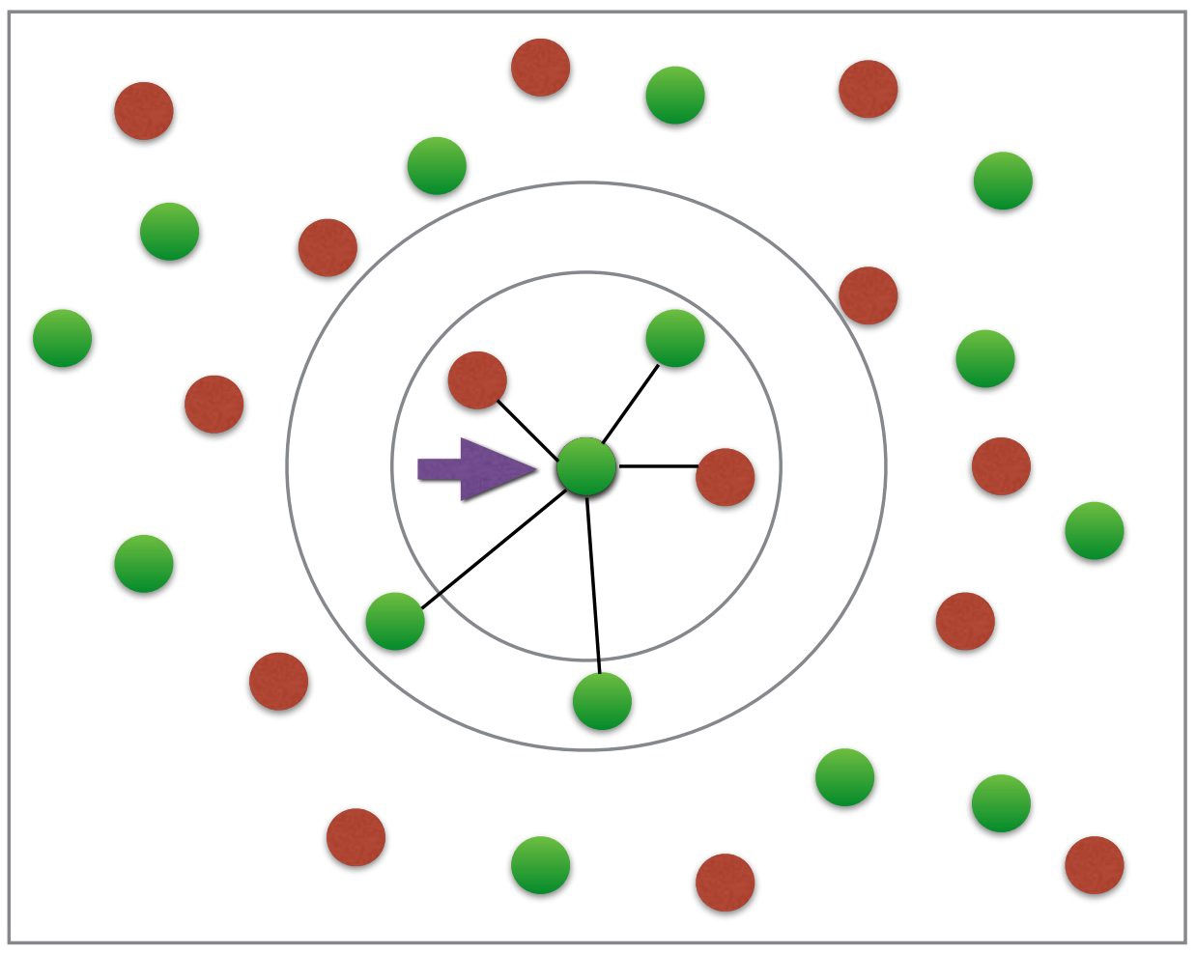
Graph-based clustering (k-nearest neighbors)
Measure Euclidian distances between cells up to K nearest neighbors (edges)
Weight of edges scales with similarity metric (Euclidian distance)
Calculate “connectedness” of nodes (cells) by the number of shared neighbors
Refine densely connected modules as communities

Slide 33
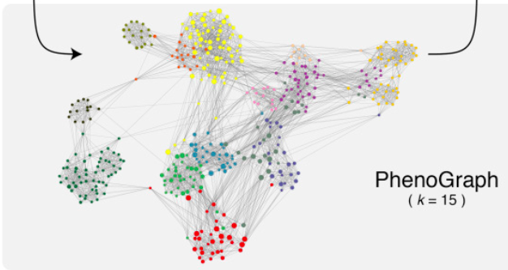
Graph-based clustering (k-nearest neighbors)
Cells are represented as nodes in the graph. Each cell is connected to its K most similar cells, which are typically obtained using Euclidean distances on the PC-reduced expression space. Depending on the size of the dataset, K is commonly set to be between 5 and 100 nearest neighbors. The resulting graph captures the underlying topology of the expression data
Levine et al. 2015 Cell
Notes:
Louvain clustering starts with each single cells as its own cluster, and then iteratively merges clusters as long as the merging increases the modularity of the graph. This means that the Louvain algorithm detects communities as groups of cells that have more links between them than expected based on the number of links that the cells have in total. This is the default method in many analysis packages such as SCANPY. Leiden is the successor to Louvain and is the preferred method because it is more efficient and ensures connected communities

Slide 34
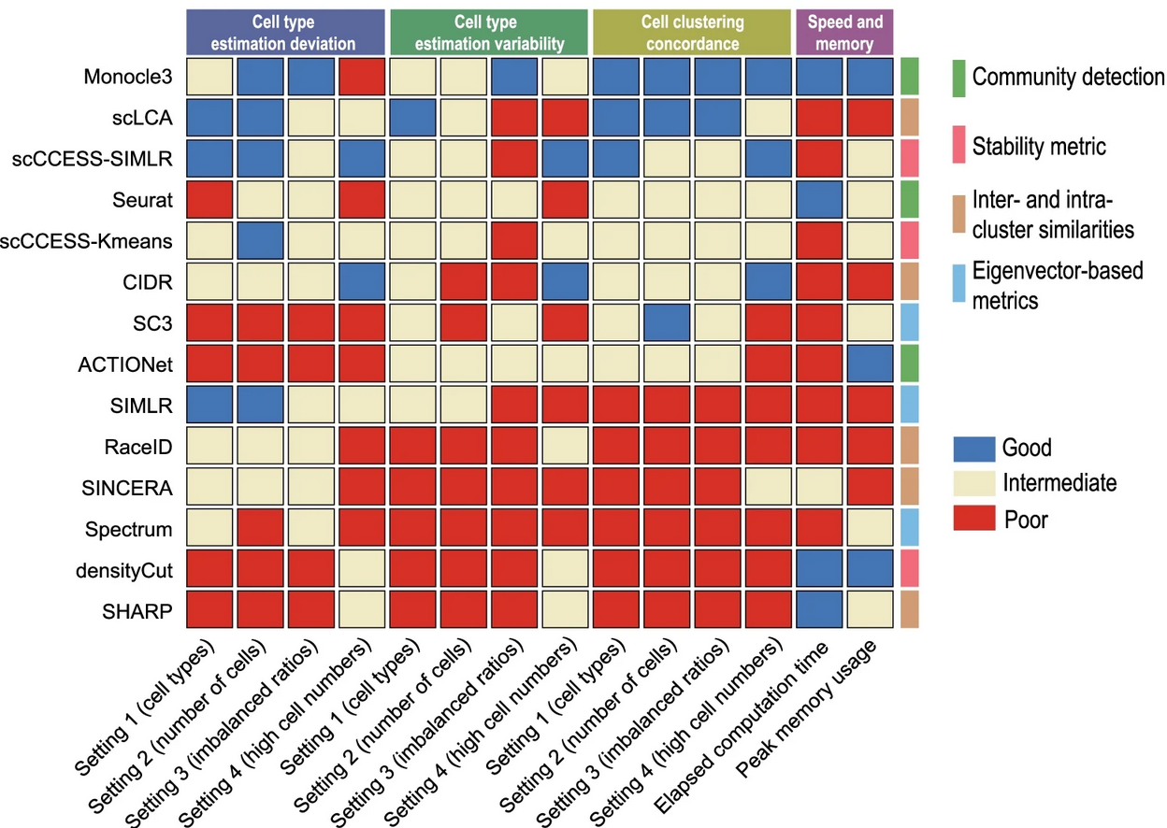
Clustering tool performance
Yu, L., Cao, Y., Yang, J.Y.H. et al. Benchmarking clustering algorithms on estimating the number of cell types from single-cell RNA-sequencing data. Genome Biol 23, 49 (2022). https://doi.org/10.1186/s13059-022-02622-0

Slide 35
Cluster Annotation
Compare marker genes in data to marker genes in reference dataset
Notes:
Marker gene sets can be found by applying differential expression (DE) testing between two groups: the cells in one cluster and all other cells in the dataset. Typically, we focus on genes that are up-regulated in the cluster of interest. As marker genes are expected to have strong differential expression effects, simple statistical tests such as the Wilcoxon rank-sum test or the t-test are often used to rank genes by their difference in expression between these two groups. The top-ranked genes from the respective test statistic are regarded as marker genes. This method uses cells as independent replicates so you get very low p-values so it is good to use logfold change as well or make pseudo-bulk counts.
- Do not use marker gene P-values to validate a cell-identity cluster, especially when the detected marker genes do not help to annotate the community. P-values may be inflated.
• Note that marker genes for the same cell-identity cluster may differ between datasets purely due to dataset cell type and state compositions.
• If relevant reference atlases exist, we recommend using automated cluster annotation combined with data-derived marker-gene-based manual annotation to annotate clusters. -See MARS etc.

Slide 36
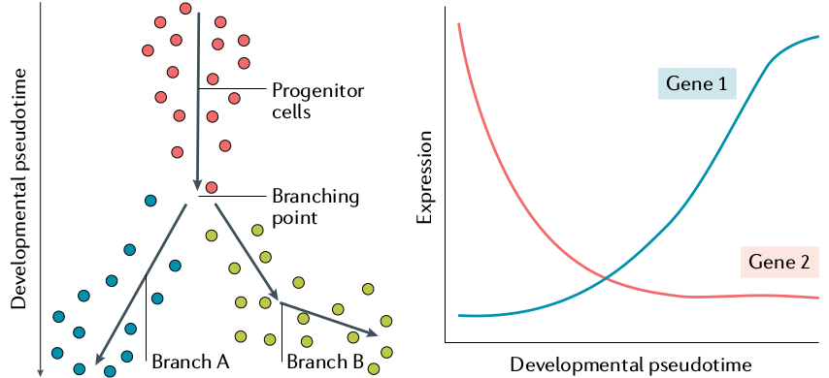
Trajectory analysis
Clustering groups cells into cell identities and trajectory analysis captures transitions between cell identities, differentiation processes, or changes in biological function.
Inferring pseudotemporal orderings or trajectories of cells: assumes that data lie on a connected manifold and labels cells with a continuous variable
Multiple methods should be tested
Wu et al., 2020 https://doi.org/10.1038/s41581-020-0262-0
Notes:
Trajectory inference methods interpret single-cell data as a snapshot of a continuous process. This process is reconstructed by finding paths through cellular space that minimize transcriptional changes between neighbouring cells. The ordering of cells along these paths is described by pseudotime.
Genes that vary smoothly across pseudotime characterize the trajectory and can be used to identify the underlying biological process. Furthermore, this group of trajectory-associated genes is expected to contain genes that regulate the modelled process.
Recent comparisons revealed that Slingshot (Street et al, 2018) outperformed other methods for simple trajectories that range from linear to bi- and multifurcating models. If more complex trajectories are expected, PAGA (Wolf et al, 2019)

Slide 37
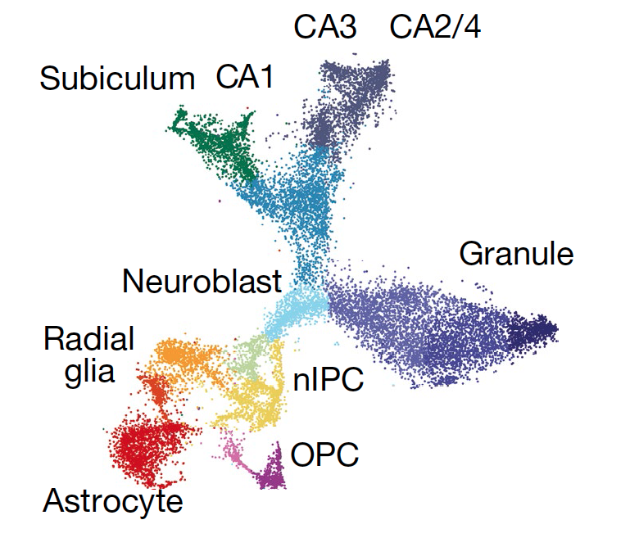
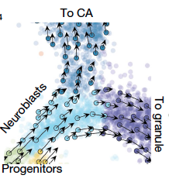
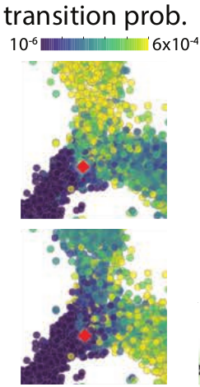
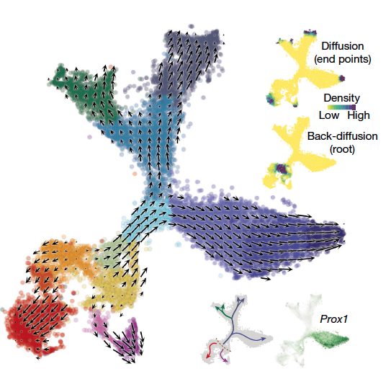
Fate Decisions of Major Neural Lineages
1
3
t-SNE
2
RNA Velocity can orient a lineage tree (predict future) without prior knowledge of the developmental process by assessing the ratio of spliced to unspliced RNA molecules present. High ratio of unspliced/spliced = increasing gene expression
Notes:
The two adjacent cells at the entrance of the branching point between the CA and granule fates in red show that although their current state showed that they were neighbors, their futures were already tilted toward different fates as shown by looking at the transition probabilities from the two starting cells to neighboring cells.

Slide 38
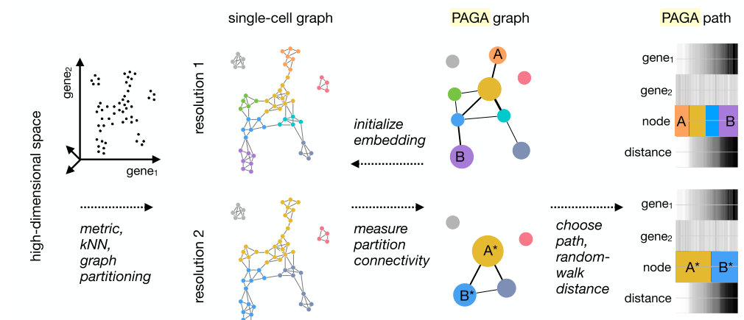
F. A. Wolf et al., Graph abstraction reconciles clustering with trajectory inference through a topology preserving map of single cells. bioRxiv 208819 [Preprint]. 25 October 2017.
PAGA (Partition-based graph abstraction)
PAGA is a statistical model for the connectivity of groups of cells whose nodes correspond to cell groups and whose edge weights quantify the connectivity between groups. Groups are connected if their number of inter-edges exceeds a fraction of the number of inter-edges expected under random assignment.
By quantifying the connectivity of partitions (groups, clusters) of the single-cell graph, PAGA generates a much simpler abstracted graph (PAGA graph) of partitions
By averaging over single-cell paths, it becomes possible to trace a putative biological process from a progenitor to fates

Slide 39
Partition-based graph abstraction (PAGA)
PAGA generates graph-like maps of cells that preserve both the continuous and disconnected structure in single cell mRNA-seq data, reconciling clustering and pseudotemporal ordering algorithms
F. A. Wolf et al., Graph abstraction reconciles clustering with trajectory inference through a topology preserving map of single cells. bioRxiv 208819 [Preprint]. 25 October 2017.
Notes:
Starting from the neighborhood graph of single cells, in which cells are represented as nodes, the algorithm quantifies the connectivity of cell clusters and generates a much simpler abstracted graph in which nodes correspond to the clusters identified by a clustering algorithm of your choice and edges represent putative transitions between clusters. The differentiation tree is then computed as the treelike subgraph in the abstracted graph that best explains all continuous progressions along the original single-cell graph. The statistical model considers groups as connected if their number of inter-edges exceeds a fraction of the number of inter-edges expected under random assignment. The connection strength can be interpreted as confidence in the presence of an actual connection and allows discarding spurious, noise-related connections.
High-dimensional gene expression data is represented as a kNN graph by choosing a suitable representation and an associated distance metric for computing neighborhood relations. The kNN graph is partitioned at a desired resolution — partitions represent groups of connected cells. A PAGA graph is obtained by associating a node with each partition, which are connected by weighted edges that represent the statistically estimated connectivity of partitions. By discarding spurious edges with low weights, PAGA graphs reveal the denoised topology of the data at a chosen resolution and reveal its connected and disconnected regions. Combining high-confidence paths in the PAGA graph with a random-walk based distance measure on the single-cell graph, we order cells within each partition according to their distance from a root cell. A PAGA path then averages all single-cell paths that pass through the corresponding groups of cells. This allows to trace gene expression changes along complex trajectories at single-cell resolution.
A PAGA graph whose nodes correspond to cell groups and whose edge weights quantify the connectivity between groups.

