Slide 1
BNFO262: Quantitative Methods in Genetics and Genomics
Day 1 - 1/07/25
Notes:
PJ

Slide 2
Outline for Day 1
Basics of Jupyter Notebook
Basics of Programming in Python
  Fundamentals
  Packages
Basics of Programming in R
  Fundamentals
  Packages

Slide 3

Jupyter Notebook
“The Jupyter Notebook is an open-source web application that allows you to create and share documents that contain live code, equations, visualizations, and narrative text.”
Visualizations
Mathematical equations
Statistical modeling
Narrative text
Any other rich media
Tutorial: Introduction to Jupyter Notebook

Slide 4

Logging into DataHub and Accessing Jupyter Notebooks
Go to https://datahub.ucsd.edu/
Click “Log in”. This should take you to the google sign-in page

Slide 5

3. Sign in using your @ucsd.edu email. This will take you to the SSO page where you will have to type in your username and password and authenticate using Duo

Slide 6
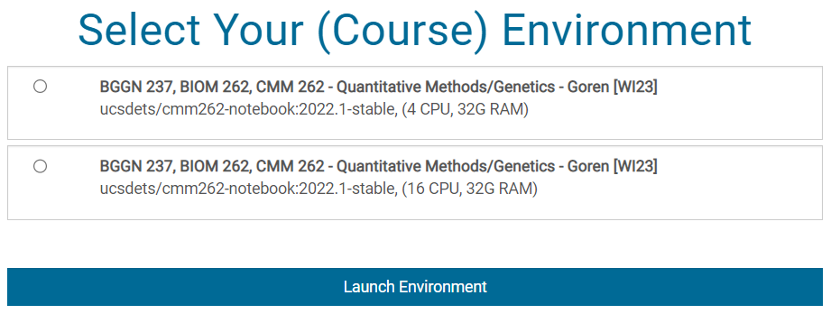
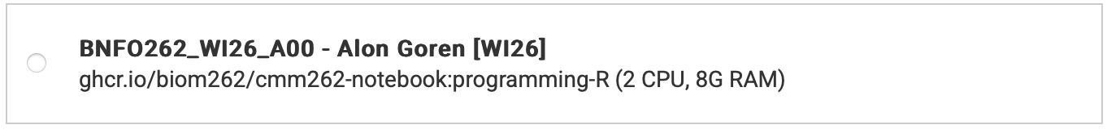
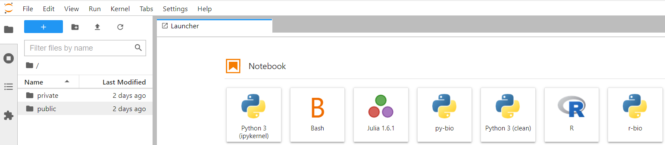
4. Now you should see a page that looks like this.
Select BNFO 262 ghcr.io/biom262/cmm262-notebook:programming-R and click “Launch Environment”
①
②
Your screen should look something like this:

Slide 7
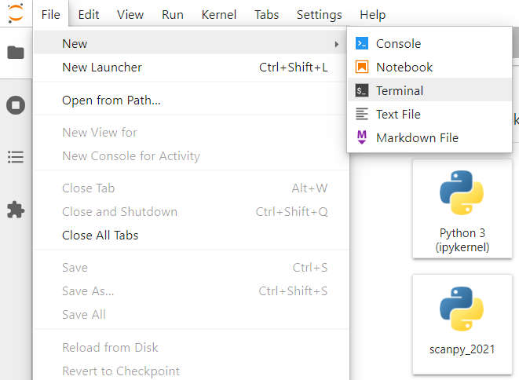
5. Open a new terminal window by going to File > New > Terminal

Slide 8
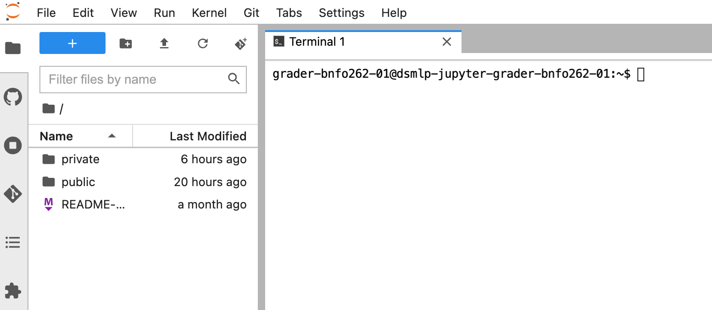
6. Your screen should look like this

Slide 9
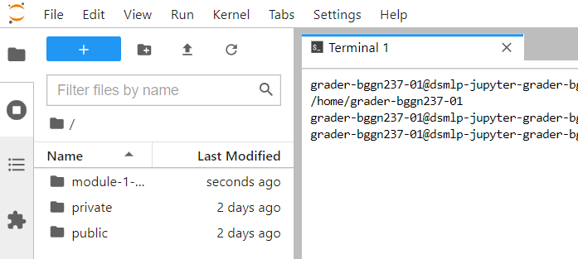
7. In your terminal window, type in pwd. The returned path should be:
/home/<your user ID>
8. Copy over the directory with all of the notebooks for module 1 using the following command:
cp -r public/bnfo262-2025/module-1-programming .
9. You should now see the module-1-programming directory on your jupyterhub homepage. (You might need to click the refresh button.)

Slide 10
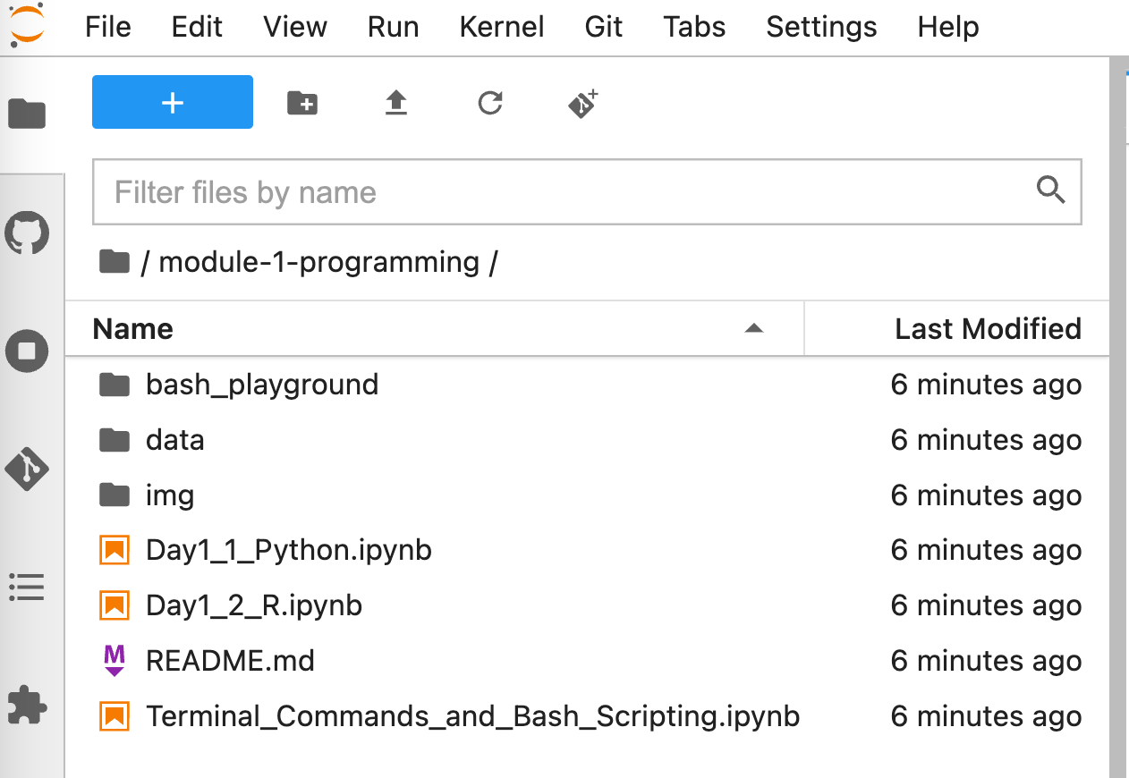
DEMO: Jupyter Notebook
Notes:
JJ

Slide 11
Outline for Day 2
Basics of Jupyter Notebook
Basics of Programming in Python
  Fundamentals
  Packages
Basics of Programming in R
  Fundamentals
  Packages

Slide 12
The Fundamentals
Jeff Jaureguy
Notes:
JJ

Slide 13
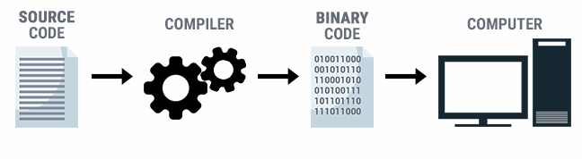
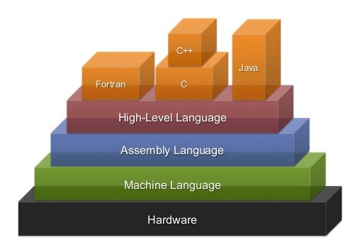
What are programming languages?
The natural language of computers is binary code (0s and 1s)
A programming language is a tool to communicate with computers
High level programming languages are farther from machine language
  closer to how humans communicate
  Take more time to run
  E.g. Python, R, Java, C++, Pascal, bash
Low level programming languages are closer to machine language
  Fast
  Give precise control
  E.g. Assembly
Notes:
JJ
-info from: https://news.codecademy.com/programming-languages/
By learning programming you become and ambassador between humans and computers. You can call yourself a technical diplomat

Slide 14
The Backbone of Programming Languages
Like how we break up languages into basic structures (e.g., part of speech, verb tense, etc.), we can also deconstruct programming languages into five basic concepts:
① VARIABLES
② CONDITIONAL STATEMENTS
③ LOOPING & ITERATION
④ DATA TYPES & DATA STRUCTURES
⑤ FUNCTIONS
Notes:
JJ
After this: PB&J Python demo.

Slide 15
DEMO: Python Fundamentals
Notes:
JJ

Slide 16
Packages
Notes:
JJ
Image from: https://www.google.com/url?sa=i&url=https%3A%2F%2Fwww.wikihow.com%2FMake-a-Peanut-Butter-and-Jelly-Sandwich&psig=AOvVaw0R2ZBtqhGZL4ozSynz7Uxe&ust=1607497985390000&source=images&cd=vfe&ved=0CAIQjRxqFwoTCLjihuXqve0CFQAAAAAdAAAAABAP

Slide 17
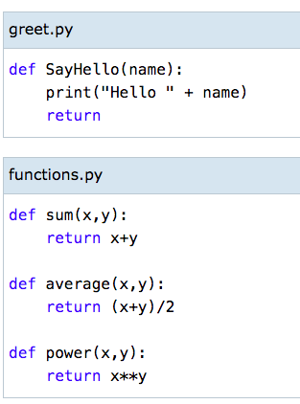
Packages
A package is a folder that contains one or more modules that you can import into your script
1
2
3
4
greet
Package
import
Script
misc_functions
functions
Notes:
JJ

Slide 18
Using packages in your script
greet
Package
import
Script
functions
misc_modules
Script
from misc_modules import functions
>>>functions.sum(3,2)
5
>>>functions.average(3,2)
2.5
Notes:
JJ

Slide 19

Common Python Packages
You don’t have to reinvent the wheel!
Math
  Numpy
  Scipy
Graphing
  Matplotlib
  Seaborn
Data Manipulation/Analysis
  Pandas
Operating System Functionalities
  os
Machine Learning
  Scikit Learn
  Pytorch
Notes:
JJ

Slide 20
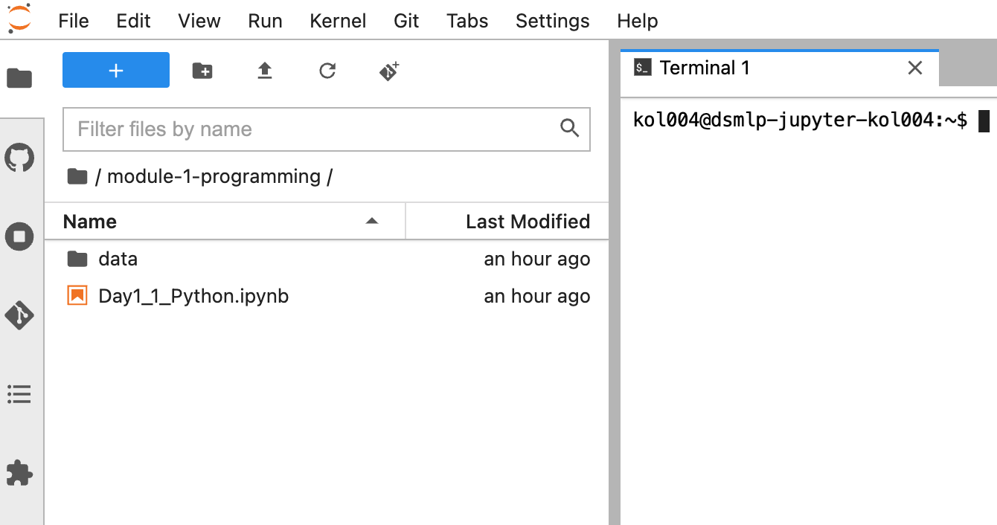
DEMO: Python Packages
Notes:
JJ

Slide 21
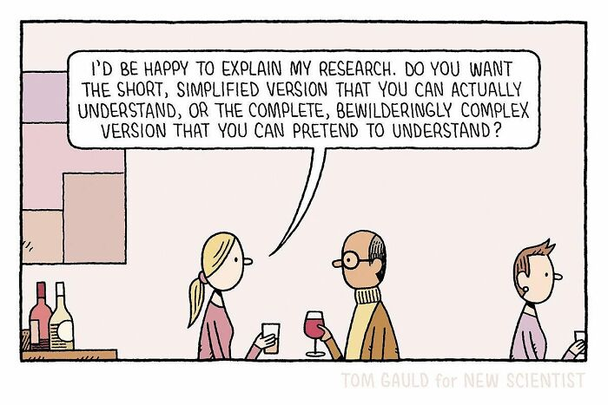
10 minute break!

Slide 22
Outline for Day 1
Basics of Jupyter Notebook
Basics of Programming in Python
  Fundamentals
  Packages
Basics of Programming in R
  Fundamentals
  Packages

Slide 23

Introduction to R: What is R?
R is a high-level language used by many statisticians
Strengths: data analysis, complex statistics, detailed visualizations
Similarities to python
  R is also an interactive environment (R studio)
  R has built-in functions and packages
R has its own syntax and structure
Notes:
JJ

Slide 24
The Purpose of Using Both Python and R
R | Python
Objective: analysis and statistics Users: statisticians and academics Lots of models available for use in analysis Larger catalog for data analysis, more customizable visualizations | Objective: deployment and production Users: programmers and developers Can use pre-existing models or easily create new models from scratch Easier to publish and share packages
Use whatever works best for you!
Notes:
JJ
Both can handle large amounts of data
Python is more human-readable and usually more intuitive to learn
R (strengths)
Overall, the two packages are truly complementary and each has unique applications where they are preferred. Specifically, depending on the work you’re doing, packages that support your analyses may only be available in one or the other. For example, I’ve recently been primarily using R because it has a specific package that I need for integrating the multiomic single cell data I work with.
https://www.guru99.com/r-vs-python.html#:~:text=R%20and%20Python%20are%20both,general%20approach%20to%20data%20science.&text=Python%20is%20a%20general%2Dpurpose%20language%20with%20a%20readable%20syntax.

Slide 25
The Backbone of Programming Languages
Like how we break up languages into basic structures (e.g., part of speech, verb tense, etc.), we can also deconstruct programming languages into five basic concepts:
① VARIABLES
② CONDITIONAL STATEMENTS
③ LOOPING & ITERATION
④ DATA TYPES & DATA STRUCTURES
⑤ FUNCTIONS
Notes:
JJ
As a programming language, R is composed of the same backbone components that we talked about on Tuesday when we learned about python. Although the exact syntax of R is different than python, it’s pretty easy to translate between the two when working with all of these elements. However, in comparison to python, R places a different emphasis on the key components. For example, although there are ways to create for loops in R, many users prefer to use built in functions rather than loops.
Now, I’ll briefly walk through some examples of these components and compare them between python and R

Slide 26
① VARIABLES
① VARIABLES
>>> a = [1, 2, 3]
>>> a
>>> a[0]
Python Script
> a <- c(1,2,3)
> a
> a[1]
R Script
Out:
[1, 2, 3]
1
Out:
[1] 1 2 3
[1] 1
R is 1-indexed!!!
Notes:
JJ

Slide 27
R: Vectors vs. Lists
Vectors | Lists
Atomic One-dimensional Can hold values of one type Most basic data structure Easier to manipulate | Recursive Multi-dimensional Can hold values of multiple types Commonly used to represent datasets or modules
> a <- c(1,2,3)
> a
> a[1]
> b <- list(values=c(1,2,3), ids=letters[1:3])
> b
> b$values
> b[[1]]
Out:
[1] 1 2 3
[1] 1
$values
[1] 1 2 3
$ids
[1] "a" "b" "c"
[1] 1 2 3
[1] 1 2 3
Notes:
JJ

Slide 28
R: Vectors vs. Lists
Vectors | Lists
Atomic One-dimensional Can hold values of one type Most basic data structure Easier to manipulate | Recursive Multi-dimensional Can hold values of multiple types Commonly used to represent datasets or modules
> a <- c(1,2,3)
> a
> a[1]
> b <- list(values=c(1,2,3), ids=letters[1:4])
> b
> b$values
> b[[1]]
Out:
[1] 1 2 3
[1] 1
$values
[1] 1 2 3
$ids
[1] "a" "b" "c" "d"
[1] 1 2 3
[1] 1 2 3
Notes:
JJ

Slide 29
② CONDITIONAL STATEMENTS
③ LOOPING & ITERATION
② CONDITIONAL STATEMENTS
③ LOOPING & ITERATION
x=[1, 2, 3]
for i in x:
if i > 2:
return “high”
else:
return “low”
Python Script
> x <- c(1,2,3)
> for (i in x){
if (i>2){
print(“high”)
} else {
print(”low”)
}
}
> ifelse(x>2,"high","low")
R Script
Out:
Out:
low
low
high
[1] “low”
[1] “low”
[1] “high”
[1] "low" "low" "high"
Many R functions will automatically loop through vectors
Notes:
JJ

Slide 30
R: Alternatives to Loops
> a <- c(1,2,3)
> a
> sin(a)
> b <- list(c(1,2,3),c(T,F,T,T))
> b
> lapply(b,mean)
> c <- matrix(c(1,2,3,4,5,6), nrow=2,ncol=3)
> c
> apply(c,1,mean)
Many functions will automatically loop through atomic vectors
lapply: run a single function on all entries of a list
  lapply(x, function)
apply: run a single function on all rows or columns of a matrix or dataframe
  apply(x, margin, function)
Out:
[1] 1 2 3
[1] 0.8414710 0.9092974 0.1411200
[[1]]
[1] 1 2 3
[[2]]
[1] TRUE FALSE TRUE TRUE
[[1]]
[1] 2
[[2]]
[1] 0.75
[,1] [,2] [,3]
[1,] 1 3 5
[2,] 2 4 6
[1] 3 4
Notes:
JJ

Slide 31
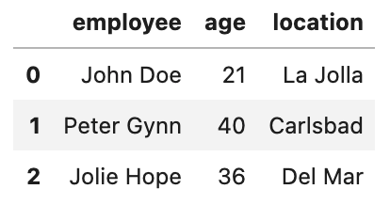
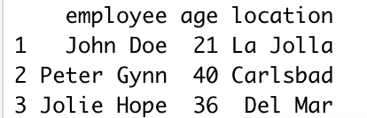
④ DATA TYPES & DATA STRUCTURES
④ DATA TYPES & DATA STRUCTURES
>>> import pandas as pd
>>> employee_data = {'employee':['John Doe','Peter Gynn','Jolie Hope'],'age':[21, 40, 36],'location':['La Jolla','Carlsbad','Del Mar']}
>>>df = pd.DataFrame(employee_data)
>>> df.head()
Python Script
> employee <- c('John Doe','Peter Gynn','Jolie Hope')
> age <- c(21, 40, 36)
> location <- c('La Jolla','Carlsbad','Del Mar')
> employ.data <- data.frame(employee, age, location)
> employ.data
R Script
Out:
Out:
Notes:
JJ

Slide 32
⑤ FUNCTIONS
⑤ FUNCTIONS
def fahrenheit_to_celsius(temp_F):
temp_C = (temp_F - 32) * 5 / 9
return temp_C
fahrenheit_to_celsius(32)
Python Script
> fahrenheit_to_celsius <- function(temp_F) {
temp_C <- (temp_F - 32) * 5 / 9
return(temp_C)
}
> fahrenheit_to_celsius(32)
R Script
Out:
0.0
Out:
[1] 0
R functions can only return one object
Notes:
JJ
https://swcarpentry.github.io/r-novice-inflammation/02-func-R/

Slide 33

The Dangers of R Warnings
R differentiates between Errors and Warnings
  Error: the function cannot continue and must stop running
  Warning: something has gone wrong but the function has been able to recover and keep running
Warnings may change your data in unknown ways!
> mat <- matrix(c(1,2,3,4), nrow=2,ncol=3)
> mat
Out:
Warning message:
In matrix(c(1, 2, 3, 4), nrow = 2, ncol = 3) :
data length [4] is not a sub-multiple or multiple of the number of columns [3]
[,1] [,2] [,3]
[1,] 1 3 1
[2,] 2 4 2
Notes:
JJ
https://adv-r.hadley.nz/conditions.html#:~:text=Errors%20are%20the%20most%20severe,to%20at%20least%20partially%20recover.

Slide 34

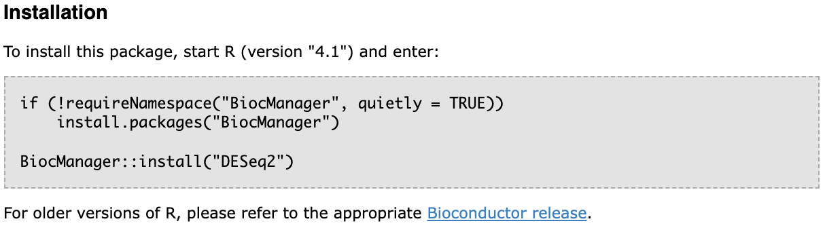
Bioconductor
A free, open-source and open development software repository that hosts statistical tools for analyzing biological data
Contributions are primarily based in R
Notes:
DV
https://en.wikipedia.org/wiki/Bioconductor

Slide 35

Commonly Used R Packages
ggplot2 — data visualization
Tidyverse — collection of packages used for data science (includes ggplot2)
R Script
> install.packages("tidyverse")
> library(tidyverse)
> dplyr::filter()
CRAN: The Comprehensive R Archive Network
Notes:
DV
https://www.tidyverse.org/packages/

Slide 36

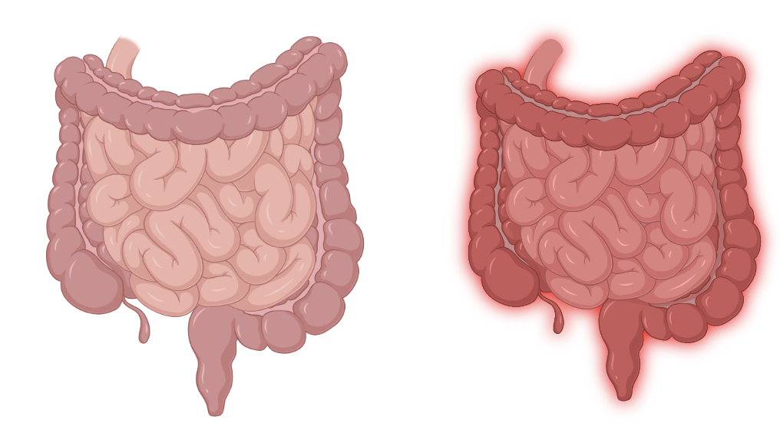
Dataset We Will Look At Today: GSE166925
Today:
Data Manipulation
Data Visualizations
Uninflamed
Sample Types:
Inflammatory Bowel Disease (UC and CD)
Colorectal Cancer (Non-tumor)
Inflamed
Notes:
DV

Slide 37
DEMO: R
Notes:
JJ

Slide 38

See you again next week!
Please fill out the surveys!
Attendance
Module 1 feedback
The survey for attendance is due today at 1pm.
Survey for this module will be released on Thurs after class and is due next Tues at 9 am!

