Slide 1
AGENTIC AI CHALLENGE · ROUND 2
Maintenance Wizard
Agentic predictive-maintenance decision support for heavy steel plants
A System of Action — it predicts what will break, prepares the fix, and refuses to close a job until every compliance step is logged.
CRITICAL · HIGH · MEDIUM · LOW priority-banded triage
Consolidated-Brain agent · runs on numpy + pandas + Streamlit alone

Slide 2
THE PROBLEM
Fragmented data, manual diagnosis, costly downtime
In a steel plant, an engineer diagnosing a fault juggles five disconnected systems — by hand, under time pressure, dependent on expert judgement. The result is slow, inconsistent decisions and avoidable unplanned downtime.
Equipment manuals & SOPs
torque specs, isolation steps
1
2
Sensor / condition data
temperature, vibration, pressure…
3
Historical delay logs
downtime, tonnage lost
5 → 1
4
Failure / incident records
root cause, resolution
five fragmented sources collapsed into one traceable decision
5
ERP spares inventory
stock levels & procurement lead time

Slide 3
THE IDEA
Not a System of Record — a System of Action
SYSTEM OF RECORD
SYSTEM OF ACTION
Passive databases
An autonomous agent
Tells you what broke and when
Waits for a human to ask
Knowledge scattered across silos
Reactive troubleshooting
Predicts what will break — and when
Prepares the work order before login
Fuses all five sources in one loop
Closes the loop: blocks non-compliant jobs

Slide 4
WHAT IT DELIVERS
One decision, five answered questions
1
2
3
4
5
Operational Risk
Root-Cause Diagnosis
Maintenance Blueprint
Supply-Chain Strategy
Traceability & Audit
How urgent is this?
Why is it failing?
How do I fix it?
Can I get the parts?
Can I trust it?
priority band + score, delay severity
probable fault + SHAP drivers
isolation steps + verified SOP tasks
stock, lead time, mitigations
cited manuals, incidents, the SQL run
Every diagnosis returns the same mandatory five-block output — scannable, structured, and fully cited.

Slide 5
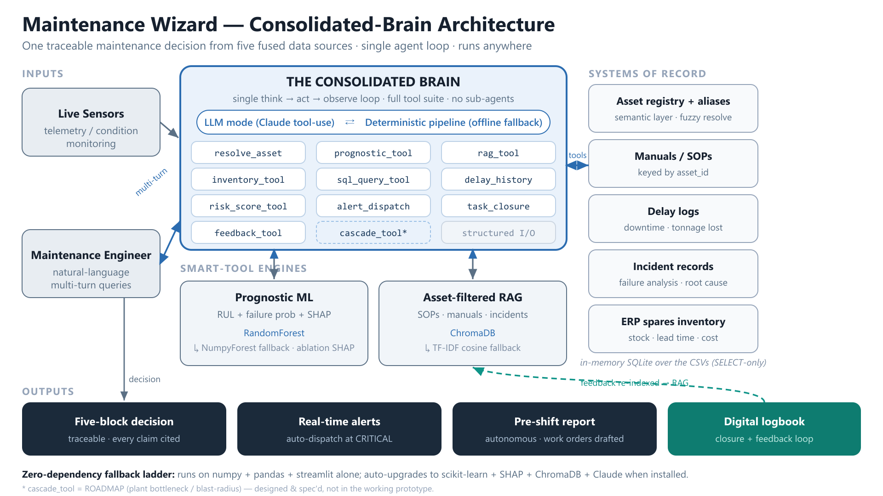
ARCHITECTURE
The Consolidated Brain
One loop
A single think→act→observe agent holds the full context and the entire tool suite — no sub-agents.
Dual mode
Identical tools run via Claude (LLM) or a deterministic Python pipeline — the reproducible offline baseline.
Smart tools
Every tool returns a rich structured object: RUL+SHAP, cited SOPs, stock+lead time, the exact SQL it ran.

Slide 6
DESIGN CHOICE
One brain beats many agents
MULTI-AGENT (supervisor + sub-agents)
CONSOLIDATED BRAIN (this project)
Planning split across a supervisor and specialised agents
"Split-brain": agents hold mismatched slices of context
More moving parts, more orchestration overhead
Harder to trace one coherent decision
One loop holds the full context + the entire tool suite
No knowledge mismatch — nothing to reconcile
Simpler, cheaper, fully observable trace
Same five-stage capability, one accountable answer
Following the Omni / Blobby lesson: consolidate planning, don't fragment it.

Slide 7
REASONING PIPELINE
Think → act → observe
0
1
2
3
4
5
Resolve
Predict
Retrieve
Supply
Prioritise
Reconcile
map jargon → asset_id
RUL, failure prob, SHAP
SOPs, incidents, SQL
stock & lead times
constraint-aware score
emit 5-block, alert
resolve_asset
prognostic_tool
rag_tool · sql_query
inventory_tool
risk_score_tool
alert_dispatch
STEP 4.5 — Plant impact [ROADMAP — not in the prototype]: a designed cascade_tool would compute downstream blast radius so an asset's priority reflects what it idles, not just its own health.

Slide 8
MODEL DESIGN & EXPLAINABILITY
Prognostics you can interrogate
Remaining Useful Life + 30-day failure probability, from a Random Forest trained on per-asset-type deviations (z-scores vs a healthy baseline). One model serves furnaces, pumps, valves…
SHAP drivers — Mill Drive Gearbox 5 (example)
SHAP attribution explains every prediction — negative bars push RUL down (accelerate failure). Falls back to model-agnostic ablation when the SHAP library is absent.

Slide 9
SIGNATURE BEHAVIOUR
Constraint-aware prioritization
Priority = 100 × ( 0.40·RUL + 0.30·criticality + 0.15·delay-history + 0.15·spares )
deterministic, explainable, 0–100 → CRITICAL / HIGH / MEDIUM / LOW
The constraint flag
GEARBOX-05 — worked example
When an out-of-stock part's lead time exceeds the predicted RUL, the repair physically cannot finish before failure. The agent flips its own recommendation.
Predicted RUL: ~38 days
Pinion lead time: 45 days
→ part arrives AFTER failure
Recommendation flips: "replace now" → monitored-degradation plan + auto-alert

Slide 10
RUNS ANYWHERE
Production stack, zero-dependency fallback
Layer | Production path | Zero-dep fallback
Prognostics | scikit-learn RandomForest | NumpyForest (bagged CART, numpy)
Explainability | shap.TreeExplainer | ablation attribution
Retrieval | ChromaDB vector store | TF-IDF cosine index (numpy)
Reasoning | Claude tool-use loop | deterministic Python pipeline
Layer
Production path
Zero-dependency fallback
The deterministic path is also the reproducible baseline the eval judges score against — the same fixed inputs always land in the same risk band.

Slide 11
WHY IT STANDS OUT
Six things most submissions miss
✓
Real prognostic ML
✓
Zero-hallucination
✓
Runs offline
RUL + failure prob + SHAP — not just LLM-over-docs
tool outputs are the only source of truth; SQL shown
deterministic mode + numpy fallback ladder
✓
Multi-turn dialogue
✓
Feedback loop
✓
Trace-based evals
context-aware follow-ups keep the asset in focus
engineer corrections re-index RAG + adjust priority
judges guard every change against regressions

Slide 12
SEE IT WORK
Demo scenarios
“what's wrong with the mill gearbox?”
Constraint-aware triage
RUL < lead time → flips to monitored degradation + auto-alert
“that valve that keeps leaking on the caster”
Fuzzy resolution
plant jargon → HYD-VALVE-07 before any tool call
“check the EAF”
Abbreviation
resolves to FURNACE-01
“Pre-Shift Report tab”
Proactive autonomy
work orders drafted for every flagged asset before login
“Digital Logbook tab”
Loop closure
job closure blocked until all five compliance items are green

Slide 13
BEYOND THE BRIEF
Roadmap — surpassing the requirements
Plant cascade graph
Designed
Domain-specific SLM
Planned
blast-radius / bottleneck propagation across the line
distilled maintenance model as an offline reasoning rung
Quantified outcomes
Planned
Optimized scheduling
Planned
back-tested downtime-hours & cost avoided
place repairs in the RUL window vs production calendar

Slide 14
FROM REACTIVE TO PROACTIVE
Predict. Prepare. Close the loop.
Reduce unplanned downtime
Faster, more consistent diagnosis
Proactive, prioritized maintenance
Audit-grade, traceable decisions
Maintenance Wizard · Consolidated-Brain agent for heavy steel plants

