Slide 1
Testing with JavaScript
React

Slide 2
Contents page
Manual Testing
Unit Testing
Content Tests
Snapshot Tests
Test Coverage

Slide 3
Course objectives
Adequately test the sample project, making use of:
Shallow Rendering
Mounting
Snapshot Testing
Utilise Test Coverage to ensure a proper level of testing.

Slide 4
Manual Testing
There are many downsides to this approach including:
Time-Consuming
Prone to Human Error
Irregular results

Slide 5
Live Demo
Watch as the trainer demonstrates testing in JavaScript
Discuss some of the improvements that automating this process affords us

Slide 6
Unit Testing
We will be using Enzyme
Allows us to render simple components and check that they contain some of the elements we expect.
We can check the values of elements in our components.

Slide 7
Content
import React from 'react';
import { shallow } from 'enzyme';
import App from '../App';
import RoutingExample from '../Router.js'
it('renders routingExample comp', () => {
const wrapper = shallow(<App />);
const content = <RoutingExample />;
expect(wrapper.contains(content)).toEqual(true);
});

Slide 8
Shallow vs Mount
Shallow
We use shallow when we want to test just one layer of a component
Mount
We use mount when we want to also test child components
Start by using shallow as it is less computationally intensive

Slide 9
Simulating Events
Once we have rendered a component, we may want to test what happens when a certain event is triggered.
For instance, submitting a form or clicking a button.
it("clicks a button", () => {
const wrapper = shallow(<Label title="A Title" />);
expect(wrapper).toMatchSnapshot();
wrapper.find('a').simulate('click');
expect(wrapper).toMatchSnapshot();
});

Slide 10
Snapshot testing
We create a snapshot of what our component will look like when it is rendered.
This is saved as a ‘snap’ file, which is then used by Jest to check for changes.
As this method renders child components as well it is a form of integration testing.
Subsequent tests compare the component against the snapshot to see if the way it is rendered has changed. A change can be caused by various reasons:
A bug, which you will then have to fix.
A change made to the original component that hasn’t been updated in the snapshot.

Slide 11
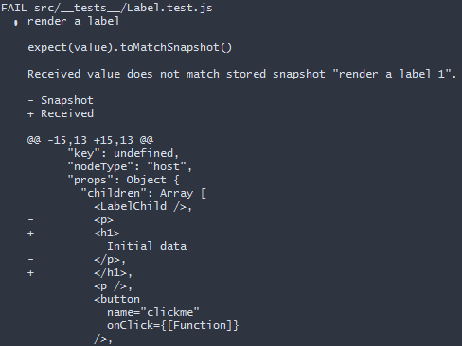
What is going on here?
We are comparing a new ‘snapshot’ of a component to the original stored value.
As a change has been made to the way the component is rendered the snapshot test notices this and fails.

Slide 12
Live Demo
Watch as the trainer demonstrates Snapshot testing in JavaScript
Discuss some of the improvements that automating this process affords us

Slide 13
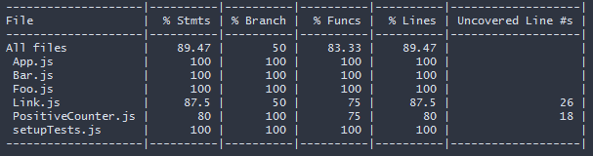
Coverage
A vital concept when we test our system is to see to what extent it has been tested.

Slide 14
Which Coverage is more important?
From the column names on the previous page:
Which is the most important % to focus on?
What % should you try to attain?
Spend 5 minutes in pairs debating the above:
Back in groups we will discuss what you have decided.

Slide 15
Course objectives
Adequately test the sample project, making use of:
Shallow Rendering
We have seen examples of Shallow Rendering
Mounting
We have seen examples of Mounting
Snapshot Testing
We have seen examples of Snapshot Testing
Utilise Test Coverage to ensure a proper level of testing.
We have seen how we can perform a test with test coverage and considered the importance of Test Coverage.

Slide 16
Thank you for listening.
Any questions?

