Slide 1
NPM
MERN

Slide 2
Contents page
NPM
Package.json

Slide 3
Course objectives
Learn the purpose of NPM
To understand some of the information in package.json
To learn how to install a module using NPM
To have some idea as to how we can configure VSCode to make our development easier.

Slide 4

NPM – Node Package Manager
The worlds largest software registry
NPM is used to install and manage JavaScript packages
Publish packages online for others to use
Automate your tooling
As of 26/04/19 there is over 800,000 published NPM packages for you to download.
http://www.modulecounts.com/
Notes:
CONTINUED <number>

Slide 5
Package.json
Located in the root of your project
Contains meta information about your project.
Author
Name of the app
Entry point
Scripts
Dependencies
And more
Notes:
CONTINUED <number>

Slide 6
"name": "academy_tracker",
"version": "1.0.0",
"description": "",
"main": "server.js",
"scripts": {
"start": "node server.js",
"server": "nodemon server.js",
"client-install": "npm install --prefix client",
"client": "npm start --prefix client",
"dev": "concurrently \"npm run server\" \"npm run client\""
},
"author": "Matt Hunt",
"license": "MIT",
"dependencies": {
"bcryptjs": "^2.4.3",
"body-parser": "^1.18.3",
"concurrently": "^4.1.0",
"express": "^4.16.4",
Scripts you can use.
Package.json
Dependencies needed for this Node application

Slide 7
Popular Packages
Express
Lodash
Mongoose
Webpack
Mocha
Passport
React
ESLint
Express & Lodash boast 10,000,000+ downloads a month
Whilst these might be the most popular, there are packages for almost anything you can think of.
Twitter Integration? Yep!
Pokémon API Wrapper? Yep!
Harry Potter Spells Generator? …Yep…
You must always think before you write some code
“Does a module exist already that will do this for me?”
Notes:
CONTINUED <number>

Slide 8
Adding Dependencies to package.json
Navigate to the root of the project
Open a Command Prompt here
Run the NPM command
npm install <package name here>
This will:
Download the files for the module
Modify the package.json to reflect the new dependency.

Slide 9
Modules
A module is a JavaScript library/file you can import into other code using Nodes require() function.
The require() function will only work if the correct dependency exists in the package.json.
We can also create and export our own modules.
We can then use these modules in other areas of our project.
//Example module import
let _ = require("lodash");
_.shuffle([1, 2, 3]); //returns a shuffled array
//Example exports in example.js
exports.area = function (width) { return width * width; }
exports.name = "jeff";
exports.ExampleLibraryName = {
exampleFunc: (input) => output * 2,
name: "Jeff",
dogCount: 5
}

Slide 10
Modules
require imports modules
exports exposes features to be imported.
//another JS file where we are importing our own modules
let example = require("./example");
console.log(example.ExampleLibraryName.dogCount);
//If you want to have one big export of everything you want to export. Easier to keep track of.
module.exports = {
area: function(width) { return width * width;},
name: "Jeff",
dogcount: 5
}

Slide 11
Basic Node App Demonstration
Notes:
Create a folder, open it in visual studio code
Open the integrated terminal, run npm init , Talk about each prompt, then show them npm init –y
Create a js file with console.log(“Hello World!”);
Through the integrated terminal, run the file using node “filename”
Create an npm script to run the file, then run the script to show it working.
“exampleScript” : “node example.js”
npm run “script-Name”
Install lodash library
Var _ = require(“lodash”);
Open lodash docs, show them around it
https://lodash.com/docs/
Tell them about lodash handout
Create a basic app using lodash
const _ = require("lodash");
let array = [1,2,3,4,5];
console.log(array);
array = _.shuffle(array);
console.log(array);
Put them on basic exercises to get comfy with lodash, assuming this lecture takes an hour put them on exercises for 1-2 hours then start on express, inform them if they get ahead to carry on with the exercises.
CONTINUED <number>

Slide 12
Hello World
Create a new Node project using npm init
Create a js file with console.log(“Hello World!”);
Through the integrated terminal, run the file using node <filename>
As a group we will discuss what you have found.
8

Slide 13
Writing Node Scripts
In the package.json we have some scripts we could run.
Here we can our own bespoke scripts
We call these scripts by writing:
Npm run <name of script>
"scripts": {
"start": "node server.js",
"server": "nodemon server.js",
"client-install": "npm install --prefix client",
"client": "npm start --prefix client",
"dev": "concurrently \"npm run server\" \"npm run client\""
},

Slide 14
Basic Node Script Demonstration
Notes:
Take an the previous demo package.json
Add a script to run the js file in it
Run the script
Change name of script
Run again
Answer questions
CONTINUED <number>

Slide 15
Hello World
Create an npm script to run the file you created in the last exercise, then run the script.
As a group we will discuss what you have found.
<number>

Slide 16
Practice Activity
Time: 15 minutes
Create a new directory and use NPM to install Lodash. Use the --save flag.
Create a new JS file. Experiment with importing Lodash and using its built in utilities
Create a module in a separate file. Try importing it into your original file.
Write a script in your package.json that runs the file
<number>

Slide 17
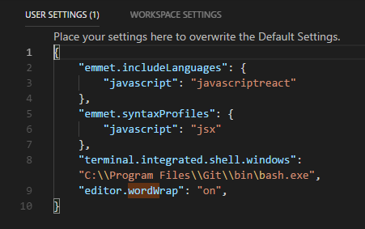
Setting up vscode

Slide 18
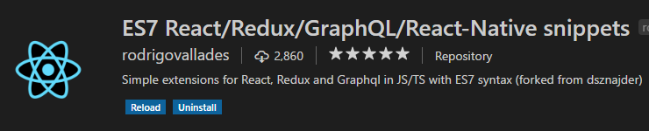
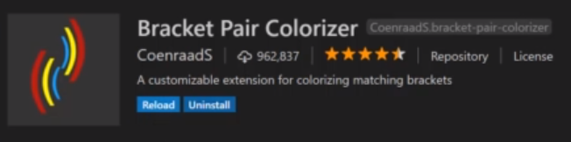
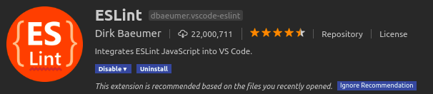
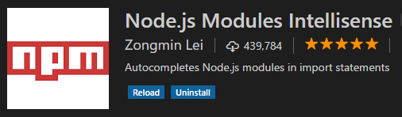
These are the ones that I will be using – feel free to use your own
plugins

Slide 19
Course objectives
Learn the purpose of NPM
NPM is a package manager. It manages external dependencies for a project
To understand some of the information in package.json
We have seen where information about the dependencies of a project are stored in the package.json.
To learn how to install a module using NPM
Modules can be imported into your code. You can easily create your own modules too.
To have some idea as to how we can configure VSCode to make our development easier.
We have seen some plugins available to us and some of the benefits that they offer.

Slide 20
Thank you for listening.
Any questions?

