Slide 1
Node.js
MERN

Slide 2
Contents page
What is Node.js?
How does it work?

Slide 3
Course objectives
Describe Node.js and what it can be used for.
Install Node.js.
Gain practical experience with Node.js.

Slide 4
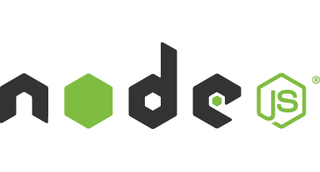
What is Node.js?
JavaScript runtime environment
Runs on chrome v8 engine
Server-side JavaScript
For developing powerful, fast and scalable web apps.

Slide 5
What is Node.js?
We do more with JavaScript then just making websites interactive
The Node run-time environment has everything you need to run to execute a program written in JS.
The V8 engine takes the JS you write and converts it into machine code.
Uses a single thread, event driven non-blocking I/O model

Slide 6
Single Threaded Event Driven Non-Blocking I/O Model
Single Thread as opposed to Multi-Thread means the engine can only do 1 thing at a time
I / O refers to Input and Output
An easy example is making a HTTP request
These requests take time and hence can block other functions from being performed.
However Node has a Non-Blocking model meaning that these requests do not block the stack.

Slide 7
Single Threaded
Traditional
1 request = 1 thread
1 thread = 2mb
16gb RAM machine = 8000 concurrent requests
Node.JS
In 2012, typical 16gb machine
1,000,000 concurrent requests.
Notes:
http://blog.caustik.com/2012/08/19/node-js-w1m-concurrent-connections/

Slide 8
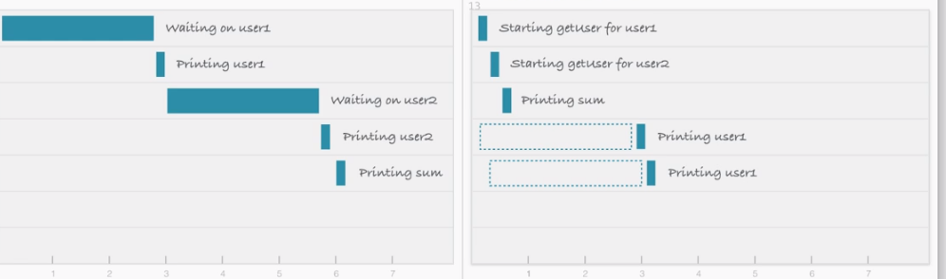
Single Threaded Non-Blocking I/O Model
Notes:
On the left blocking
On the right non blocking

Slide 9
Demo – How does this work?
Watch the trainer Demo
In Pairs spend 5 minutes discussing what you think is happening.
Notes:
Single_thread_demo

Slide 10
Usability? What is Node used for?
REST APIS & other backend applications
Real-time services, chat and games.
Blogs, CMS, Social applications.
Utilities and tools.
Anything that doesn’t require a lot of CPU.
Paypal
Linkedin
Uber
Netflix
Ebay
Trello
Notes:
Paypal boasted that their conversion to node was built twice as fast with even fewer people than the previous java version. 33% fewer lines of code and 40% fewer files.
Linkedin boasted their node backend increased the speed of their mobile app by 20 times and only uses a fraction of the resources, they cut their number of servers from 30 to 3…
In conjunction with all this, every company that switched to node had to express how much better the teams morale and integration is now that their entire stack is in the same language, it brings everyone together and the JavaScript community really enforces that.

Slide 11
Why do they use Node?
All your development is done in the same language throughout the entire stack.
The MERN stack is JS in the Front-end, Back-end and Data Layer.
No need for costly conversion from one data type to another
All your JS developers can be utilised across the stack.

Slide 12
Course objectives
Describe Node.js and what it can be used for.
Node.js is server-side JS that can be used for numerous purposes including making fast and responsive web servers.
Install Node.js.
The provided handout takes us through this process.
Gain practical experience with Node.js.
We have seen Node.js used and now it is installed we can start using it.

Slide 13
Thank you for listening
Any questions?

