Slide 1
Microsoft Azure
Control and organise azure resources

Slide 2
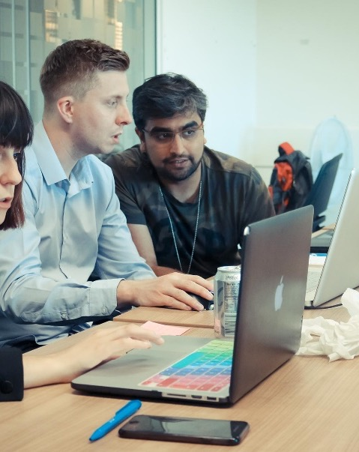
Presentation contents:
Resource Groups
Tags
Resource Locks

Slide 3
Course objectives
Learn how to use resource groups to organise Azure resources
Discuss how tags can be used to organise resources
Learn how resource locks can be used on Azure resources

Slide 4
Resource Groups
Fundamental element of the Azure platform
Logical container for resources deployed on Azure
All resources must be in a resource group, and you can’t provision a resource without a resource group
A resource can only be a member of a single resource group
Resources can be moved between resource groups at any time
Resource groups can’t be nested
How could you use resource groups effectively in Azure?
Notes:
Answer: Organize and manage resources.
Try to put resources of a similar usage, type or location in same resource group
Resource group deletion = everything in it also deleted
Can apply RBAC to resource group

Slide 5
Tags
Tags are name/value pairs of text data that you can apply to resources and resource groups
Really useful for organizing resources. Can use tags such as:
Department (finance, marketing, etc.)
Environment (prod, test, dev)
Cost Centre
A resource can have up to 15 tags
Not all resource types support tags

Slide 6
Resource Locks
Setting that can be applied to any resource
Primarily to block modification of deletion
Delete – Allows all operation against the resource, but block the ability to delete it
Read-Only – only allows read activities to be performed against it, blocking any modification or deletion of the resource
Can be applied to subscriptions, resource groups and/or individual resources
They are inherited when applied at higher levels

Slide 7
Course Summary
We have discussed how resource groups are needed to create any resource in Azure
We looked at how best too organise our resource in Azure, using resource groups and tags
We also discussed how to prevent accidental deletion or modification of a resource in Azure, using resource locks

Slide 8
Thank you for listening
Any Questions?

