Slide 1
Microsoft Azure
Azure Portal

Slide 2

Presentation contents:
Azure Portal
Azure PowerShell & CLI
Azure Portal Dashboards

Slide 3
Course objectives
Learn about Azure management options
Navigate the Azure Portal
Customise the dashboard

Slide 4
Azure Management Options
Azure Portal
Interact with Azure via a Graphical User Interface (GUI)
Public website accessible with any web browser
Sign in to create, manage and monitor any available Azure service
Any disadvantage to the Azure Portal?
Notes:
Answer – no way of automating repetitive tasks. To set up multiple VMs, you would need to do one at a time!

Slide 5
Azure Portal
Azure Portal Dashboard view

Slide 6
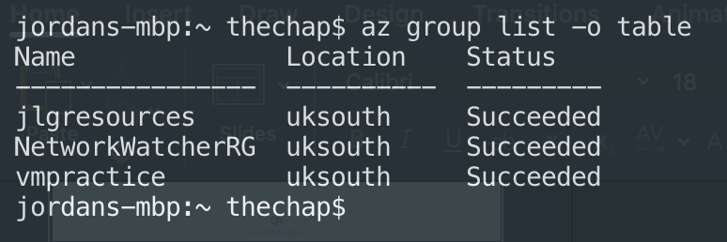
Azure Management Options
Azure CLI
Cross-platform command-line program that connects to Azure
Executes administrative commands on Azure resources

Slide 7
Azure Management Options
Azure PowerShell
Module that you can install for Windows PowerShell
Can also install on PowerShell Core, which is a cross-platform version of PowerShell
Can connect to Azure Subscription and manage resources
Notes:
Creating admin scripts and using automation tools is a powerful way to optimize your workflow – you can automate repetitive tasks!

Slide 8
Azure Management Options
Azure Cloud Shell
Browser based scripting environment
Command-line administration of Azure resources
Bash or PowerShell

Slide 9
Azure Portal
Almost everything you do with Azure can be done through this web interface
Typically the best interface for carrying out single tasks or where you want to look at the configuration options in detail
Resource Panel – left hand sidebar
Lists main resource types, but only those that are part of your favourites
Dashboard – default view. Will go into detail later
Notes:
Log into Portal at start of this slide!

Slide 10
Blades
Azure Portal uses a blades model for navigation
A blade is a slide out panel containing the UI for aa single level in a navigation sequence
Each one of these would be a new blade: Virtual machines → Compute → Ubuntu Server
Each blade contains some information and configurable options (which may generate another blade)
The best way to get to grips with this type of navigation is with practice!

Slide 11
Task: Navigate the Portal
Directions:
Spend some time navigating the Azure Portal. Try to navigate to:
Azure Marketplace
Configure some Azure Portal settings
The Cloud Shell
The Feedback blade
The Help blade
The Directory and subscription blade
Your profile settings
Azure Advisor

Slide 12
Azure Portal Dashboards
Customisable collection of UI tiles
Add, remove and position tiles to create the exact view you want.
Multiple dashboards are supported and dashboards can be shared with other Team Members.
Dashboards stored as JavaScript Object Notation (JSON) files
This means they can be uploaded and downloaded to other computers, and customized programmatically
Notes:
Good for using with RBAC. E.g. database admin could have a dashboard with views of SQL database
Some tiles can be query based, so can update automatically when the source data changes

Slide 13
Task: Create a new Dashboard
Directions:
Create a new dashboard in Azure
Add some tiles to customize the dashboard how you want it
Try re-sizing tiles and customizing some tile settings
Save and switch to that dashboard
Download your dashboard as a JSON file to your computer

Slide 14
Course Summary
We discussed the different options you could use to manage Azure resources
We spoke about the Azure Portal and how to navigate this
You created your own dashboard in the Azure Portal

Slide 15
Thank you for listening
Any Questions?

