Slide 1
Microsoft Azure
Azure Compute services

Slide 2
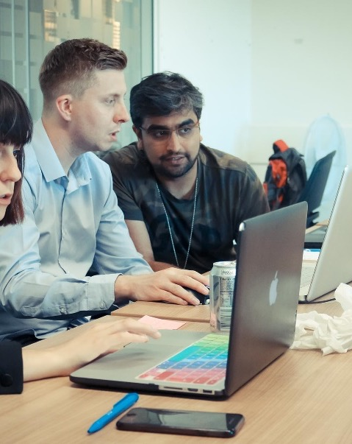
Presentation contents:
Azure Resource Groups
Azure Virtual Machines
Azure Containers
Azure App Service
Serverless Computing

Slide 3
Course objectives
Identify Azure compute options
Be able to deploy a Virtual Machine using the Azure Portal
Explore how to select compute options that are appropriate for your business

Slide 4
Azure Compute
What is Azure compute?
Four common techniques for performing compute in Azure:
Virtual Machines
Containers – don’t include operating system, instead using host OS
Azure App Service – PaaS for hosting enterprise-grade web-orientated applications
Serverless Computing – cloud-hosted execution environment that runs code but completely abstracts it from underlying host environment
Notes:
On-demand computing service for running cloud based applications.
Resources available on-demand and can be created in minutes/seconds
Pay only for what you need, and as long as you are using the resources

Slide 5
Azure Virtual Machines
Let you create and use VMs in the cloud
Provide IaaS in form of a virtualized server
VMs are an ideal choice when you need:
Total control over an OS
The ability to run custom software
To use custom hosting configurations
Can be created and provisioned in minutes when you select a pre-configured VM image
Notes:
Image – important decision. Template to create a VM, and include OS and other software (such as development tool or web hosting environments)

Slide 6
Moving to the Cloud with VMs
Excellent choice when moving from physical server to the cloud – lift and shift
Create image of physical server and host it within a VM with little or no changes
Up to you, as the user, to update and maintain the VM (just as you would the physical server)
You can scale VMs in the cloud using:
Virtual Machine Scale Sets – think, elasticity!
Azure Batch – large scale job scheduling and compute management
Can scale tens, hundreds or thousands of VMs

Slide 7
Containers in Azure
Great choice if running multiple instances of an application on a single virtual machine
Container orchestrator can start, stop, and scale out application instances as needed
Meant to be lightweight, created, scaled out and stopped dynamically
Why is this design good?
Can run multiple isolated applications on a single VM host – don’t need separate VMs for
each app
Notes:
Answer – allows you to respond quickly to changes in demand on failure

Slide 8
Manage Containers in Azure
Azure supports Docker containers, which can be managed in several ways:
1) Azure Container Instances (ACI)
PaaS offering = Fastest and simplest way to run a container in Azure
No management of any VMs or configuration of any additional services
2) Azure Kubernetes Services (AKS)
Automating & managing large no. of containers is known as orchestration
AKS is a complete orchestration service
Why would we use containers in our solutions?
Notes:
Answer:
Talk about microservice architecture:
Solution broken into smaller, independent pieces (eg, front end, back end, storage - container for each)
Means you can maintain, scale and update independently!

Slide 9
Azure App Service
PaaS – allows you to focus on the website and API logic
Azure takes care of infrastructure to run and scale your web apps
Offers auto-scaling & high availability
Supports Windows and Linux
Enables automated deployments from GitHub, Azure DevOps or any Git repo

Slide 10
Azure App Service - Costs
You pick an App Service Plan
There is a free-tier! (for small, low-traffic sites)
You pay for the Azure compute resources your app uses while it processes requests
The App Service Plan determines how much hardware is devoted to your host

Slide 11
Serverless Computing
Infrastructure isn’t your responsibility – it’s handled by Azure
Scaling & performance are handled automatically
Billed on resource used – no need to reserve capacity
You focus solely on the logic needed to execute and the trigger that is used to run your code
Can you think of an example?
Notes:
Example – notifications! Serverless apps respond to events!

Slide 12
Serverless Computing
Configure Serverless App to respond to events: REST endpoint, periodic timer, message from another Azure service!
App only runs when it’s triggered by an event
1) Azure Functions
Commonly used when you need to respond to an event
Used when this can happen quickly (within seconds or less)
2) Azure Logic Apps
Can be used like functions, but specifically for executing workflows from pre-defined logic blocks (instead of executing code)
Designed to automate business processes, and created using a visual designer
Notes:
Azure Logic Apps could be used to create an order numbers & send a follow-up email to a customer when they place an order, for example. Has to go through a workflow (doesn’t happen in a seconds or less…)

Slide 13
Serverless Computing - Costs
Scaling on demand means Serverless Computing is a solid choice when demand is variable
For example, receiving more data during a game when using an IoT solution to monitor athletes
Why is this better than a VM based approach?
Notes:
Top point – lots of sensors, input from others during game, etc. May want a notification when a player is showing signs of tiredness (could be HR monitor triggered)
Answer – Incur costs even when VM is idle. With SC Azure runs code when triggered and automatically deallocates resources when finished.
Only charged for the CPU time when SC runs!

Slide 14
Task: Deploy an Azure VM
Directions:
Create a resource group
Add a VM to this resource group and deploy it in UK South
Connect to the Virtual Machine using Microsoft Remote Desktop
Delete your Virtual Machine so no costs are incurred moving forward
Debrief:
Feedback thoughts to rest of group

Slide 15
Which computing strategy is right?
You don’t need an ‘all or nothing’ approach
Each of the previously seen options provide benefits as well as trade-offs against other options
Any examples of trade-offs?
Important to think about what task you need carried out before picking a strategy
Should always consider costs implications – for example, don’t use a VM when you can use Serverless Computing for a specific task, use containers on one VM instead of creating separate VMs, etc
Notes:
Trade-off – serverless computing removes the need to manage infrastructure; however, work is expected to be completed quickly (usually seconds)

Slide 16
Course Summary
We discussed multiple Azure compute options, such as:
VMs
Containers
App Service
Serverless Computing
You deployed a Virtual Machine in Azure(!)
We discussed how to devise a good computing strategy using Azure services

Slide 17
Thank you for listening
Any Questions?

