Slide 1
Microsoft Azure
Azure networking

Slide 2
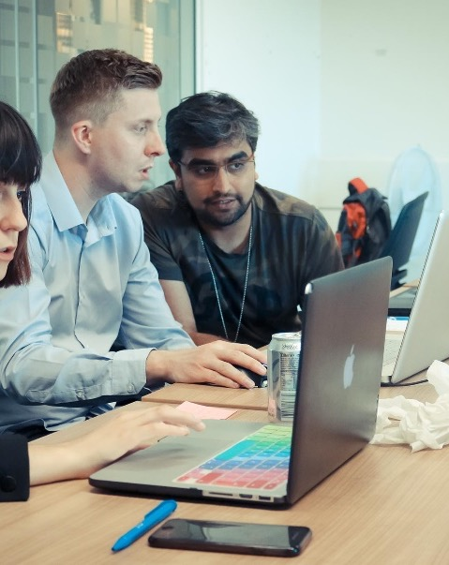
Presentation contents:
Azure Virtual Network
Azure Load Balancer
Azure Traffic Manager

Slide 3
Course objectives
Learn how an Azure virtual network provides secure network communication between resources such as VMs and other networks
Learn how Azure Load Balancer can increase resiliency within a single geographic region
Learn how Azure Traffic Manager can help reduce network latency

Slide 4
Azure Virtual Network
Virtual network is a logically isolated network on Azure
Allows Azure resources to securely communicate with each other, the internet and on-premises networks
Can be segmented into one of more subnets
Subnets help you organise and secure resources in discrete sections
If users interact with resources inside a VM, that VM will need a public and private IP
If you have a VM with data in that a user doesn’t interact with, this will only need a private
IP
Both VMs in same Virtual Network, but different subnets!
Notes:
Last point – useful for front-end (as this needs public ip) and back-end (this only needs private)

Slide 5
Azure Virtual Network
A VPN Gateway provides a secure connection between an Azure Virtual Network and an on-premises location
For example, if you wanted your data stored on-premises but your Web App on Azure
Azure manages the physical hardware for you
You configure Virtual Networks and gateways through software

Slide 6
Network Security Group
A NSG allows or denies inbound network traffic to your Azure resources
Think of it as a cloud level firewall for your network
Uses ports
You can configure a NSG to accept traffic only from known sources, such as IP addresses that you trust

Slide 7
N-Tier Architecture
Divides an application into two or more logical tiers
Architecturally, a higher tier can access services from a lower tier, but a lower tier should never access a higher tier
Using a tiered architecture simplifies maintenance – tiers can be updated or replace independently
Three-tiers refers to an n-tier application that has three tiers
Web tier – provides web interface to users through browser
App tier – runs business logic
Data tier – databases and other storage
Notes:
Can anybody explain the diagram?

Slide 8
Azure Load Balancer
A load balancer distributes traffic evenly among each system in a pool
Can help you achieve both high availability and resiliency
Allows you to run maintenance tasks without interrupting service
If you manually configure a Load Balancer on a VM, you now need to maintain
this – Azure Load Balancer takes care of this for you
Notes:
Without Load Balancer – each VM has it’s own IP and you have no way of distributing traffic is one VM is busy/down
User doesn’t know (or need to know) which system the load balancer chooses to receive the request

Slide 9
Azure Traffic Manager
Latency – the time it takes for data to travel over the network. Typically measured in milliseconds.
Bandwidth – refers to the amount of data that can fit on a connection
Azure Traffic Manager reduces latency by routing users to the closest endpoint
If your app is running in multiple regions, this is perfect!
Can route traffic to the endpoint with the lowest latency

Slide 10
Course Summary
We discussed Azure Virtual Networks, Subnets and VPN Gateways
We looked at how an N-tier architecture works and the advantages of this
We learnt how Azure Load Balancer can be used to achieve high availability and resiliency
We looked at how Azure Traffic Manager can be used to reduce latency

Slide 11
Thank you for listening
Any Questions?

