Slide 1
MicroServices and Spring Boot
Spring boot

Slide 2
Contents page
SOA
Benefits
Technical approach

Slide 3
Course objectives
To re-familiarise ourselves with Micro Services and their benefits.
To learn how to apply a Micro Services Architecture to our application.

Slide 4
Micro Services Concepts
Historically called SOA
A Monolithic application is broken down into smaller parts.
These smaller services can be deployed separately.
They communicate via HTTP.
What are the benefits?

Slide 5
Benefits of MicroServices
Increased modularity – easier to maintain system
Easier to swap out new and improved services
If one services fails the other services in the application may still be operational.
Improves CD – faster time to market with MVP.

Slide 6
How does it look in Spring Boot
HTTP Request
Service 1
Service 2
HTTP Response

Slide 7
Service 1 (Sending request)
URI
@GetMapping("/getMicro")
public String getMicro() {
ResponseEntity<String> exchangeCocktail = restTemplate.exchange("http://localhost:8081/getMicro",
HttpMethod.GET, null, String.class);
return exchangeCocktail.getBody();
}
HTTP Method
Request Body (can be null)
Data Type of response

Slide 8
Service 1 (Sending request)
@Bean
public RestTemplate restTemplate(RestTemplateBuilder builder) {
return builder.build();
}
Which classes will these 2 code snippets appear in?
private RestTemplate restTemplate;
public MicroController(@Autowired RestTemplate restTemplate) {
this.restTemplate = restTemplate;
}

Slide 9
Service 2 (Receiving request)
@RequestMapping("/getMicro")
public ResponseEntity<String> getMicro() {
ResponseEntity<String> retVal = new ResponseEntity<String>("Response Body", HttpStatus.OK);
return retVal;
}

Slide 10
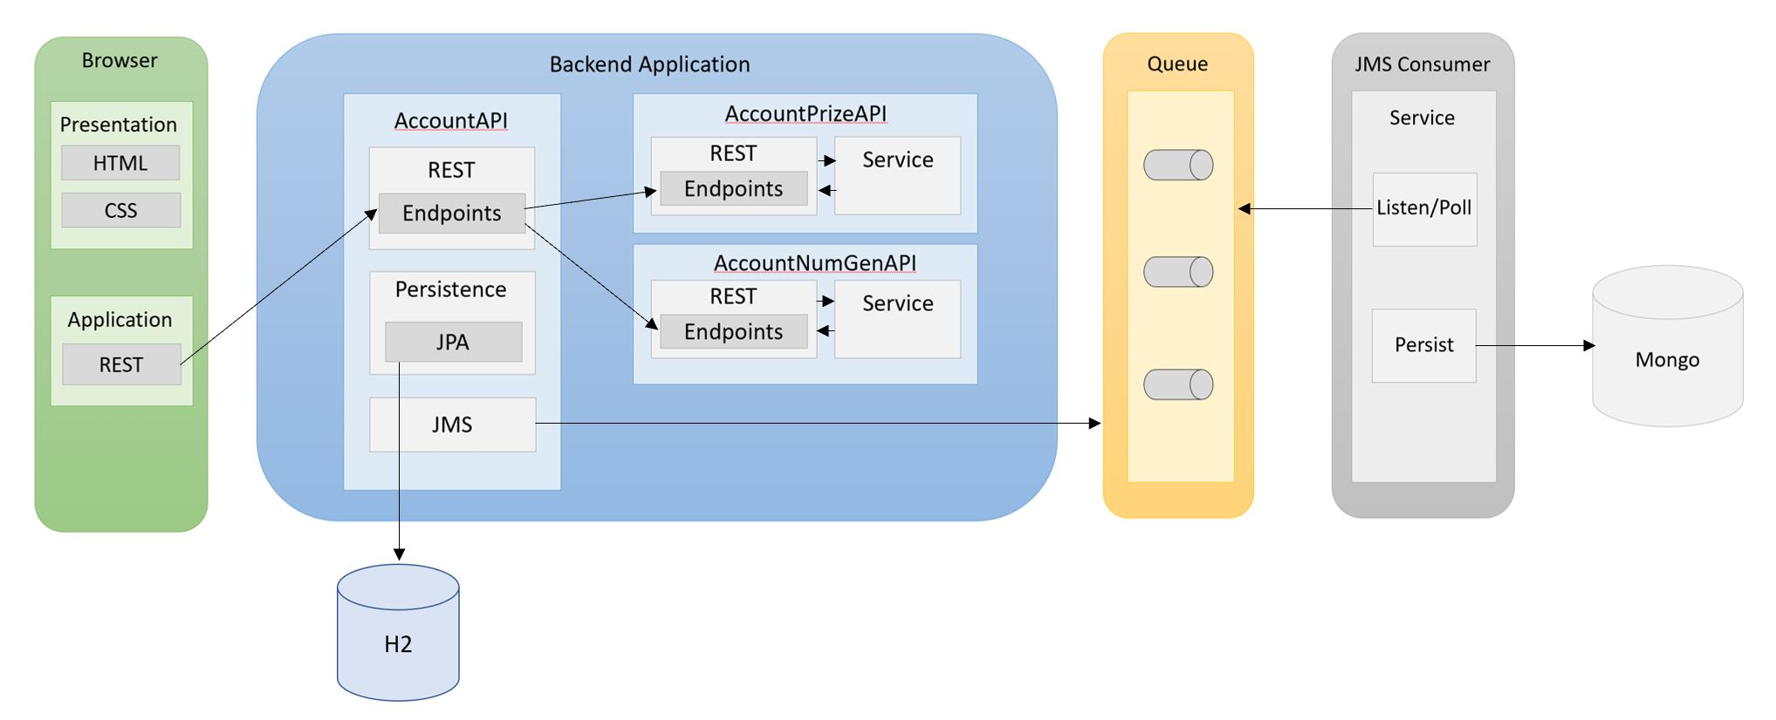
Project Structure

Slide 11
Course objectives
To re-familiarise ourselves with Micro Services and their benefits.
Micro Services modularise our application, making it easier to maintain and improve. It also introduces an element of resiliency into our system.
To learn how to apply a MicroServices Architecture to our application.
In Spring Boot we make use of the Rest Template Object to facilitate communication between Services.

Slide 12
Thank you for listening
Any questions?

