Slide 1
ActiveMQ
Springboot

Slide 2
Contents page
Synchronous and Asynchronous Communication
JMS
How JMS fits into our architecture

Slide 3
Course objectives
To understand the concept of asynchronous communication.
To understand how JMS fits in to our architecture.
To understand the core principles of JMS.
To see how to configure JMS into our system.

Slide 4
Synchronous Communication
A conversation between 2 people will take this format.
One person waits whilst the other speaks.
This is synchronous communication.
Person 1
Person 2

Slide 5
Asynchronous Communication
An email conversation between 2 people would be an example of asynchronous communication
One person fires off an email, and then can continue working whilst the other party reads and responds to the email.
Either party does not wait.

Slide 6
Lets talk about Amazon
When you buy your something, this *simple* process triggers a lot of processes in the backend, including but not limited to:
A stock checker or IMS
A payment processor service
A Delivery service – to work out where to go
A dispatch service – to organise the delivery itself
If our main API was linked directly to each of these services we would have to sit and wait for the chain of responses to come back before we could continue.

Slide 7
Practice activities
Think about the process on the previous slide
How could we improve this process?
Get into pairs for this exercise which should take 10 minutes.
What do we think would be a better architecture?

Slide 8
A Better Alternative
If we used Asynchronous Communication we would not have to wait for a response form each service
We would also not be tied into each implementation directly, affording us the flexibility to swap different components out as we need them.
We can achieve this using JMS

Slide 9
JMS
JMS gives us a way to send async message in our system
It provides us with loose coupling.
Common workflow of a queuing service is producer -> intermediate device (broker) -> consumer

Slide 10
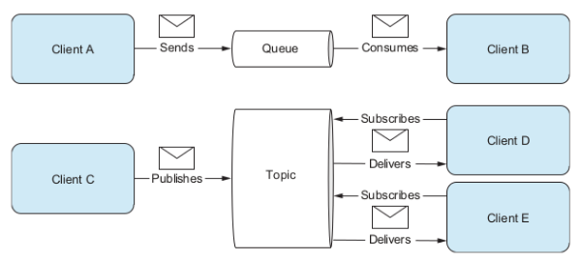
JMS

Slide 11
JMS Cont.
On envelope we put where we are sending it – the name of the queue
We then send our message to a queue
The consumer is listening all the time to the queues for something new
Consumer takes something off the queue and does something with it - process it for instance
FIRE AND FORGET - you don’t care what is consuming it you just fire off the message.

Slide 12
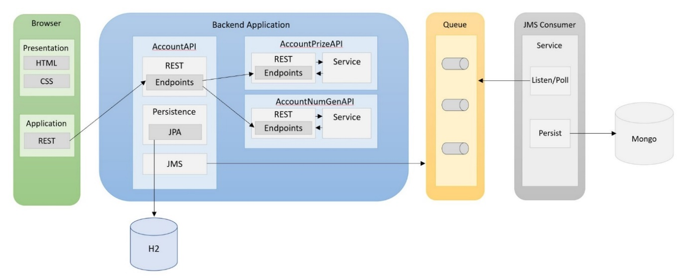
Project Architecture
This is our consumer
This is our broker

Slide 13
Summary
To understand the concept of asynchronous communication.
Asynchronous communication is like communication via email, one party can continue working whilst the other works on a response.
To understand how JMS fits in to our architecture.
Our Service API will send message onto the ActiveMQ Queue. A consumer will listen to the queue and take message from it, they will then be stored in a database.
To understand the core principles of JMS.
FIRE AND FORGET - you don’t care what is consuming it you just fire off the message.
To see how to configure JMS into our system.
We will look at this next in the labs

Slide 14
Thank you for Listening
Any quESTIONS

