Slide 1
Automated Testing
Module 1 – Introduction to Testing

Slide 2

Contents
What is testing?
Why do we do testing?
When should we do testing?
The 7 testing principles

Slide 3
Course objectives
Describe what testing is and why it is needed
Discuss what the 7 testing principles are, and their importance in testing

Slide 4
What is Testing?
Notes:
Open air discussion with the class – ask them what they think testing is and why they think it is necessary – get many points from across the class and find a middle ground for understanding.

Slide 5
What is Testing?
According to ANSI/IEEE 1059 standard –
“A process of analysing a software item to detect the differences between existing and required conditions (i.e., defects) and to evaluate the features of the software item.”.
What does this mean?
Simply put – it is the activity of running code under various circumstances to highlight where defects exist.
Discover the application’s characteristics, in comparison to business requirements and rules.

Slide 6
Open Air Discussion
Directions:
In groups of 2-4 (class size dependent)
5 minutes
Each group create a list of issues that may arise when copying a single file, from one place to another.
Debrief:
Report to the class what issues you can foresee.

Slide 7
What Could Go Wrong?
Considering the previous exercise of detailing all of the possible issues that could occur for the simple task of copying a file from one location to a new destination. Some of the pertinent issues are:
File not found
Destination unavailable
File already in use
Incorrect permissions
As you can see, a lot can go wrong for just a simple task.
Network failure during transmission
File corrupted during transmission
Disk space availability
Blocked by firewall

Slide 8
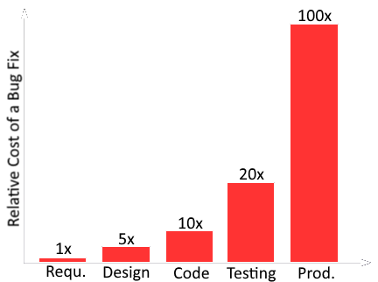
Why Do We Do Testing?
Studies show that around 90% of investment in software involves the maintenance of code after the initial project is complete.
The cost of fixing code defects when a product is in production (live) is exponentially more expensive than code defects identified in an earlier phase.
Releasing buggy code, often, can have impact on customer faith, and business reputation.
In short, testing aids in providing quality assurance to a business.
Notes:
Consider the worst case scenarios of why we need testing – if software fails in critical places, then excessive costs or lives may be lost.

Slide 9
When Should We Do Testing?
It has been shown that some 56% of all software defects emerge during the requirement phase, 27% in the design phase, and only 7% during the development phase.
A report from IBM System Institute revealed that defects identified and resolved during the requirement & design phase are ~100 times less expensive to fix, than those identified after the initial release of a product/service.
With these two figures in mind, we test as early as possible – the requirements phase.
Testing as early as possible is known as “Shifting Left”.

Slide 10
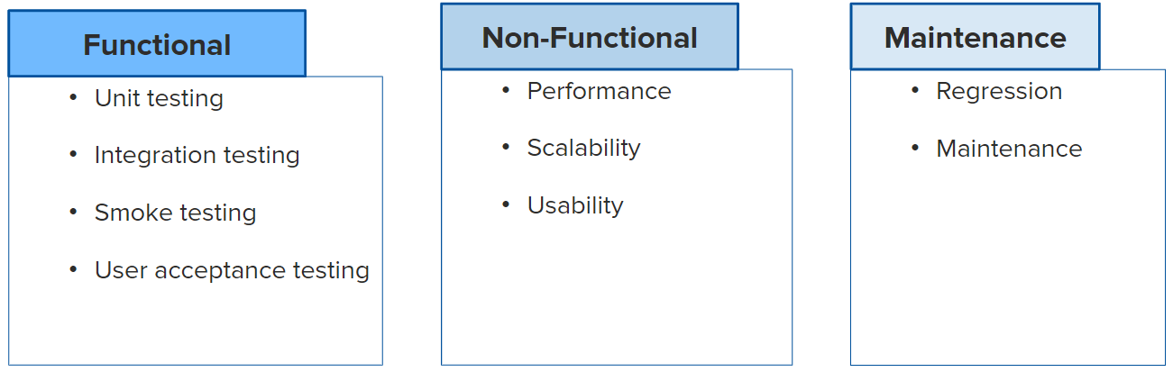
Types of testing
Functional: If I click a button – does it do what it is supposed to?
Non-Functional: If 10,000 people all click the button at the same time – does it respond in an acceptable time?
Maintenance: Once changes have been made, do previously passed tests still pass now?

Slide 11
Open Air Discussion
Directions
In groups of 2-4 (class size dependent)
15 minutes
Each group to research one of:
Unit Testing, Integration Testing, Smoke Testing, Acceptance Testing, Performance Testing, Scalability Testing, Usability Testing, Regression Testing, Maintenance Testing.
Debrief
Report to the class what you have found.
Notes:
Unit – A unit is the smallest increment. A Unit test, is testing a small piece of code, such as a method.
Integration Testing – This is testing whether our methods are talking together in the correct way. We integrate test after test with each method until we have tested the entirety of the system.
Smoke – Testing whether the system is working. In performance testing, this would be a single user (in appose to a load test of 1000s of users).
Acceptance Testing– Whether it is fit for purpose.
Performance – How well an application responds under different load profiles.
Scalability – how well it scales. A method might be great at searching when there are 20 items in an array, but what if there are millions.
Usability – How easy is it to use. Does it have a clear contrast between interact able objects. Is the website easy to navigate etc.
Regression – Re-running tests which had previously passed to make sure the system is still working.
Maintenance – Testing on deployed software.

Slide 12
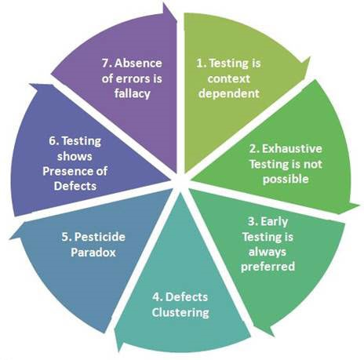
The Seven Testing Principles
Testing is context dependent
Exhaustive testing is not possible
Early testing is preferred
Defect clustering
Pesticide paradox
Testing shows presence of defects
Absence of error fallacy

Slide 13
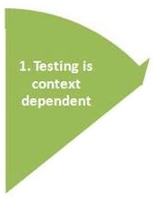
Testing is Context Dependent
Dependant on the application under test, different methodologies, techniques and types of testing are employed, relative to the type and nature of the application.
Testing a medical device will go through a more rigorous testing procedure, requiring risk based testing, be compliant with medical industry regulators, and possibly specific test design techniques.
Testing a web application will go through performance and functionality testing.
As you can tell, both of these software need testing, but in clearly different ways.

Slide 14
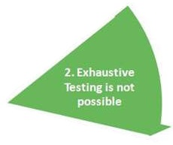
Exhaustive Testing is NOT Possible
Testing all the functionalities using all valid and invalid inputs and preconditions is known as Exhaustive Testing.
Testing all possible combinations of inputs is not feasible, except in the most trivial of circumstances.
Budget, Time and System Resources all impact the ability to do exhaustive testing.
Instead, risk analysis, test techniques and priorities should be used to focus test efforts.
Notes:
Give example of a single input field that accepts the numbers 0-10, exhausting testing is possible. Imagine that field was capable of 0-1,000,000, testing becomes incredibly expensive and time costly. Imagine that there are 5 different input fields, all able to accept the numbers 0-1,000,000 – as you can see this becomes incredibly unrealistic very easily

Slide 15
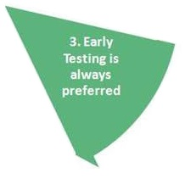
Early Testing
It is common for testing to be a last-minute activity, if there is time and budget, but this is almost always a recipe for disaster.
As highlighted previously in “When we do Testing”, it was stated that it becomes increasingly expensive to rectify defects that are found, once the product has reached the production (live) environment.
For this reason, testing must be completed as early as possible, in appose to “at the end”. We want to start testing earlier in the project lifecycle, and as far left in this cycle as possible.
Notes:
The high level lifecycle of: requirements, design, code, test, prod
Starting testing in the requirements stage will start a trend of identifying defects early

Slide 16
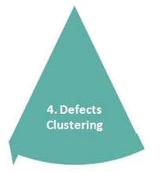
Defect Clustering
As per the Pareto Principle (80-20 rule), 80% of issues come from only 20% of code. The remaining 20% of issues are in 80% of the code.
For this reason, we focus testing on the cluster of possible defects.
Predicted defect clusters, and the actual observed defect clusters in test or operation, are an important input into a risk analysis used to focus the test effort.
Notes:
When talking about 80-20, mention that when we import packages, we don’t need to test that code, that code has and will be extensively tested (either by the community or by the developers of the package), and so, we focus on our code

Slide 17
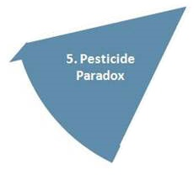
Pesticide Paradox
The pesticide paradox, in software testing, reflects the pesticide paradox in biology. In biology, it is the ability of pests to become immune to the effects of pesticides and fungicides.
In software testing, if the same tests are executed repeatedly, eventually, the tests will no longer be able to identify new defects.
To detect new defects, existing tests and test data may need changing, and new test may need to be written.
Notes:
Tests eventually become ineffective at finding new defects, just as pesticides are no longer effective at killing insects

Slide 18
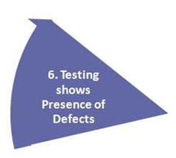
Testing Shows Presence of Defects
Although it may sounds obvious, testing will highlight defects that exist in the application.
Testing cannot prove that there are no defects.
Testing reduces the probability of undiscovered defects remaining in the software but, even if no defects are found, testing is not a proof of correctness.
Therefore, it is important to design test cases that aim to find as many defects as possible.

Slide 19
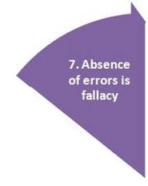
Absence of Error Fallacy
It is a common misconception that a tester can run all possible tests, and find all the defects in a piece of software.
As we have seen from “Exhaustive Testing is not possible” and “Testing shows the presence of defects, not their absence”, it is clear that no software can be free from errors.
Furthermore, it is a fallacy to expect that finding and fixing a large number of defects will ensure the success of a system.
The product could still be difficult to use, does not fulfil user requirements, or is generally inferior to other competing systems.
Notes:
Great consideration must be made prior to any testing, to understand what should be tested, when it should be tested, and the effectiveness of the tests

Slide 20
Course Objectives - Summary
Describe what testing is, why it is needed, and when to test:
Testing is performed as early as possible, and is used to reduce the number of errors and issues that go in to a live (production) environment where remediation of bug fixing can be costly.
Discuss what the 7 testing principles are:
Exhaustive testing is not possible
Defect clustering
Pesticide paradox
Testing shows presence of defects
Absence of error fallacy
Early testing
Testing is context dependent

Slide 21
Thank you.
Questions?

