Slide 1
Maven
Module 1 – MAVEN

Slide 2

Contents
Features and capabilities
Convention > Configuration
The POM file
.m2 folder
Build lifecycle
Co-ordinates

Slide 3
Course objectives
Describe what Maven is and how to install it.
Discuss it’s features and capabilities.
Explain the POM file and how to use it.

Slide 4
Introduction
Maven is a build automation tool and dependency manager used for Java-based projects.
Can also be used to build and manage projects written in C#, Ruby, Scala and others.
The primary functions of Maven are:
Describing how software is built (by way of Project Object Model).
Describing and managing any dependencies.
Maven is ‘opinionated’.
It has a defined life-cycle and a set of common plugins that know how to build and assemble software.

Slide 5
Features and Capabilities
Maven as a project management tool includes the following key components:
A Project Object Model (POM)
An XML file that contains information about the project and the configuration details used to build the project.
Defined set of standards
This can include a common interface, life-cycle, a standard repository format and standard directory layout (Maven will assume a number of default directory structures for source code, resources, classes, etc.).

Slide 6
Features and Capabilities Cont.
Dependency management system
Retrieving dependencies and plugins (referred to as ‘artefacts’) from the remote Maven repository. The base Maven download only provides minimal functionality, extra components are pulled down as and when necessary.
Logic for executing plugin goals
Logic for executing plugin goals - “in order to achieve x goal, I require y plugin which has a dependency on z plugin”.
Notes:
POM, defined set of standards, dependency management system, logic for executing plugin goals

Slide 7
Convention > Configuration
Maven values “Convention over Configuration”, which means developers are not required to create build process themselves.
Developers do not have to mention each and every configuration detail. Maven provides sensible default behaviour for projects.
When a Maven project is created, Maven creates default project structure. Developer is only required to place files accordingly and he/she need not to define any configuration in pom.xml.
Much of the project management and build related tasks are maintained by Maven plugins, meaning Developers can build any given Maven project without the need to understand how the individual plugins work.

Slide 8
The POM File
The Project Object Model (POM) is an XML file that contains information about the project and the configuration details used to build the projects.
In its simplest form, the POM must contain:
The project root, top-level containing all underlying code.
The version of the model – typically 4.0.0 for new Maven builds.
The ID of the group for the product (conventionally reversed domain – e.g. com. sonatype or org.apache).
An artefact ID – a unique identifier for the group that represents a single projects.
A ‘version’ number for specific release of a project.

Slide 9
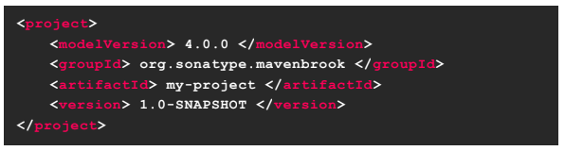
Example pom file
The POM file is formatted in an XML file.
Everything is encased in tags.
Each tag needs an opening and closing tag – similar to HTML.
Within the tags is where the information on a project will be held.
For example:

Slide 10
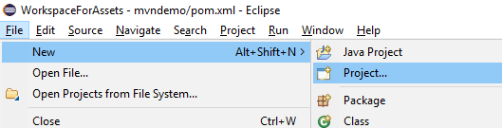
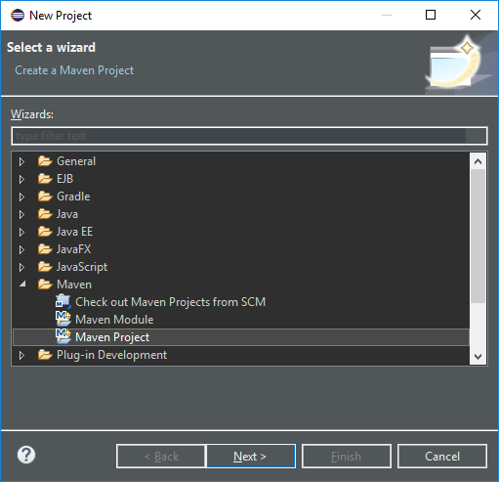
The POM File – Quick Example
1
2
To create a new maven project, you will need to select the Maven Project option from the New Project wizard.

Slide 11
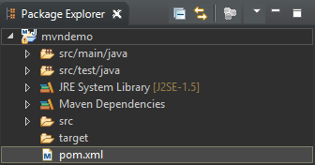
The POM File – Quick Example Cont.
3
Inside the Package Explorer there is a pom.xml file.
Opening this file, then opening the pom.xml tab opens the xml view of the file.
4

Slide 12
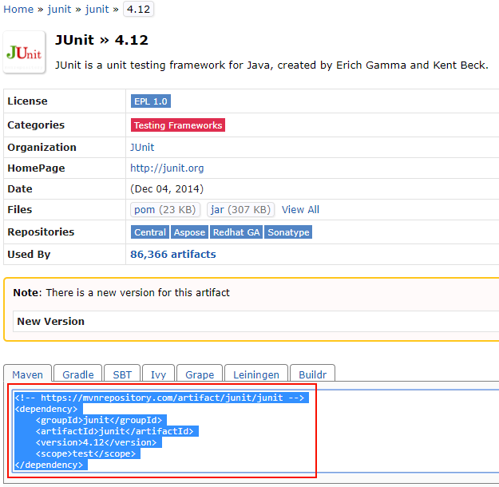
The POM File – Quick Example Cont.
Navigating to the web address https://mvnrepository.com will allow you to search for any dependency you require. Copying the code from the website…

Slide 13
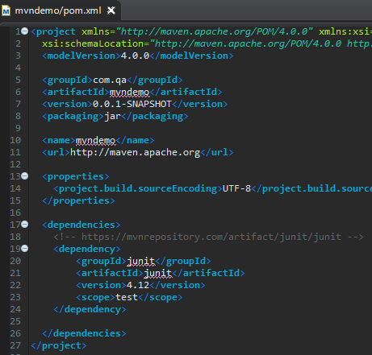
The POM File – Quick Example Cont.
…and pasting it in to the pom.xml file will allow you to begin using that repository.

Slide 14
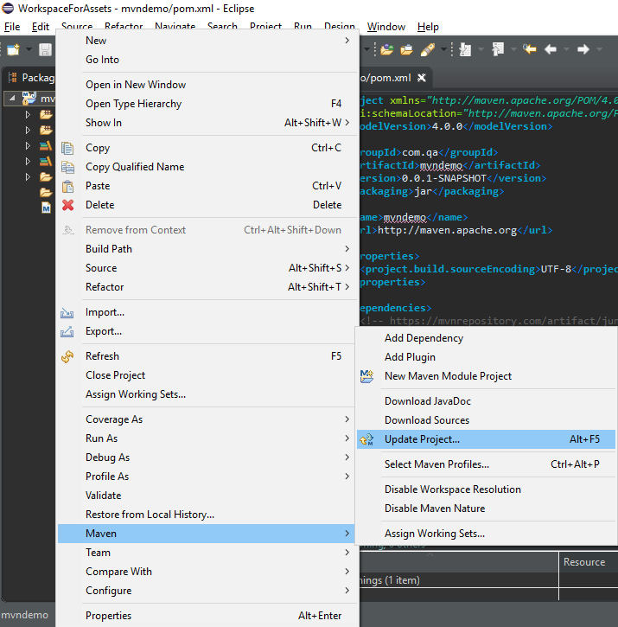
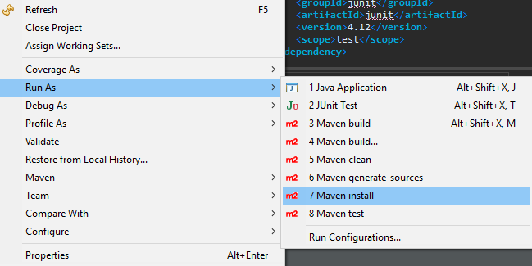
The POM File – Quick Example Cont.
Right click your project, Maven -> Update Project…
Right click your project, Run As -> Maven install
These two commands allow your project to see the maven dependencies, and updates the .m2 folder
This will ensure that your project is able to use and access the dependencies within your code.

Slide 15
.m2 Folder
The .m2 folder is a hidden folder that holds all of the local copies of various Maven artifacts, either caches of artifacts pulled down from remote repositories, such as Maven Central, or artifacts built by your local maven builds.
It is created when you run any Maven command for the first time. It is populated when you do a ‘Maven install’, downloading required dependencies stated in the pom.xml.
It is typically located in ‘C:\users\<currentUser>\.m2’
The folder is labelled .m2 as it is a hidden folder (denoted by the .), and is the second version of maven (m2).
Notes:
If you are struggling with an error regarding Maven, and cannot root cause analysis the issue, sometimes deleting the .m2 folder and getting Maven to re-download it’s dependencies can often remedy the issue.

Slide 16
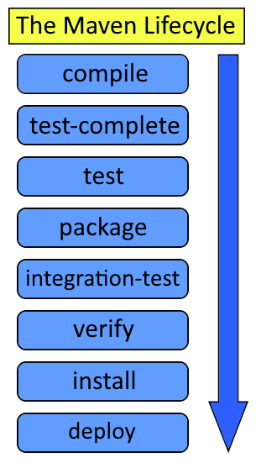
Build lifecycle
The Maven Lifecycle defines the sequence of phases, which define the order in which the goals are to be executed.
Each phase represents a stage in the lifecycle:
Compile: Source code compilation is done.
Test: Tests the compiled source code suitable for testing framework.
Package: This phase creates the JAR/WAR package as mentioned in the packaging in the POM.xml: <packaging>jar</packaging>
Verify: validates if the project is correct and if all necessary information is available.
Install: installs the package in local/remote Maven repository/
Deploy: Copies the final package to the remote repository/

Slide 17
Co-ordinates
Maven uses co-ordinates to uniquely identify individual artifacts for your projects.
Repositories are organised by the identifiers – when a project is installed it becomes available to all other local projects (adding it as a dependency will enable usage).
Maven repositories will store artefacts in the following directory structure:
/<groupId>/<artifactId>/<version>/<artifactId>-<version>.<packaging>
So for an artifact with the co-ordinates:
org.apache.commons:commons-email:1.1
The directory structure would be:
/org/apche/commons/commons-email/1.1/comons-email-1.1.jar

Slide 18
Course Objectives - Summary
Describe what Maven is and how to install it.
A build automation tool used for Java-based projects.
Discuss it’s features and capabilities.
POM, defined set of standards, dependency management system, logic for executing plugin goals.
Explain the POM file and how to use it.
The Project Object Model (POM) is an XML file that contains information about the project.

Slide 19
Thank you.
Questions?

