Slide 1
Introduction to OpenGL
What is OpenGL?
OpenGL has it origins in the earlier GL (“Graphics Library”) system which was invented by Silicon Graphics for programming their high-performance specialised graphics workstations.
OpenGL deﬁnes a set of functions for doing computer graphics.
APIs are mechanisms that enable two software components to communicate with each other using a set of definitions and protocols.
OpenGL programs are typically written in C and C++.
OpenGL is a “platform independent" means that the application can run in different operating environments.

Slide 2
OpenGL-Related Libraries
A number of libraries exist to allow you to simplify your programming tasks, including the following:
GLUT
The OpenGL Utility Toolkit (GLUT) is a library of utilities for OpenGL programs, which primarily perform system-level I/O with the host operating system.
All GLUT function names start with “glut”.
GLU
GLU provides functions for drawing more complex primitives than those of OpenGL, such as curves and surfaces, and also functions to help specify 3D views of scenes.
All GLU function names start with “glu”.
Core OpenGL (GL): consists of hundreds of commands, which begin with a prefix "gl" (e.g., glColor, glVertex, glTranslate, glRotate). The Core OpenGL models an object via a set of geometric primitives such as point, line and polygon.

Slide 3
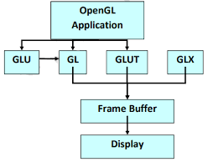
Core OpenGL (GL): consists of hundreds of commands, which begin with a prefix "gl" (e.g., glColor, glVertex, glTranslate, glRotate). The Core OpenGL models an object via a set of geometric primitives such as point, line and polygon.
OpenGL Command datatypes
`f' float
`d' double float
`s' signed short integer
`i' signed integer
`b' character
`ub' unsigned character
`us' unsigned short integer
`ui' unsigned integer

Slide 4
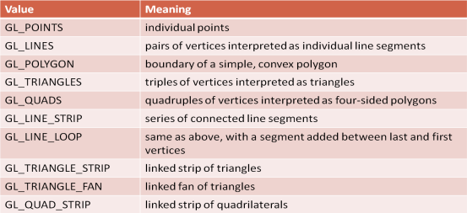
OpenGL Primitives

Slide 5
Creating a GLUT Display Window
Function | Description
glutInit (&argc, argv); | An initialization function.
glutInitWindowPosition (xTopLeft, yTopLeft); | The first of these functions gives the integer, screen-coordinate position for the top-left corner of the display window, relative to the top-left corner of the screen. The default position is (−1, −1).
glutInitWindowSize (dwWidth, dwHeight); | Width and height for the display window in positive integer pixel dimensions. The default size is 300 by 300.
glutCreateWindow ("Title of Display Window"); | This function creates the display window, with the specified size and position, and assigns a title.

Slide 6
Setting the GLUT Display-Window Mode and Color
Function | Description
glutInitDisplayMode (GLUT_SINGLE | GLUT_RGB); | We use this function to choose a color mode (RGB or index) and different buffer combinations, and the selected parameters are combined with the logical or operation. The default mode is single buffering and the RGB (or RGBA) color Mode.
glClearColor (red, green, blue, alpha); | A background color for the display window is chosen in RGB mode with this OpenGL routine.
glClearIndex (index); | In color-index mode, we set the display-window color with this function. Where parameter index is assigned an integer value corresponding to a position within the color table.

Slide 7
GLUT Display-Window Identifier
Function | Description
windowID = glutCreateWindow ("A Display Window"); | Multiple display windows can be created for an application, and each is assigned a positive-integer display-window identifier, starting with the value 1 for the first window that is created. Once we have saved the integer display-window identifier in variable name windowID, we can use the identifier number to change display parameters or to delete the display window.

Slide 8
Relocating and Resizing a GLUT Display Window
Function | Description
glutPositionWindow (xNewTopLeft, yNewTopLeft); | To reset the screen location for the current display window
glutReshapeWindow (dwNewWidth, dwNewHeight); | To reset the size of the current display window
glutFullScreen ( ); | To expand the current display window to fill the screen

Slide 9
Viewing Graphics Objects in a GLUT Display Window
Function | Description
glutDisplayFunc (pictureDescrip); | After we have created a display window and selected its position, size, color, and other characteristics, we indicate what is to be shown in that window. If more than one display window has been created, we first designate the one we want as the current display window. Then we invoke the following function to assign something to that window.

Slide 10
Keyboard Callbacks
-The keyboard function is called when the user types a character such as 'b' or 'A' or a space.
-The keyboard function has a parameter of type unsigned char .
void keyFunc( unsigned char ch, int x, int y )
-It also has two int parameters that give the location of the mouse when the key was pressed, in pixel coordinates with (0,0) at the upper left corner of the display area.

Slide 11
Mouse Callback
glutMouseFunc(mouseFunc) — The mouse function is called both when the user presses and when the user releases a button on the mouse, with a parameter to tell which of these occurred.
void mouseFunc(int button, int buttonState, int x, int y) {
if (buttonState == GLUT_DOWN) {
// handle mousePressed event
}
else { // buttonState is GLUT_UP
// handle mouseReleased event
}
}

Slide 12
Menus
int glutCreateMenu ((int value)
Creates top level menu that uses callback f( ) which is passed an integer value from the menu entry. Returns a unique menu identifier
void glutAddMenuEntry (char *name, int value) Adds entry to the current menu. Name is the entry name and value is returned to the menu callback
EX: glutAddMenuEntry("DDA Algorithm", 1);

Slide 13
Menus
int glutAttachMenu(int button)
Attaches current menu to the specified mouse button. Button is GLUT_LEFT_BUTTON, GLUT_RIGHT_BUTTON or GLUT_MIDDLE_BUTTON.
void glutAddSubMenu (char *name, int menu)
Adds a submenu entry name as the next entry in the current menu. The value of menu is the id of the submenu returned when the submenu was created.

Slide 14
Menus
Example:
glutCreateMenu(mymenu); // single menu, no need for id
glutAddMenuEntry(“Clear Screen”, 1);
glutAddMenuEntry(“Exit”, 2);
glutAttachMenu(GLUT_RIGHT_BUTTON);
Callback:
void mymenu(int value)
{
if(value == 1)
glClear( );
if(value == 2)
exit(0);
}

Slide 15
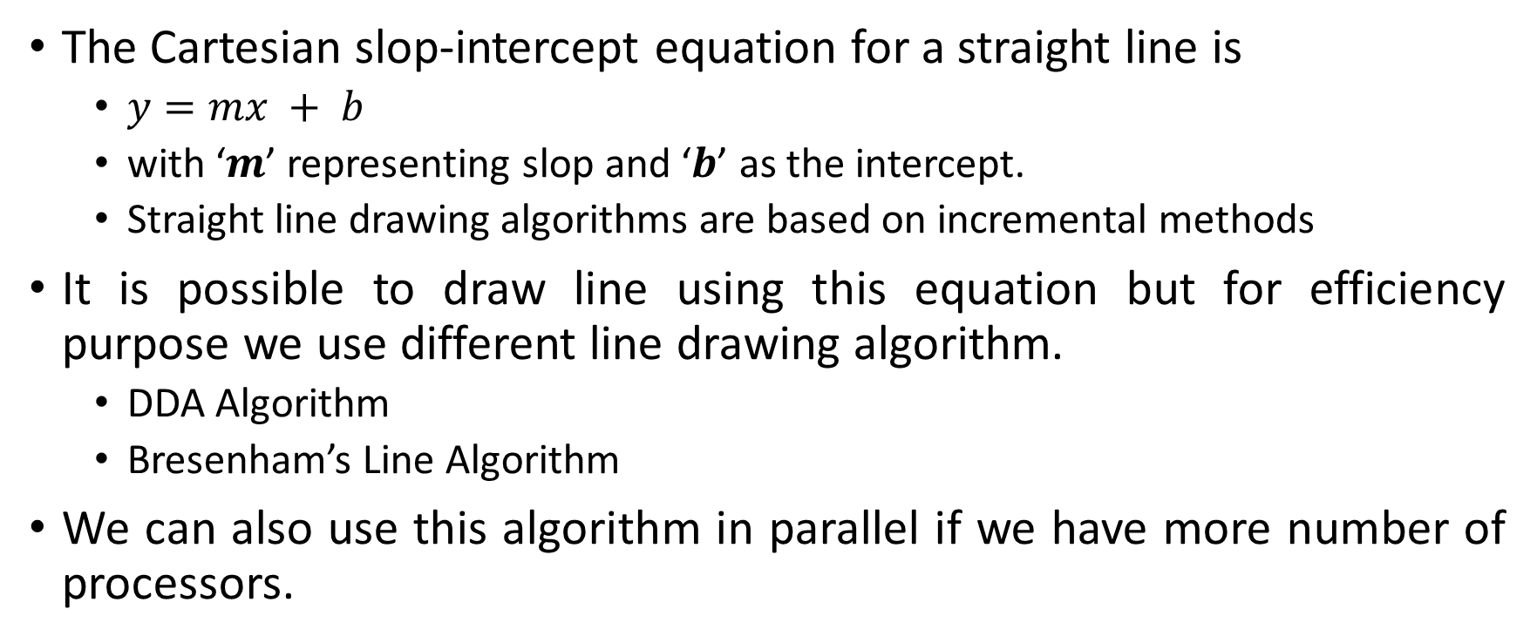
Line Drawing Algorithms
The Cartesian slop-intercept equation for a straight line is
$y=mx + b$
with ‘$m$’ representing slop and ‘$b$’ as the intercept.
Straight line drawing algorithms are based on incremental methods
It is possible to draw line using this equation but for efficiency purpose we use different line drawing algorithm.
DDA Algorithm
Bresenham’s Line Algorithm
We can also use this algorithm in parallel if we have more number of processors.

Slide 16
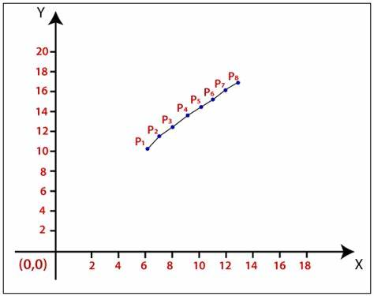
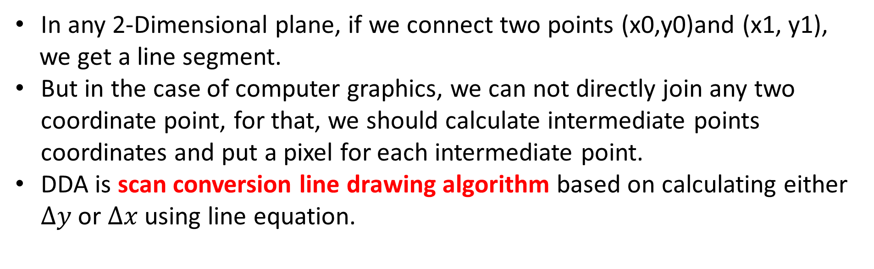
DDA Algorithm (Digital Differential Analyzer)
In any 2-Dimensional plane, if we connect two points (x0,y0)and (x1, y1),
we get a line segment.
But in the case of computer graphics, we can not directly join any two coordinate point, for that, we should calculate intermediate points coordinates and put a pixel for each intermediate point.
DDA is scan conversion line drawing algorithm based on calculating either $∆y$ or $∆x$ using line equation.

Slide 17
Procedure for DDA line algorithm.
Void lineDDA (int xa, int ya, int xb, int yb)
{
int dx = xb – xa, dy = yb – ya, steps, k;
float xincrement, yincrement, x = xa, y = ya;
if (abs(dx)>abs(dy))
{
Steps = abs (dx);
}
else
{
Steps = abs (dy);
}
xincrement = dx/(float) steps;
yincrement = dy/(float) steps;
setpixel (ROUND (x), ROUND (y));
for(k=0;k<steps;k++)
{
x += xincrement;
y += yincrement;
setpixel (ROUND (x), ROUND (y));
}
}

Slide 18
World Window the rectangular window in world coordinates, spec
For 2D drawing,gluOrtho2D() -- set world window
Example:
glMatrixMode ( GL_PROJECTION );//specifies which matrix is the current matrix.
glLoadIdentity();// replaces the current matrix with the identity matrix.
gluOrtho2D( 0.0, 2.0, 0.0, 1.0 );

Slide 19
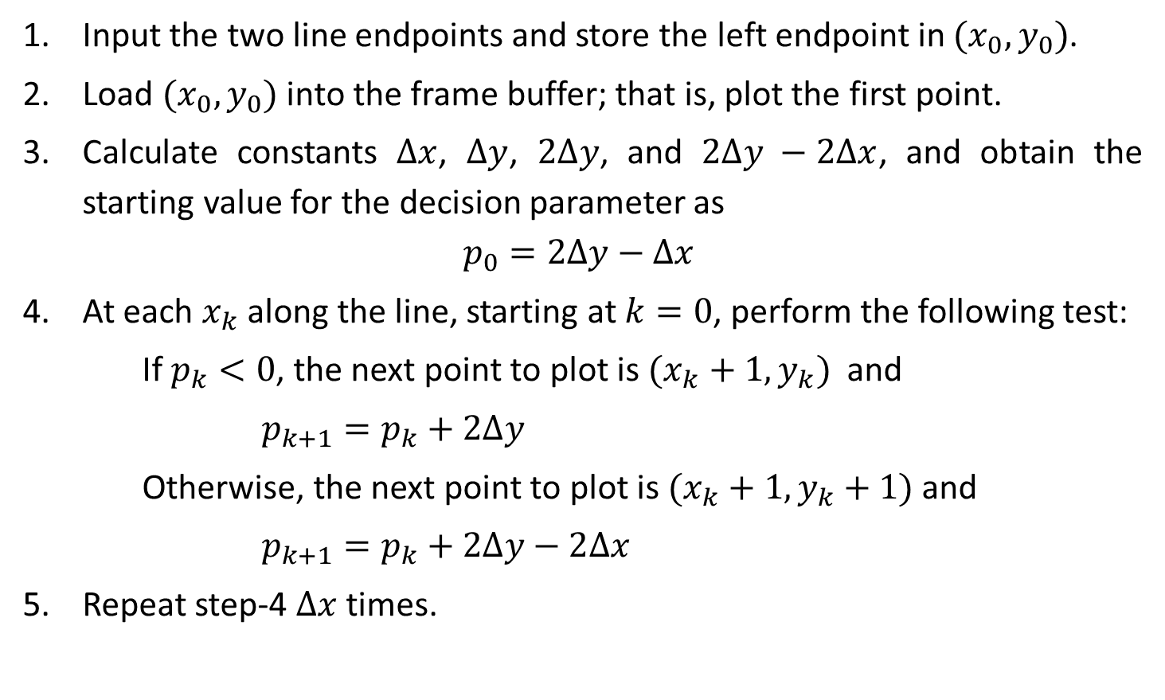
Bresenham’s Line Algorithm
Input the two line endpoints and store the left endpoint in $(x_{0},y_{0})$.
Load $(x_{0},y_{0})$into the frame buffer; that is, plot the first point.
Calculate constants $∆x$, $∆y$, $2∆y$, and $2∆y −2∆x$, and obtain the starting value for the decision parameter as
$$p_{0}=2∆y−∆x$$
At each $x_{k}$ along the line, starting at $k=0$, perform the following test:
If $p_{k}<0$, the next point to plot is $(x_{k}+1,y_{k})$ and
$$p_{k+1}=p_{k}+2∆y$$
Otherwise, the next point to plot is $(x_{k}+1,y_{k}+1)$ and
$$p_{k+1}=p_{k}+2∆y−2∆x$$
Repeat step-4 $∆x$ times.

Slide 21
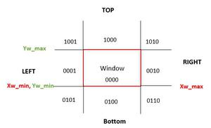
Cohen-Sutherland Line Clipping
This algorithm immediately removes the lines which are lying totally outside the window.
This algorithm divides the plane in nine parts and assign the binary number to each part.
The central part is the viewing region or window, all the lines which lie within this region are completely visible.
4 Bit binary code-Outcode
Line inside window then display
directly without clipping

Slide 22
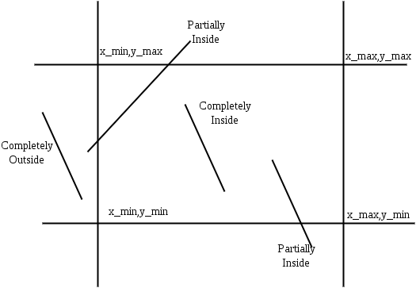
Cohen–Sutherland Line Clipping Algorithm
There are three possible cases for any given line.
Line inside the window: Not Clipped
Lines outside the window : Take AND operation of the end points of the line. If answer of AND operation is non zero means line is outside the window and hence discard those lines.
Partially inside the window :Lines for which AND operation of the end coordinate is ZERO. These are defined as partially visible lines

Slide 23
Pseudocode-Cohen Sutherland Algorithm
Step 1 : Assign a region code for two endpoints of given line.
Step 2 : If both endpoints have a region code 0000 then given line is completely inside.
Step 3 : Else, perform the logical AND operation for both region codes.
Step 3.1 : If the result is not 0000, then given line is completely outside.
Step 3.2 : Else line is partially inside.
Step 3.2.1 : Choose an endpoint of the line that is outside the given rectangle.
Step 3.2.2 : Find the intersection point of the rectangular boundary
Step 3.2.3 : Replace endpoint with the intersection point and update the region code.
Step 3.2.4 : Repeat step 2 until we find a clipped line either trivially accepted or rejected.
Step 4 : Repeat step 1 for other lines

