Slide 1
Two hypothesis: Cell-to-cell transmission vs. diffusing viral
Graw F, Perelson AS (2013) Spatial Aspects of HIV Infection. Mathematical Methods and Models in Biomedicine: Springer. pp. 3-31.

Slide 2
Cell-to-cell transmission model:
The infection of a new cell requires one of the neighbors is infected already
100 by 100 cell array, and suppose all the cells are fixed.
Simulation results are shown in the next two slides:
Clustering infection can be observed.

Slide 3
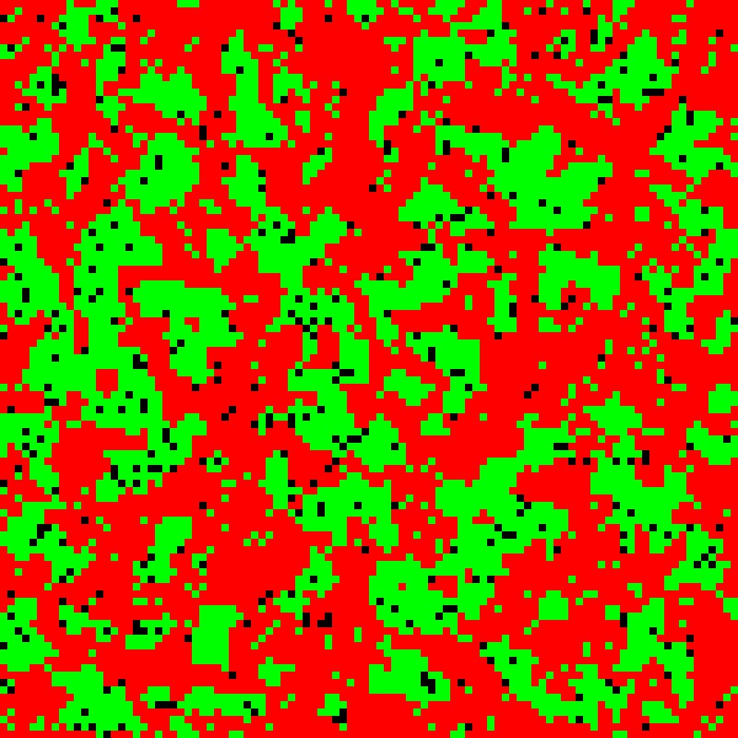
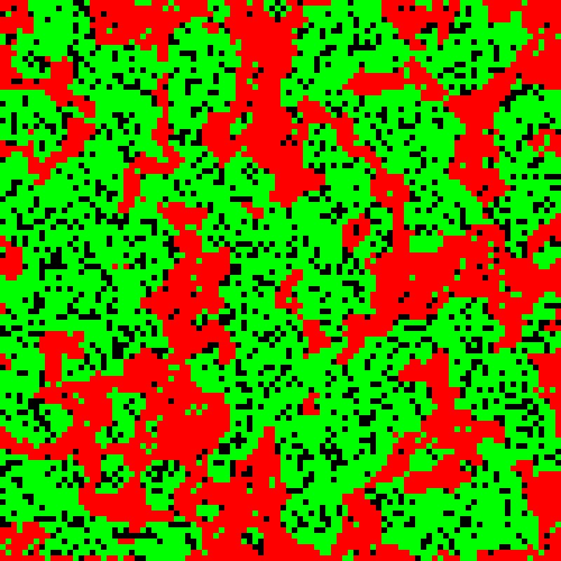
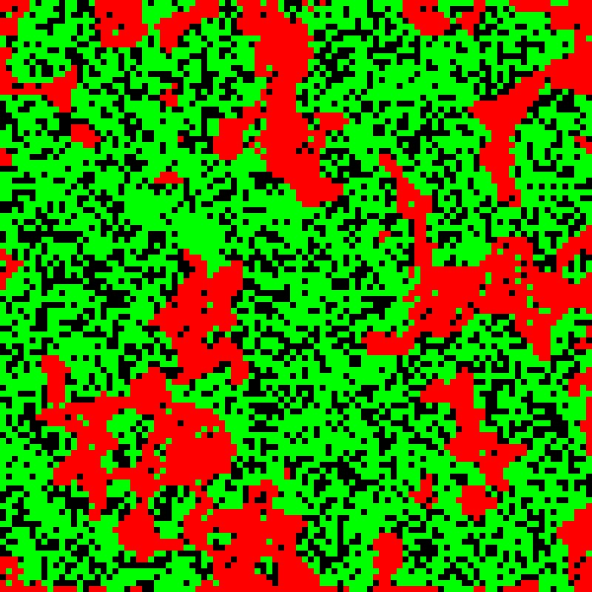
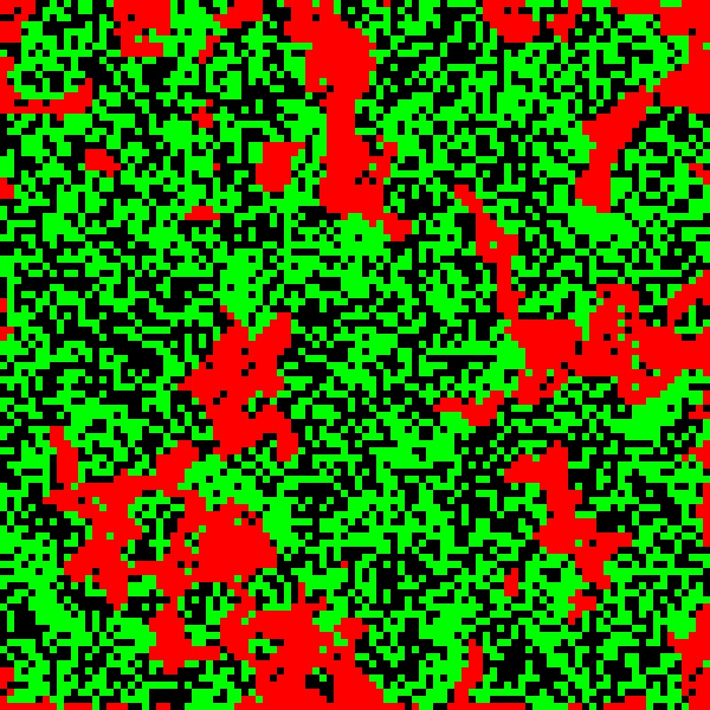
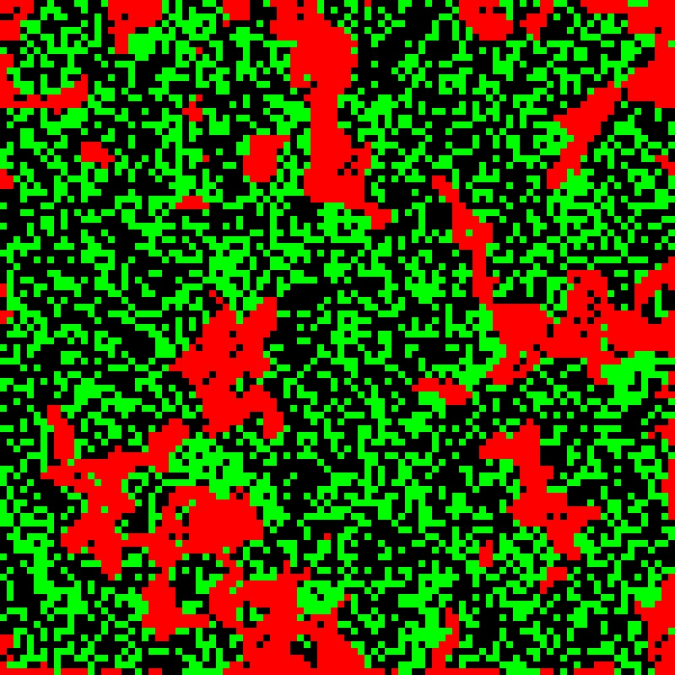
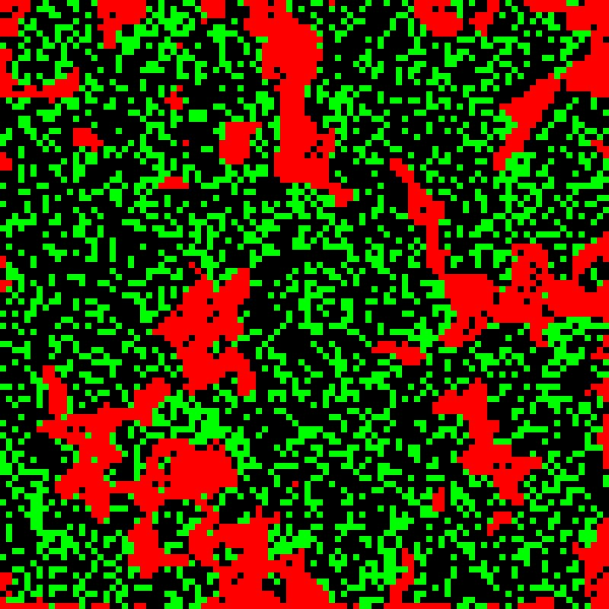
t = 10 pi
t = 20 pi
t = 30 pi
100 by 100 cell grids
Moi = 0.1
t = 40 pi
t = 50 pi
t = 60 pi
Red spot: Heathy cell
Green spot: infected cell
Black spot: Dead cell
Clustering infection
Notes:
Clustering infection

Slide 4
Infection fraction
Time (p.i.)

Slide 5
Diffusing viral model:
The new infection requires the virus and the cell are in the same spot
The virus can randomly diffuse in this 100 by 100 cell arrays
Also suppose all the cells are fixed
Simulation results are shown in the next two slides.
Randomly distributed infection can be observed.

Slide 6
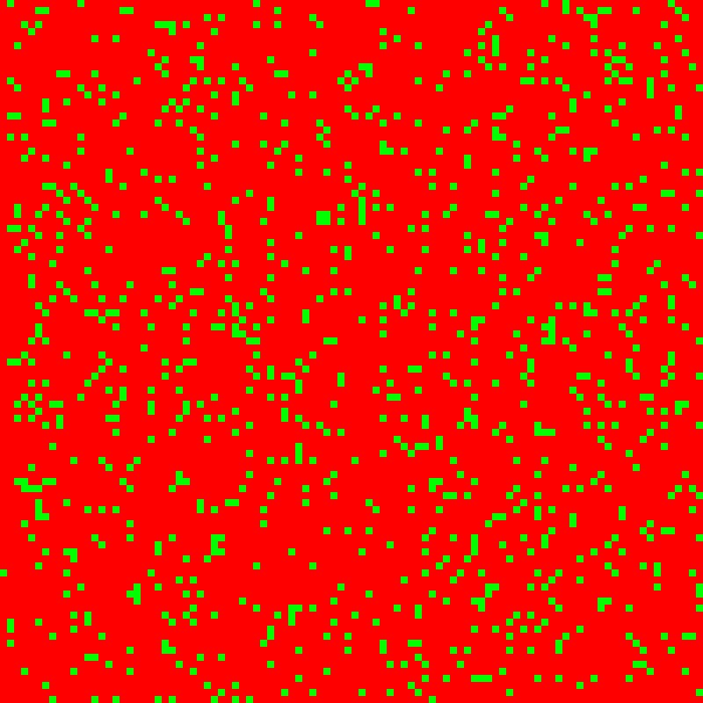
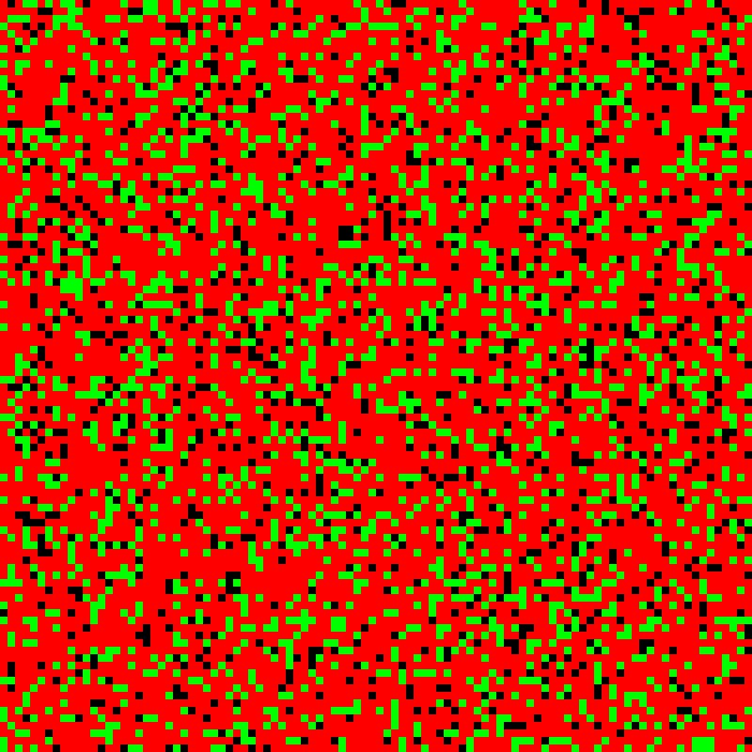
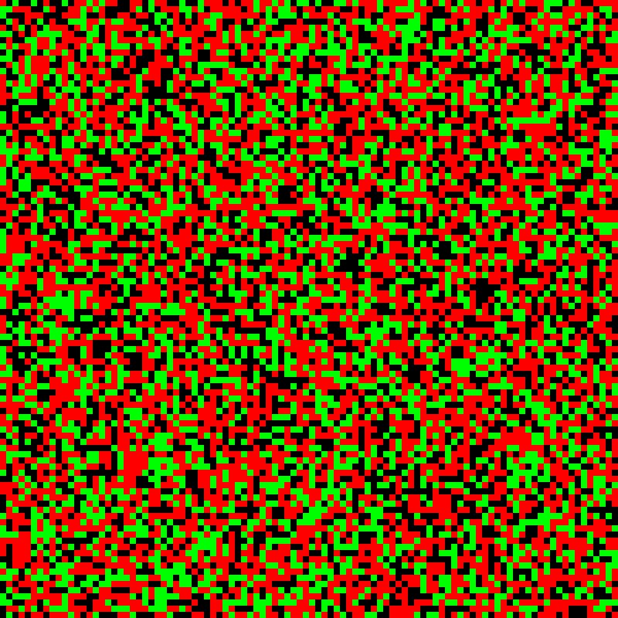
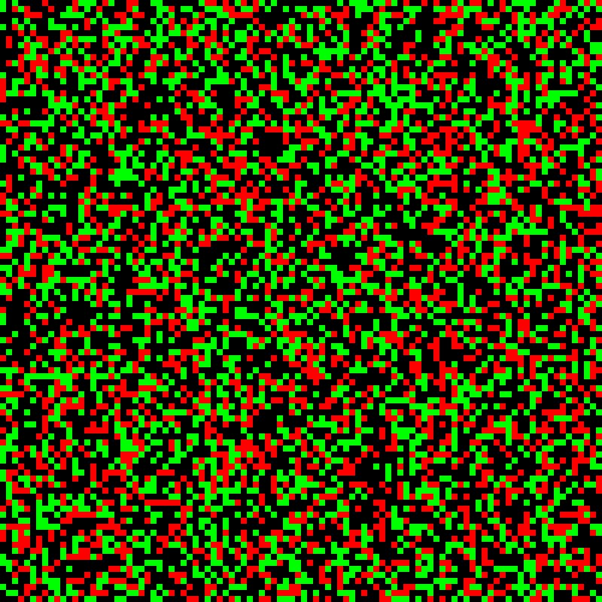
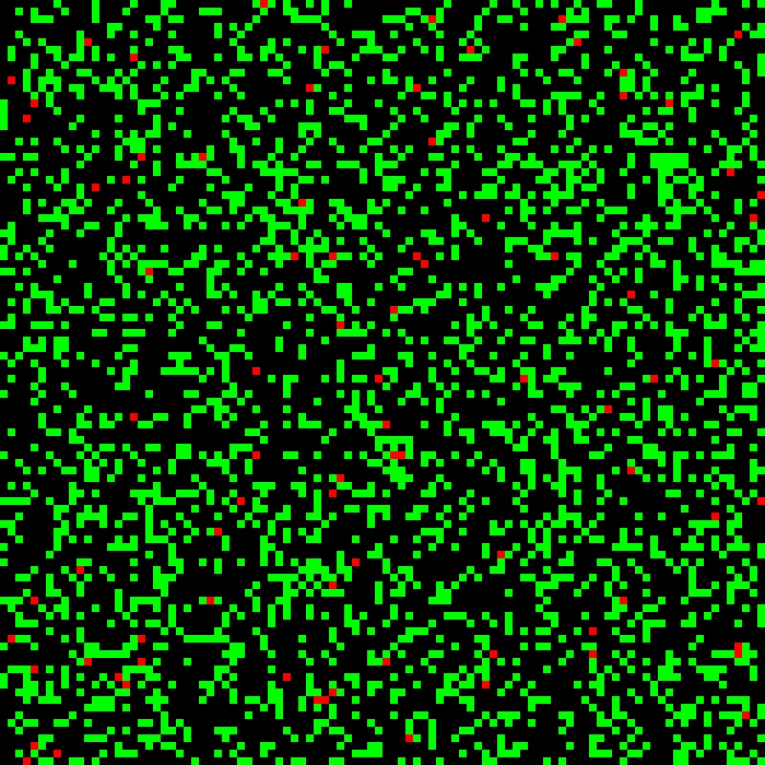
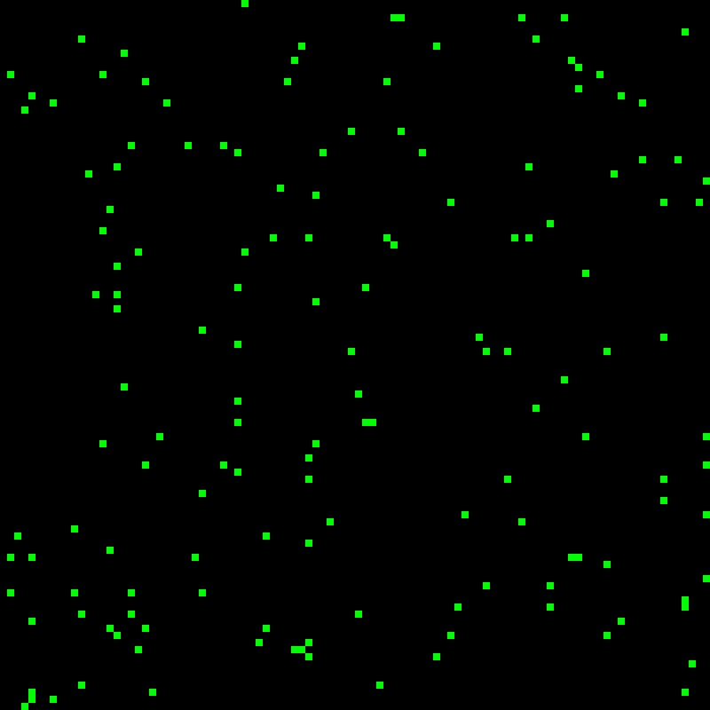
t = 10 pi
t = 20 pi
t = 30 pi
100 by 100 cell grids
Moi = 0.1
t = 40 pi
t = 50 pi
t = 60 pi
Red spot: Heathy cell
Green spot: infected cell
Black spot: Dead cell
Notes:
Each spot represent a cell.
Red spot: Heath cell
Green spot: infected cell
Black spot: Dead cell

Slide 7
Multi-round infection
Infection fraction
Time (p.i.)

Slide 8
The goal of this study is to explore the infection pattern and dynamics of infection fraction in vitro with or without nucleotides.
My intracellular model can provide an infection probability parameter to the Cellular Automata (CA) model shown here. In this way, the two models are linked.
Adding nucleotides will increase RT efficiency in my intracellular model and change the probability of individual infection. This parameter change will be reflected by using the CA model to show how the dynamics of infection fraction time courses changes correspondingly. The experimental setting can directly measure the infection dynamics by using p24 antibodies.

