Slide 1
Average plot (new data vs. old data )
Old data
New data

Slide 2
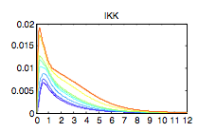
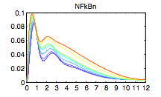
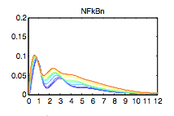
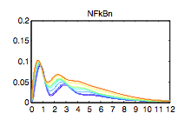
Didn’t change IKK simulation results.
New data
n(10:12)= [5; 37; 37 ]; % inducible txn delay
n(30:32)= [0.828; 0.414; 0.414]*0.1; % IkB:NFkB Export
This case, first trough is too high
n(10:12)= [10; 37; 37 ]; % inducible txn delay
n(30:32)= [0.828; 0.414; 0.414]*0.1; % IkB:NFkB Export
We choose this one.

Slide 3
Average plot (data against average model)
Simulate average model (no distribution of parameters)
n(10:12)= [5; 37; 37 ]; % inducible txn delay
n(30:32)= [0.828; 0.414; 0.414]*0.1; % IkB:NFkB Export
lps scale = 1; (for simulate bulk data it is
New data

Slide 4
Average plot (data against single cell model)
Ensemble average of 100 simulations (lognormal distribute 3 parameters:
Ikba txn delay, myd88 activation and trif activation)
New data

Slide 5
Single cell model
Randomize the MyD88 and TRIF activation together (0~1 fold range)
Technical Problems:
1. Second peak is not strong enough.
2. The trough of first peak is a little bit high
3. Possible of 3rd peak not shown in simulation.
Old experimental data

Slide 6
Single cell model
Randomize the MyD88 and TRIF activation together (0~1 fold range)
Technical Problems:
1. Second peak is not strong enough.
2. The trough of first peak is a little bit high
3. Possible of 3rd peak not shown in simulation.
New experimental data

Slide 7
Single cell model
Randomize the MyD88 and TRIF activation together (0.1~10 fold range)
Technical Problems:
1. Second peak is not strong enough.
2. The trough of first peak is a little bit high
3. Possible of 3rd peak not shown in simulation.
Old experimental data

Slide 8
Single cell model
Randomize the MyD88 and TRIF activation together (0.1~10 fold range)
Technical Problems:
1. Second peak is not strong enough.
2. The trough of first peak is a little bit high
3. Possible of 3rd peak not shown in simulation.
New experimental data

Slide 9
Single cell model
Randomize the ikba transcription delay (0.1~10 fold change of 10 mins, lognormal)
Technical Problems:
1. Second peak is not strong enough.
2. The trough of first peak is a little bit high
3. Possible of 3rd peak not shown in simulation.
New experimental data

Slide 10
Single cell model
Randomize the ikba transcription delay,myd88 and trif activation (0.1~10 fold change, lognormal)
Technical Problems:
1. Second peak is not strong enough.
2. The trough of first peak is a little bit high
3. Possible of 3rd peak not shown in simulation.
New experimental data
Notes:
1. Initial time delay: Diffusion time of the LPS.
2. Less sensitive in single cell setting.
3. More heterogenous in the first peak height.

