Slide 1
A
TLR9
TLR4
TLR3
Input
Output
B
CpG
LPS
PolyI:C
wild-type
wild-type
TNF
Nascent TNF RNA
TNF mRNA
proTNF
MyD88
TRIF
3
AAA
IKK
wild-type
wild-type
2
Nascent TNF
proTNF expression
Secreted TNF (ng/mL)
Werner
et al
2005
κB
TNF
NF -κB
1
NF -κB
C
D
trif ^{-/-}
trif ^{-/-}
PolyI:C
CpG
myd88 ^{-/-}
myd88 ^{-/-}
TNF mRNA
TNF mRNA
Nascent TNF RNA
TNF mRNA
TNF mRNA
trif ^{-/-}
trif ^{-/-}
PolyI:C
CpG
myd88 ^{-/-}
myd88 ^{-/-}
proTNF expression
Secreted TNF (ng/mL)
Secreted TNF (ng/mL)
Secreted TNF (ng/mL)

Slide 2

A
Input
C
Model Simulation
TLR9
TLR4
TLR3
wild-type
wild-type
TNF
CpG
LPS
PolyI:C
tnf ^{-/-}
tnf ^{-/-}
TNF
NFκB Activity %
NFκB Activity %
Werner
et al
2008
TTR
MyD88
TRIF
3
AAA
D
Experimental Quantification
IKK
wild-type
wild-type
2
tnf ^{-/-}
tnf ^{-/-}
Werner
et al
2005
NFκB Activity %
NFκB Activity %
NF -κB
1
NF -κB
B
Model Simulation
LPS
CpG
PolyI:C
LPS
CpG
PolyI:C
wild-type LPS
tnf ^{-/-} LPS
wild-type CpG
0
tnf ^{-/-} CpG
8
h
0
1
2
4
8
0
1
2
4
8
0
1
2
4
8
1
2
4
Secreted TNF (ng/mL)
NFκB
EMSA

Slide 3
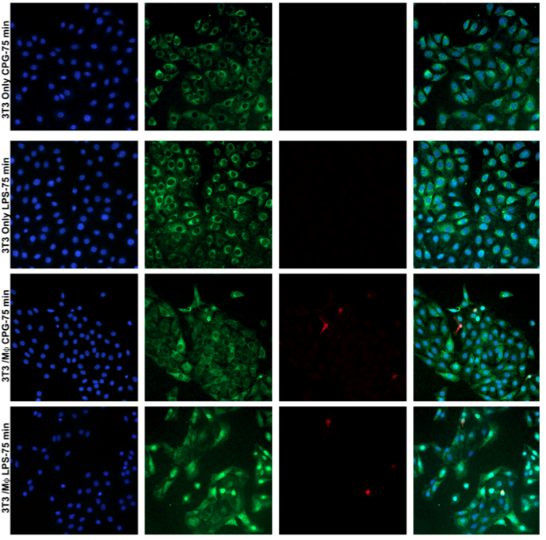
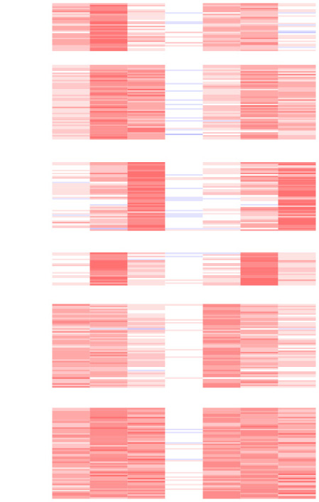
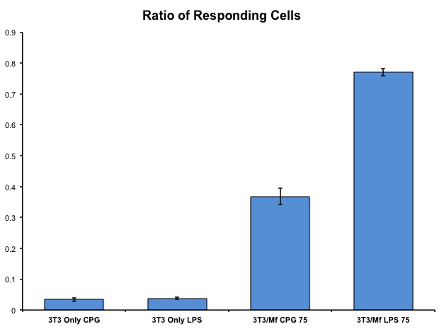
A
B
C
Cluster
wild-type
tnf ^{-/-}
Cluster Median
D
Reported
Function
0
3
8
24
0
3
8
24
wild-type
A
tnf ^{-/-}
A
wild-type
Bacterial
Recognition
and Killing
RNA (fold)
tnf ^{-/-}
B
B
RNA (fold)
Inflammasome
Activation
C
C
D
D
RNA (fold)
Macrophage
Resolution
E
E
NFkB
Attenuation
RNA (fold)
F
F
RNA (fold)
Adaptive
Immune Control
0
3
8
24
0
3
8
24
0
3
8
24
0
3
8
24

