Slide 1
Joerg and Frank and Joe are creating ICA > CE RNAseq Pipelines
SRA repository pull > ICA/Dragen-driven Differential Expression > CE Import
Jim and Mike are creating 2 CE > ICA Proof of Principle Use Cases
Coronavirus host infection RNA Meta-Signatures – Notebook & Portal
- Analyses from CE Meta-Analysis app export (API not available) > Summarization > ICA.
- An ICA created data exploration portal to complement our novel to-be-published research.
- Meta-Signatures decrease variability in individual experiments by cross-Study feature enrichment.
Breast Cancer Multi-Omics - Notebook
- An ICA toolbox to pull CE Biosets from APIs for additional processing and visualization.
- based on validated potential using 84 CE RNA Expression Biosets across 3 phenotypes
- Combines RNA, Somatic Mutation, DNA Copy Number, SNP-GWAS, DNA Methylation,
Histone Modification, Proteomic, Literature, …

Slide 2
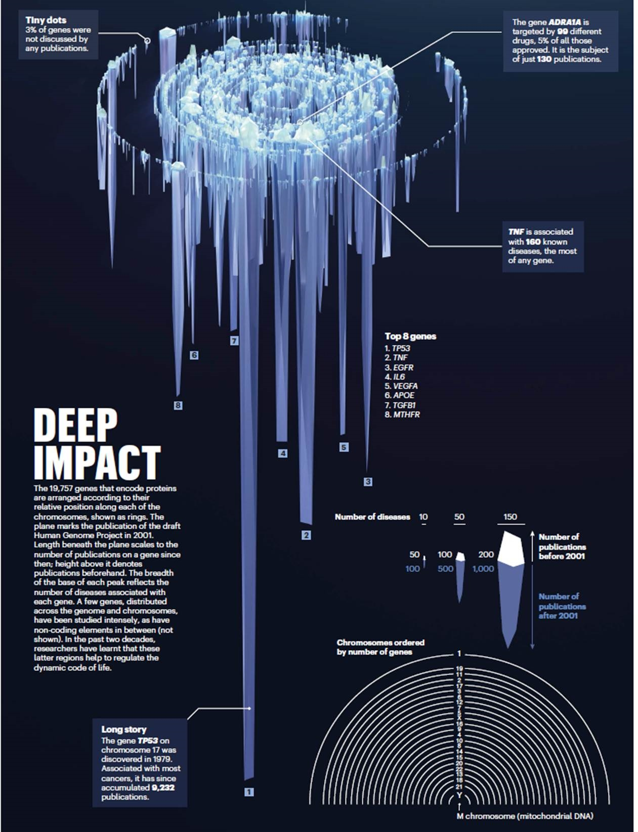
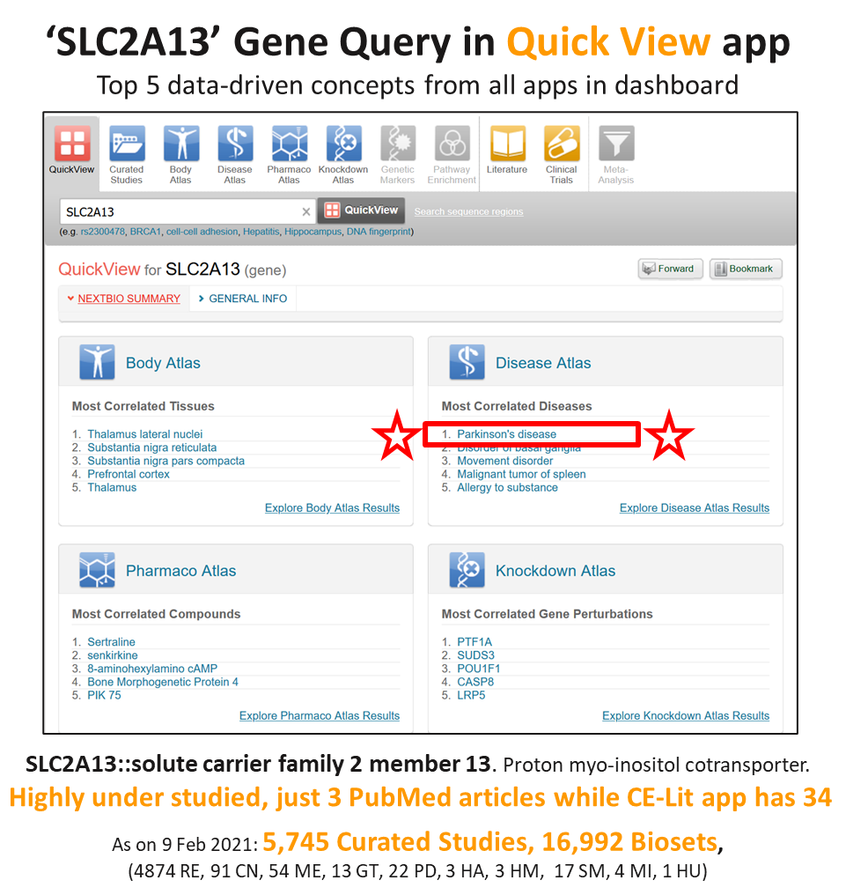
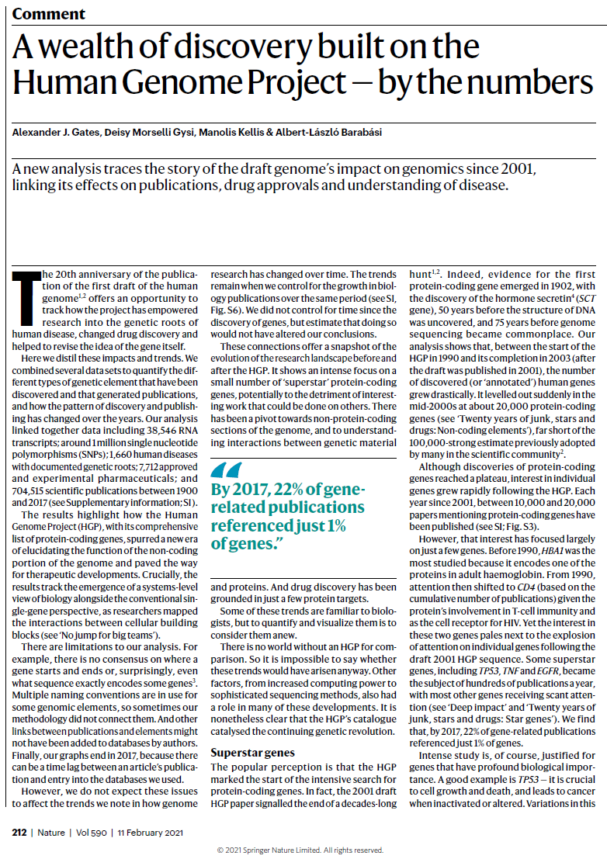
Correlation Engine & Illumina Connected Analytics - Synergies
https://www.nature.com/articles/d41586-021-00314-6

Slide 3
Correlation Engine API commands are similar to User Interface REST-based queries
Correlation Commands
Correlations between search terms, studies and biosets
Data Access and Download Commands
Studies, biosets, associated files, Projects, etc.
Bulk Import Commands
Load your repositories of omics data programmatically
Create/Update/Delete Commands
Create projects, edit/delete biosets, edit/delete studies
Atlas Commands
Body Atlas, Disease Atlas, Knockdown Atlas and Pharmaco Atlas commands
Biogroup, Genetic Markers, Ontology, Literature and Clinical Trial Commands
Client
(Java, R, Matlab, Python)
HTTPS, REST-based API Key, Parameters
Correlation
Engine
XML, JSON, CSV
Representational State Transfer (REST) is a web service architectural style
For Research Use Only. Not for use in diagnostic procedures.

Slide 4
Coronavirus host infection RNA Meta-Signatures – Notebook & Portal
- Analyses from CE Meta-Analysis app export (API not available) > Summarization > ICA.
- An ICA created data exploration portal to complement our novel to-be-published research.
- Meta-Signatures decrease variability in individual experiments by cross-Study feature enrichment.

Slide 5
Crowdsourcing Temporal Transcriptomic Coronavirus Host Infection Data
James Flynn^{1*}, Michael Kubal¹, Mehdi Ahmadi², Chase McFarland², Mark Taylor³, Enrique C. Torchia² and Michael Edwards^{4*}

Slide 6
Identify gene expression studies curated in BSCE (e.g., search for ‘coronavirus’ studies)
Categorize experimental designs for aggregate analyses (e.g. animal species infected, infected tissue, host age, viral species and severity,
viral dose, days post infection)
ICA
opens data exploration to the world
Run aggregate analyses using BSCE Meta-Analysis app for normalized, rank based prioritization of biomarkers
Visualize and Perform QC:
Hierarchical Clustering & PCA analyses
Generate Meta-Signatures using bioset-specific normalized gene scores modified with fold change directionality, sum and take mean
Perform compound analysis with BSCE Pharmaco Atlas: Identify candidate compounds with potential to reverse dysregulated RNA expression patterns
Perform Functional Enrichment in BSCE using Gene Ontology gene set analysis to prioritize and distinguish biological activities
Perform gene network analysis using String
Perform gene perturbation analysis with BSCE Knockdown Atlas: identify
candidate genes with potential to reverse dysregulated RNA expression patterns
Generate novel in silico insights for further refinement and experimentation
Validate with published literature
Coronavirus Host Infection Meta-Signature Development and Interpretation Process. The diagram outlines the process to obtain and analyze an aggregate gene signature from an unbiased accounting of all coronavirus RNA Expression Curated Studies in BaseSpace™ Correlation Engine (BSCE). The orange arrows depict tasks performed within the BSCE platform, blue arrows are tasks performed using other software packages and the purple arrow depicts an iterative refinement of contributing data. The generation of Meta-Signatures requires the identification of relevant studies and biosets that can be refined after visualization and inspection of aggregated biosets via clustering algorithms in combination with categorization criteria.

Slide 7
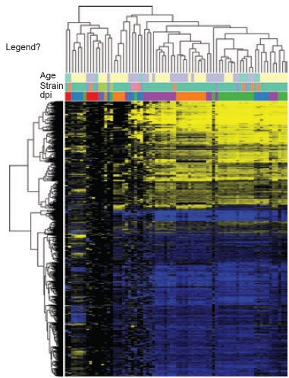
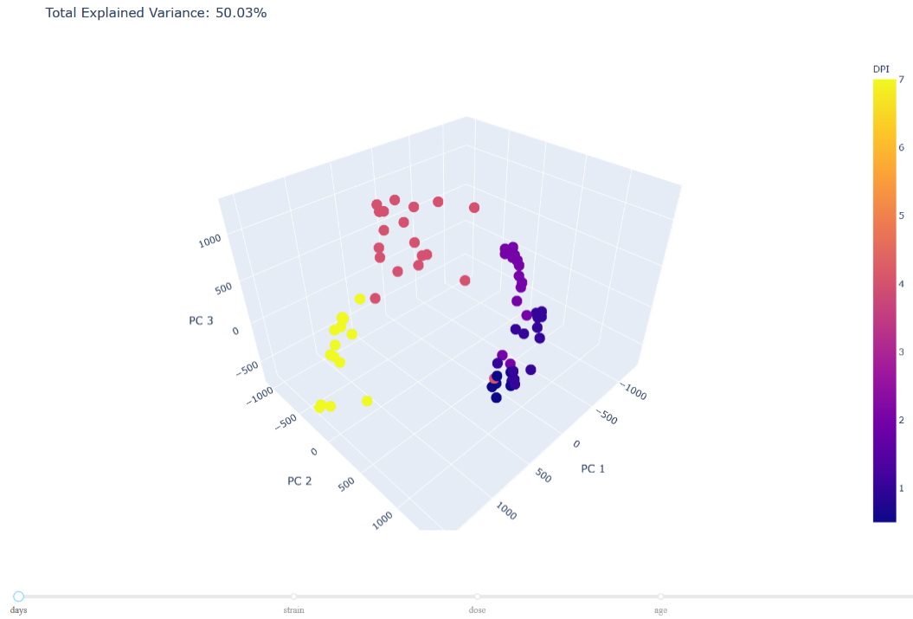
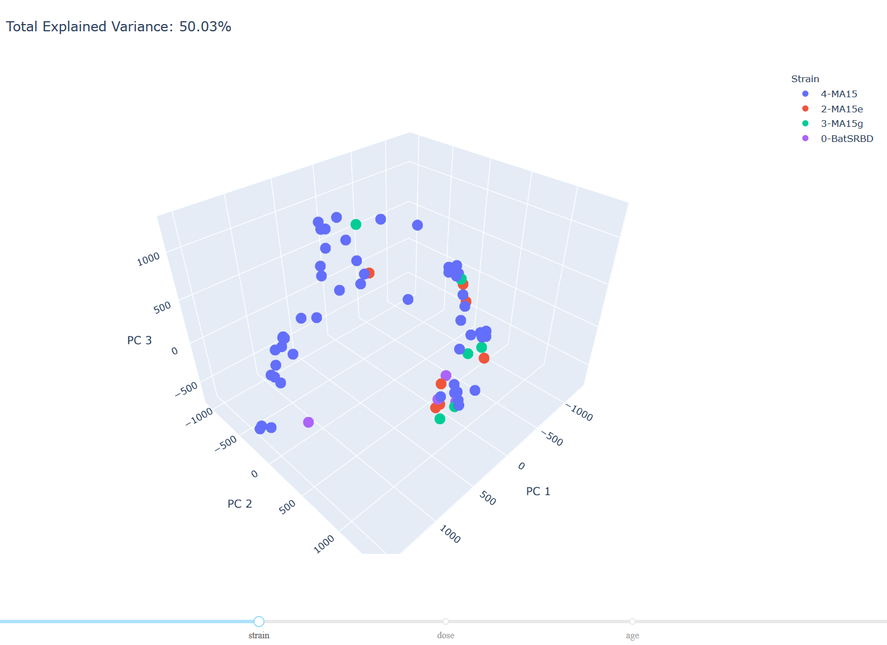
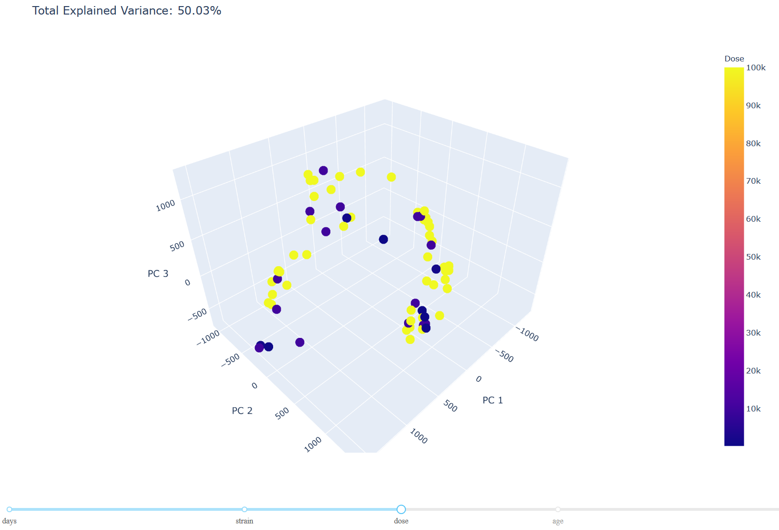
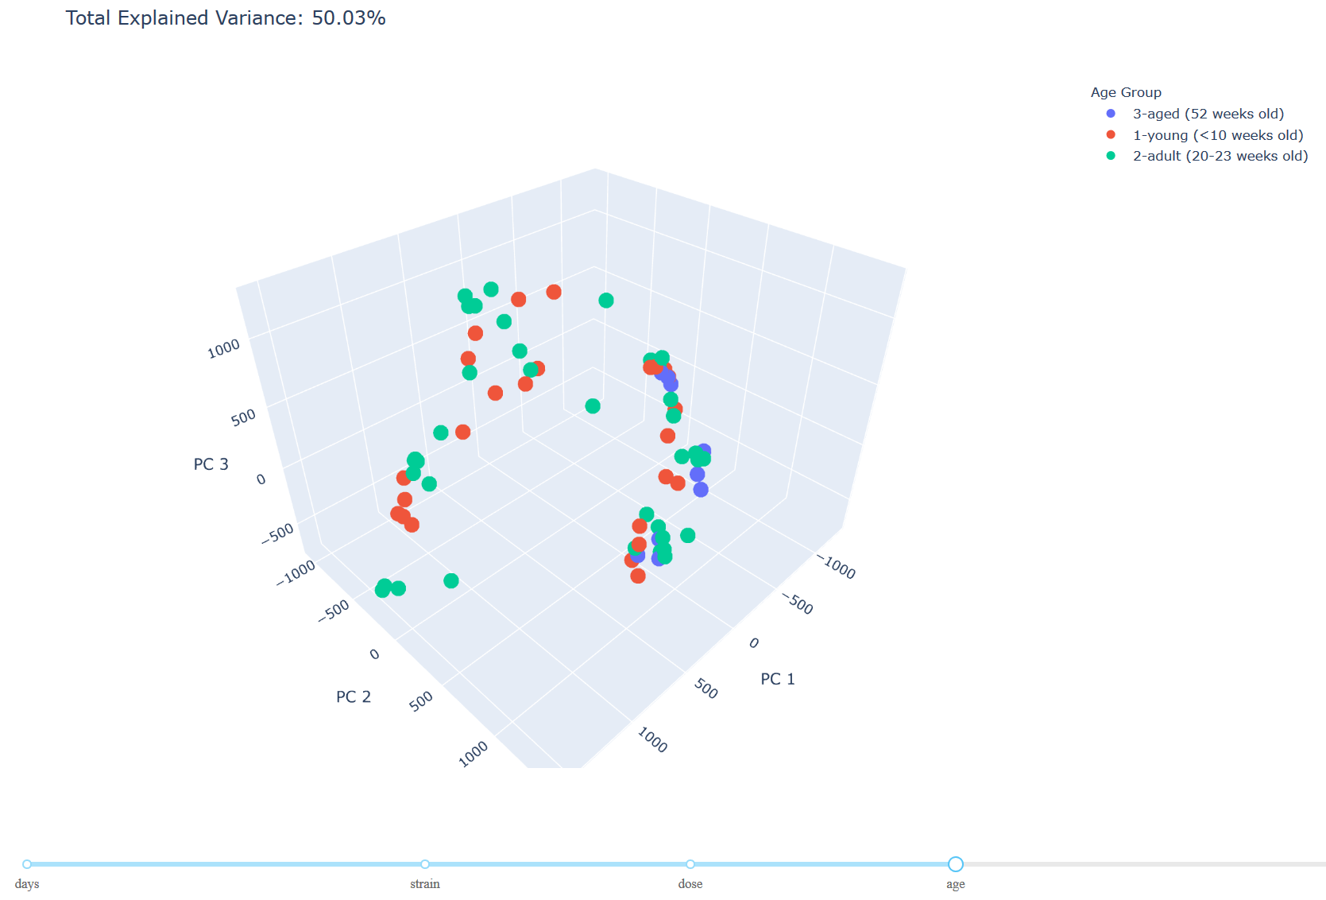
74 Sample CoV Hierarchical Clustering & Principal Component Analysis
http://3.14.252.12:8050/
Days Post Infection
Viral Variant ‘strain’
Viral Dose (PFU)
Host Age
Days Post Infection is only variable trending into distinctive cluster

Slide 8
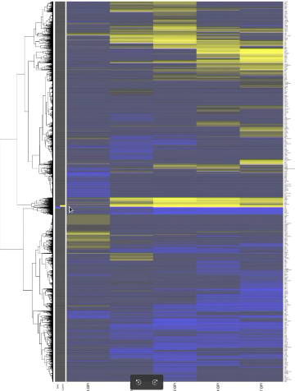
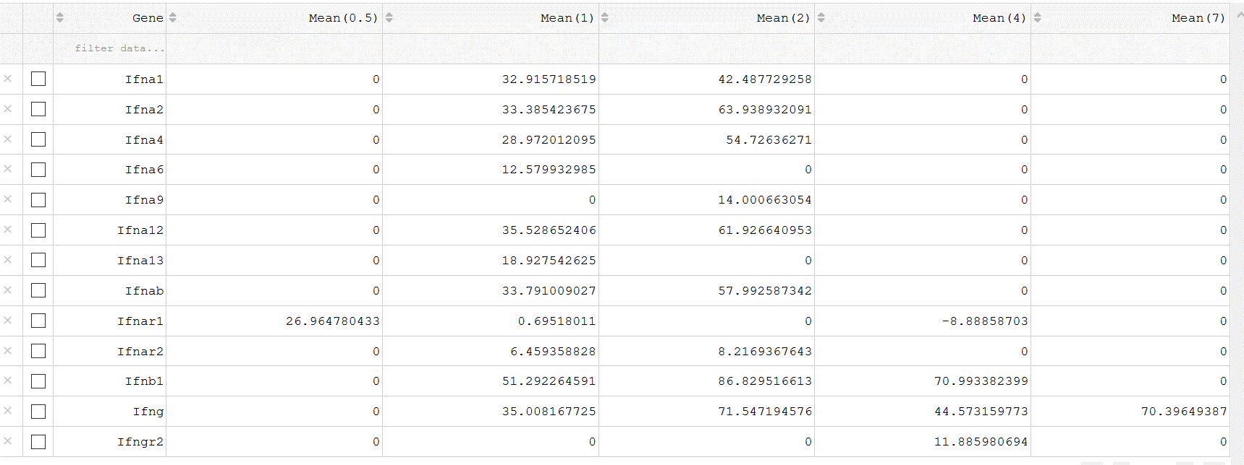
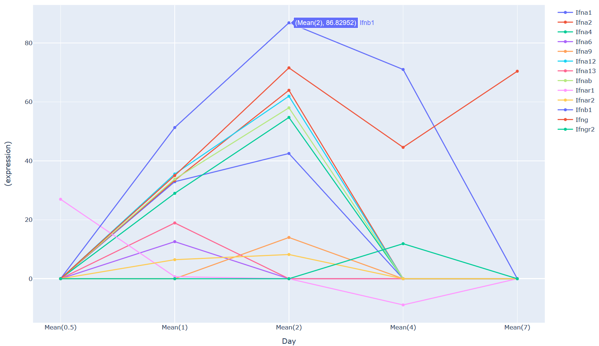
5 Temporal Meta-Signature Clustering, Table Lookup and Expression Profiles
Interferon and Interferon Receptor Transcriptional Response to Infection
Gene Programs
sequentially up-regulated
Gene Programs highly
up-regulated throughout
Gene with Directional Scores
Gene Programs highly
down-regulated throughout
Gene Programs
sequentially down-regulated
http://3.14.252.12:8050/
Days Post Infection

Slide 9
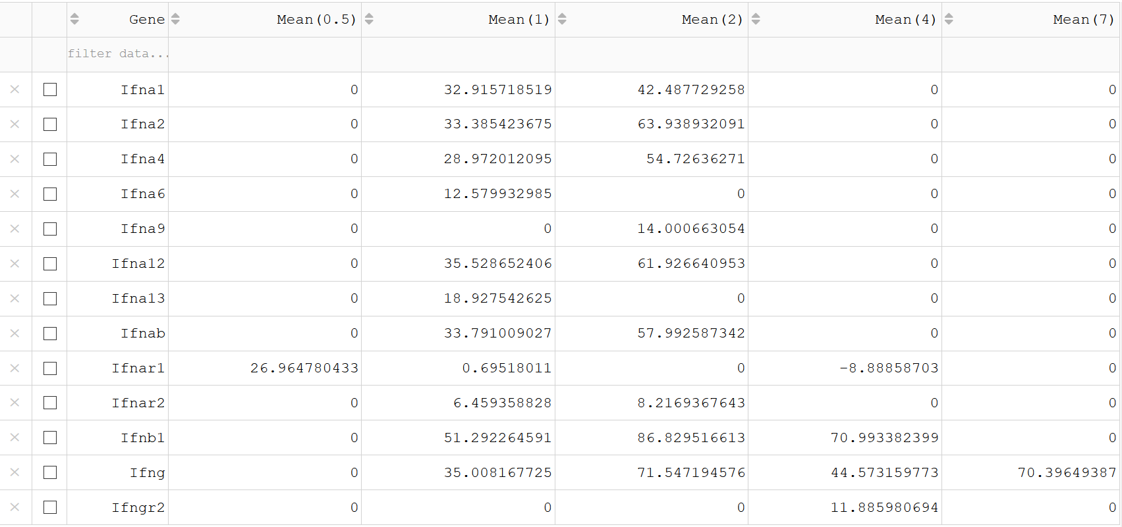
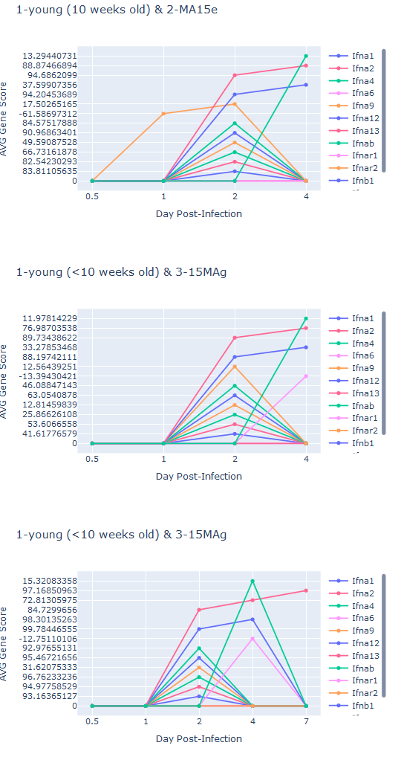
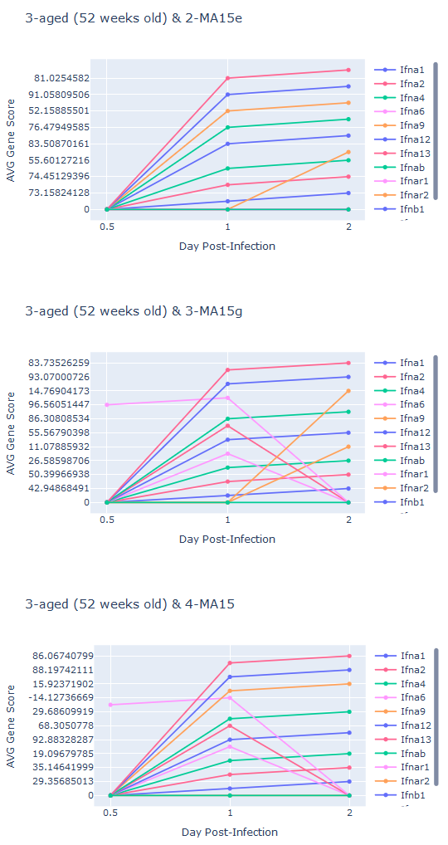
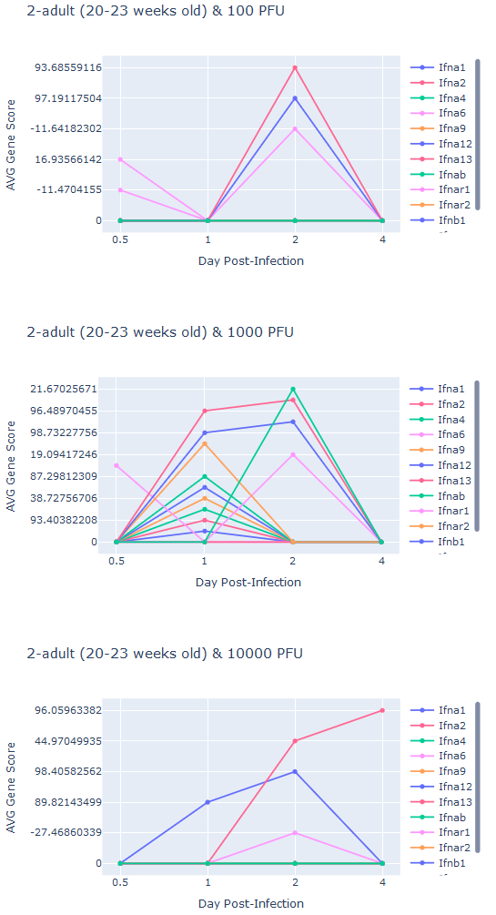
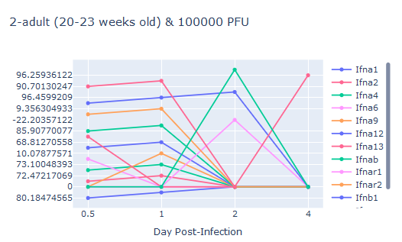
5 Temporal Meta-Signature Gene Table Lookup & Variable Breakdowns
http://3.14.252.12:8049/

Slide 10
Breast Cancer Multi-Omics – Notebook
- An ICA toolbox to pull CE Biosets from APIs for additional processing and visualization.
- based on validated potential using 84 CE RNA Expression Biosets across 3 phenotypes
- Combines RNA, Somatic Mutation, DNA Copy Number, SNP-GWAS, DNA Methylation,
Histone Modification, Proteomic, Literature, …

Slide 11
Dozens of Breast Cancer clinical phenotype definitions are in use today:
- Carcinoma, Adenocarcinoma, Sarcoma, Angiosarcoma
- TNM Classification of Malignant Tumor Stages and Grades
- Lobular, Ductal, Medullary, Mucinous, Squamous, Luminal, Basal, Inflammatory
- ER, PR, HER2, Triple Negative, BRCA1, p53, EGFR, KRT, Ki67, PTEN, PIK3CA
- invasive, lymph node status, metastatic
- recurrent and survival status
WHAT?
So much variability
Correlation Engine contains numerous studies where these phenotypes and many more can be operated upon
Breast Cancer RNA Expression based Diagnostic Tests:
- MammaPrint: 70 gene risk of recurrence signature
- BluePrint: 80-gene molecular subtype signature intrinsic breast cancer molecular subtypes
HR-positive patients are mostly Luminal-type, triple-negative are Basal-type, and HER2-positive are HER2-type
- Oncotype DX Breast Recurrence Score Test for people diagnosed with early-stage, estrogen-receptor-positive,
HER2-negative invasive breast cancer
- Oncotype DX Breast DCIS Score Test for people diagnosed with DCIS (ductal carcinoma in situ)
- PAM50 (Prosigna): 50-genes to classify as Luminal A, Luminal B, HER2-enriched, Basal-like, Normal-like. Luminal A has best
prognosis; HER2-enriched and Basal-like are more aggressive
- Breast Cancer Index test predicts risk of node-negative or -positive, hormone-receptor-positive breast cancer
5-10 year recurrence and benefit from an additional 5 years of hormonal therapy.
- EndoPredict test predicts risk of distant recurrence of early-stage, hormone-receptor-positive, HER2-
negative breast cancer
WHY?
More precise tests
Gene Expression Assay in the Management of Early Breast Cancer.
MapQuant Dx, IHC4, and Theros-Breast Cancer Gene Expression Ratio Assay
Notes:
• The distribution of breast cancer subtypes varies in the population:
◦◦ Luminal A: 35–40 percent
◦◦ Luminal B: 25–30 percent
◦◦ HER2-enriched 10–20 percent
◦◦ Basal-like: 10–20 percent
• Luminal A tumors usually have intermediate to high expression of ESR1 and estrogen-regulated genes and rarely have high ERBB2 expression.
• Luminal B tumors usually have intermediate to high expression of ESR1 and estrogen-regulated genes and often have higher proliferation than Luminal A tumors.
• HER2-enriched tumors usually have intermediate to high expression of ERBB2 and intermediate to low expression of ESR1 and estrogen-regulated genes. Approximately one-third of tumors subtyped as HER2-enriched are not HER2+ by immunohistochemistry (2+ or 3+ HER2 score) or fluorescence in-situ hybridization (DNA amplified for ERBB2).
• Basal-like tumors usually have low expression of ESR1, PGR, ERBB2, and estrogen-regulated genes, but have high proliferation.
MammaPrint = https://bmccancer.biomedcentral.com/articles/10.1186/s12885-020-6534-z

Slide 12
Breast Cancer: CE + ICA Multi-Omic Factory
CE - defining what is shipped :: ICA - what is received, operated upon and sold
Export all human Breast Cancer 1,097 Studies/6,475 Biosets, separate into sets for each molecular data type
[RE, GT, CN, ME, SM, GM, PD, MI, HM, HA, HU, MU]
Assess RE biomarker distinction discovery across the 3 limited phenotype sets (25 max for micrographs)
Assess and choose sub-phenotypes for good representation across all available data
Assess individual sub-phenotypes across multi-omic space
‘Estrogen Receptor negative vs positive’
‘HER2::ERBB2 positive vs negative’
‘triple negative vs triple positive’
Assess all 3 sub-phenotypes across multi-omic space
Assess RNA data consistency within phenotype to limit sets to reasonable # for Meta-Analysis visualizations (25 max for micrographs)
Create ML/AI extensions, algorithms & outputs
Private content
Ontologies
D
Literature
Consortia content
B

Slide 13
Breast Cancer, human samples and representation in CE
Notes:
Triple negative breast cancer (TNBC) is a breast cancer subgroup defined by lack of estrogen receptors (ER) and progesterone receptors (PGR) (ER/PGR negative) and normal HER2 protein expression. TNBC constitutes approximately 15% of all breast cancers and despite high response rates to chemotherapy, these patients have a poor prognosis compared to patients with other breast cancer subtypes
Cell Lines of human Breast Cancer could be pursued, would need to assign phenotypes to them
Would be richer across certain data types [PD, SM, …]

Slide 14
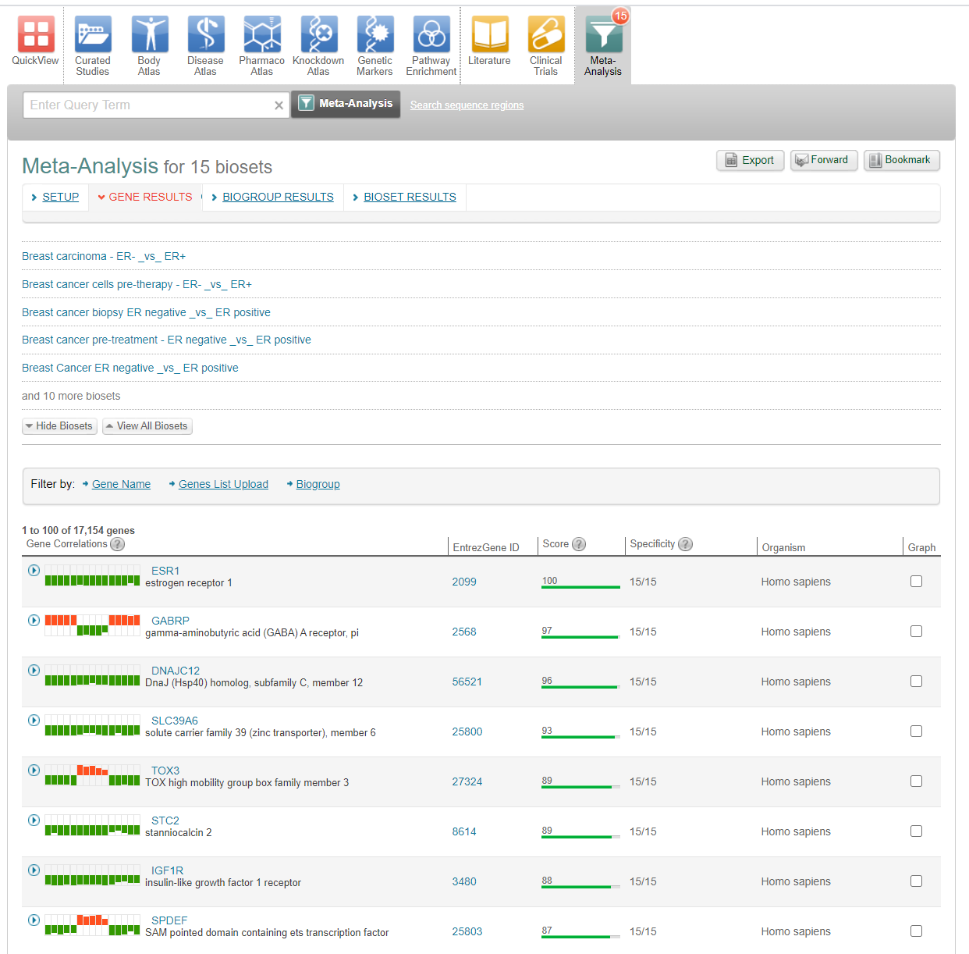
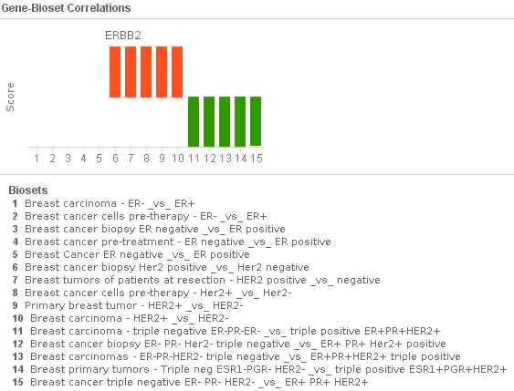
Breast Cancer: Wisdom of Crowds RNA Expression Distinctions between Clinical Phenotype
Five representative RNA Expression Biosets for ER- vs ER+, HER2+ vs HER2- & triple - vs triple +
ESR1 RNA is down in all 15 independent experiments
not a distinctive marker
ERBB2::HER2 RNA:
up in only the 5 HER2+ vs HER2-
down in only Triple Negative vs Triple Positive
no significant change in ESR1 negative vs ESR1 positive
Find genes with
similar pattern
https://enterprise.ce.basespace.illumina.com/c/search/adv.nb?ids=502888,422983,347861,254920,86350,347867,291652,423004,650150,503608,503569,347864,996634,601042,176296

Slide 15
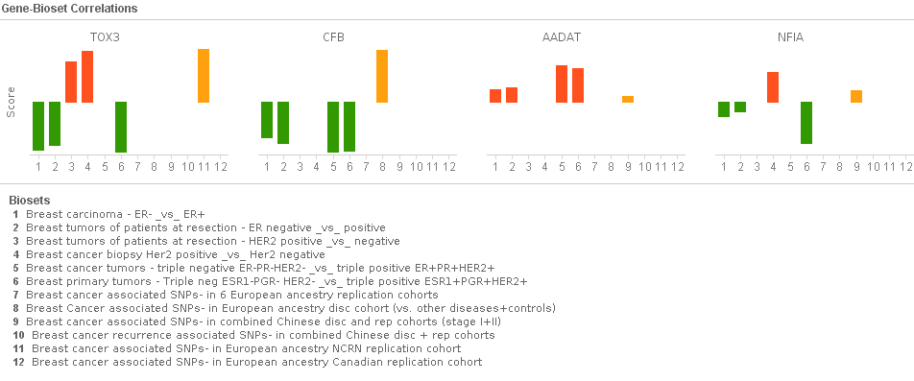
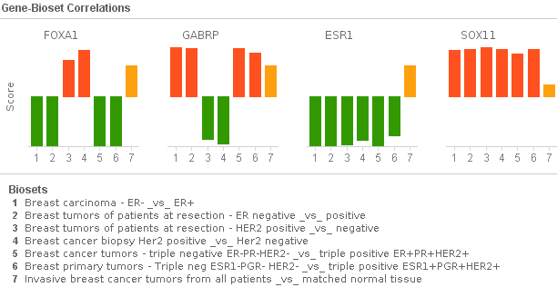
Can constitutional and somatic mutation status improve distinction of phenotype specific RNA markers?
+6 GT https://enterprise.ce.basespace.illumina.com/c/search/adv.nb?ids=502888,291643,291652,347867,969112,601042,992896,494815,528457,657824,313633,375859
Though sparse with limited set,
Potential to combine RNA with
population specific SNP-GWAS observations to determine distinctions
NFIA: HER2pos RNA up, Chinese SNP
+ 1 SM
https://enterprise.ce.basespace.illumina.com/c/search/adv.nb?ids=502888,291643,291652,347867,969112,601042,797383
Has SM and RNA distinction
FOXA1 distinctive up in HER2 pos vs neg
GABRP distinctive down in HER2 pos vs neg
Has SM, but no RNA distinction
ESR1 and SOX11

Slide 16
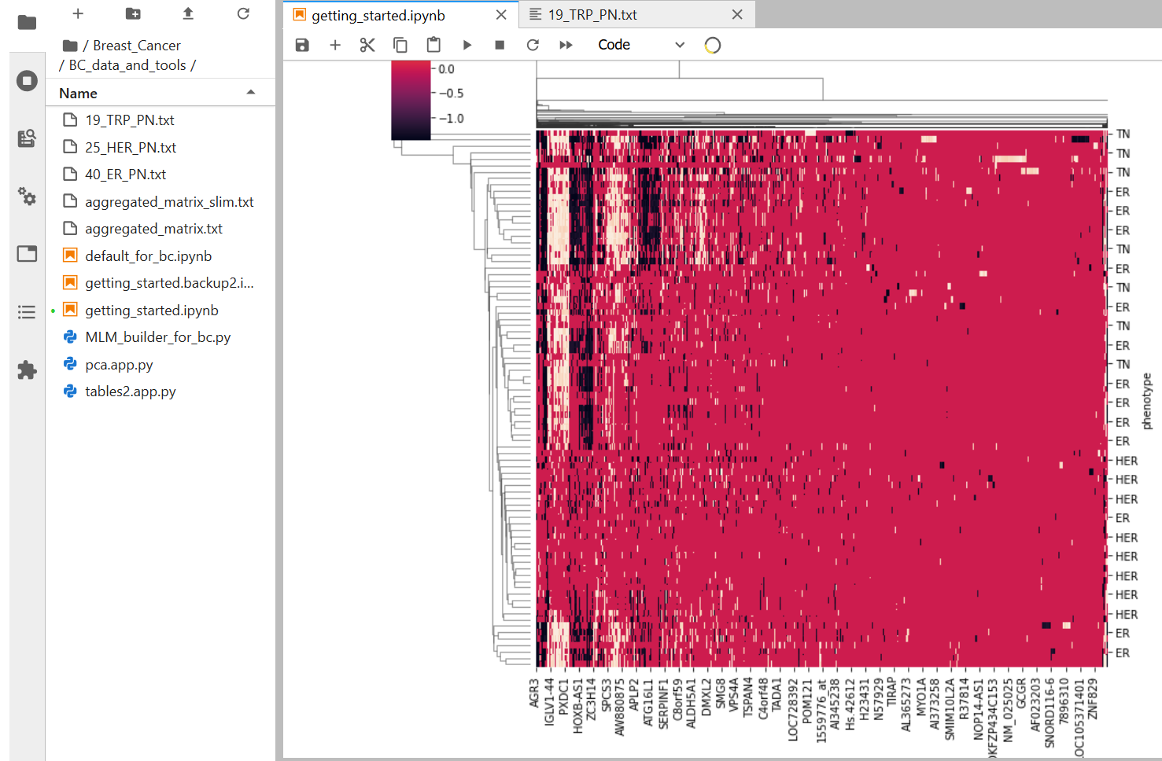
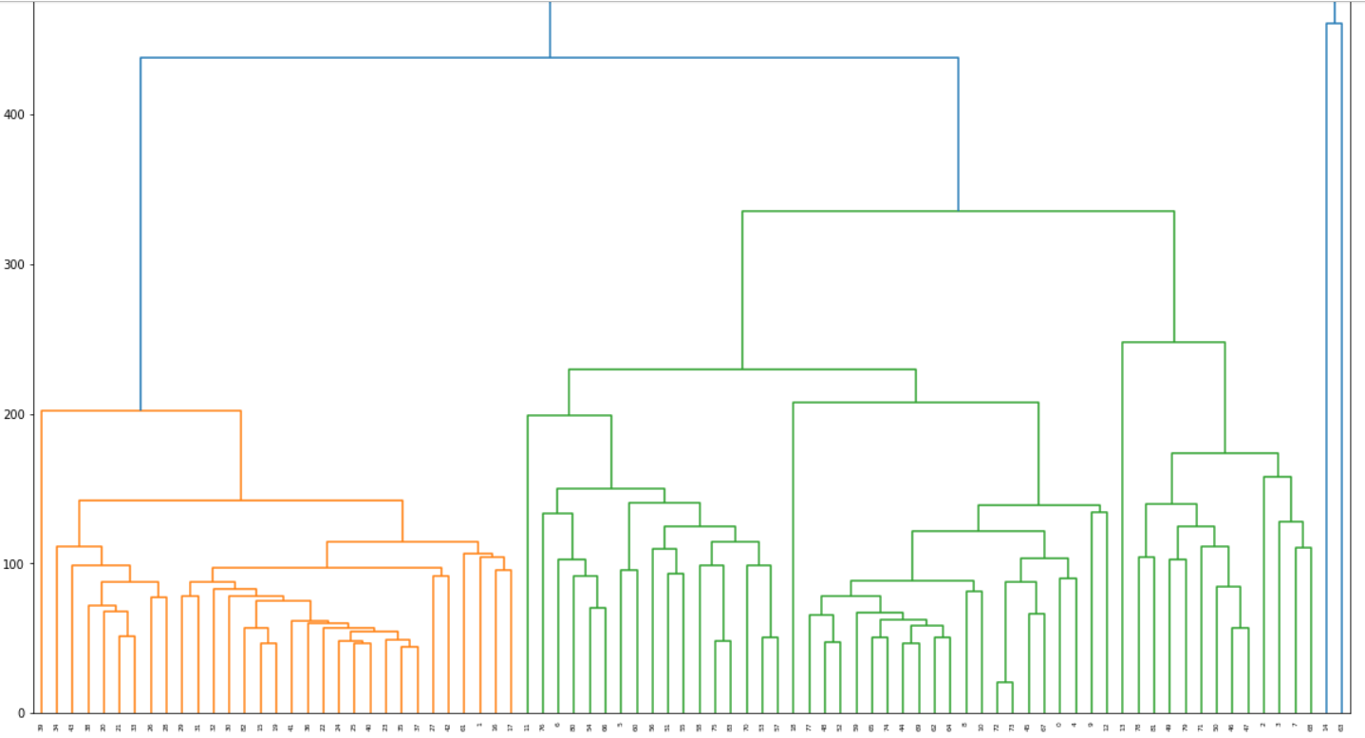
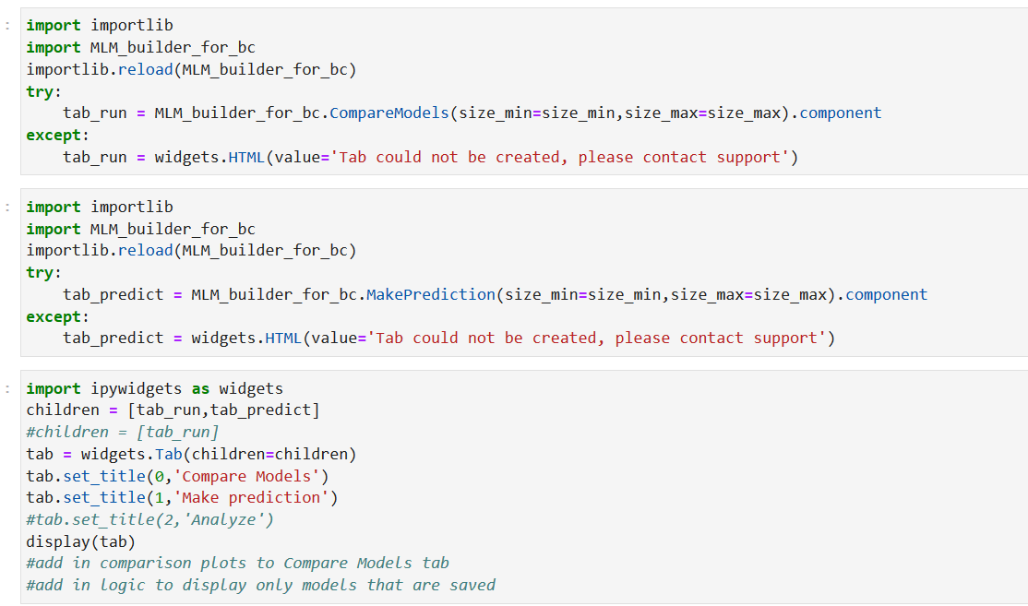
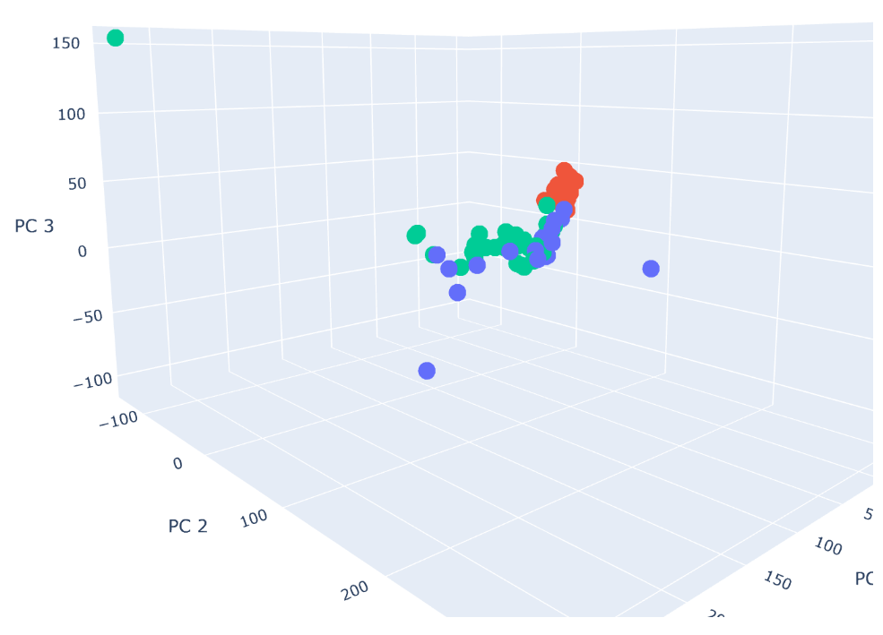
Agglomerative Clustering & PCA of Samples shows Distinction Potential
Used less than ideal signed fold change values, directional scores shown to improve results with COVID example
What could Machine Learning do?

Slide 17
ASKS:
- CE API ‘biosetfeatures’ to output normalized gene Scores with +/- directionality
- Curate relevant non-RNA Studies to make the results more effective (CN, ME, SM, GT, PD, HM, HA, HU, MI)
- Reanalyze SM for Disease vs Normal, CN is essentially Disease vs Normal

