Slide 1
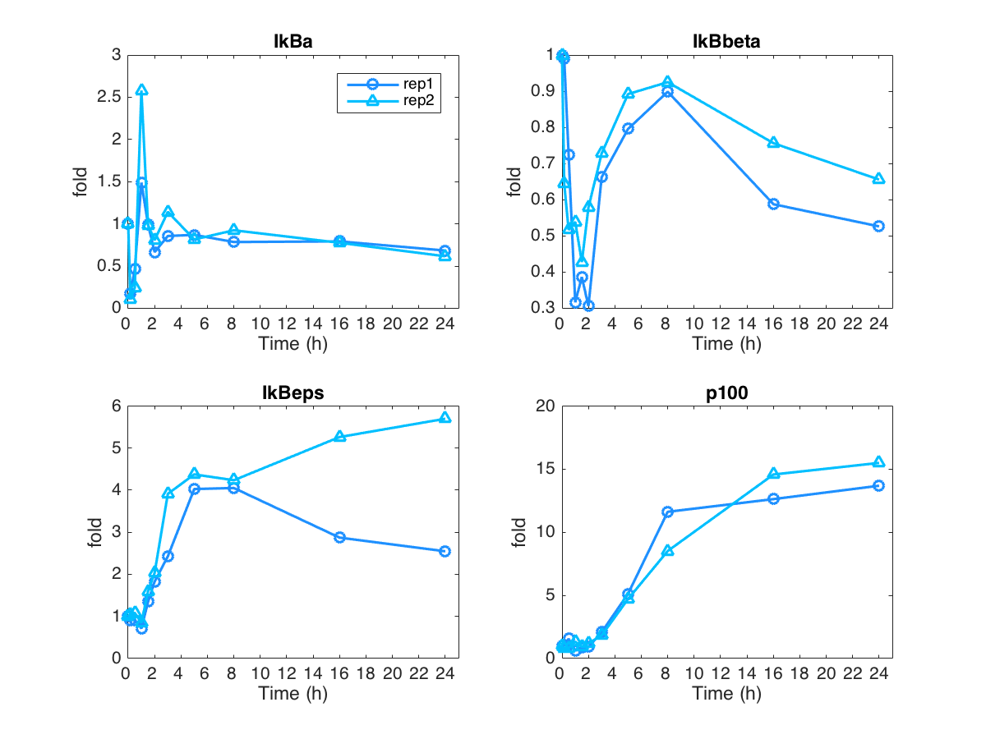
Quantified whole cell western data for L929 cell after 10ng/ml TNF stimulation

Slide 2
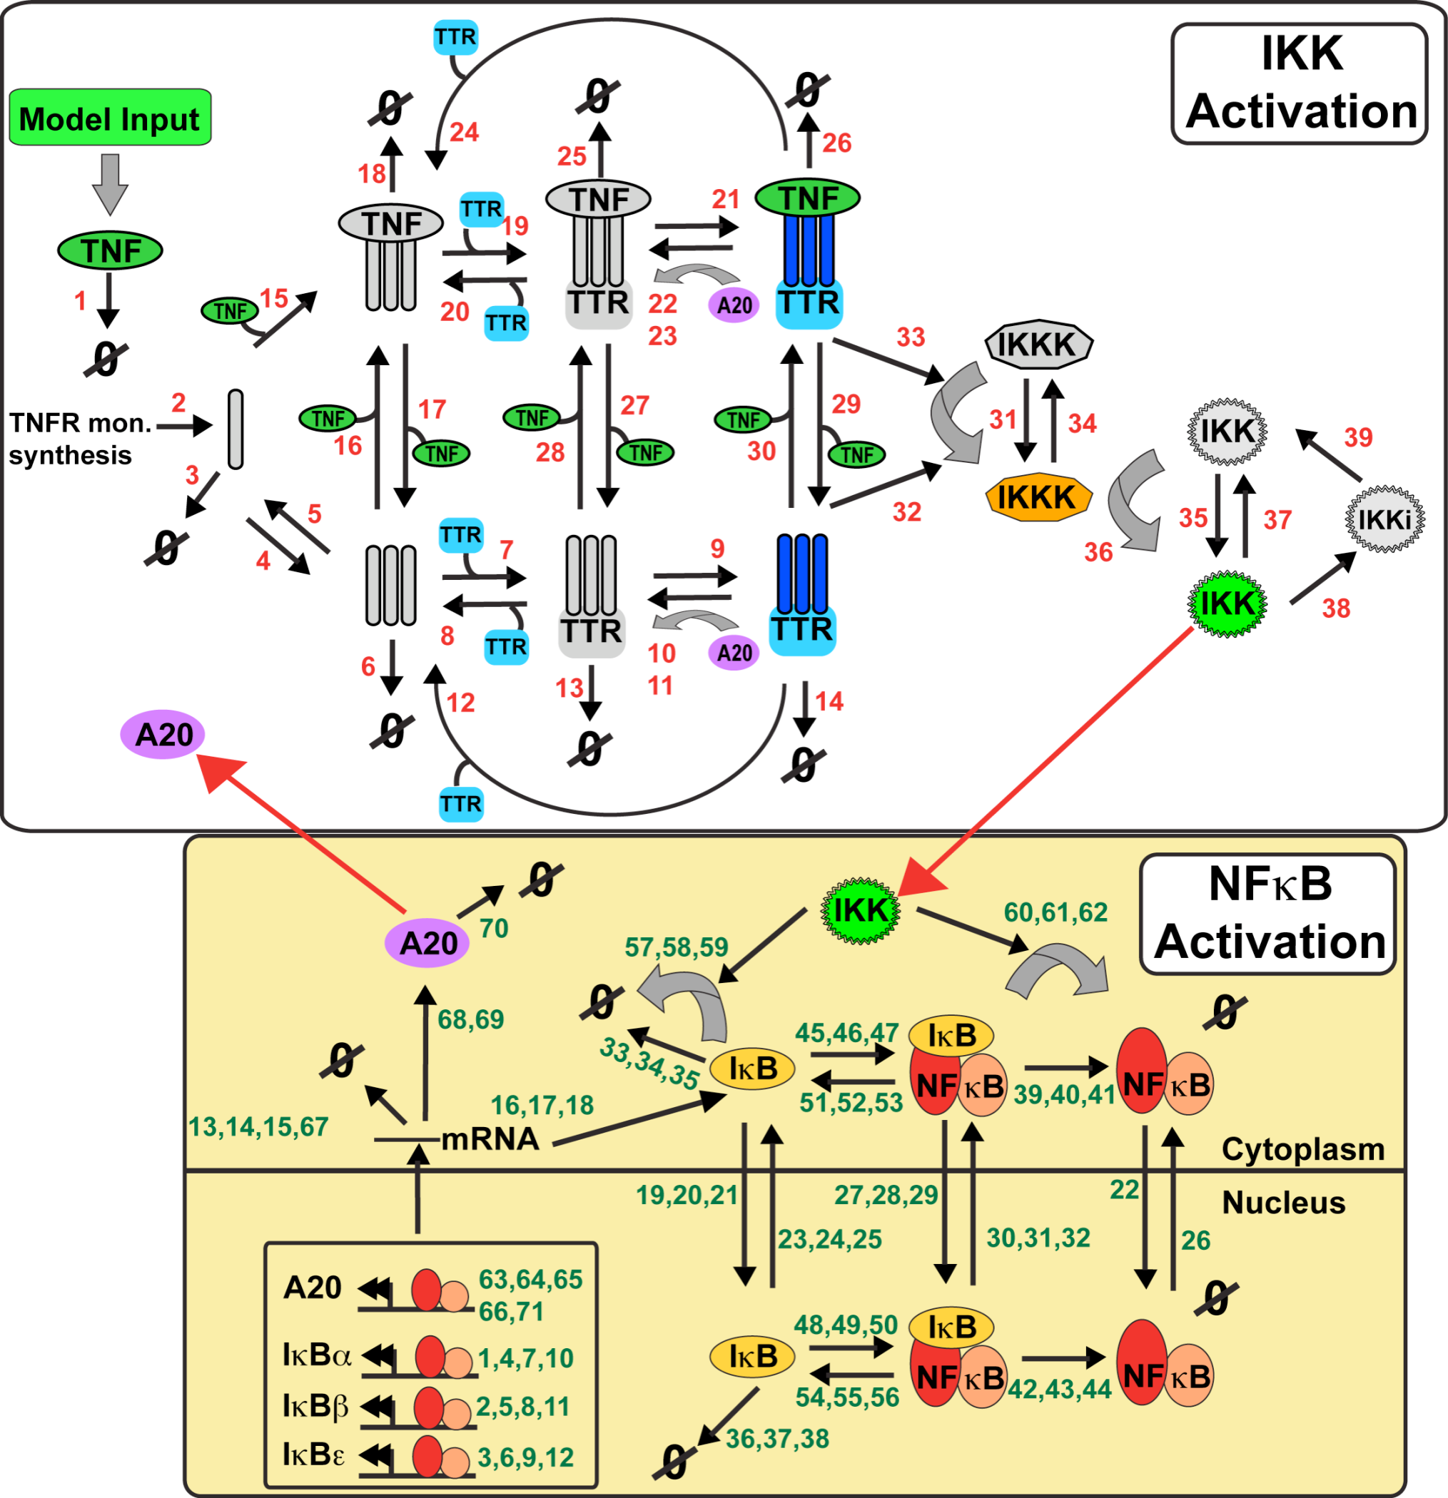
TNF response model
(Werner et al. 2008 + ikbd Shih et al. 2009)
IKK1
IkBd
IkBd
IkBd
IkBd
Notes:
IKK2

Slide 3
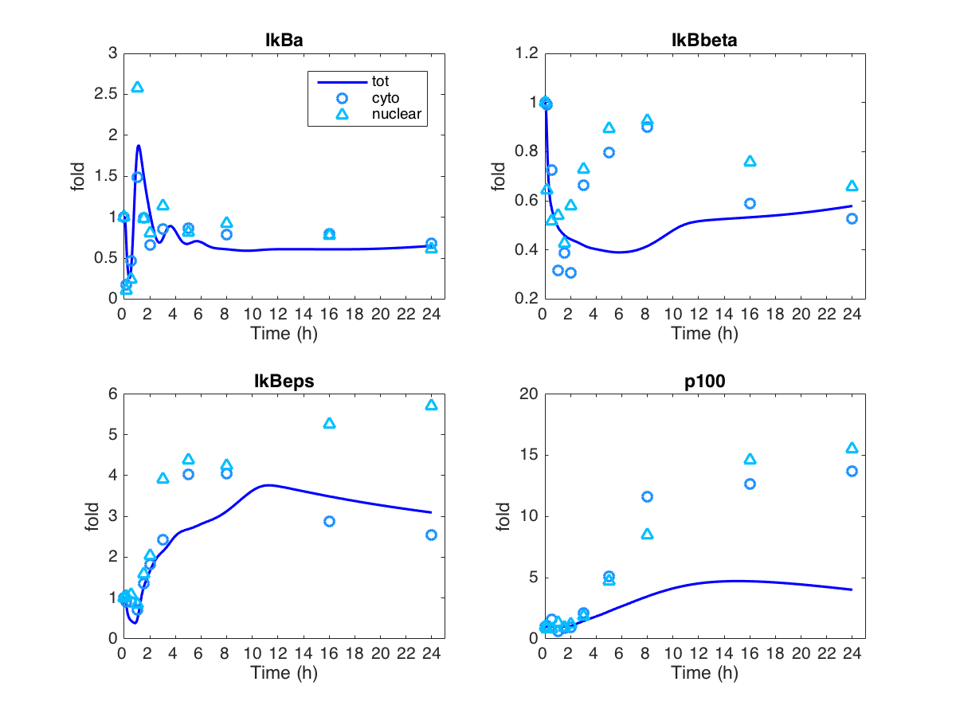
Simulation result with default parameters already show a good consistency between data and model

Slide 4
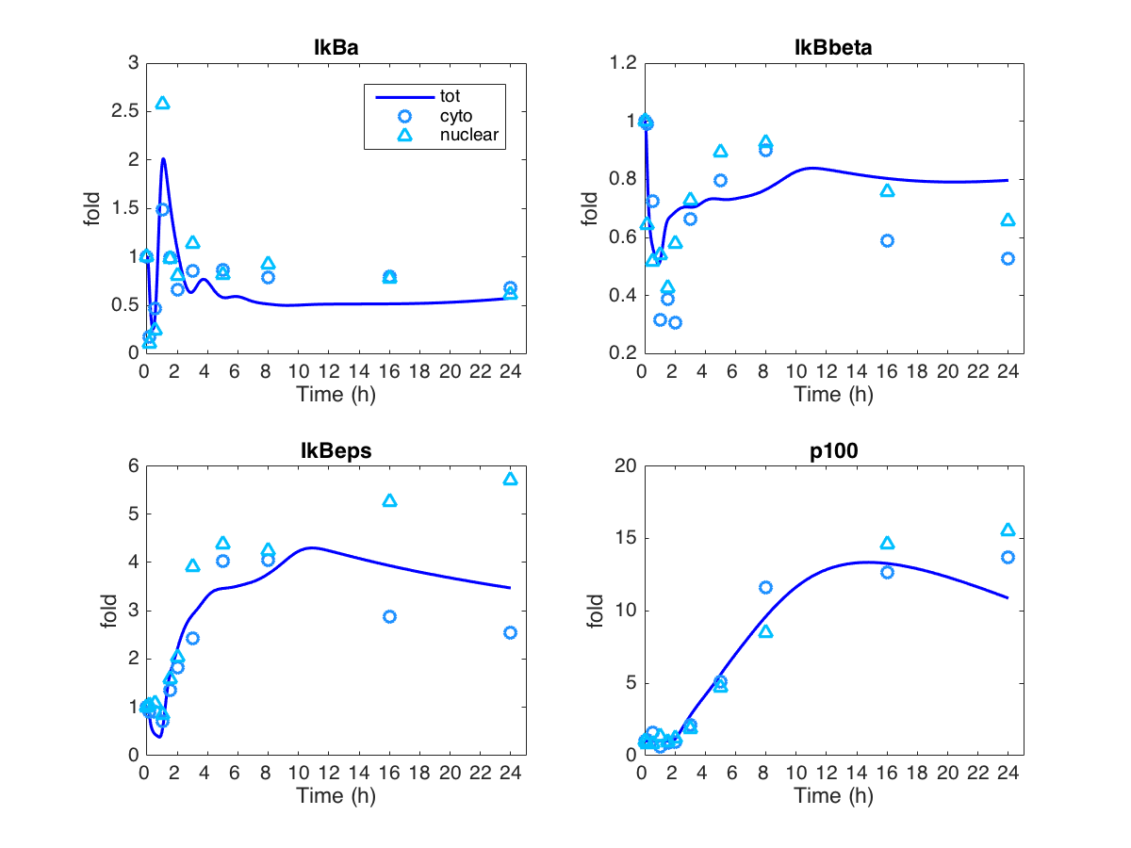
Three changes made the matching better
Basal transcription rate constant: IkBd decreased 3 fold
Induced transcription rate constant: IkBb increased to 15 fold (from 0.02 to 0.3)
Induced transcription rate constant: IkBe increased to 1.4 fold (from 0.3 to 0.4)

Slide 5
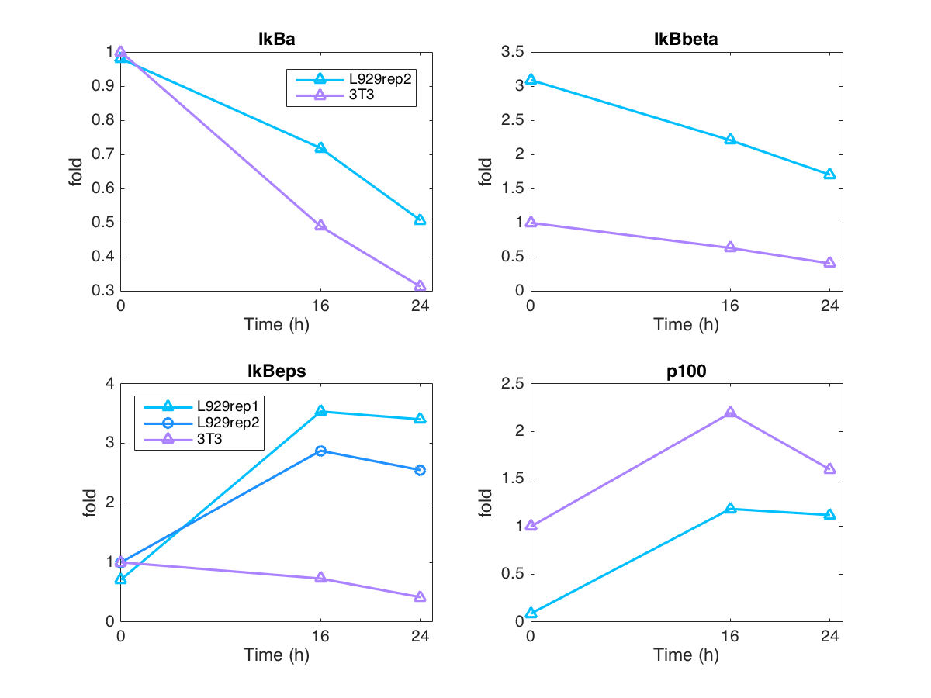
Accounting cell type differences – experimental data
Basal transcription rate constant: IkBb increase 3 fold
Basal transcription rate constant: IkBd decrease 5 fold
Ikbe: not sure, untouch

Slide 6
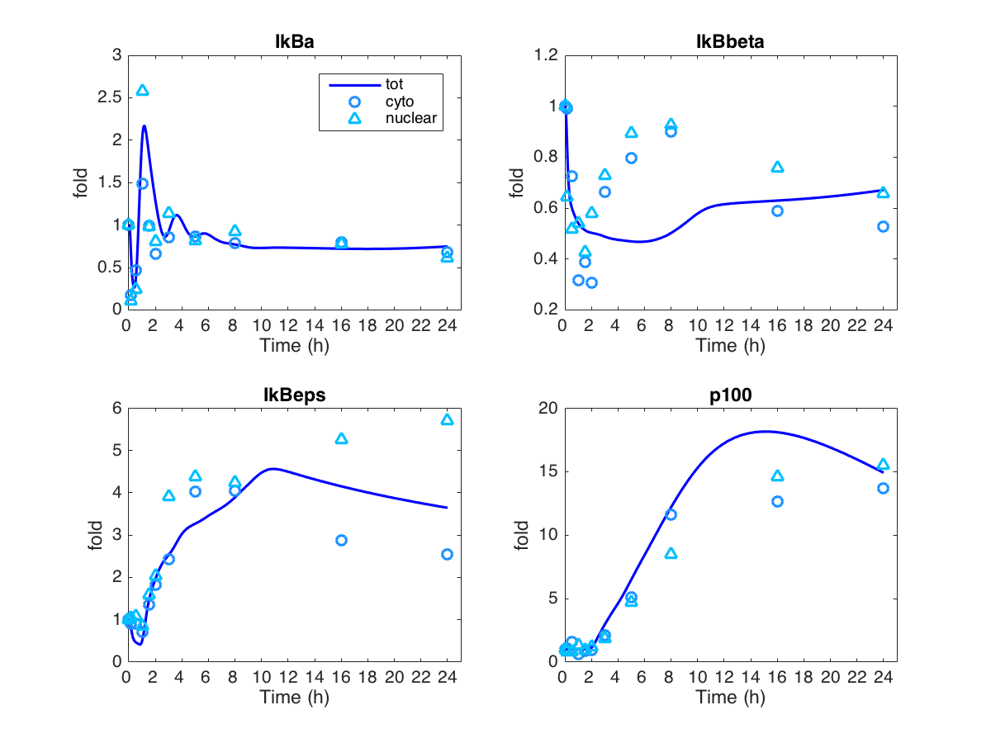
Accounting cell type differences – Simulation results
Basal transcription rate constant: IkBb increase 3 fold
Basal transcription rate constant: IkBd decrease 5 fold
Ikbe: not sure, untouch

Slide 7
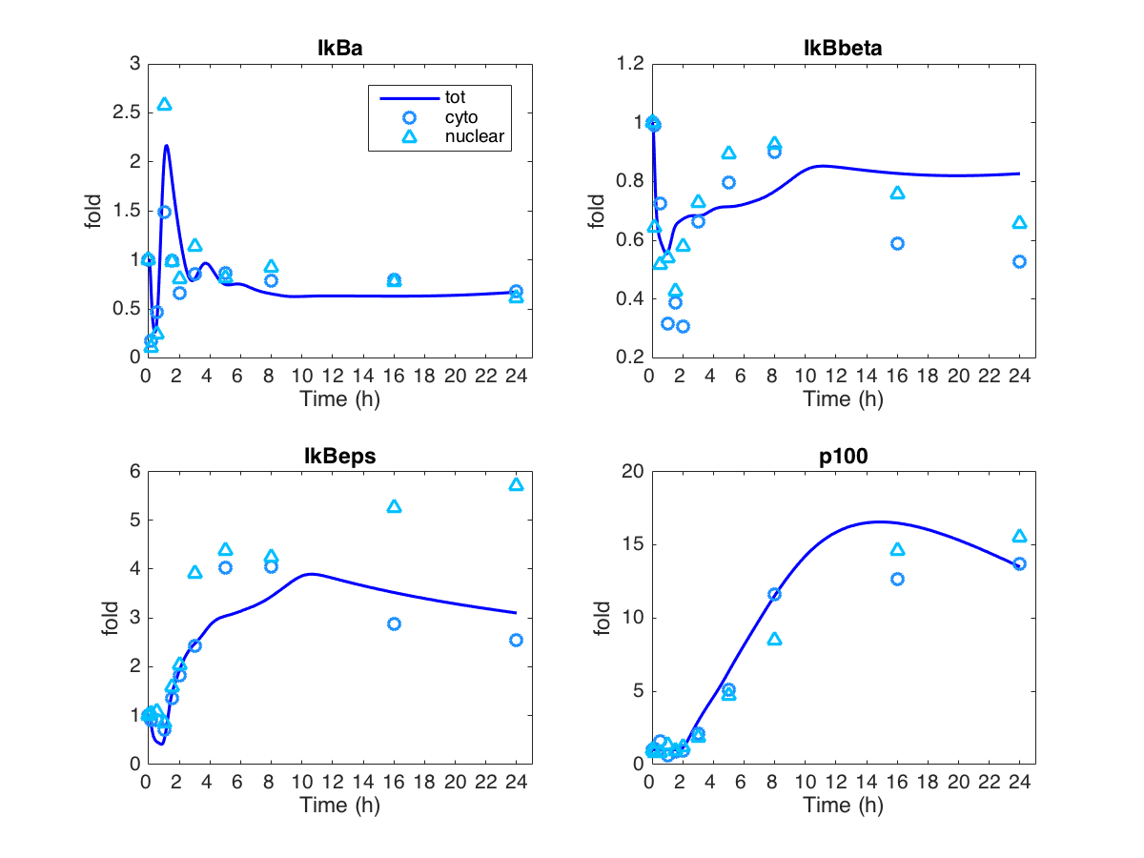
Accounting cell type differences – Simulation results
Basal transcription rate constant: IkBb increase 3 fold
Basal transcription rate constant: IkBd decrease 5 fold
Ikbe: not sure, untouch
Induced transcription rate constant: IkBb decrease from 0.025 to 0.6

