Slide 1
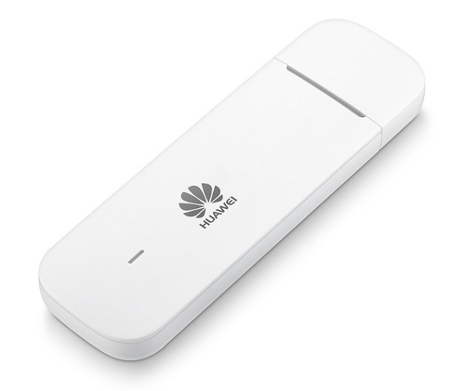



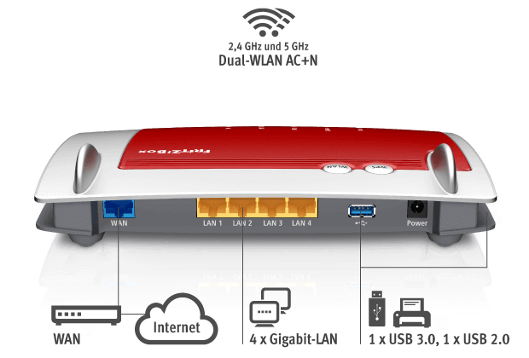


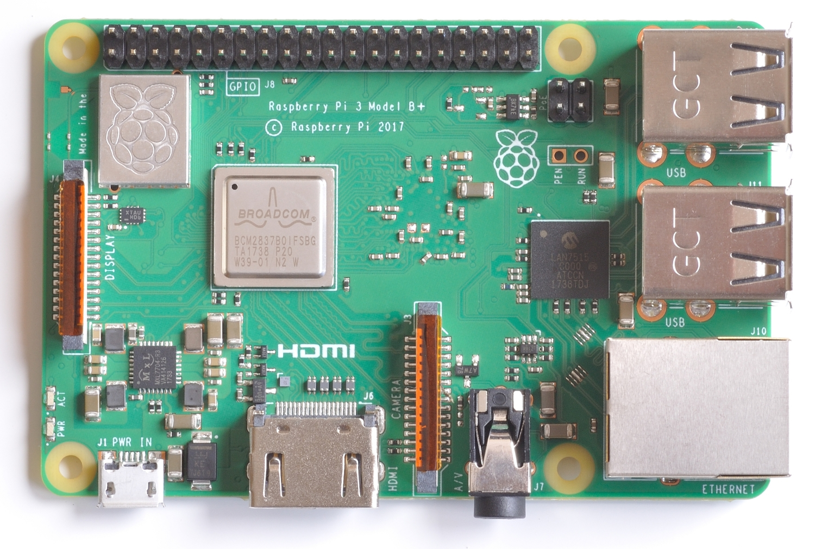
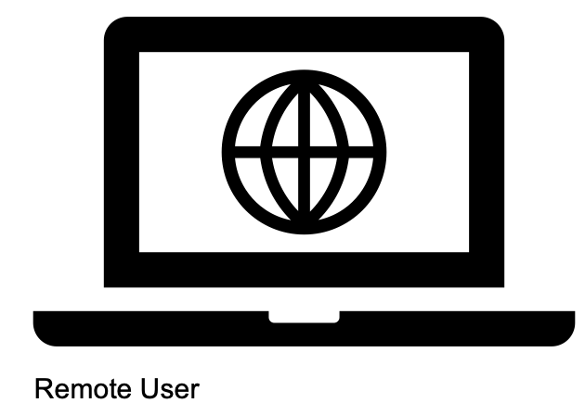
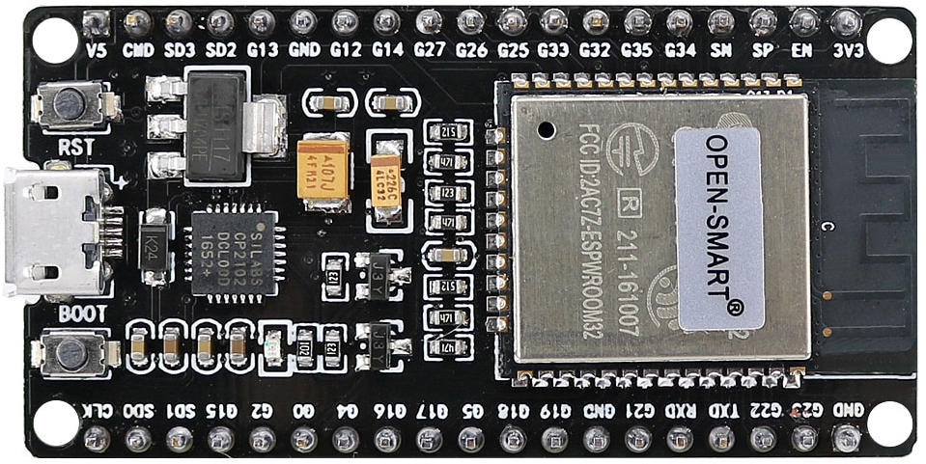
Redirects
to
Gives
dynamic IP
+
Telekom 10GB
UMTS
HUAWEI E3372
USB LTE / 4G Stick
Redirects to:
uc2.hopto.org
WWW
Primary Device = RasPi
> Runs OpenVPN server
FritzBox 4040 with STICK
dynDNS is configured here
PortForwarding active
NAT
Connects to
Arbitrary access, eg:
SSH [20], HTTPS [443]
VPN[1194]
Secondary Devices (access by RasPi)
…

