Slide 1
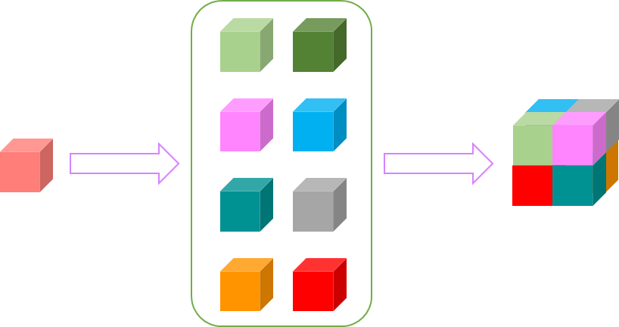
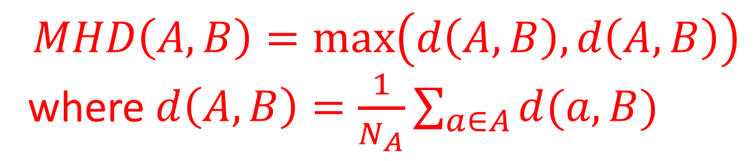
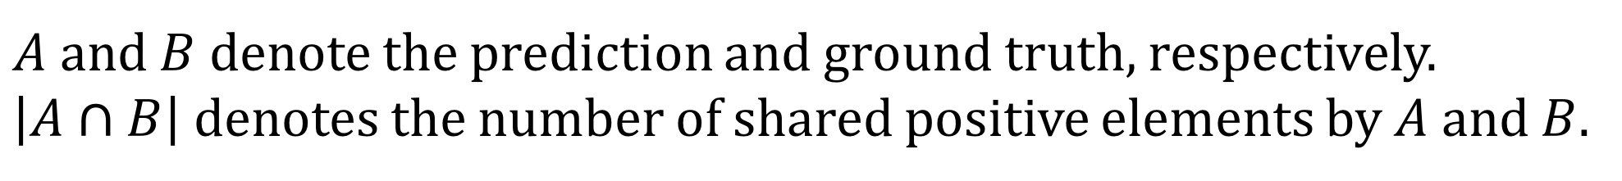

Advanced Deep Learning Methods for Multi-modality Isointense Infant Brain Image Segmentation
Zhengyang Wang Dinggang Shen Shuiwang Ji
School of Electrical Engineering and Computer Science Department of Radiology and BRIC School of Electrical Engineering and Computer Science
Washington State University University of North Carolina at Chapel Hill Washington State University
zwang6@eecs.wsu.edu dgshen@med.unc.edu sji@eecs.wsu.edu
Project Objectives
Advanced Methods
It is an important step in brain development study to perform automatic segmentation of infant brain magnetic resonance (MR) images into white matter (WM), grey matter (GM) and cerebrospinal fluid (CSF) regions. This task is especially challenging in the isointense stage (approximately 6-8 months of age) when WM and GM exhibit similar levels of intensities in MR images. Deep learning has shown its great promise in various image segmentation tasks. However, existing deep learning segmentation models usually suffer from the so-called checkboard problem of deconvolutional layers and the fixed-context limitation of regular convolutional networks. In this work, we extend the standard U-net convolutional networks from 2D to 3D, making fast and accurate voxel-wise dense predictions. To address the checkboard problem of deconvolutional operations, we propose the voxel deconvolutional layer (VoxelDCL), which basically adds dependencies among adjacent voxels by applying the pixel deconvolutional layer (PixelDCL) in 3D cases. We further employ dense transformer network to overcome the fixed-context limitation, which enables the networks to learn the shapes and sizes of receptive fields when doing prediction for each voxel.
Voxel/iVoxel Deconvolution Layer
One cause of checkboard artifacts can be easily found if we decompose the 3D deconvolution operation into two steps. First, it generates eight separate groups of feature maps. Second, they are shuffled and combined. Note that there is no dependency among them. To address this problem, we propose the voxel/ivoxel deconvolution layer (VoxelDCL/iVoxelDCL) which can build dependencies among different groups of feature maps. They alleviate the checkboard artifacts and improve the segmentation accuracy.
Dense Transformer Network
To overcome the fixed-context limitation of fully convolution-deconvolution networks, we propose dense transformer network (DTN). It learns some transformations performed on the feature maps, reshaping the receptive fields so that they can be processed using normal convolution kernels. Particularly, as we are doing dense prediction, the transformations must have corresponding inverse operations, which is properly implemented by our DTN.
Baseline Method
Results
Measurements of the performance
Dice
Ratios:
$$DR=2\frac{|A∩B|}{\left|A\right|+|B|}$$
$A$ and $B$ denote the prediction and ground truth, respectively. $\left|A∩B\right|$ denotes the number of shared positive elements by $A$ and $B$.
Hausdorff Distance:
$$MHD\left(A,B\right)=\max\left(d\left(A,B\right),d\left(A,B\right)\right)$$
where $d\left(A,B\right)=\frac{1}{N_{A}}\sum_{a∈A}{d(a,B)}$
To make MHD a reasonable evaluation for image segmentation, we compute the mean of MHDs along each dimension of images.
The U-net architecture achieved great success in 2D electron microscopy (EM) image segmentation. We extend it from 2D to 3D. Here is an example of depth 4 with 32 starting feature maps. As demonstrated in the figure, 3D U-net involves four kinds of layers: normal convolution layer followed by batch normalization and ReLU activation function, output convolution layer with softmax, down sampling layer which is usually pooling and up sampling layer which is usually deconvolution.
Table of Results
In terms of deep learning method, the limitation of
this model lies in two aspects:
Visualization of Results
It employs deconvolution as the up sampling layer, which has a problem known as checkboard artifacts.
It is a fully convolution-deconvolution model. Recent study indicated that such models suffer from fixed-context limitation, meaning fixed-sized convolutional kernels cannot fit receptive fields of different shapes.
Reference
W. Zhang, R. Li, H. Deng, L. Wang, W. Lin, S. Ji, D. Shen (2015). Deep convolutional neural networks for multi-modality isointense infant brain image segmentation. NeuroImage 108:214-224.
H. Gao, H. Yuan, Z. Wang, S. Ji (2017). Pixel deconvolutional networks. arXiv preprint, arXiv: 1705.06820
J. Li, Y. Chen, L. Cai, I. Davidson, S. Ji (2017). Dense transformer networks. arXiv preprint, arXiv:1705.08881

