Slide 1
Linux Inspector
Cameron Whipple, Robert Miller
CSE 522S - Advanced Operating Systems
Notes:
Cameron

Slide 2
Project Goals
Develop set of tools for performing process analysis on Linux
Snapshot process state
Snapshot process memory (stack, heap, etc..)
Target any user space process on system
Periodic snapshot support for offline analysis
Plug-n-Play
Install tools without kernel modification becoming necessary
Extendable
Developed to support the ability to extend support
Notes:
Cameron

Slide 3

Motivation
Cyber Security
Reverse Engineering
Malware Analysis
Research
Software Development
Memory Layout
Performance Tuning
Software Verification
Existing Tools
ftrace
strace
http://www.kpcb.com/blog/three-boardroom-questions-every-cybersecurity-entrepreneur-must-answer
Notes:
Cameron

Slide 4
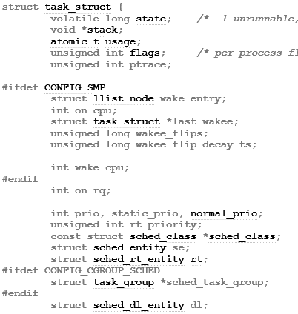
Linux Process
Represented by the task_struct
Processes task_structs are linked together
Approximately 1700 bytes in size, much of which are pointers
Included attributes touch many sub-systems in kernel
Memory Management Unit (MMU)
File System (FS)
Completely Fair Scheduler (CFS)
Exported by the module when the “--task” command is provided to tskdmp
Notes:
Cameron

Slide 5
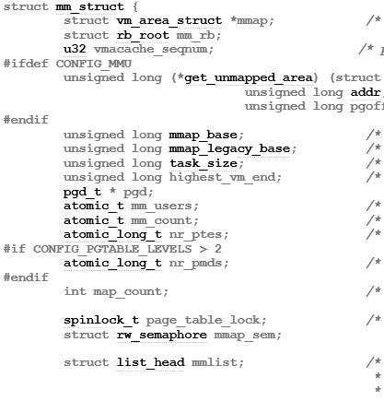
Linux Address Space
Represented by the mm_struct
Contains a vm_area_struct for each section of memory (stack, heap, etc…)
Contains atomic usage counters for synchronization
Attribute of the task_struct for the associated process
Holds reference to page tables to support virtual to physical address translations
Exported by the module when the “--mem“ command is provided to tskdmp
Notes:
Cameron

Slide 6
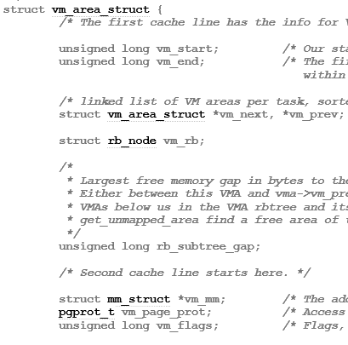
Linux Virtual Memory Region
Represented by the vm_area_struct
All virtual memory area (VMA) regions connected through linked list
VMA Flags
VM_READ
VM_WRITE
VM_EXEC
Exported by the module when the “--mem“ command is provided to tskdmp
Examples
Stack
Heap
BSS
Notes:
Cameron

Slide 7
Linux Memory Architecture
task_struct
mm_struct
pid
state
mmap
mm
pgd
mm_rb
mm_users
…
mm_count
start_stack
…
Virtual Memory
vm_area_struct
vm_area_struct
vm_area_struct
vm_start
vm_start
vm_start
Stack
vm_end
vm_end
vm_end
vm_next
vm_next
vm_next
vm_prev
vm_prev
vm_prev
vm_flags
vm_flags
vm_flags
…
…
…
Notes:
Cameron

Slide 8
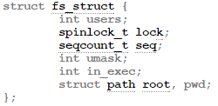
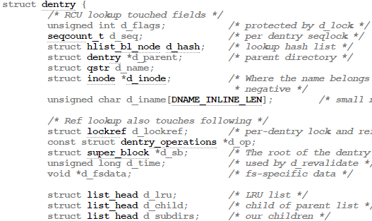
File System
File system information is in the fs field
Relevant pieces in dentry field within path struct

Slide 9
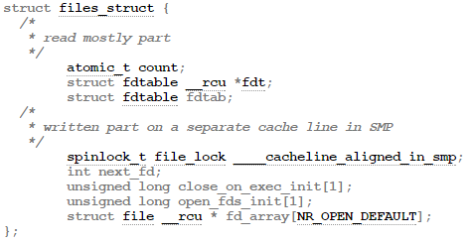
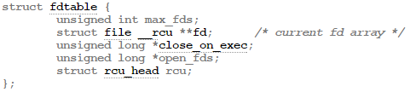
Files
Contained in the files field of the task struct
All open files held in files->fdt
Call files_fdtable to get copy
Iterate over contents of fdt->fd
File struct contains path, owner, current position, etc.
Notes:
Robert

Slide 10
Architecture
User Space (tskdmp)
Initiates snapshot of kernel memory
Snapshots all data accessible from user space
Controls exported elements
Linux Kernel Module
Interprets and executes commands from tskdmp
Snapshots all data accessible from within kernel space
Exports data to files
tskdmp
User Space
Sysfs
Linux Inspector Module
Kernel Space
Notes:
Robert

Slide 11
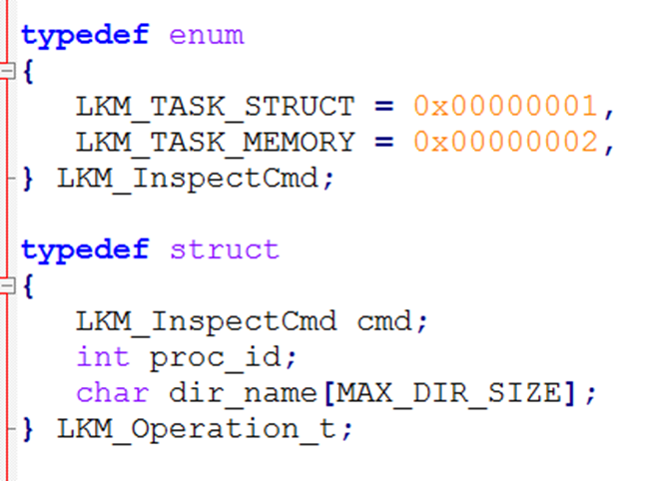
Tskdmp Interface
Initiates all snapshot operations
Communicates through sysfs: /sys/kernel/linux_inspect/operation
Performs snapshots on processes memory content
/proc/pid/mem
/proc/pid/maps
Controls elements included within the snapshot
Task
Mem
Snapshots support analysis through tools such as Meld
Notes:
Robert

Slide 12
Inspect Kernel Module
Commands received through sysfs: /sys/kernel/linux_inspect/operation
Processes LKM_Operation_t to determine elements to include within the snapshot
Removes targeted process from run queue
Performs a snapshot of the specified elements
Task
Mem
Notes:
Robert

Slide 13
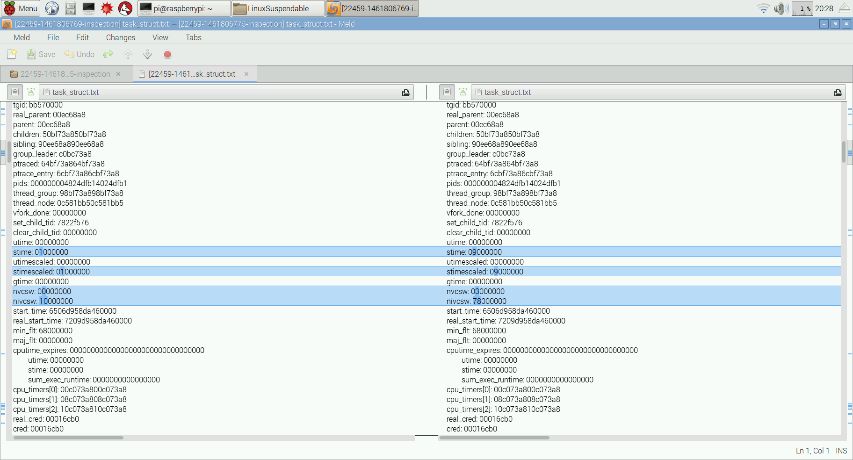
Task Struct Verification
Snapshot test app
Same instance
Across instances
Snapshot bash shell
Proves support for general user process
Snapshot directories compared with diff tools such as Meld
Analyze the differences in the two snapshots
Notes:
Cameron

Slide 14
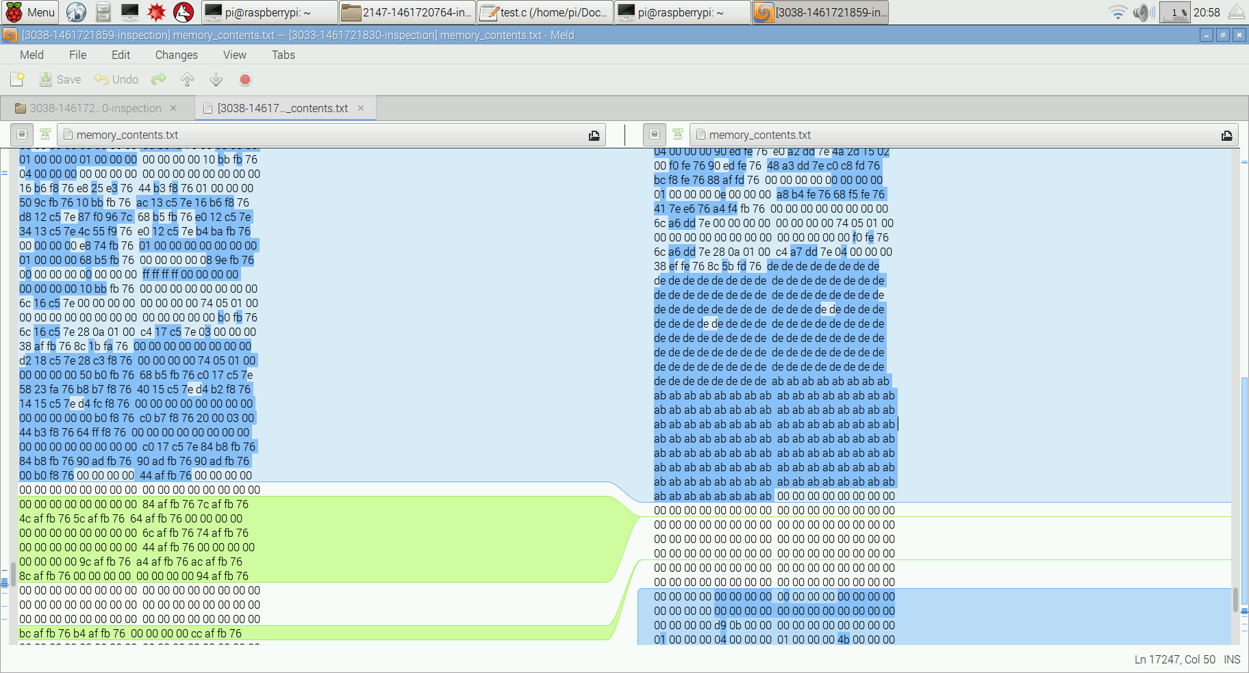
Memory Verification
Exported memory of a test application in two modes
No stack/heap manipulations
Stack/Heap Manipulations
Snapshot directories compared with diff tools such as Meld
Analyze the differences in the two snapshots
Notes:
Cameron

Slide 15
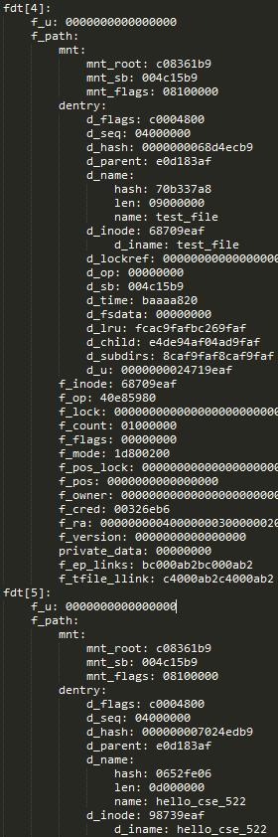
Files Verification
Ran test application with several open files
test_file and hello_cse_522 shown to the right
Listed indices match userspace file descriptors
0, 1, and 2 are standard I/O
Notes:
Robert

Slide 16
Challenges
Complex and multi-tiered struct definitions
Breadth of involved kernel sub-systems
Kernel vs Module application programming interface (API)
Lack of kernel API documentation
Notes:
Robert

Slide 17
Demo
Snapshot being performed against bash
“Tskdmp -p <pid> --task --mem”
Notes:
Robert

Slide 18
Questions?

