Slide 1
Linux Inspector
Cameron Whipple, Robert Miller
CSE 522S - Advanced Operating Systems

Slide 2
Project Goals
Develop set of tools for performing process analysis on Linux
Snapshot process state information as seen by kernel
Snapshot process memory (stack, heap, etc..)
Snapshot files currently opened by process
Target any user space process on system
Periodic snapshot support for offline analysis
Plug-n-Play
Install tools without kernel modification becoming necessary
Extendable
Developed to support the ability to extend support

Slide 3

Motivation
Cyber Security
Reverse Engineering
Malware Analysis
Research
Software Development
Memory Layout
Performance Tuning
Software Verification
Existing Tools
ftrace
strace
http://www.kpcb.com/blog/three-boardroom-questions-every-cybersecurity-entrepreneur-must-answer

Slide 4
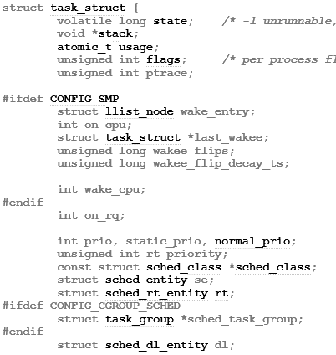
Linux Process
Represented by the task_struct
Processes task_structs are linked together
Approximately 1700 bytes in size, much of which are pointers
Included attributes touch many sub-systems in kernel
Memory Management Unit (MMU)
File System (FS)
Completely Fair Scheduler (CFS)
Exported by the module when the “--task” command is provided to tskdmp

Slide 5
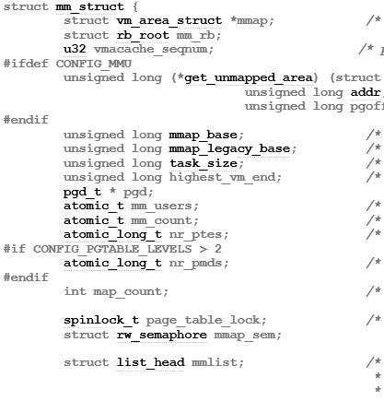
Linux Address Space
Represented by the mm_struct
Contains a vm_area_struct for each section of memory (stack, heap, etc…)
Contains atomic usage counters for synchronization
Attribute of the task_struct for the associated process
Holds reference to page tables to support virtual to physical address translations
Exported by the module when the “--mem“ command is provided to tskdmp

Slide 6
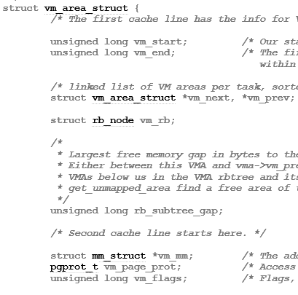
Linux Virtual Memory Region
Represented by the vm_area_struct
All virtual memory allocated (VMA) regions connected through linked list
VMA Flags
VM_READ
VM_WRITE
VM_EXEC
…
Exported by the module when the “--mem“ command is provided to tskdmp

Slide 7
Linux Memory Architecture
task_struct
mm_struct
pid
state
mmap
mm
pgd
mm_rb
mm_users
…
mm_count
start_stack
…
Virtual Memory
vm_area_struct
vm_area_struct
vm_area_struct
vm_start
vm_start
vm_start
Stack
vm_end
vm_end
vm_end
vm_next
vm_next
vm_next
vm_prev
vm_prev
vm_prev
vm_flags
vm_flags
vm_flags
…
…
…

Slide 8
Files Slides
Remove if the file export option does not get completed

Slide 9
Architecture
User Space (tskdmp)
Initiates snapshot of kernel memory
Snapshots all data accessible from user space
Controls exported elements
Linux Kernel Module
Interprets and executes commands from tskdmp
Snapshots all data accessible from within kernel space
Exports data to files
tskdmp
User Space
1. Target pid
Sysfs
Linux Inspector Module
Kernel Space

Slide 10
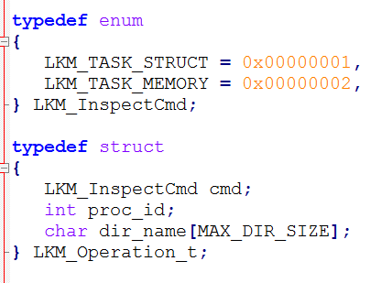
Tskdmp Interface

Slide 11
Challenges
Kernel Synchronization
Complex and Multi-tiered struct definitions
Breadth of involved kernel sub-systems
Kernel vs Module (symbol availability)
Lack of formalized documentation on Linux kernel

Slide 12
Lessons Learned

Slide 13
Future Work

