Slide 1
Parameterized Optimization of Variable-Timeslice Process Scheduling
Robert Miller
CSE 543T: Algorithms for Nonlinear Optimization
Notes:
Cameron

Slide 2
Presentation Outline
Overview of process scheduling
Primary considerations
Existing solutions
Proposed solution
Modeling of process scheduling as nonlinear optimization problem
Analysis of advantages/disadvantages
Description of experimental model
Outlook for further research opportunities
Notes:
Cameron

Slide 3
Introduction to Process Scheduling
Main goal: select next process to run
Need to fairly allot access to limited processing resources
Primary concerns
Latency: minimize total task runtime
Response time: minimize time between timeslices
Starvation/fairness: split processor resources relatively evenly among processes
Overhead: minimize time spent scheduling

Slide 4
Existing Schedulers
Round Robin—every task runs in turn for a fixed timeslice
FIFO—tasks are run in the order in which they were enqueued
CFS—runtime-aware scheduler which varies timeslice length to even out processor usage
Default Linux scheduler
Many further schedulers have been proposed/implemented

Slide 5
Analysis of Existing Schedulers
Low overhead
RR/FIFO are O(1)
Variable quality of solution
FIFO can have massive latency/response time
‘Good’ solution is contextual and depends on use case

Slide 6
Proposal: PVT Scheduling
Parameterized Variable-Timeslice Scheduling
Model scheduling as an optimization problem
Objective function: minimize unfairness of process selection
Parameterize problem to generalize solution quality
User knows what scheduling concerns are most important for them

Slide 7
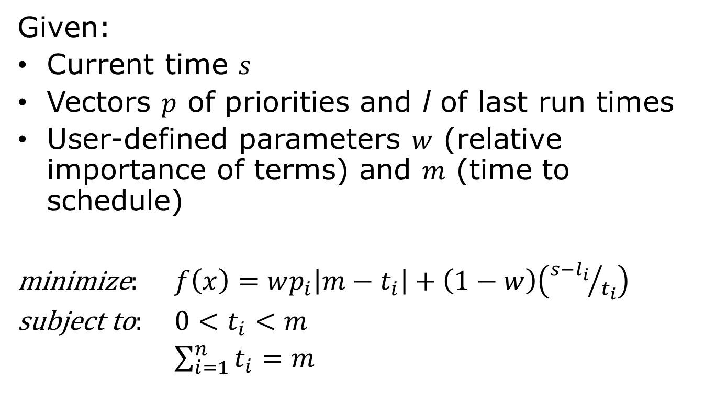
Scheduling Model
Given:
Current time $s$
Vectors $p$ of priorities and l of last run times
User-defined parameters $w$ (relative importance of terms) and $m$ (time to schedule)
minimize: $f\left(x\right)=wp_{i}\left|m−t_{i}\right|+\left(1−w\right)\left({s−l_{i}}/{t_{i}}\right)$
subject to: $0<t_{i}<m$
$\sum_{i=1}^{n}{t_{i}=m}$

Slide 8
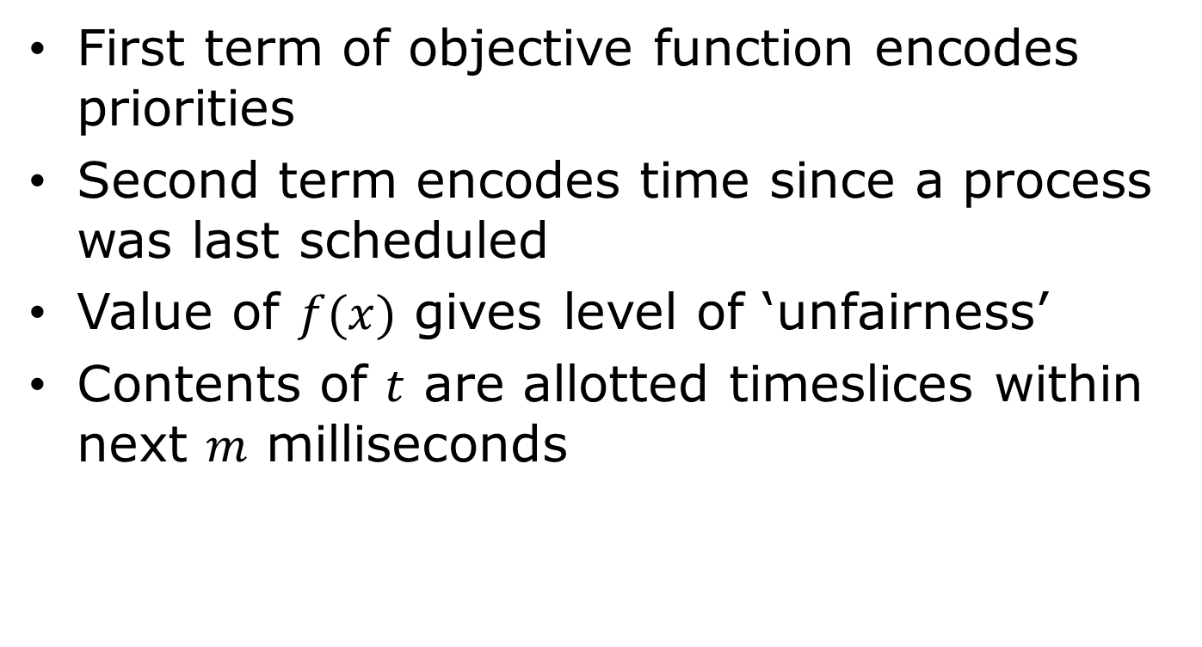
Scheduling Model
First term of objective function encodes priorities
Second term encodes time since a process was last scheduled
Value of $f(x)$ gives level of ‘unfairness’
Contents of $t$ are allotted timeslices within next $m$ milliseconds

Slide 9
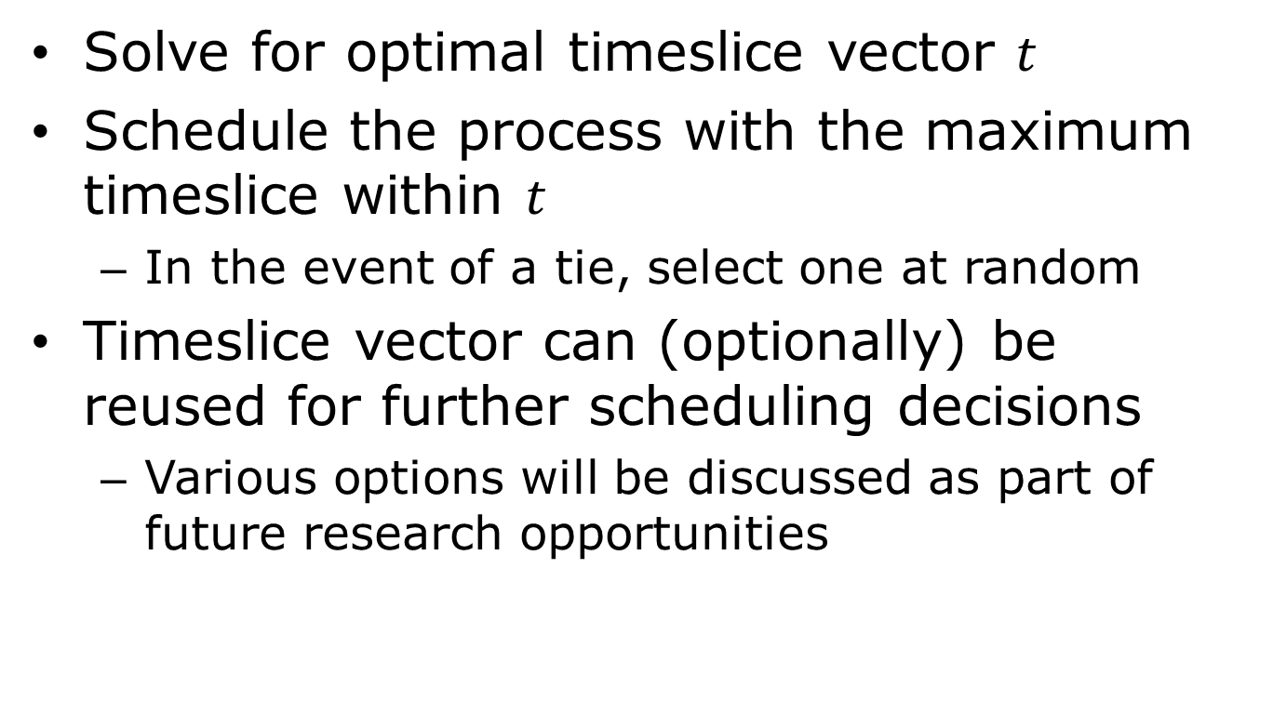
Scheduling Methodology
Solve for optimal timeslice vector $t$
Schedule the process with the maximum timeslice within $t$
In the event of a tie, select one at random
Timeslice vector can (optionally) be reused for further scheduling decisions
Various options will be discussed as part of future research opportunities

Slide 10
Advantages & Disadvantages
Advantages
Parameterized (customizable)
Varies timeslices to find most optimally fair solution
Easily extendable by modifying objective function
Disadvantages
Scheduling overhead
Difficulty of dialing in parameters offloaded to user (not an “out of the box” solution)

Slide 11
Experimental Model
Test scheduler built using MATLAB
Create some number of ‘processes’ and run for some number of iterations
Processes are assigned a random priority
Track the total amount of time that each process was allotted
Graph the results in comparison to expected, perfectly fair outcome
Repeat experiment with varying parameters
No results available at this time; these will be presented in the final paper

Slide 12
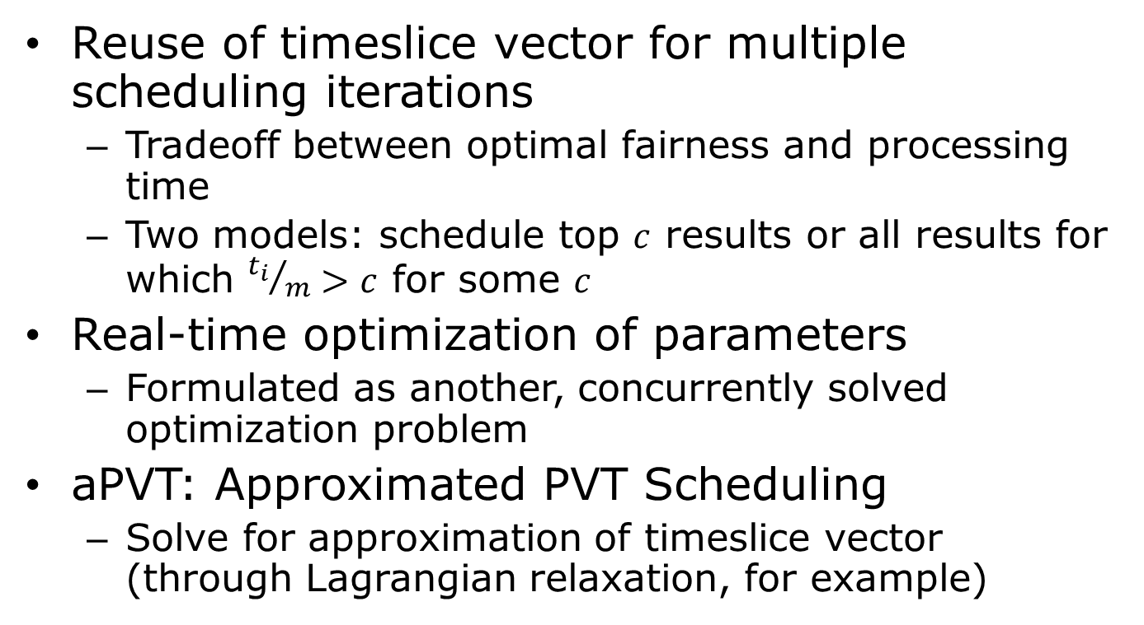
Further Research Opportunities
Reuse of timeslice vector for multiple scheduling iterations
Tradeoff between optimal fairness and processing time
Two models: schedule top $c$ results or all results for which ${t_{i}}/m>c$ for some $c$
Real-time optimization of parameters
Formulated as another, concurrently solved optimization problem
aPVT: Approximated PVT Scheduling
Solve for approximation of timeslice vector (through Lagrangian relaxation, for example)

